Slide 1
Week 13 Technical Presentation
Scalable Backend Architecture for a Web Application
Objectives: understand high-level architecture and design backend systems that scale reliably.
Load Balancing
Caching
Database Scaling
Week 13 • Scalable Backend Architecture • 1

Slide 2
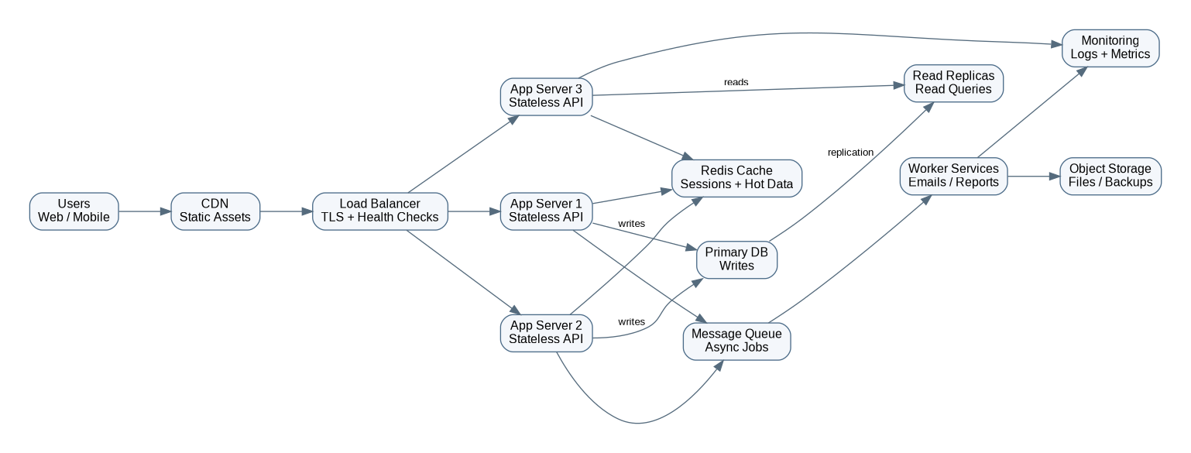
High-Level System Architecture
Design goal
Route traffic through CDN and load balancer
Scale stateless APIs horizontally
Use Redis for hot data and sessions
Split reads and writes at database layer
Move slow work to background workers
Core pattern: scalable, stateless, observable
Week 13 • Scalable Backend Architecture • 2

Slide 3
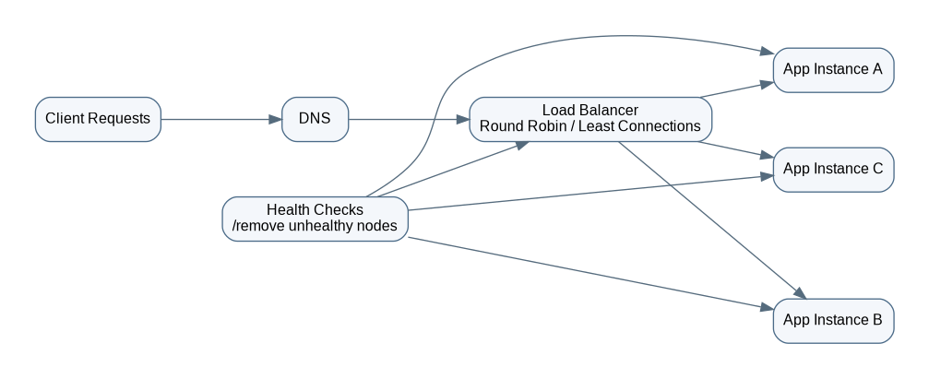
Load Balancer Design
Why it matters
Distributes traffic across multiple app instances
Runs health checks and removes unhealthy nodes
Supports rolling deployments with minimal downtime
Improves availability during traffic spikes
Recommended policies: least connections for uneven workloads, round-robin for simple balanced traffic, and sticky sessions only when absolutely required.
Week 13 • Scalable Backend Architecture • 3

Slide 4
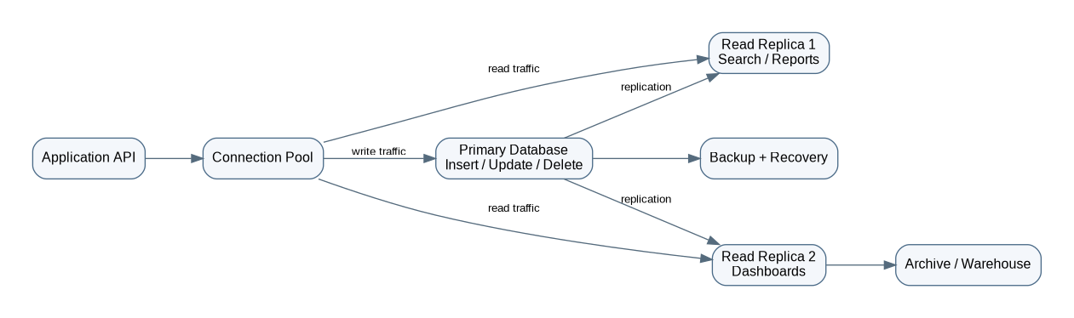
Database Scaling Strategy
Primary + replicas
Write transactions go to primary database
Read-heavy traffic goes to replicas
Connection pool protects database from overload
Indexes and query tuning reduce latency
Backups support recovery and compliance
Next stage: partitioning or sharding
Week 13 • Scalable Backend Architecture • 4

Slide 5
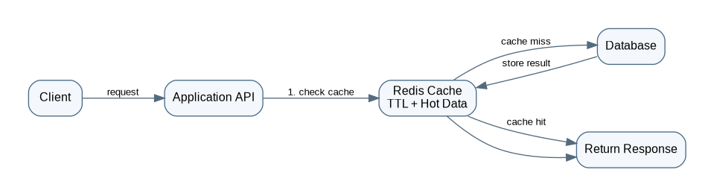
Caching Layer: Redis Cache-Aside Pattern
Cache candidates
Product catalog and reference data
User session data
Recently viewed order status
Rate-limit counters
Frequently requested dashboard summaries
Expected impact: lower database load, faster API response time, and better user experience during traffic spikes.
Week 13 • Scalable Backend Architecture • 5

Slide 6
Scalability Strategies
Traffic
Application
Data
Operations
CDN, load balancer, rate limiting
Horizontal scaling, stateless APIs, autoscaling
Redis cache, read replicas, indexes, backups
Metrics, logs, alerts, health checks, rollback plan
The architecture should scale gradually: start simple, measure bottlenecks, then add infrastructure where it provides clear performance or reliability value.
Week 13 • Scalable Backend Architecture • 6

Slide 7
Architecture Decisions and Trade-Offs
Decision
Reason
Trade-off
Load balancer
Availability and traffic distribution
Additional infrastructure
Stateless APIs
Easy horizontal scaling
External session management
Redis cache
Fast reads and lower DB load
Cache invalidation
Read replicas
Read scalability
Replication lag
Message queue
Faster APIs and retry support
Async complexity
Final recommendation: modular backend + horizontal scaling + Redis + read replicas + queue + monitoring.
Week 13 • Scalable Backend Architecture • 7

Slide 8
Submission Summary
Designed scalable web application architecture
Created diagrams for load balancer, database scaling, and caching
Documented scalability strategies and architecture decisions
Prepared technical presentation for review
Deliverables are organized as a submission-ready repository.

