Slide 1
SPORTS EQUIPMENT MANAGEMENT SYSTEM
Team Puzzles
Anuja Naik
Bishop Sankhe
Priyanka Malpekar
Siddhi Prabhu
Tanvi Gurav

Slide 2
Summary
Sports equipment management system deals with large amounts of data by streamlining the availability of the product
The management maintains data about their Employees, Vendors, Customers, Products, Inventory, Orders, Payments and Delivery
This design assists customers to locate products as per category, track online orders and manage vendors and inventory
It helps the business figure out the popular products and brands using customer feedback
Reports are generated demonstrating total sales, total revenue and total profit helping business build an effective marketing and financial strategy

Slide 3
Problem Definition
Sports equipment management system has to deal with large amount of data since there is vast diversification in sports
Inconvenience of the management to maintain centralized data about their employees and stock in different branches
The management is unable to track the popularity of products
There are many problems a customer faces while purchasing a product (availability, location, stock, etc)

Slide 4




Proposed Solution
EASE OF PRODUCT ACCESSIBILITY FOR THE CUSTOMER
USING
PRODUCT LOCATOR
DETERMINING THE POPULAR PRODUCTS AMONGST CUSTOMER AND DEVISE A MARKETING STRATEGY
BASED ON DEMAND OF THE PRODUCT, SUPPLY MANAGEMENT FROM THE VENDORS CAN BE EFFICIENTLY DONE
HELP TO TRACK BRANCH RECORDS FOR BETTER INVENTORY CONTROL DUE TO CENTRALIZED DATABASE

Slide 5
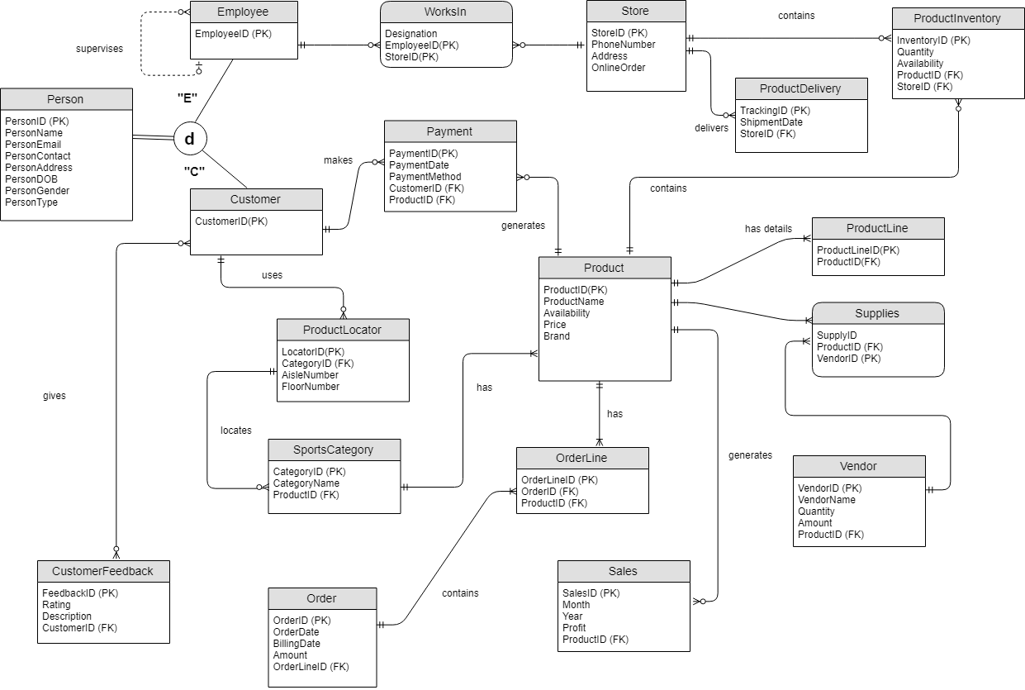
ERD Diagram

Slide 6
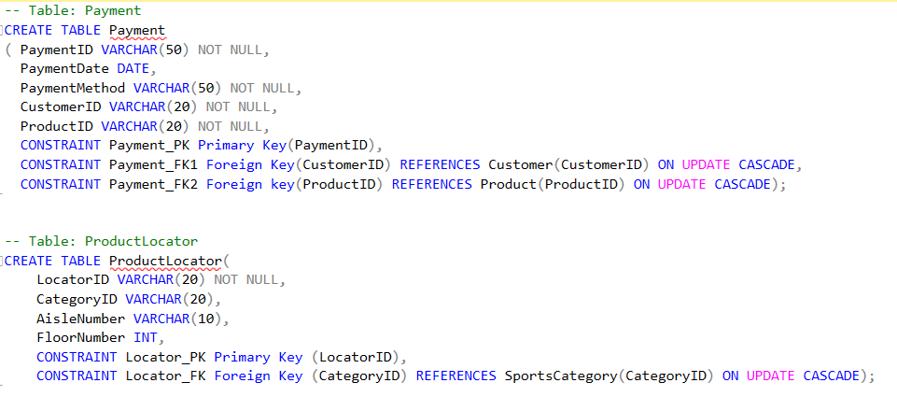
Creating Tables

Slide 7
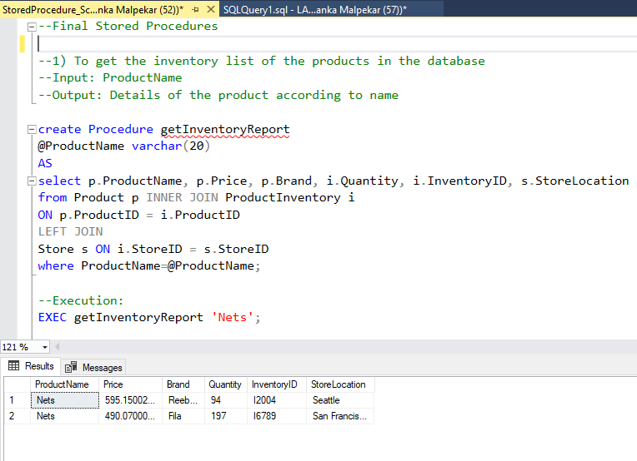
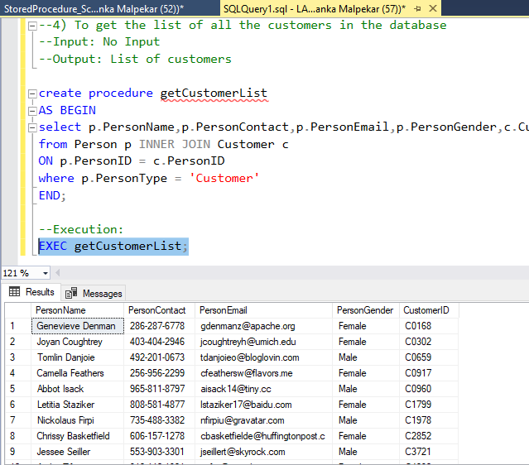
Stored Procedure

Slide 8
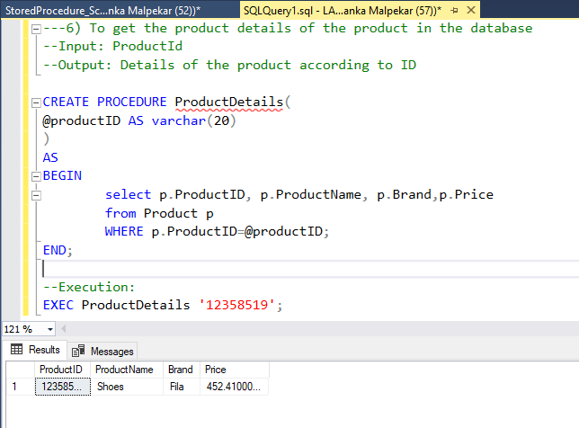
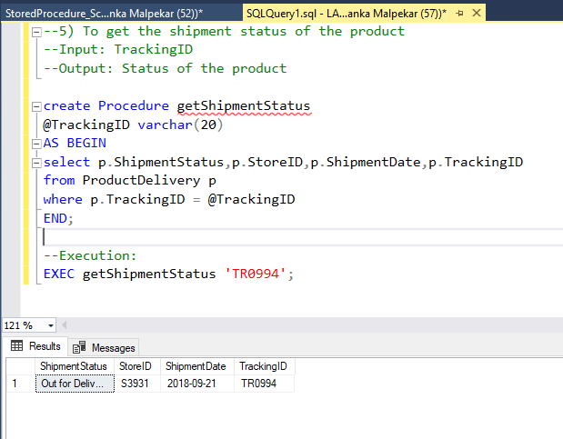
Stored Procedure

Slide 9
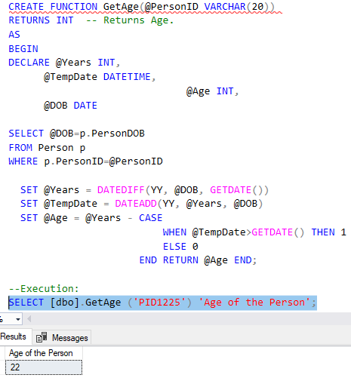
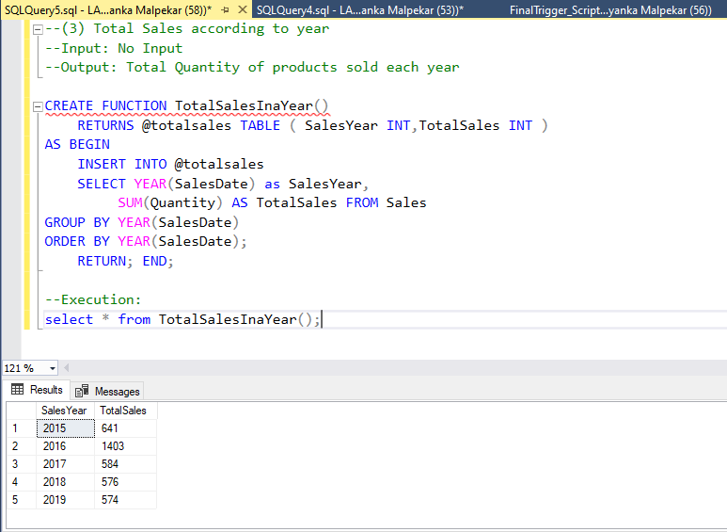
User-Defined Functions

Slide 10
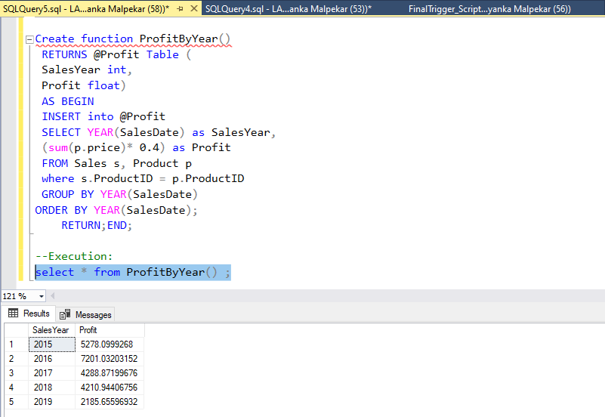
User-Defined Functions

Slide 11
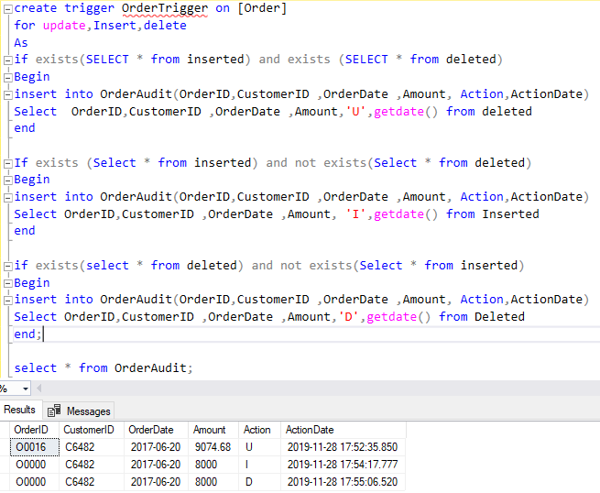
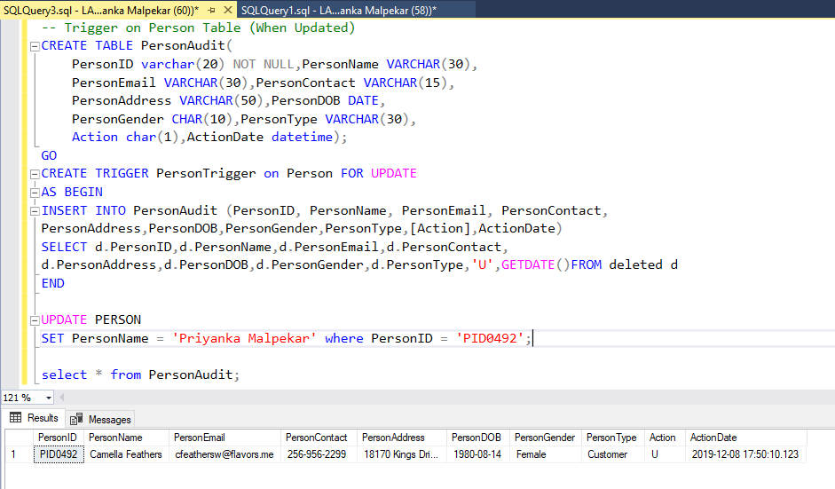
Triggers

Slide 12
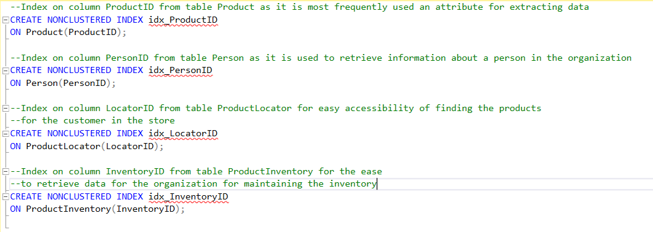
Indexes

Slide 13
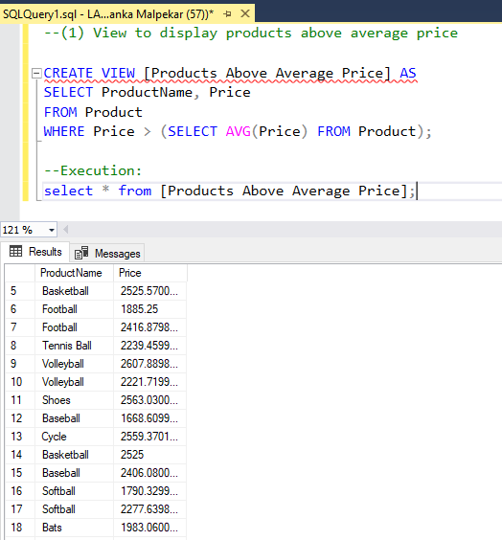
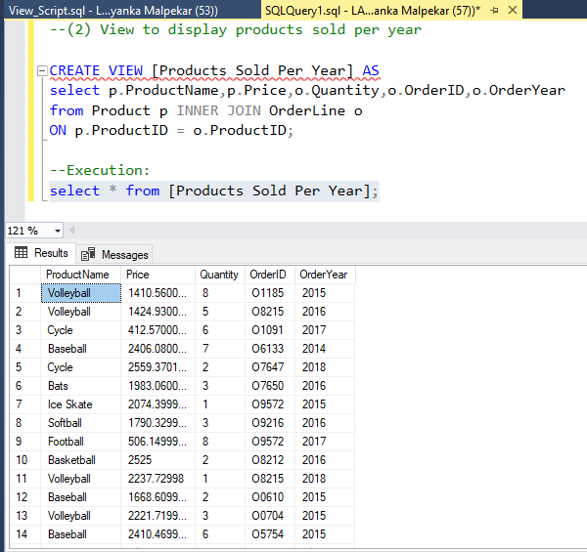
Views

Slide 14
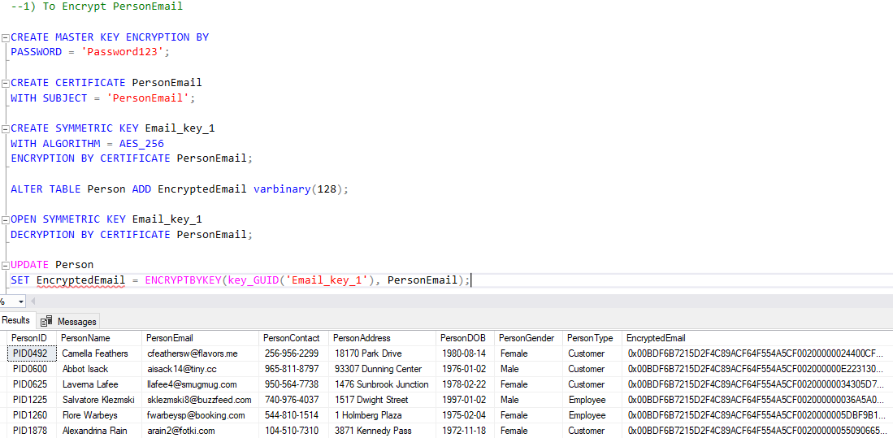
Data Encryption

Slide 15
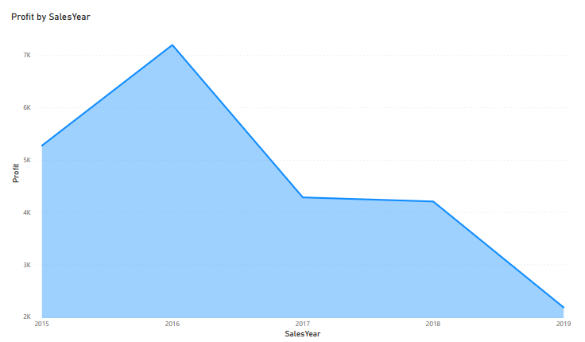
Profit by Sales Year
Profit is calculated as 40% of sum of price as per the product sold in that particular year
Generating the report helps determine how much profit was incurred for that particular year.
Also, comparative study of profit incurred between last five years can be done with the help of this report

Slide 16
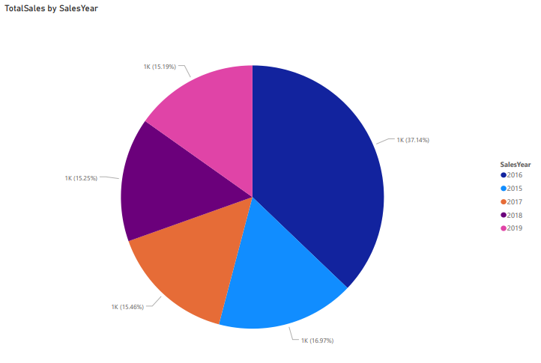
TotalSales by SalesYear
TotalSales by SalesYear is calculated as Sum of the quantity of the product sold in that particular year
Visualizing TotalSales by SalesYear helps determine a reasonably accurate projection of the near term performance of the business

Slide 17
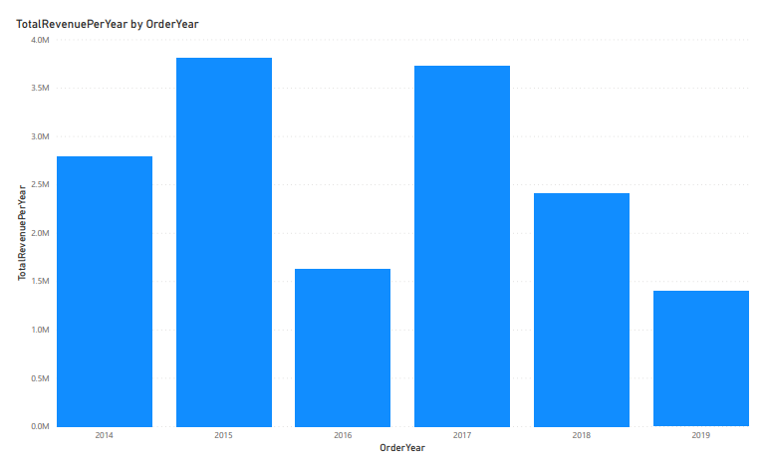
TotalRevenuePerYear
Total revenue is calculated as Sum of product of price and quantity of a particular product as per OrderYear
The report gives an idea of how much money is flowing into your company for the determined period

Slide 18
Thank You

