Slide 1
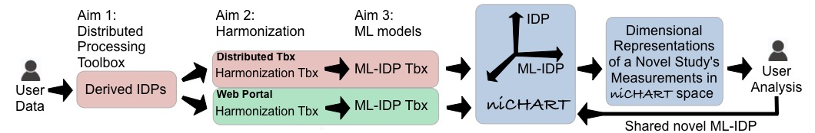
Fig 1. Schematic of NiChart software suite

Slide 2
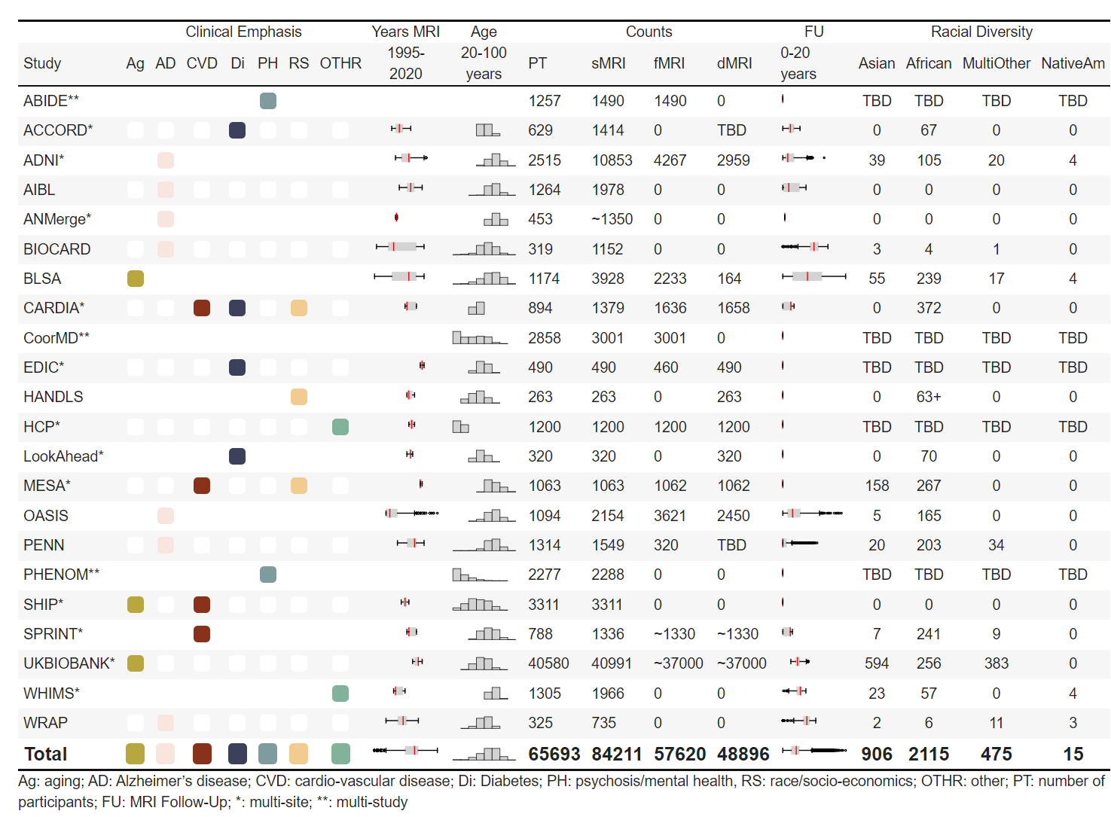
Fig 2. Reference MRI dataset used for data harmonization and for training machine learning (ML) models

Slide 3
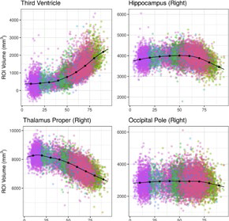
Fig 3. Age trends of selected imaging features after data harmonization

Slide 4
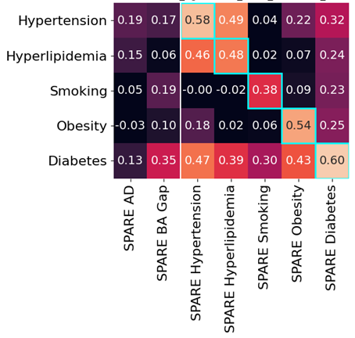
Fig 4. Panel of SPARE scores derived from the reference dataset. Correlations between SPARE scores for various diseases and conditions

Slide 5
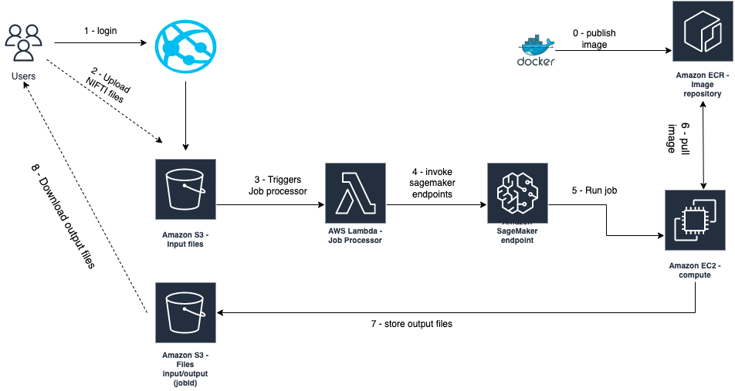
Fig 5. Architecture diagram of the web interface

