Slide 1

Online Fraud Detection
Name : Gurdit Singh
Student ID: 23185190
Date: 14-01-2024

Slide 2

Introduction
Online Payment Fraud Detection, uses machine learning techniques and data analytics to effectively detect and significantly pattern in online fraud detection.
The project applied machine learning methods to a Kaggle dataset on online fraud, successfully resolving three related issues. Online fraud in finance is a widespread issue affecting both companies and individuals.
Online fraud detection using machine learning can identify patterns in cyber attacks, aiding in prevention.
It is important to educate legitimate users on safe online behaviors to avoid becoming victims of such frauds.

Slide 3
Problem Statement
Scenario 1: Predict a transaction whether it is fraudulent or not based on the features, not every transaction fraudulent. To identify this classification model is used.
Scenario 2: Check if user received any intimation or alert before fraud happened, to do this clustering model is used. By group transactions into clusters based on their transaction characteristics as features that will help on to check whether a person received Flagged Fraud or not.
Scenario 3: Check if there is any similar pattern between fraudulent on the base of their transaction for each account and check with which transaction is victim of fraud and which transaction is not by compare with few attribute that will help to understand the pattern of fraud transaction occurrence in each account. To address this is problem linear regression is used.

Slide 4
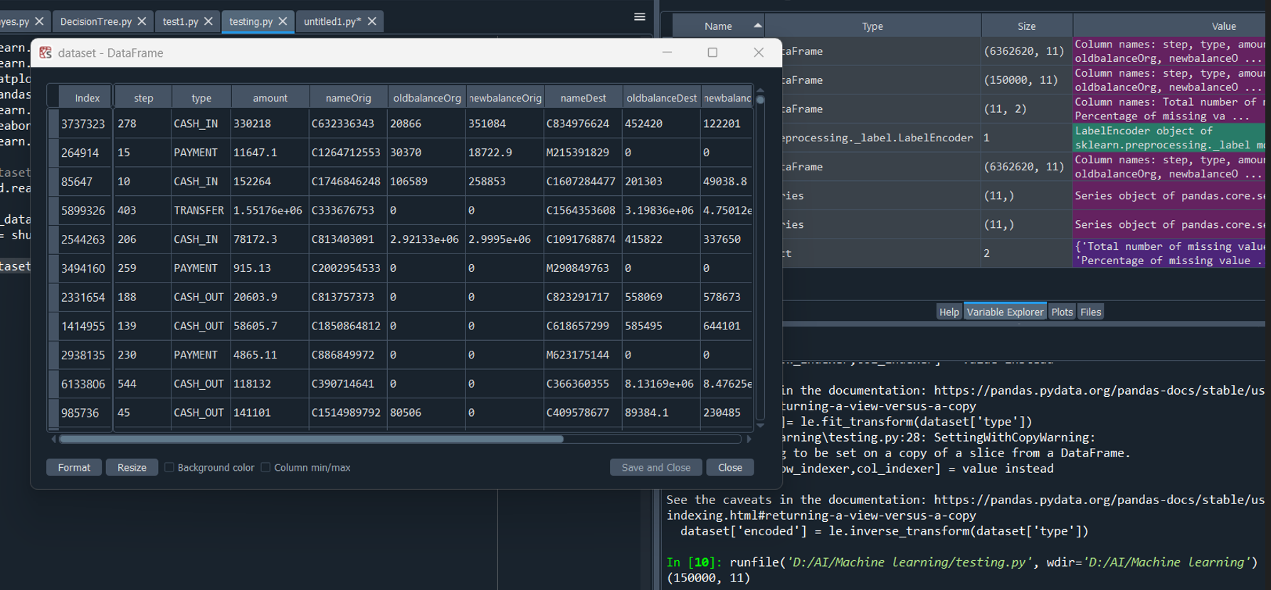
Dataset Description
The selected dataset for this task focuses on online fraud detection and was obtained from Kaggle. It consists of 200000 rows and 11 columns.
The dataset highlights the transaction amount, nameOrig, oldbalanceOrig, newbalanceOrig, nameDest, oldbalanceDest, newbalancedDest, isFraud and isFlaggedFraud. By analyzing these features, the machine learning model is used to create fraud detection system can identify any anomalies in transaction patterns, such as an unusually high number of transactions in a short period or a significant increase in transaction amounts. This can help the system to identify potential fraud cases early in the process, significantly reducing the associated costs

Slide 5
Methodology
it can effectively distinguish between fraudulent and non-fraudulent transactions based on distinct feature similarities.
Accuracy, Efficiency, Simplicity
Case 1
Classification Model
k-Nearest Neighbors
Case 2
Clustering Model
K-means clustering
Grouping transactions to detect fraudulent activity
effectively identifying patterns and similarities
Case 3
Regression Model
Linear regression
Detects patterns in fraudulent transactions effectively.

Slide 6
Data Preprocessing
Checking null values in row and columns
Data is ready to used in machine learning model
If there is any null values present, In my case I have no null values
Checking If there is any outlier present in dataset, I my case I have outliers
No
Yes
Yes
Remove with mode function or if columns is not important then drop the columns
Remove the outliers from dataset

Slide 7
Model Development
Case 1
Case 2
Case 3
k-Nearest Neighbors
K-means clustering
Linear regression
Libraries
Train, Test and split
Take 60 % for Tain and 40 % for test
Take user input values of K
Apply the KNN model
Fit and predict the KNN model
Libraries
Train, Test and split
Take 60 % for Tain and 40 % for test
Calculate distance with Elbow method
Apply the K-Mean model
Fit and predict the k-mean model
Libraries
Train, Test and split
Take 60 % for Tain and 40 % for test
Apply the Linear regression model
Fit and predict the Linear regression model.

Slide 8
Model Evaluation
Case 1
Case 2
Case 3
k-Nearest Neighbors
K-means clustering
Linear regression
Take 15 values of K and found that onwards 6 model provide good accuracy about 99.9% and using confusion matrix to check the number of false and true valse.
Take 1 to 11 values of WCSS and found that onwards 4 model provide good accuracy about 99.1% and using confusion matrix to check the number of false and true valse.
silhouette_score Ise about 0.824
The accuracy of linear regression after creating new variable is about 1, which is very accurate.
https://colab.research.google.com/drive/1Q7yTiGxSUh1cPAUS-u149FDXZulCTyek#scrollTo=Rnqd2078XSzc

Slide 9
Findings
Case 1: Using a classification model, we can predict whether a transaction is fraudulent based on its features, as not all transactions are fraudulent.
Case 2: We can verify if a user was alerted prior to a fraud occurrence by using a clustering model. By grouping transactions into clusters based on transaction characteristics, we can see if a person received a Flagged Fraud alert.
Case 3: A linear regression model is used to examine patterns of fraudulent transactions within individual accounts, comparing attributes to determine which transactions fell victim to fraud and which did not, aiding in the understanding of fraudulent transaction patterns.

Slide 10
Conclusions
To sum up, the above scenarios illustrate the use of different data analytics models to combat fraud. A classification model helps identify whether a transaction is fraudulent based on its features, while a clustering model assists in determining whether an individual received a fraud alert prior to the illicit activity by grouping similar transactions together. Lastly, a linear regression model can help understand the pattern of fraudulent transactions by comparing certain attributes across accounts. Each method serves to aid in fraud detection and prevention. At the end, the combination of both supervised and unsupervised learning techniques contributes to a robust understanding of online fraud detection, pattern and accurate prediction.

Slide 11
Future Work
Going to create GUI of this 3 case which help user to interact what kind of similarity behaviour.
Enhanced Machine Learning Models.
Behavioral Analytics and User Profiling.

Slide 12

Thank you ..!

