Slide 1
Name:Daiyu Zhang StudentId:20061805 Course:SSD4 module:web programming

Slide 2
Student Feedback Web Application.
a web application for managing student feedback on the subjects they have studied.

Slide 3
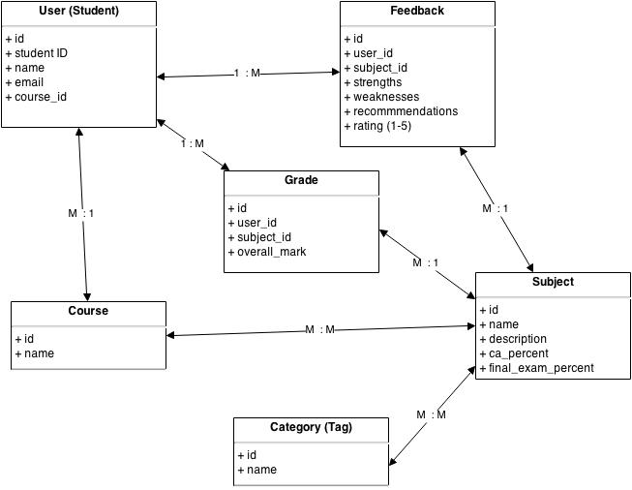

Slide 4
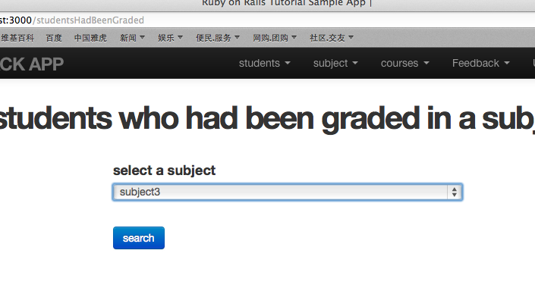
screenshots
Notes:
List all students which had been graded according to specific subject.

Slide 5
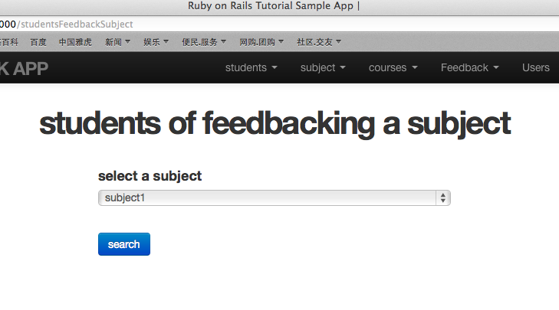
Notes:
All students which had posted feedbacks to specific subject.

Slide 6
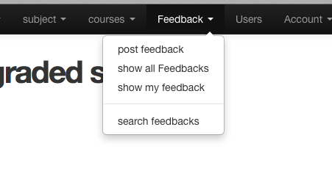
Notes:
Here, user can post a feedback, list all feedbacks, list all his own feedbacks as well as search feedbacks according to specific subject.

Slide 7
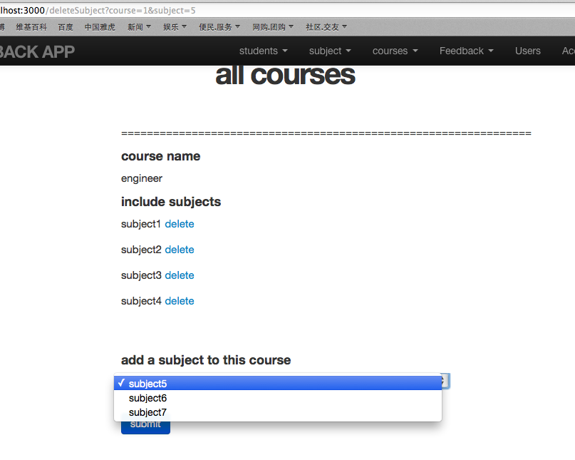
Notes:
Here, user can add a sujbect to a course as well ass delete a subject from a couse.after a subject add to a course, it will not be appear on the add menuS.

Slide 8
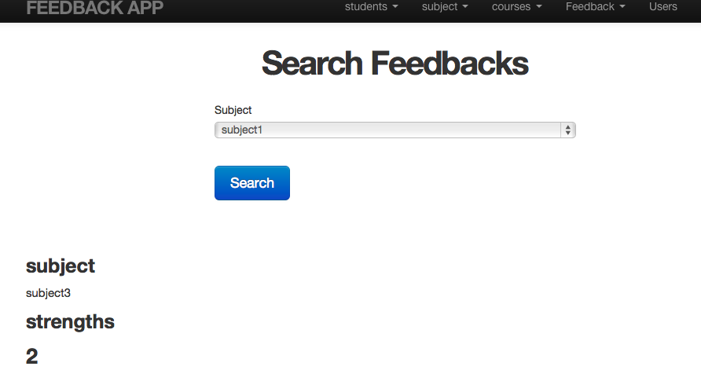
Notes:
List feedbacks according to specific subject.

Slide 9
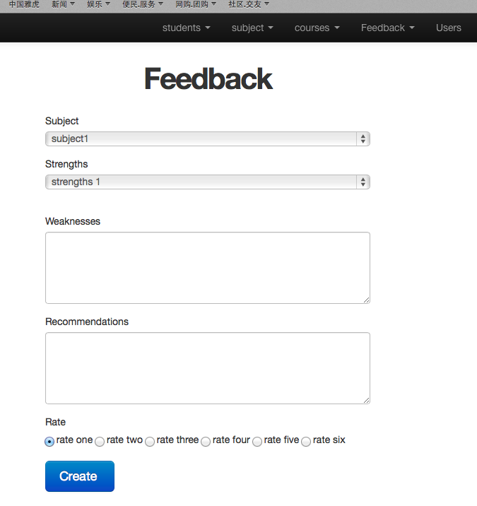
Notes:
Post a feedback.

Slide 10
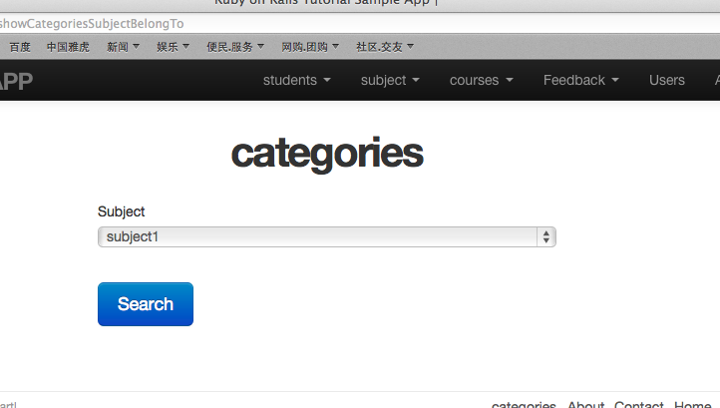
Notes:
List all categories according to specific subject.

Slide 11
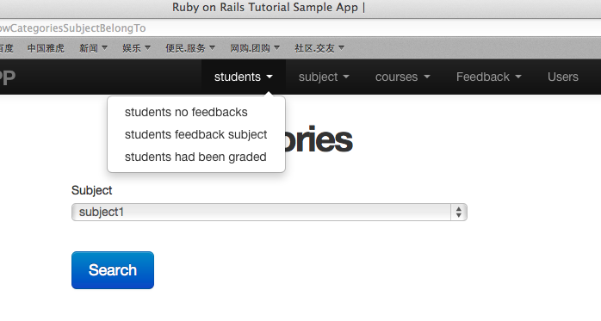
Notes:
List students which are no feedbacks and have feedbacked specific subject as well as have been granded according to specific subject..

