Slide 1

BRAIN
TRAIN
Your personal mental-care application

Slide 2
PROBLEM STATEMENT
We are presently living in a world of social boast but mental despair.
In the past few years there has been a sharp rise in bad emotional health of people (especially youth) all over the globe.
People aren't open or comfortable enough to consult a psychiatrist given their social reputation.
Most of them are not even aware, of how the grave issue is.

Slide 3
56,675,969
people suffer from depression in India as of 2015.
*Source : WHO

Slide 4
OUR SOLUTION
A PWA working alongside a headgear, relaying real time information about the user's brain activity to detect depression and it’s extent.
The application recognises the severity of the issue and suggests warnings to evade similar circumstances.
If the “sadness quotient” goes below a certain threshold then the user is given a psychiatric recommendation, the following day, via notification.
A mail would be sent to all the confidants to update the severity of the issue.
A user can view his monthly stress calendar and can be suggested measures, like music, to avoid the latter.
This stress calender can also be downloaded by therapists using the user’s credentials for more efficient/faster conditioning.
Our solution could be sold to corporates to supplement the HRA, to have a check on Employee Stress Calendars whose inputs would help them improvise the work distribution.
It can also be used for social experiments to recognise different impact scales of various life scenarios on the mind, body and soul

Slide 5
THOUGHT PROCESS
According to a research done by IEEE, brain waves can be used to extract EEG signals which could further be used for Emotional Recognition. The idea is to use the statistics/data recordings of the headset and get an estimate of how "Sad" the person is. These inputs from the cap would now be plotted alongside regular activity and the person would be notified if a particular moment is getting too heavy for him.

Slide 6
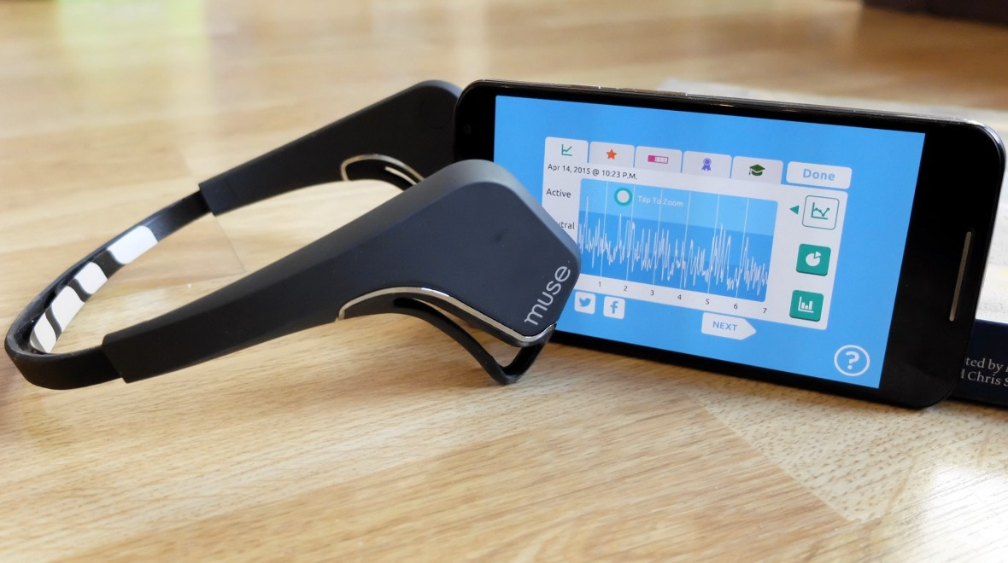
How we do this?
MUSE. - the brain sensing headband

Slide 7
IMPLEMENTATION
We read a few papers on feature extraction for prediction of emotions using EEG waves and tried to incorporate some of their viable options in our model.
We subsequently preprocessed the data and extracted the main features and finally fed the latter to the classifiers to update a user’s sadness quotient on a daily basis.
Next, we modified the label space (given in the DEAP Dataset), in an attempt to extract meaningful information (when a person depressed, happy, sad, etc) based on the valency, arousal, dominance and liking matrix as given in the Dataset.
We designed a progressive web application using Flask and modern web technologies to create an accessible and user friendly interface.
The user interface was specifically designed to be simple, minimal yet appealing to the eye. The main components are highlighted specifically and insights are the main focus.

Slide 8
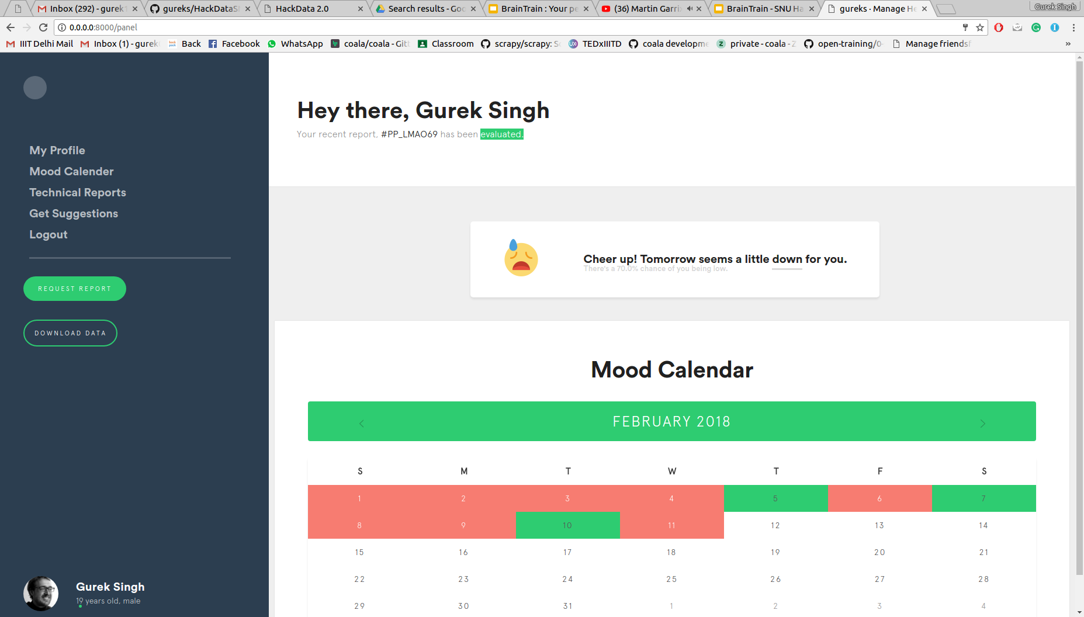
Place your screenshot here
TIME!
DEMO

Slide 9
FUTURE POSSIBILITIES
We could have trained the classifier for a bit longer to get better results.
We could merge fitbit data with our app for more comprehensive evaluation.

Slide 10
TEAM
G4884R5
GUREK SINGH @gureks on Github/LinkedIn/Facebook/Twitter @IllegalSardar on Instagram/Snapchat/Dribble
MRIDUL SHARMA @mridul.sharma.92123 on LinkedIn/Facebook @mridulsharma2203 on Instagram

