Slide 1
Introduction to Algorithms
Second Edition by
Cormen, Leiserson, Rivest & Stein
Chapter 3

Slide 2
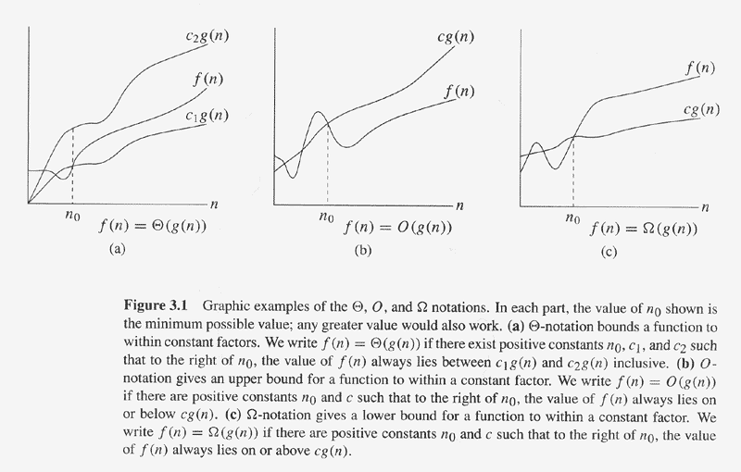
Copyright © The McGraw-Hill Companies, Inc. Permission required for reproduction or display.

