Slide 1
Introduction to Algorithms
Second Edition by
Cormen, Leiserson, Rivest & Stein
Chapter 26

Slide 2
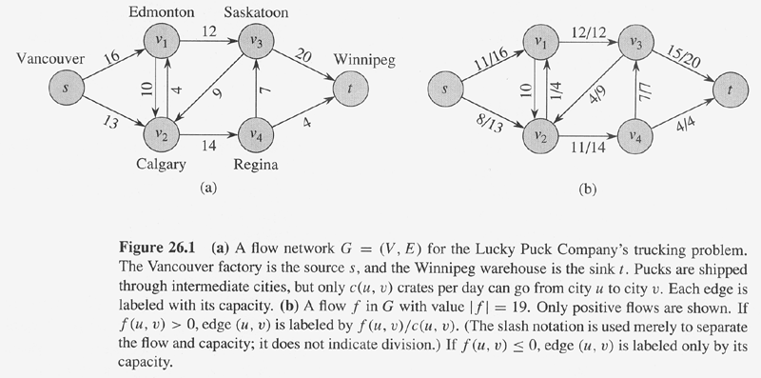
Copyright © The McGraw-Hill Companies, Inc. Permission required for reproduction or display.

Slide 3
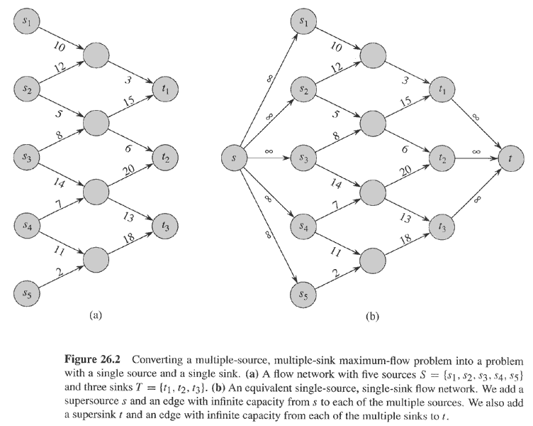
Copyright © The McGraw-Hill Companies, Inc. Permission required for reproduction or display.

Slide 4
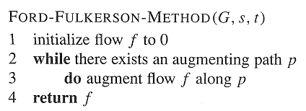
Copyright © The McGraw-Hill Companies, Inc. Permission required for reproduction or display.

Slide 5
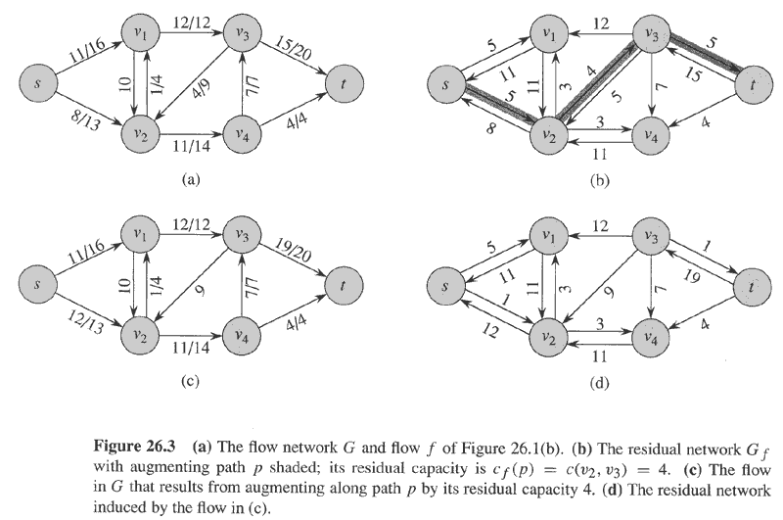
Copyright © The McGraw-Hill Companies, Inc. Permission required for reproduction or display.

Slide 6
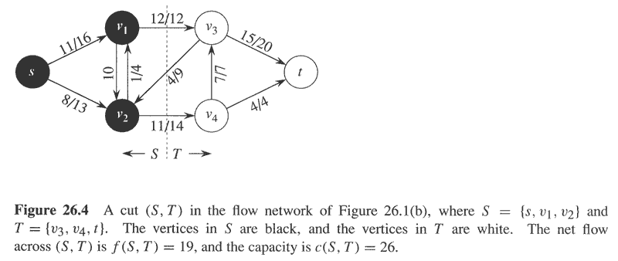
Copyright © The McGraw-Hill Companies, Inc. Permission required for reproduction or display.

Slide 7
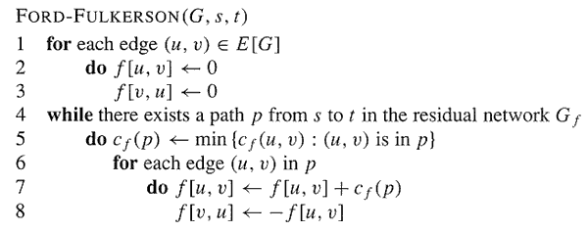
Copyright © The McGraw-Hill Companies, Inc. Permission required for reproduction or display.

Slide 8
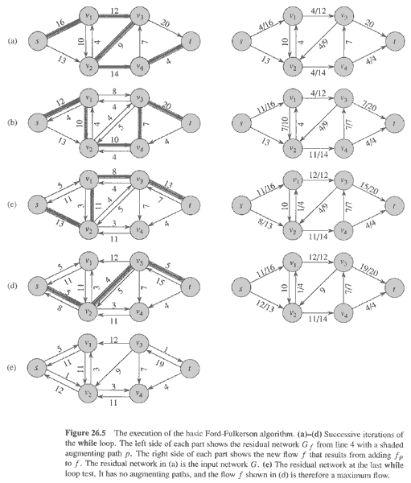
Copyright © The McGraw-Hill Companies, Inc. Permission required for reproduction or display.

Slide 9
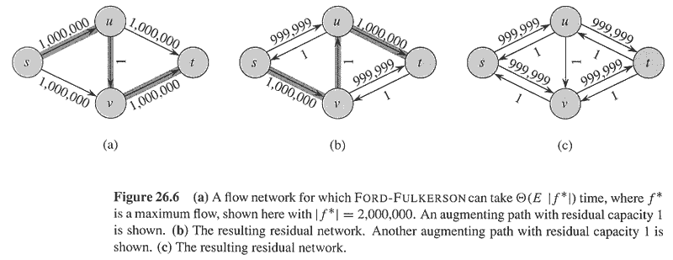
Copyright © The McGraw-Hill Companies, Inc. Permission required for reproduction or display.

Slide 10
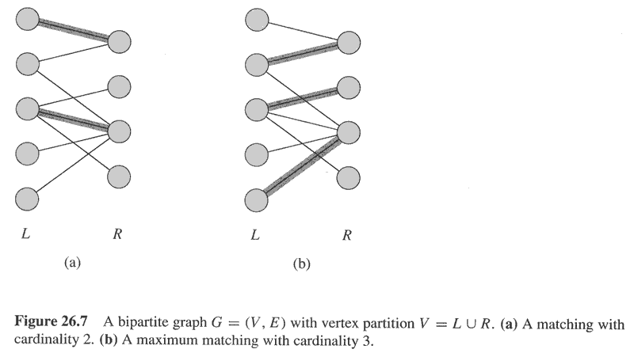
Copyright © The McGraw-Hill Companies, Inc. Permission required for reproduction or display.

Slide 11
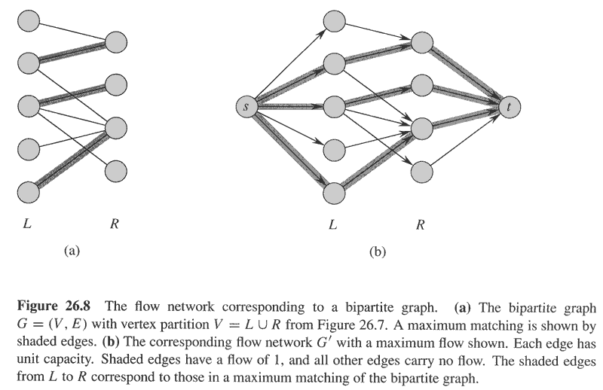
Copyright © The McGraw-Hill Companies, Inc. Permission required for reproduction or display.

Slide 12
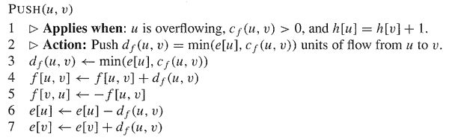
Copyright © The McGraw-Hill Companies, Inc. Permission required for reproduction or display.

Slide 13
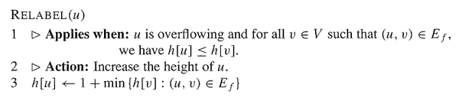
Copyright © The McGraw-Hill Companies, Inc. Permission required for reproduction or display.

Slide 14
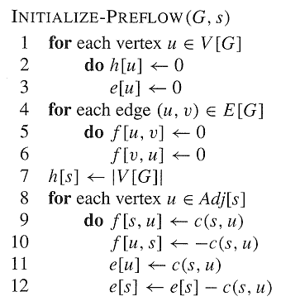
Copyright © The McGraw-Hill Companies, Inc. Permission required for reproduction or display.

Slide 15
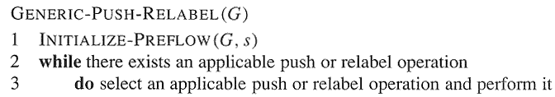
Copyright © The McGraw-Hill Companies, Inc. Permission required for reproduction or display.

Slide 16
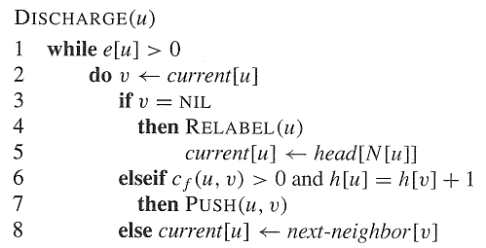
Copyright © The McGraw-Hill Companies, Inc. Permission required for reproduction or display.

Slide 17
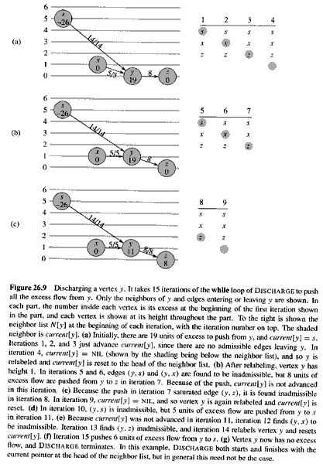
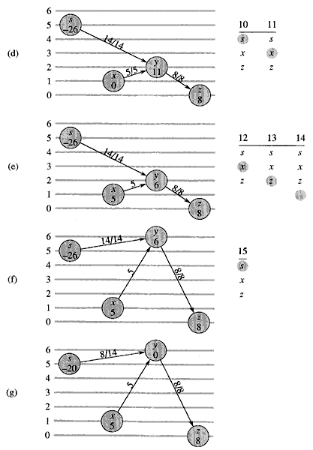
Copyright © The McGraw-Hill Companies, Inc. Permission required for reproduction or display.

Slide 18
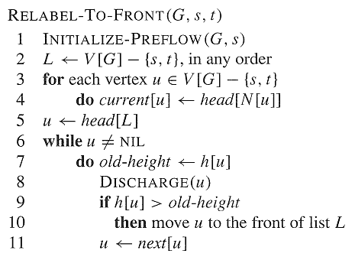
Copyright © The McGraw-Hill Companies, Inc. Permission required for reproduction or display.

Slide 19
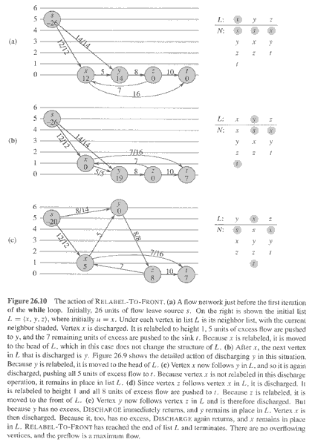
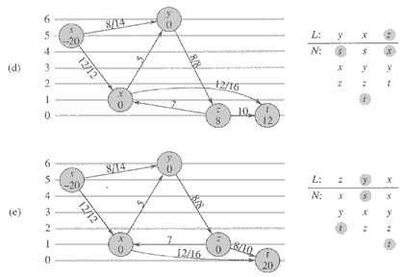
Copyright © The McGraw-Hill Companies, Inc. Permission required for reproduction or display.

Slide 20
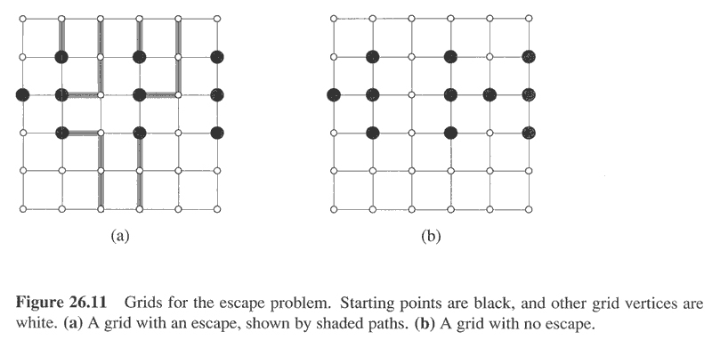
Copyright © The McGraw-Hill Companies, Inc. Permission required for reproduction or display.

Slide 21
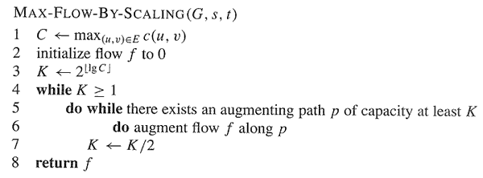
Copyright © The McGraw-Hill Companies, Inc. Permission required for reproduction or display.

Slide 22
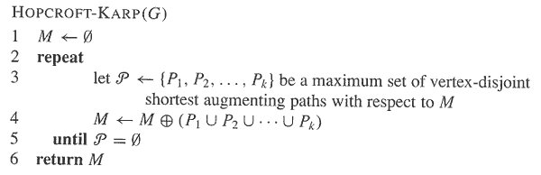
Copyright © The McGraw-Hill Companies, Inc. Permission required for reproduction or display.

