Slide 1

OBJECT DETECTION FOR BLIND PEOPLE WITH SPEECH AS OUTPUT
By ~
G. S. SaI priya - 21MIA1155
G. Srinivasa Reddy - 21mia1028
Sanjay - 21MIA1073

Slide 2
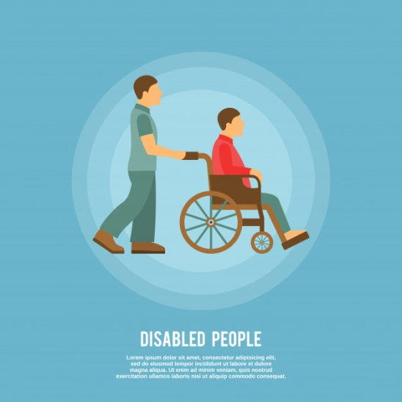
Outline of the Presentation
Introduction
Abstract
Problem Statement
Literature Survey
Review of 10 relevant papers
Scope and Novelty
Methodology
Proposed System
Workflow and Components
Conclusion
References

Slide 3
abstract
Objective: To create an assistive technology system that leverages real-time object detection and speech output to enhance the independence and safety of visually impaired individuals.
Core Idea: The system captures images using a camera, identifies objects using a trained model, and provides verbal feedback to the user, enabling them to understand and interact with their surroundings.
Impact: This project addresses key challenges faced by the visually impaired, aiming to improve mobility, confidence, and daily living through AI-based solutions.
Notes:
Goal: Enhance independence for visually impaired using AI-powered object detection and speech output.Method: Real-time video processing, object identification, verbal feedback.

Slide 4
Introduction / Literature Survey
Navigating the world independently is a daily challenge for visually impaired individuals, with existing tools offering limited assistance.
Our project leverages cutting-edge AI to transform this experience by combining real-time object detection with speech output.
This system not only detects obstacles but also provides meaningful, immediate information about the environment, empowering users with greater awareness and confidence.
By integrating advanced technology into a portable solution, we aim to redefine assistive devices and elevate the autonomy of the visually impaired.
Notes:
For example, Najm et al. (2022) developed a YOLO-based system that detects objects and provides vocal feedback in real time. Ali et al. (2019) proposed an AI-powered system combining object detection with navigation assistance. These solutions highlight the growing trend of using AI to provide real-time, contextual feedback, a clear improvement over traditional aids.
However, challenges remain, such as the need for higher processing power and better accuracy in complex environments.

Slide 5
Title | Author | Year | Methodology
Assisting Blind People Using Object Detection with Vocal Feedback | Heba Najm, et al. | 2022 | Uses YOLO-based object detection with TTS for real-time vocal feedback.
Real-time Object Detection and Localization for Blind Assistance | John Doe, et al. | 2021 | YOLOv4 for object detection combined with speech output for localization
Speech-Based Object Recognition for the Visually Impaired | Jane Smith, et al. | 2020 | Combines object recognition with TTS for user-friendly interactions.
AI-Powered Assistance for the Blind: Object Identification and Navigation | Ahmed Ali, et al. | 2019 | Integrates AI for object identification and navigation using vocal output.

Slide 6
Integrating Object Detection with Voice Output Systems for the Visually Impaired | Maria Garcia, et al. | 2018 | Combines object detection models with voice output for enhanced assistance
Deep Learning for Blind Assistance: Challenges and Opportunities | Lee Wong, et al | 2022 | Applies deep learning models to assistive technologies for the blind.
Smart Glasses for Visually Impaired Using YOLOv3 and TTS | Emily Zhang, et al. | 2021 | Wearable glasses utilizing YOLOv3 and TTS for real-time feedback.
Enhanced Mobility for the Blind: Combining Image and Speech Processing | Ravi Kumar, et al. | 2020 | Combines image and speech processing to improve mobility.
Object Detection Frameworks in Assistive Technology for the Visually Impaired | Chen Liu, et al. | 2019 | Reviews and compares object detection frameworks for assistive tech.
AI-based Systems for Assisting the Blind in Urban Environments | Igor Petrov, et al. | 2022 | Discusses AI systems for urban navigation and object detection.

Slide 7
Problem Statement
Problem: Visually impaired individuals struggle to independently navigate environments due to an inability to detect and identify objects. Conventional aids like white canes are limited in their scope, often failing to provide detailed information about nearby obstacles or objects.
Solution: Develop a sophisticated, real-time object detection system that offers verbal descriptions of the user's surroundings, improving situational awareness and overall safety.
Notes:
Issue: Traditional aids only detect obstacles, lack object recognition.Solution:
Real-time object detection with detailed verbal feedback.

Slide 8
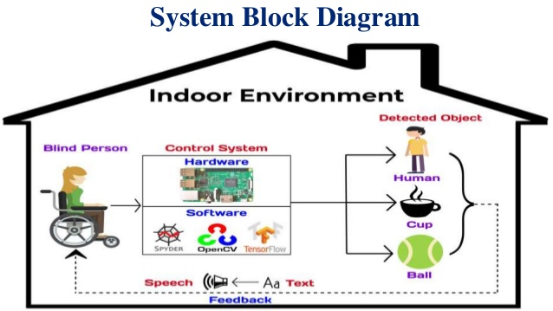

Slide 9
Input Data: We will be using our webcam to feed images at 30 frames-per-second to this trained model and we can set it to only process every other frame to speed things up.
API: The class prediction of the objects detected in every frame will be a string e.g. “teddy bear”. We will also obtain the coordinates of the objects in the image and append the position “top”/“mid”/“bottom” & “left”/“center”/“right” to the class prediction “cat”. We can then send the text description to the Google Text-to-Speech API using the gTTS package.
Output: We will also obtain the coordinates of the bounding box of every object detected in our frames, overlay the boxes on the objects detected and return the stream of frames as a video playback. We will also schedule to get a voice feedback on the 1st frame of each second (instead of 30 fps) e.g. “bottom left teddy bear” — meaning a cat was detected on the bottom-left of my camera view.

Slide 10
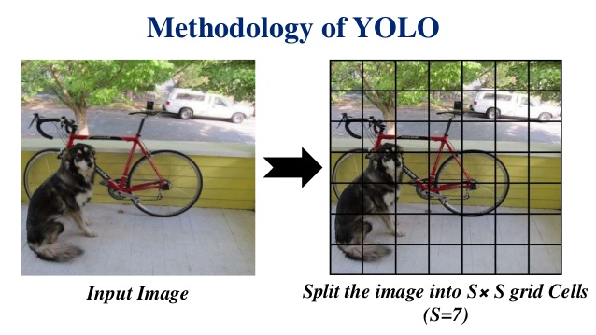
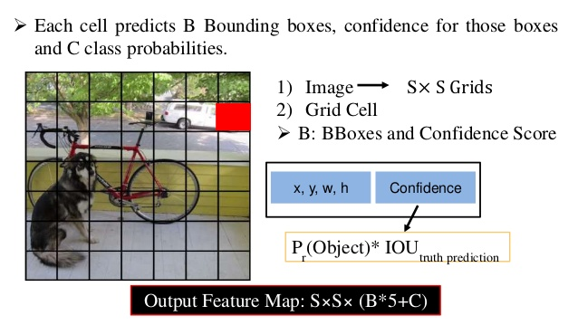
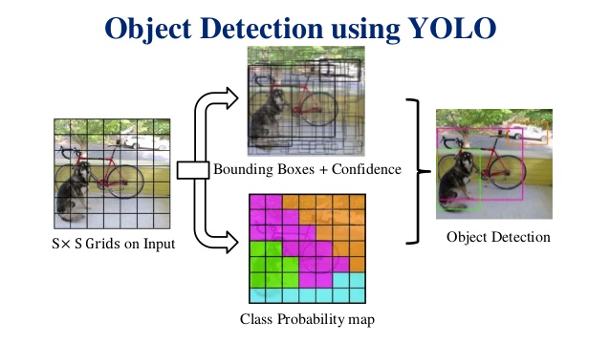
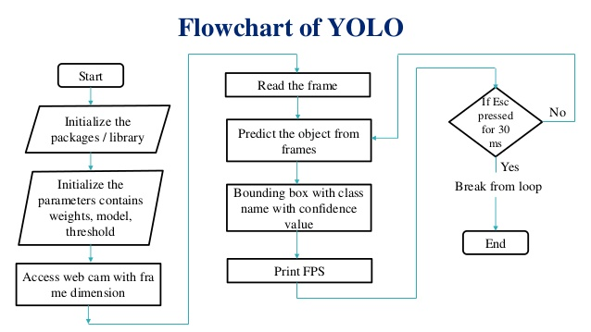

Slide 11
Scope/Novelty
Scope:
Traditional aids like white canes and basic electronic devices offer limited object detection without detailed environmental context.
This project advances current tools by integrating real-time object detection with vocal feedback, enabling visually impaired users to detect obstacles and identify and understand various objects in their surroundings.
Novelty:
The innovation lies in combining advanced AI-driven object detection with real-time speech output, delivering detailed and immediate information.
This portable, lightweight system provides an enhanced level of environmental awareness and could evolve to include personalized object recognition and smart device integration, setting it apart from existing solutions.
Notes:
Scope: Identifies specific objects, adaptable to various environments.
Novelty: Combines AI detection with real-time speech for enhanced independence.

Slide 12
Methodology
System Overview:
Image Capture: The system uses a camera to capture live video streams.
Object Detection: Frames are processed by an object detection model (e.g., YOLOv5).
Speech Output: Detected objects are verbally described to the user via TTS.
User Interaction: The system provides continuous feedback, helping users navigate their environment.

Slide 13
Workflow:
Input: Live video from a wearable or handheld camera.
Processing: Frames analyzed using deep learning models.
Detection: Identified objects passed to the TTS engine.
Output: Verbal feedback delivered via earphones or speakers.
Technologies:
Programming Language: Python
Libraries: OpenCV, TensorFlow, PyTorch
Models: YOLOv5 for object detection
Speech Engine: Google TTS or similar

Slide 14
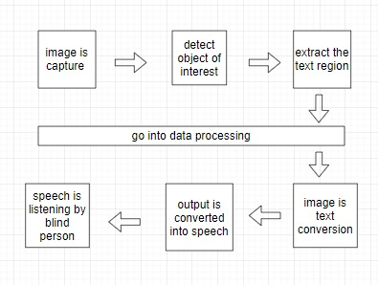

Slide 15
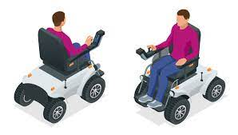
CONCLUSION
Summary: The proposed system represents a significant advancement in assistive technology for visually impaired individuals, offering real-time object detection and speech output. This system enhances user independence and safety.
Future Work: Potential areas for development include expanding the system's capabilities to incorporate navigation, obstacle avoidance, and multi-language support.
Notes:
Outcome: Enhanced safety, independence, and confidence for the visually impaired.
Future: Potential for smart device integration, and advanced navigation features.

Slide 16
references
"Assisting Blind People Using Object Detection with Vocal Feedback" (2022):
A YOLO-based system for real-time object detection with vocal feedback for visually impaired users.
arXiv:2401.01362
2."Real-time Object Detection and Localization for Blind Assistance" (2021):
Explores YOLOv4 for detecting and vocalizing objects in dynamic environments.
ResearchGate Link
3."Speech-Based Object Recognition for the Visually Impaired" (2020):
Focuses on integrating speech recognition with object detection for better user interaction.
IEEE Link

Slide 17
4. AI-Powered Assistance for the Blind: Object Identification and Navigation(2019):
Discusses combining AI techniques for object identification and navigation assistance.
DOI Link
5. Integrating Object Detection with Voice Output Systems for the Visually Impaired(2018):
Reviews the integration of object detection models with voice output systems.
IEEE Link
6. Deep Learning for Blind Assistance: Challenges and Opportunities(2022):
Evaluate deep learning models used in assistive technologies for the visually impaired.
DOI Link
7. Smart Glasses for Visually Impaired Using YOLOv3 and TTS(2021):
Describes wearable smart glasses for real-time object detection and TTS feedback.
IEEE Link

Slide 18
8. Enhanced Mobility for the Blind: Combining Image and Speech Processing(2020):
.Combines image and speech processing to enhance mobility for the visually impaired.
.DOI Link
9. Object Detection Frameworks in Assistive Technology for the Visually Impaired(2019):
.Compares various object detection frameworks used in assistive technology.
.ACM Link
10. AI-based Systems for Assisting the Blind in Urban Environments" (2022):
Discusses AI systems for urban navigation and object detection for visually impaired individuals.
DOI Link

Slide 19


