Slide 1
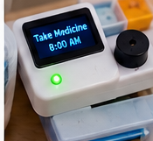
MedGuide AI
Smart Medicine Reminder &
Accessible Prescription Reader
CARE CIRCUIT | REMIND • READ • RESPOND
Hardware + Software + AI
A practical accessibility-focused prototype that helps users follow a verified medication schedule.
Department of ECE • KL University Hyderabad

Slide 2
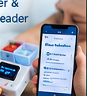
The Healthcare Challenge
02
Why medication routines can be difficult
Unreadable instructions
Small print or unclear handwriting can make labels hard to understand.
Missed reminders
Busy routines, memory difficulties, or complex schedules can lead to missed doses.
Accessibility barriers
People with low vision may need spoken guidance instead of relying on text.
Design goal: make reminders clearer, more accessible, and easier to acknowledge.
MEDGUIDE AI • CARECIRCUIT • HEALTH TRACK

Slide 3

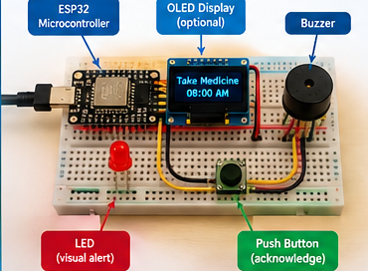
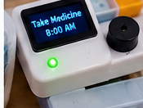
Introducing MedGuide AI
03
A connected assistance loop — with the person in control
01
02
03
04
Scan
Review
Schedule
Alert
→
→
→
User or caregiver captures the prescription label in the web app.
OCR extracts text; a person verifies medicine name and schedule.
The verified reminder plan is sent to the ESP32 device.
At the scheduled time, the device activates sound and light.
Core principle: AI helps read the label, but the user/caregiver verifies the schedule before reminders are activated.
MEDGUIDE AI • CARECIRCUIT • HEALTH TRACK

Slide 4
System Architecture
04
Separate the software intelligence from the physical reminder device
PHONE / COMPUTER
VERIFICATION
SCHEDULE
ESP32
ALERTS
Camera • OCR • Voice guidance
→
User/caregiver checks extracted details
→
Verified times and reminder data
→
Clock/check logic & outputs
→
Buzzer • LED • Button
Connectivity can be wired or Wi-Fi-based depending on the prototype. The ESP32 handles reminder outputs; OCR and text-to-speech run on the phone/computer.
MEDGUIDE AI • CARECIRCUIT • HEALTH TRACK

Slide 5
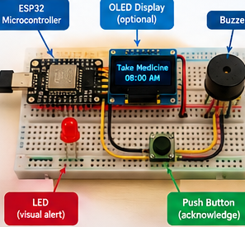
Hardware Components and Their Purpose
05
ESP32
Main controller; checks the reminder schedule and controls outputs.
Buzzer
Produces an audible alert when a reminder is due.
LED
Provides a visual alert, useful alongside sound.
Push button
Acknowledges the alert; software can log the acknowledgement.
OLED display (optional)
Shows the time, medicine label, or short instruction.
USB power supply
Powers the controller and connected components.
Prototype illustration: breadboard-based electronics
MEDGUIDE AI • CARECIRCUIT • HEALTH TRACK

Slide 6
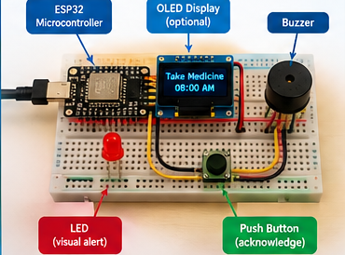
Hardware Setup — Working Model
06
Prototype parts
ESP32 board
Runs the reminder logic.
OLED display (optional)
Shows a short reminder message.
Buzzer
Makes the alert audible.
LED
Gives a visible signal.
Push button
Lets the user acknowledge the alert.
Slide 6: physical prototype and component callouts
MEDGUIDE AI • CARECIRCUIT • HEALTH TRACK

Slide 7
How Does the Hardware Work?
07
1
Verified schedule
The phone/computer sends or configures the reminder schedule.
2
Time check
The ESP32 checks whether a reminder is due.
3
Alert output
The buzzer sounds and LED lights up; the OLED may show instructions.
4
User acknowledgement
The user presses the button; the system records the acknowledgement.
Important: button press confirms acknowledgement only — it does not prove that medicine was taken.
MEDGUIDE AI • CARECIRCUIT • HEALTH TRACK

Slide 8
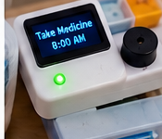
Example Use Case: A Reminder at 8:00 AM
08
7:00 AM
Schedule prepared
Caregiver verifies the medicine and reminder time in the app.
8:00 AM
Device alerts
ESP32 activates buzzer and LED; optional OLED displays the reminder.
After alert
User responds
User presses the button to acknowledge; the app logs the response.
Illustrative workflow, not a medical instruction.
MEDGUIDE AI • CARECIRCUIT • HEALTH TRACK

Slide 9
AI / ML and Software Details
09
Prescription OCR
Schedule verification
Voice and dashboard
•
Captures label or prescription image
•
User/caregiver checks medicine name
•
Text-to-speech reads verified instructions
•
Extracts visible text
•
Confirm timing and instructions from trusted prescription
•
Dashboard can show schedule and alert status
•
May misread handwriting or low-quality images
•
Only verified data enters the schedule
•
Optional multilingual voice output
•
Requires human review
•
Do not infer missing doses
•
ESP32 handles physical alerting
OCR supports accessibility; it must not independently prescribe, diagnose, or decide dosage.
MEDGUIDE AI • CARECIRCUIT • HEALTH TRACK

Slide 10
End-to-End System Flow
10
Prescription image
OCR extraction
Human verification
ESP32 reminder
Alert + response
→
→
→
→
Captured in web app
Text converted to fields
Confirm medicine + time
Checks due time
Buzzer / LED / button
The schedule should be verified before activation. Acknowledgements can be logged for later review.
MEDGUIDE AI • CARECIRCUIT • HEALTH TRACK

Slide 11
What Makes MedGuide AI Useful?
11
Accessible reminders
Human-verified information
Sound and light offer more than a text-only notification.
A caregiver or user reviews OCR output before scheduling.
Practical prototype
Expandable design
ESP32, buzzer, LED and button can be demonstrated on a breadboard.
OLED, phone connectivity and multilingual audio can be added in stages.
The device supports medication routines; it does not replace professional medical advice or a prescribed care plan.
MEDGUIDE AI • CARECIRCUIT • HEALTH TRACK

Slide 12
24-Hour Hackathon Implementation Plan
12
Hours 0–4
Assemble hardware
ESP32 + buzzer + LED + push button; verify each output.
Hours 4–9
Build reminder logic
Configure schedule, alert trigger, button acknowledgement.
Hours 9–15
Build software flow
Create upload screen, OCR extraction, verification form.
Hours 15–20
Connect components
Send verified reminder data to ESP32; test timing.
Hours 20–24
Validate and pitch
Test edge cases, prepare demo, explain limitations clearly.
MVP priority: reliable alert + acknowledgement. Add OLED and connectivity if time permits.
MEDGUIDE AI • CARECIRCUIT • HEALTH TRACK

Slide 13

Safety, Limitations and Responsible Use
13
Keep the prototype safe and honest
•
OCR can make mistakes, especially with handwriting, glare, or low-resolution images.
•
A person must verify medicine names, timing, and instructions before scheduling.
•
A button press records acknowledgement only; it cannot confirm ingestion.
•
The prototype is a reminder aid, not a dispenser, diagnostic system, or dose-decision tool.
•
Follow the prescribed label and consult a healthcare professional if instructions are unclear.
Never let the AI invent a missing dosage or change a prescribed medication schedule.
MEDGUIDE AI • CARECIRCUIT • HEALTH TRACK

Slide 14
Future Enhancements
14
Phone connectivity
OLED display
Battery operation
Sync reminders and send optional SMS/app alerts.
Show reminder time and short, high-contrast instructions.
Add safe portable power and low-battery indication.
Accessibility options
Caregiver dashboard
Reliability testing
Larger controls, adjustable volume, multiple languages.
Review schedules and acknowledgement history with consent.
Test restart behavior, connectivity loss, and incorrect OCR cases.
Build in stages: reliable core reminders first, optional features only after testing.
MEDGUIDE AI • CARECIRCUIT • HEALTH TRACK

Slide 15
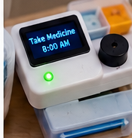
CARE CIRCUIT | HEALTH TRACK
MedGuide AI
Making medication reminders more accessible, understandable, and timely.
Hardware + Software + AI
A practical 24-hour proof of concept
THANK YOU • QUESTIONS?
Department of ECE • KL University Hyderabad

Slide 16
Image Credits and Prototype Notes
16
Visuals and project assumptions
•
Hardware setup image: prototype illustration supplied with the project materials.
•
Device and prescription visuals: illustrative images supplied with the project materials.
•
System workflow, component roles, and safety statements are based on the project description provided.
•
The OLED display and phone connectivity are optional extensions, not required for the minimum hardware demo.
•
Before public presentation, replace illustrative images with original prototype photographs if available.
Reminder: do not present illustrative device imagery as a photograph of a completed working product.
MEDGUIDE AI • CARECIRCUIT • HEALTH TRACK

