Slide 1
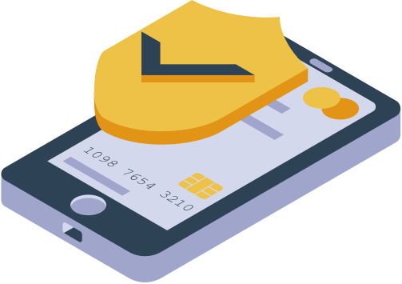
BAG & GO
A Cashierless Shopping Experience
Beran Orkan Işık
Miraç Merthan Durdağ
Yiğit Güriş
Yiğit Alp Bilgin
Kerem Er
Cemal Yılmaz
Ceren Birsu Yılmaz
Ataberk Çiftlikli

Slide 2

Agenda
What is our mission?
User Case Diagram
Our Features
Who we are
Technologies we have used
Our meetings
Customer interactions
What we promised &
What we delivered

Slide 3
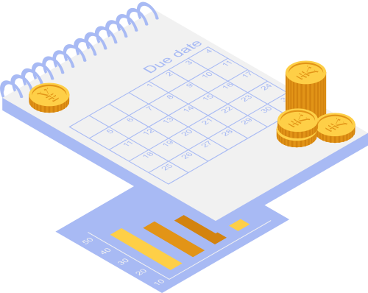


What Is Our Mission
Problem
Traditional checkout systems.
Traditional checkout systems
are time consuming.
are inefficient
are too dependant on staff availability
are too costly.
requires human interaction
What is the solution

Slide 4
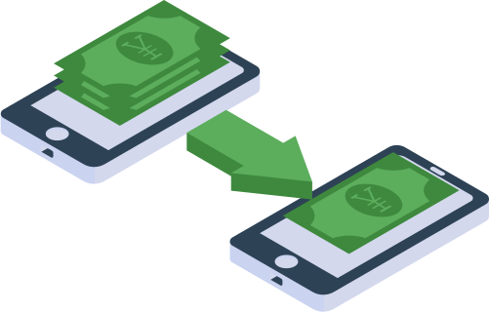
The Solution is Bag&Go

Slide 5
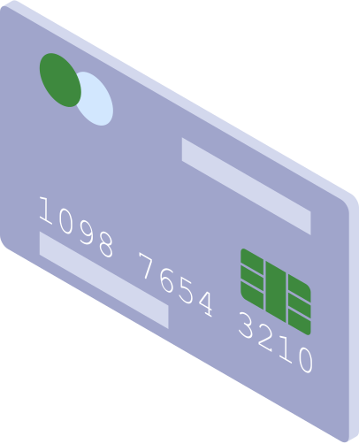
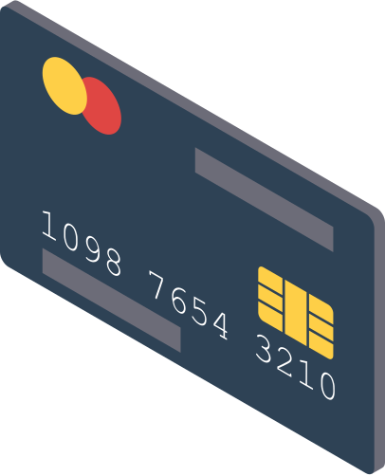
A cashierless shopping experience!
Self-checkout using your phones!
The Bag & Go offers:
No more times spent in lines.
No more unnecessary human interaction.
Less cost for the store managements.
Easier Transaction.
Easier product management

Slide 6
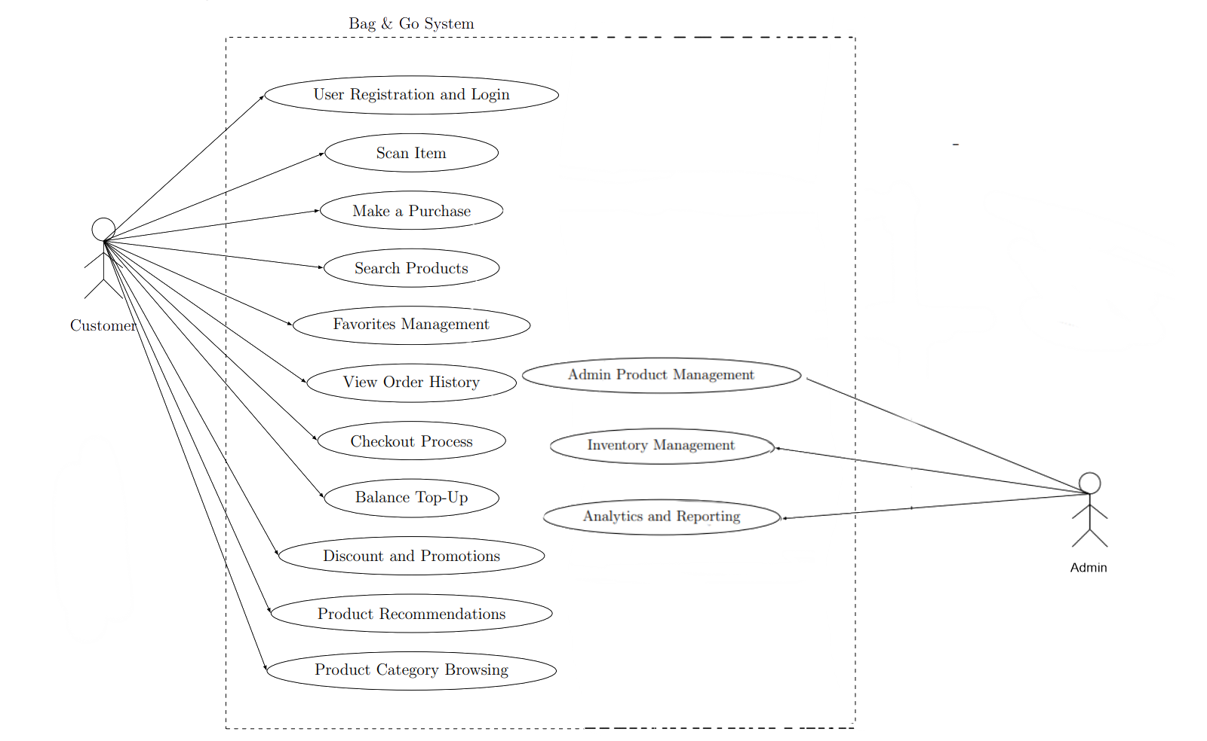
USER CASE DIAGRAM

Slide 7
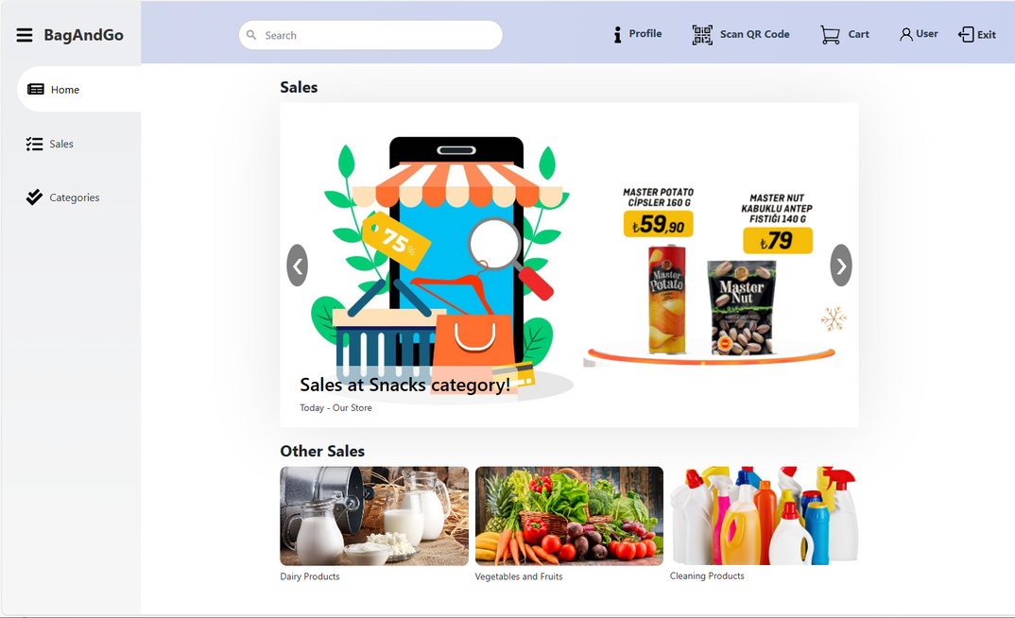
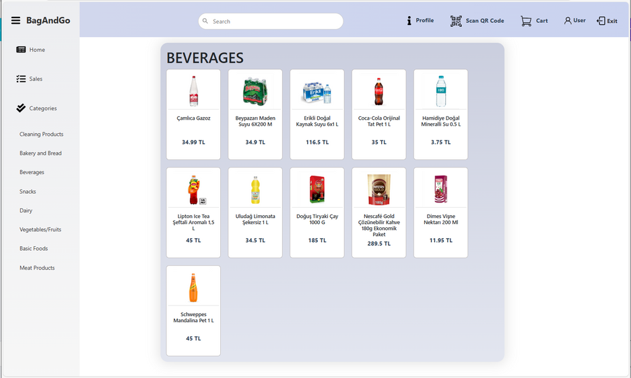
FEATURES
Secure Authorization
Clear UI
Dynamic Search Operations
Sales Sub Menu
Categories Sub Menu
Profile Page
Order Histoy
Favorites Sub Menu
QR Code Scanner
Cart Page and Checkout

Slide 8
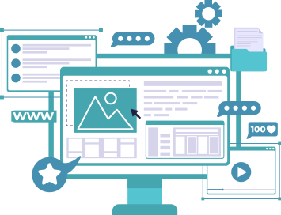
Team KING
Backend Division
Ataberk Çiftlikli
DevOps
Subject Expert
Beran Orkan Işık
DevOps
Back-end developer
Kerem Er
Scribe
Back-end developer
Miraç Merthan Durdağ
Back-end developer
Budget Manager
Yiğit Güriş
Back-end developer
Business Analyst
Frontend Division
Yiğit Alp Bilgin
Front-end developer
Budget Manager
Ceren Birsu Yılmaz
Front-end developer
QA
Cemal Yılmaz
Front-end developer
Business Analyst

Slide 9
PEOPLE OF
Backend Division
Ataberk
Çiftlikli
Beran Orkan Işık
Kerem
Er
Project Setup
Dockerized Project
Product API
Product Categories API
Register API
Login API
Register API
Order History API
Update Profile API
Update Password API
Cart API
Checkout API
Liked Products API
Unit Testing
Server Setup
Dockerized Project
Created admin accounts for server
Unit Testing
Product Categories API
Login API
Update Profile API
Update Password API
Unit Testing

Slide 10
PEOPLE OF
Backend Division
Yiğit
Güriş
Merthan Durdağ
Product API
Checkout API
Cart API
Liked Products API
Unit Testing
Product API
Checkout API
Cart API
Liked Products API
Register API
Unit Testing

Slide 11
PEOPLE OF
Frontend Division
Yiğit Alp Bilgin
Ceren Birsu Yılmaz
Cemal Yılmaz
React and Typescript Environment Setup
Register Page
Login Page
Home Page
Sales Sub Menu
Search Bar
Header and Sidebar
Cart Page
Profile Page
Favorites Sub Menu
Order History Sub Menu
Black-Box Testing
Colour Palette
QR Code Scanner
Categories Sub Menu
Black Box Testing
White Box Testing
Colour Palette
Profile Page User section
Database population
White Box Testing

Slide 12
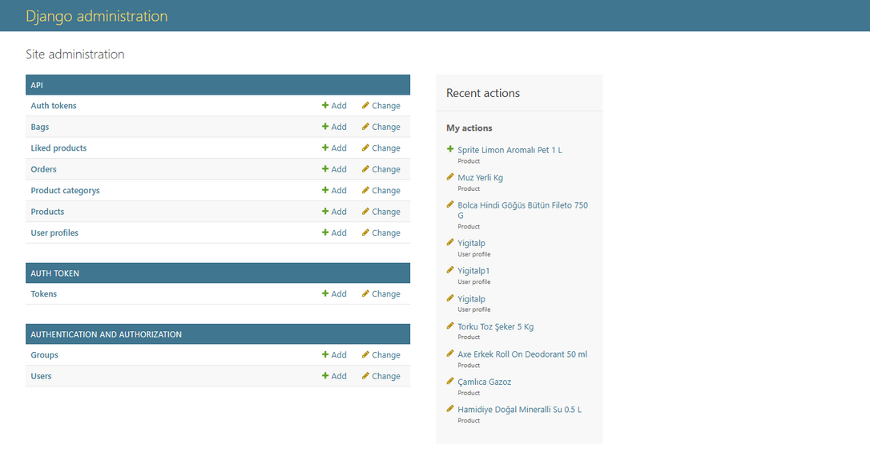
Tools We Have Used
Backend Technologies
Python Django REST Framework: Used to develop the RESTful API for the backend, providing robust and scalable server-side logic.
SQLite Database: Chosen for its lightweight and efficient storage, ideal for the project’s requirements during the development phase.
Cloud Hosting: The backend is deployed on a cloud platform, ensuring scalability, reliability, and accessibility.

Slide 13
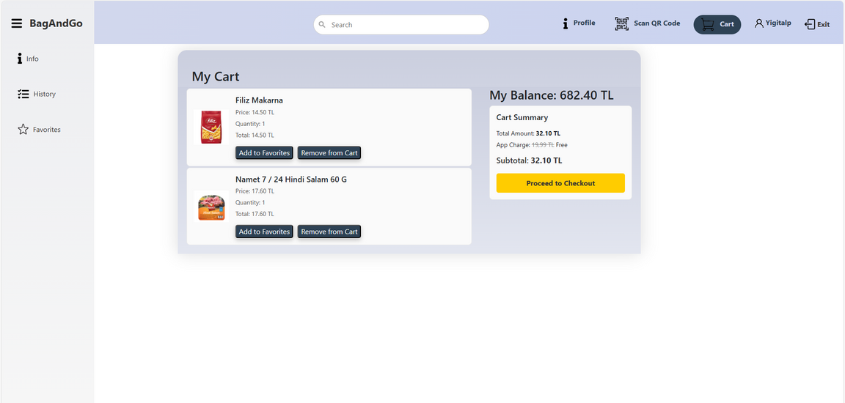
Tools We Have Used
Frontend Technologies
ReactJS: Utilized to create a responsive and dynamic user interface.
Typescript: It prevents bugs and scalability is great for large projects.
HTML/CSS: Employed to structure and style the web interface.
BOOTSTRAP Library: Implemented for easier styling.

Slide 14


Tools We Have Used
DevOps Tools
Docker: Used to containerize the application, ensuring consistent environments across development, testing, and production.
VSCode: The primary development environment, enhancing productivity with its extensions and integrated tools.

Slide 15

Tools We Have Used
Testing Tools
Postman: Used for API testing to ensure proper functionality and adherence to requirements.
Django’s test.py: Leveraged for unit testing, covering individual components and backend logic

Slide 16
Tools We Have Used
Project Tracking and Version Control
GitHub Issues: Employed as the project tracking tool to organize tasks, manage milestones, and track progress efficiently.
Git & GitHub: Used for version control to maintain code integrity and facilitate collaborative development.

Slide 17



Our Meetings
Customer Meetings
Customer Meeting 1 - 17.10.2024
Meeting On Project Plan
Customer Meeting 2 - 31.10.2024
Meeting On Project Requirements
Customer Meeting 3 -28.11.2024
Meeting On Design Specifications
Customer Meeting 4 - 26.12.2024
Meeting on Test Specifications
Customer Meeting 5 - 02.01.2025
Meeting on final deliverables
Frontend Meetings
Frontend Team Meeting 1 - 27.10.2024
Decided on the color palette.
Frontend Team Meeting 2 - 25.11.2024
Divided each page into members.
Frontend Team Meeting 3 - 08.12.2024
Checked on the progress.
Frontend Team Meeting 4 - 24.12.2024
Finalized all pages.
Full Team Meetings
Full Team Meeting 1 - 06.10.2024
Prepared the Project Charter
Full Team Meeting 2 - 01.11.2024
Decided on the requirements
Full Team Meeting 3 - 27.11.2024
Finalized the design specifications.
Full Team Meeting 4 - 24.12.2024
Decided on the test strategy.

Slide 18

Customer Interactions
Changes asked from us by our client:
Asked for github issues documentation.
- 28.11.2024
Asked for better UI design.
- 26.12.2024
Our customer
was
Elif Yıldırım
Implemented Changes:
Implemented github issues with milestones.
- 24.12.2024
Improved the UI design.
- 26.12.2024

Slide 19

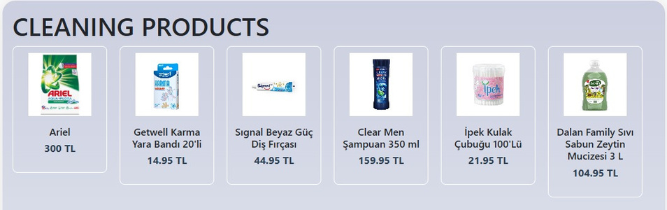
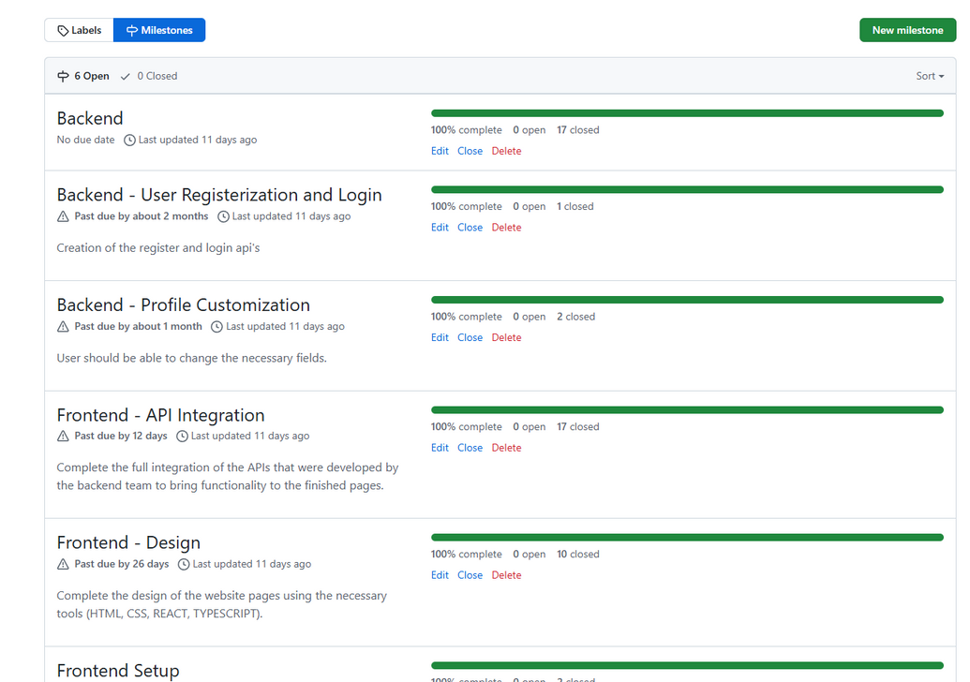
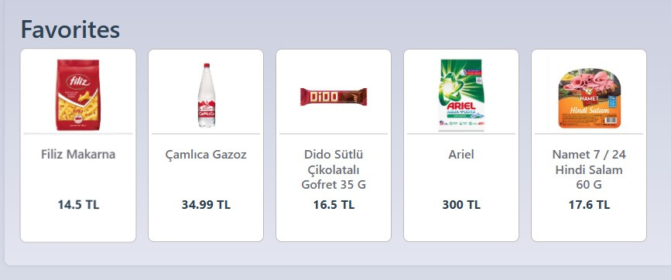
We have addressed the changes.
Github Issues
Modified UI

Slide 20
We used what we planned
Project Charter
Developed Project
Technology Stack
Project-Configuration Management:
Git, Docker, VsCode
Backend stack:
Python, SQL, Postman
Frontend stack:
HTML/CSS, ReactJS, Typescript
Technology Stack
Project-Configuration Management:
Git, Docker, VsCode
Backend stack:
Python (Django)
SQL (SQLite)
Postman (for testing api)
Frontend stack:
HTML/CSS, ReactJS, Typescript

Slide 21
We developed everything we have planned and even more
Project Charter
Developed Project
Designated features:
Registration and login page
Basic identity verification system
QR code reader for scanning items
Digital receipt for each purchase
The amount spent will be deducted from the balance users
Admin page for adding, removing products and other changes
Categories for items
Page for discounted items
Search bar
Implemented features:
Detailed user management
T.C. verification system
QR/barcode reader for scanning items
Digital receipt for each purchase
Balance system
Detailed admin panel
Categories
Page for discounted items
Live search bar
Liked products
and more...

Slide 22

Thank you for listening!

