Slide 1

Pune Institute of Computer Technology, Pune Dept. of E&TC
304200: Mini Project (MP) (2019 Course)
“Colour and Weight Based
Sorting Model”
Guided By: Prof. Vaibhav Vaijapurkar
By:
1) Omkar Navalgundkar (32128)
2) Prajwal Padwal (32133)
3) Pravin Gurjar (32139)

Slide 2
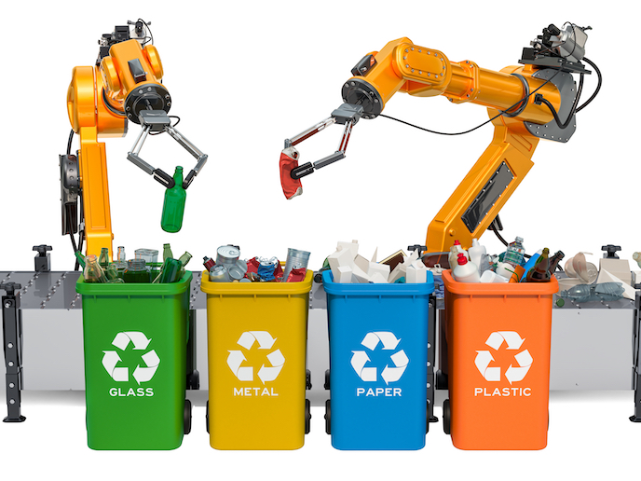
Introduction
Wide use of sorting mechanisms in industries.
Recycling plants: They sort materials based on types, size and weight.
Manufacturing industries: They sort products based on defects or quality control criteria and ensure good product delivery.
The proposed project is inspired by these different sorting mechanisms.
Contribute to industries like toys industries, food and beverages processing industries etc.
Will feature sorting based on parameters:
Colour
Weight

Slide 3
Aim and Objectives
Aim:
To design a sorting mechanism to sort objects based on colour and weight.
Objectives:
To study existing sorting techniques.
To develop a conveyor belt for the model using various motors.
To implement and verify the designed sorting system.
TE 5

Slide 4

Block Schematic
Sorting Mechanism
Power Supply
Motor Driver for flaps
Object Detection
Flaps
Colour Sensor
Microcontroller
Motor Driver
DC Motor
Weight Sensor
Conveyor System

Slide 5
Resources Required
Hardware
Software
ATMega 32
Permanent Magnet Stepper Motor
Conveyor Belt
DC motor
Colour sensor
IR sensor
Load cell
Soldering Gun and Solder
AVR Studio
Proteus Design Suite 8.0
AutoCAD

Slide 6
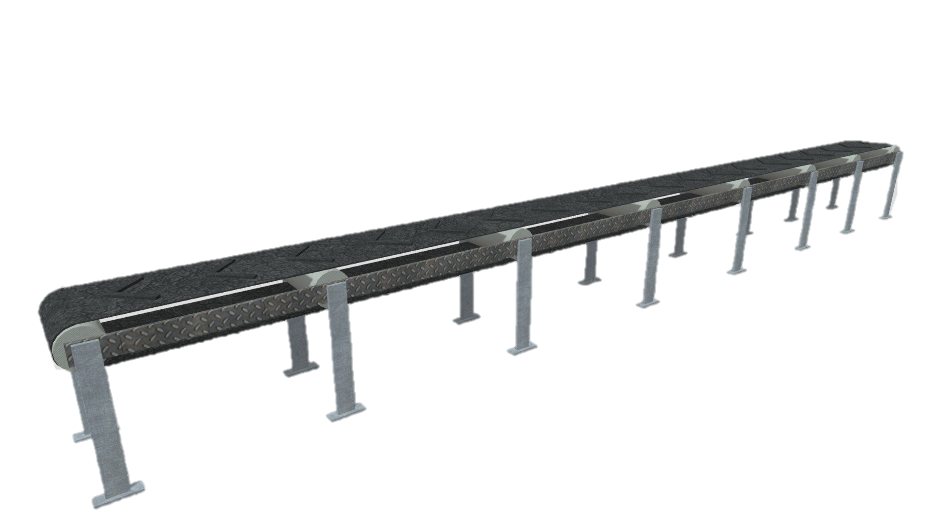
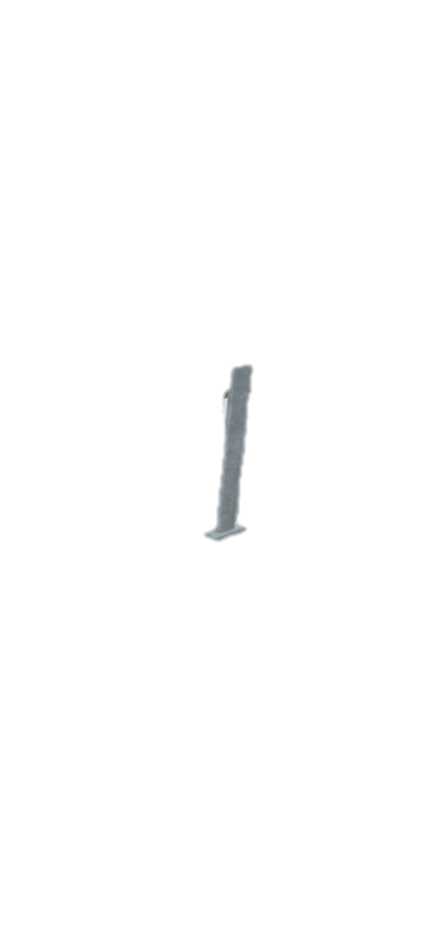
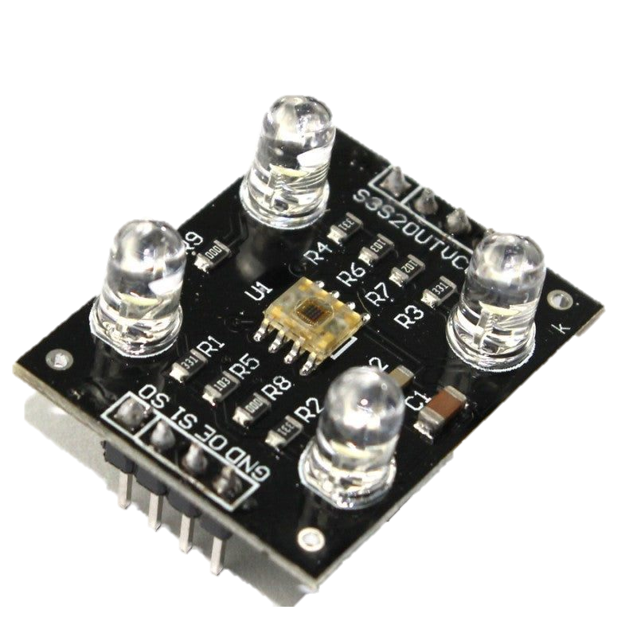
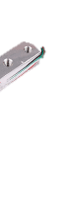
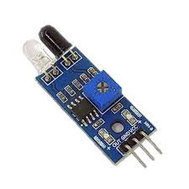
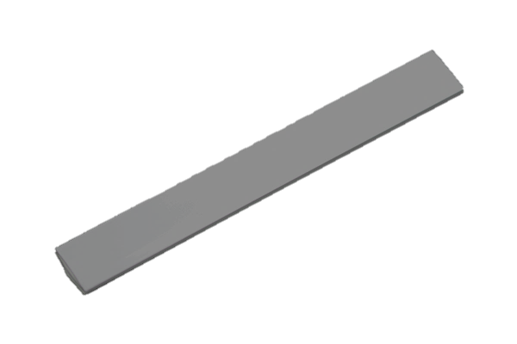
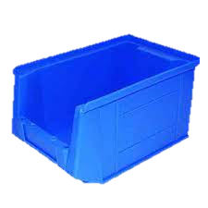
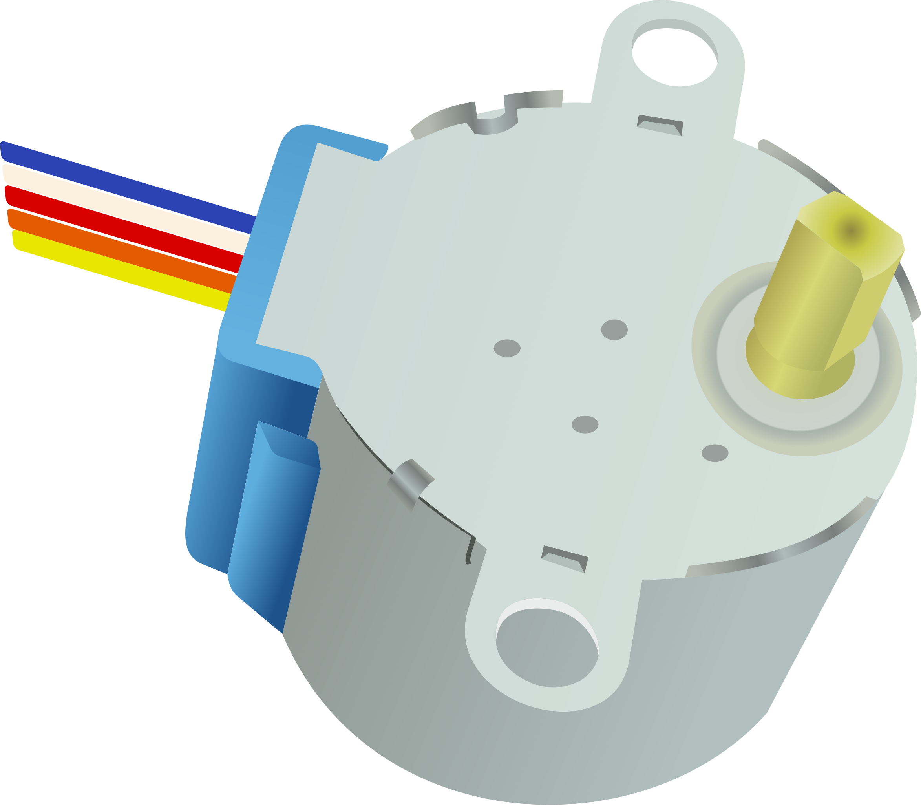
Flaps
Color sensor
Simulation Labels
IR sensor
Stepper Motor
Load cell
IR sensor
Atmega 32

Slide 7
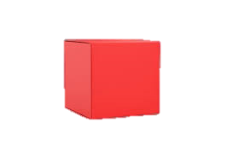

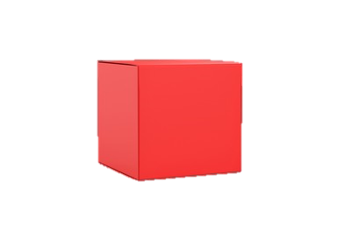
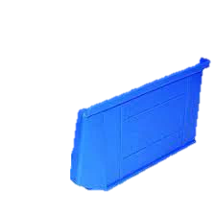
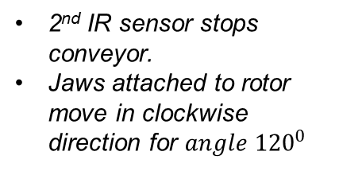
Color sensor
IR Sensor detects object, conveyor stops
Colour sensor and load cell decide sorting parameter
IR sensor
Example 1: Heavy Red object
Example 2: Lightweight Green box
2nd IR sensor stops conveyor.
Jaws attached to rotor move in clockwise direction for $angle {120}^{0}$
Colour and weight detection
Lightweight green
Load cell
Lightweight red
Heavy green
Atmega 32
Heavy red

Slide 8
Features, future Scope
Features:
A four-way automated sorting mechanism.
Single belt and multiple object sorting.
Future Scope:
Size and shape of object may be considered.
Time required may be reduced and number of objects sorted may be increased.
Adding flap mechanism to increase ways for sorting.
TE 5

Slide 9
References
S. Huang and S. S. Zhang, "Design and Control of a Conveyor-Based Sorting System," in IEEE Transactions on Automation Science and Engineering, vol. 10, no. 3, pp. 728-736, July 2013, doi: 10.1109/TASE.2012.2236971.
N. S. A. Ali, A. R. A. Rahman, A. F. M. Asib and A. F. M. Hidayatullah, "Design and Development of Conveyor Sorting Mechanism for Industrial Applications," in 2018 IEEE Conference on Sustainable Utilization and Development in Engineering and Technology (CSUDET), Kuala Lumpur, Malaysia, 2018, pp. 1-5, doi: 10.1109/CSUDET.2018.8644758.
DATASHEET:
Drivers: https://www.ti.com/lit/ds/symlink/l293d.pdf?ts=1677431306623&ref_url=https%253A%252F%252Fwww.ti.com%252Fproduct%252FL293D
https://www.st.com/resource/en/datasheet/uln2001.pdf

Slide 10
Thank You!

