Slide 1
Data Cleaning
Records: 200
Missing values: 0
Duplicates: 0
Data types were already consistent.
No missing values or duplicate records required removal.

Slide 2
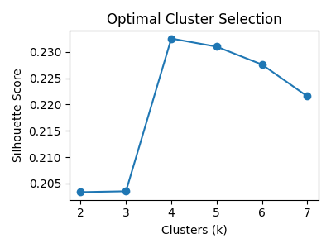
Clustering Methodology
Features: Age, Workouts_per_Week, Avg_Session_Duration_Min, Steps_per_Day
Standardized numeric variables.
Applied K-Means clustering.
Optimal k = 4 using silhouette score.

Slide 3
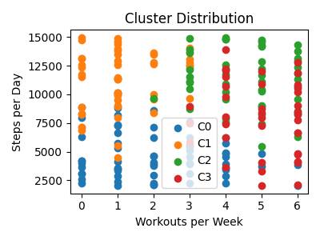
Key Findings
Age Workouts_per_Week Avg_Session_Duration_Min Steps_per_Day
Cluster
0 32.73 2.13 46.14 4659.54
1 46.63 1.18 40.03 11247.37
2 28.41 4.61 51.58 11215.71
3 51.38 4.97 35.36 8065.43

