Slide 1

MUSIC DATABASE
Key insights into music sales.

Slide 2
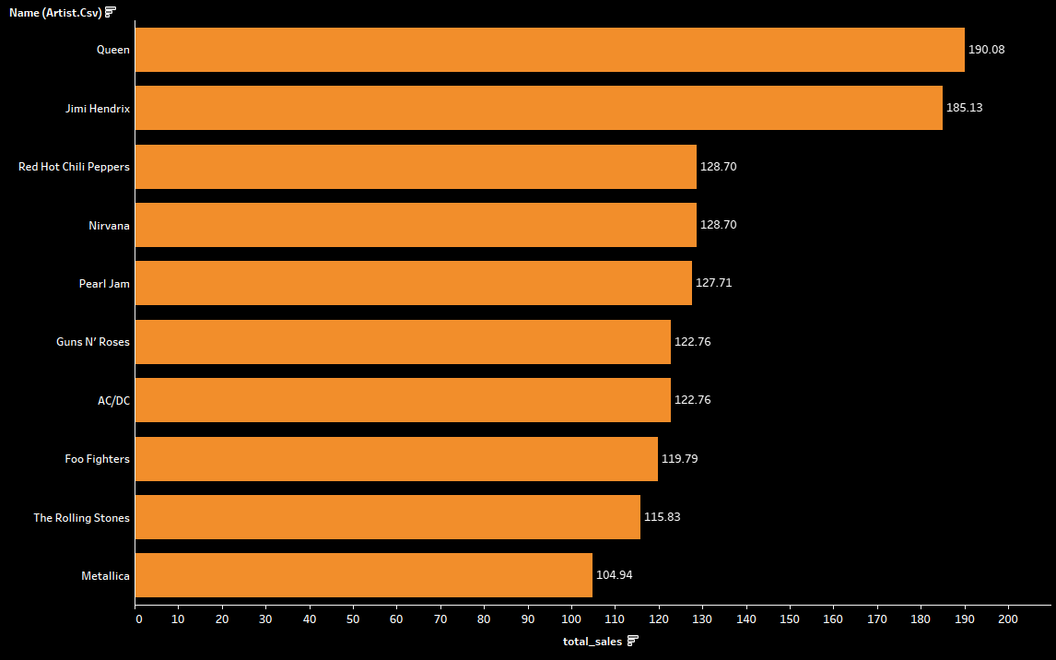
Top 10 Artists
Queen is best selling artist with sales worth $190

Slide 3
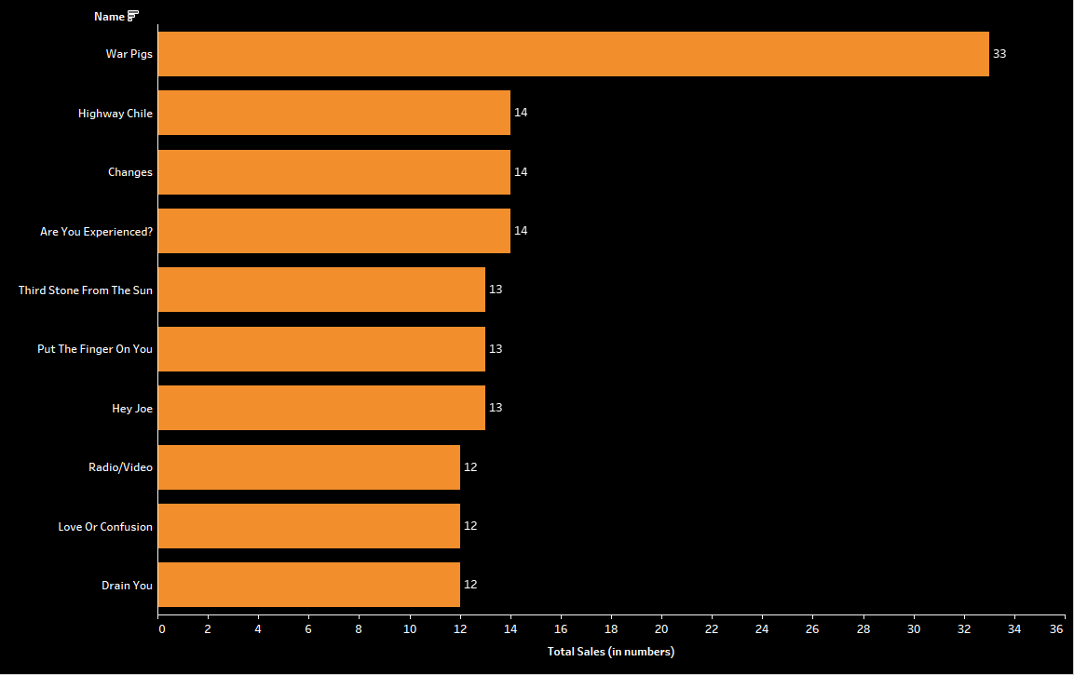
Top 10 Songs
War Pigs has sold the most.

Slide 4
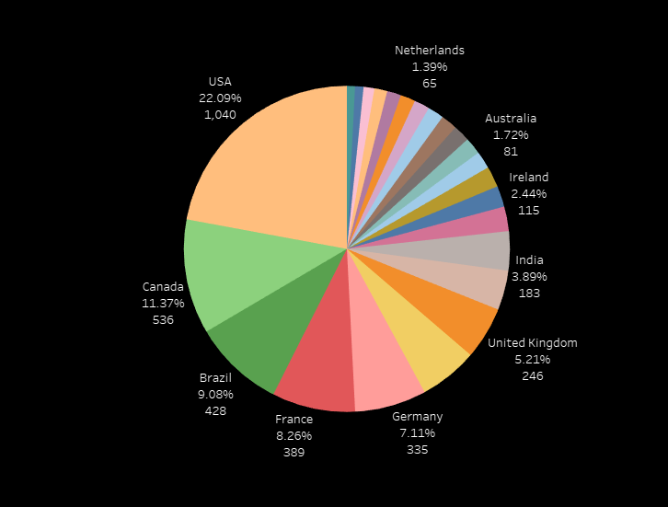
Total Sales by countries
USA ranks number 1 country based on total sales

Slide 5
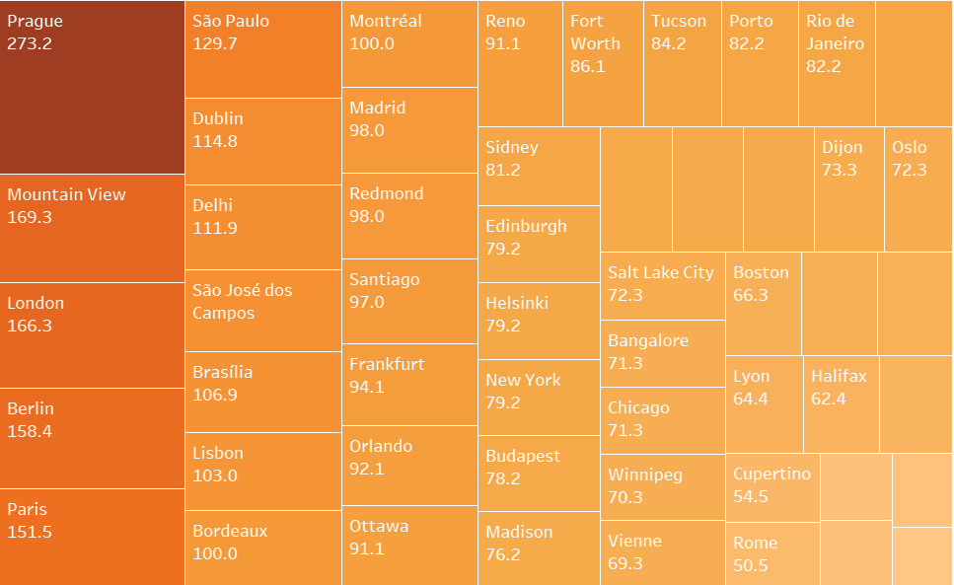
Cities with most sales
Prague has the most sales

Slide 6
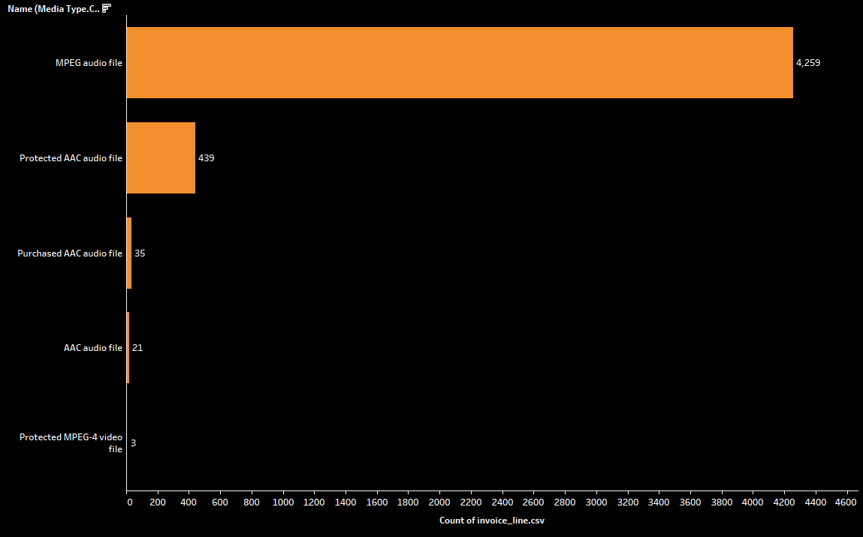
Most Popular Media Type
MPEG is the most common media type sold

Slide 7
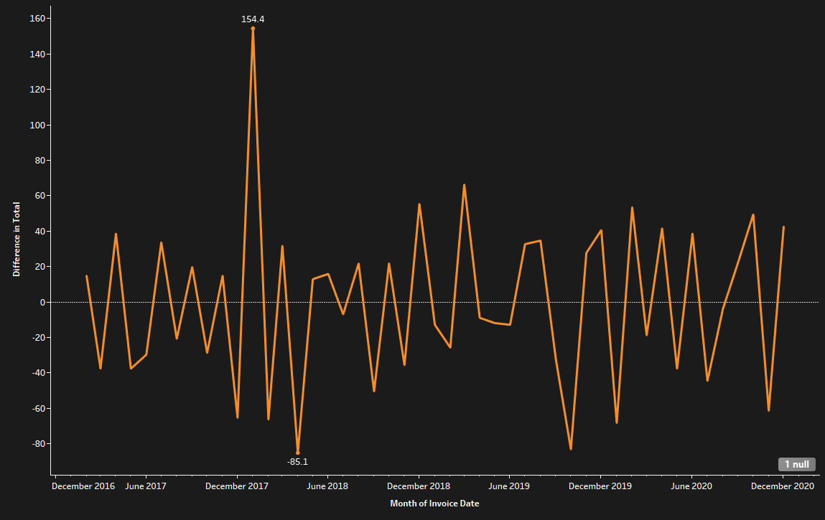
MONTHLY CHANGE IN SALES
The sales have been stagnant.

Slide 8
Summary
Queen is the bestselling artist.
War Pigs is the most purchased song.
USA has the most sales as a country.
Prague is the city with most number of purchases.
MPEG is the most selling media type.
Monthly sales have been stagnant.

