Slide 1

DΣLTA
A platform to increase your skill graph.

Slide 2
This pandemic has made this running world to still. People were locked in their houses. Schools, colleges, offices were closed. During this long pandemic many of us got stuck in different parts of the world and were not able to reach our home and even those are at their home don’t know how to spend their time wisely. During initial days people tried many different skills like cooking, drawing, gardening etc. but get bored with them very soon Do you know what the reason was ?
The reason was lack of knowledge and guidance of the skill.
We have a solution for your problems – DΣLTA.

Slide 3
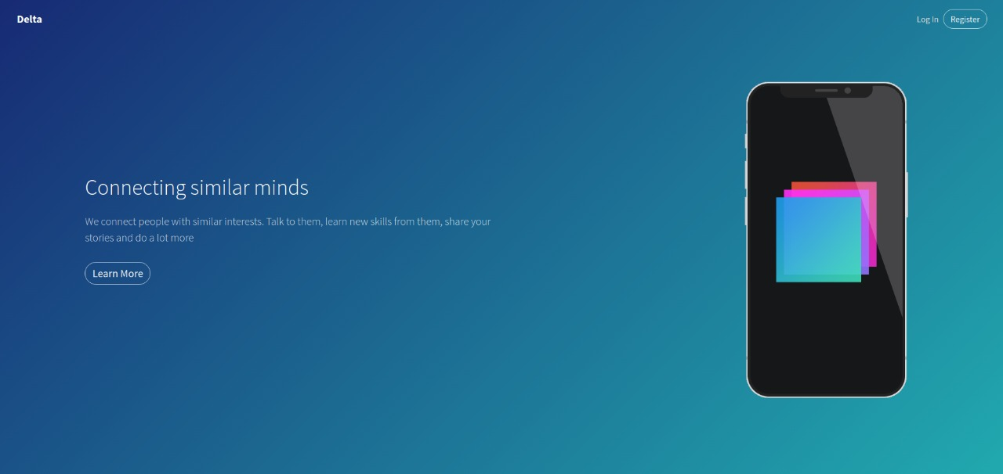

Slide 4
DΣLTA is a platform which helps us to make yourself skillful and will let us connect with people of same interest.
DΣLTA asks us about our field of interest and shows you videos related to interest.
Every skill video will be made by our experts in that particular field.
You will be able to interact with people having same field of interest .

Slide 5
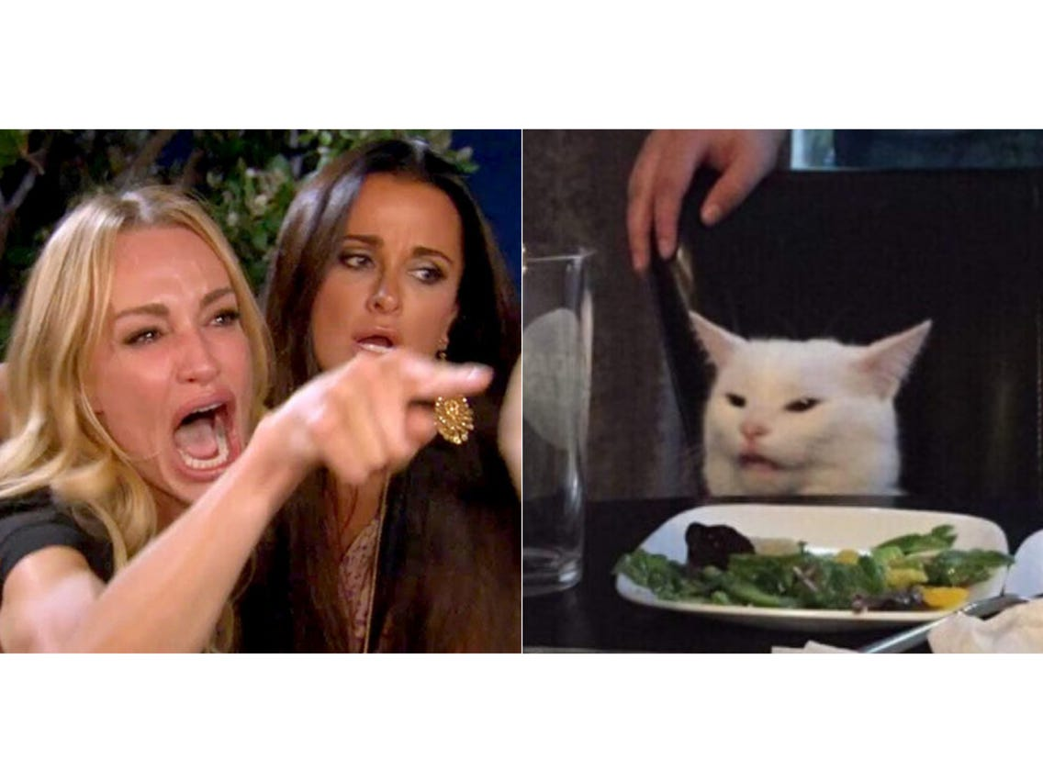
People thinking they mastered the skill and they can move to next level without test
We ,who are not letting them go for next level
Each skill will be divided in multiple levels having exams after every level as exams are the best way to check ones knowledge in particular field.
No matter what the result is, important part is participation.
If one fails to clear the test it shows there are still some loop holes in his skill.
There is a famous saying “what is success, the next chapter after failure.”

Slide 6
How DΣLTA is different from others -
There are many skill learning apps where we can learn skill but main drawback of them are we are not able to interact with people having same interest.
DΣLTA filters people according to field of interest and locality. So that one can interact with them and can feel how much they have mastered the field.
These kind of interaction increases the feeling of competition and make one force to excel in their skill.

Slide 7
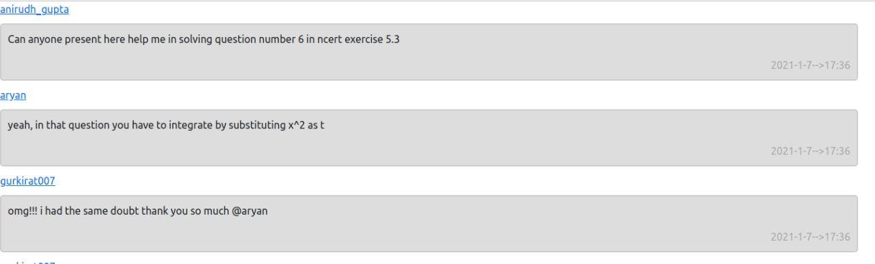

Slide 8
People with same interest and locality will be able to raise their local issues and can directly contact government officials.
Skill certificate will be provided by government to the candidate after the completion of all levels.
These certificate will help them in securing a good job of their interest.
It will increase their friend circle and will decrease loneliness and boredom.

Slide 9
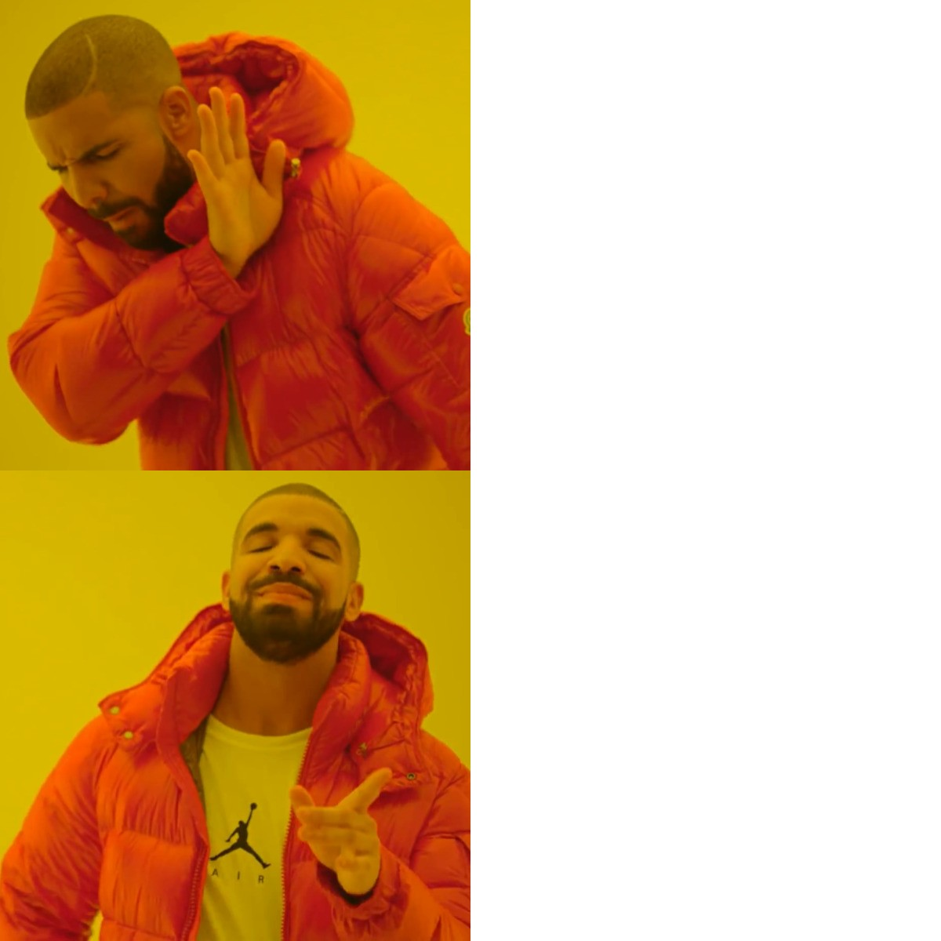



DΣLTA

