Slide 1
Self-Driving Infrastructure
Tut 06
Team 17

Slide 2
Problem Statement _______________________________________________________________________________________________________
Redesigning an intersection that incorporates self-driving vehicles with human-driven vehicles using PERSEID methods to aid in navigating designs.
Notes:
→ A demonstration of how the design addresses the Problem Statement, especially as it relates to the conflicting, arguable, or ethical points raised by PERSEID (spread out into perseid layers)
When we started this project, we set out to design a better intersection for a future where self-driving vehicle technology is available; however, over the term, our perspective on what makes a good intersection design has changed significantly. Wait times are not the only measure of an intersection. Even beyond PERSEID there are things to consider like the fit of the intersection to its location, demographic, and how it fits in with road infrastructure on the larger scale.

Slide 3
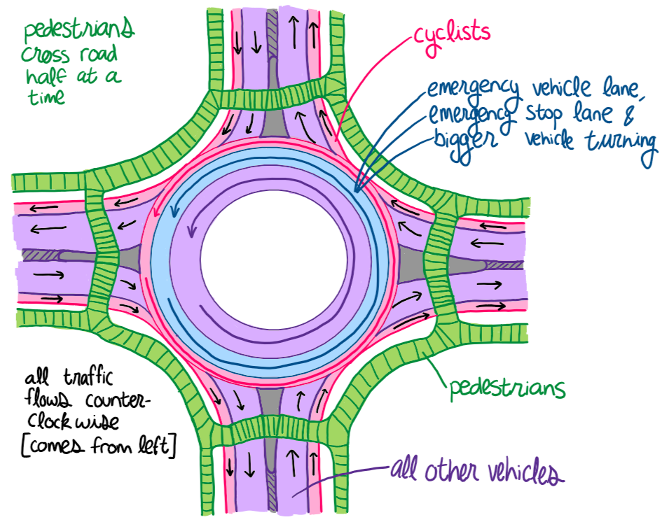
Final Design _______________________________________________________________________________________________________
Environmental
Performance
Regulatory
Socio-Cultural
Notes:
Brief explanation of design:
Our final design is a roundabout comprised of 3 lanes (one for regular vehicles, one for emergency vehicles, and one for cyclists) and also contains a pedestrian pathway that travels all the way around the roundabout a safe distance away from the roundabout. In this design, all road stakeholders are only permitted to travel counter-clockwise around the roundabout, while the pedestrians can go in both directions.
Our team prioritized socio-cultural and performance over regulatory over environmental, but at many times, decisions that were taken to prioritize a one persied layer ended up being a befefit for another layer

Slide 4
Socio-Cultural _______________________________________________________________________________________________________
Pedestrian walkway
Cyclist lane
Emergency vehicle lane
Notes:
For the socio-cultural persied layer, we wanted a design that could be beneficial to as many of our stakeholders as possible, or atleast ensure that the design is not greatly negatively impacting any stakeholder.
when we were incorporating the self-driving vehicles into a new design for a traffic intersection, we had to consider the socio-cultural persied layer as having exclusive lanes for self-driving vehicles may bring negative feedback from other stakeholder, which is why self-driving vehicles were not prioritized in this design, but they were considered when choosing between designs and altering small aspects of the design in order for them to function at the roundabout
Pro: Allows emergency vehicles to easily pass through traffic using the emergency vehicle lane
Pro and Con: pedestrians can cross roads half at a time but their distance to the walkway has to be increased for vehicle safety and performance reasons (reasons being that pedestrians might block vehicles trying to exit roundabout if they are too close to the exit)
Pro: cyclists have their own lane on the very right side so that they do not interfere with vehicles that are already in the roundabout and have the emergency lane between the vehicle and them to keep them safe
Pro and Con: the emergency lane can assist larger vehicles such as busses and trucks enter the roundabout, but it is much harder for them to find a big enough opening to enter, and in real life, we would have to ensure that the size of the roundabout is large enough for those vehicles to make proper turns

Slide 5
Performance _______________________________________________________________________________________________________
Traffic has a zero to low wait time
All traffic comes from the left (including pedestrians)
Pedestrians cross walkway half at a time
Notes:
For the performance persied layer
Roundabout help lower wait time and help vehicles cross intersections much faster as traffic is non-stop and one simply has to merge and exit at the right times
All road traffic coming from the left helps reduce wait time compared to if traffic were to be coming from both sides at the same time
Vehicles do not have to be concerned with pedestrians crossing from both directions when entering and exiting the roundabout as their walkway is located a safe distance away from the roundabout
Having pedestrians cross half of the walkway at a time helps them reach their destination faster and doesn’t make vehicles and cyclists come to a complete stop on both sides of the walkway
There are no lights to indicate if pedestrians are crossing as the light timer would have to be generalized, so vehicles and cyclists would have to stop if they see a pedestrian crossing

Slide 6
Regulatory _______________________________________________________________________________________________________
Pedestrian walkway distance from roundabout
Notes:
In our original design, the pedestrian crosswalk was much closer to the roundabout compared to out new design, but this had to be changed as having pedestrians cross at random intervals while there were still vehicles or cyclists present in the roundabout could be very dangerous as some vehicles/cyclists may be trying to exit the roundabout when a pedestrian decides to cross. In the case that the vehicle driver does not notice the pedestrian, both the pedestrian and vehicle driver would not longer be safe. If the vehicle driver does notice the pedestrian, the sudden change in situation may cause them to either come to a complete stop in the roundabout (which will not be very safe as well) or continue going around the roundabout, which would negatively impact the performance and environmental layers. In order to maintain safety at the roundabout, the walkway had to be pushed back so that the vehicle will have space to stop for a few seconds while pedestrians cross infront of them.

Slide 7
Environmental _______________________________________________________________________________________________________
Reduced Idle Time
Notes:
Tied to the performance aspect of having vehicles wait less and travel faster, roundabouts would have a reduced idle time compared to a regular traffic light intersection

Slide 8
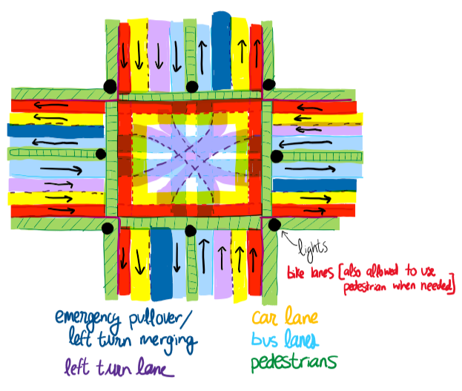
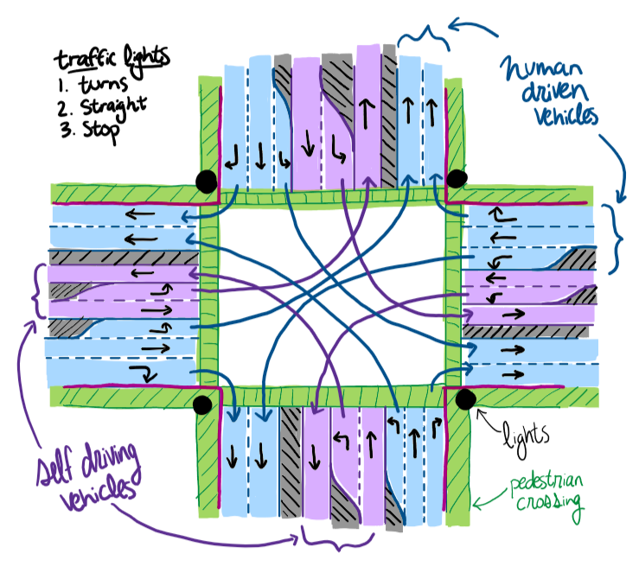
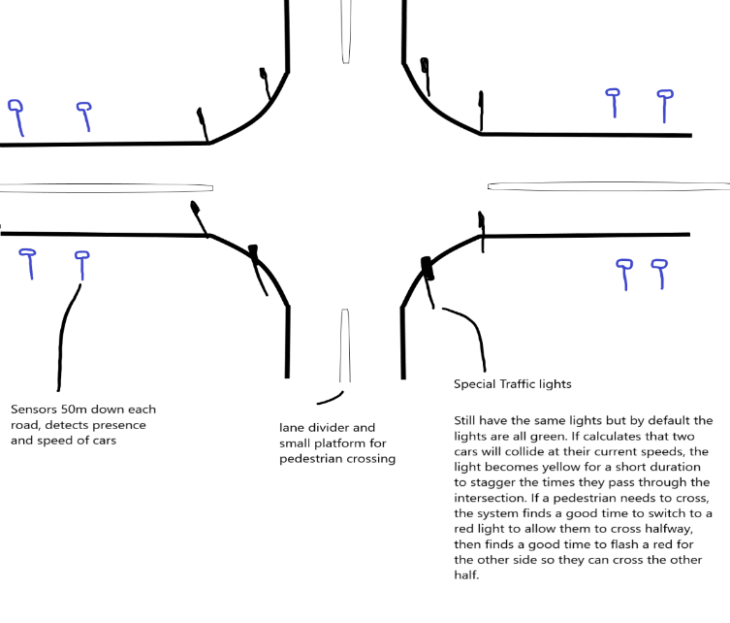
Other Potential Designs _______________________________________________________________________________________________________
Notes:
First design: too many components which affects performance relative to the overall size of the intersection. Too niche of a design (what roads have are used by both busses and bicycles)
Pro: This design has the highest coverage of the stakeholder set
Pro: can handle high traffic (a trait inherent to the four-way traffic light intersections)
Con: High space requirement ~7 lanes wide not including sidewalks, of which only 4 are actually used by cars.
Con: potential safety issues for cyclists with such a large intersection
Pro/Con: no performance benefits/deficits over a regular intersection
Second design: our design accommodates more stakeholders and has a better performance for all vehicles in medium traffic
Pro: improved average wait times over regular intersection
Pro: can handle high traffic
Con: requires self-driving vehicle exclusive lanes where self-driven vehicles can operate at higher speeds which brings up the issue of fairness
Con: Lanes are set in size once constructed, making them only optimal for a specific percentage of self-driven vehicles. This results in wastage of space when the percentage is lower than optimal, and not enough when the percentage is higher than optimal.
Third design: our design accommodates more stakeholders and is safer
Pro: the lowest wait times for low to medium (and potentially high traffic)
Pro: can worst-case fall back on behaving like a regular 4 way traffic light intersection
Con: for medium traffic or higher, it requires far too much skill on the part of drivers (more than can be consistently expected from the average driver) in situations where failure could potentially be fatal.
Con: potentially catastrophic for safety for medium to high traffic
Both first and second design also have longer wait times

Slide 9
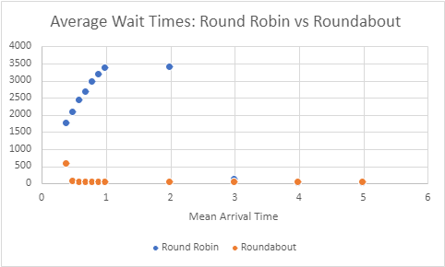
Review + Results _______________________________________________________________________________________________________
Notes:
→ A review of how/why this design successfully rose to the top as compared to the other potential designs. This review should be supported by the results of the simulations / models.
As one might expect roundabouts are able to handle significantly higher traffic than a simple 4 way round robin. While the round robin design begins to fail at 1 vehicle every 2 seconds, the roundabout can handle up to 2 vehicles per second gracefully, after which it also fails. It pays for this performance with its much greater space requirement, but this set of features makes it perfect for medium sized intersections in areas with decently high pedestrian and cyclist traffic.

Slide 10

Questions?

