Slide 1
Group Members : 1. Ramanvir Singh Sahota 2. Nandini Nandini 3. Sajagpreet Singh 4. Malak Singh 5. Gurleen Singh Khaira

Slide 2



Concept
Providing every possible travelling facility at a single place.
Figure 1. Palm tree at Playa Rincon, Dominican Republic

Slide 3
Features:
Choose destination
Book a hotel
Book a room
Book a flight
Book a guide for specific time

Slide 4

Audience Targeted
Family
Businessmen
Couples
School tours
Friends
Figure 2. Family day Alberta & Saskatchewan

Slide 5
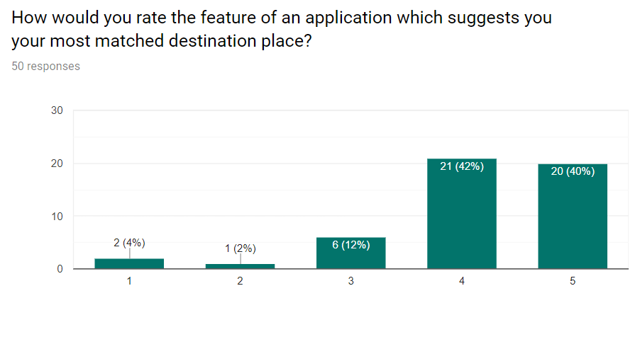
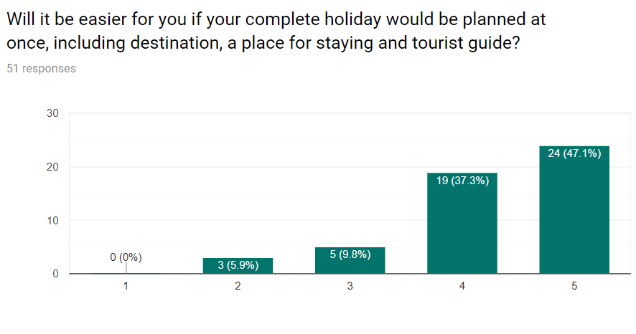
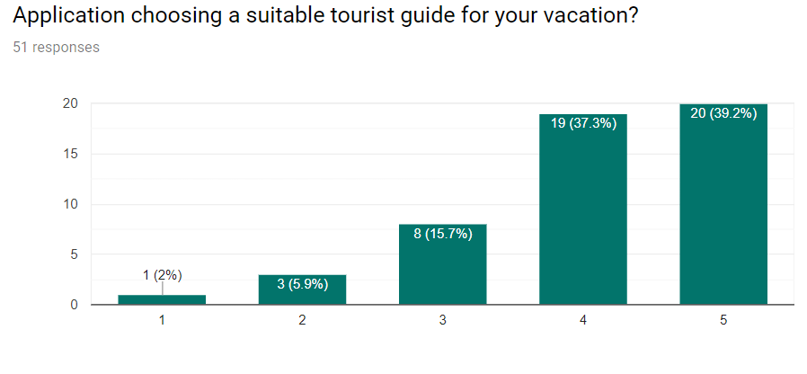
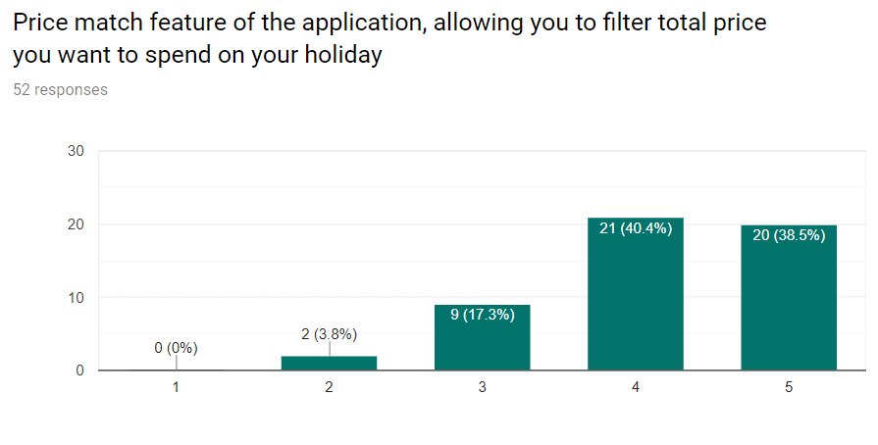
Findings from User Survey

Slide 6
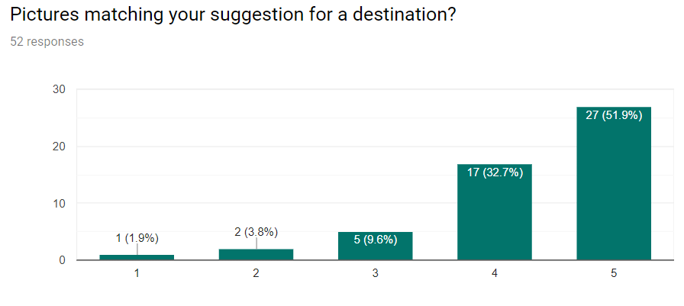
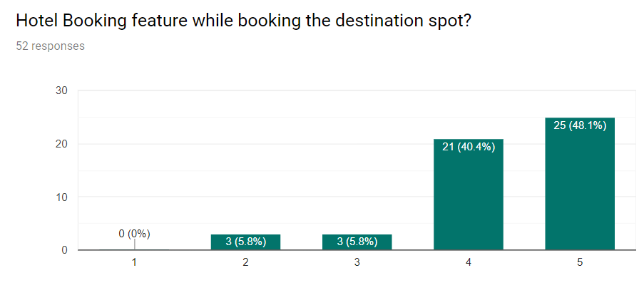
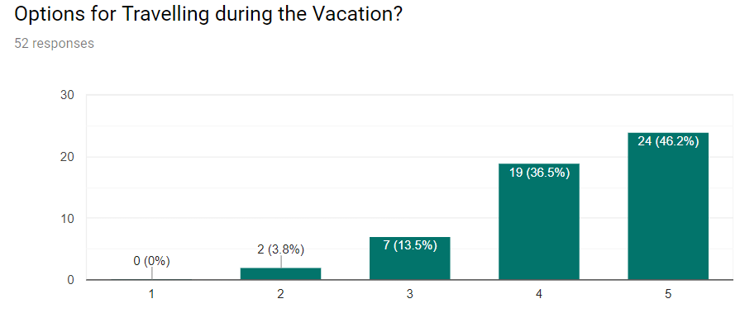
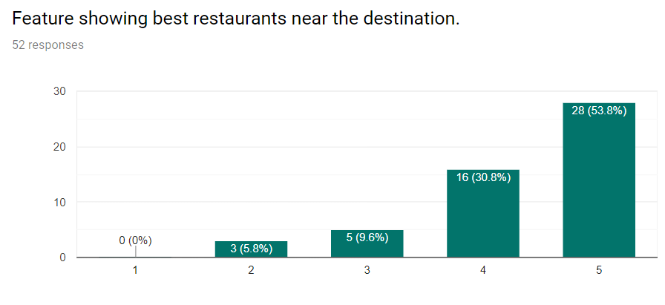
Findings from User Survey

Slide 7
Top Ranked Features
Pictures matching the suggestion for Destination
Feature showing the best Restaurants near the Destination
Lowest Ranked Features
Feature allowing to choose a Tourist guide
Price Filter Feature

Slide 8
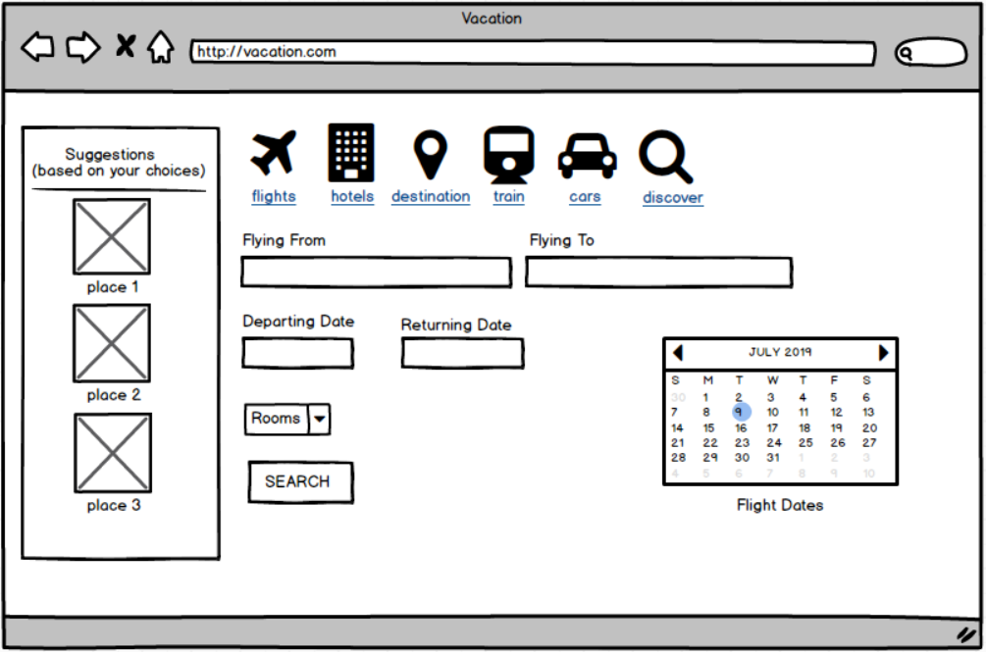
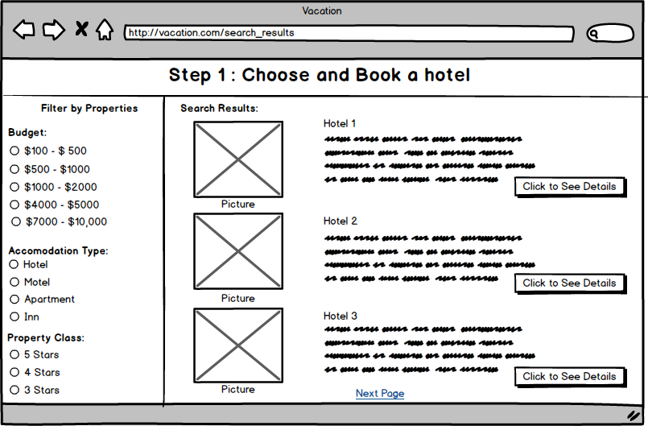
Initial Wireframes

Slide 9
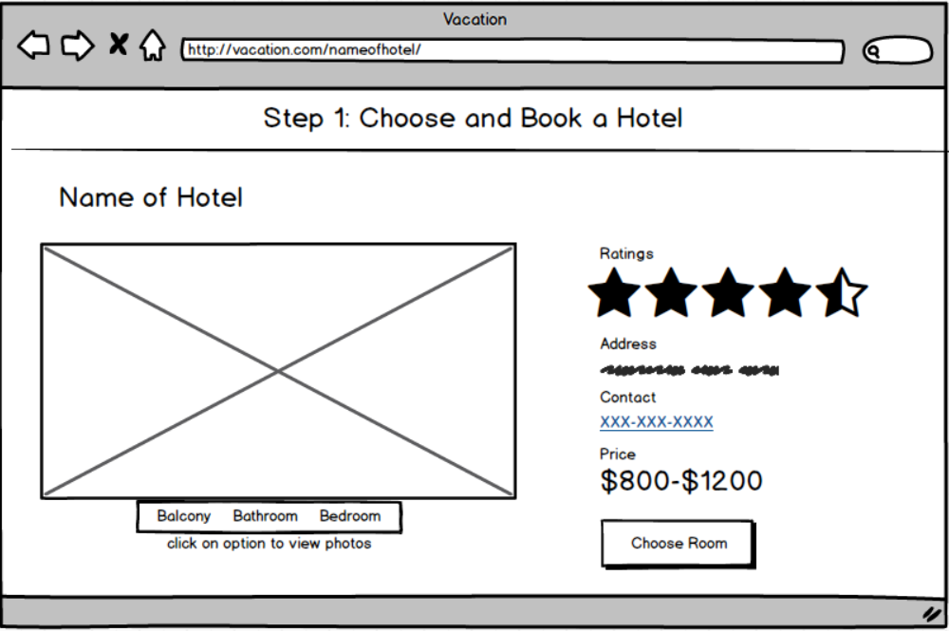
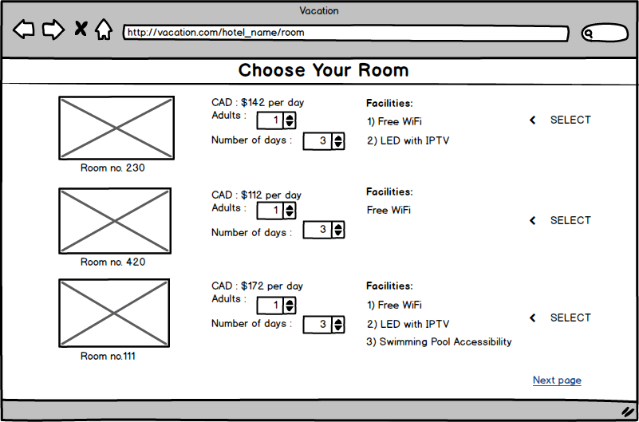
Initial Wireframes

Slide 10
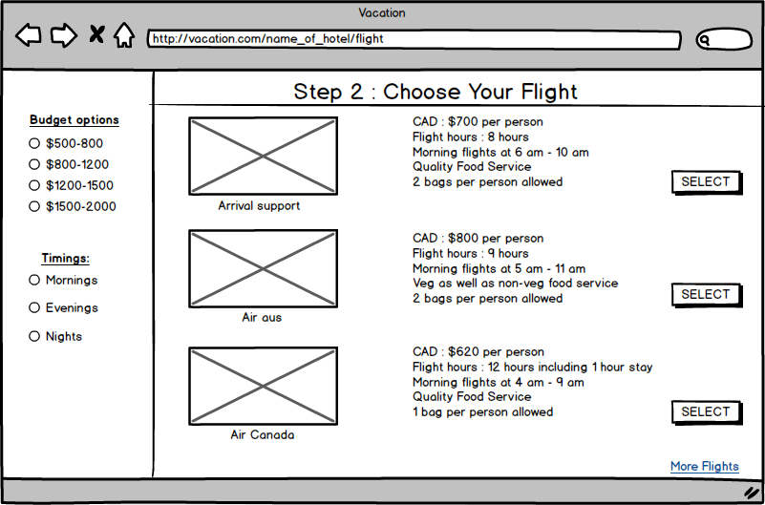
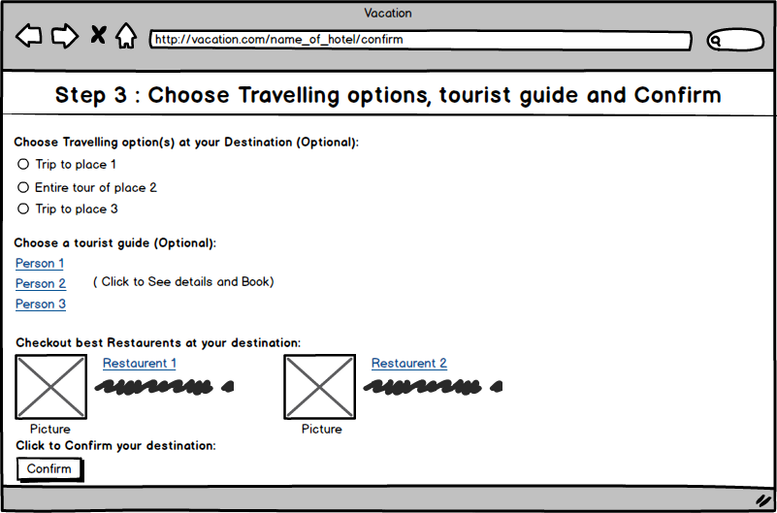
Initial Wireframes

Slide 11
Findings from user testing:
Overall all the user testing result went well.
In most tests users found the layout organised and given good rating and feedback.
Features liked by users:
Budget-wise distribution of rooms and flights which helps in booking a room or flight according to one’s needs.
Interface is cool and well organised.
Suggestion box in Destination section.
Re-views regarding the rooms (tells the reality and condition of hotel).

Slide 12
Problems diagnosed by Users:
Some users found a few prototypes confusing and problematic like:
Unavailability of Home button on the pages.
Role of Select button in room selection page.
Less information regarding hotels.
Missing of Date selection option.
Confusion in comparison with different airlines.

Slide 13

What Went Well?
For most part the tasks well simple and easy for the users.
We tried many new features. Which the users liked.
We were able to make the site more user-friendly.

Slide 14
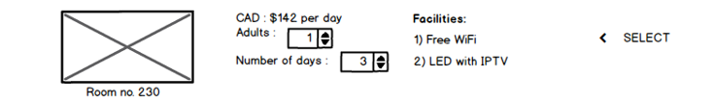
What Didn't go well?
Users found a flaw in Hotel Booking option.
NO Date choosing option.
Less filters in Flight Booking option.

Slide 15
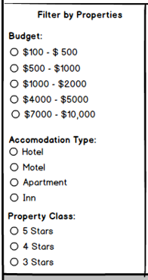
Positive Feedback
People liked the interface.
Budget Filtration option was highly encouraged.
Suggestion option was liked a lot.
Reviewed simple, easy and user-friendly.

Slide 16
Negative Feedback
Absence of date selection in hotel booking.
NO home or navigation buttons.
Lesser filters in Flight Booking

Slide 17
Surprise Findings
Tourist Guide and Ride options were well liked.
Addition of small widgets were helpful.
People cared more about the reviews than the facilities.

Slide 18
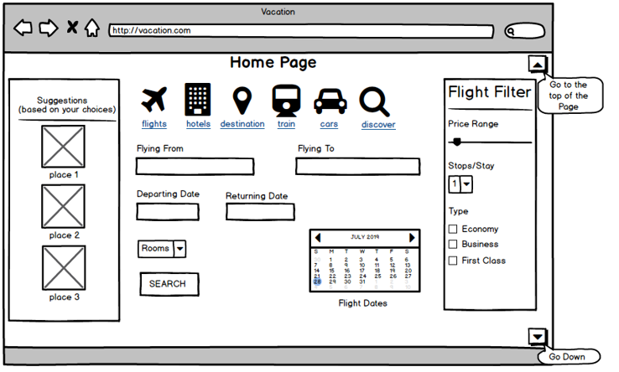
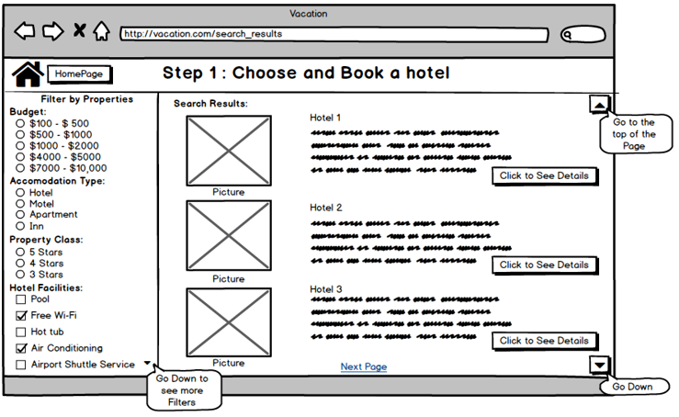
Revised Wireframes

Slide 19
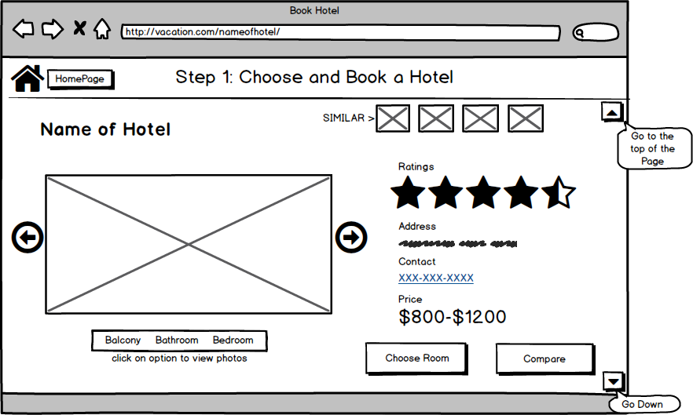
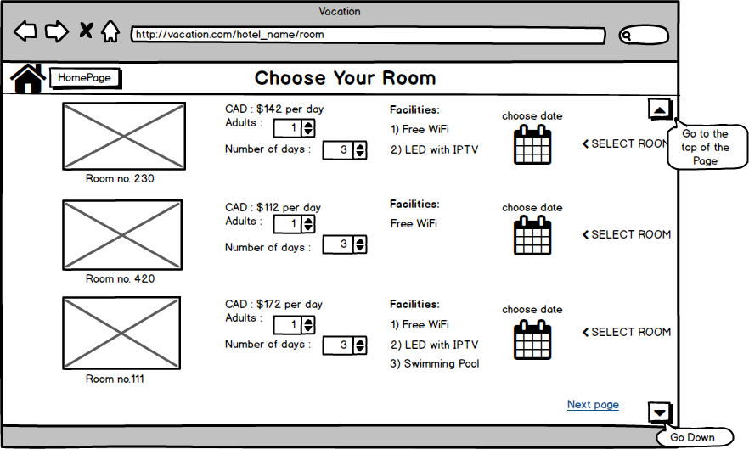
Revised Wireframes

Slide 20
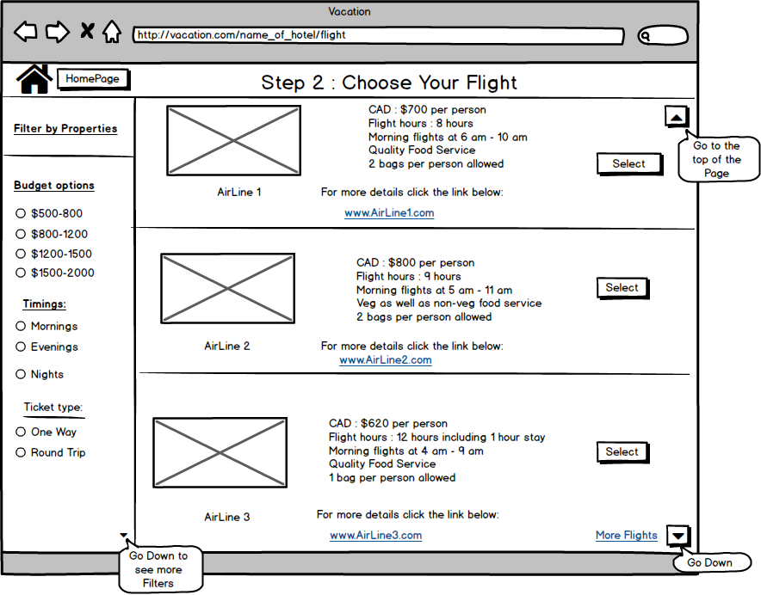
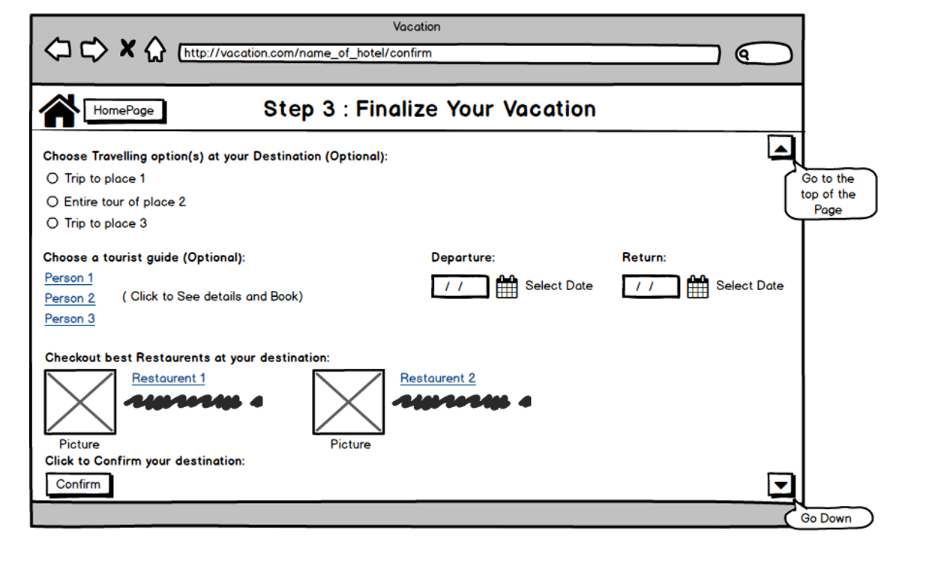
Revised Wireframes

Slide 21
Lessons Learned
Comparison is important.
Filters should be focused.
Users believe mainly on reviews.
Widgets or buttons should be clear of their meaning.

Slide 22
References
Palm tree at Playa Rincon, Dominican Republic [Photograph]. Retrieved from:
https://media.tripcentral.ca/media/00_0X_PL_vacation-packages-dominican-republic.jpg
Family day Alberta & Saskatchewan [Photograph]. Retrieved from:
https://www.google.com/search?q=family-day-alberta-saskatchewan&rlz=1C1CHZL_enCA830CA830&source=lnms&tbm=isch&sa=X&ved=0ahUKEwiJ_f7ZzezjAhWIZM0KHW0CBJMQ_AUIESgC&biw=1163&bih=481#imgrc=Bkr62MpOzfL6LM:

