Slide 1
CSE 5322
Design Patterns
Iteration 1
Group 9
Gurleen, Vyshak, Siva, Deepa, Travis

Slide 2
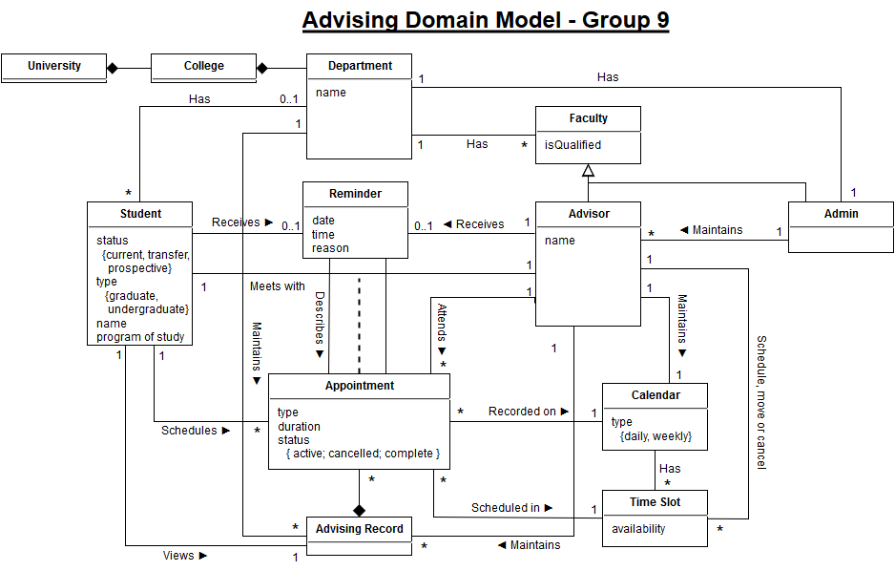

Slide 3
Requirements
R1. The application shall provide an Account for each User and restrict access to different application features based on the Account Type.
R2. The application shall provide the following minimum security requirements:
R2.1. All users must authenticate with the system to access features relevant to their account.
R2.1.1. Users shall log in with an e-mail address or (optionally) a username.
R2.1.2. Users shall log in with a password.
R2.1.2.1. All passwords shall be stored in the database in a hashed format.
R2.3. Users shall be able to log out from their account.
R3.4. The Administrator shall create Advisor accounts within his/her department.
R4.1. Advisor shall be able to create, edit and delete time slots during which advising is offered.
R4.1.1. Advisor can manage individual time slots or recurring time slots.
R4.6.1. The Home Screen of the Advisor Dashboard shall display a tabular summary of the day’s advising appointments and the reason for each appointment. Selecting an appointment shall display a Detail View.
R5.1. Students shall be classified as either Current, Prospective or Transfer.
R5.3. The Home Screen of the Student Dashboard shall display a table showing upcoming advising appointments as well as a history of previous advising appointments. Selecting an appointment shall display a Detail View.
R6. The application shall allow Students to schedule Appointments according to the following minimum requirements:
R6.1. The application shall display Time Slots on a standard calendar view.

Slide 4
Abstract & High Level Use Cases
UC1. Log In (system: MavAdvisor, actor: User)
  TUCBW a user enters their username and password and clicks “Submit”.
  TUCEW the user sees their dashboard.
UC2. Reset password (system: MavAdvisor, actor: User)
  TUCBW a user clicks the “Forgot Password” link from the login area.
  TUCEW the user sees a success message “Password successfully reset.”
UC3. Log Out (system: MavAdvisor, actor: User)
  TUCBW a user clicks the Log Out button.
  TUCEW the user sees the home page and the username and password fields.
UC4. Submit Feedback (system: MavAdvisor, actor: User)
  TUCBW a user clicks the “Submit Feedback” link from the menu.
  TUCEW the user sees a success message “Feedback successfully submitted.”
UC5. Edit Preferences (system: MavAdvisor, actor: User)
  TUCBW the user clicks the “Edit Preferences” link from the menu.
  TUCEW the user sees a success message “Preferences successfully updated.”
UC6. Create Advisor Account (system: MavAdvisor, actor: Admin)
  TUCBW the admin clicks the “create advisor” link from the menu.
  TUCEW the admin sees a success message “Advisor successfully created.”
UC7. Create Time Slot (system: MavAdvisor, actor: Advisor)
  TUCBW the advisor clicks the “Create Time Slot” link from the menu.
  TUCEW the advisor sees a success message “Time slot successfully created.” and the updated calendar view.
UC8. Edit Time Slot (system: MavAdvisor, actor: Advisor)
  TUCBW the advisor clicks the “Edit Time Slot” link from the menu.
  TUCEW the advisor sees a success message “Time slot successfully updated” and the updated calendar view.
UC9. Delete Time Slot (system: MavAdvisor, actor: Advisor)
  TUCBW the advisor clicks the “Delete Time Slot” link from the menu.
  TUCEW the advisor sees a success message “Time slot deleted” and the updated calendar view.
UC10. Cancel Appointment (system: MavAdvisor, actor: Advisor)
  TUCBW the advisor clicks the “Cancel Appointment” button from the appointment’s detail page.
  TUCEW the advisor sees a success message “Appointment canceled” and the appointment is removed from the advisor’s appointments table.
UC11. Show Appointment Details (system: MavAdvisor, actor: Advisor/Student)
  TUCBW an advisor/student selects an appointment from their upcoming appointments table.
  TUCEW the advisor/student sees the appointment detail page for the selected appointment.
UC12. Cancel Appointment (system: MavAdvisor, actor: Student)
  TUCBW a student clicks the “Cancel Appointment” button from the appointment’s detail page.
  TUCEW the student sees a success message “Appointment canceled” and the appointment is removed from the student’s appointments table.
UC13. Create Account (system: MavAdvisor, actor: Student)
  TUCBW a student clicks the “Register” link from the menu.
  TUCEW the student sees a success message “Account successfully created.”
UC14. Create Appointment (system: MavAdvisor, actor: Student)
  TUCBW a student clicks the “Schedule Appointment” link from the menu.
  TUCEW the student sees the success message “Appointment scheduled” and the updated appointments table.

Slide 5
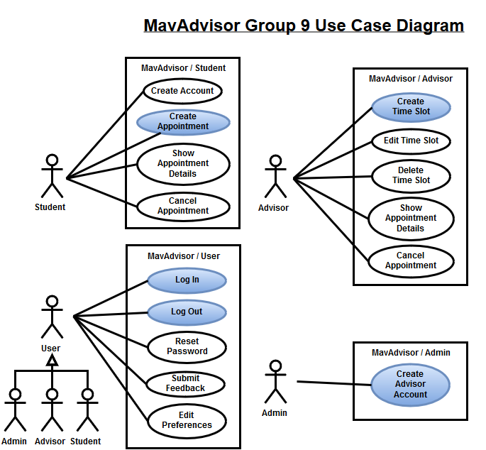

Slide 6
UC1 – Log In

Slide 7
Precondition: User is not logged in to MavAdvisor.
Actor: User | System: MavAdvisor
 | 0. MavAdvisor displays any page. A username and password field are displayed in the page header area.
1. TUCBW a user enters their username and password and clicks “Submit”. | 2. If the user authenticates correctly, MavAdvisor displays the user’s dashboard. *
3. TUCEW the user sees their dashboard.
Postcondition: NONE

Slide 8
Scenario Description
1. The user enters their username and password and clicks “Submit” from the GUI (any page).
1.1. GUI (any page) sends login request to the Authentication Controller using the username and password.
1.2. Authentication Controller sends a get user request to the Database Manager using the username.
1.3. Database Manager returns User object from the database using the username.
1.4. If the User exists:
1.4.1. Authentication Controller verifies the password of the User using the hashed password.
1.4.2. If password verifies:
1.4.2.1. Authentication Controller creates a Session object using the username.
1.4.2.2. Authentication Controller requests the Database Manager save the Session object.
1.4.2.3. Database Manager returns a result to Authentication Controller.
1.4.2.4. Authentication Controller redirects the User Dashboard page.
1.4.2.5. User Dashboard returns the Session cookie to the user.
1.4.3. Else:
1.4.3.1 Authentication Controller returns an “Invalid username/password” message to the GUI.
1.4.3.2. GUI returns the error message to the User.
1.5. Else:
1.5.1. Authentication Controller returns an “Invalid username/password” message to the GUI.
1.5.2. GUI returns the error message to the User.
2. System displays the User Dashboard (or error message).

Slide 9
# | Subject | Subject Action | Other Data/Objects | Object Acted Upon
1. | User | Enters | Username, password | GUI
1.1. | GUI | Request login | Username, password | Authentication Controller
1.2. | Authentication Controller | Request user | Username | Database Manager
1.3. | Database Manager | Returns | User | Authentication Controller
1.4. | If User is exists
1.4.1. | Authentication Controller | Verifies | Submitted password, hashed password | User
1.4.2. | If password verified:
1.4.2.1. | Authentication Controller | Creates | Username | Session
1.4.2.2. | Authentication Controller | Requests save | Session | Database Manager
1.4.2.3. | Database Manager | Returns | Result | Authentication Controller
1.4.2.4. | Authentication Controller | Redirects |  | User Dashboard
1.4.2.5. | User Dashboard | Returns | Session cookie | User
1.4.3. | Else:
1.4.3.1. | Authentication Controller | Writes | “Invalid username/password” | GUI
1.4.3.2. | GUI | Returns | Message | User
1.5. | Else:
1.5.1. | Authentication Controller | Writes | “Invalid username/password” | GUI
2. | GUI | Returns | Message | User

Slide 10
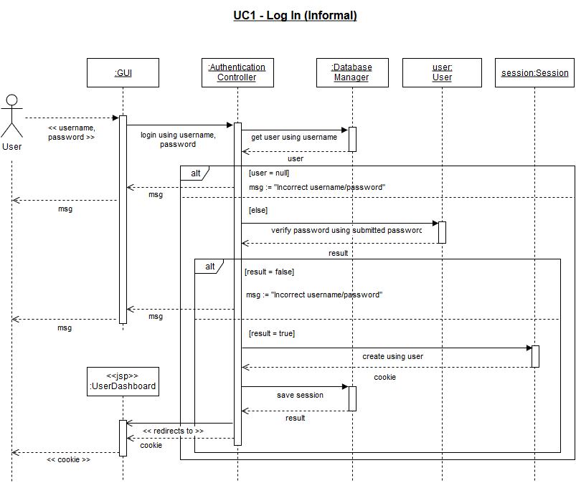

Slide 11
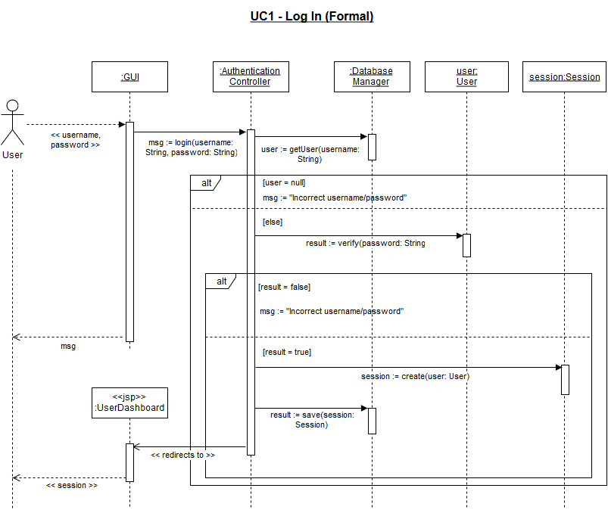

Slide 12
UC3 – Log Out

Slide 13
Precondition: The user is logged in to MavAdvisor.
Actor: User | System: MavAdvisor
 | 0. MavAdvisor displays any page. The log out button is shown in the page header area.
1. TUCBW a user clicks the Log Out button | 2. MavAdvisor displays the home page. The header area shows the username and password fields to indicate the user has logged out. *
3.TUCEW the user sees the home page and the username and password fields.
Postcondition: NONE

Slide 14
Scenario Description
1. User clicks the Log Out button from the GUI (any page).
1.1. GUI sends logout request to Authentication Controller (using cookie sent by the browser).
1.2. Authentication Controller requests the Database Manager terminate the session using the cookie.
1.3. Database Manager returns the result to the Authentication Controller.
1.4. Authentication Controller redirects the GUI to the Home Page.
2. GUI (home page) displays to the User.

Slide 15
# | Subject | Subject Action | Other Data/Objects | Object Acted Upon
1. | User | Request logout | Cookie | GUI (any page)
1.1. | GUI (any page) | Request logout | Cookie | Authentication Controller
1.2. | Authentication Controller | Terminate session | Cookie | Database Manager
1.3. | Database Manager | Returns | Result | Authentication Controller
1.4. | Authentication Controller | Redirect to Home Page |  | GUI
2. | GUI (home page) | displays |  | User

Slide 16
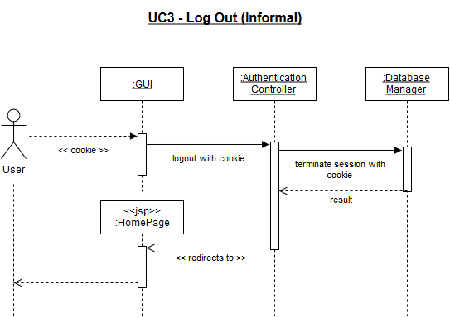

Slide 17
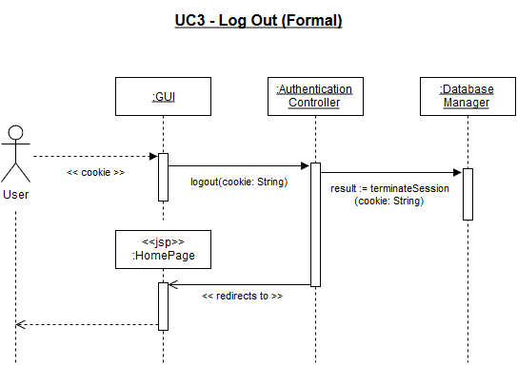

Slide 18
UC6 – Create Advisor Account

Slide 19
Precondition: The admin is assigned to the appropriate department and is logged in to MavAdvisor.
Actor: Admin | System: MavAdvisor
 | 0. MavAdvisor displays the admin dashboard.
1. TUCBW the admin clicks the “create advisor” link from the menu. | 2. MavAdvisor displays the “Create Advisor” form.
3. The admin fills out all fields on the create advisor from and clicks the Submit button. | 4. MavAdvisor displays a success message “Advisor successfully created.” *
5. TUCEW the admin sees a success message “Advisor successfully created.”
Postcondition: NONE

Slide 20
Scenario Description
3. Admin enters the username, password and email for the advisor and clicks the submit button of the GUI.
3.1. GUI sends create advisor request to the Admin Controller with the username, password and email.
3.2. Admin Controller requests the Database Manager create an advisor using the username, password, and email.
3.3 Database Manager returns a result to the Admin Controller.
3.4. If the result is true (success):
3.4.1. Admin Controller writes “Advisor successfully created” to a message.
3.5. Else:
3.5.1. Admin Controller writes “Unable to create advisor” to a message.
3.6. Admin Controller returns the message to the GUI.
4. GUI displays the message to the Admin.

Slide 21
# | Subject | Subject Action | Other Data/Objects | Object Acted Upon
3. | Admin | Enters | Username, password, email | GUI
3.1. | GUI | Create advisor | Username, password, email | Admin Controller
3.2. | Admin Controller | Create advisor | Username, password, email | Database Manager
3.3 | Database Manager | Returns | Result | Admin Controller
3.4. | If result is true (success):
3.4.1 | Admin Controller | Writes | “Advisor successfully created” | Message
3.5. | Else:
3.5.1 | Admin Controller | Writes | “Unable to create advisor” | Message
3.6. | Admin Controller | Returns | Message | GUI
4. | GUI | Displays | Message | Admin

Slide 22
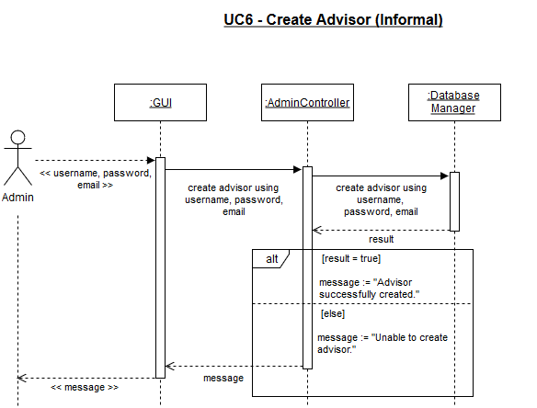

Slide 23
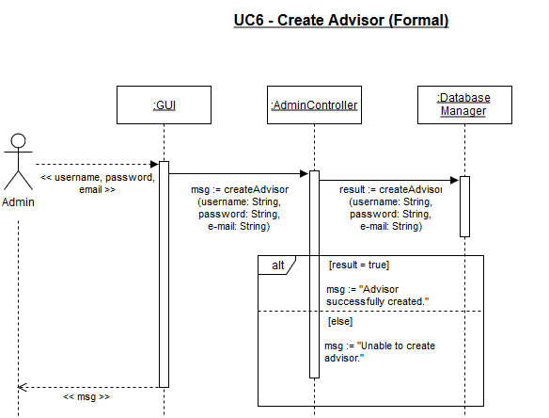

Slide 24
UC7 – Create Time Slot

Slide 25
Precondition: The advisor is logged in to MavAdvisor.
Actor: Advisor | System: MavAdvisor
 | 0. MavAdvisor displays the advisor dashboard.
1. TUCBW the advisor clicks the “Create Time Slot” link from the menu. | 2. MavAdvisor displays the calendar view.
3. The advisor selects an empty region on the calendar. | 4. MavAdvisor displays a modal “Create Time Slot” form. The start time is pre-filled based on where the advisor clicked on the calendar, but it editable.
5. The advisor fills out the start time, stop time and whether the time slot is recurring and clicks the Submit button. | 6. MavAdvisor displays the calendar view with the newly created time slots and a success message “Time slot successfully created.” *
7. TUCEW the advisor sees a success message “Time slot successfully created” and the updated calendar view.
Postcondition: NONE

Slide 26
Scenario Description
5. Advisor fills out the start time, stop time and whether the time slot is recurring and clicks the Submit button.
5.1. GUI sends create time slot request to the Advisor controller using the start time, stop time and “is recurring” flag.
5.2. Time Slot Controller sends create time slot request to Database Manager.
5.3. Database Manager returns a result to the Time Slot Controller.
5.4. If result is true (success):
5.4.1. Time Slot Controller writes “Time slot successfully created” to a message.
5.5. Else:
5.5.1. Time Slot Controller writes “Unable to create time slot” to a message.
5.6. Time Slot Controller requests get all Time Slots from the Database Manager using the Advisor’s username.
5.7. Database Manager returns the time slots to the Time Slot Controller.
5.8. Time Slot Controller returns the message and time slots to the GUI.
6. GUI displays the time slots on the calendar view and displays the message for the Advisor.

Slide 27
# | Subject | Subject Action | Other Data/Objects | Object Acted Upon
5. | Advisor | Create time slot | Start time, end time, is recurring | GUI
5.1. | GUI | Create time slot | Start time, end time, is recurring | Time Slot Controller
5.2. | Time Slot Controller | Create time slot | Start time, end time, is recurring | Database Manager
5.3. | Database Manager | Returns | Result | Time Slot Controller
5.4. | If result is true (success):
5.4.1. | Time Slot Controller | Writes | “Time slot successfully created.” | Message
5.5. | Else:
5.5.1. | Time Slot Controller | Writes | “Unable to create time slot.” | Message
5.6. | Time Slot Controller | Get all time slots | Username | Database Manager
5.7. | Database Manager | Returns | Time slots | Time Slot Controller
5.8. | Time Slot Controller | Returns | Time slots, message | GUI
6. | GUI | Displays | Time slots, message | Advisor

Slide 28
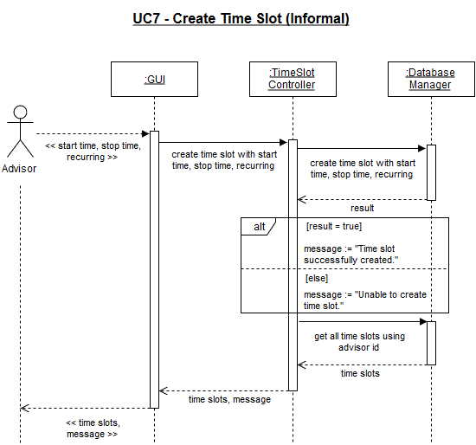

Slide 29
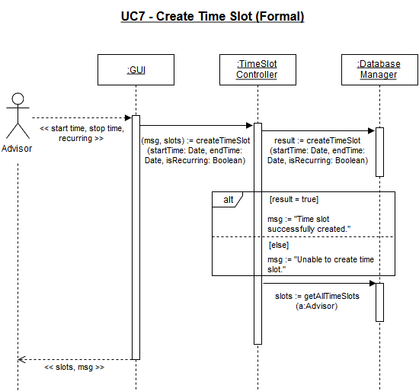

Slide 30
UC14 – Create Appointment

Slide 31
Precondition: NONE
Actor: Student | System: MavAdvisor
 | 0. MavAdvisor displays the student dashboard.
1. TUCBW a student clicks the “Schedule Appointment” link from the menu. | 2. MavAdvisor displays the calendar view, with all time slots for all advisors the student is able to meet with. The time slot will show the advisor name and show whether the slot is available or taken.
4. The student clicks on an available time slot with the desired advisor. | 6. MavAdvisor displays a modal “Schedule Appointment” form. Advisor, student, and start time are pre-filled and un-editable.
7. The student selects and advising task, optionally enters notes and clicks the Submit button. | 8. MavAdvisor displays the student dashboard with the newly added appointment and displays a success message “Appointment scheduled.” *
9. TUCEW the student sees the success message “Appointment scheduled.”
Postcondition: NONE

Slide 32
Scenario Description
7. The student selects an advising task, optionally enters notes and clicks the submit button.
7.1. GUI sends a schedule appointment request to the appointment controller with the start time, end time, student, advisor, task, and notes.
7.2. Appointment controller creates a blank message.
7.3. Appointment controller requests all appointments from the database manager based on the start time, end time, and advisor.
7.4. Database manager returns the requested appointments to the appointment controller.
7.5. If any appointment is returned:
7.5.1. Appointment controller writes “Unable to schedule appointment” to message.
7.6. Else:
7.6.1. Appointment controller creates an Appointment object using student s, advisor a, start time st, end time et, advising task at, and notes n.
7.6.2. Appointment controller saves the Appointment object with the database manager.
7.6.3. Appointment controller writes “Appointment scheduled” to message.
7.7. Appointment controller requests all appointments from the database manager for the given student.
7.8. Database manager returns the requested appointment list to the appointment controller.
7.9. Appointment controller returns the appointment list and the message to the GUI.
8. GUI displays the student dashboard with the newly added appointment and displays a success message “Appointment scheduled.”

Slide 33
# | Subject | Subject Action | Other Data/Objects | Object Acted Upon
7. | Student | Selects | Advising task, notes (optional) | GUI
7.1. | GUI | Sends schedule appointment request | Start time, end time, student, advisor, task, notes | Appointment Controller
7.2. | Appointment controller | Creates |  | Message
7.3. | Appointment controller | Requests all appointments | Start time, end time, advisor | Database Manager
7.4. | Database Manager | Returns | Appointments appts | Appointment Controller
7.5. | If any appointment is returned (appts.size() > 0):
7.5.1. | Appointment Controller | Writes | “Unable to schedule appointment” | Message
7.6. | Else:
7.6.1. | Appointment controller | Creates | Student s, advisor a, start time st, end time et, advising task at, notes n | Appointment
7.6.2. | Appointment controller | Saves | Appointment | Database Manager
7.6.3. | Appointment controller | Writes | “Appointment scheduled” | Message
7.7. | Appointment controller | Requests all appointments | student | Database Manager
7.8. | Database Manager | Returns | Appointments appts | Appointment Controller
7.9. | Appointment controller | returns | Appointments appts, Message | GUI
8. | GUI | displays | Appointments appts, Message | Student

Slide 34
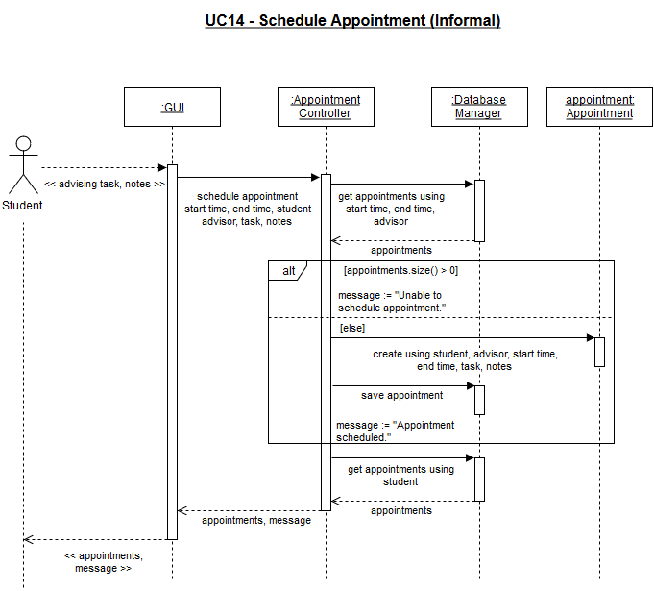

Slide 35
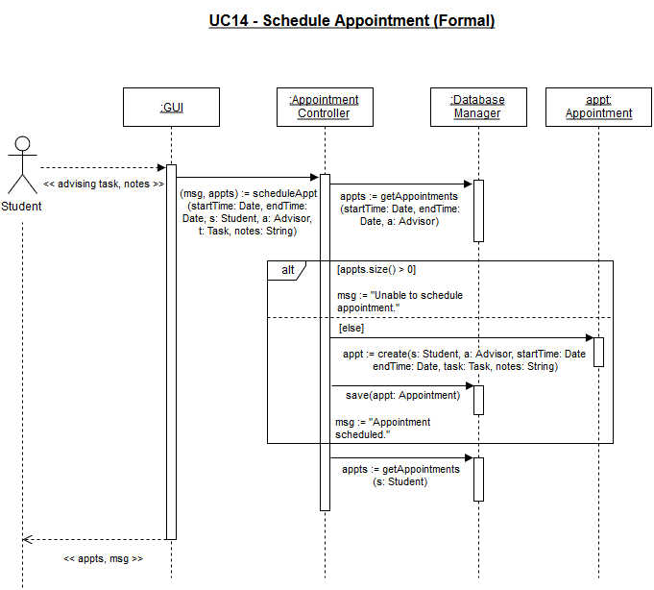

Slide 36
Design Class Diagram

Slide 37
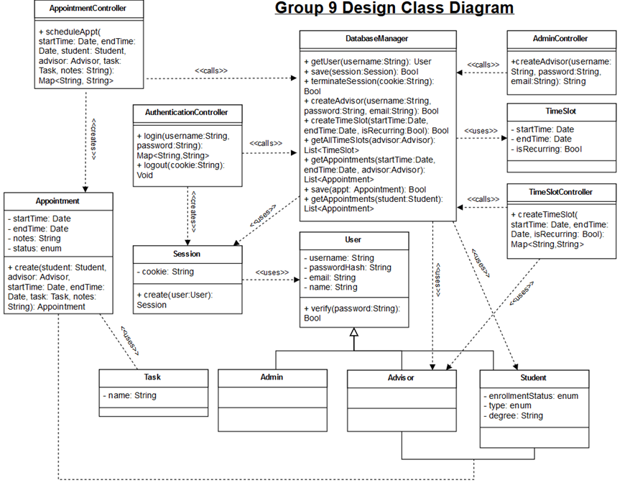
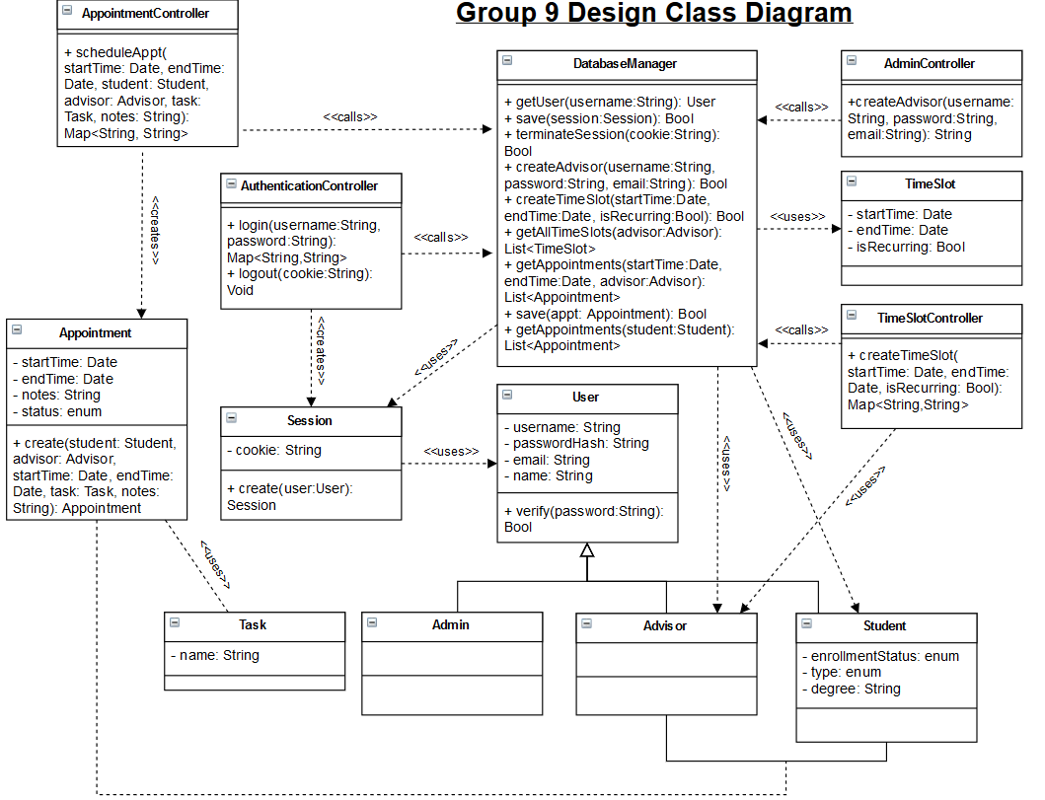

Slide 38
Iteration 2 Plan
Singleton – Database Manager
Bridge – MySQL implementation of DatabaseManager
Command – Encapsulate database requests
Template – Standardize the “execute” method of command objects

Slide 39
Questions?

