Slide 1
CSE 5322
Design Patterns
Iteration 2
Group 9
Gurleen, Vyshak, Siva, Deepa, Travis

Slide 2
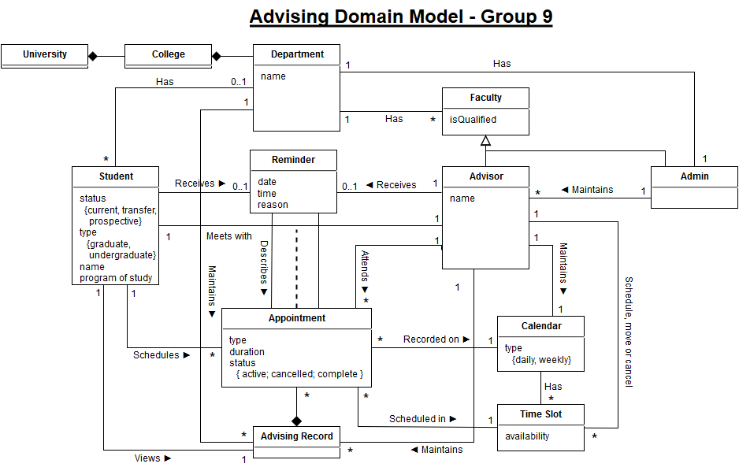

Slide 3
Requirements
R1. The application shall provide an Account for each User and restrict access to different application features based on the Account Type.
R2. The application shall provide the following minimum security requirements:
R2.1. All users must authenticate with the system to access features relevant to their account.
R2.1.1. Users shall log in with an e-mail address or (optionally) a username.
R2.1.2. Users shall log in with a password.
R2.1.2.1. All passwords shall be stored in the database in a hashed format.
R2.3. Users shall be able to log out from their account.
R3.4. The Administrator shall create Advisor accounts within his/her department.
R4.1. Advisor shall be able to create, edit and delete time slots during which advising is offered.
R4.1.1. Advisor can manage individual time slots or recurring time slots.
R4.6.1. The Home Screen of the Advisor Dashboard shall display a tabular summary of the day’s advising appointments and the reason for each appointment. Selecting an appointment shall display a Detail View.
R5.1. Students shall be classified as either Current, Prospective or Transfer.
R5.3. The Home Screen of the Student Dashboard shall display a table showing upcoming advising appointments as well as a history of previous advising appointments. Selecting an appointment shall display a Detail View.
R6. The application shall allow Students to schedule Appointments according to the following minimum requirements:
R6.1. The application shall display Time Slots on a standard calendar view.

Slide 4
Abstract & High Level Use Cases
Demo Functionality
UC1. Log In (system: MavAdvisor, actor: User)
  TUCBW a user enters their username and password and clicks “Submit”.
  TUCEW the user sees their dashboard.
UC3. Log Out (system: MavAdvisor, actor: User)
  TUCBW a user clicks the Log Out button.
  TUCEW the user sees the home page and the username and password fields.
UC6. Create Advisor Account (system: MavAdvisor, actor: Admin)
  TUCBW the admin clicks the “create advisor” link from the menu.
  TUCEW the admin sees a success message “Advisor successfully created.”
UC7. Create Time Slot (system: MavAdvisor, actor: Advisor)
  TUCBW the advisor clicks the “Create Time Slot” link from the menu.
  TUCEW the advisor sees a success message “Time slot successfully created.” and the updated calendar view.
UC14. Create Appointment (system: MavAdvisor, actor: Student)
  TUCBW a student clicks the “Schedule Appointment” link from the menu.
  TUCEW the student sees the success message “Appointment scheduled” and the updated appointments table.

Slide 5
Abstract & High Level Use Cases
Design Presented
UC5. Edit Preferences (system: MavAdvisor, actor: User)
  TUCBW the user clicks the “Edit Preferences” link from the menu.
  TUCEW the user sees a success message “Preferences successfully updated.”
UC11. Show Appointment Details (system: MavAdvisor, actor: Advisor/Student)
  TUCBW an advisor/student selects an appointment from their upcoming appointments table.
  TUCEW the advisor/student sees the appointment detail page for the selected appointment.
UC12. Cancel Appointment (system: MavAdvisor, actor: Student/Advisor)
  TUCBW a student clicks the “Cancel Appointment” button from the appointment’s detail page.
  TUCEW the student sees a success message “Appointment canceled” and the appointment is removed from the student’s appointments table.
UC13. Create Student Account (system: MavAdvisor, actor: Student)
  TUCBW a student clicks the “Register” link from the menu.
  TUCEW the student sees a success message “Account successfully created.”

Slide 6
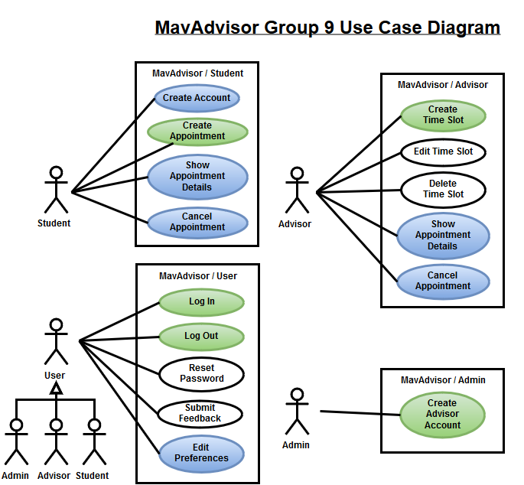

Slide 7
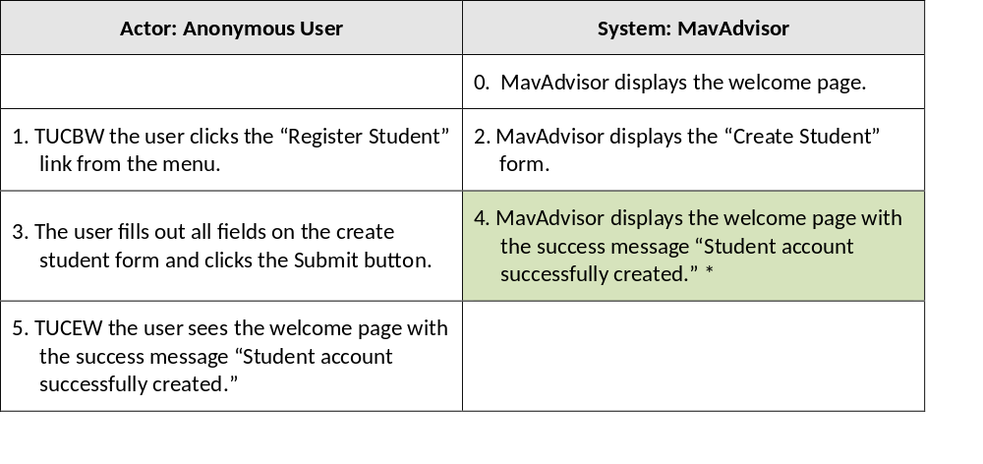
UC13 – Create Account (Student)

Slide 8
Scenario Description
3. The user fills out all fields on the create student form and clicks the Submit button.
3.1. Page sends a POST request to the CreateStudentAccount controller.
3.2. CreateStudentAccount controller creates a Student object with the submitted parameters.
3.3. CreateStudentAccount controller sends a CreateStudentAccount request to the DatabaseManager with the Student object.
3.4. DatabaseManager creates a CreateStudentAccountCommand object with the Student object.
3.5. DatabaseManager sends an execute request to the CreateStudentAccountCommand object.
3.6. CreateStudentAccountCommand inserts a record into the users table.
3.7. CreateStudentAccountCommand retrieves the id of the newly inserted user.
3.8. CreateStudentAccountCommand inserts a record into the students table with the associated user id.
3.9. DatabaseManager sends a getResults request to the CreateStudentAccountCommand.
3.10. CreateStudentAccountCommand returns whether the action was successful to the DatabaseManager.
3.11. DatabaseManager returns whether the action was successful to the CreateStudentAccount controller.
3.12. CreateStudentAccount controller renders the welcome page with the message “Student account successfully created.”
4. MavAdvisor displays the welcome page with the success message “Student account successfully created.”

Slide 9
# | Subject | Subject Action | Other Data/Objects | Object Acted Upon
3. | User | Submits | form fields | Page
3.1. | Page | Sends request | form fields | Create Student Account Controller
3.2. | Create Student Account Controller | Creates |  | Student
3.3. | Create Student Account Controller | Sends create student account request | Student | Database Manager
3.4. | Database Manager | Creates | Student | Create Student Account Command
3.5. | Database Manager | Requests execute |  | Create Student Account Command
3.6. | Create Student Account Command | Insert | User record | Database
3.7. | Create Student Account Command | Retrieves | User record id | Database
3.8. | Create Student Account Command | Insert | Student record | Database
3.9. | Database Manager | Reqeuests results |  | Create Student Account Command
3.10. | Create Student Account Command | Returns success status |  | Database Manager
3.11. | Database Manager | Returns success status |  | Create Student Account Controller
3.12. | Create Student Account Controller | Renders |  | Welcome Page
4. | Welcome Page | Displays for |  | User

Slide 10
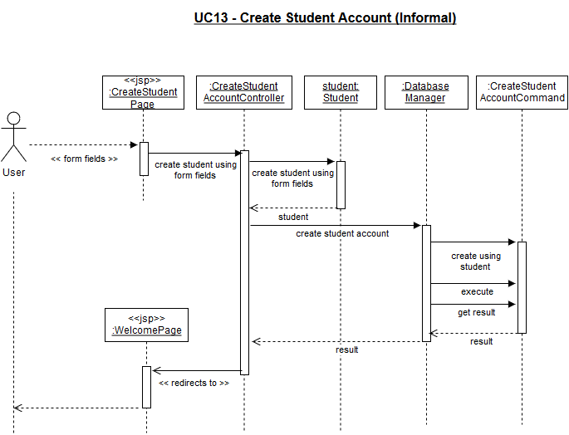

Slide 11
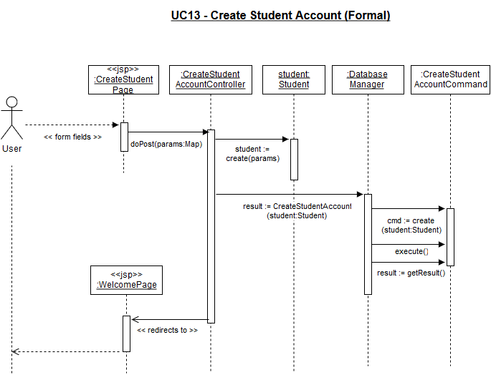

Slide 12
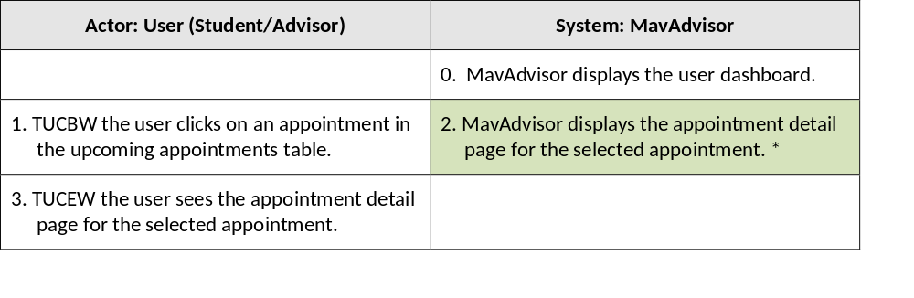
UC11 – Show Appointment Details

Slide 13
Scenario Description
1. The user clicks on an appointment in the upcoming appointments table.
1.1. Page sends a request to the ShowAppointmentDetails controller with the appointment id.
1.2. ShowAppointmentDetails controller sends a GetAppointment request to the DatabaseManager with the appointment id.
1.3. DatabaseManager creates a GetAppointmentCommand object with the appointment id.
1.4. DatabaseManager sends an execute request to the GetAppointmentCommand.
1.5. GetAppointmentCommand retrieves the appointment record from the database with the provided appointment id.
1.6. GetAppointmentCommand creates an Appointment object with the retrieved data.
1.7. DatabaseManager sends a getResults request to the GetAppointmentCommand object.
1.8. GetAppointmentCommand returns the created Appointment object to the DatabaseManager.
1.9. DatabaseManager returns the Appointment object to the ShowAppointmentDetails controller.
1.10. ShowAppointmentDetails controller renders the appointment detail page using the Appointment object.
2. MavAdvisor displays the appointment detail page for the selected appointment.

Slide 14
# | Subject | Subject Action | Other Data/Objects | Object Acted Upon
1. | User | Clicks | Appointment | Page
1.1. | Page | Sends request | appointment id | Show Appointment Details Controller
1.2. | Show Appointment Details Controller | Sends get appointment request | appointment id | Database Manager
1.3. | Database Manager | Creates | appointment id | Get Appointment Command
1.4. | Database Manager | Requests execute |  | Get Appointment Command
1.5. | Get Appointment Command | Retrieves | appointment data | Database
1.6. | Get Appointment Command | Creates | appointment data | Appointment
1.7. | Database Manager | Requests results |  | Get Appointment Command
1.8. | Get Appointment Command | Returns | Appointment | Database Manager
1.9. | Database Manager | Returns | Appointment | Show Appointment Details Controller
1.10. | Show Appointment Details Controller | Renders | Appointment | Appointment Details Page
2. | Appointment Details Page | Displays |  | User

Slide 15
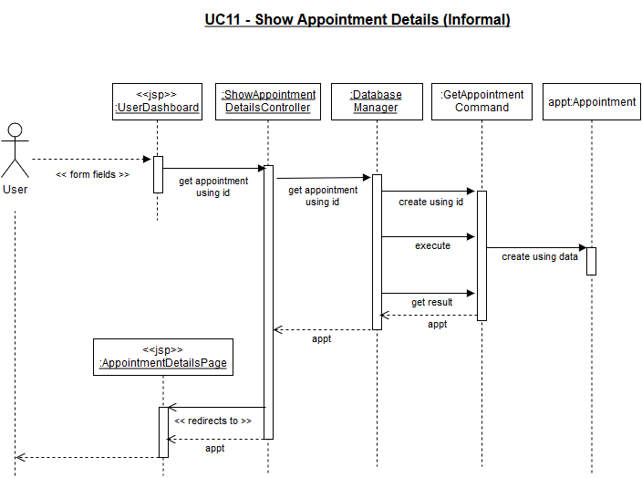

Slide 16
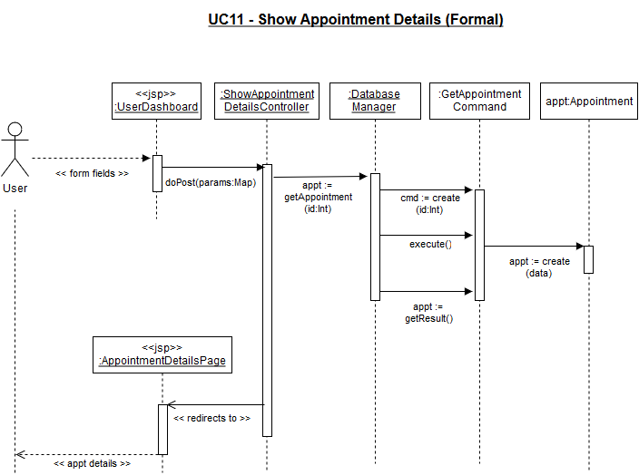

Slide 17
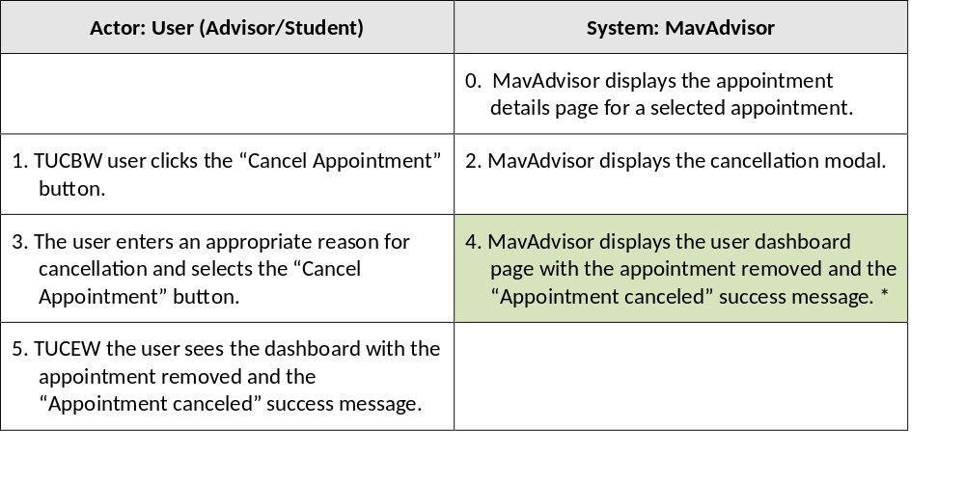
UC12 – Cancel Appointment

Slide 18
Scenario Description
3. The user enters an appropriate reason for cancellation and selects the “Cancel Appointment” button.
3.1. Page sends a POST request to the CancelAppointmentController with the appointment id and the reason.
3.2. CancelAppointmentController sends a GetAppointment request to the DatabaseManager with the appointment id.
3.3. DatabaseManager returns the Appointment object to the CancelAppointmentController.
3.4. CancelAppointmentController updates the Appointment object by setting its status to CANCELED and appending the reason to the Advisor or Student notes.
3.5. CancelAppointmentController sends an UpdateAppointment request to the DatabaseManager with the Appointment object.
3.6. DatabaseManager creates an UpdateAppointmentCommand object with the Appointment object.
3.7. DatabaseManager sends an execute request to the UpdateAppointmentCommand object.
3.8. UpdateAppointmentCommand updates the database with the Appointment object.
3.9. DatabaseManager sends a getResults request to the UpdateAppointmentCommand object.
3.10. UpdateAppointmentCommand returns whether the update was successful to the DatabaseManager.
3.11. DatabaseManager returns whether the update was successful to the CancelAppointmentController.
3.12. CancelAppointmentController renders the user dashboard page with the appointment removed and the “Appointment canceled” success message.
4. MavAdvisor displays the user dashboard page with the appointment removed and the “Appointment canceled” success message.

Slide 19
# | Subject | Subject Action | Other Data/Objects | Object Acted Upon
3. | User | Clicks “Cancel Appointment” | reason, appointment id | Appointment Details Page
3.1. | Appointment Details Page | Sends request | reason, appointment id | Cancel Appointment Controller
3.2. | Cancel Appointment Controller | Sends get appointment request | appointment id | Database Manager
3.3. | Database Manager | Returns | Appointment | Cancel Appointment Controller
3.4. | Cancel Appointment Controller | Updates | reason | Appointment
3.5. | Cancel Appointment Controller | Request update appointment | Appointment | Database Manager
3.6. | Database Manager | Creates | Appointment | Update Appointment Command
3.7. | Database Manager | Request execute |  | Update Appointment Command
3.8. | Update Appointment Command | Updates | Appointment | Database
3.9. | Database Manager | Requests results |  | Update Appointment Command
3.10. | Update Appointment Command | Returns | success status | Database Manager
3.11. | Database Manager | Returns | success status | Cancel Appointment Controller
3.12. | Cancel Appointment Controller | Renders |  | User Dashboard Page
4. | User Dashboard Page | Displays |  | User

Slide 20
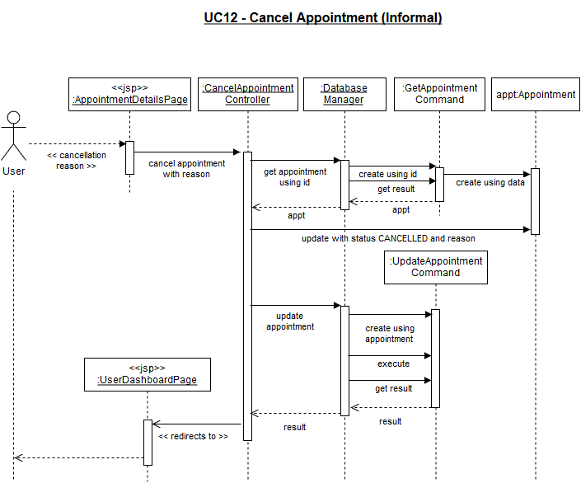

Slide 21
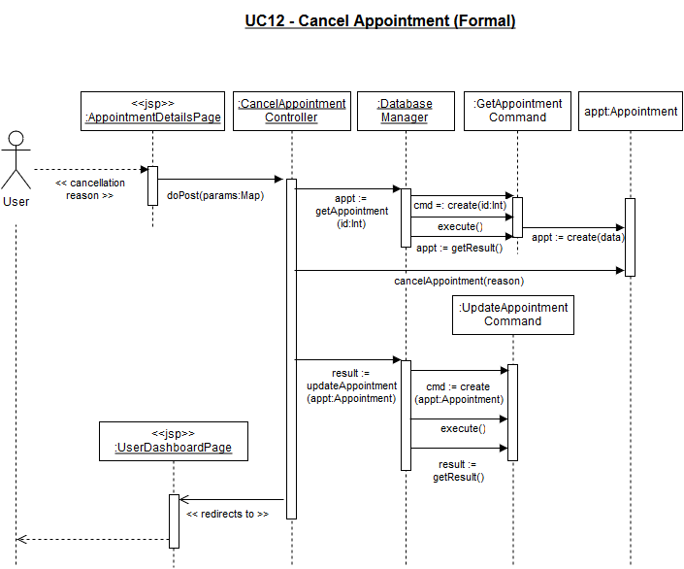

Slide 22
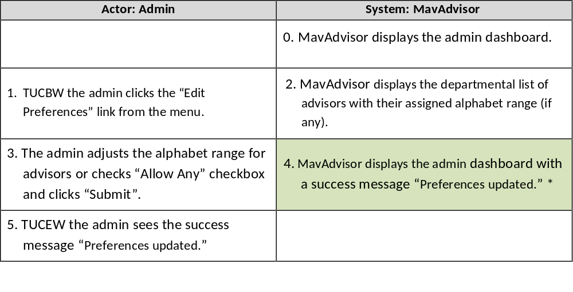
UC5 – Edit Preferences
(Assign Students to Advisors)

Slide 23
Scenario Description
3. The admin adjusts the alphabet range for advisors or checks “Allow Any” checkbox and clicks “Submit”.
3.1 Page sends a POST request to the UpdateAdminPreferences controller with the updated advisor settings.
3.2 UpdateAdminPreferences controller constructs an array of AdvisorAssignment objects from the submitted parameters.
3.3 UpdateAdminPreferences controller sends UpdateAdminPreferences request to the DatabaseManager using the array of AdvisorAssignments.
3.4 DatabaseManager creates an UpdateAdminPreferencesCommand object with the array of AdvisorAssignments.
3.5 DatabaseManager executes the UpdateAdminPreferencesCommand object.
3.6 The UpdateAdminPreferencesCommand clears the advisor assignments table.
3.7 The UpdateAdminPreferencesCommand inserts an entry in the advisor assignments table for each AdvisorAssignment object.
3.8 DatabaseManager sends a getResult request to the UpdateAdminPreferencesCommand.
3.9 UpdateAdminPreferencesCommand returns whether the action was successful to the DatabaseManager.
3.10 DatabaseManager returns whether the action was successful to the UpdateAdminPreferences controller.
3.11 UpdateAdminPreferences controller renders the admin dashboard with the message “Preferences updated.”
4. MavAdvisor displays the admin dashboard with a success message “Preferences updated."

Slide 24
# | Subject | Subject Action | Other Data / Objects | Object Acted Upon
3. | Admin | Clicks “Submit” | advisor assignments | Edit Admin Preferences Page
3.1. | Edit Admin Preferences Page | Sends request | advisor assignments | Update Admin Preferences Controller
3.2. | Update Admin Preferences Controller | Creates | advisor assignments | Advisor Assignments
3.3. | Update Admin Preferences Controller | Sends update admin preferences request | Advisor Assignments | Database Manager
3.4. | Database Manager | Creates | Advisor Assignments | Update Admin Preferences Command
3.5. | Database Manager | Requests execute |  | Update Admin Preferences Command
3.6. | Update Admin Preferences Command | Clears advisor assignments table |  | Database
3.7. | Update Admin Preferences Command | Inserts | Advisor Assignments | Database
3.8. | Database Manager | Requests results |  | Update Admin Preferences Command
3.9. | Update Admin Preferences Command | Returns | success status | Database Manager
3.10. | Database Manager | Returns | success status | Update Admin Preferences Controller
3.11. | Update Admin Preferences Controller | Renders |  | Admin Dashboard Page
4. | Admin Dashboard Page | Displays |  | Admin

Slide 25
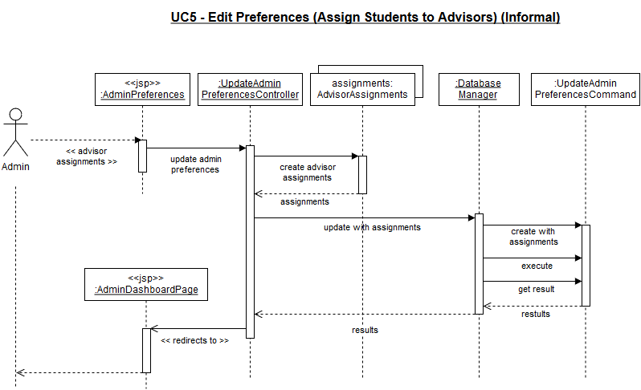

Slide 26
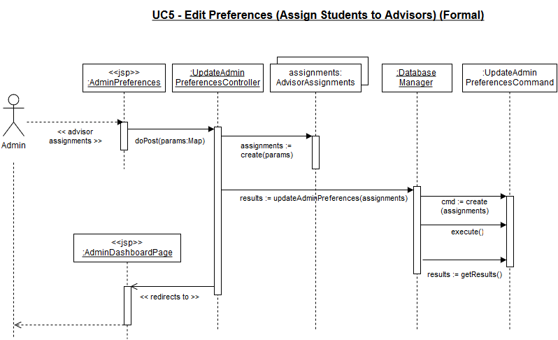

Slide 27
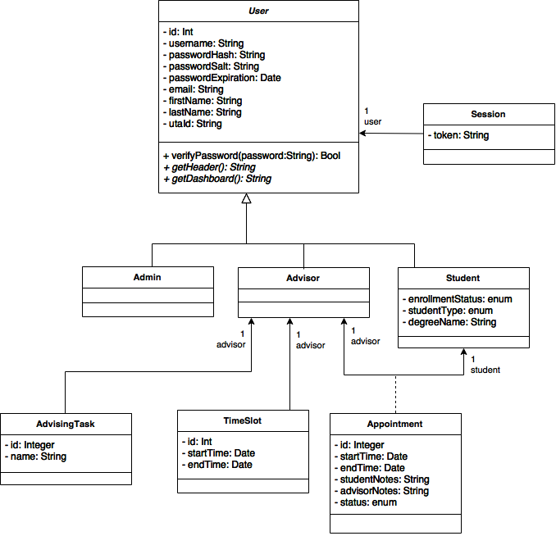

Slide 28

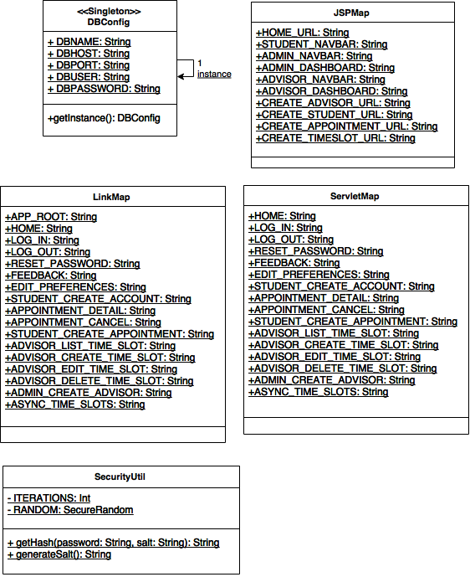
Singleton
Pattern

Slide 29

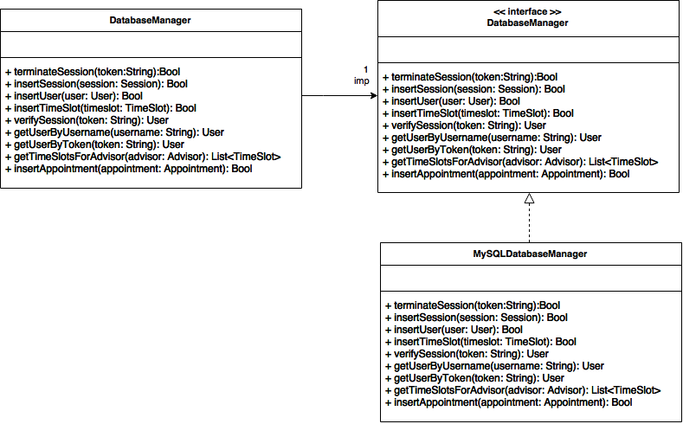
Bridge Pattern

Slide 30

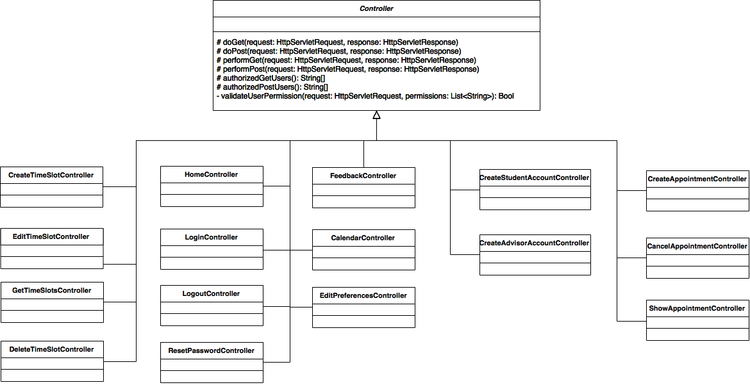

Protection Proxy Pattern
Template Method
Pattern

Slide 31
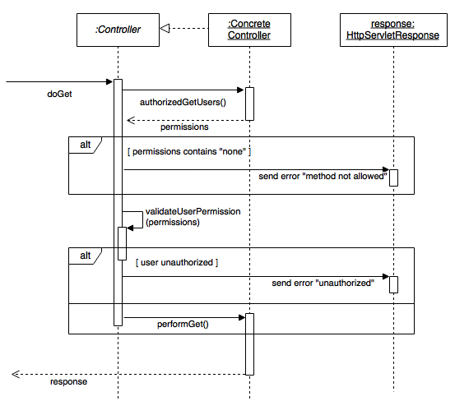
Protection Proxy Pattern

Slide 32

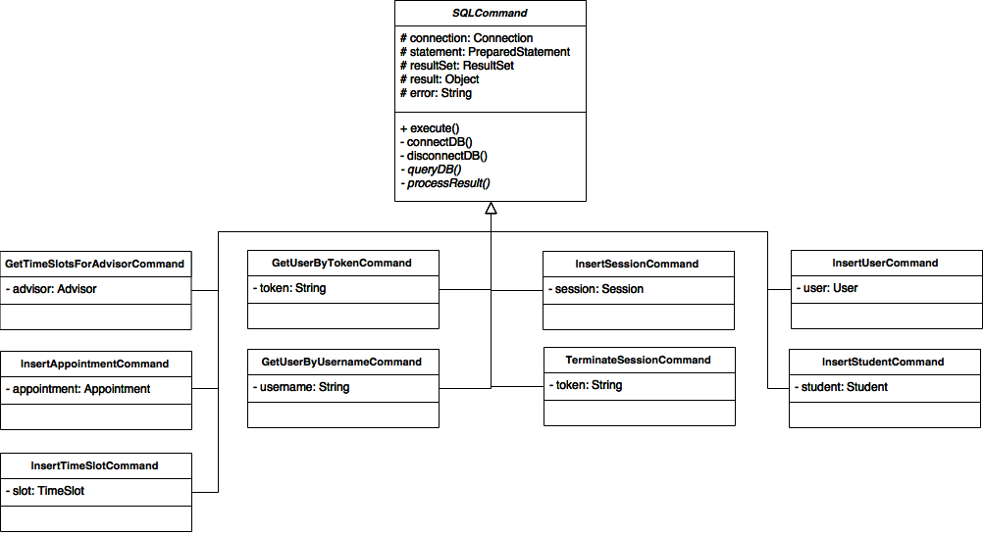

Command Pattern
Template Method
Pattern

