Slide 1
User Experience/User Interface
EECS3311 Group X “LionsList”

Slide 2
Registration Scenario

Slide 3
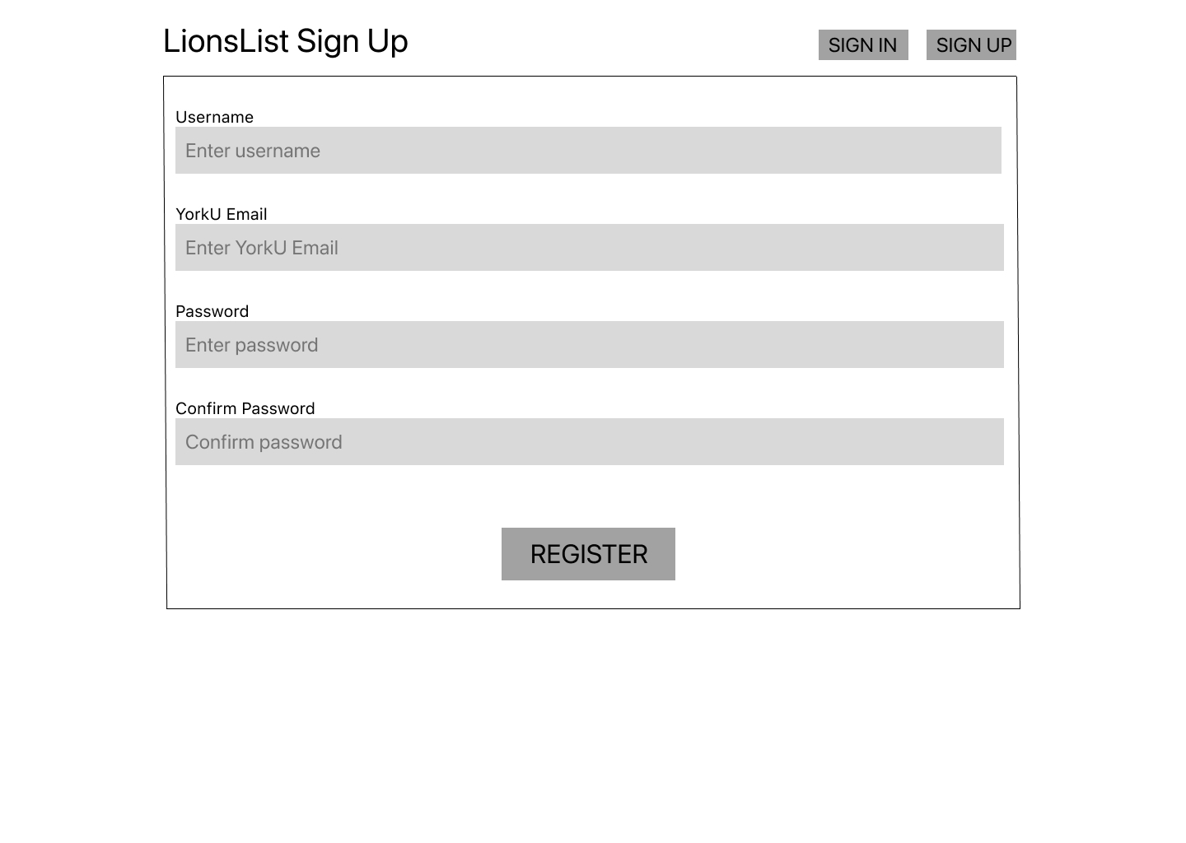
(Registration page)

Slide 4
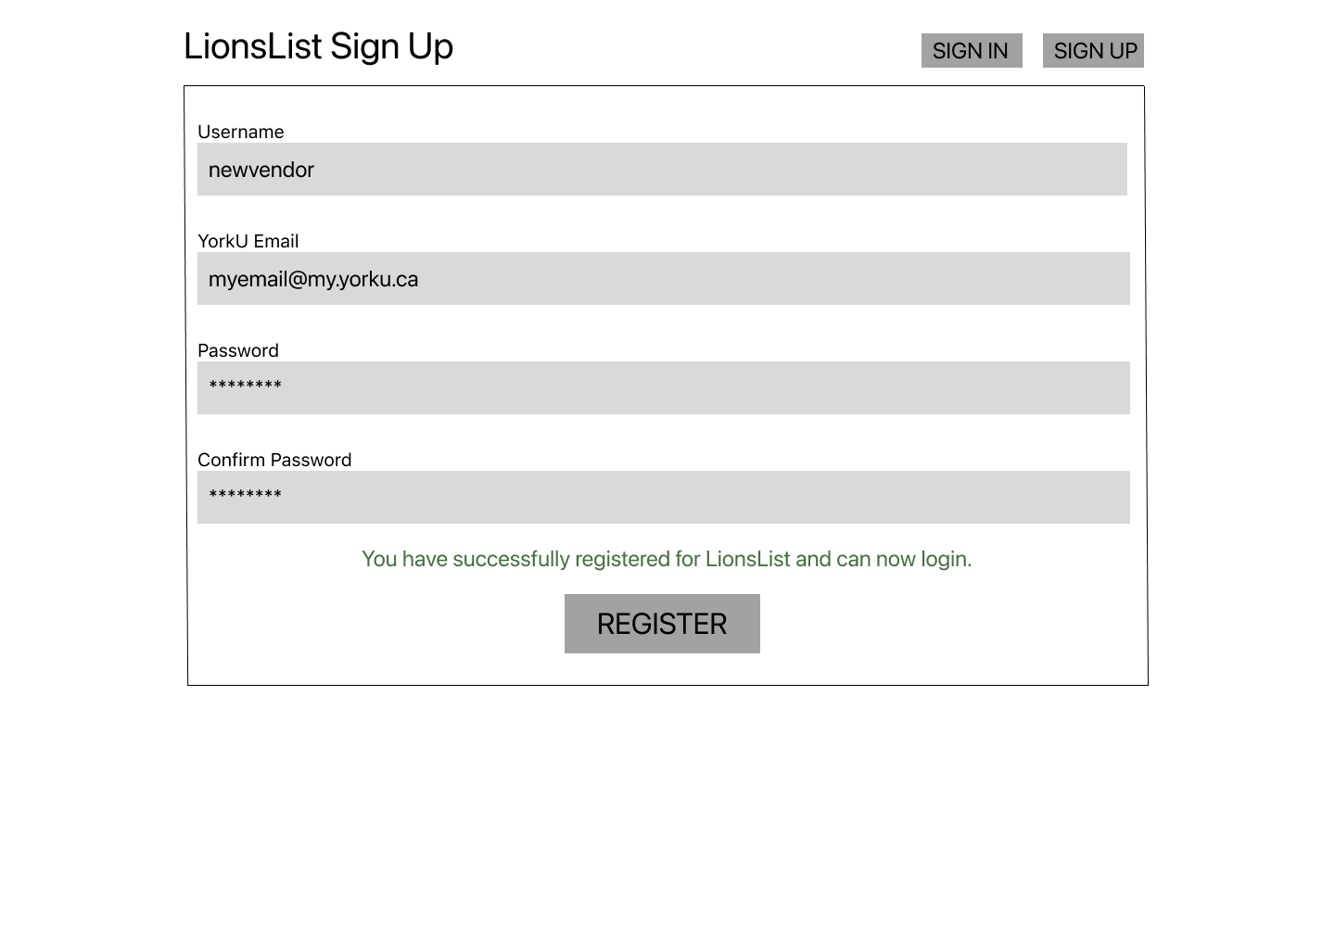
(Successful registration)

Slide 5
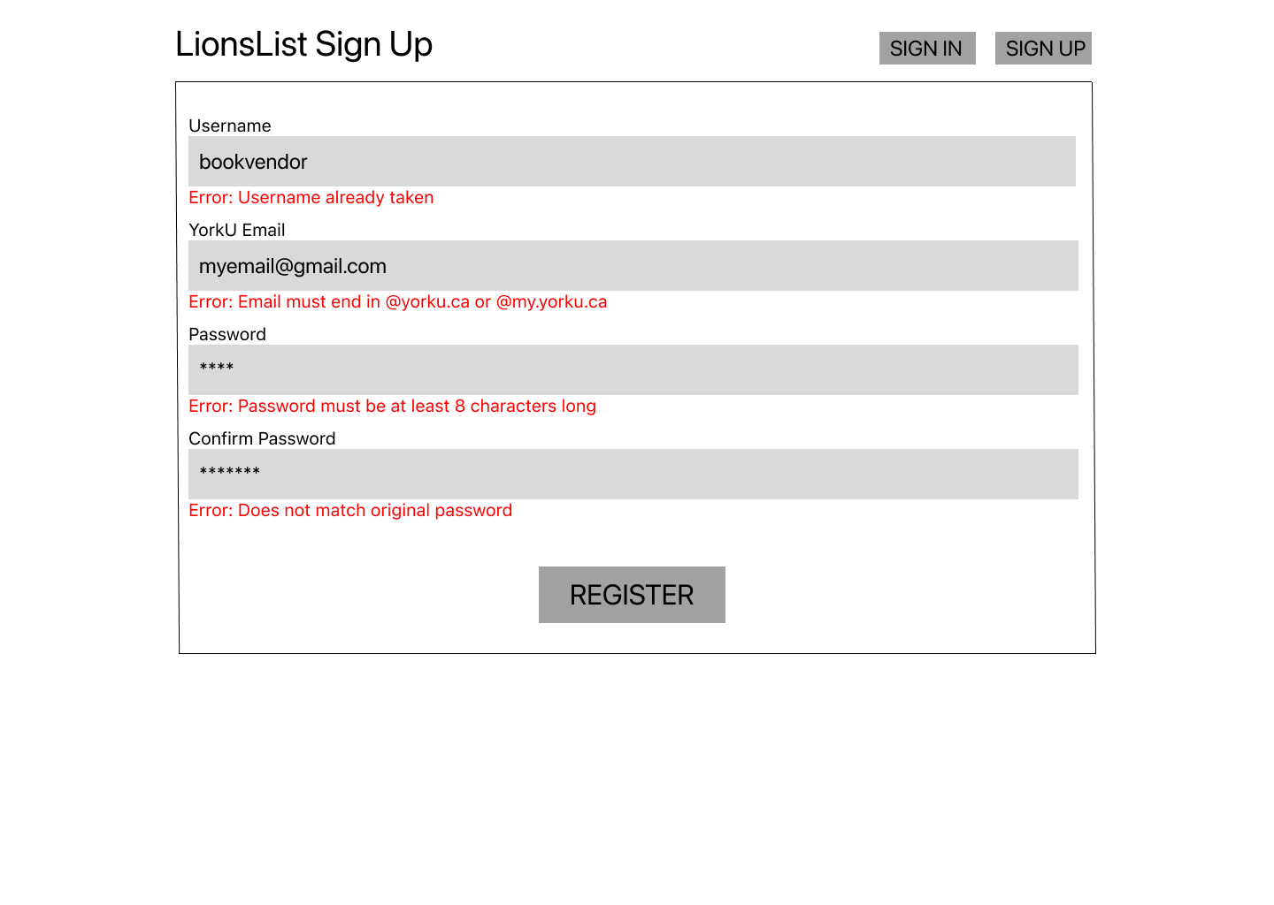
(Unsuccessful registration and possible errors)

Slide 6
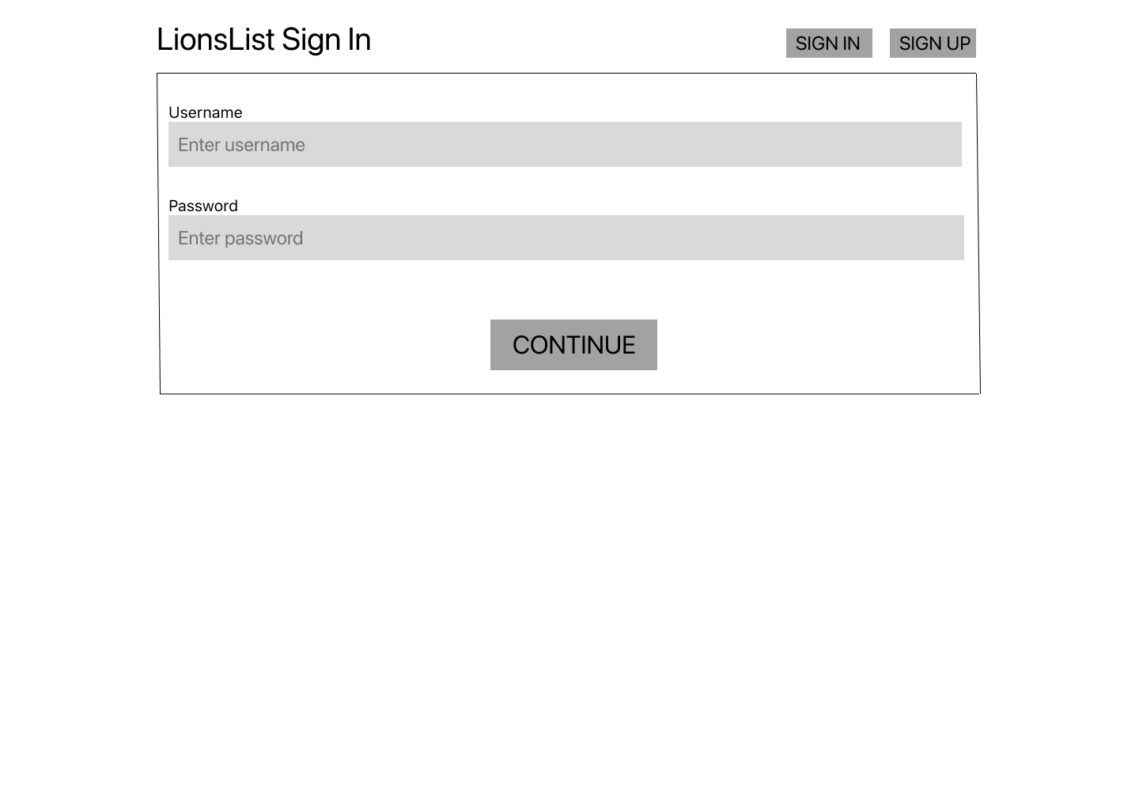
(Sign in page)

Slide 7
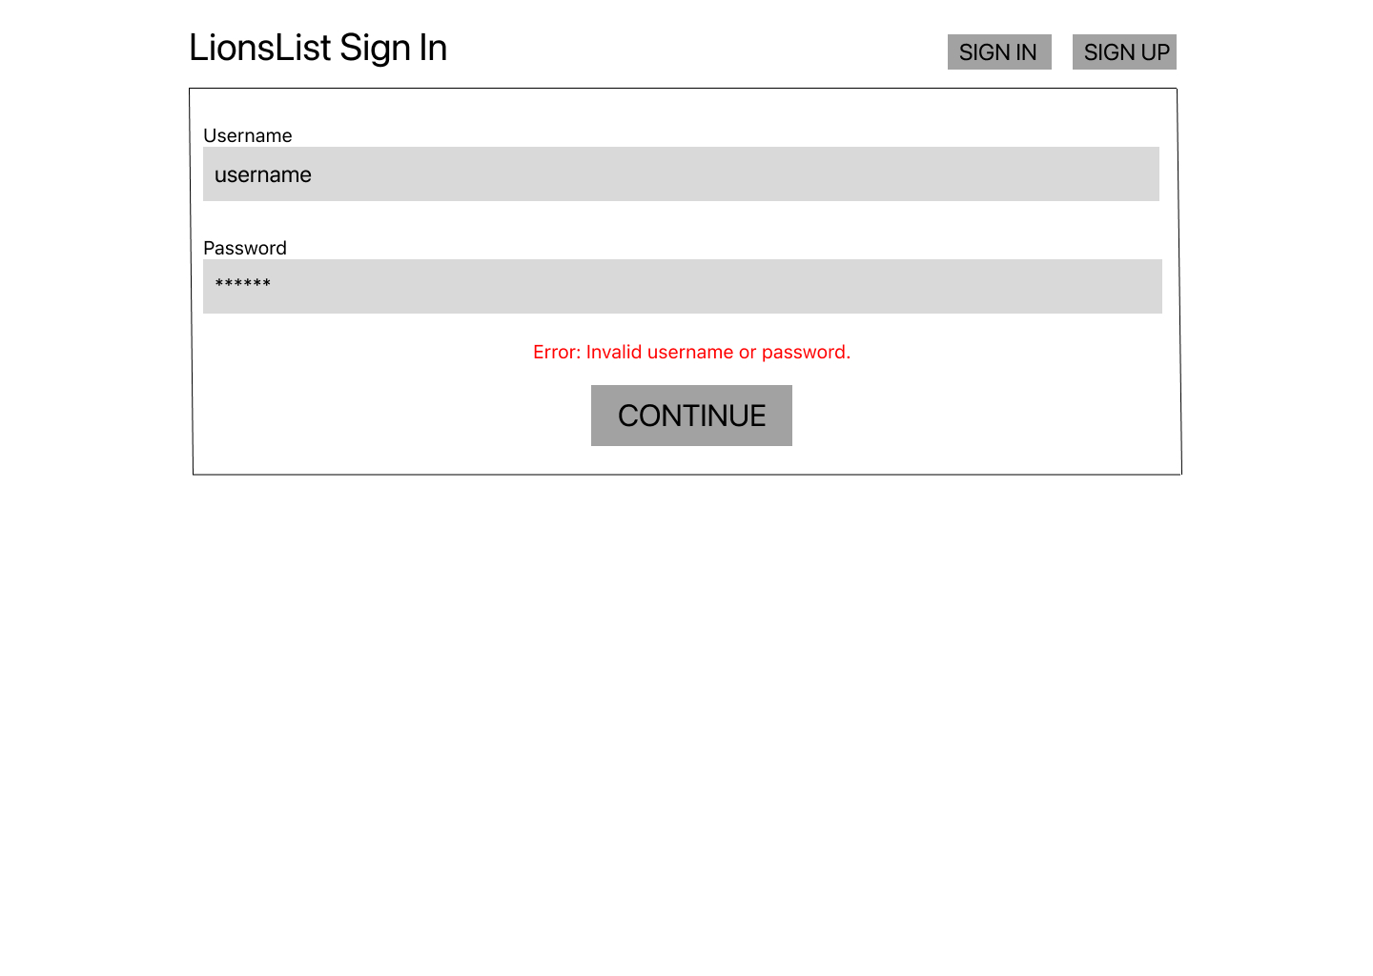
(Unsuccessful sign in)

Slide 8
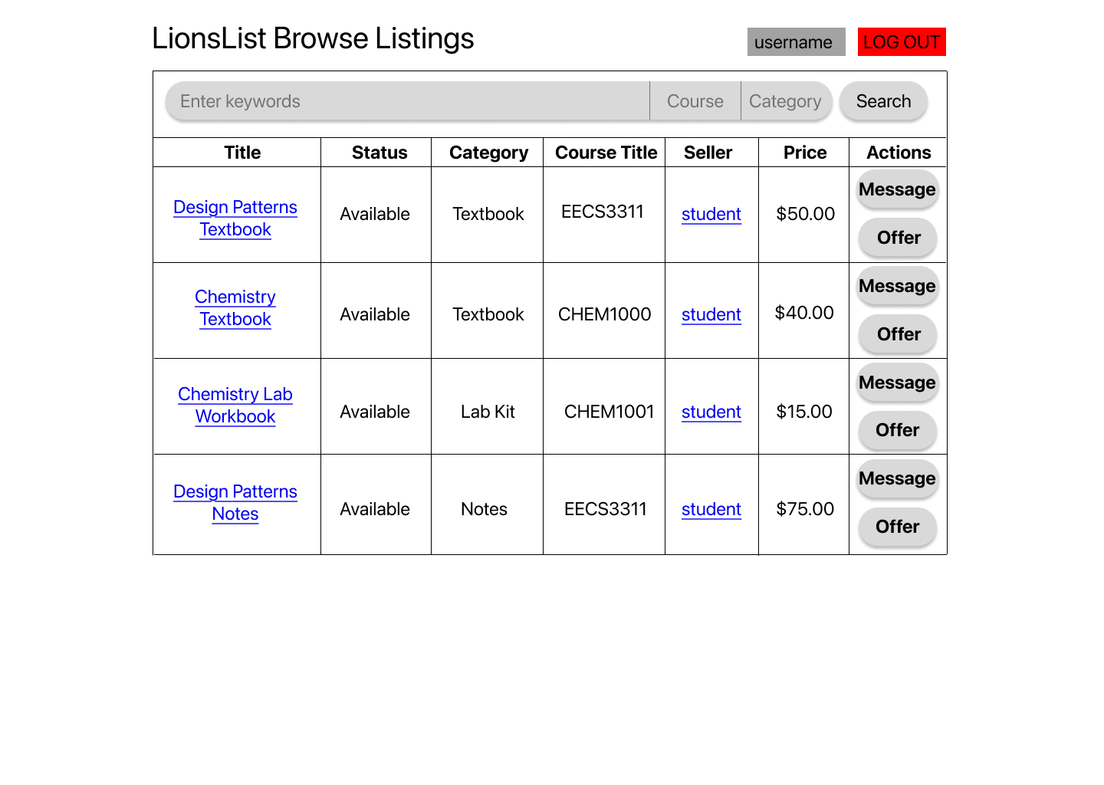
(Landing page after successful sign in)

Slide 9
Buyer Scenario

Slide 10
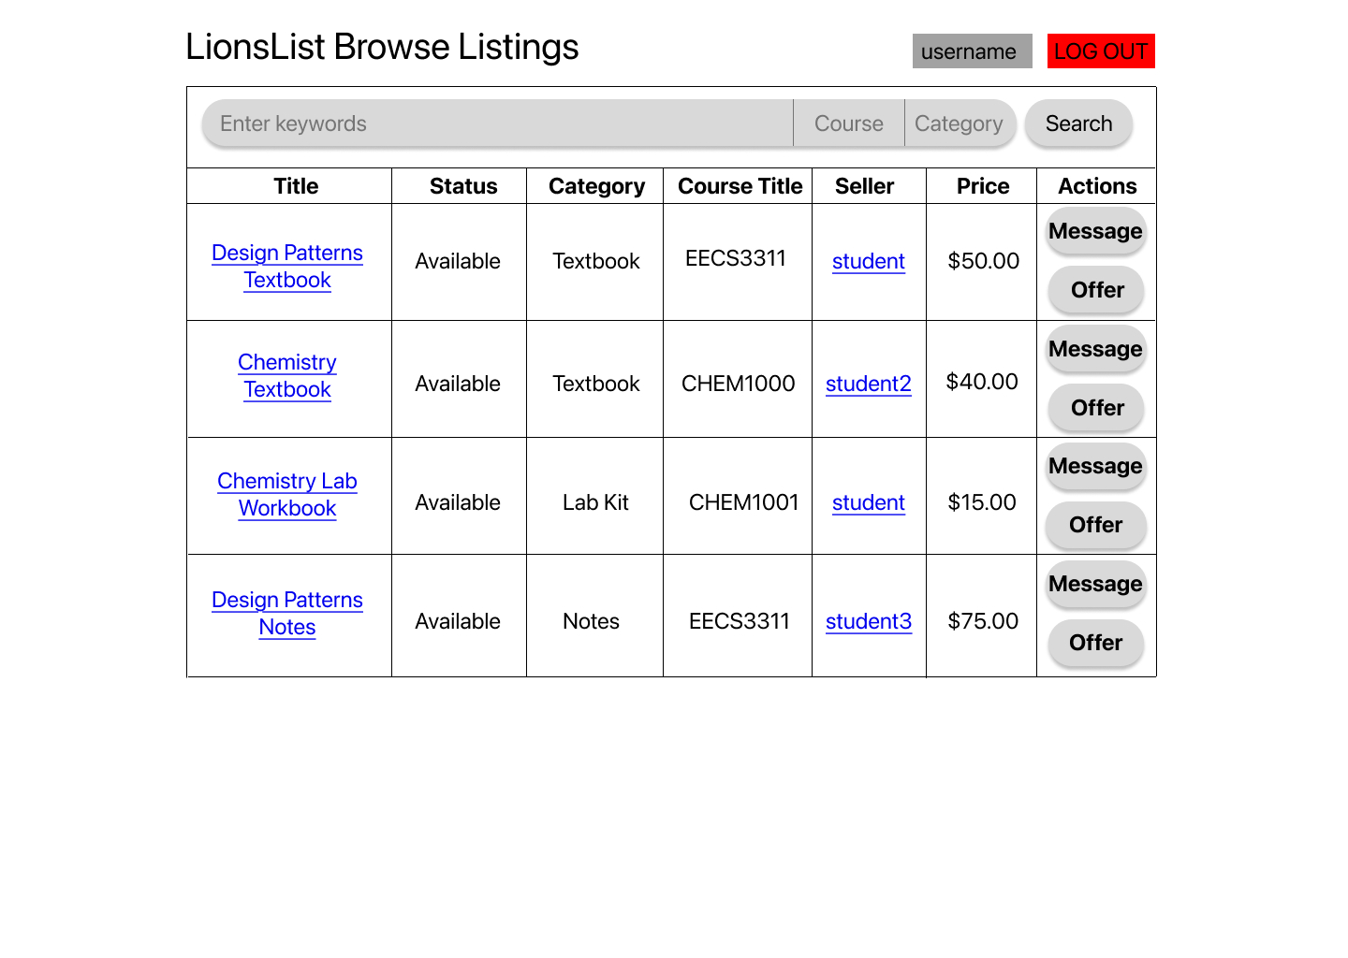
(Unfiltered listings page)

Slide 11
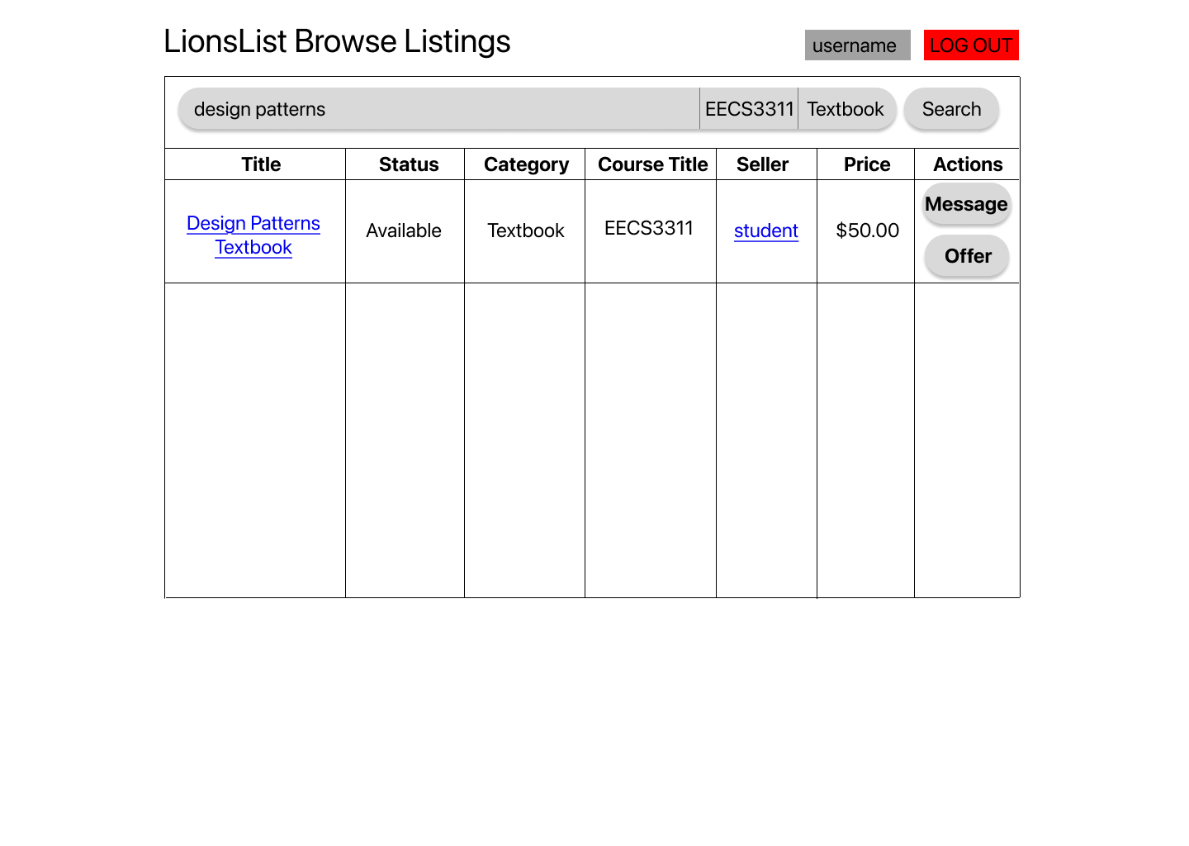
(Filtered listings page)

Slide 12
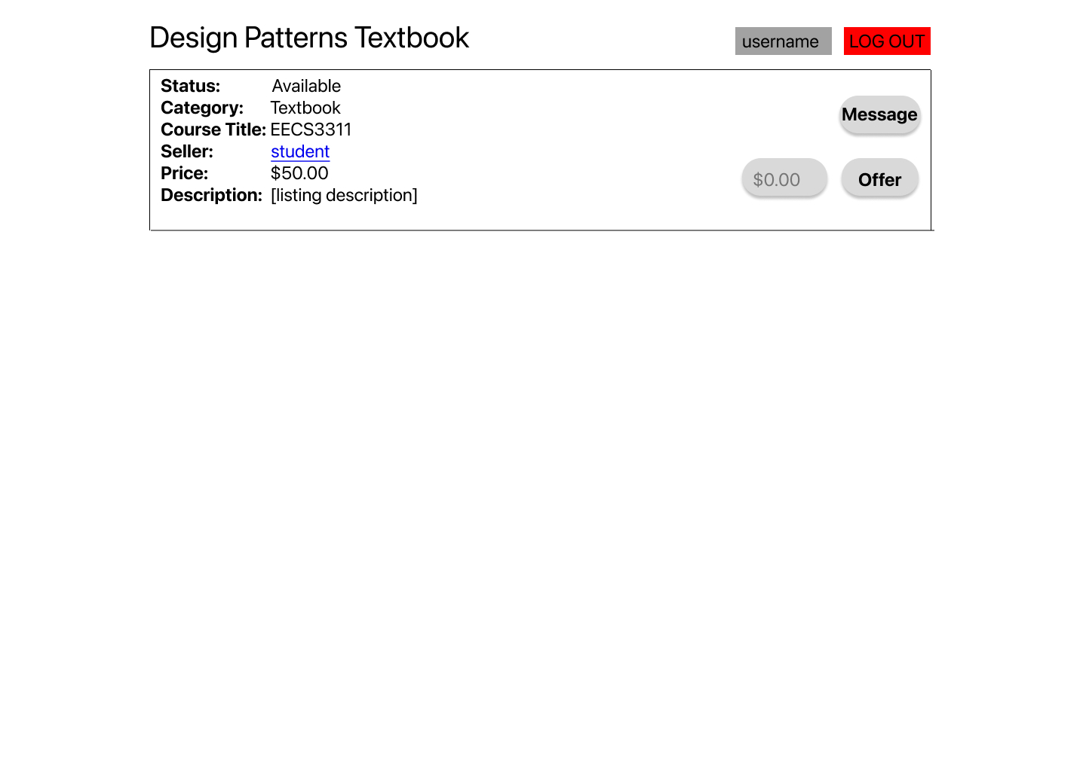
(Listing details page)

Slide 13
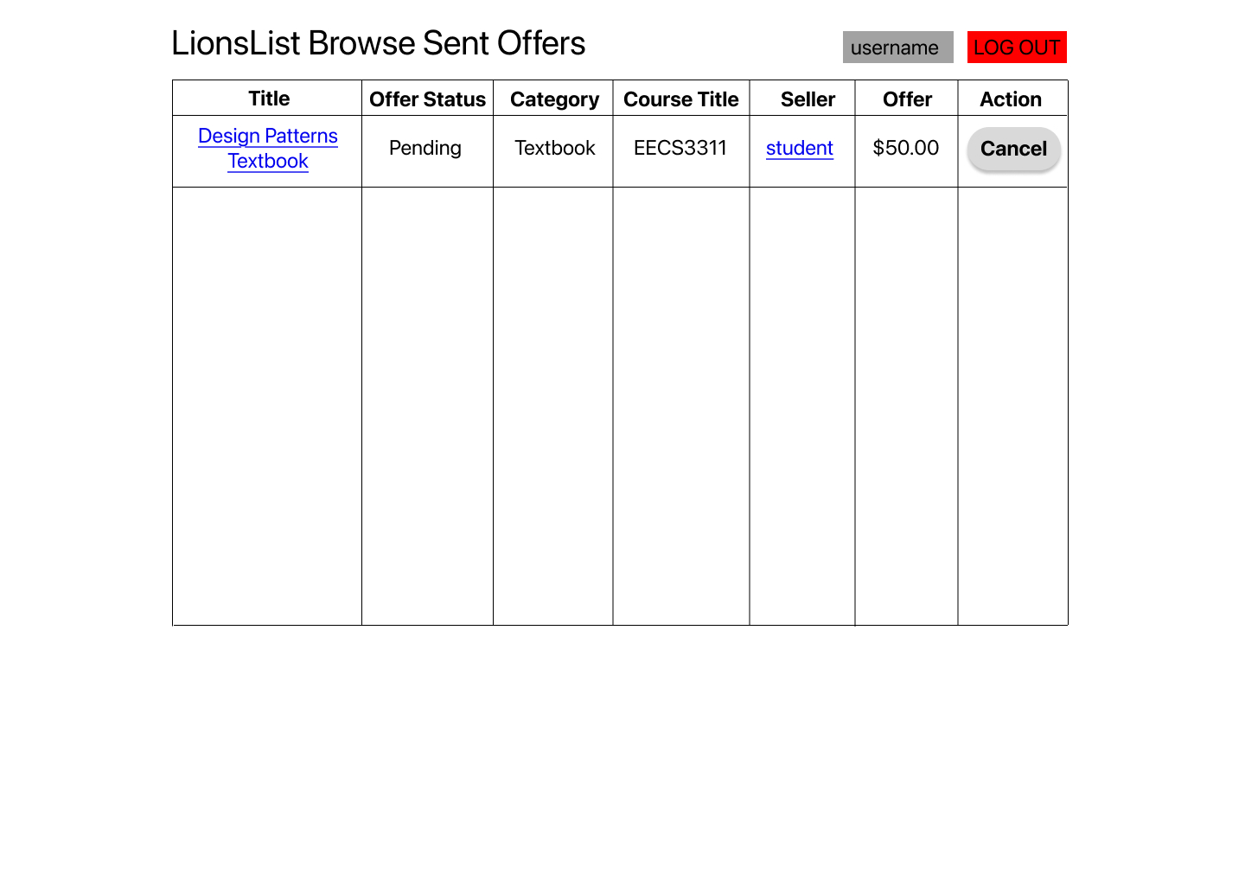
(Buyer can cancel pending offers)

Slide 14
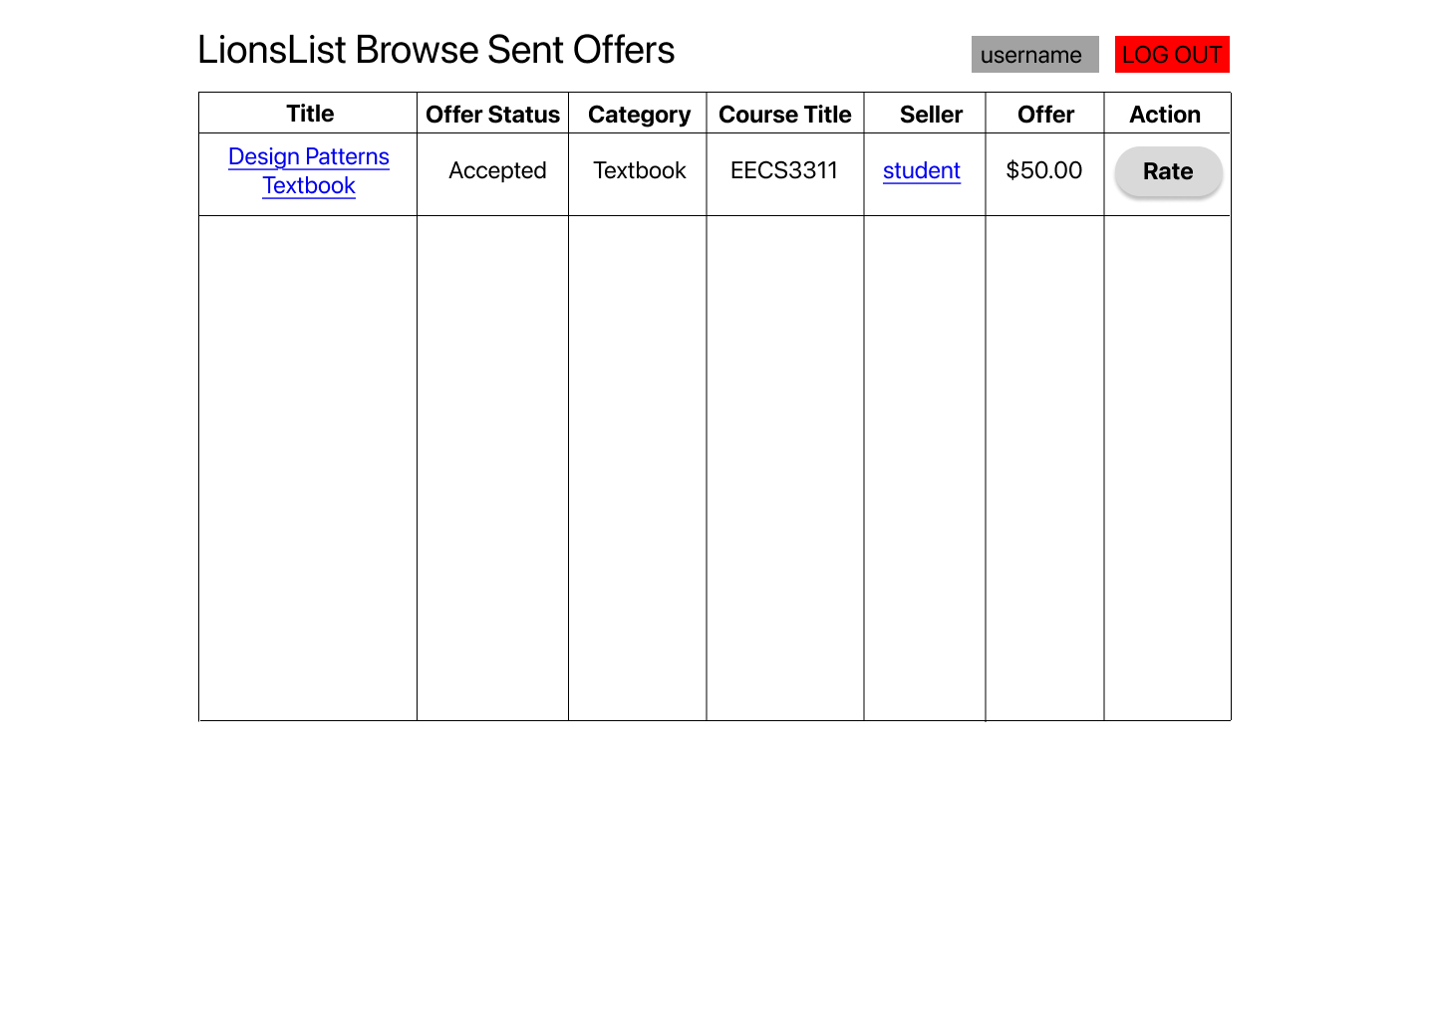
(Buyer can rate after offer is accepted)

Slide 15
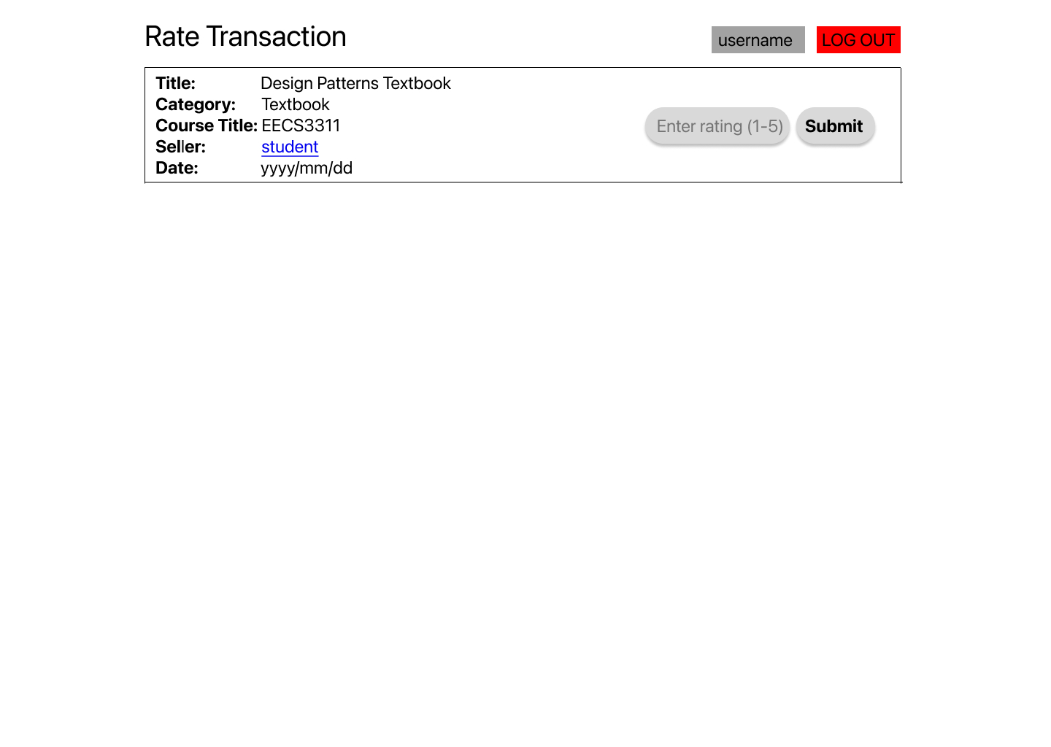

Slide 16
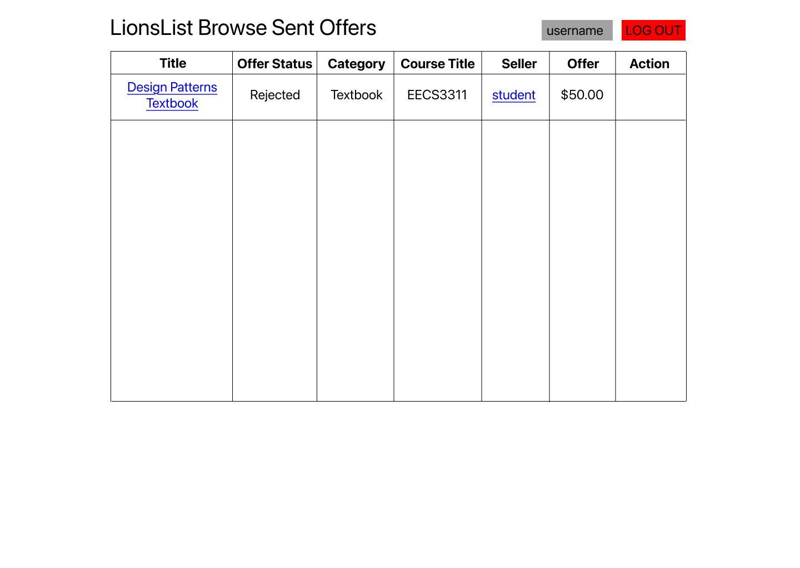
(Buyer cannot rate if offer is rejected)

Slide 17
Seller Scenario

Slide 18
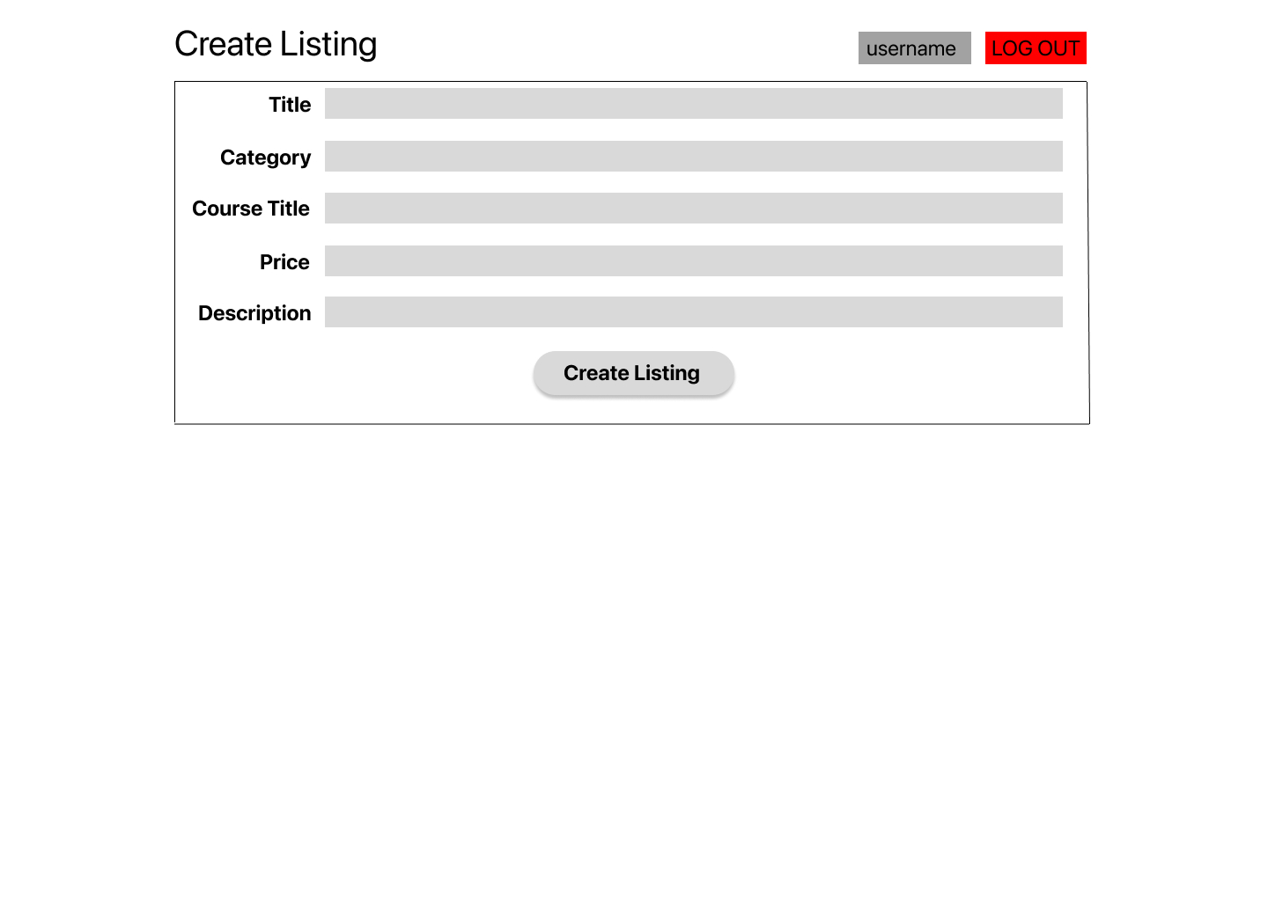
(Listing creation page)

Slide 19
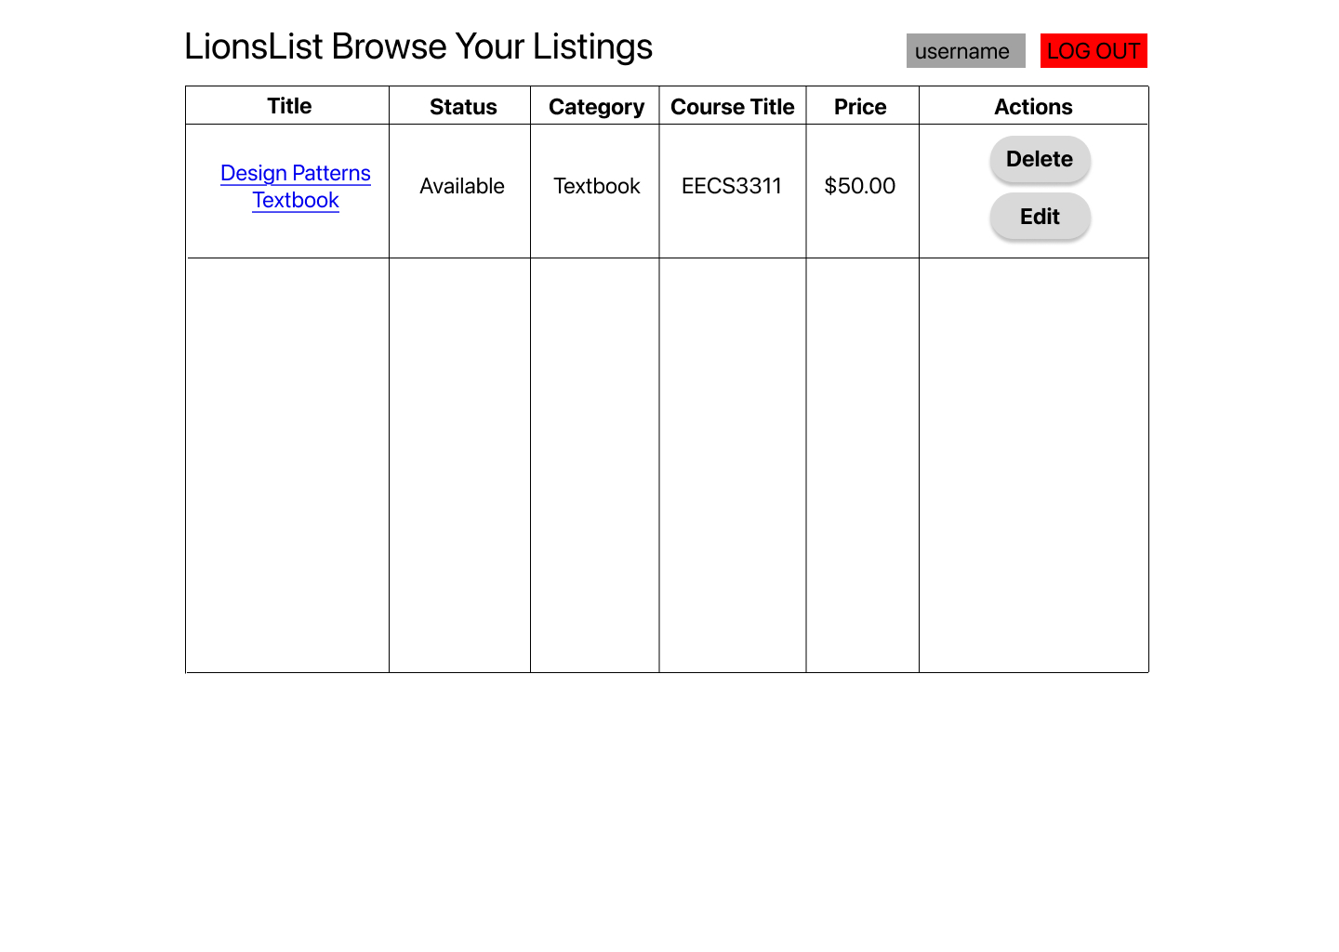
(Sellers can view and modify all of their created listings)

Slide 20
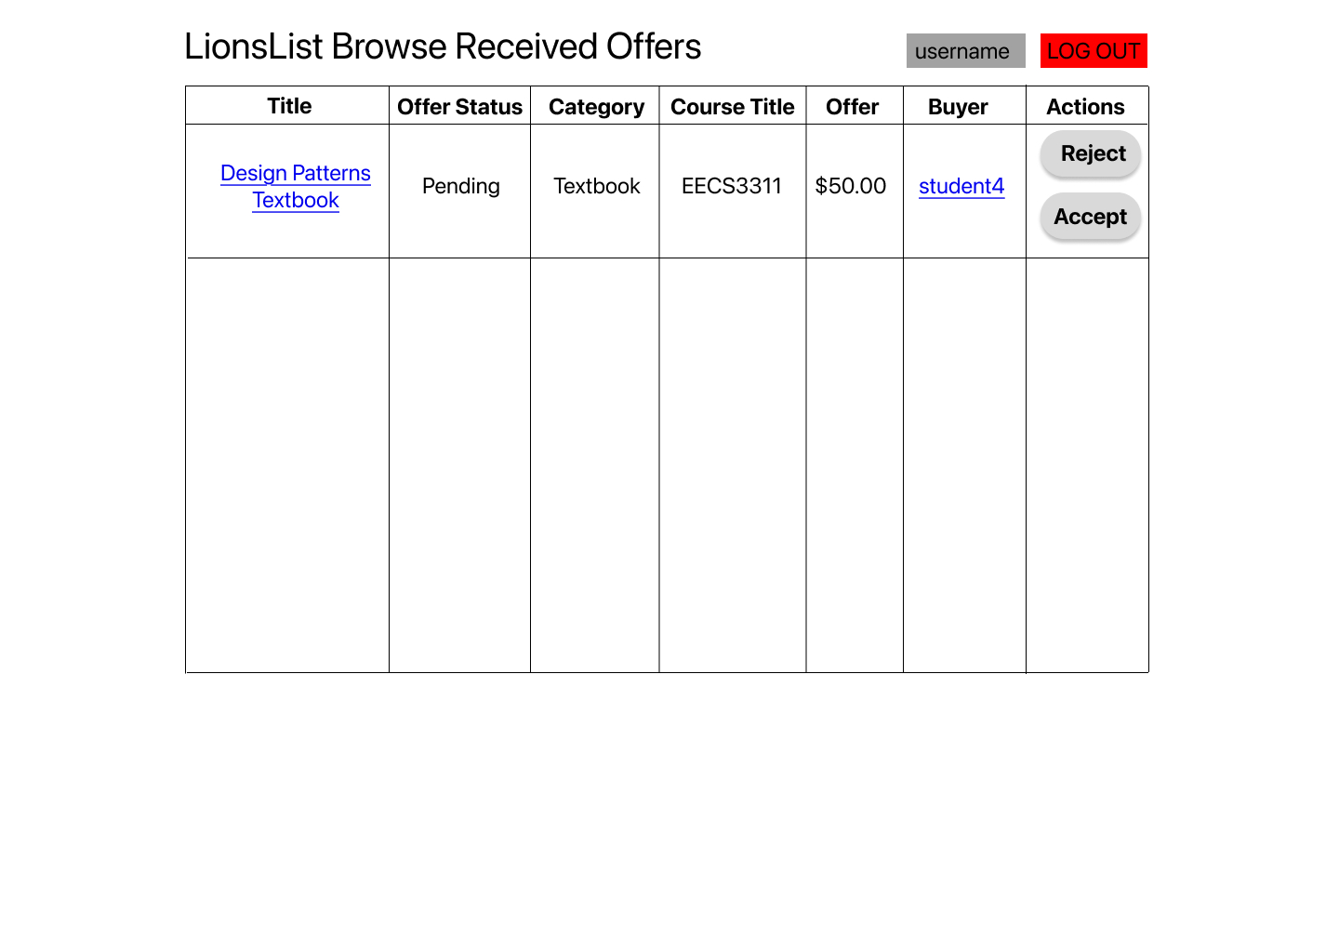
(Sellers can reject or accept any received offers on their listings)

Slide 21
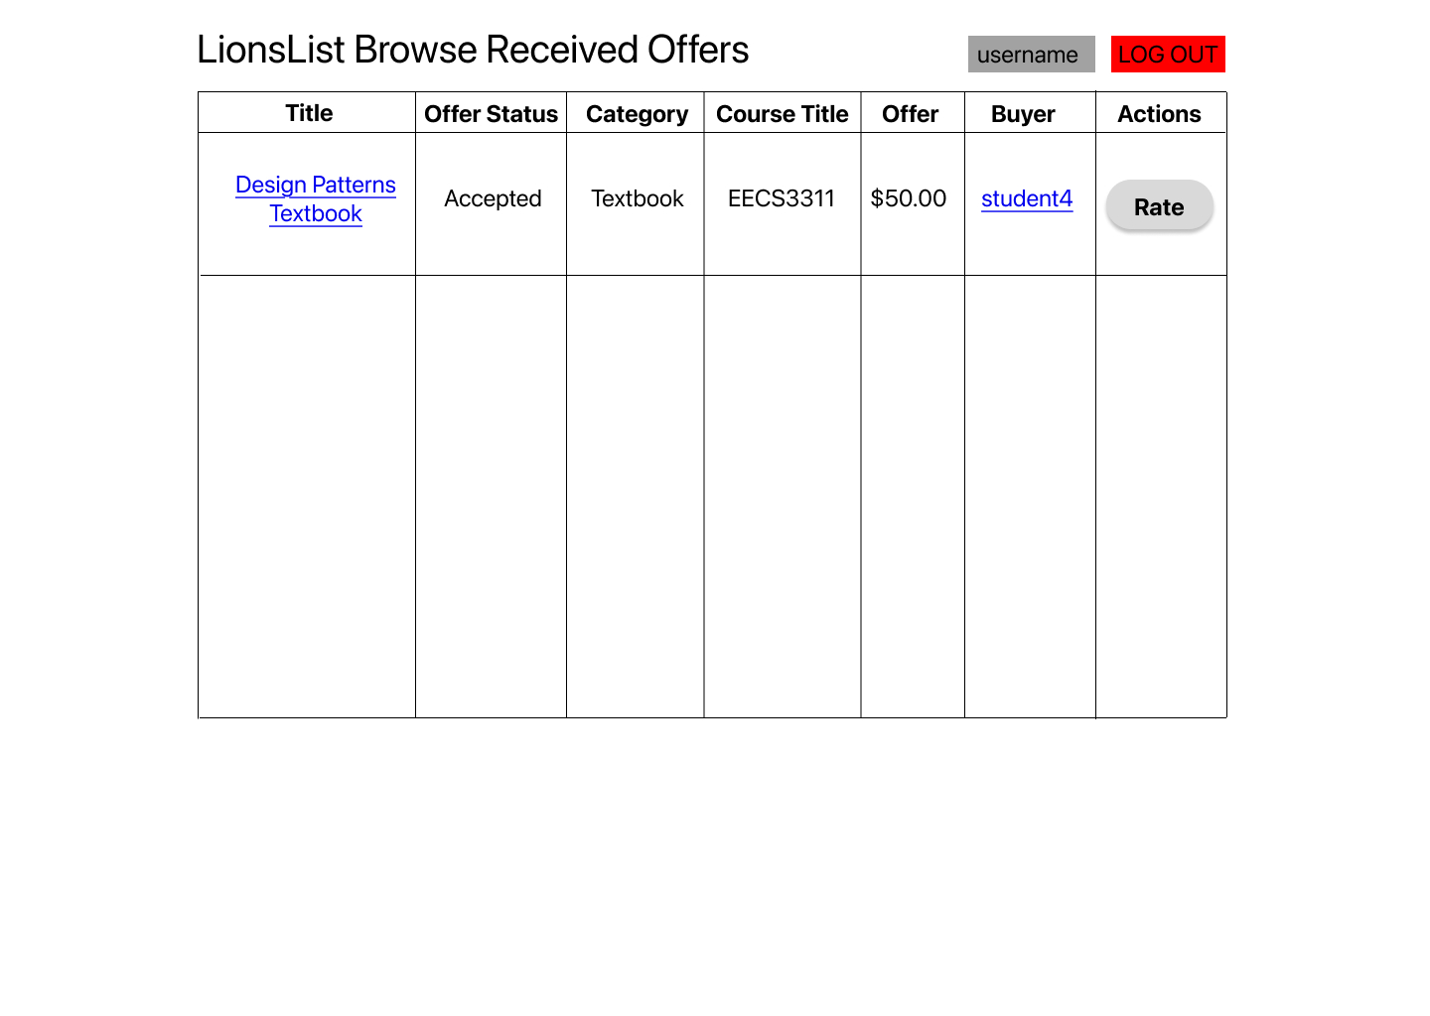
(Sellers can rate buyers after offer is accepted)

Slide 22
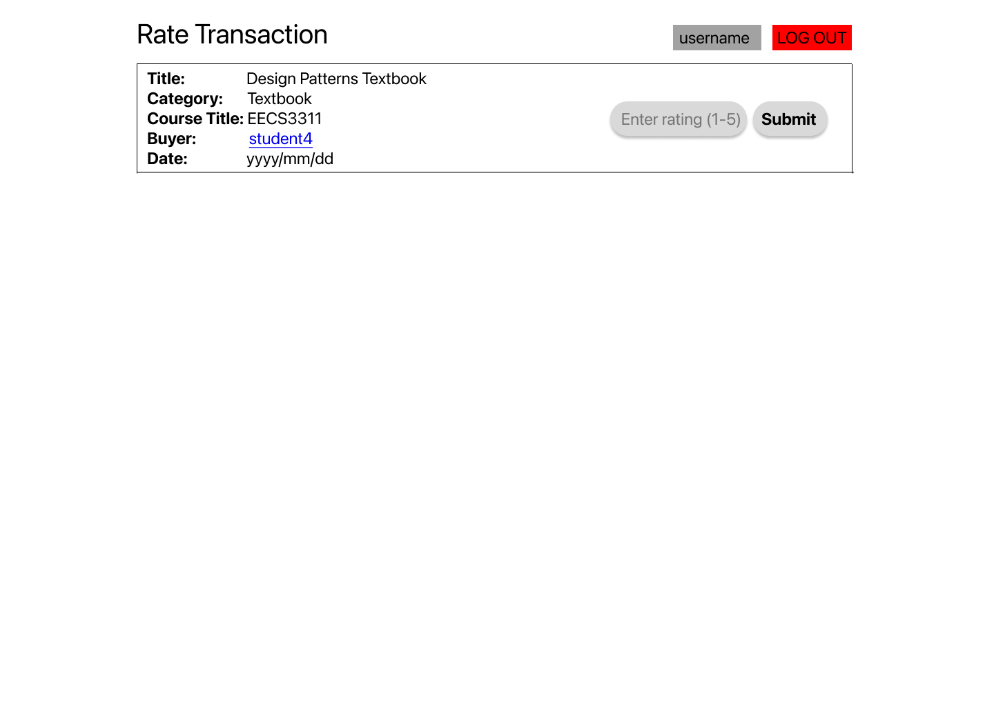

Slide 23
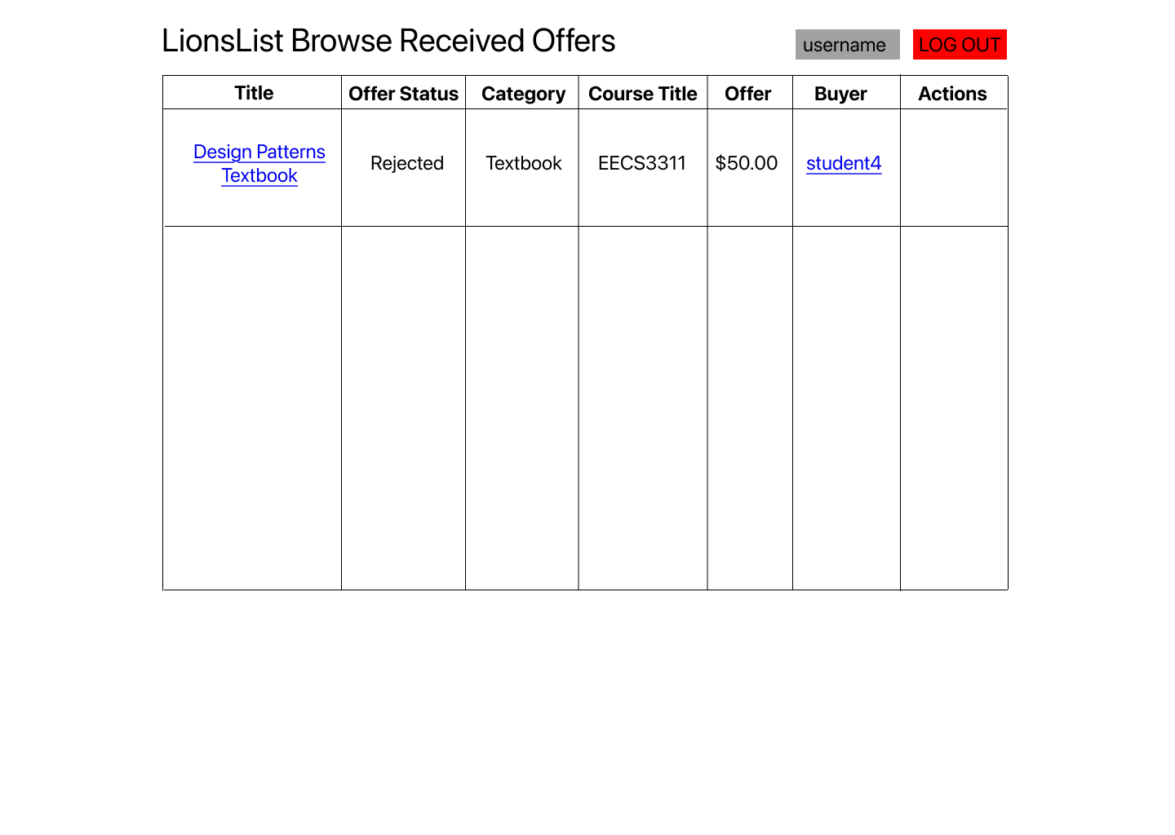
(Sellers cannot rate buyers if offer is rejected)

Slide 24
Messaging Scenario

Slide 25
(Accessing listing message conversation from filtered listings)

Slide 26
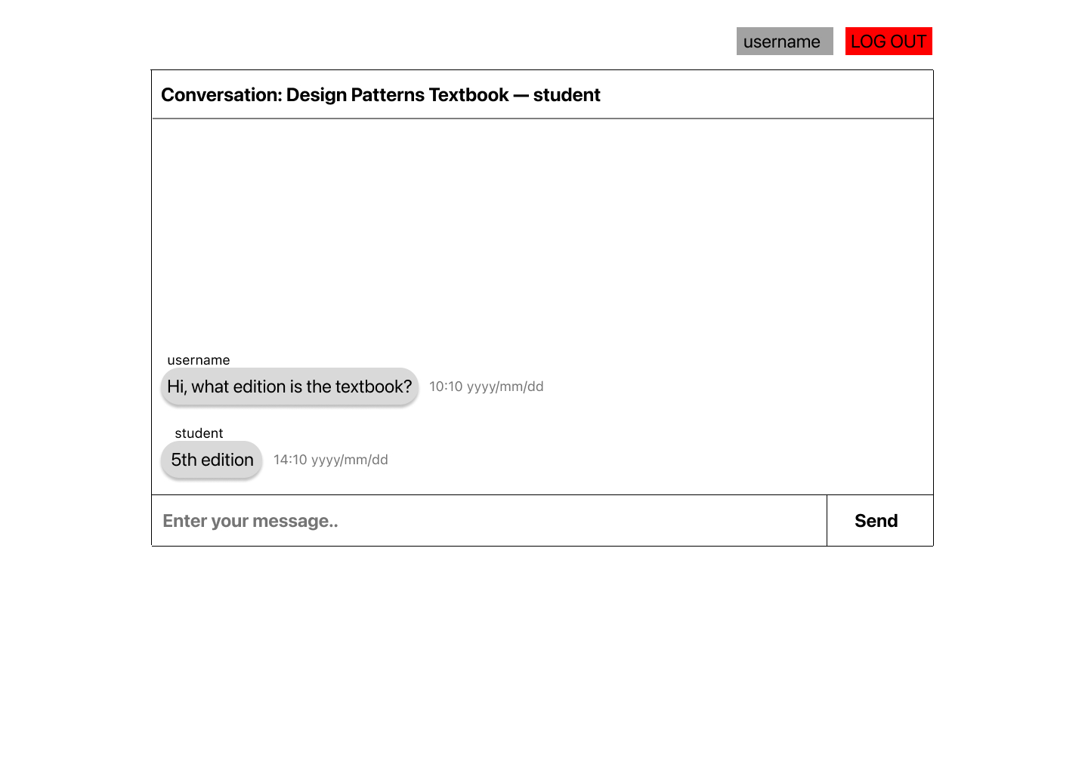

Slide 27
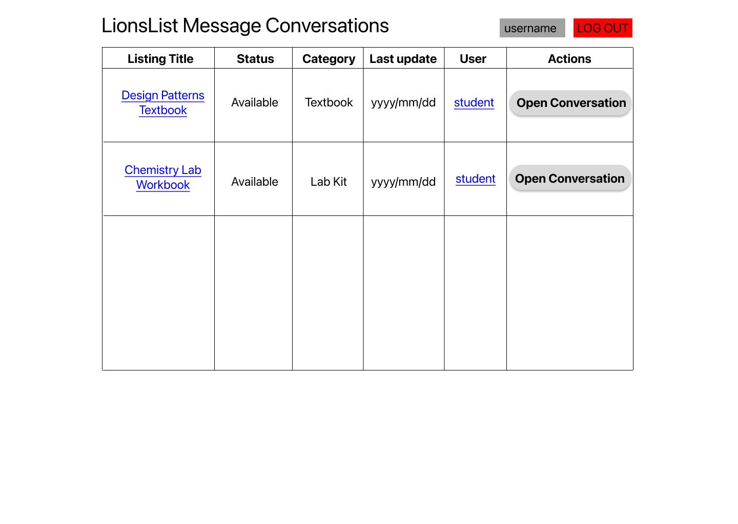
(Inbox where users can see all conversations, both as buyer and seller)

Slide 28
View Profile/Rating Scenario

Slide 29
(Accessing user profile from listing details page)

Slide 30
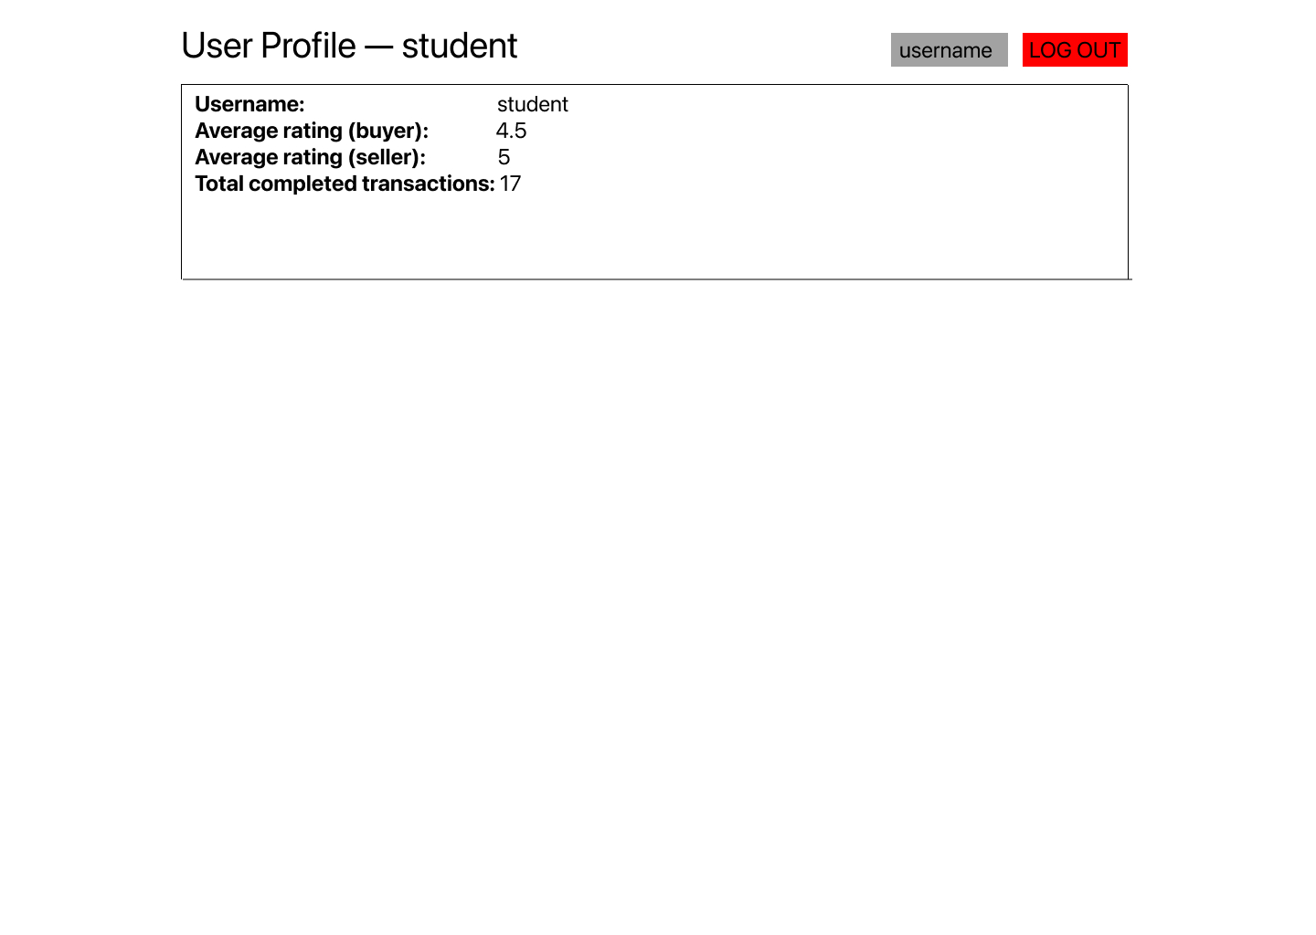
(User profile shows rating and sales information)

