Slide 1
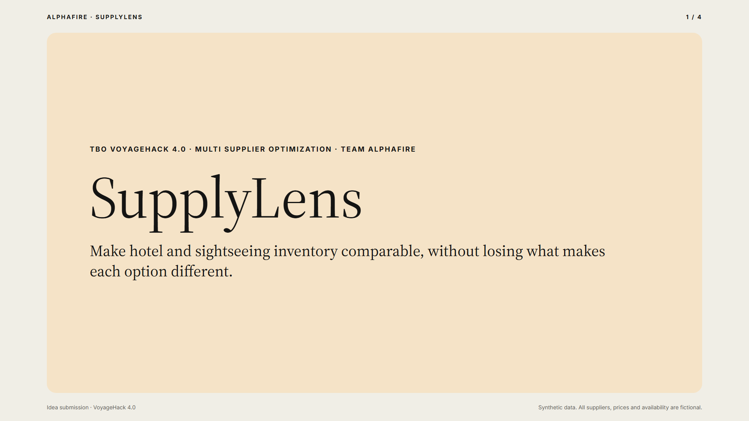
Notes:
Hi, we are Team AlphaFire. Our idea for Multi Supplier Optimization is SupplyLens. It makes hotel and sightseeing inventory from many suppliers comparable, without erasing what makes each option different.

Slide 2
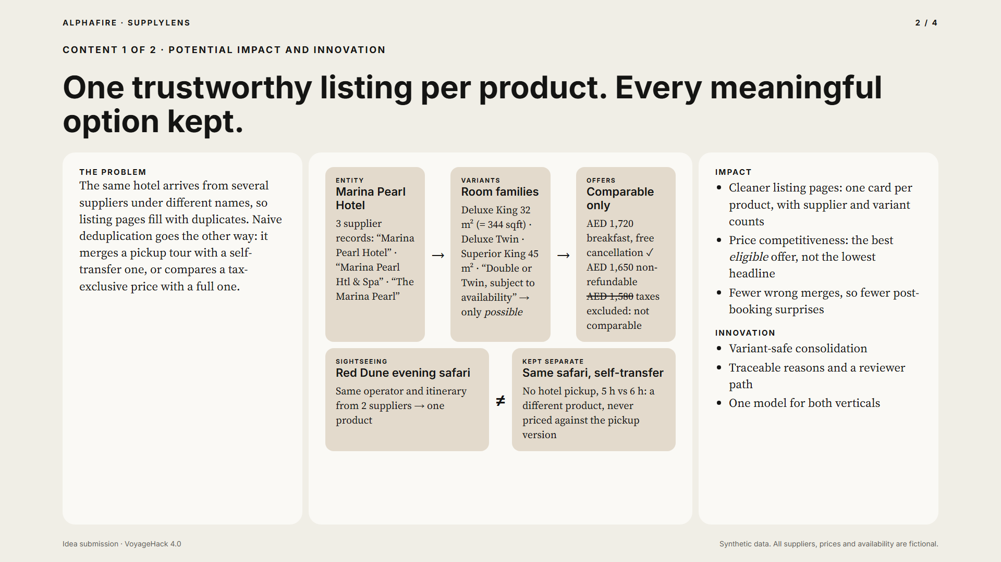
Notes:
Today the same hotel arrives from three suppliers under three names, and the listing page fills with duplicates. But naive deduplication is just as harmful. It merges a tour with hotel pickup into one without pickup, or compares a price without taxes against a full price. SupplyLens separates three things. The entity: the same physical hotel or the same experience. The variants: room families, transfers, meals, access. And the offers: each supplier's price and policy. So one listing per product, with every meaningful option kept. The innovation is variant-safe consolidation, the best eligible offer instead of the lowest headline price, and visible reasons for every decision.

Slide 3
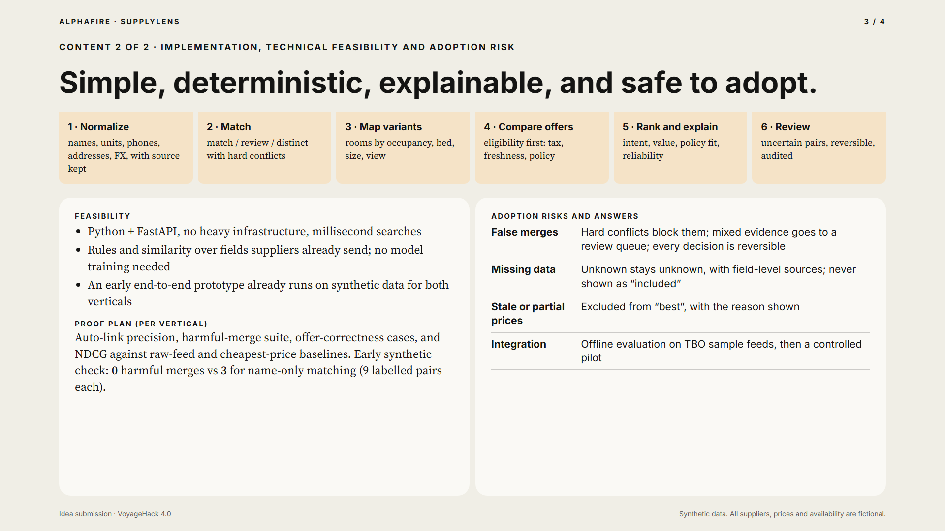
Notes:
Implementation is a deterministic pipeline. Normalize names, units and currencies, keeping the source of every field. Match records into match, review, or distinct, where hard conflicts like a different street number, a missing pickup, or premium access block a merge. Map room variants by occupancy, bed, size and view. Compare only eligible offers, with complete prices, fresh availability, and the required policy. Then rank for the traveller's intent and explain why. It runs on Python and FastAPI with no heavy infrastructure, and an early prototype already works end to end on synthetic data. For adoption, false merges go to a reversible review queue, missing data stays visibly unknown, and stale prices can never win. We will prove it per vertical with precision, harmful-merge tests and ranking baselines. In an early synthetic check, name-only matching made three harmful merges per vertical. SupplyLens made zero.

Slide 4
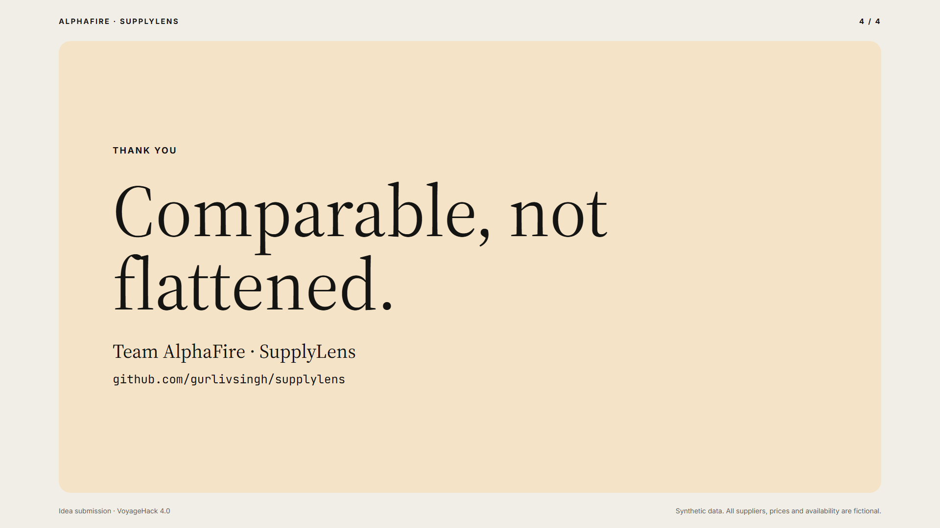
Notes:
SupplyLens. Comparable, not flattened. Thank you.

