Slide 1
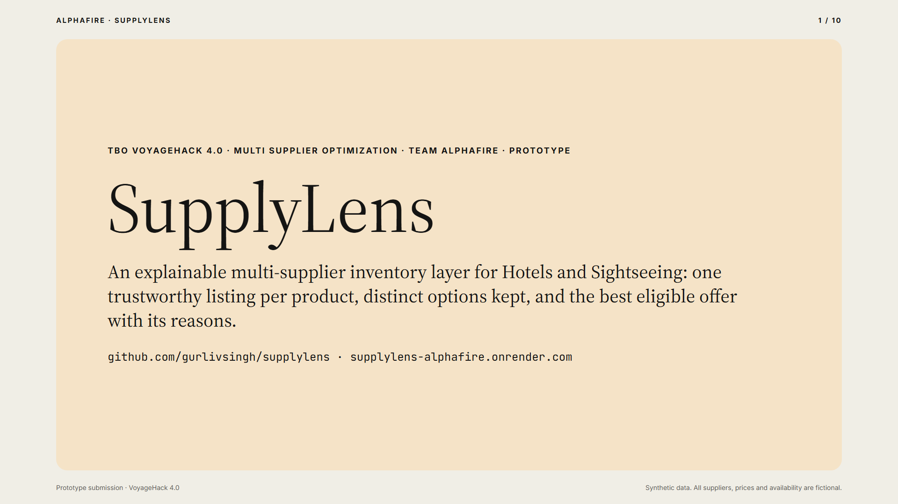
Notes:
This is SupplyLens, by Team AlphaFire, for Multi Supplier Optimization. It is an explainable inventory layer for hotels and sightseeing. It gives one trustworthy listing per product, keeps distinct options, and recommends the best eligible offer with its reasons.

Slide 2
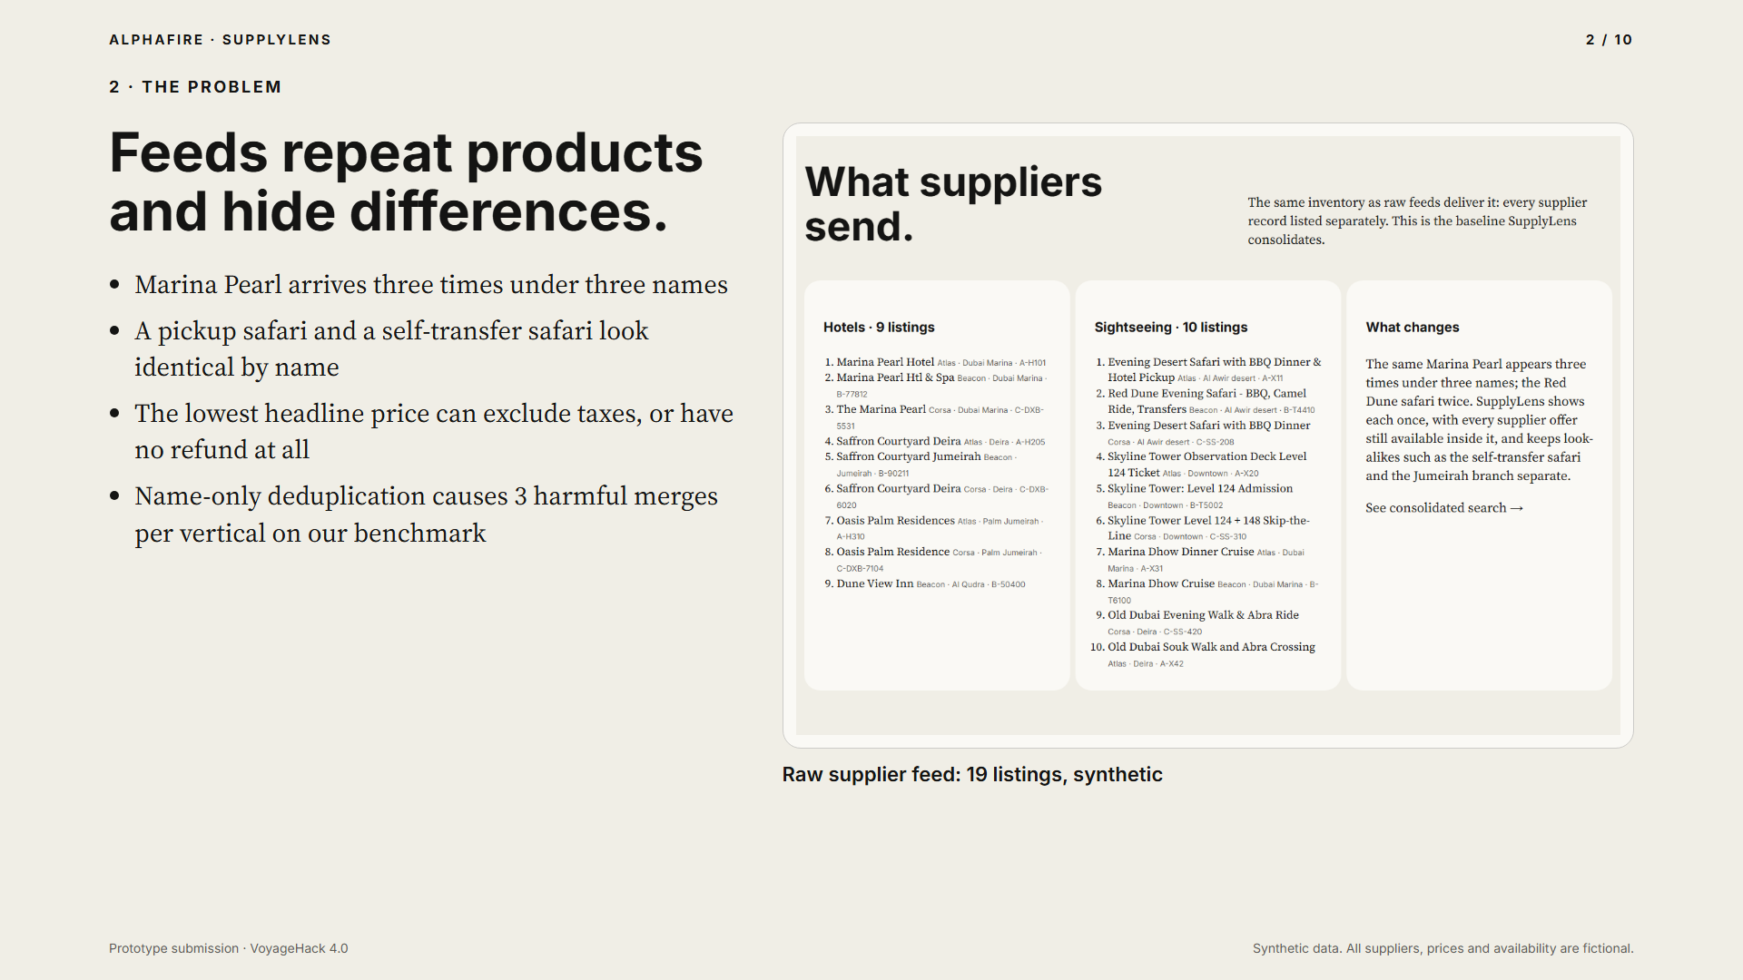
Notes:
Supplier feeds repeat the same product and hide the differences that matter. Here, the same hotel arrives three times under three names. A safari with hotel pickup and one without look identical by name. And the cheapest headline price may exclude taxes or have no refund at all.

Slide 3
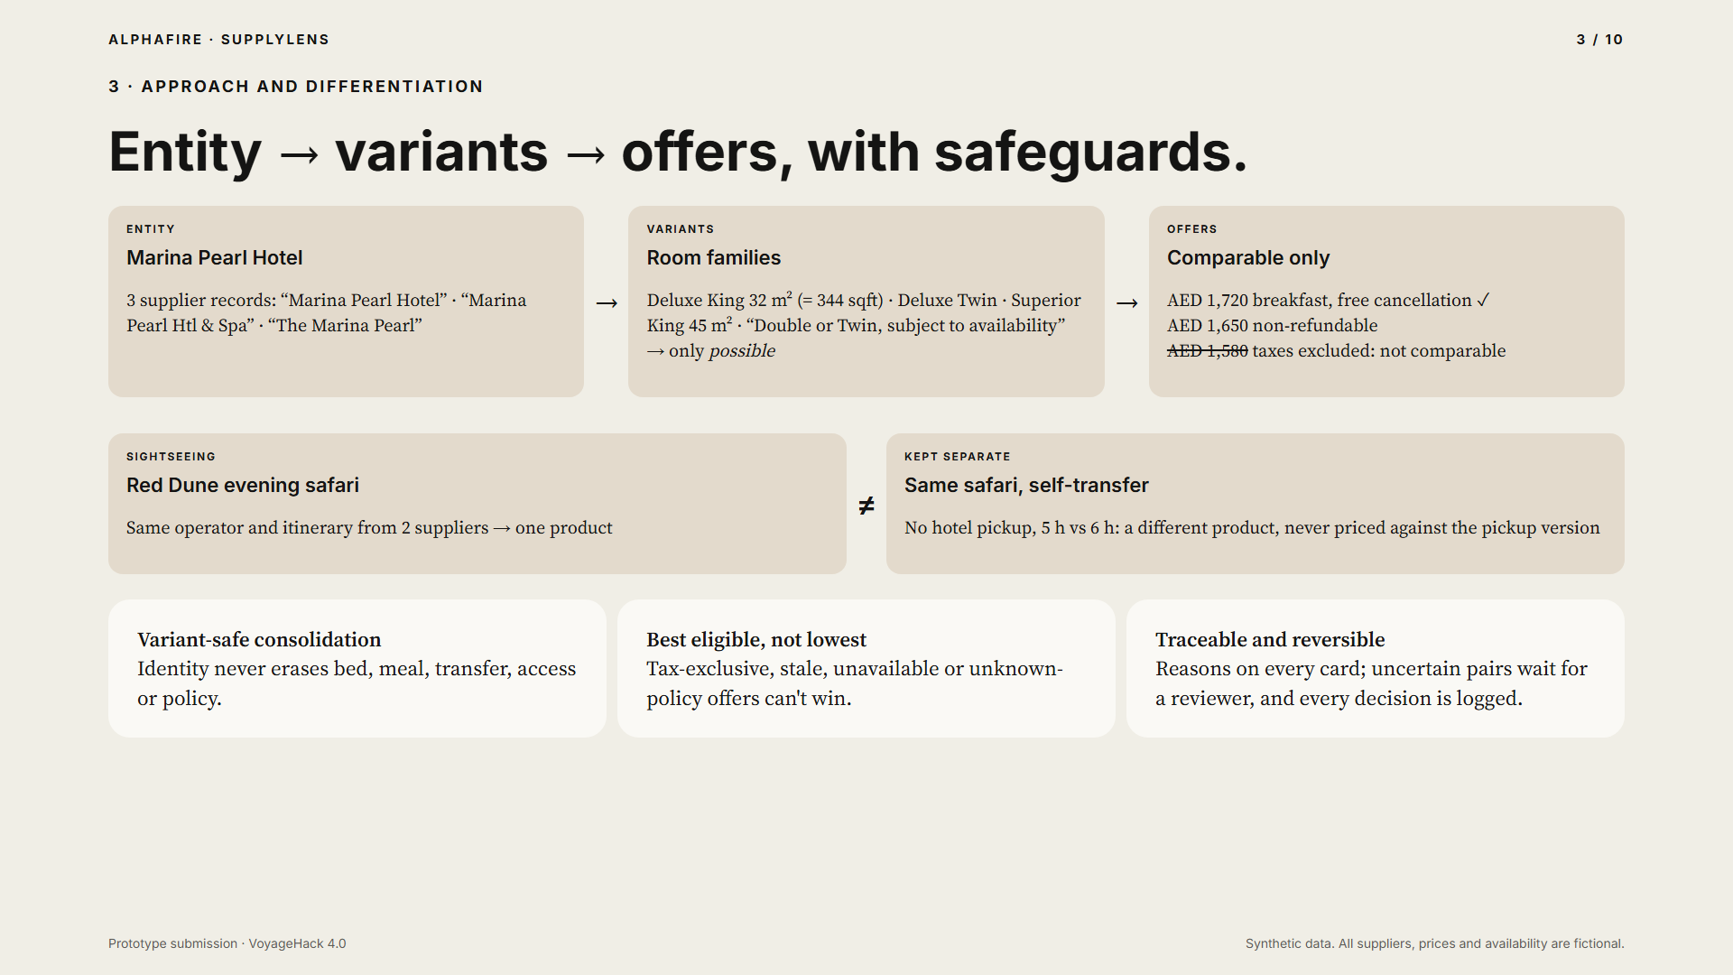
Notes:
Our approach separates three decisions. Identity: is it the same product. Equivalence: are these room or activity variants interchangeable. And recommendation: which eligible offer is best for this traveller. Identity never erases bed, meal, transfer, access or policy differences.

Slide 4
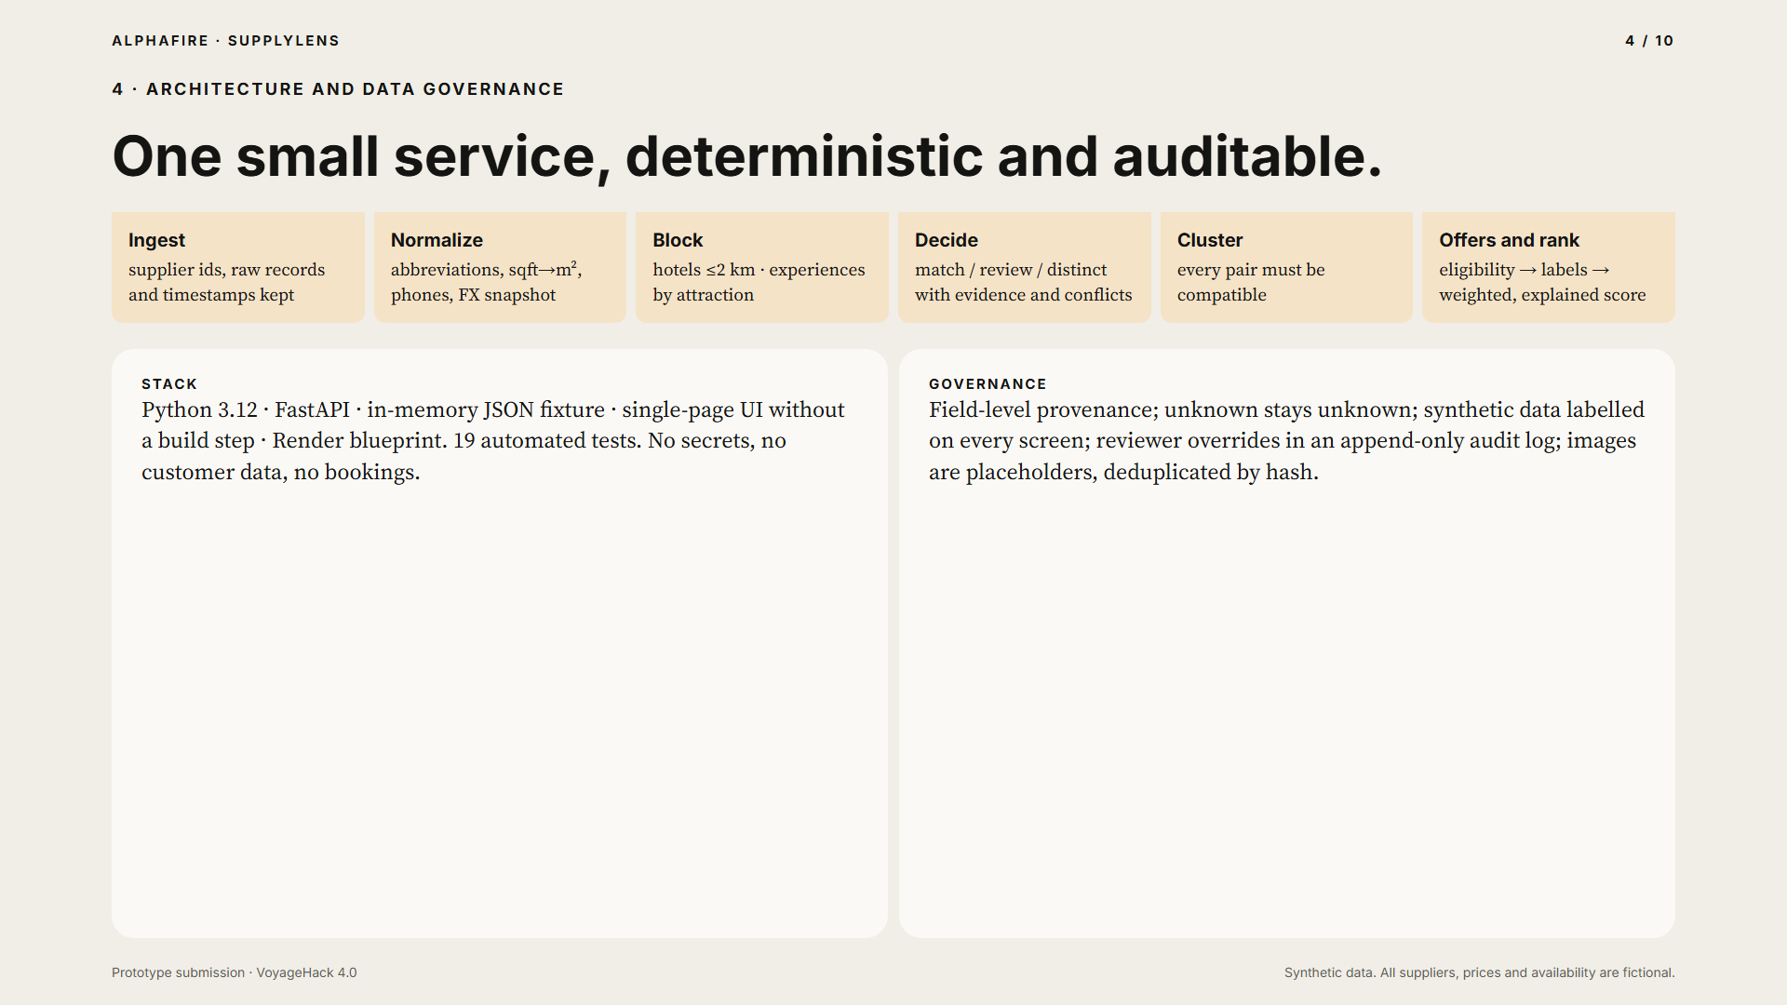
Notes:
Architecture is one small FastAPI service. Records are normalized, blocked into candidates, and decided as match, review or distinct, with evidence and conflicts. A cluster only grows if every pair is compatible. Offers are checked for eligibility before any score. Everything is deterministic, sourced, and auditable.

Slide 5
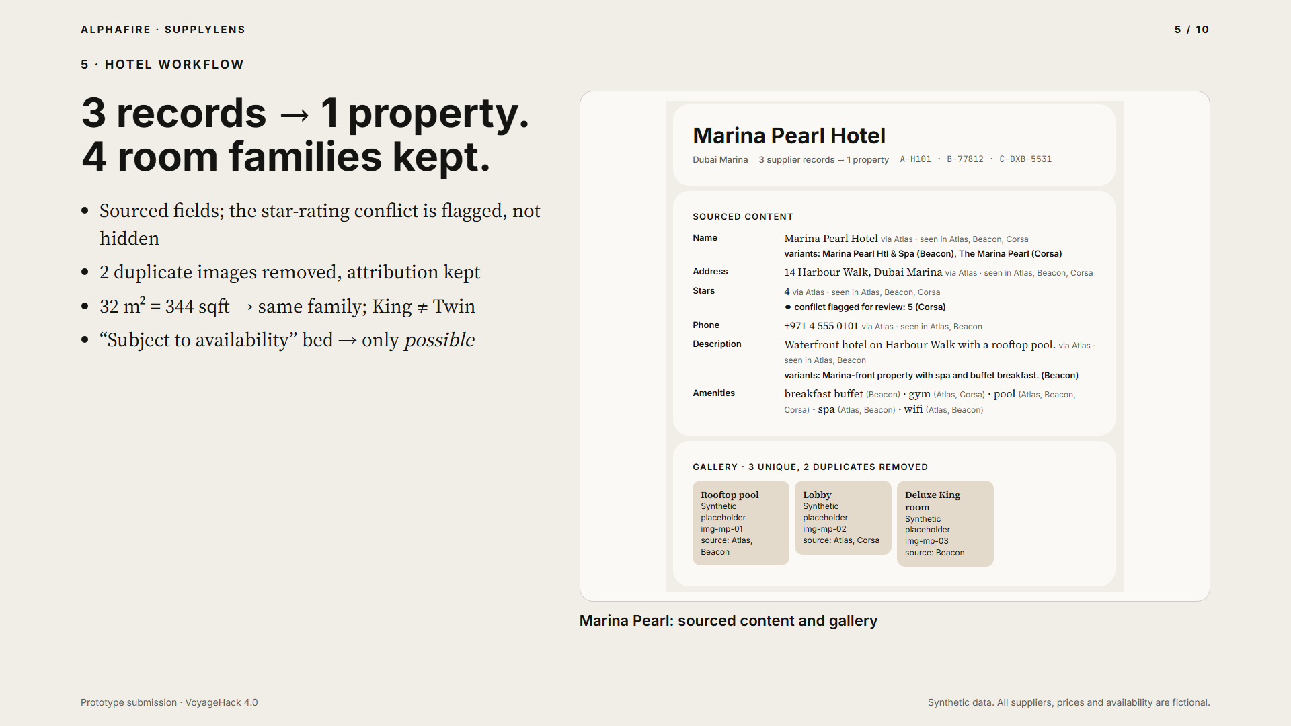
Notes:
For hotels, three supplier records become one property. Every field shows which supplier it came from, and the star rating conflict is flagged rather than hidden. Duplicate images are removed with attribution kept. Room sizes in square feet and square metres are normalized, so the King rooms match, while Twin stays separate, and a bed that is subject to availability is only a possible match.

Slide 6
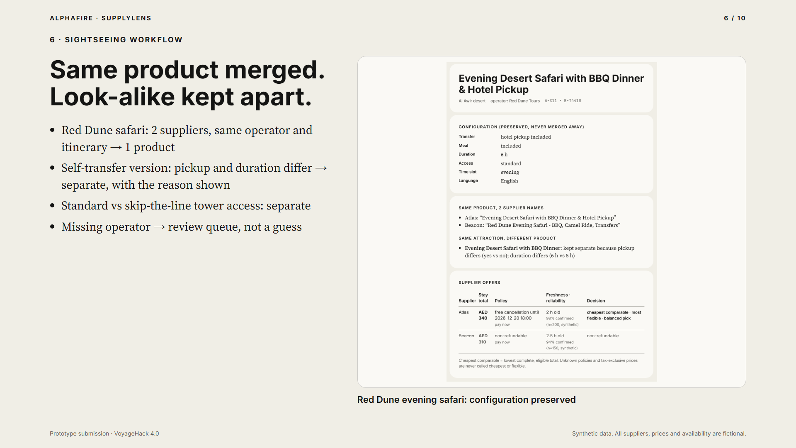
Notes:
For sightseeing, the Red Dune safari from two suppliers becomes one product. The self-transfer version from the same operator stays separate, because pickup and duration differ, and the screen says why. Standard and skip-the-line access stay separate too, and a record with a missing operator goes to review instead of being guessed.

Slide 7
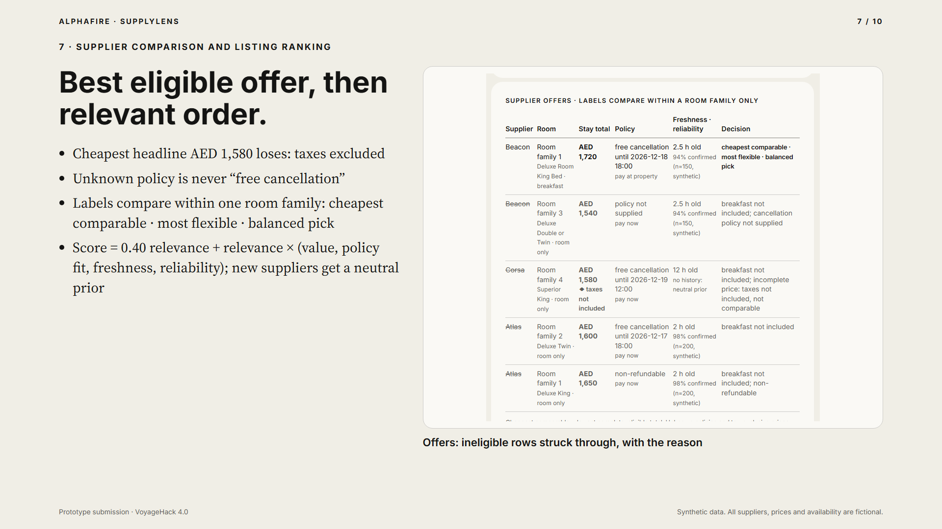
Notes:
Offers are compared only when they are comparable. The cheapest headline price loses here because taxes are excluded, and an unknown policy is never shown as free cancellation. Listings are ranked with a documented score where relevance comes first, so a cheap but off-intent result cannot win. A new supplier gets a neutral prior, not a penalty.

Slide 8
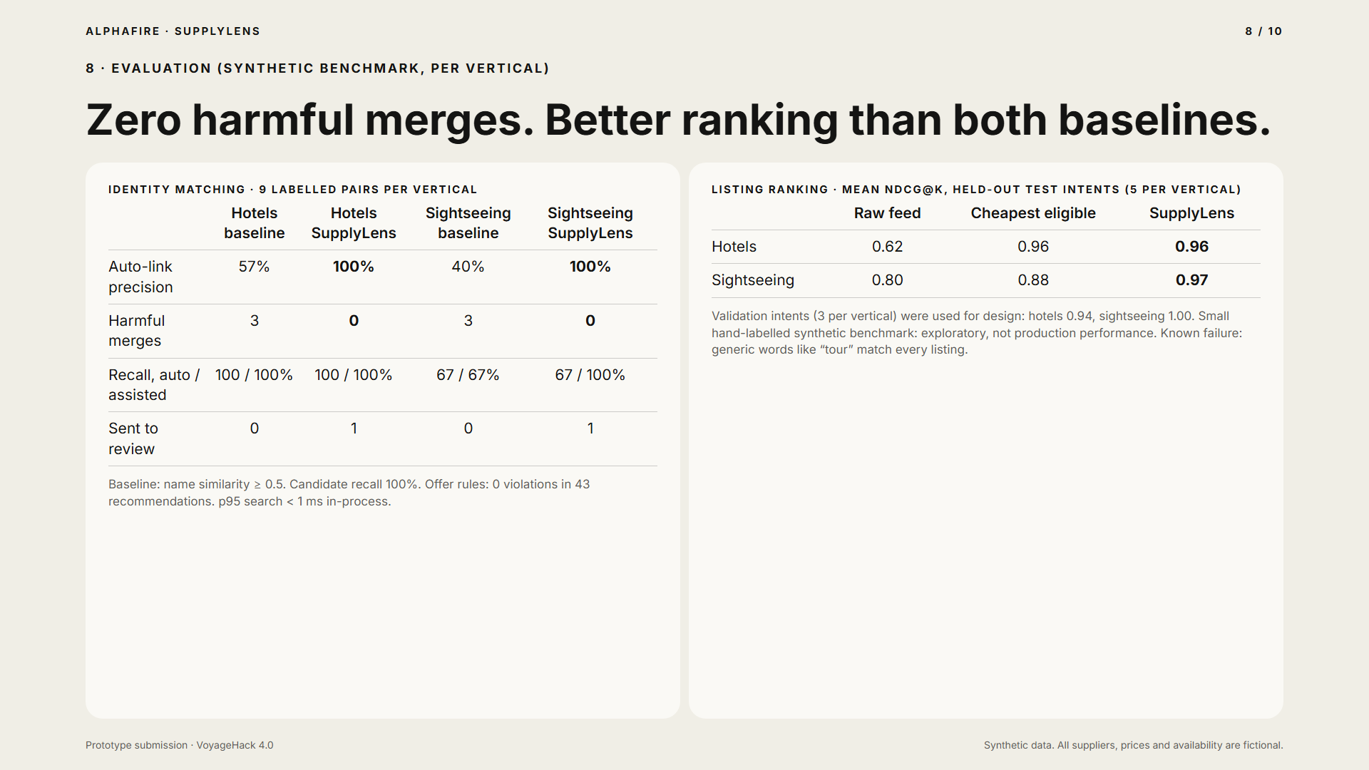
Notes:
We measured it on a small, hand-labelled synthetic benchmark, separately per vertical. Name-only matching made three harmful merges in each vertical. SupplyLens made zero, with one uncertain pair per vertical sent to review. On held-out ranking intents, SupplyLens matched or beat both the raw feed and the cheapest-price baseline. These samples are small, so we treat them as exploratory, and we report the failures too.

Slide 9
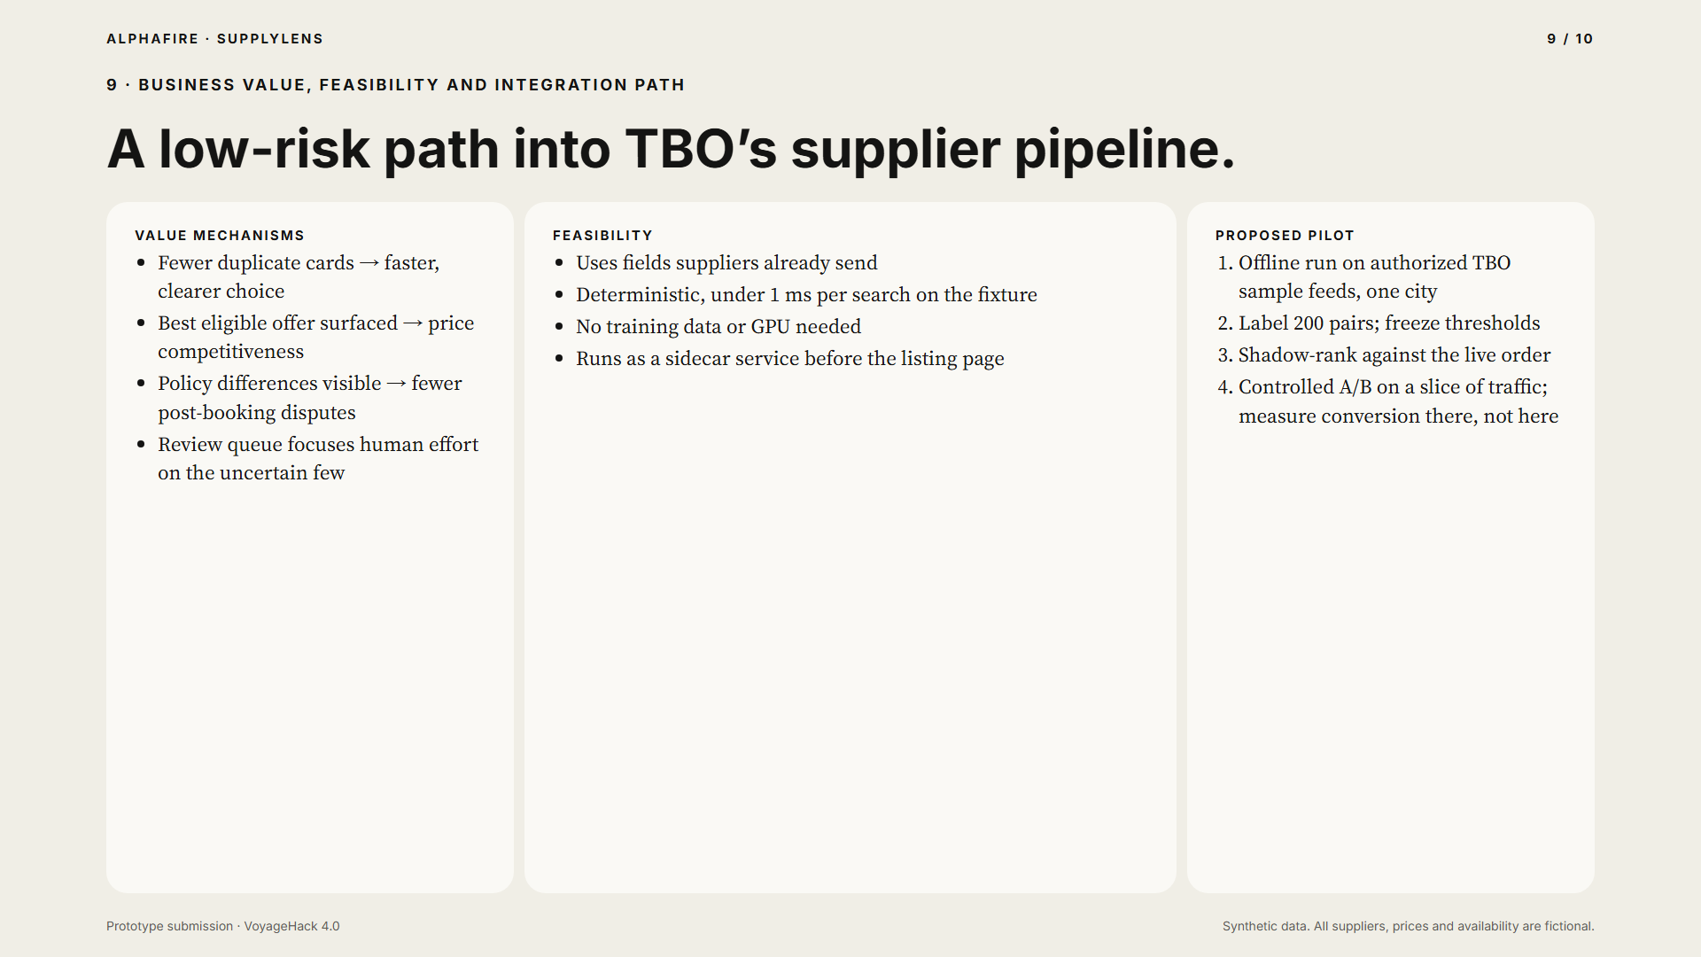
Notes:
The business value comes from clear mechanisms. Fewer duplicate cards, the best eligible offer surfaced, and policy differences made visible. It uses fields suppliers already send, needs no training data, and can run as a sidecar before the listing page. We propose a pilot: an offline run on authorized TBO feeds for one city, then shadow ranking, then a controlled test where conversion is actually measured.

Slide 10
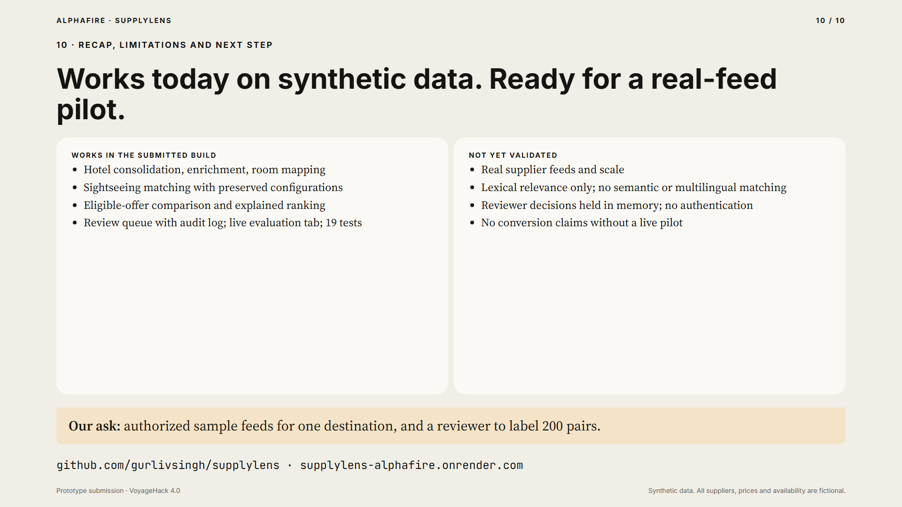
Notes:
To recap. Hotel consolidation, room mapping, sightseeing matching, eligible-offer comparison, explained ranking and a review queue all work today, on synthetic data. Real feeds, scale and semantic matching are not yet validated, and we make no conversion claims. Our ask is authorized sample feeds for one destination, so we can run the pilot. Thank you.

