Slide 1
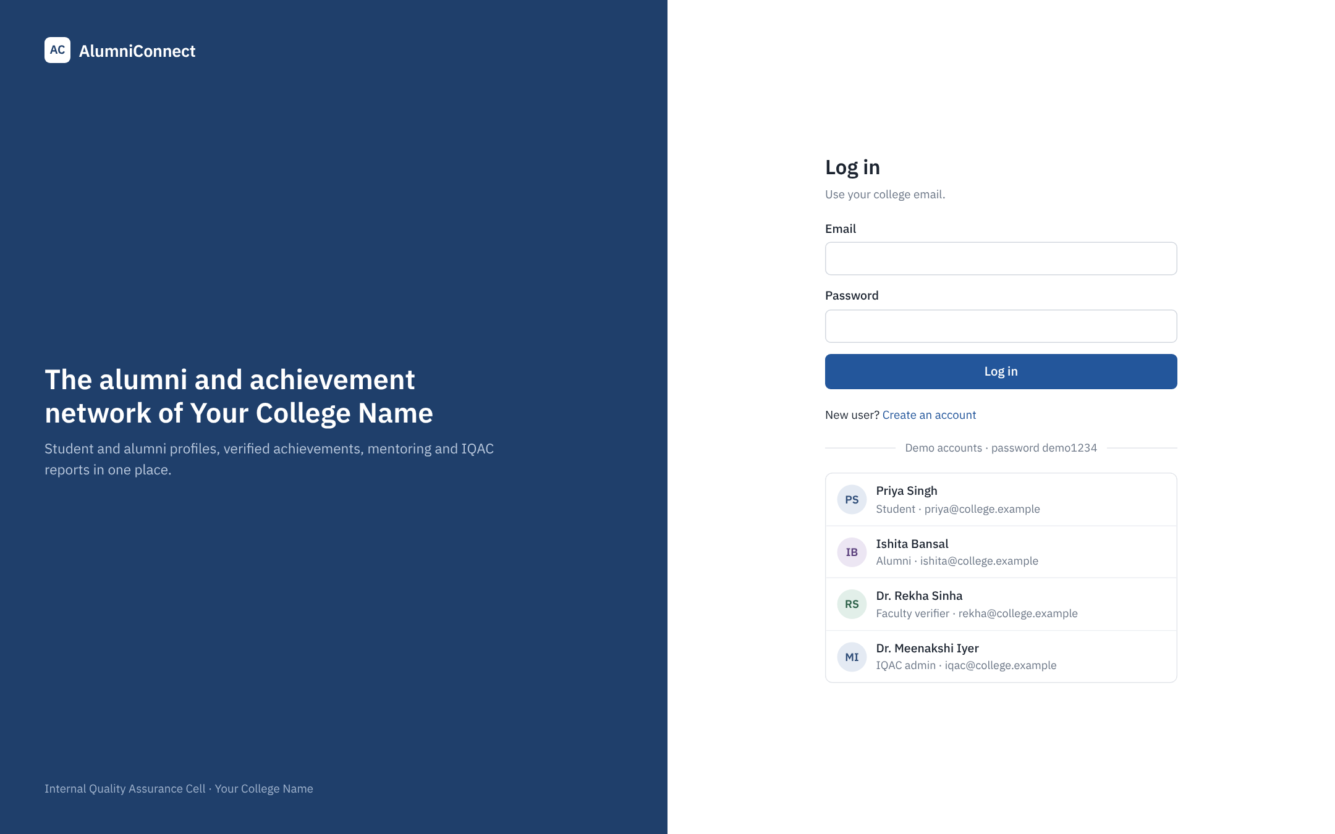
AlumniConnect
A verified alumni, achievement and placement network for Your College Name
Prepared for the IQAC
Live demo: alumniconnect-cpva.onrender.com
Notes:
AlumniConnect brings students, alumni, faculty and the IQAC onto one platform where every achievement is verified by the college.

Slide 2
How alumni data is handled today
30,000+
Every year
No link
alumni files exist only on paper, with nothing stored online
IQAC collects NAAC and NIRF data by hand from forms and email
between current students and the seniors who could guide them
Achievements are self-reported, so nobody can rely on them.
Placement and higher-studies figures are counted manually for each report.
Graduates drop out of contact once they leave.

Slide 3

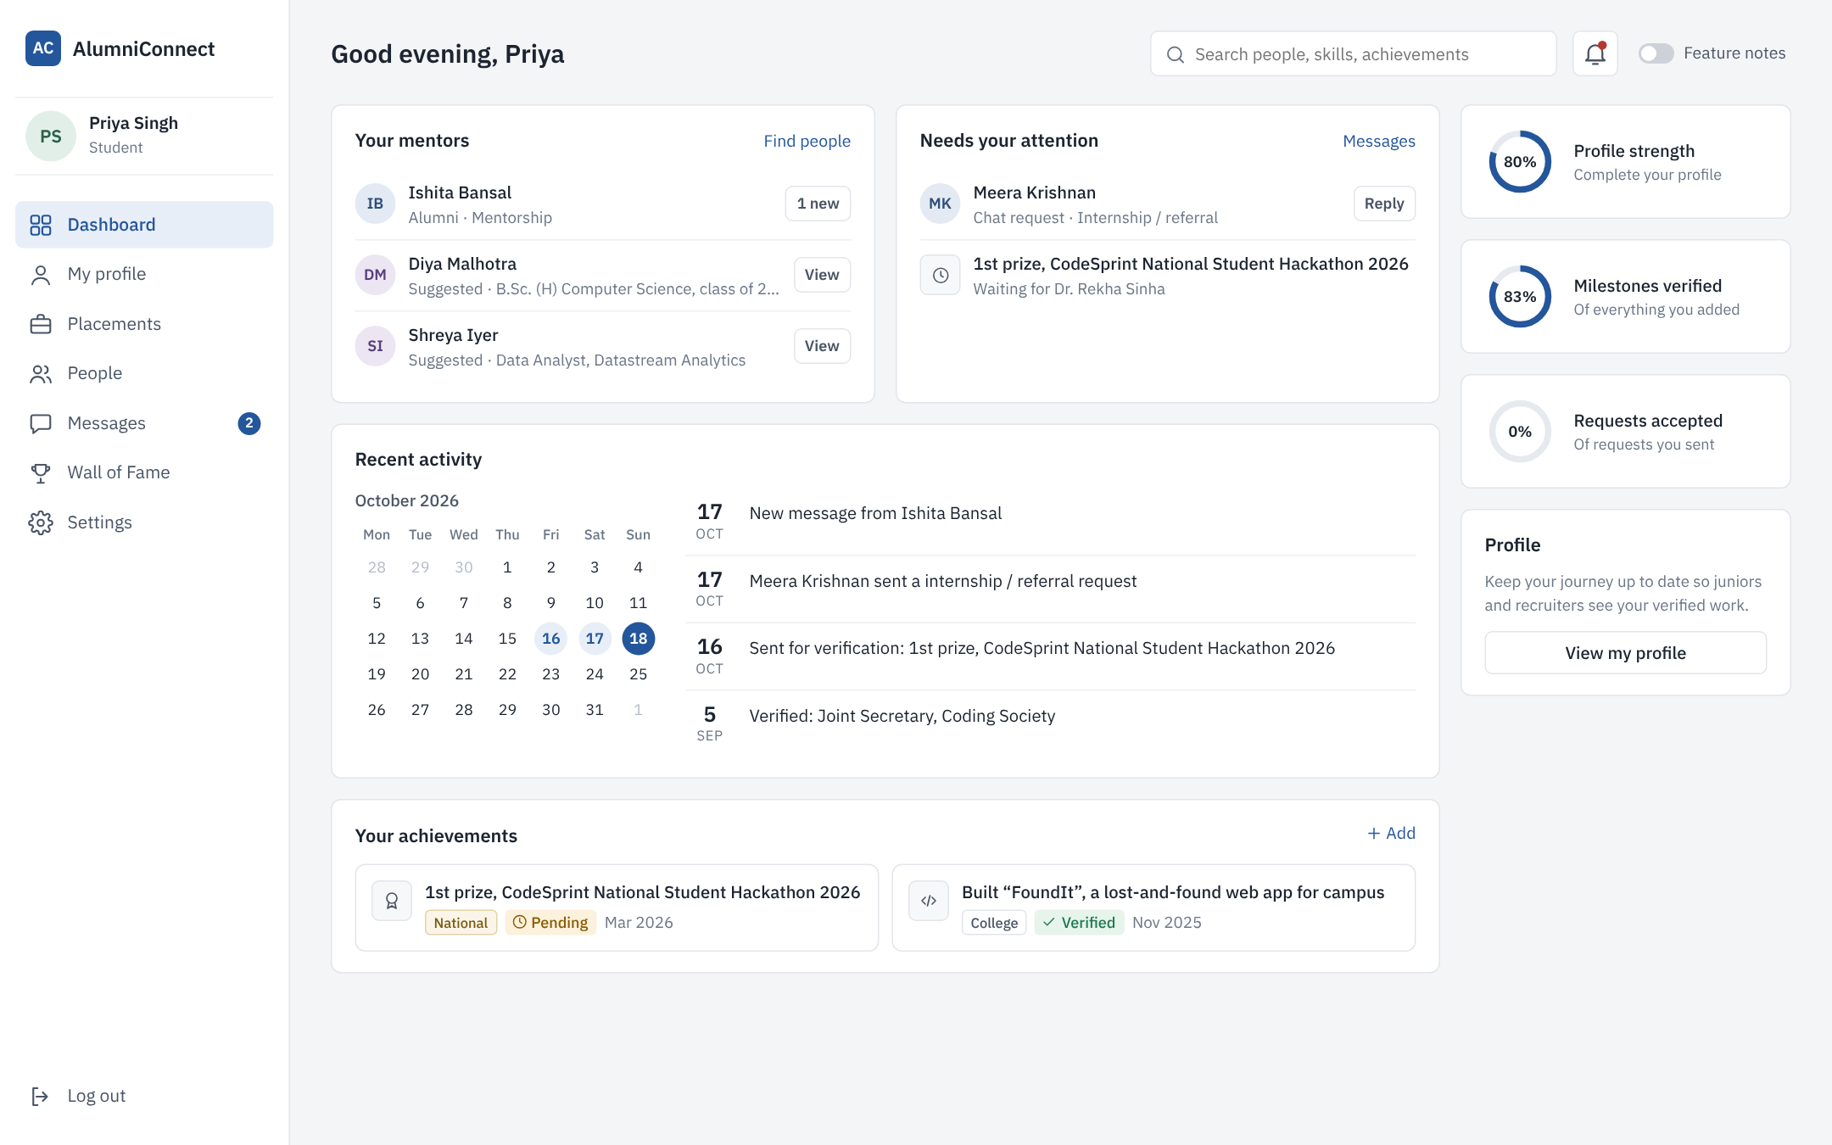



One platform, four kinds of users
Students
Build a verified profile from 1st year and find seniors who took the path they want.
Alumni
Keep their status current, mentor juniors, and fill the alumni form online.
Faculty
Approve achievements in one click with the proof in front of them.
IQAC
Digitize old records and get placement, NAAC and NIRF numbers instantly.
Student dashboard: mentors, things waiting, activity and progress

Slide 4
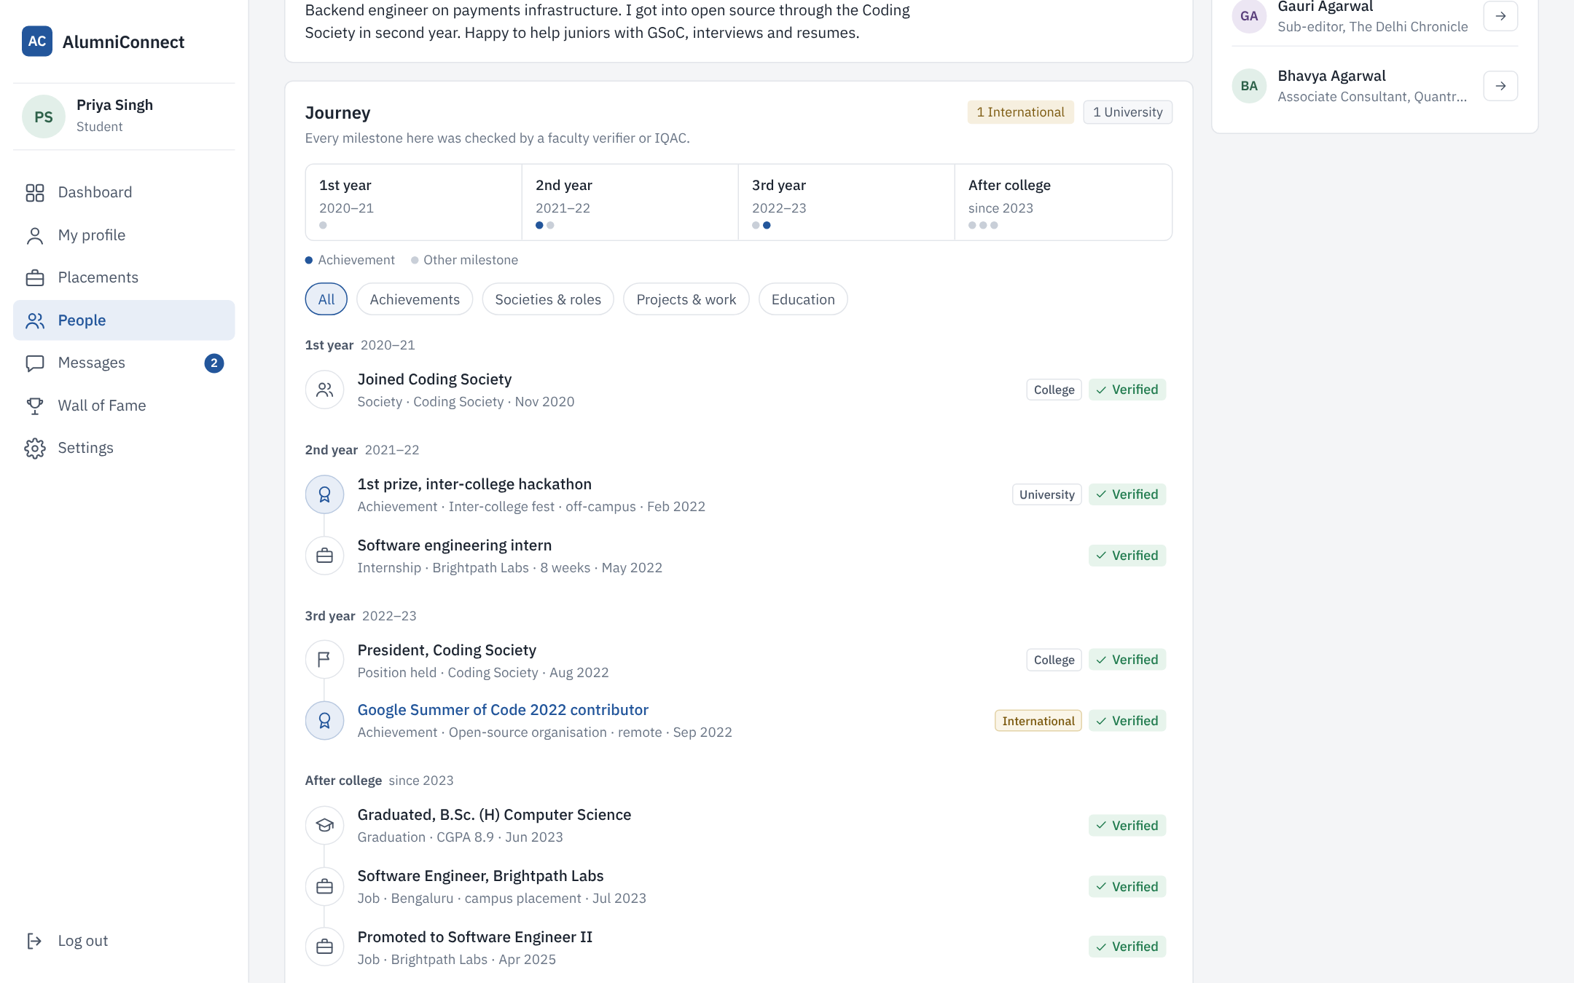



Profiles that show a verified journey
Year by year
Societies, roles, internships and achievements laid out from 1st year to career.
Verified by the college
Each milestone shows who verified it and when. Others see only verified items.
One shareable link
A profile students can put on a resume instead of self-claimed lines.
An alumna’s profile as a student sees it (sample data)

Slide 5
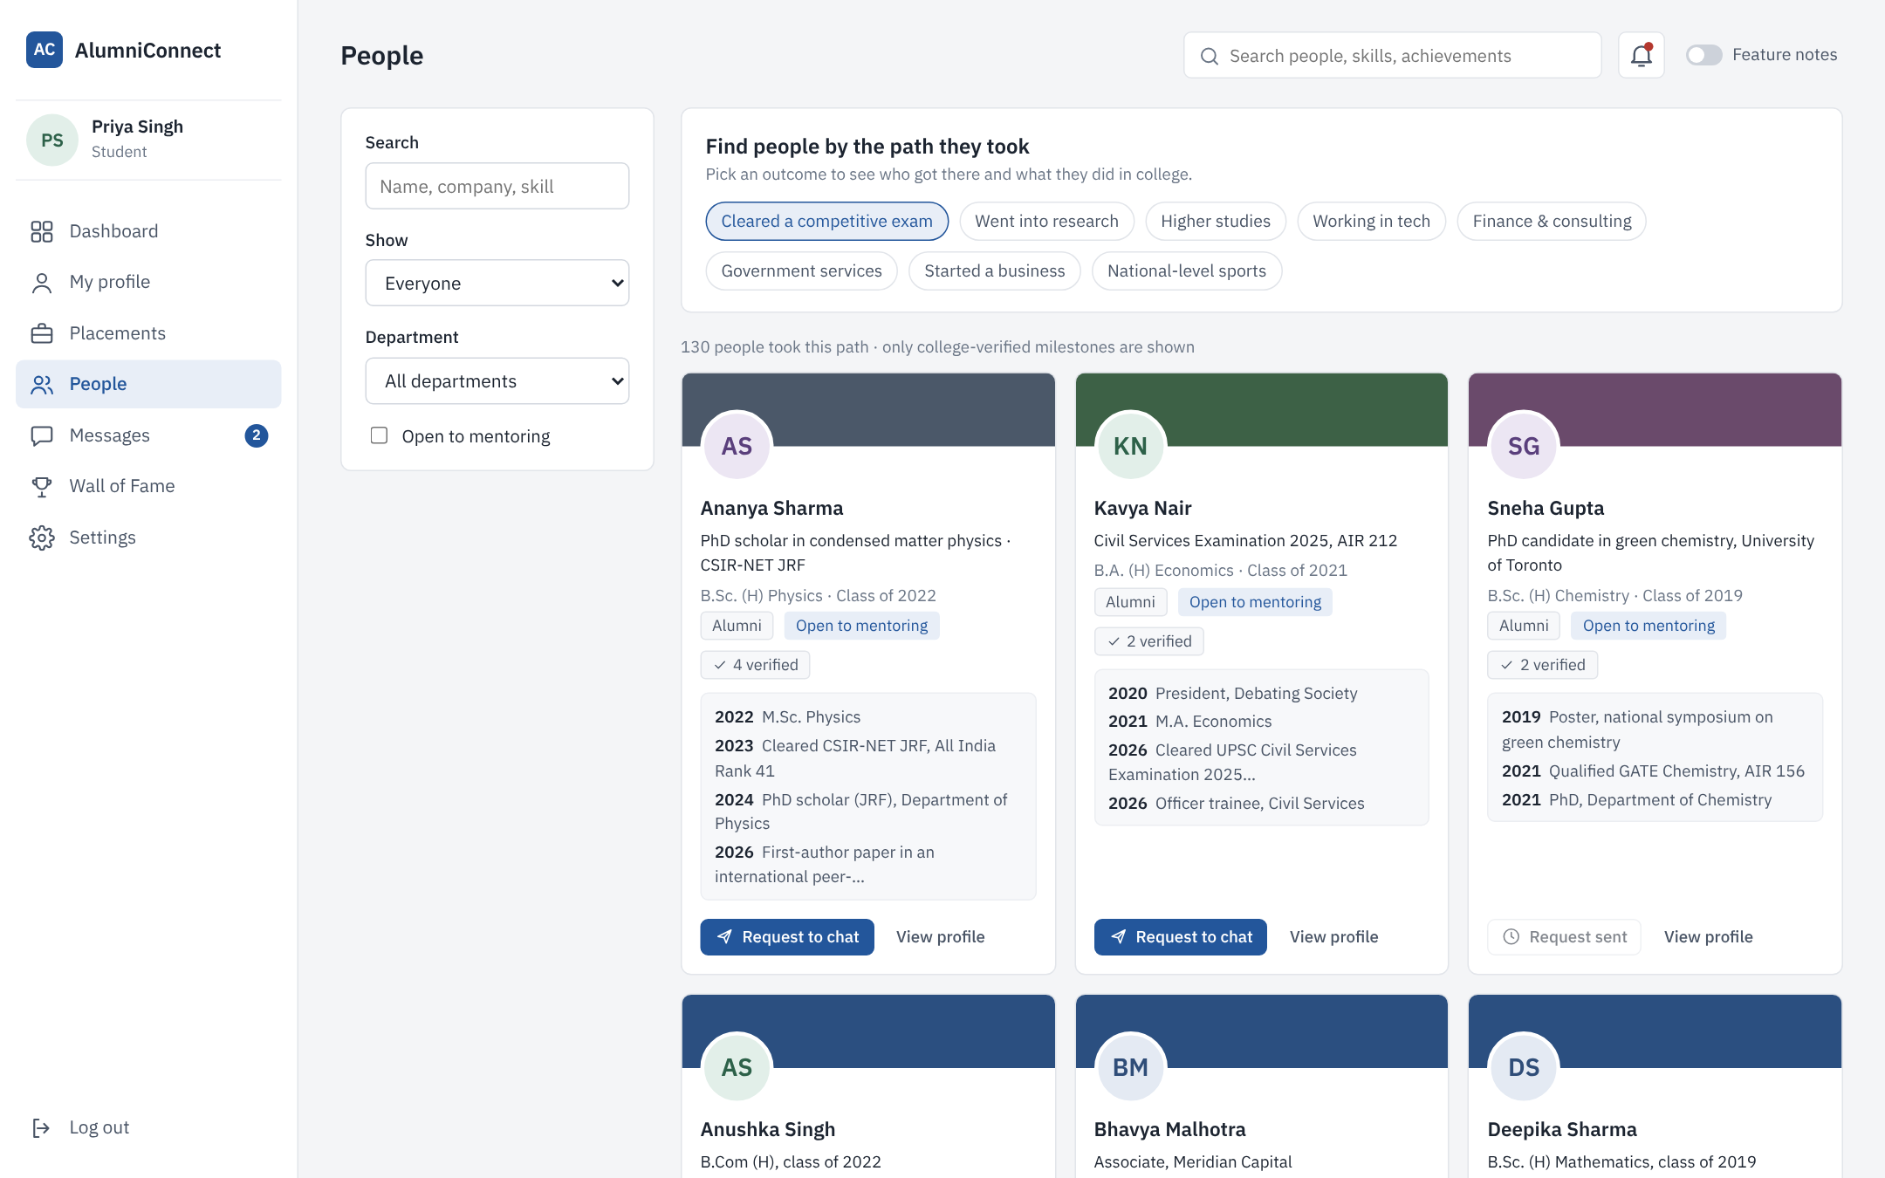


Find seniors by the path they took
Search by outcome
Cleared a competitive exam, went into research, working in tech, started a business.
See how they got there
Each result shows the milestones that led to the outcome.
Filters
Department, alumni or students, and who is open to mentoring.
People who cleared a competitive exam (sample data)

Slide 6
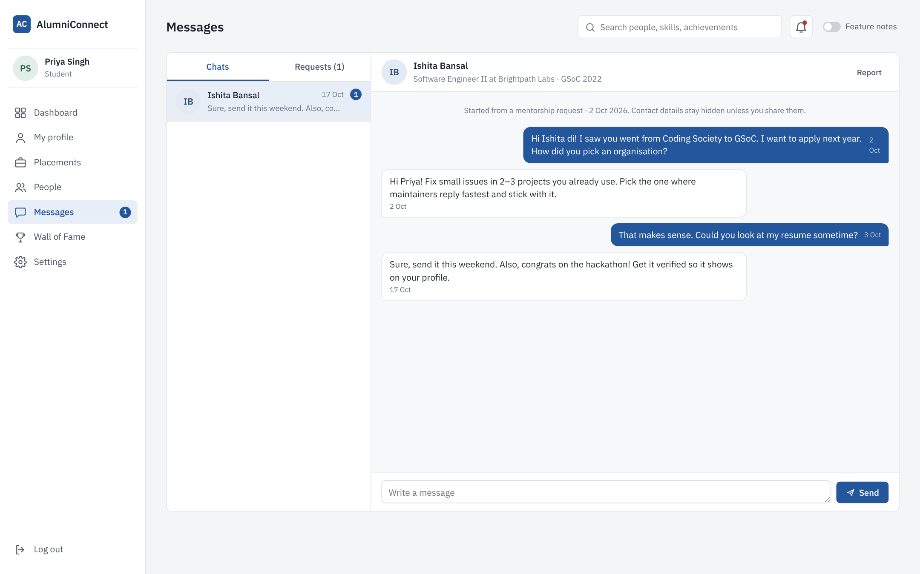


Mentoring chat that starts with a request
Request first
A student sends a short note and a purpose. The chat opens only if the senior accepts.
Private by default
Phone numbers and emails are never shown. Anyone can turn requests off or report a user.
Counts as engagement
Accepted requests feed the NAAC alumni engagement report.
Students, alumni and faculty can chat. The IQAC admin account cannot.

Slide 7
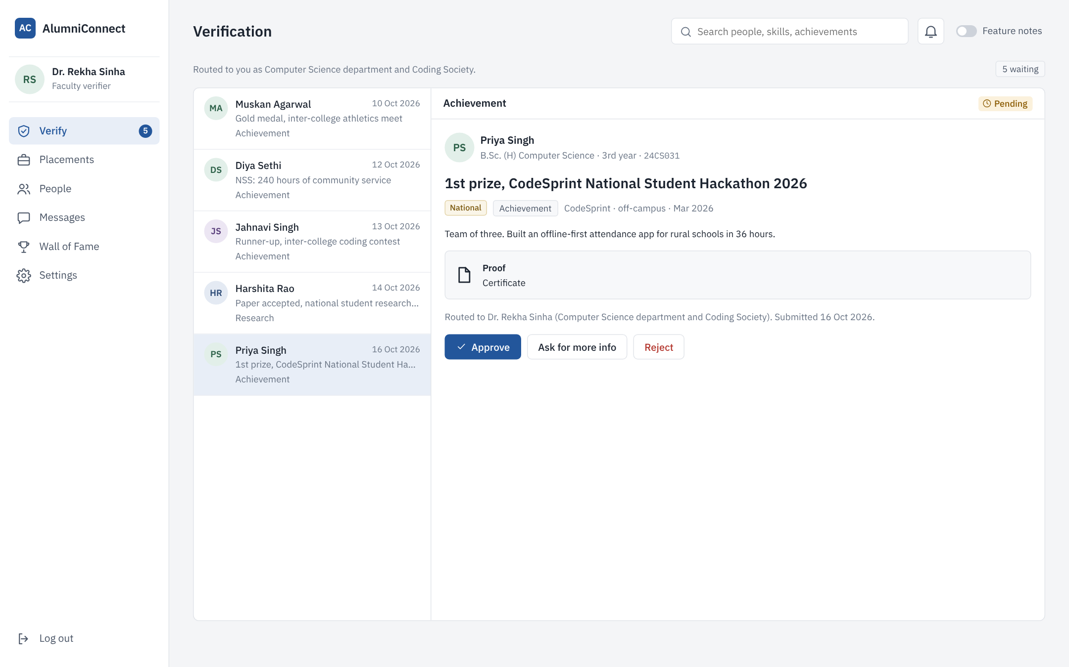

Faculty verify every achievement
Proof attached
Certificate or link, level (college to international) and date.
Routed automatically
To the department’s faculty verifier, or to IQAC for alumni updates.
Approve, ask, or reject
Students see the decision and the reason on their profile.

Slide 8
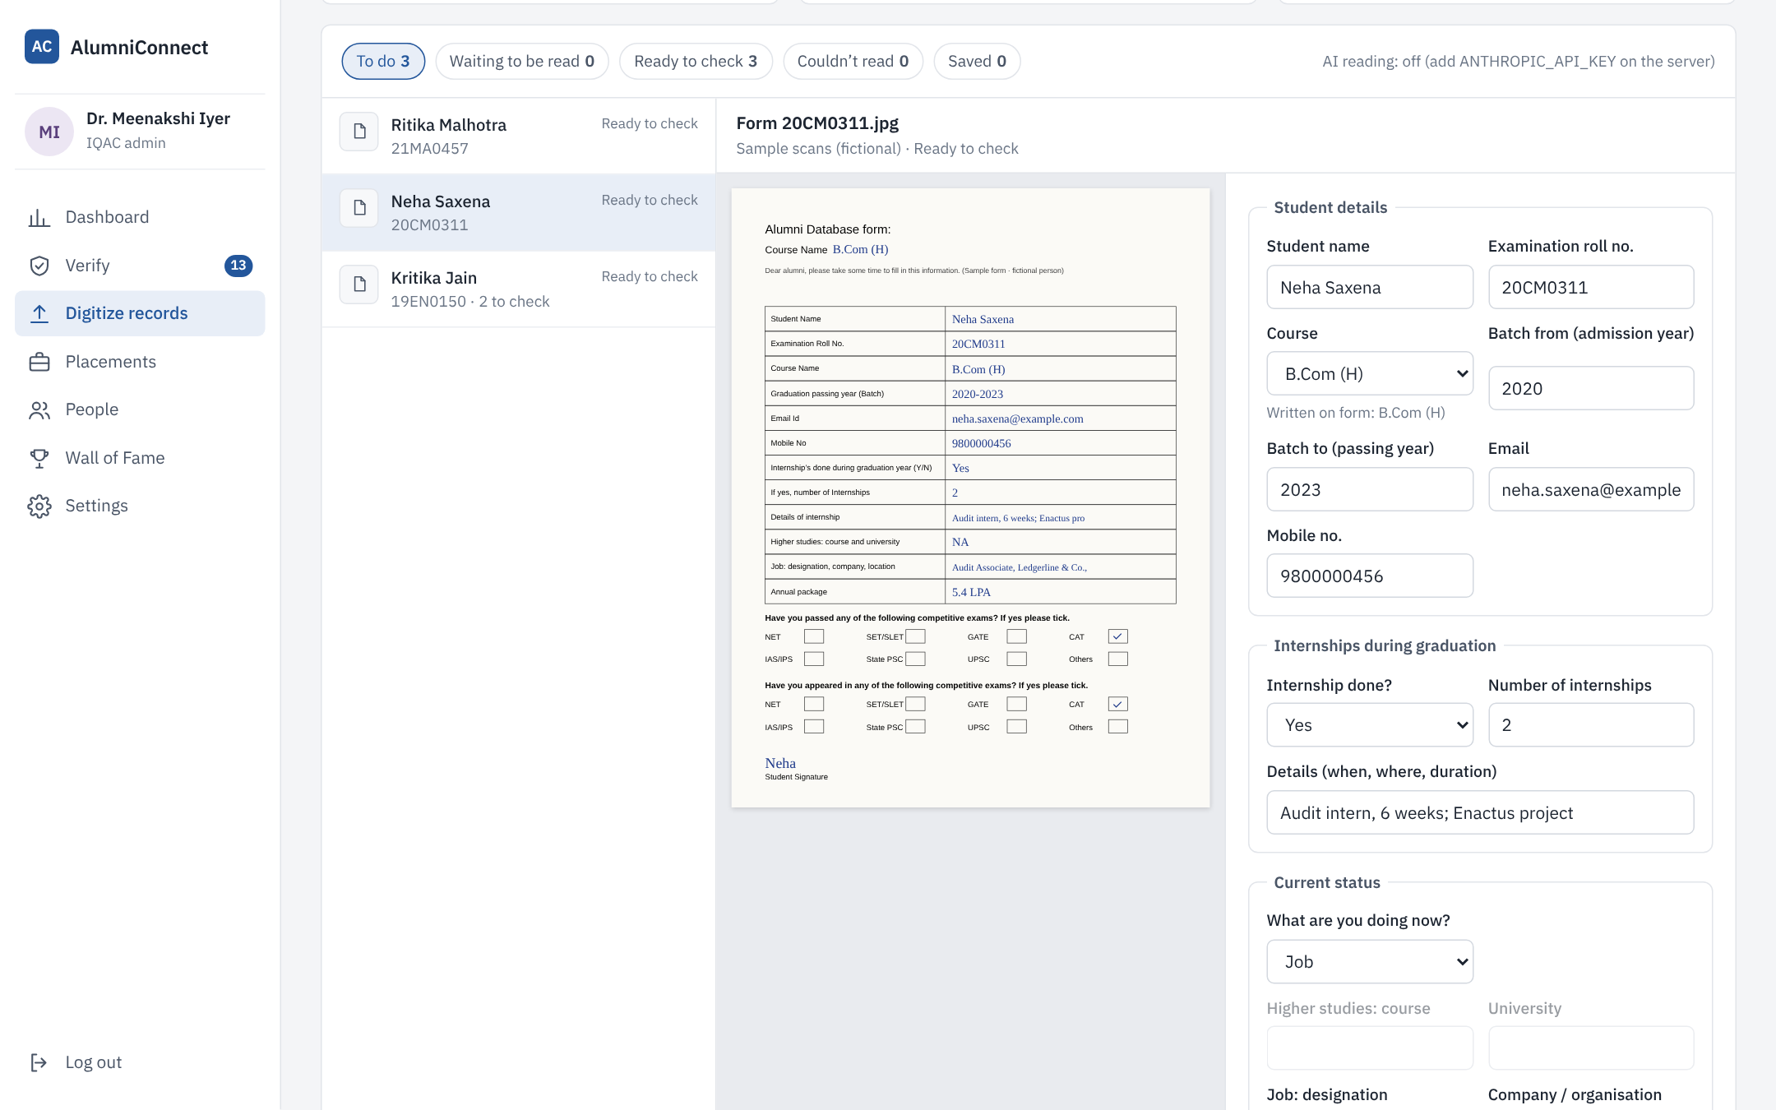



Digitizing 30,000 paper forms
1. Scan in bundles
Phone photos or scanner files, one form per file.
2. Or type it in
A screen laid out exactly like the paper form.
3. Or import Excel
Batches already in a spreadsheet go in through a template.
A person checks every record against the scan before it is saved. AI reading of handwriting is optional and only pre-fills the fields.
Scan on the left, form fields on the right (fictional sample form)

Slide 9
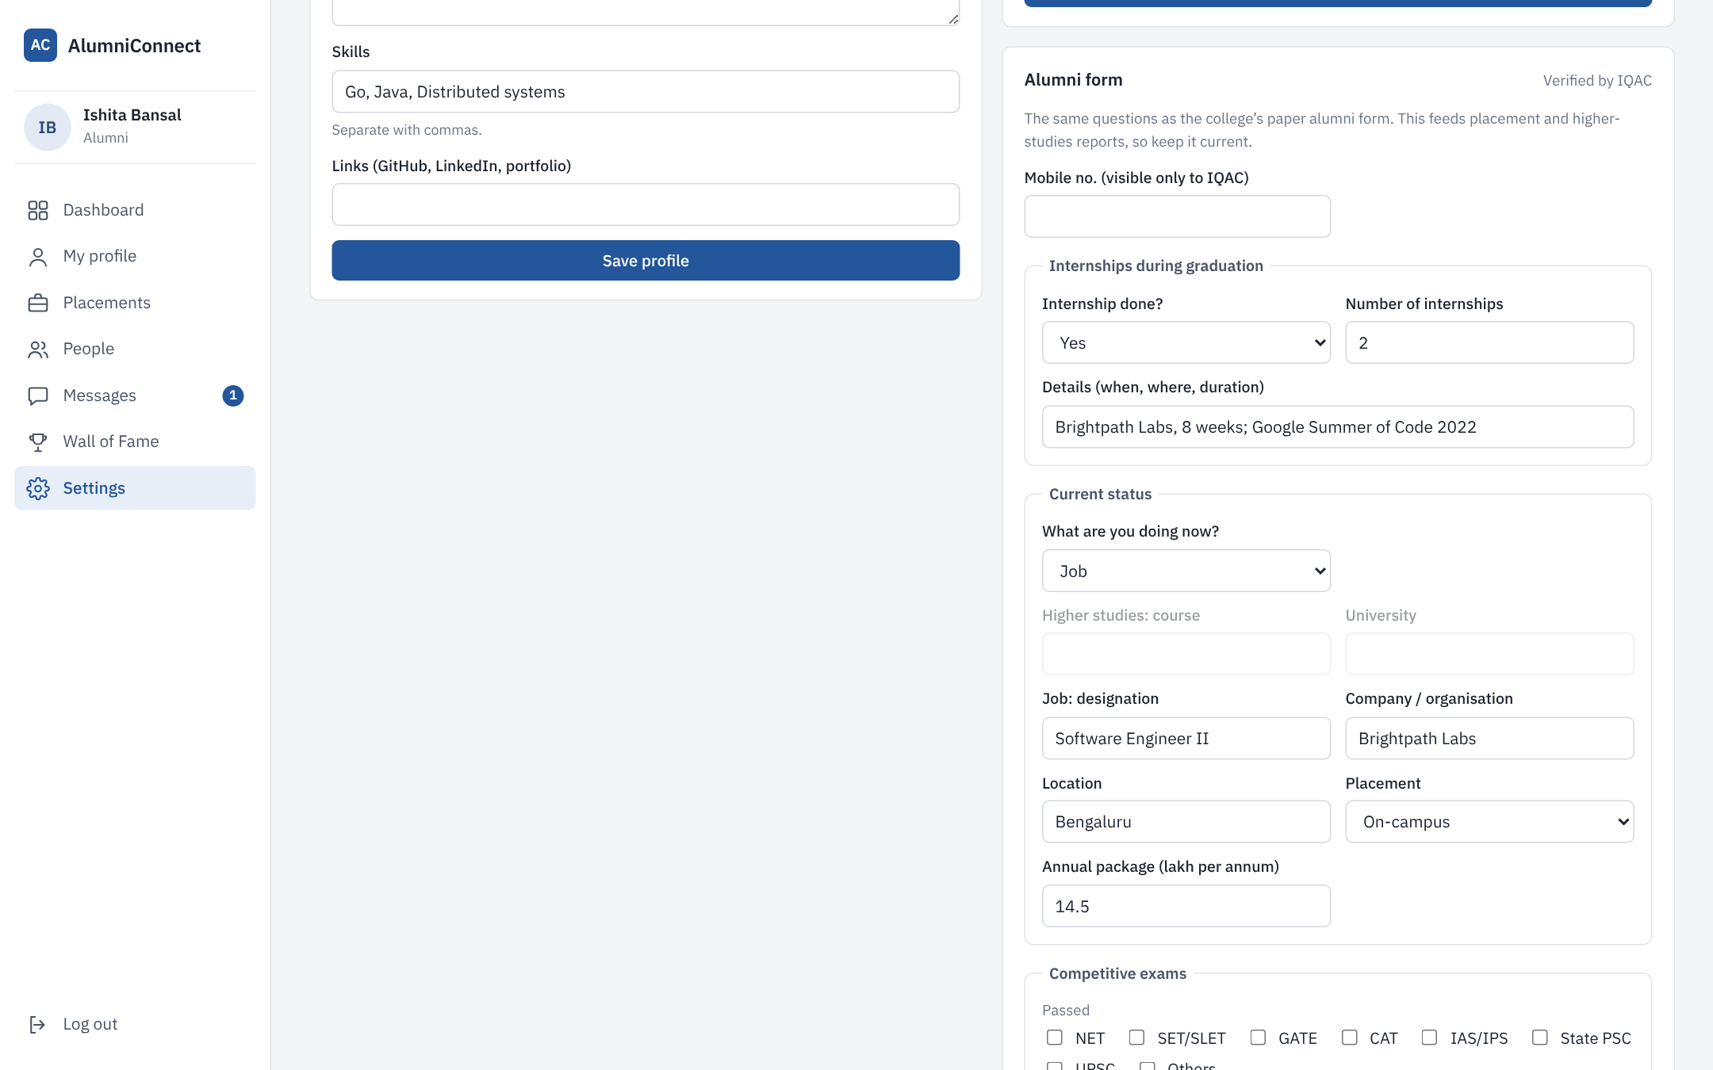
The paper alumni form, now online
Same questions
Internships, current status, course and university, or company, designation, location and package.
Exams in two rows
Passed and appeared: NET, SET/SLET, GATE, CAT, IAS/IPS, State PSC, UPSC, others.
Offer letter as proof
Alumni attach it once. IQAC verifies the form from Records.

Slide 10
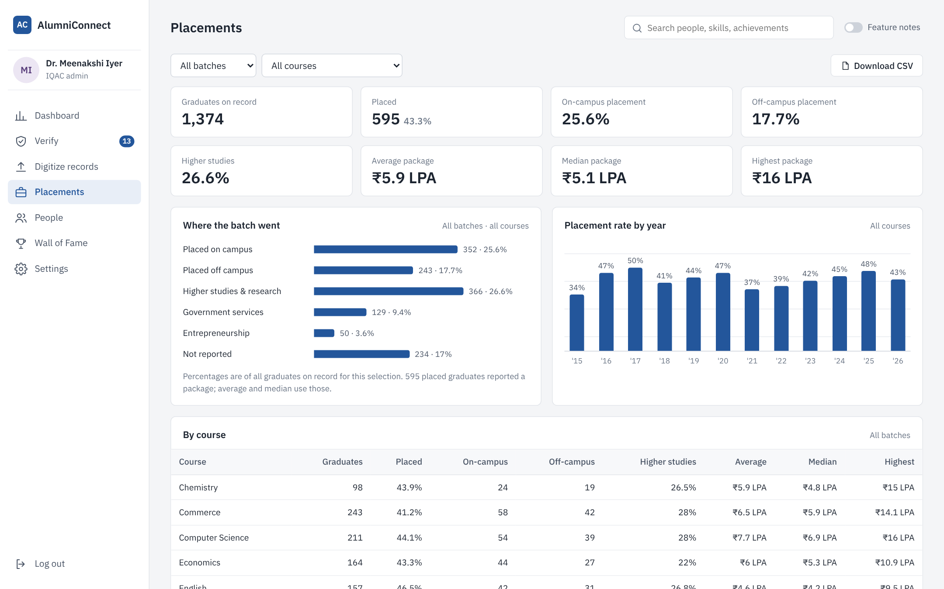

Placement records, ready to present
Placed, on-campus, off-campus
As a share of each batch, with higher studies and other outcomes.
Average, median, highest
Packages by batch, by course, year by year and by recruiter.
Right level of detail
IQAC and faculty see names and download CSV. Students see totals only.
All figures are from the fictional sample data

Slide 11
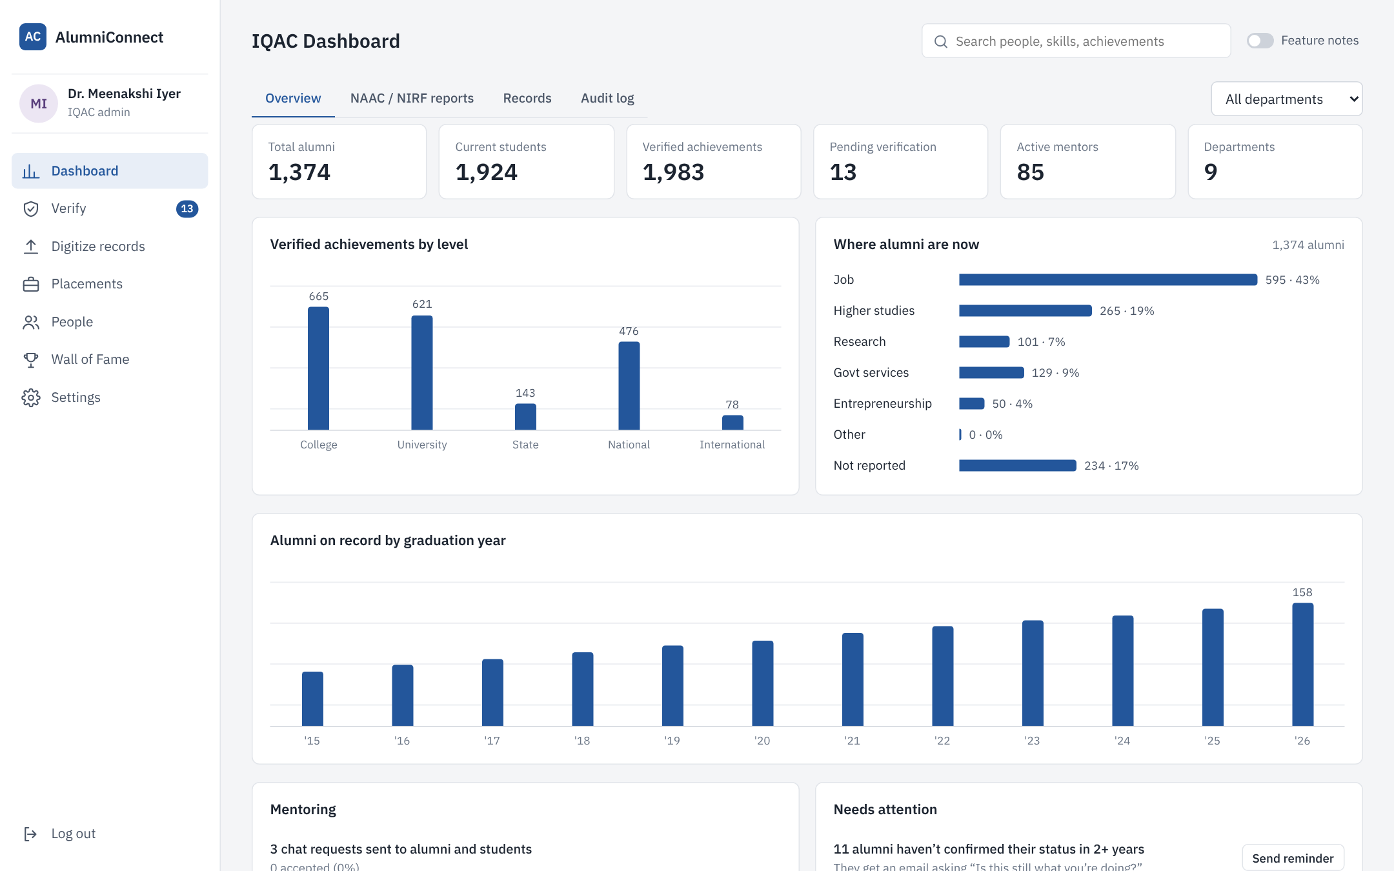
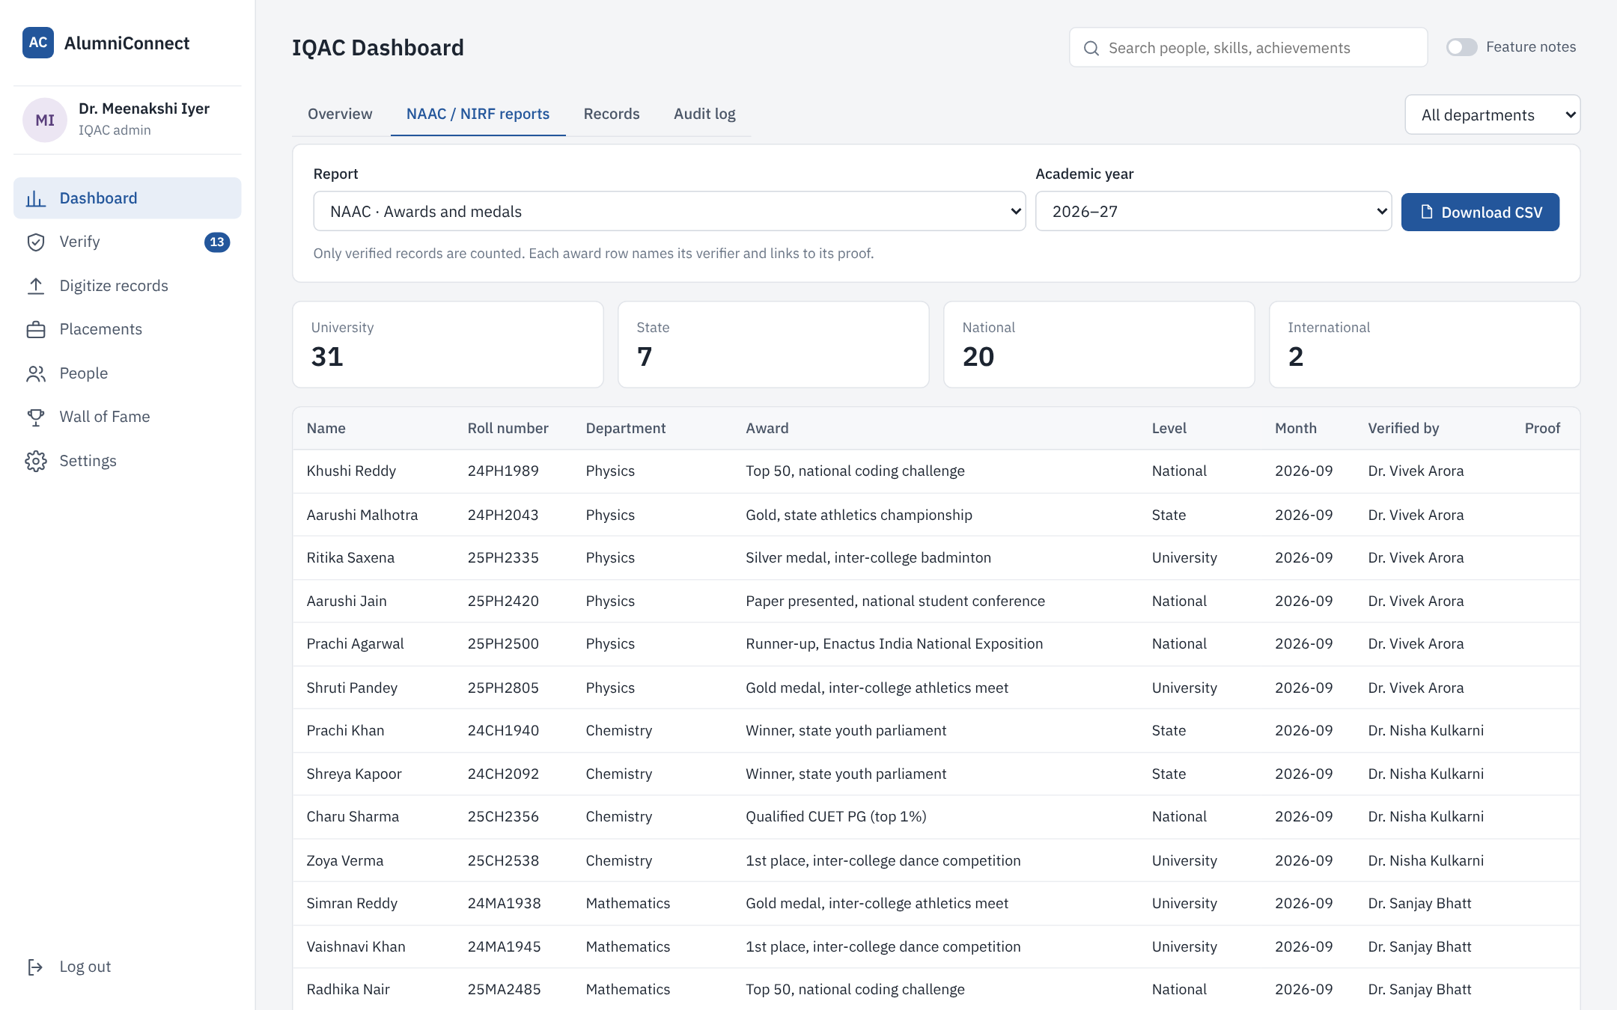
IQAC dashboard and NAAC / NIRF reports
Live totals and charts, filterable by department
Awards report with the verifier and proof for every row, downloadable as CSV
Reports: student progression, awards and medals, NIRF graduation outcomes, alumni engagement. Every action is recorded in an audit log.

Slide 12
How a record moves through the system
Submitted
→
Verified
→
On the profile
→
In the reports
Student or alumna adds it, or IQAC enters a paper form
Faculty or IQAC checks the proof
Shows as verified and becomes searchable
Counts towards placements, NAAC and NIRF
Data is entered once, at the source, with proof. Every later use reads from the same verified record.

Slide 13



How it is built
Frontend
HTML, CSS and JavaScript. Works on phones and computers, no app install.
Security
Hashed passwords, secure session cookies, parameterised queries, proof files visible only to owner and verifiers.
Backend
Node.js with Express, a REST API with role checks on every request.
Roles
Student, alumni, faculty verifier and IQAC admin each see only what they need.
Database
SQLite for the prototype. Standard SQL, so it moves to MySQL or PostgreSQL for production.
Optional AI
Reads handwritten scans into fields when switched on. Nothing is saved without a person’s approval.

Slide 14
Rollout plan
Phase 1
Phase 2
Phase 3
Pilot
All departments
Every year
One department. Digitize one batch of paper forms and test with its students and alumni.
Faculty verifiers in every department. Older batches digitized in bundles by IQAC staff and volunteers.
Final-year students become alumni automatically. NAAC, NIRF and placement reports come straight from the system.
Not in this version yet: email notifications and attendance.

Slide 15
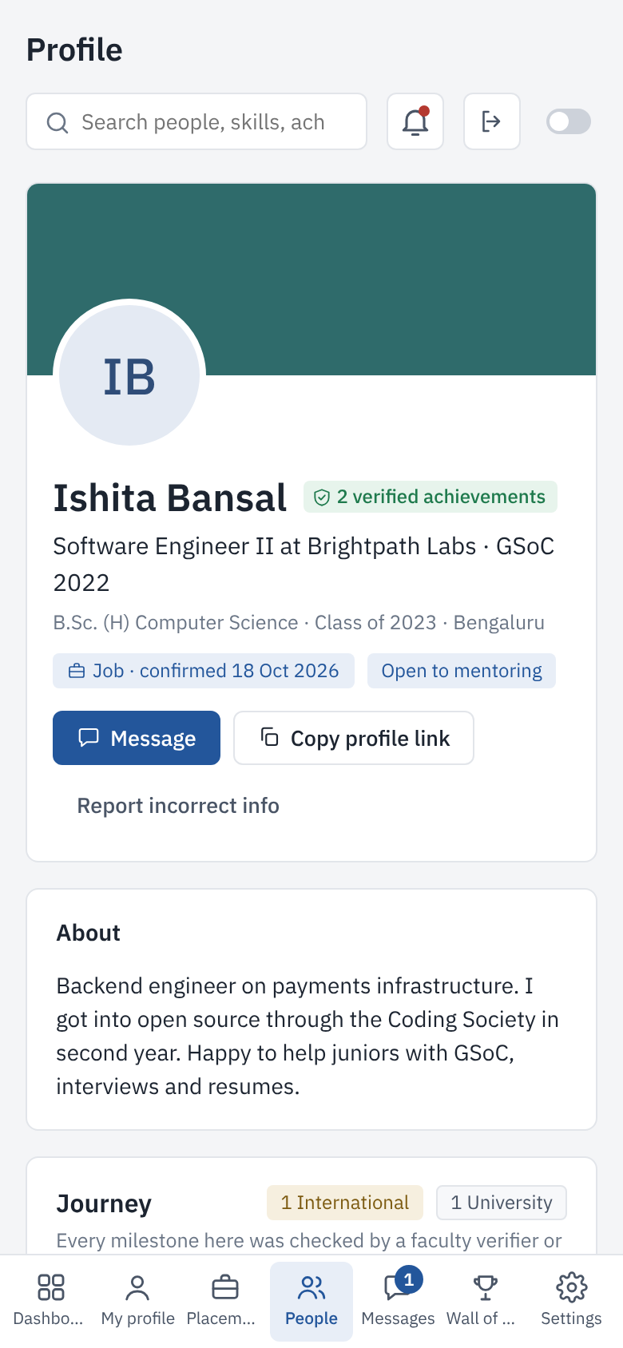
Thank you
Try it live: alumniconnect-cpva.onrender.com
Demo account | Email
Student | priya@college.example
Alumni | ishita@college.example
Faculty | rekha@college.example
IQAC admin | iqac@college.example
Password for all: demo1234 · All names and figures are fictional sample data.

