Slide 1

SMART INDIA HACKATHON 2026
TITLE PAGE
• Problem Statement ID – 26121
• Problem Statement Title- eRTMAC NWIS: AI-powered offset well knowledge and decision support platform for drilling operations
• Theme- Smart Automation
• PS Category- Software
• Team ID- 187666
• Team Name- COOLKATS

Slide 2
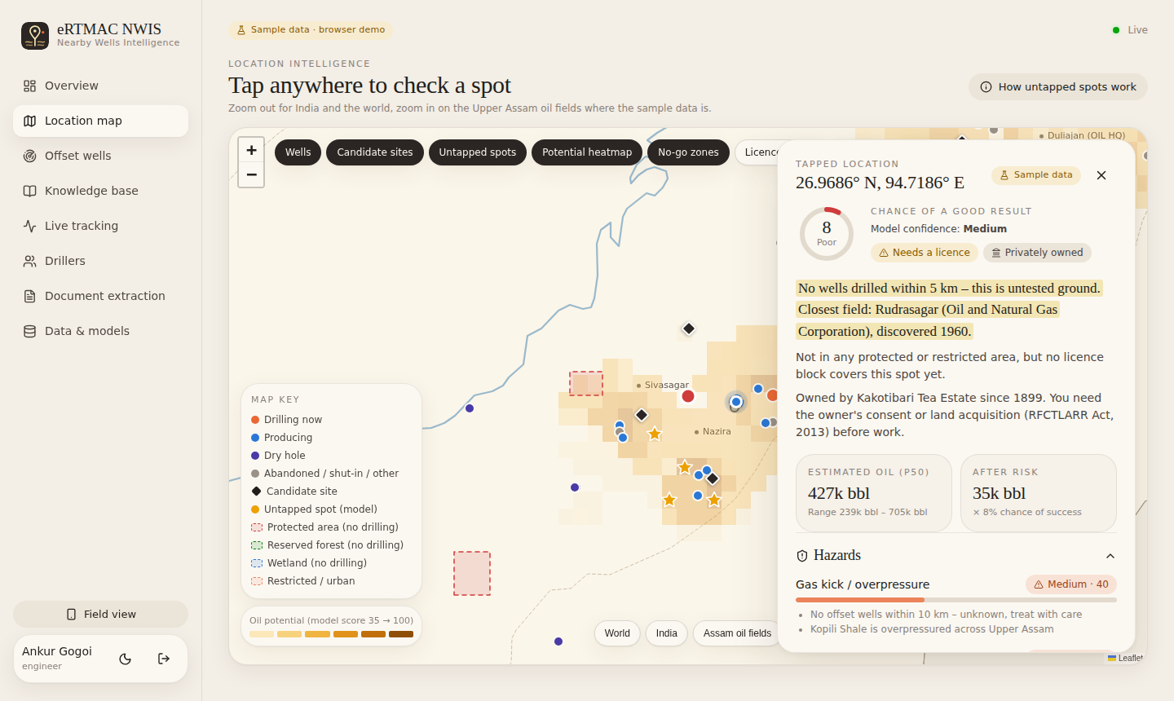
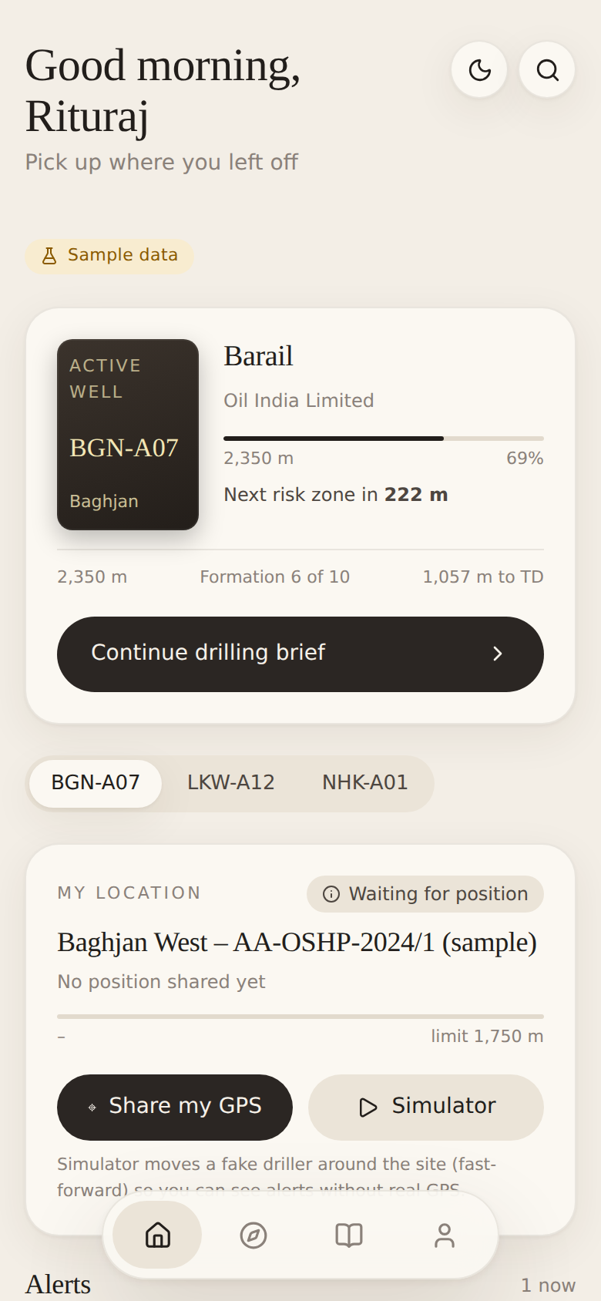
COOLKATS
IDEA TITLE: eRTMAC NWIS
• Proposed Solution (Describe your Idea/Solution/Prototype)
One map-first platform that turns old offset-well reports into early warnings for the well being drilled today.
• Location intelligence map: tap any spot → history, rock & soil, success score, hazards (landslide, flood, subsidence, gas kick), legal / illegal zone, estimated oil (P90–P10) and land ownership.
• Offset well intelligence: wells within a chosen radius, searchable events (mud loss, kick, stuck pipe, torque, cementing, NPT) with cause, fix and lesson; depth-vs-formation view.
• Alert engine: matches offset problems to the active well by formation and warns ~150 m before the bit gets there, with “what worked nearby”.
• Driller registration + live geotag: documents approved by admin, rigs declared; allowed zone = rig reach + safety margin; breach of zone or forest/protected area is flagged instantly.
• AI document extraction: PDF drilling reports → OCR → LLM/rules → structured events, lessons and formation tops.
• Innovation and uniqueness
• Formation-based depth correlation, not raw depth
• Untapped-spot layer: ML score + confidence
• Legality + land ownership in the same tap
• Physics for range: haversine + minimum-curvature bottom-hole
• Works offline with a built-in India basemap
• How it addresses the problem
• Knowledge buried in DDRs, WCRs and engineers’ memory becomes searchable in seconds.
• Correlates drilling, geology and reservoir data by depth and formation across wells.
• Field view on phone/tablet for rig crews, office view with analytics and approvals.
@SIH Idea submission- Template
2

Slide 3
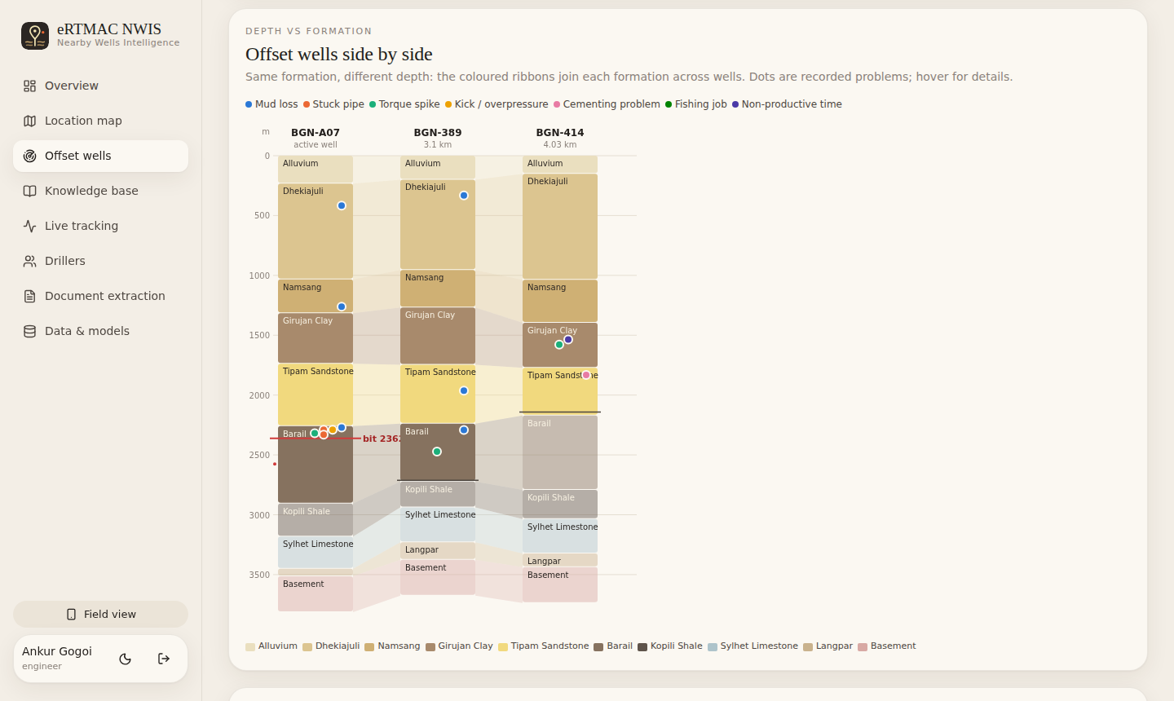
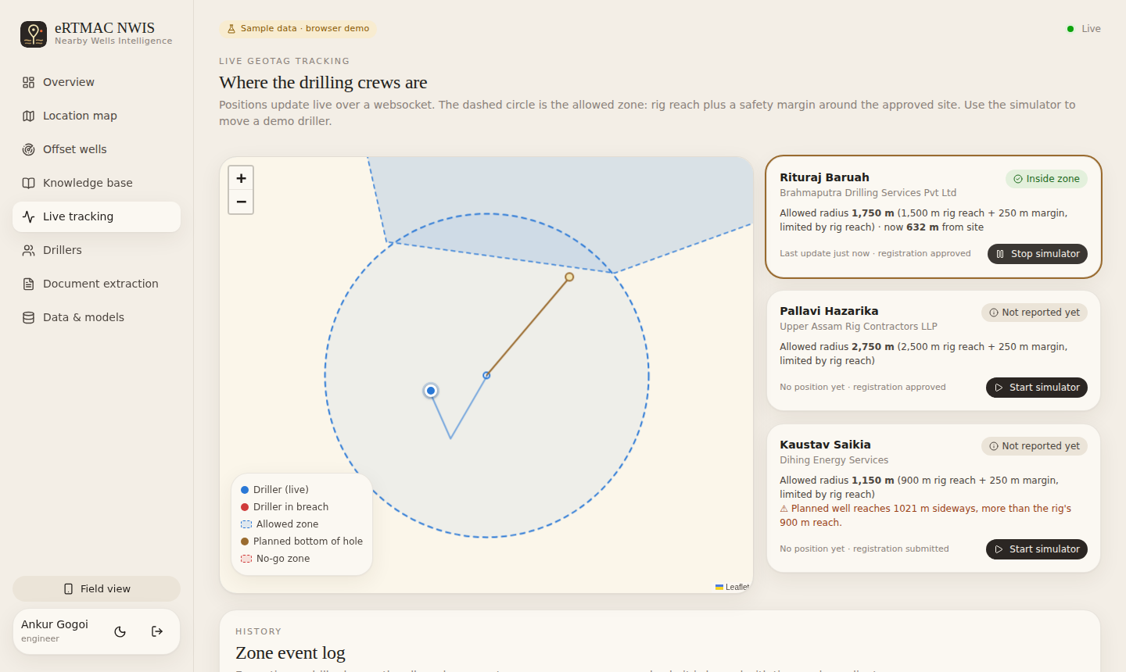
COOLKATS
TECHNICAL APPROACH
• Technologies to be used
Frontend
React + Vite, Leaflet maps, Recharts, light/dark theme, PWA-style field view
Backend
Python FastAPI, WebSockets (live tracking & alerts), JWT roles: driller / engineer / admin
Data
SQLite → PostgreSQL + PostGIS in production; GEM tracker, Volve DDR, GSI Bhukosh, SoilGrids, WDPA, NASA GLC
AI / ML
scikit-learn random forests (success score, risk per problem type); OCR (Tesseract) + Claude LLM with rule-based fallback
Physics
Haversine, point-in-polygon, minimum-curvature trajectory, volumetric STOIIP with Monte Carlo
Offset-well correlation view (depth vs formation, problems as dots)
• Methodology and process for implementation
Ingest
PDF / DDR / GIS
Extract
OCR + LLM
Store
wells, events, zones
Analyse
ML + formation correlation
Act
map, alerts, tracking
Live loop: bit depth updates → alert engine re-runs → WebSocket pushes warning + recommendation to field & office. Driller GPS → range check → breach logged with time & coordinates.
Live tracking: allowed zone, breach log
@SIH Idea submission- Template
3

Slide 4
COOLKATS
FEASIBILITY AND VIABILITY
Analysis of the feasibility of the idea
Potential challenges and risks
Strategies for overcoming these challenges
• Working prototype already built and deployed (web + phone view)
• Open-source stack – no licence cost; runs on one server or Docker
• Plugs into eRTMAC as a knowledge layer; public datasets exist for all layers
• Loaders ready for real data (GEM, Volve, Bhukosh, WDPA, SRTM)
• 36 automated tests on geometry, alerts, APIs, extraction
• Old reports are scanned, handwritten or inconsistent
• Real drilling data is confidential; limited training data
• Poor connectivity at remote rig sites
• False alerts reduce trust of drilling engineers
• Land-record and zone boundaries are not digital everywhere
• OCR + LLM with human review; rule-based fallback always available
• On-premise deployment inside OIL network, role-based access
• Offline-capable field view, built-in basemap, sync when online
• Every alert shows its evidence wells; engineers confirm or dismiss
• Start with DGH NDR + state land portals; flag “needs licence” when unknown
@SIH Idea submission- Template
4

Slide 5
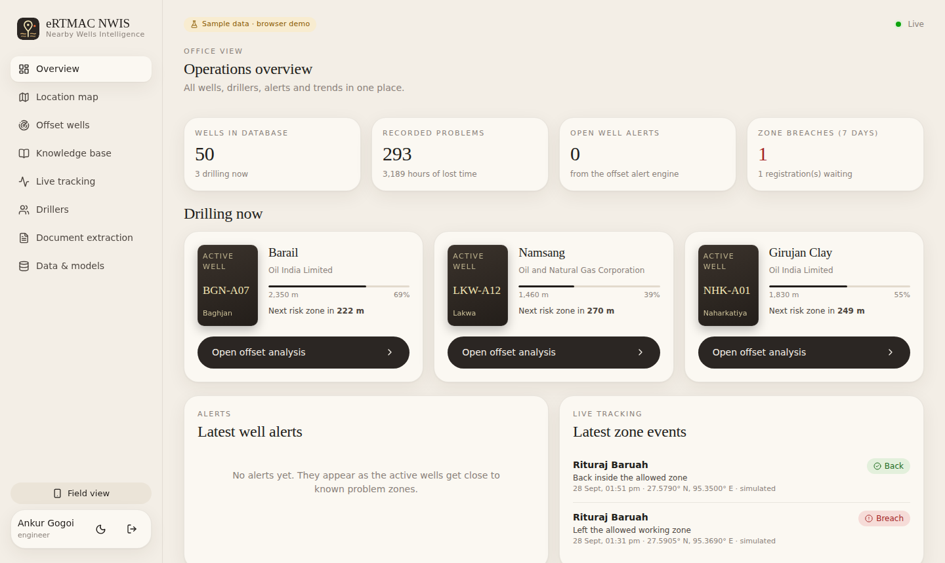
COOLKATS
IMPACT AND BENEFITS
• Potential impact on the target audience
▸ Drilling engineers: warnings before trouble zones; lessons from nearby wells in one tap
▸ Rig crews (field): simple phone view: current well, alerts, live location, risk ahead
▸ Office & management: all wells, drillers, NPT trends, approvals in one dashboard
▸ Regulators / admin: verified drillers, documented rigs, zone breaches logged
• Benefits of the solution (social, economic, environmental)
Economic
Less NPT from losses, kicks and stuck pipe; faster decisions; better well placement with untapped-spot scoring
Safety
Kick / overpressure alerts ahead of the bit; earthquake, flood and landslide checks at site selection
Office dashboard: KPIs, alerts, NPT by formation, trends
What changes for OIL
Before: hours searching PDFs and asking seniors
After: offset lessons and risks in seconds, pushed live to the rig
Before: site legality & ownership checked manually
After: one tap on the map
Environmental
No drilling inside forests, wetlands or protected areas (e.g. Baghjan 2020 lesson); breach alerts
Social / knowledge
Expert knowledge preserved when engineers retire; land ownership shown before work starts
@SIH Idea submission- Template
5

Slide 6
COOLKATS
RESEARCH AND REFERENCES
• Details / Links of the reference and research work
Problem & domain
Prototype
Live demo: gurltff.github.io/eRTMAC-NWIS
Code: github.com/gurltff/eRTMAC-NWIS
Demo logins: engineer@nwis.demo / Engineer@123
driller@nwis.demo / Driller@123
Note: prototype runs on sample data for Upper Assam; field and formation names are real, all values illustrative.
• SIH 2026 PS 26121 – Oil India Limited, eRTMAC NWIS
• DGH National Data Repository – ndr.dghindia.gov.in
• Mitchell & Miska, Fundamentals of Drilling Engineering (SPE) – minimum curvature, well control
Datasets
• Global Energy Monitor – Global Oil & Gas Extraction Tracker
• Equinor Volve field data (daily drilling reports) – equinor.com/energy/volve-data-sharing
• GSI Bhukosh geology – bhukosh.gsi.gov.in
• ISRIC SoilGrids v2.0 – rest.isric.org
• World Database on Protected Areas – protectedplanet.net
• NASA Global Landslide Catalog; OpenTopography SRTM 30 m
• Natural Earth (India point-of-view boundaries); OpenStreetMap
Tools
• FastAPI, React, Leaflet, scikit-learn, Tesseract OCR, Anthropic Claude API
@SIH Idea submission- Template
6

