Slide 1
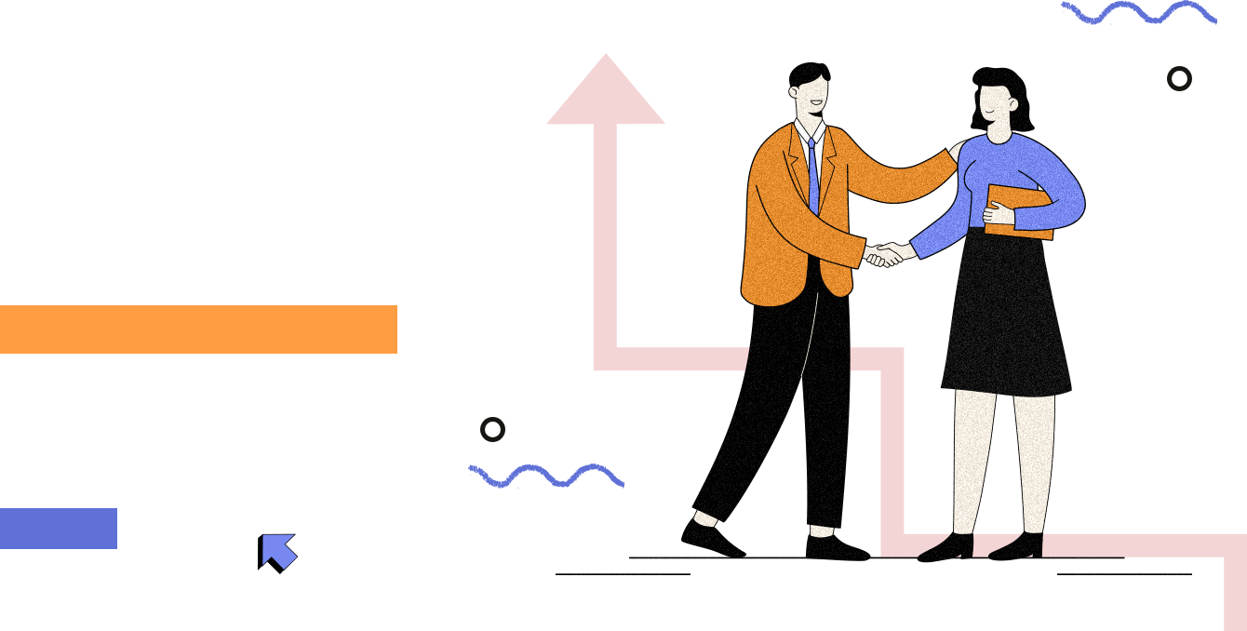
Introduction
Our project’s UI is designed to provide users with a visually appealing and intuitive experience for investment management. The interface emphasizes simplicity and clarity while delivering essential information through clean and structured sections.
Team : HackinTech (17) Members: 1. Lakshya Ashwini 2. Gurmehak Kaur
3. Naman Kumar

Slide 2
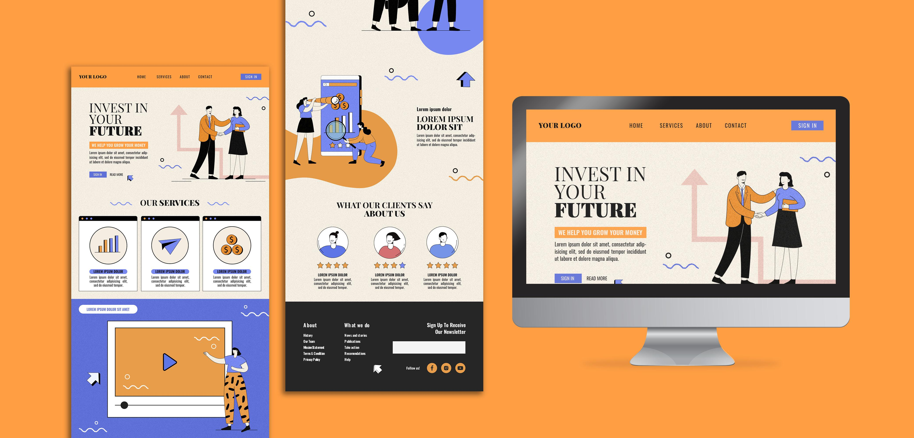
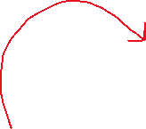
Website design
Here is the snapshot of the website to be replicated

Slide 3
Technology used
1.HTML (Hypertext Markup Language)
Purpose: Structures web content.
Role in Project:
Defines layout with headers, sections, and forms.
Supports accessibility and SEO.
Key Features:
Semantic tags for structure.
Forms for user interaction.
2. CSS (Cascading Style Sheets)
Purpose: Styles and enhances the visual appearance of HTML.
Role in Project:
Creates responsive layouts and visual elements.
Adds transitions and animations for interactivity.
Key Features:
Flexbox/Grid for layout.
Media queries for mobile responsiveness.

Slide 4
Features
1. User-Friendly Navigation: Clear navigation bar with Home, Services, About, Contact, and Sign-In options.
2. Responsive Design: Optimized for various screen sizes, ensuring a seamless experience across devices.
3. Engaging Hero Section: Strong call-to-action and visual design that captures attention immediately.
4. Service Overview Section Visual icons with descriptions that explain core services quickly and clearly.
5. Client Testimonials: Incorporates user reviews with star ratings to build trust and credibility.
6. Call-to-Action Buttons : Strategically placed buttons like “Sign In” and “Read More” to drive user interaction.
7. Illustration-Based Design Custom illustrations to create a friendly, approachable feel.
8. Footer with Essential Links Includes About Us, Terms, Privacy Policy, and Newsletter sign-up for additional user engagement.
9. Interactive Elements Hover effects, transitions, and animations to enhance the user experience.

Slide 5
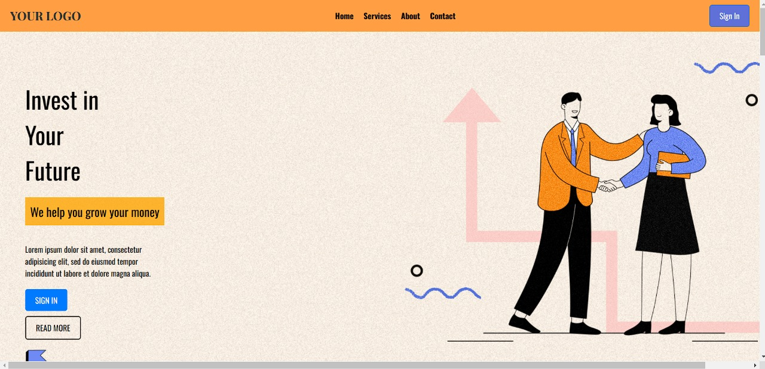
deployed website
https://17-hackin-tech.vercel.app/

