Slide 1


EnGen – GenAI Requirements Workflow
Solution
This document is confidential and contains proprietary information, including trade secrets of CitiusTech. Neither the document nor any of the information contained in it may be reproduced or disclosed to any unauthorized person under any circumstances without the express written permission of CitiusTech.
© 2025 CitiusTech | Private & Confidential

Slide 2
Data Flow
25
Final Refinement workbook
1
3
History Refinement workbook
Vector DB
7
18
19
10
9
2
5
8
15​
HLVS
Lean IA
17
Vector DB
BO & Requirement
Storage
20
1​1
24
L2 Mapping
16
6
Meeting Notes
Vector DB
21
12
4
L4 Mapping
Placement Document
HITL
23
22
13
14
Mapping Consolidation Agent
Acceptance Criteria

Slide 3
Description of Data Flow
Step 1: History Refinement Workbook
The process begins with the History Refinement Workbook, which contains previously refined data or historical mappings. This serves as the foundation for further refinement and validation.
Step 2 & 3: Storage and Vector DB
The workbook data is stored in Storage (Step 2) and indexed in a Vector Database (Step 3). This enables efficient retrieval and semantic search during later stages of processing.
Step 4: Placement Document
Next, the Placement Document is introduced. This document likely contains capability placement or mapping details that need to be processed and integrated into the system.
Step 5 & 6: Storage and Vector DB
Similar to the previous step, the placement document is stored in Storage (Step 5) and indexed in the Vector Database (Step 6) for quick access and embedding-based search.
Step 7 & 9: HLVS Lean IA and Vector DB
The HLVS Lean IA document is added to the workflow. After processing, its embeddings are stored in the Vector Database (Step 9), ensuring that all relevant documents are searchable for downstream agents.
Step 10 to 14: Agent Processing
The core processing involves multiple specialized agents:
Step 10: BO & Requirement Agent – Handles business objectives and requirement analysis.
Step 11: L2 Mapping Agent – Performs Level 2 mapping for structured alignment.
Step 12: L4 Mapping Agent – Handles advanced Level 4 mapping for detailed integration.
Step 13: Acceptance Criteria Agent – Defines and validates acceptance conditions.
Step 14: Mapping Consolidation Agent – Combines outputs from multiple mappings into a unified structure.
Step 15: Storage
Intermediate outputs from these agents are stored in Storage for persistence and traceability.
Step 16: Meeting Notes
Additional context from Meeting Notes is introduced, providing human insights or clarifications for refining mappings.
Steps 17–18: Vector DB (Connected to HITL)
The processed data and embeddings are stored in Vector Databases linked to HITL (Human-in-the-Loop) components, enabling human review and feedback.
Steps 19–23: HITL Review
Each major agent output—BO & Requirement, L2 Mapping, L4 Mapping, Acceptance Criteria, and Mapping Consolidation—is connected
to HITL for validation and feedback. This ensures quality and correctness before finalization.
Step 24: Storage
All validated and consolidated outputs are stored again for final processing.
Step 25: Final Refinement Workbook
The process concludes with the generation of the Final Refinement Workbook, which contains the fully validated, consolidated, and refined mappings ready for downstream use.

Slide 4
Workflow Diagram
Vector store
Input data embeddings(HLVS, LeanIA, meeting notes)
History Refinement workbook embedding
Capability placement embeddings
Agents
Data Processing
Manager
Data Extraction
Chunking
Embedding -Generation
Document processing
BO’s and Requirement
L2 Mapping
Admin Input
History refinement workbook , Capability Placemat
Critic
UI
Display
Storage Bucket
Acceptance Criteria
L4 Mapping
Mapping Consolidation
User Input documents
HLVS, LeanIA and meeting notes
BigQuery
Human in loop user feedback
Refinement workbook

Slide 5

























Datastore
Firestore
History Embeddings
Front End
Cloud Function
Pub/Sub
In State Memory
CI/CD
Historical docs - RPIC
Workflow Initiator Agent
Agent Development Kit
Storage bucket
Agent-1
Workbook workflow initiator
Agent-2
State Memory
Cloud Build
UI
CloudRun
MCP Toolbox
RL Agent
Function Call
Final Agent Output
.
.
Current Documents
Gateway
Tool Calling
IAM
Agent-N
MCP Host
MCP Server
Agent reinforcing user feedback
Network Security
Seeking User Feedback
Excel Output
Current Document Embeddings
Human Feedback Agent
Prompt Templates
Looker Studio
Output to user for feedback/ confirmation
Storage Bucket
Vector Search
Human in Loop
Cloud Monitoring
Cloud Function
Cloud Logging
BigQuery
Agent Performance and quality monitoring

Slide 6
Description of Workflow daigram
Following is the description of the workflow diagram.
The workflow begins with two primary sources of input: User Input Documents and Admin Input. User Input Documents include HLVS, LeanIA, and meeting notes, which are typically unstructured or semi-structured textual data. Admin Input consists of the History Refinement Workbook and Capability Placement data. These inputs are fed into a Data Processing Pipeline that performs three key operations: Data Extraction, Chunking, and Embedding Generation. Data Extraction involves parsing the documents to identify relevant content, while Chunking breaks down large documents into smaller, manageable segments. These chunks are then transformed into vector embeddings using natural language processing models, enabling semantic understanding and similarity-based operations.
The generated embeddings are stored in a Vector Store, which acts as a semantic memory for the system. This store contains embeddings from both user and admin inputs, allowing for cross-referencing and intelligent querying. In parallel, all processed data and metadata are saved in a Storage Bucket, which serves as a centralized repository for raw and transformed data. For scalable querying and analytics, the system integrates with BigQuery, enabling complex joins, filtering, and data exploration across large datasets.
To ensure continuous improvement, the system incorporates a Human-in-the-Loop Feedback mechanism, where users can provide feedback on the accuracy and relevance of mappings and document interpretations. This feedback is used to update the Refinement Workbook, which in turn enhances future processing and mapping accuracy. The core decision-making logic resides in the Manager Module, which orchestrates Document Processing, extracts Business Objectives (BOs) and Requirements, and performs hierarchical capability mapping at Level 2 (L2) and Level 4 (L4). This module also includes a Critic component that evaluates the quality of mappings, an Acceptance Criteria validator to ensure compliance with standards, and a Mapping Consolidation unit that finalizes and merges mappings for output.
Supporting this entire workflow are Agents, which may be autonomous services or microservices responsible for executing specific tasks such as embedding generation, feedback processing, or mapping evaluation. Finally, the results are presented through a UI Display, offering users a clear and interactive view of mappings, document insights, and feedback loops. This end-to-end system ensures robust, scalable, and intelligent processing of business documents with continuous refinement through user interaction.

Slide 7
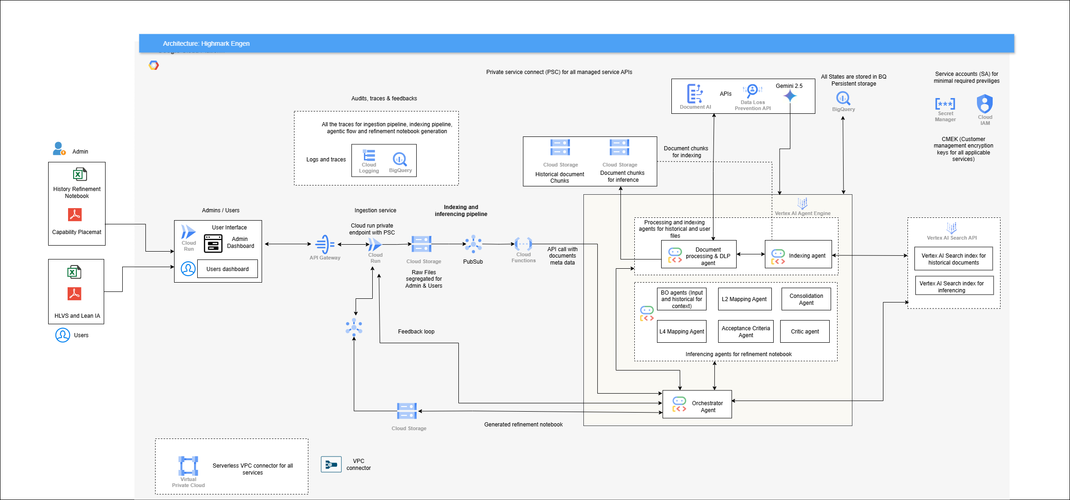
Architecture

Slide 8
Client - Query Log With Answers

