Slide 1
OpenERP / odoo Connector
OpenDays 2014
Guewen Baconnier / Alexandre Fayolle

Slide 2
30 seconds to say...
Documentation:
http://www.openerp-connector.com
Mailing list:
https://launchpad.net/~openerp-connector-community
Notes:
Since you will remember only the first 30 seconds, here are the most important things...

Slide 3
What is a connector?
Connect odoo with external systems
Exchange any data between them
Notes:
What do we mean by « connector » ?

Slide 4
What is not the connector?
A middleware, it is a module inside odoo
It does not listen external systems, it speaks to them
Notes:
“It does not listen external systems, it speaks to them” → usually it pulls changes on a regular basis

Slide 5
A framework
Does not do anything “out of the box”, rather:
Suggests an implementation style
Proposes bare “interface” classes
Defines bricks
  Jobs
  Events
  Backend / version mechanisms

Slide 6
Glossary
Backend
Event
Job / jobs queue
Worker
Binding
Notes:
Backend : a name for an external system with which we are interfacing. Backends can refer to other backends and inherit behaviors.
Event: something happeinig in Odoo which can create a Job record
Job: a specification of a task to be done. (decorated python function) Asynchronous (added in a queue, with a priority). Created by events or cron.
Worker: A thread or process in charge of processing jobs (running the function)
Binding: link between an external entity and it Odoo counterpart

Slide 7
Existing implementations
Magento
Prestashop
Multicompany (odoo to odoo)
Solr
CMIS
Connector E-Commerce (not a full implementation)
See http://openerp-connector.com/ for links!
Notes:
Finally, Connector E-Commerce is a bit special, not a full implementation of a connector, but shares common knowledge for connectors exchanging with e-commerce systems.

Slide 8
Find the doc
http://www.openerp-connector.com
Have a look at http://www.openerp-magento-connector.com(reference implementation, lots of great examples)
Source code itself.
Notes:
Magento connector being the implementation reference, you will find useful things on its documentation too.
The source code of this implementation will also be useful.

Slide 9
Mailing List
Join the team on https://launchpad.net/~openerp-connector-community
Shared for discussions about the connector and all the different implementations

Slide 10
How to install
Just like any other add-on!
Grab the source code
bzr branch lp:openerp-connector/7.0
Add to --addons-path
Install in odoo like any other add-on

Slide 11
Multiprocessing and Workers
One odoo process: all is fine
Several processes: at least one independent process must be launched for the processing of the jobs queue
  Tip: use the provided openerp-connector-worker script
http://openerp-connector.com/guides/multiprocessing.html
Notes:
One odoo process: a cron pushes the jobs in the queue.
The good thing is that you can launch as many workers as you want for the jobs, according to the physical capacity of course.
Beware with Magento though: it does not like to have several concurrent accesses to the API, at least for writing. It is advised to launch 1 worker when using Magento

Slide 12
Multiple databases and Workers
Supported!
Gotcha:
Only runs on databases that are
  in the option database in the command line
  or db_name in the configuration file
  if nothing is provided, will run on all databases
Notes:
Several times people have had problems because the workers where not running on some databases.
If the –database option is given and the db is not listed, this is expected, as like as the crons. But this is common enough to evoke this point.

Slide 13
Design goals – Overview
Do not impose a way of using the framework to the developer, only strong advices
Propose bits of implementation, which can be used or not, and the developer can cherry pick
The developer is in charge of choosing her path through the code, the code does not choose it for her
Do not mix everything in Model objects

Slide 14
Design goals - Events
Declare an event only once
Consume it several times
  → several actions can be triggered
Different connectors can share events

Slide 15
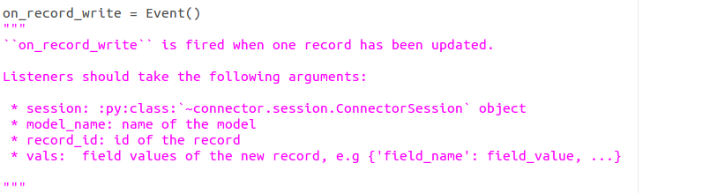
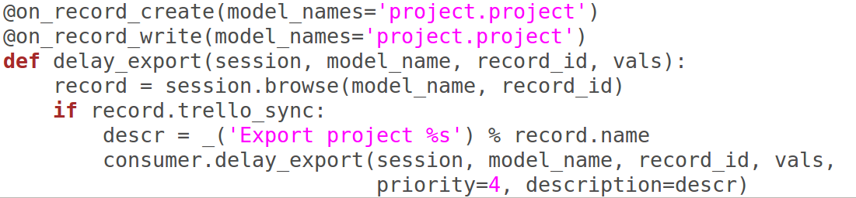
Code example: Events

Slide 16
Design goals - Jobs
Reliable
No batches!
Run in the background in a separate process
Overview of what is running, failing, waiting.
Notes:
No batches! → 1 failure should not make all the rest fail

Slide 17
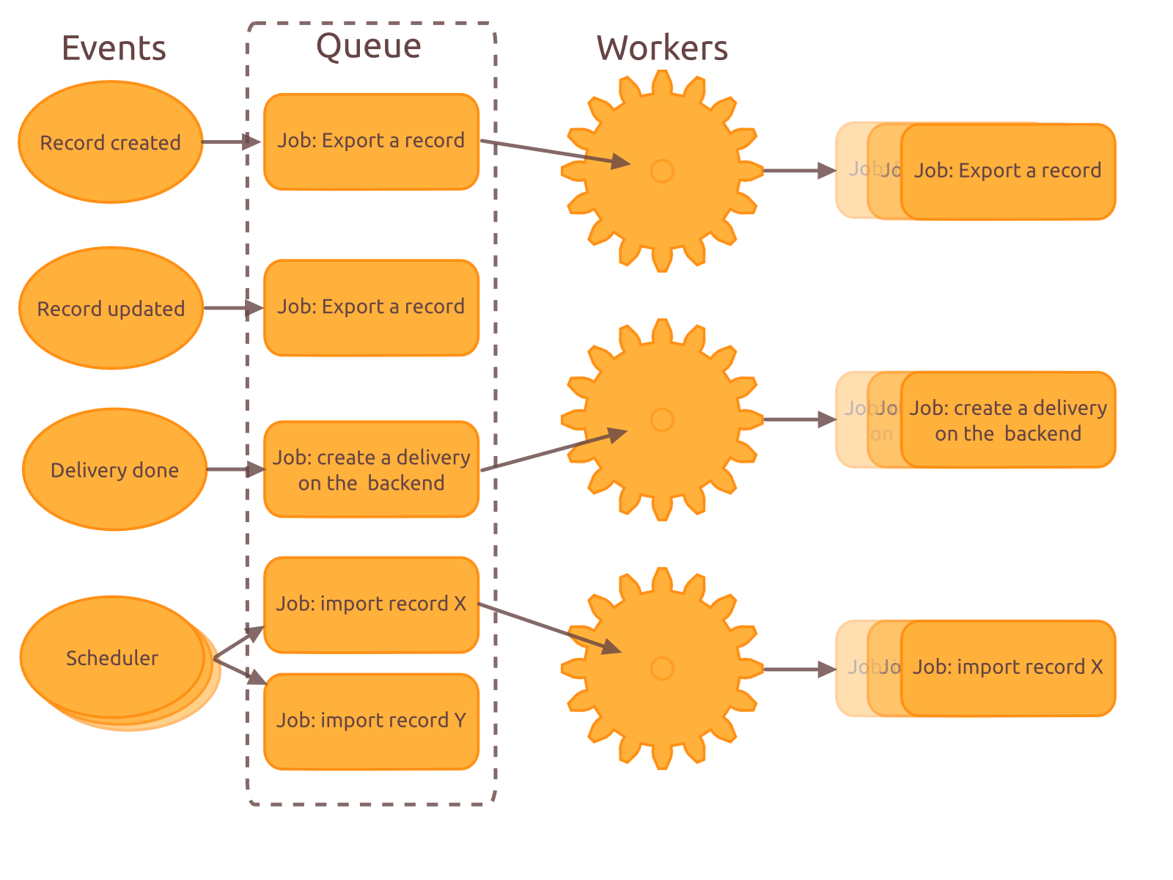
Overview - Jobs

Slide 18
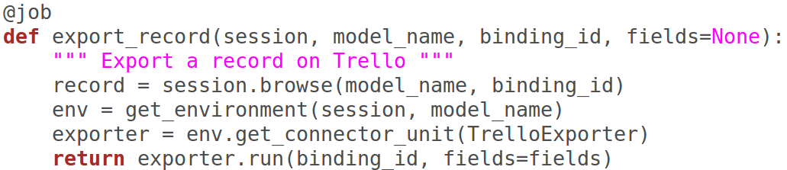
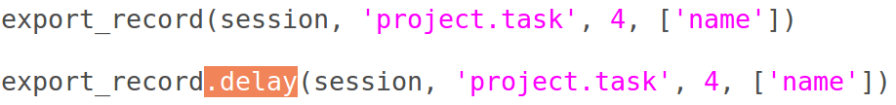
Code example: Jobs
Notes:
Environment: encapsulates the session, model and backend
connector_unit: finds the correct expoter (here) for the backend and model
Calling the job does a synchronous execution (rarely useful except for tests) → call .delay, possibly with priority kwarg

Slide 19
Design goals - Backends
Different behaviors across versions of a backend (Magento 1.7 or 2.0, or a customized Magento version...)
Extensible

Slide 20
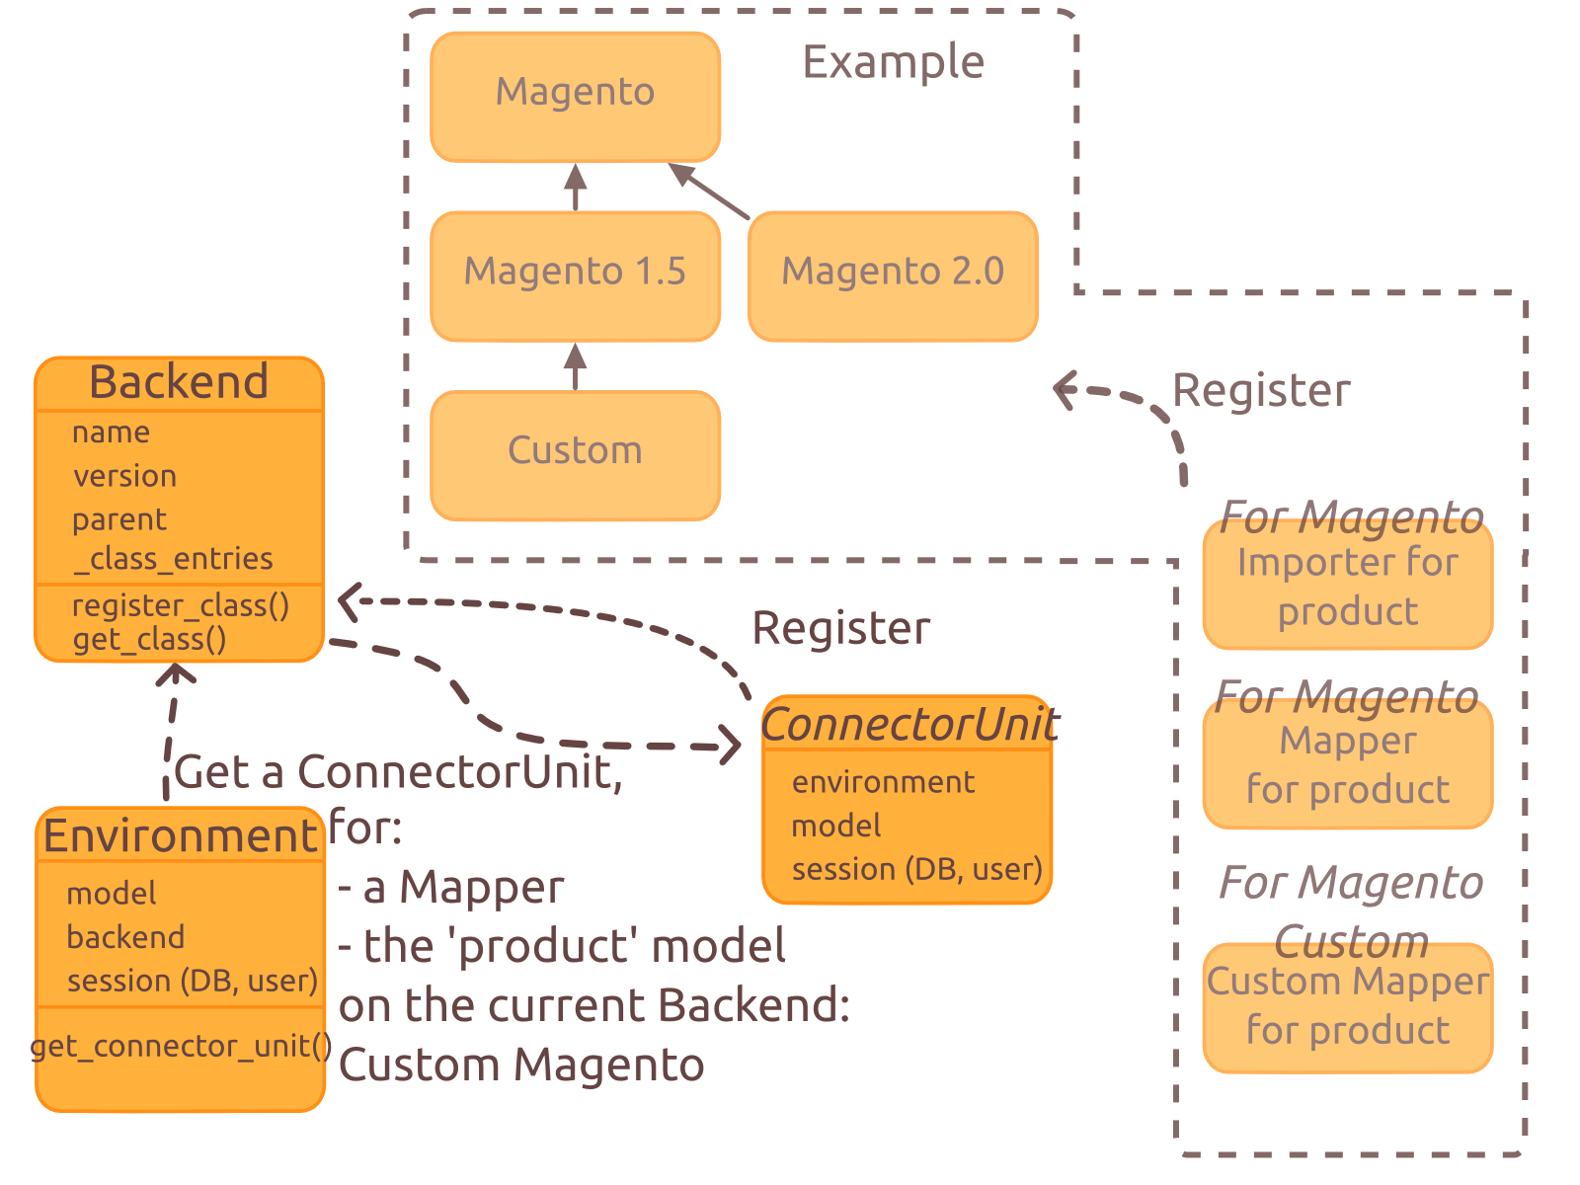
Overview - Backends

Slide 21
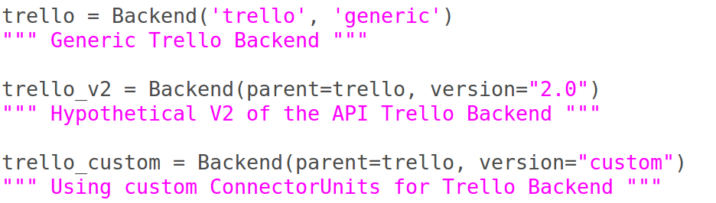
Code example: Backends

Slide 22
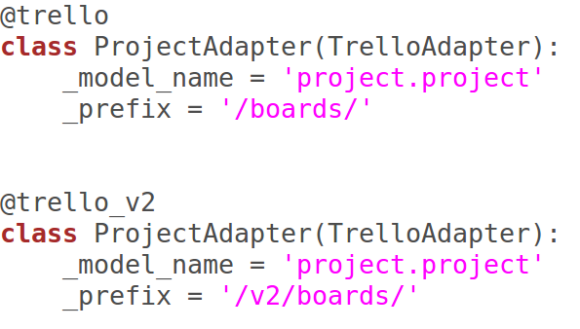
Code example: Backends

Slide 23
The glue: Environment and ConnectorSession
Environment is the current working context:
  Model
  Backend (with version)
  ConnectorSession
ConnectorSession is a container for:
  Cursor
  User
  Context

Slide 24
Design goals – Binding records
Store the external / odoo couples of IDs
  Plus synchronization date
  And possibly extra data related only to this record and this backend
If several backends are possible (e.g. Magento):
  → _inherits on the model
If only one backend possible (e.g. Trello):
  → data may be added directly in the model

Slide 25
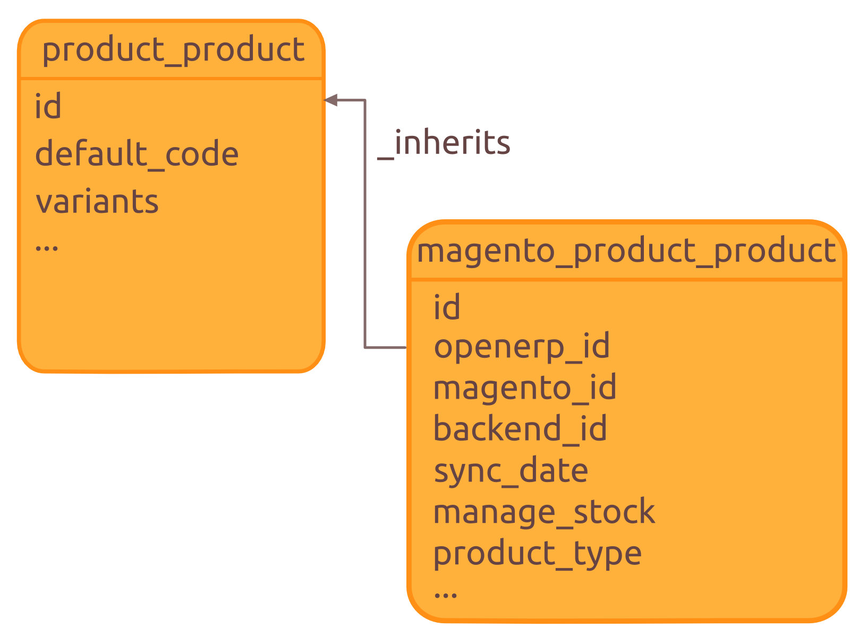
Example of binding record

Slide 26
Design goals - ConnectorUnit
Bare, decoupled, classes
Registered with a backend
1 class: 1 responsibility
Combined to do the synchronizations

Slide 27
ConnectorUnit – Synchronizer
2 kinds of synchronizers:
  Importer
  Exporter
Manage the flow of the synchronization
  Use all or part of the other ConnectorUnit classes to perform each synchronization step
Notes:
A synchronizer defines the flow of a synchronization with a backend. It can be a record’s import or export, a deletion of something, or anything else. For instance, it will use the mappings to convert the data between both systems, the backend adapters to read or write data on the backend and the binders to create the link between them.

Slide 28
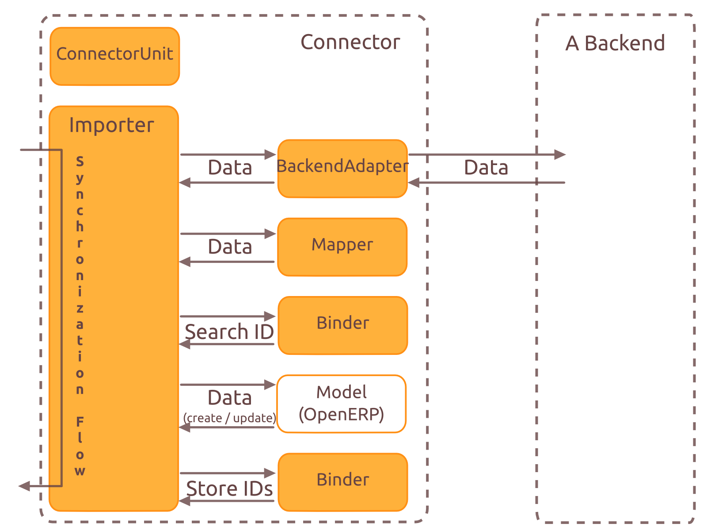
Overview – ConnectorUnit (importer)
Notes:
Only an simplified example.
The Exporter is quite similar.
A synchronizer could be anything, sometimes it uses only a BackendAdapter, but no mapper, no binder...

Slide 29
ConnectorUnit - Mapper
Transform data
Take data in, give data out
Notes:
A mapping translates an external record to an OpenERP record and conversely.

Slide 30
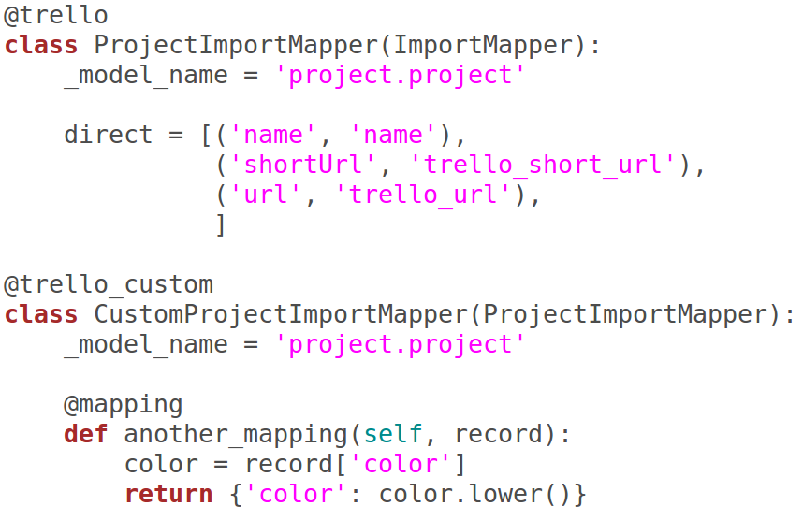
Code example: Mapper

Slide 31
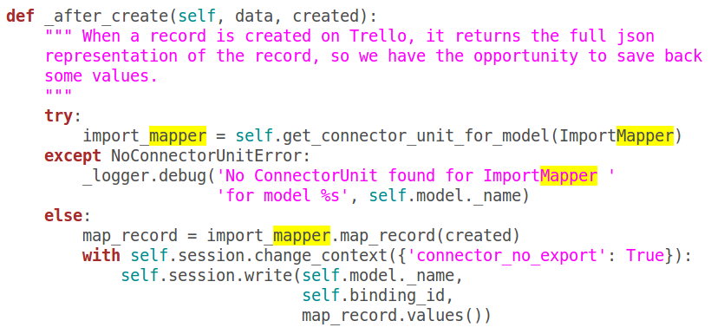
Code example: using a Mapper in a Synchronizer

Slide 32
ConnectorUnit - Binder
Know the external ID for an odoo ID (and conversely)
Store the couple “external / odoo” IDs in binding records
Notes:
Binders are classes which know how to find the external ID for an OpenERP ID, how to find the OpenERP ID for an external ID and how to create the binding between them.

Slide 33
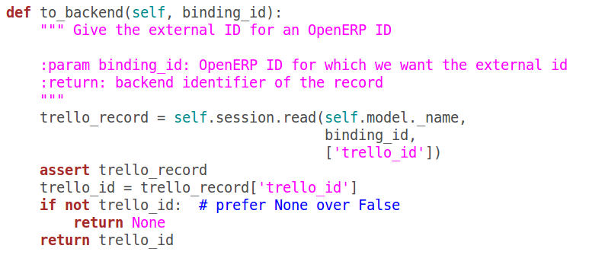
Code example: Binder

Slide 34
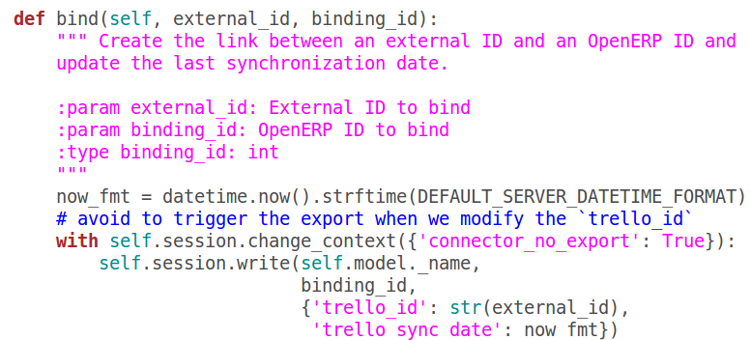
Code example: Binder bind method

Slide 35
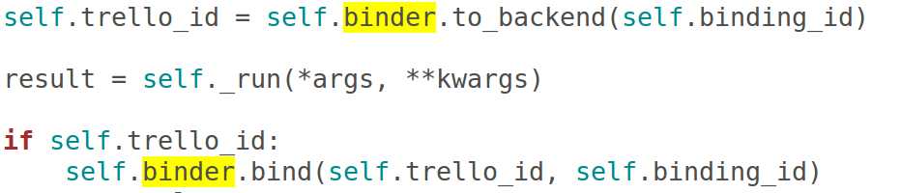
Code example: using a Binder in a Synchonizer
Notes:
Shows the use of shortcuts from within the importer

Slide 36
ConnectorUnit - BackendAdapter
Communicate with the external system
Speak the external language (REST, XML/RPC, …)
But 1 interface within odoo
  Typically CRUD
  Often uses helper library (trollop, requests, magento, gdata...)
Notes:
An external adapter has a common interface to speak with the backend. It translates the basic orders (search, read, write) to the protocol used by the backend.

Slide 37
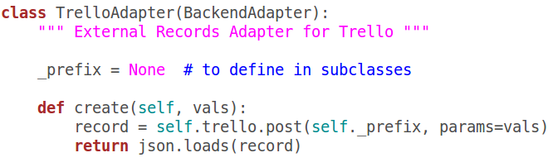
Code example: BackendAdapter

Slide 38
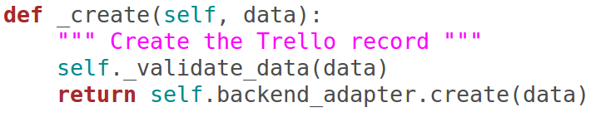
Code example: using a BackendAdapter in a Synchronizer

Slide 39
Tests
Tests!
External system should not be required to run the tests
  → Mock the external API
  Examples in the Magento connector

Slide 40
Tips
When developing, deactivate the cron tasks / worker process in charge of assigning and queueing the jobs
Use erppeek to run jobs one by one:
model('queue.worker').assign_then_enqueue(1)
Set a high priority on the job(s) you want to process first
  high priority == low value

Slide 41
Demo: Trello connector
https://launchpad.net/openerp-trello-connector

