Slide 1

SAMSUNG PRISM
Generative AI
Hackathon
3rd Edition 2026 – 27
Theme ID - Theme 3 — Teachable Voice Automation
Team Name - Legacy
College Name - Thapar Institute of Engineering & Technology
Member Name & Email 1- Gurnoor Pannu — gurnxxrpannu@gmail.com
Member Name & Email 2-
Member Name & Email 3-
Member Name & Email 4-
Submission Github link - github.com/gurnoorpannu/MYNA
MYNA · Mimic Your iNteractions & Automate — show once, then just say it.

Slide 2
Theme 3 — Teachable Voice Automation
The problem: our phones make us repeat the same 8–15 taps every day, and no assistant can learn them.
1
Repetitive by design
2
Assistants can't learn
3
Automation is for experts
Re-ordering the usual pizza, restocking groceries, re-buying a phone case: the same search, the same item, the same options — tapped by hand every single time.
Bixby and Google Assistant only do what their makers built in. "My usual Domino's order on Zomato" is impossible unless the app ships an integration.
Tasker / MacroDroid / auto-clickers need rules or screen coordinates, and silently break the moment the app's layout changes or a pop-up appears.
What the theme asks for
Teach once
by voice + one demonstration
Replay by voice
with new values (item, qty, address)
Survive change
pop-ups, moved buttons, new screens
Ask when unsure
never a silent wrong guess
Stop at the boundary
zero taps on payment / OTP / login
Rules: AccessibilityService only · no app SDKs · no deep links · no hard-coded flows · flows must take parameters

Slide 3
Existing Solutions & Gaps
Approach | Learns a new app task from one demo | Voice with changed values | Survives UI changes | Hard stop at payment / OTP | AI cost per run
Bixby / Google Assistant | ✗ built-in tasks only | ✓ built-in intents | ✓ | ✓ | cloud NLU
Tasker · MacroDroid · auto-clickers | ~ manual rules / coordinates | ✗ | ✗ fixed positions | ✗ | none
Research record-replay (SUGILITE, VASTA) | ✓ | ✓ | ~ text + OCR match | ✗ no hand-off | none
LLM phone agents (AutoDroid, MobileGPT, AppAgent) | ✗ re-plans every run | ✓ | ✓ | ~ prompt-based | 1 LLM call per step
MYNA (ours) | ✓ one voice + tap demo | ✓ blanks, qty, address | ✓ 4-level finder + recovery | ✓ rule gate, 0 AI | ≈1 call per command, 0 on replay
The gap. Nobody combines one-shot teaching, parameterised voice replay and a hard safety boundary at near-zero AI cost.
Assistants can't learn new apps; macro tools break on the next UI change; LLM agents are slow, costly and non-deterministic — they re-think every tap, every time. Record-replay research proved the idea but never stopped itself at a payment screen or handled today's apps (web views, Compose lists, buttons drawn as images).

Slide 4
Our Solution & Architecture
Show once, then just say it. One demo becomes a recipe with blanks; a sentence replays it with new values.
TEACH TIME
Voice / typed command
"Order a Margherita from Domino's"
Recorder
AccessibilityService events → steps, inferred hidden taps
Compiler
deterministic blanks + 1 Gemini call
Recipe store
JSON on device · {item} {restaurant}
recipes
RUN TIME
Voice command
in-app speech + mis-hearing fix
Intent matcher
embeddings rank · blank fill · asks if unsure
Executor (no AI)
finder → fallbacks → goals (qty, address)
Safety gate
checks every tap and type
AI is never on the normal replay path.
Finding buttons, tapping and the safety gate are rules — fast, repeatable, offline.
AI helper — only when lost
numbered screen list · 1 call · still gated
Run log → History
"Did the last run work?"
Tap / type
in the app
🔒 Your turn
payment · OTP · login

Slide 5
Our Solution — learning a task from one demo
1
Capture every step
2
Generalise into a recipe
THE LEARNED RECIPE
Order a {item} pizza from {restaurant} on Zomato
Merges all of the app's windows into one screen tree (UiNode).
Each tap gets an identity: label, id, sub-texts, neighbours, card anchor → a unique key.
Taps apps hide are inferred from what changed:
typed, then landed → search goal
sheet closed → confirm options (+ your choices)
keyboard gone → Enter pressed
web page changed / cart count up → "Add to cart"
Call screens, double taps and tap-then-Back are dropped as noise.
Blanks found without AI: spoken words that match what you typed, searched or tapped → {item}, {restaurant}.
Half-typed or typo'd searches are completed ("margerit" → Margherita).
1 Gemini call names blanks, writes a summary, paraphrases, a "why" per step and flags mistake steps.
Options you picked become habit defaults.
No key / no quota → rule-based fallback, still works.
1
Open Zomato (clean start)
2
Search {restaurant} → open it
3
Search the menu for {item}
4
Tap ADD next to {item}
5
Confirm options — New Hand Tossed · Regular
6
Continue → checkout
7
🔒 Hand off at payment
Say "a farmhouse" → same recipe, new {item}

Slide 6
Our Solution — replay that recovers, safety that holds
Finding the right button on a changed screen
🔒 Safety gate — rules only, zero AI
L1
Exact key the demo's id / label / child text
Payment screens UPI / card / wallet / EMI choices, pay buttons
L2
Same element matched by neighbours and card anchor
Credentials password, OTP and secure fields
L3
Fuzzy text Levenshtein ≥ 0.8, singular/plural
Final commit Place order, Pay, Send order to business
L4
On-device OCR ML Kit reads text drawn as images
Login screens sign-in and account walls
↺
Bounded fallbacks close pop-up (✕ only) · open search · Enter · scroll · best result
GatedActor is the only code path that can tap or type — every action is checked first.
One exception: choosing a saved address on the checkout screen ("deliver to work").
Tuned on real screens: cart offers, a Wallet tab and colour radios are not payment.
AI
Last resort Gemini picks from a numbered list — still gated
■
Stop with a reason closed restaurant · Hindi screen · no progress in 30 s

Slide 7
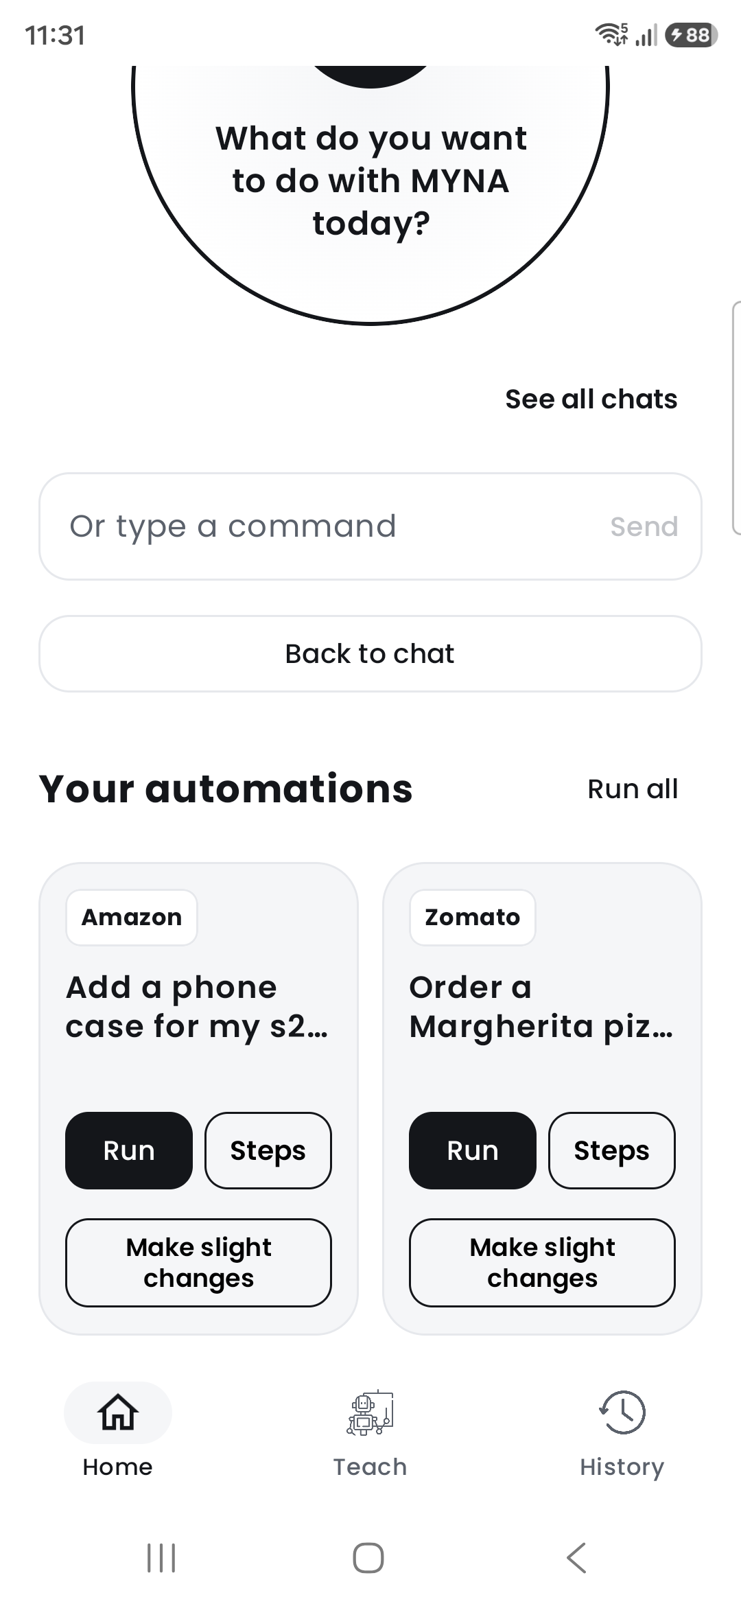
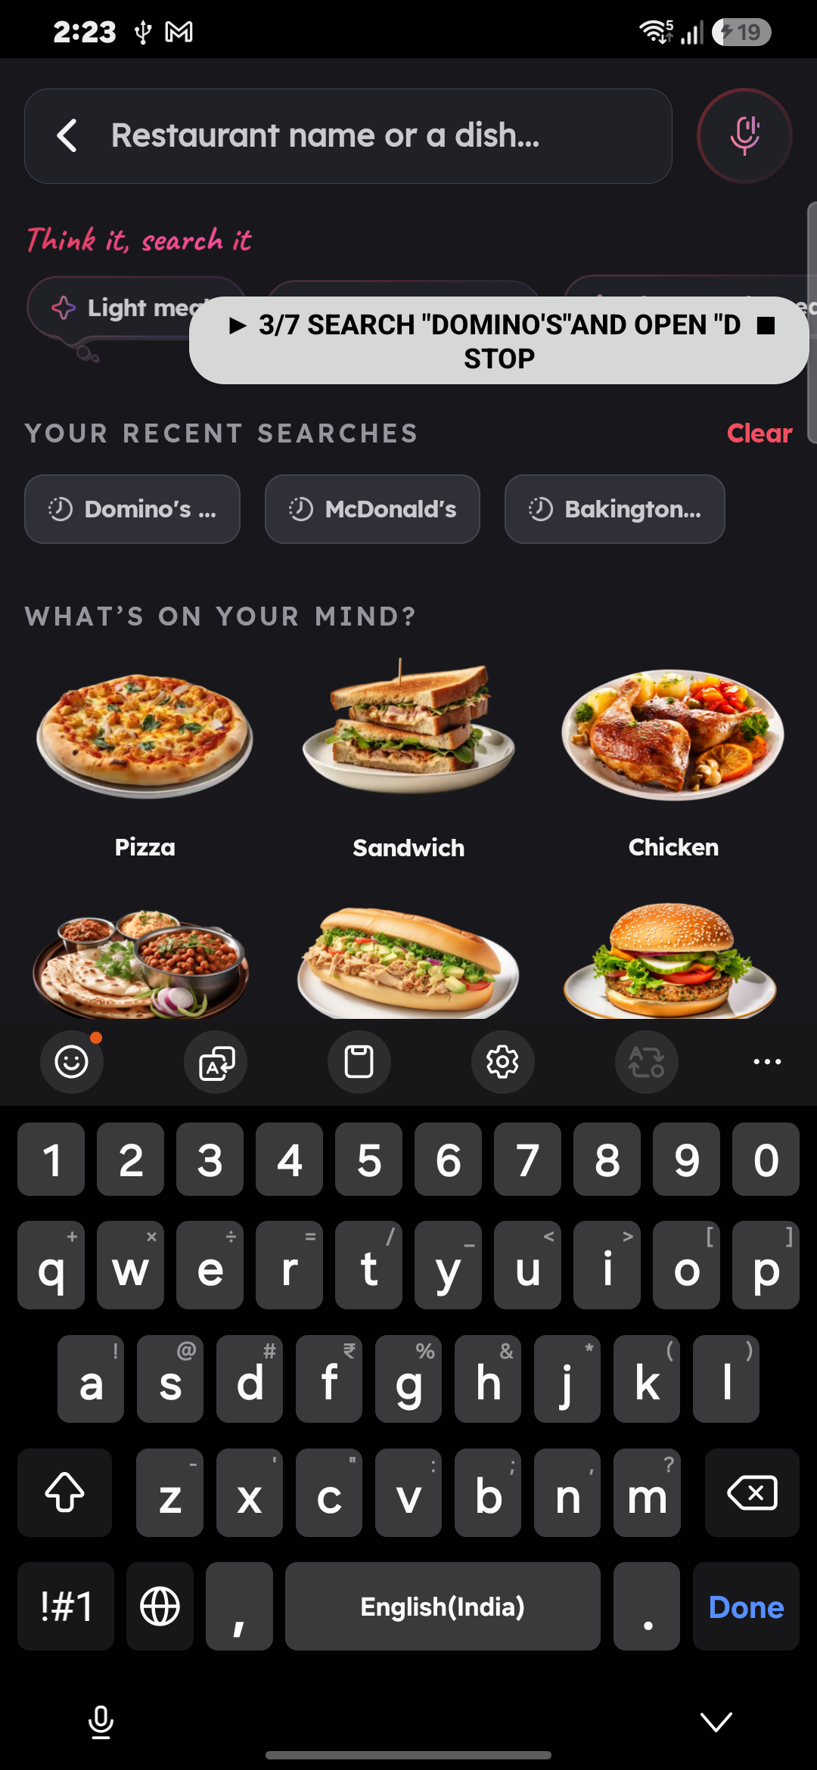
Demo & Product Walkthrough
1
Teach
Say "Order a Margherita pizza from Domino's on Zomato", tap Show me once and just do it. The 🔒 stops the demo at payment.
2
Learned
MYNA says "Learned: …" and shows every step with its why. Mistake taps are left out.
3
Just say it
Tap the mic: "get me 2 farmhouses from dominos, deliver to work". A chat confirms what it heard.
4
Replay
MYNA opens Zomato, searches, adds, sets quantity and address — asking only if unsure.
5
Your turn
Zero taps on payment. "Did the last run work?" → one-sentence report; History shows each step.
▶ Demo video (≤ 5 min): drive.google.com/file/d/1DHrpgInpbme7hSHadp0A3DoQJjBCN2yX
Home: mic + saved automations
Replay: live progress, ■ Stop

Slide 8
Tools and Tech Stack
App
Kotlin 2.2 · Jetpack Compose (Material 3) · minSdk 30 (Android 11+) · Poppins UI
Screen control
AccessibilityService: window trees, events, gestures, screenshots, key events
A
S
Vision
ML Kit on-device text recognition — reads buttons drawn as images
Language AI
Gemini Flash (JSON schema, temp 0, 1 retry) · gemini-embedding-001 for intent ranking
V
L
Voice
Android SpeechRecognizer in-app, partial results, biased to recipe words · TextToSpeech replies
Data
kotlinx.serialization JSON recipes & run logs on device · private apps never sent to AI
V
D
Quality
172 JVM tests (full replays on fake Zomato & Amazon built from real screen dumps) + 8 on-device tests
Build & tools
Android Studio · Gradle AGP 9 · adb debug hook for dumps/replays · GitHub
Q
B

Slide 9
Impact & Use Cases
8–15 → 1
0
≈1
Any app
taps become one sentence
taps on payment, OTP or login
AI call per voice command — 0 on the replay path
from the launcher — no SDK, no partner deal
Everyday re-orders
"My usual pizza", weekly groceries, medicines, a phone case — the same flow with a new item or quantity.
Accessibility
Older users and people with low vision or motor impairments say one sentence instead of hitting many small targets.
Hands busy
Cooking, carrying, multitasking: speak the task, check the result, press pay yourself.
Samsung ecosystem
A teachable layer for Bixby: users add their own skills on any app, with no integration from the app maker.
Privacy-first
Recipes and logs stay on the phone. Messaging apps (WhatsApp, SMS) are never sent to AI or saved as screens.

Slide 10
Innovation Highlights
1
2
3
Learns what apps hide
Blanks without guessing
Never-taught parameters
Web views, Compose lists and buttons drawn as images send no events — MYNA infers those taps from what changed on screen.
{item}, {restaurant} come from matching your words to your taps — deterministic; AI only names and explains them.
"2 margheritas, deliver to work" → taps + on the stepper and picks the Work address: steps never shown in the demo.
4
5
6
Asks instead of guessing
AI off the hot path
Built for real phones
"Did you mean … like last time?", "Which restaurant?", confirms 2+ changes, asks for a finger tap when an app refuses.
Replay, finding and safety are rules: repeatable and offline. Gemini is used 3 ways, each with a fallback.
Speech mis-hearing fixes, slow-network waits, pop-ups closed by ✕ only, closed-restaurant and Hindi-screen stops.

Slide 11
Results — all 14 official test cases
ID | Test | Result
T1 | Teach — food (Zomato) | ✓ Pass
T2 | Exact replay to payment | ✓ Pass
T3 | Paraphrase (2 wordings) | ✓ Pass
T4 | Slot: item (Farmhouse) | ✓ Pass
T5 | Slot: quantity (two) | ✓ Pass
T6 | Slot: address (work) | ✓ Pass
T7 | Screen change / pop-up | ✓ Pass
T8 | Teach — e-commerce (Amazon) | ✓ Pass
T9 | Cross-app slot + replay | ✓ Pass
T10 | Genuinely stuck → reports | ✓ Pass
T11 | Credential boundary | ✓ Pass
T12 | Unknown intent | ✓ Pass
T13 | Ambiguity → asks | ✓ Pass
T14 | Reporting the last run | ✓ Pass
172 + 8
JVM tests (full fake-app replays) + on-device tests
19.6 s
to teach the Zomato order (by hand: 34 s)
18.6–34.6 s
Amazon replay, hands-free, to the payment step
1 + ≈1
AI calls: one per teach, about one per command
Every test has a screen recording linked in the README.
Tested on Galaxy S25 Ultra and Nothing Phone (3a), Android 16.

Slide 12
Limitations — and how MYNA handles them
Limitation | What MYNA does about it
Zomato's "Add item" sometimes ignores accessibility taps | Reselects your options, tries twice, then asks for one finger tap and waits 30 s
Some taps send no event while teaching | Inferred from screen changes; replay also re-finds the result or ADD by name
On-device OCR reads Latin script only | Stops on Hindi screens with a clear reason instead of tapping blindly
Gemini free tier ≈ 20 calls/day, sometimes 429/503 | Rule-based fallbacks keep teaching and replay working offline
Replay can be slower than by hand (41 s vs 34 s) | The win is hands-free and error-free; waits only while pages load
No phone-call pause, no re-teach from one step | Run ends with a reason in History; steps can be deleted or re-taught
Run button replays the taught values | Say or type quantity / address in the chat for those runs
By design: replay always stops at payment — MYNA never places an order or pays.

Slide 13
What's Next
Next
Soon
Vision
• Cross-app replay: teach on Amazon, run on Myntra / Flipkart (universal search, pick-result and cart goals)
• Re-teach from any single step
• Pause and resume around phone calls
• Ask for missing values even when you name only the app ("order a pizza on Zomato")
• On-device model (Gemini Nano) for blank filling and recovery — fully offline
• Hindi and Indic OCR + speech
• Share and import recipes between users
• Highlight each element just before it's tapped
• "Hi Bixby, my usual order": MYNA as the teachable layer of Bixby
• Triggers by time or place ("every Sunday 8 pm")
• Multi-app chains: order food, then WhatsApp the ETA
• One recipe, every similar app — a shared library of learned tasks
The goal: every Galaxy user teaches their phone once — and never taps the same flow again.

Slide 14
Brownie Points — what sets MYNA apart
Bonus criteria
Built on research, tuned on real apps
Discards unnecessary touches
Call screens and the dialer are never recorded; double taps and tap-then-Back are dropped; AI flags leftover mistakes → "I left out 2 steps that looked like mistakes."
Paper | What we took → what we added
SUGILITE (CHI '17) | demo + voice teaching → payment hand-off, hidden taps
VASTA (Samsung, IUI '20) | 3-level finder + OCR → thresholds re-measured on Gemini
AutoDroid (MobiCom '24) | numbered screen list → used once, as last resort
MobileGPT (MobiCom '24) | sub-task recipes → universal search / pick goals
OS-Kairos (ACL '25) | act vs ask by confidence → asks for missing blanks
Pop-up attack studies | never tap a pop-up's action → close by ✕ only
✓
✓
Mid-flow parameter clarification
A missing blank is recognised and asked: "Which restaurant? Last time it was Domino's" — then the flow continues with your answer.
~
Generalisation across similar apps
Search, pick-the-best-result and checkout are app-agnostic goals, proven on Zomato and Amazon; running an Amazon recipe on Myntra is next.
Extras: speech mis-hearing fixes · chat history like a messenger · volume key silences MYNA · WhatsApp catalog orders stop before Send.
3 bonus criteria · 2 fully met, 1 foundation built

Slide 15
Checklist — updated on public GitHub
Y
Working prototype code — public GitHub repo
github.com/gurnoorpannu/MYNA
Y
README with reproducible setup instructions
build, run, AI key, tests — README.md
Y
Demo video, max 5 minutes
drive.google.com/file/d/1DHrpgInpbme7hSHadp0A3DoQJjBCN2yX
Y
Presentation file (PPT or PDF)
this deck
Y
One video per official test case (T1–T14)
linked in the README test table
Y
Architecture and known limitations docs
docs/architecture.md · docs/limitations.md

Slide 16
Thank you
MYNA · Team Legacy · github.com/gurnoorpannu/MYNA
Organised by the Language AI Team and the PRISM Team, Samsung R&D Institute India
Notes:
Closing slide. Add the Google Form URL and a contact email before sharing. Edition 2 organising team for reference: Language AI - Sourabh Tiwari, Gaurav, Sanjeeth Pothireddy, Gorang Maniar; PRISM - Binny Lakra, Prakhar Chandrakar, Vishu Kumar; Kick-off and mentors - Giridhar Jakki, Deepraj Prabhakar Patkar (Language AI), Srimanu Prasad Nagaraju, Ashish Kumar (Tech Strategy).

