Slide 1
Big Data Analytics
PRACTICAL…

Slide 2
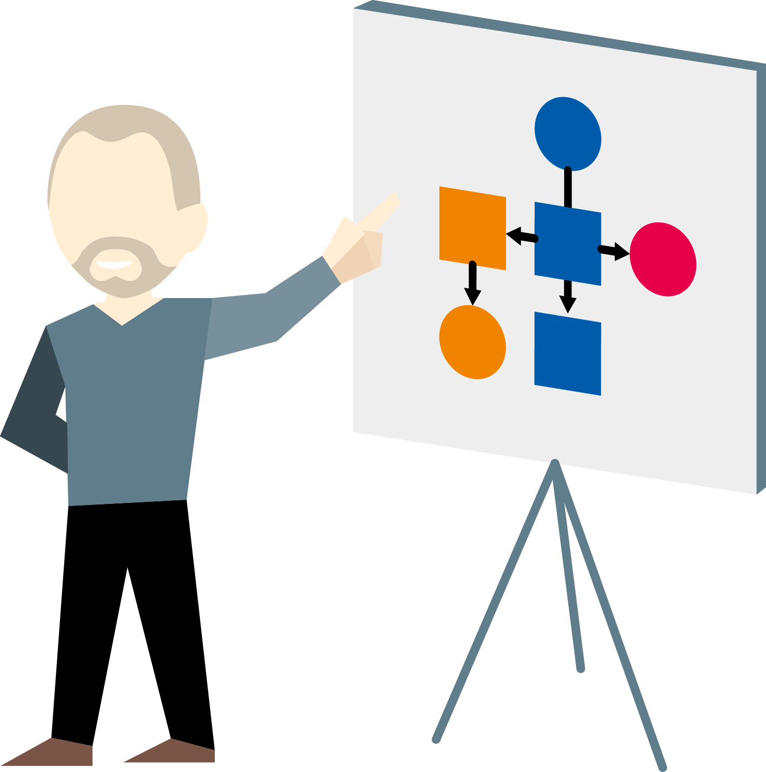
Course Introduction
Administration
Introduction
Objectives
Assumptions
Delivery

Slide 3













Slide 4
Course Objectives
By the end of the course you will have:
Explored and Analysed Data in Python
Communicated and Formalized Machine Learning Problems
Executed a Machine Learning solution to a problem
Prepared Data for Machine Learning
Trained a Machine Learning algorithm

Slide 5
Monday | Tuesday | Wednesday | Thursday | Friday
Intro to Data Science, Big Data & Analytics | Graph Analytics | Introduction to Machine Learning & AI | Intro to Parallelization, Hadoop & Spark | Spark DataFrames
Intro to Python for Data Science & Analytics | NoSQL: Neo4j, Mongo, Parquet | ML Models & Algorithms: Neural Networks | Functional Programming for Spark Analytics | ML & Data Pipelines
Intro to Big Data Concepts & Tools | Data Analytics in Python: NumPy | ML Evaluation | Spark API
Functional Programming for Graph Analytics | Data Analytics in Python: Pandas & Seaborn | Data Science Workflow

Slide 6
Assumptions
The course assumes that you have:
Prior Experience with Python
General fundamental mathematical skills
A general knowledge of IT concepts
A basic knowledge of the difference between querying and analysis of data
An interest in the analysis of data
A desire to know more about Big Data, Data Science & Machine Learning

Slide 7

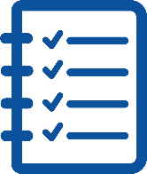




Course Delivery

Slide 8

The Training Experience
A course should be:
A two-way process
A group process
An individual experience

Slide 9

Introduction
Please say a few words about yourself for the benefit of the group…
What is your name, company and role?
What is your experience of..
Programming, Python, Software
Analytics
Data, Databases
Statistics, Mathematics
What do you want from the course?

Slide 10


Any questions?

