Slide 1
NUMERICAL COMPUTING
PYTHON…

Slide 2
OVERVIEW
numpy
matplotlib
seaborn
bokeh

Slide 3
NumPy

Slide 4
Overview
Why numpy
What is numpy
Installing numpy
ND-arrays
Slice and Dice
Array operations
Universal Functions
Summary Statistics

Slide 5
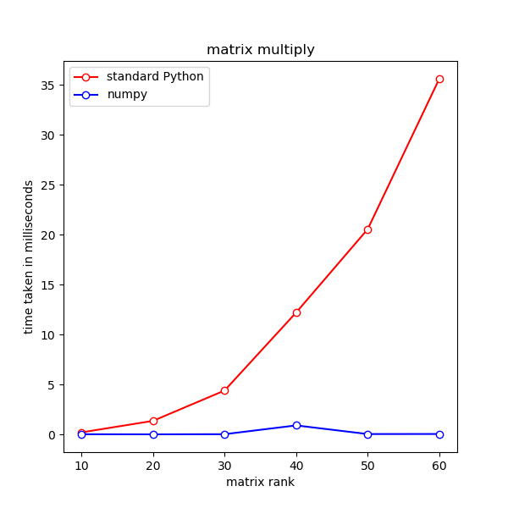
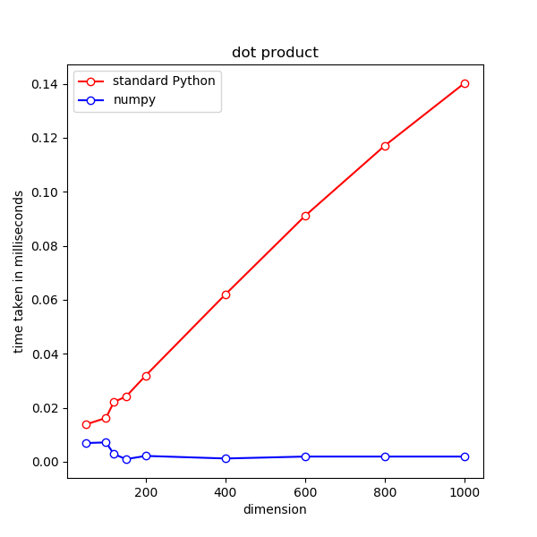
Python is Slow
Python collections are not designed for computational efficiency
C and FORTRAN arrays are much more efficient computationally than Python lists for large data setsmat_dot_times.png

Slide 6
What is numpy
Numpy package was developed by the scientific community to address the inefficiencies of Python in dealing with large amount of data
First introduced in 2006, developed from Numeric package written by Jim Hugunin and others.
Written in C and FORTRAN
Internal data structure uses C arrays
Python API for seamless integration with Python
Provides its own array types, and introduces more numerical data type for a wide range of precision requirements
Numpy arrays retain most Python collection behaviours, making numpy look and feel “native” to Python language
Incorporates fast maths libraries, such as OpenBLAS (default, open source), MKL (intel machines), ACML (AMD machines) for very efficient linear algebraic operations (dot products, matrix multiply, etc)
Numpy forms the basis of almost all Data Science packages for Python.

Slide 7
Installing numpy
Numpy Is open-source
It is not part of the official Python distribution.
The easiest way to install numpy is to use conda package manager
Numpy already comes with Anaconda
Can be installed manually using:
conda install numpy
If you wish to install numpy from source, then you need C and FORTRAN compilers.

Slide 8
ND-arrays
Stands for N-dimensional arrays
The basic data type in numpy, intends to replace Python’s list
Can be created from Python’s list using numpy.array()
ND-arrays are mutable
numpy.arange() produces a sequence of numbers contained in an array
numpy.repeat() produces an array of repeating elements

Slide 9
Dtype
ND-arrays are homogeneous---can only contain elements of the same type
The type of the elements in an array is recorded as a dtype object
Dtype of an array can be obtained using array.dtype property
Standard Python data types can be used as dtypes: e.g. int, float, str
We can perform type conversion using array.astype(new_type)
The new_type must be compatible with the original type of the elements
If in doubt, numpy automatically converts an array to an array of strings

Slide 10
Array Shape and Sizes
The built-in function len() no longer function correctly with nd-arrays
To find out size of a nd-array, use array.size property
To find out the shape --- size of each dimension --- of an array, use array.shape property
Shape of an array can be changed using array.reshape()
It is the programmer’s responsibility to make sure the new shape is compatible with the total number of elements

Slide 11
Slice and Dice
Standard Python list slices:
array[i] obtains the i-th element
array[n:m] obtains the elements array[n], array[n+1], …, array[m-1] in a new array
New to ND-arrays:
Cherry-picking:
array[[2, 4, 5, 1]] obtains the elements array[3], array[4], array[5], array[1] in a new array
Cherry picking list can be any python iterator with integer elements
Filtering
array[[True, True, False, … False, True]] obtains the elements from positions marked as True in a new array, omits those marked by False
Filter list can be any python iterator with boolean elements, and its length must be the same as the array.
The filter list is usually computed rather than written by hand

Slide 12
Operations
All arithmetic operations are performed element by element (broadcasting)
All comparisons are performed element by element
numpy.dot(v, u) computes dot product of arrays v and u
A @ B computes the matrix product of arrays A and B
Alternatively can use numpy.matmul(A, B)
array.T would transpose an array
Rounding can be performed element-wise using array.round()

Slide 13
Logical Operators and Functions
Elementwise operators:
~ NOT
& AND
| OR
^ XOR
Functions acting on entire array
numpy.all()
numpy.any()

Slide 14
Universal Functions
All numpy functions which work with nd-arrays are of the type numpy.ufunc, referred to as universal functions
Universal functions take nd-arrays as arguments, and broadcast their functionality element by element
Numpy redefines the arithmetic and comparison operators for the nd-arrays as universal functions:
+ is equivalent to numpy.add()
- is equivalent to numpy.subtract()
* is equivalent to numpy.multiply()
/ is equivalent to numpy.divide()
Normal Python functions defined using only universal functions are also universal
A normal Python function can be converted to a universal function using:
my_ufunc = frompyfunc(myfunc, num_arguments, num_outputs)

Slide 15
Reduction
A universal function with two array arguments can be reduced:
numpy.add.reduce(myarray) is equivalent to numpy.sum(myarray)
numpy.less.reduce(myarray) is equivalent to numpy.min(myarray)
Reduction takes place by applying:
my_ufunc(A, B) to a single array:
my_ufunc(my_ufunc(my_ufunc(myarray[0], myarray[1]), myarray[2]), myarray[3]) etc.

Slide 16
Accumulation
A universal function with two array arguments can be accumulated:
If “spending” is an array of amount of a person’s spending in each month
numpy.add.accumulate(spending) gives the accumulated amount the person has spend up until Jan, Feb, March, April, and so on.

Slide 17
Summary Statistics
Numpy comes with a full set of statistical functions
numpy.sum()
numpy.min()
numpy.max()
numpy.mean()
numpy.median()
numpy.var()
numpy.std()
numpy.corrcoef()

Slide 18
Visualization

Slide 19
OVERVIEW

Slide 20
Python VIz Packages
Python has a wide selection of packages for visualising data
Matplotlib is one of the most popular plotting package, designed for publication quality graphics
Seaborn is built on top of Matplotlib making statistical plots easier to produce
Bokeh is a native Python package for interactive plots, its outputs interactive plots in javascript
Ggplot is a port from R’s ggplot2 package in python, an alternative to Matplotlib
Plotly is an online platform for interactive visualisation based on javascript, it has an API that can be used with Jupyter Notebook, it is an alternative to Bokeh
Pygal is another alternative to Bokeh for interactive plots
In this course we will be focusing on Matplotlib, Seaborn and Bokeh

Slide 21
Matplotlib
First written by John D. Hunter (1968--2012) in 2003
Designed to mimic MATLAB’s plotting API --- hence the name of the package
Focuses on static 2D plots
Produces publication quality graphics
Allows imbedded mathematical symbols using LaTeX when using Postscript or PDF outputs
Relatively simple code
Integrates with numpy
Gained popularity amongst the scientific community, and became the de-facto data plotting package of Python

Slide 22
Installing Matplotlib
Matplotlib is not included as part of a basic Python distribution
It is included in Anaconda distribution
Needs numpy to work
To install manually, best to install via
conda install matplotlib

Slide 23
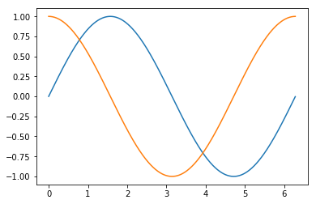
Matplotlib Graphic Structure
A plot consists of
A figure --- canvas
One or more axes --- plots
One of more artists --- glyphs
All figures, axes and artists are Python objects
figure
artists
axes

Slide 24
Figure
Defines the overall area of a plot, including its titles and legends
Each separate plot has its own figure
Figure controls the size and dimensions of the plot

Slide 25
Axes
Defines a set of x-y axes for one data plot
A figure can have several axes, so we have multiple plots appear together in one figure
Defines the appearance of the x-y axes
x, y limits
x, y ticks
x, y axis labels

Slide 26
Artists
Defines the individual glyphs appear on a plot, they can be:
lines
dots
texts
boxes, legends etc.

Slide 27
Two API modes
MATLAB like
Plot session starts with a default figure and one axes
Functions are called to modify the state of the figure, one can change:
Size and dimension of the figure
Number of axes in the figure, and how they are distributed inside
Limits and labels of axes
Titles of plots
Add or remove legends
Number of ticks and their labels
Setting plot colours
plt.show() will plot out the final state of the plot

Slide 28
Two API modes
Object-Oriented
Uses the Python OO interface
Creates individual figure and axes objects using constructors
Modifies the state of the objects using methods
In this course we will focus on the MATLAB API

Slide 29
Simple Plots
Convention for importing Matplotlib to make its name shorter
import matplotlib.pyplot as plt
To plot y = sin(x)
Create a set of x values, using x = numpy.arange(0, 2*numpy.pi, 0.1)
Calculate the corresponding values of y, using y = numpy.sin(x)
plt.plot(x, y)
plt.show()
This produces a line plot as default

Slide 30
Modifying Plot
Change figure size
plt.figure(figsize = [10, 5])
Add title
plt.title(“Plot of sin(x)”)
Change axes limits
plt.xlim(0, np.pi)
plt.ylim(-0.5, 0.5)
Add axes labels
plt.xlabel(“values of x”)
plt.ylabel(“values of y”)

Slide 31
Modifying Plot
Change ticks
plt.xticks(list_of_tick_positions, list_of_tick_labels)
plt.yticks(list_of_tick_positions, list_of_tick_labels)
Add legends
plt.legend()
Scatter plot with circular markers
plt.plot(x, y, linestyle = ‘’, marker = ‘o’)
Dotted lines with x markers
plt.plot(x, y, linestyle = ‘--’, marker = ‘x’)

Slide 32
Multiple Plots
Adding plot to same axes:
Simply add more plt.plot() for the new data to be plotted
Adding new axes to figure:
Add one function call plt.subplot() for each sub-plot
plt.subplot(2,1,1) followed by all plot modifier functions
plt.subplot(2,1,2) followed by all plot modifier functions
The arguments of subplot() for two plots stacked vertically:
2: total number of sub-plot rows (2)
1: total number of sub-plot columns (1)
1: index of the sub-plot, starts counting from 1

Slide 33
Seaborn
Developed based on Matplotlib
Tailored to produce publication quality statistical plots requiring minimum code
Comes with wide range of pre-defined colour palettes
Can be modified with Matplotlib functions

Slide 34
Installing Seaborn
Seaborn is included in Anaconda
To install manually, use:
conda install seaborn
To use Seaborn, convention uses the alias “sns”
import seaborn as sns

Slide 35
Visualising Distributions
Continuous data
sns.distplot(a = my_dataframe[‘column name’])
By default kernel density estimation (KDE) is also plotted, this is an approximation of the distribution using a linear combination of normal distributions
KDE can be turned off by setting kde = False in sns.distplot()
Discontinuous data
sns.countplot(data = my_dataframe, x = ”column name”)
Allows breaking data into sub-groups and plot in different colours
sns.countplot(data = my_dataframe, x = ‘Height’, hue = ‘Gender’)

Slide 36
Comparing Distributions
For example, we may wish see if gender has an effect on weight in a survey data we have collected
sns.distplot do not support “hue”
We can instead compare the male and female weight distributions using a box plot or a violin plot
Box (and whiskers) plot:
sns.boxplot(data = my_dataframe, x = ‘Gender’, y = ‘Weight’)
Box gives position of 25-th (Q1) and 75-th (Q3) percentile
Line inside the box gives the 50-th (Q2) percentile
Whiskers on default gives Q1 – 1.5 * (Q3 – Q1), and Q3 + 1.5 * (Q3 – Q1)
Dots outside of the whiskers are the outliners
Violin plot:
sns.violinplot(data = my_dataframe, x = ‘Gender’, y = ‘Height’)
Similar to box plot, but also plots out the actual shape of the distributions

Slide 37
Plotting Trends
Scatter plot
sns.scatterplot(data = my_dataframe, x = ‘Spending’, y = ‘Profit’)
Linear regression plot
sns.regplot(data = df, x = ‘Spending’, y = ‘Profit’)

Slide 38
Heatmaps and Correlation
Correlation coefficient between two columns
1 means there is100% linear relationship between two columns
0 means one column appears random to the other column
0.6 means somewhere in-between
Used to discover if one column can be used to predict the values of another
Pandas provides an easy way to compute correlation coefficients of all pairs of columns in a data frame:
corr_matrix = my_dataframe.corr()
The correlation coefficient matrix computed by Pandas can be visualised using a headmap:
sns.heatmap(corr_matrix)

Slide 39
Plotting Geographical Data
To visualise data mapped to geographical areas, we need to plot the following items:
The geographical map
All of the regional areas, with their boundaries
e.g. All boroughs and their boundaries in England
A way to represent data associated with the regional areas
e.g. Average house price in each borough

Slide 40
Representing Map Boundary Data
The boundaries are represented as a collection of coordinates linked by lines
Each enclosed area also has a name --- e.g. name of the Post Code region, or borough
This information is stored in various formats
CSV
GeoJSON
Keyhole Markup Language (KML)
In CSV format, each row would represent one coordinate in a boundary of a region. This format is very ineffcient
GeoJSON uses JSON file to record the meta information of each region and coordinates in its boundary in a key-value format
KML use XML format to record the same information
One need to download a GeoJSON or KML or CSV file for the map we need to plot

Slide 41
Geopandas
Based on Pandas package
Provides GeoDataFrame, which inherits from a Pandas DataFrame
GeoDataFrame represents a GeoJSON file in a tabular form, which can be manipulated in Python using standard Pandas functions
Each row in a GeoDataFrame represents a polygon, which represents a region on a map
Reads a GeoJSON file using:
import geopandas as gpd
gpd.read_file(“map_data.json”)
Can read a KML file but needs a little hacking
We use GeoPandas to prepare and modify the map data so that it incorporates the data we wish to plot

Slide 42
Plotting Interactive Maps Using Bokeh
Bokeh is not included in Anaconda, but can be installed through its package manager
Installing Bokeh:
conda install bokeh
To use Bokeh for plotting geographical data, we need to import a few features from the package:
from bokeh.models import
GeoJSONDataSource: for loading a GeoJSON file
from bokeh.plotting import
figure: for creating an interactive plot
from bokeh.io import
output_file: for setting output filename
save: for saving output into a file (usually a html file with embedded javascript)

Slide 43
Plotting Interactive Maps Using Bokeh
If we want to colour the regions according to data then, we need to:
from bokeh.models import LinearColorMapper
Basic work flow to visualise data on map:
Read data into a Pandas DataFrame
Read relevant map into a GeoPandas GeoDataFrame
Drop the irrelevant columns using DataFrame.drop()
Join the data DataFrame and GeoDataFrame together
Convert GeoDataFrame back into a GeoJSON string
Pass the GeoJSON string into GeoJSONDataSource() to produce a Bokeh compatible input object
Create a Bokeh figure using fig = figure()
Create an instance of LinearColorMapper, with lower and upper limits set by data
Plot using fig.patches(), with fill_color set to the LinearColorMapper we have created

Slide 44
Interactive Tool Tips
To display more information about a region when mouse is hovered on top of it:
from bokeh.models import HoverTool
my_hover = HoverTool()
my_hover.tooltips = [('Postcode', '@Name’), ('Region', '@REGION'), (‘Mean Price', ‘@PRICE’)]
Tool tips consists of a list of pairs
For each pair,
The first item is the field name to be displayed in the tool tip
The second item is the value to be displayed in the tool tip
@Name means display the corresponding value in the “Name” column in the GeoDataFrame

