Slide 1
INTRODUCING… DATA ENGINEERING
For those presentations you know you will need to print

Slide 2
Culture
Data: Roles
What is DevOps?
What are the pillars of tooling?
What are the aims of DevOps?
Pipelines
Developing & Monitoring
Building & Monitoring
Integrating & Monitoring
Containerizing & Monitoring
The Deployment Process Toolchain
Containerization
Containers
Virtual Machines
Docker
Docker Control
Docker Logs
Docker Layers
Dockerfile
Docker build
Docker file systems
Docker hub
OVERVIEW

Slide 3
Culture

Slide 4
Data: Roles
Data Analyst
Business Intelligence
Statistician
Data Scientist
Statistician
Software Engineer
Machine Learning Practitioner
Software Engineer
Data Engineer
DataOps
Governance
Security
Chief Information Officer

Slide 5
What is DevOps?
Development [Software Engineering]
QA
Operations
DevOps is a technical movement
agile system administration
Agile and Lean approaches to operations
Beyond taking agile to traditional Sys Admin roles
bridges the gap between developers and ops roles
collaboration between the roles
integrates traditional separations
undoes harm due to separation
DevOps is an outgrowth of Agile

Slide 6
Who is DevOps for?
Have a great idea
Write test cases
Develop it
Test it
Integrate it
Deploy it
Monitor it
Obtain feedback for refinements
Everyone:
Product owners/managers
Program managers
Team leads & Software developers
System & Database administrators
Testers, QAs, and QCs
Business analysts
Scrum masters
Change controllers
Release managers

Slide 7
What are the pillars of tooling?
The DevOps tool set is aimed at supporting the pillars
Automation is key
Testing everything as we go through
Monitoring what we have in place and catch problems before they escalate
There are many tools available for the job
Continuous Integration and Continuous Delivery
Cloud and Virtualisation
Automation and Orchestration
Monitoring and Logging
Optimisation, Testing and Performance
Notes:
The DevOps tool set is aimed at supporting the pillars
Automation is key
Testing everything as we go through
Monitoring what we have in place and catch problems before they escalate
There are many tools available for the job
Each company will have its own set
Use what is best for you
You should be able to swap one tool for another without the entire chain breaking
Continuous Integration and Continuous Delivery
We want to be able to deploy changes as they happen
Cloud and Virtualisation
No need for costly data centers, let someone else deal with this for us
Automation and Orchestration
Deployment should be reliable, testable and repeatable
Monitoring and Logging
We need to know if something is going wrong, notice and adapt
Optimisation, Testing and Performance
Test drive by default

Slide 8
What are the aims of DevOps?
Consistent, fast and safe delivery of software
new changes to be able to be pushed into production as fast as possible
add and remove as many servers as required
automate as much as possible!

Slide 9
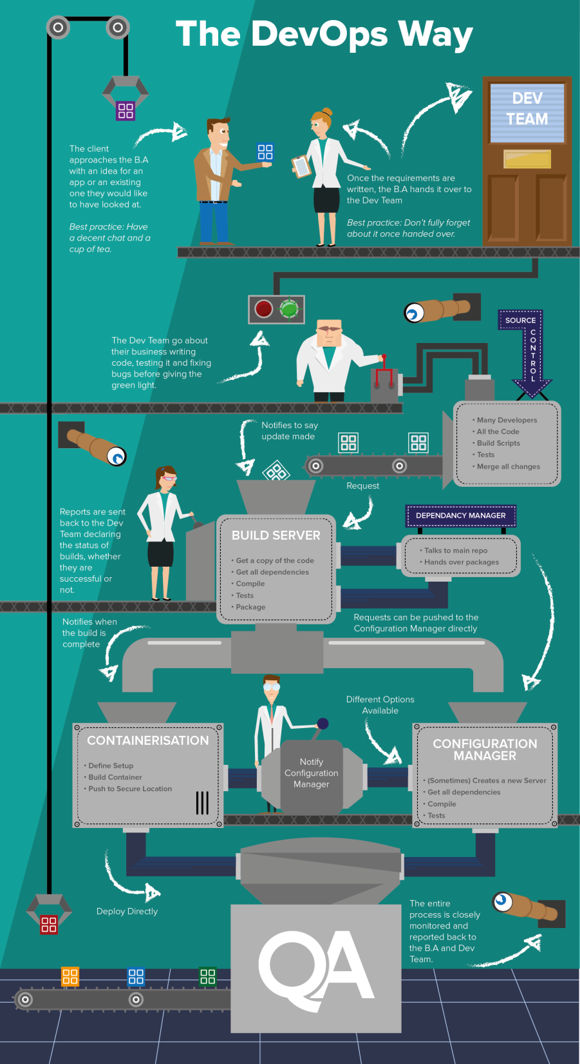
Pipelines
Visualising the software build process
The output of one tool gets pushed to the next
Everything can be automated (no more ‘forgotten’ tests)
A client has an idea for a great new product
they talk it over with the company (usually the Business Analysts)
who write up requirements and send them to the Developers
The developers write code and submit to source control
allows many people to work on the same set of files without overwriting each other’s changes
The build engine automates compiling the code
Dependency managers: automate dependency inclusion

Slide 10
Starting

Slide 11
Developing & Monitoring

Slide 12
Building & Monitoring

Slide 13
Integrating & Monitoring

Slide 14
Containerizing & Monitoring

Slide 15
The Deployment Process Toolchain
Developer writes some code, use a build manager to test locally
Update central code base with new code
CI/CD tool picks up the changes, runs tests and build
Create a container for the built product
Start a server / Connect to existing one, deploy code
Add Server to monitoring pool
Eclipse and Maven
Git Repo
Jenkins
Docker
Puppet
Nagios

Slide 16
Containerization

Slide 17
Containers
Containerization is a lightweight alternative to full machine virtualization that involves encapsulating an application in a container with its own operating environment. This provides many of the benefits of loading an application onto a virtual machine, as the application can be run on any suitable physical machine without any worries about dependencies. – Webopedia
What is a virtual machine?
Simulates hardware and software
Separate from the host OS
Containers are similar, but they are ‘light weight’
Containerisation is not a new idea
Dates back to at least 2000
LXC – Linux containers have existed for a while

Slide 18
Virtual Machines
Virtual machines need to emulate an entire operating system
Complete separation between machines
Better security – enforced from creation
Containers are made up of layers, only the changes are stored in each layer
Shared resources between containers where possible
Security isolation is possible
Fast start up time – seconds rather than minutes

Slide 19
Options
Docker
Very popular container creator / launcher
Able to integrate with many other tools (Jenkins, Puppet to name a few!)
‘De facto’ standard
rkt (Rocket)
CoreOS product
Based on the idea of only doing containers (claims Docker has too big and lost its single focus)
Can run Docker containers
Security focus
Linux Containers
LXD containerisation for OpenStack

Slide 20
Docker
“A person employed in a port to load and unload ships.”
“Docker containers wrap up a piece of software in a complete filesystem that contains everything it needs to run: code, runtime, system tools, system libraries – anything you can install on a server. This guarantees that it will always run the same, regardless of the environment it is running in.”
Designed to be hardware and software agnostic
Can run on any platform, based on linux
Windows server 2016 can support Docker natively
Compare with shipping containers
Self contained items
Can store anything
We have windows which allow us to see inside and can connect containers together
Can be stacked, loaded, unloaded independently

Slide 21
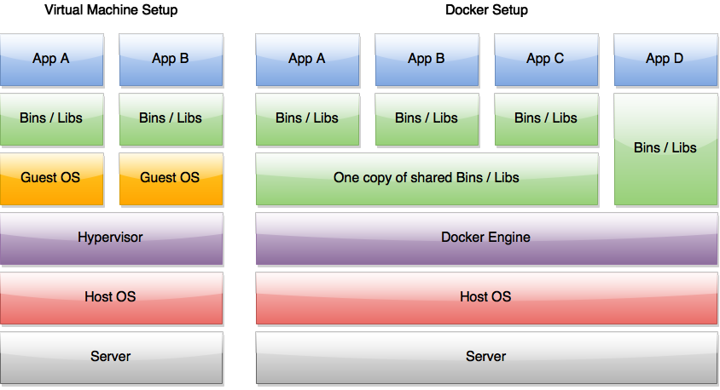
Docker Containers
Docker containers are created from different layers
Each command run creates a new layer on top of the existing structure
This means that common file bases can be shared between containers
We can build a container
in one of two ways
Run commands and
commit them one by one
Write a Dockerfile -
a script to build the
container

Slide 22
Docker Benefits
Fast to set up and start new containers
Uses caching to avoid repeated steps of compilation / setup
Avoids hardware emulation
Less overhead compared to traditional virtual machines
Sharing common layers
Docker images are created in layers
Two or more applications can share the files from the same layer
Only need to separate out the changes made
More efficient than hypervisors
Standardisation in containers
You can build a docker container on any OS and then still run it on any other OS.

Slide 23
Docker Control
All Docker commands use the main Docker binary
This must be run in su mode
The run command will see if we have a copy of the container
If not it will download one from the docker hub
List all the currently running images
-l flag shows the last container run, even if it has finished
Stopping an image
We can use either the Container ID or the name
Only usually need the first four characters of the container id
Naming an image
Finding images
Notes:
# docker ps
# docker run –-name db training/postgres
# docker kill [name]
# docker run [flags] [containername] [command to run]
# docker run –ti ubuntu bash
# docker run centos:centos6 yum update
# docker images -- images available locally
# docker search [term] -- search Docker hub for more
# docker pull [image name] -- pull down a copy of that image

Slide 24
Docker terminal
$ docker run –help
$ docker run –ti ubuntu bash
We can see the command line terminal from any container
t flag tells docker we want a psuedo terminal
i flag tells docker we want it to be interactive
Sometimes written –t –i
We can connect to containers already running
Notes:
#

Slide 25
Docker logs
$ docker logs [flags] [name]
The Docker Logs command can be used to debug containers
Shows what is being generated and displayed by the terminal
-f flag tells it to stay alive and update
This is often better than having a bash terminal alive as you can accidently close down the container

Slide 26
Docker Layers
$ docker ps –l
CONTAINER ID IMAGE COMMAND
$ docker commit --author "Name" –m "Updating the author name"
$ docker run centos7 yum install –y git
May run commands on the base containers created by Docker
If we don’t have the container it will be pulled from the repository
Unless we are in interactive mode, each comment must be able to run without any human assistance
We can see completed containers using docker ps –l
This will give us the container ID
To commit the changes to a container use the ID
This can continue until you have built everything you need

Slide 27
Dockerfile
A Dockerfile is a script that builds the container for you
It runs line by line creating new layers
FROM centos:centos6
MAINTAINER Your Name
RUN yum update –y
RUN yum install -y java
Run yum install -y git

Slide 28
Dockerfile syntax
The general form of Dockerfiles is
Capitalization of the instruction isn’t required but is convention
Each line is executed in the order it is defined in the file
You can optimize building containers by paying attention to the order of execution
From | Add
Maintainer | Copy
Run | Entrypoint
Cmd | Volume
Label | User
Expose | WorkDir
Env | OnBuild

Slide 29
Docker build
build command applies a Dockerfile
The build will look for something called “Dockerfile” in the current directory
If you want to change the file name use the --file flag
Each intermediate step of the build is given an ID
If something fails you can jump into the container at a given point with the ID
and take a look around with bash
$ docker build –t [imagename] .
$ docker build –t [imagename] --file=“Dockerfile2” .
The dot at the end is important!
This is the context the docker file builds in
Important for copy / add

Slide 30
Docker file systems
Containers should be able to be created and destroyed at will
The data inside a container is lost when the container is removed
For persistent data we should be using volumes
Volumes persist as long as there is a container referencing it
A volume is a directory mounted from outside the container
File systems can be shared between containers
The -v flag will mount a volume
Creates a directory /test inside the volume
Stored on the host system in /var/lib/docker/volumes/
Better to give it a location to use for the host directory
# docker run –v hostDirectory:containerDirectory ..
Notes:
# docker run –it –v /test ubuntu bash
# docker run -it -v /testHost:/testVolume ubuntu bash
root@53e220260718:/testVolume# echo
'hello world' > /testVolume/hello
root@53e220260718:/testVolume# exit
Exit
root@user-VirtualBox# cat /testHost/hello
hello world

Slide 31
Docker hub
The Docker hub acts as a repository for all the containers built by users (including official ones)
You can search the repository and pull down containers
Docker hub can even be linked directly to git and other services
To push one of our containers to the hub we need to ensure we have named it correctly
Sign up for an account
Your build name should include your username
Then we can push this directly to docker
The container will be uploaded layer by layer
It will check for existing layers already saved
$ docker search [term]
$ docker pull [imagename]
Notes:
username/imagename:tag

