Slide 1
Classification
Notes:
Supervised learning – data with labels (i.e. known “y”)

Slide 2
Supervised Learning
Supervised learning
model the relationship between
measured features of data and
some label associated with the data
model helps to assign labels to “new” data
classification tasks (the labels/targets are discrete categories)
“binary classification” target has two possible values
“multiclass classification” target has more than two possible values,
regression tasks (the labels/targets are continuous quantities)
Notes:
The classification problem is similar to the regression problem, except that we not want to predict values y which have only a small number of discrete values.

Slide 3
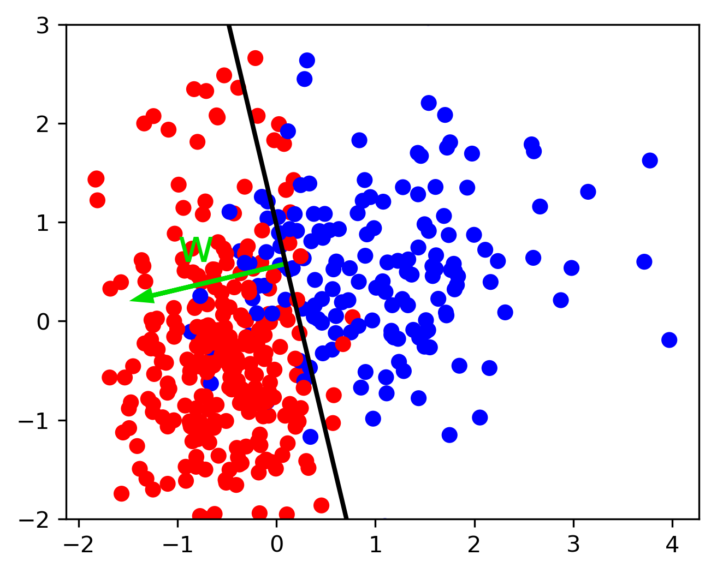
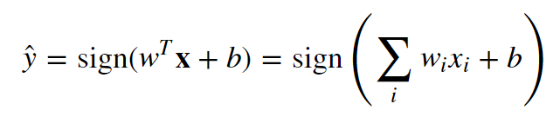

Binary Classification: Linear models
Notes:
Classification is similar to regression, however, only the sign of the result (negative or positive) helps us with prediction.
decision boundary of a linear classifier will be a hyperplane in the feature space
w is the normal vector of that plane
e.g. 2D here, thus the decision boundary is a line separating red and blue (everything on the right hand side would be classified as blue by this classifier, and everything on the left-hand side as red)
Goal? finding parameters w and b (based on the training set)
How? minimize a loss – via misclassifications, measured how?

Slide 4
Binary Classification: Linear models
sign = positive | sign = negative
predicted class | predicted class
“+1” | “-1”
“positive class” | “negative class”
“+” symbol | “-” symbol
“1” | “0”
Notes:
if sign results in 0, by convention the positive class is predicted

Slide 5
Loss Function

Slide 6
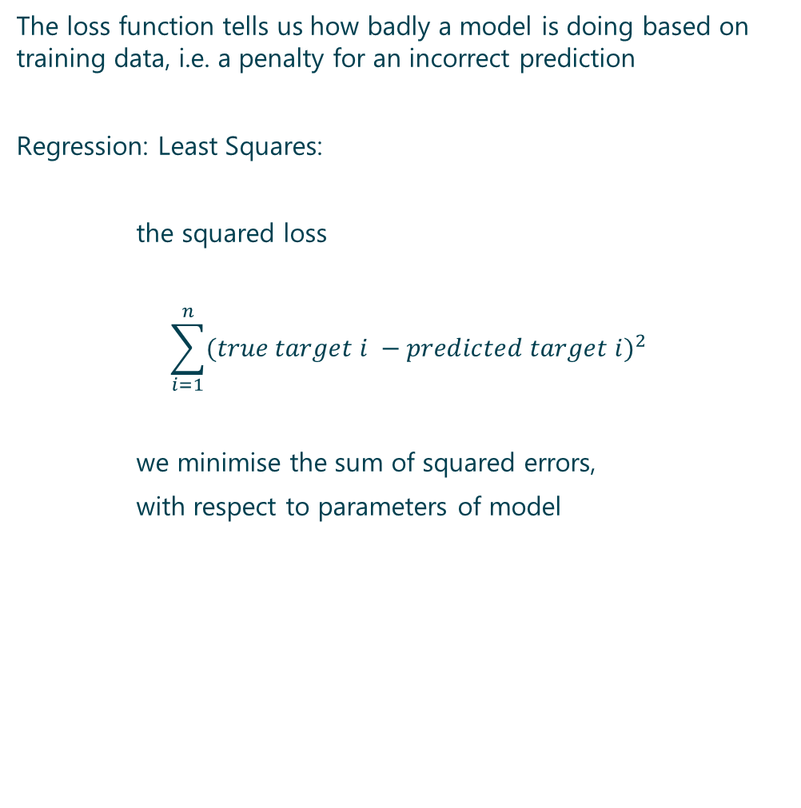
loss function
The loss function tells us how badly a model is doing based on training data, i.e. a penalty for an incorrect prediction
Regression: Least Squares:
the squared loss
$$\sum_{i=1}^{n}{{(true target i −predicted target i)}^{2}}$$
we minimise the sum of squared errors,
with respect to parameters of model
Notes:
NB: model.score() in scikit-learn is not the same as the loss function (usually similar given the intuition behind both)

Slide 7
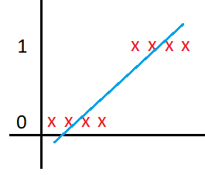
loss function
Imagine the scenario of perfect classification,:
the squared loss would be non zero
Notes:
we try linear regression on this data set
linear regression, would be dominated by more distant points, causing misclassifications

Slide 8
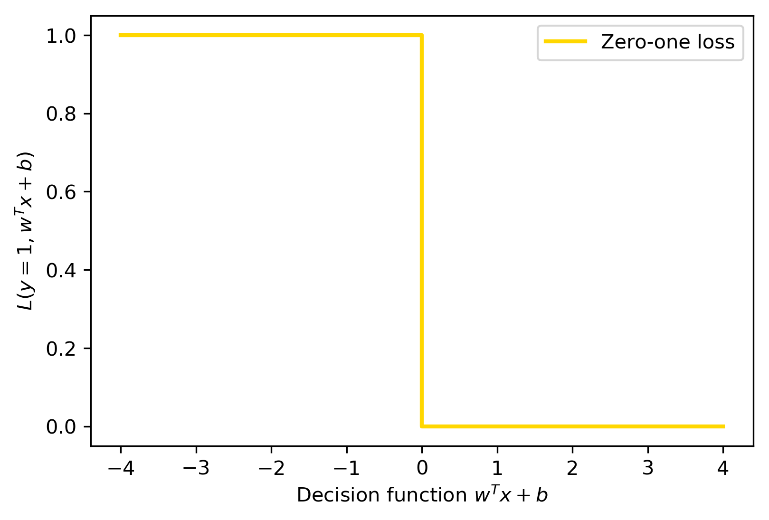

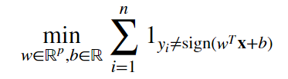
loss function
“True class” is ONE:
positive decision function
positive prediction
correct classification: y = “Zero-one loss” = 0
positive decision function
negative prediction =>
wrong classification: y = “Zero-one loss” = 1 [penalized]
minimize number of misclassifications
indicator which counts 1 every time a mistake occurs

Slide 9
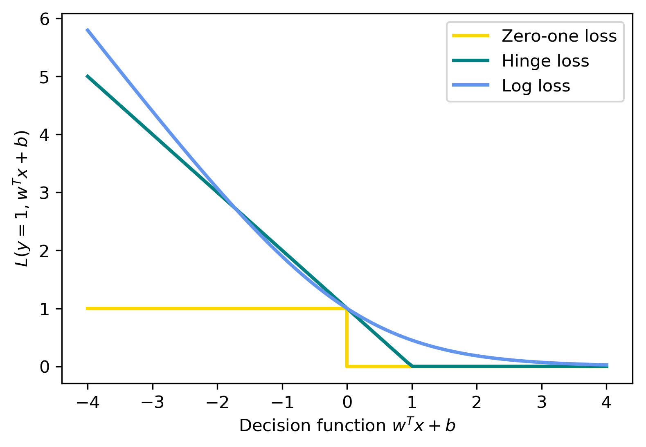
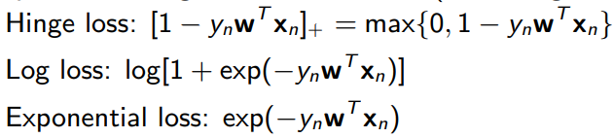
loss function
“Zero-one loss” difficult to optimise
non-convex
not continuous
non smooth
no polynomial time algorithm
Better behaved functions: Hinge Loss, Log Loss
(convex and continuous and upper bounds on the “Zero-one loss”)
"how correct" your prediction is
Notes:
Different loss function approximations lead to specific algorithms (e.g., Perceptron, SVM, Logistic Regression, etc.).

Slide 10
Sigmoid Function

Slide 11
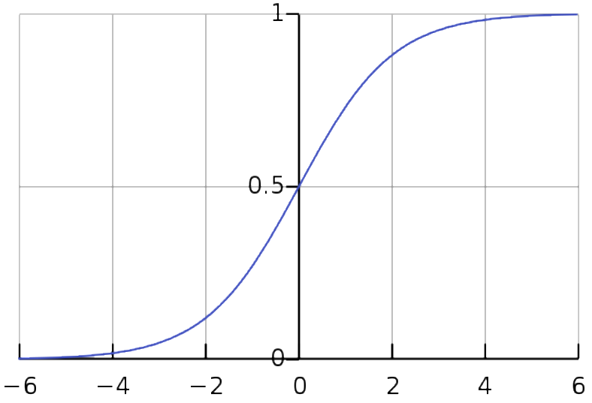


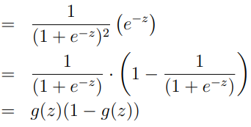
Sigmoid function
“sigmoid”
or “S-shaped”
or “logistic”
or “inverse logit”
useful property of the derivative
Notes:
map values to probabilities

Slide 12
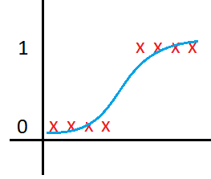
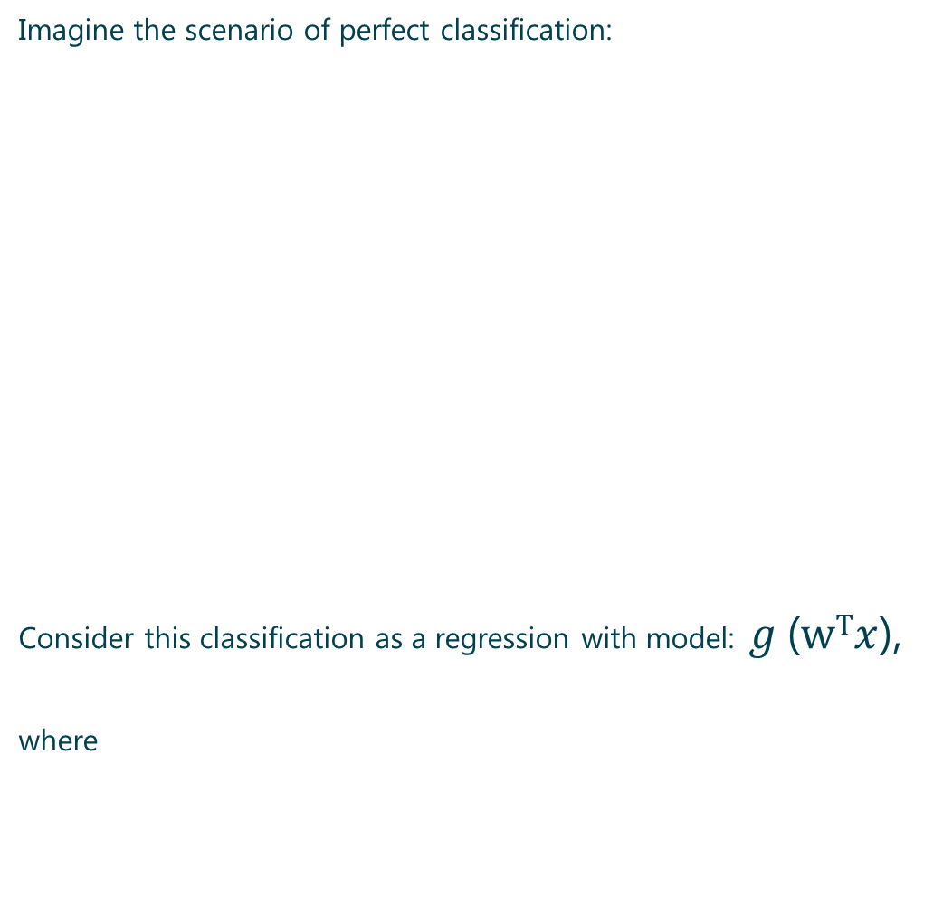
Apply sigmoid
Imagine the scenario of perfect classification:
Consider this classification as a regression with model: $g$($wTx$),
where
Notes:
With a new data point, we want to know the “chance” that this point belong to class “0” or “1”
map predicted values to probabilities

Slide 13

Decision boundary
The prediction function returns a probability (between 0 and 1)
How to map this to a discrete class (true/false, cat/dog) ?
Need a threshold value or tipping point
above which we will classify values into class 1
below which we classify values into class 2.
decision boundary:
if probability ≥ 0.5 then y = 1
[i.e. decision function w^{T}x > 0],
else y = 0
$$wTx$$
0.5
Notes:
predicting the class with maximum probability ≡ predicting which side of the hyperplane given by w we are on.
[with 2D: line cuts the coordinate plane into two halves with each class lying on either side of it]

Slide 14
Logistic Regression

Slide 15

Logistic regression: Model
Model: probability of data being from one of two classes:
$$p\left( y=1 \right|x )= \frac{1}{1+ e^{−w^{T}x}}$$
$$p\left( y=0 \right|x )= \frac{e^{−w^{T}x}}{1+ e^{−w^{T}x}}$$
This can be written more concisely:
$$\frac{p\left( y=1 \right|x ;w)}{p\left( y=0 \right|x ;w)}= e^{w^{T}x}$$
models probability(y)
i.e. between 0 and 1,
(not: predicting y: 0 or 1)
Notes:
Logistic regression is actually a classification method (not a regression)
regression on the log odds of something occuring
transform the log odds into a probability

Slide 16


Logistic regression: Model
$$\frac{p\left( y=1 \right|x ;w)}{p\left( y=0 \right|x ;w)}= e^{w^{T}x}$$
“odds”
“log odds” = $w^{T}x$
model the log-odds as a linear regression
p = 0.8, success
1-p = 0.2, failure
$$\frac{p}{1−p}= \frac{0.8}{0.2}=4$$
“ 4 to 1”
4 times out of 5
the process is
expected
to be a success
Notes:
Logistic regression is actually a classification method (not a regression)
regression on the log odds of something occuring
transform the log odds into a probability

Slide 17
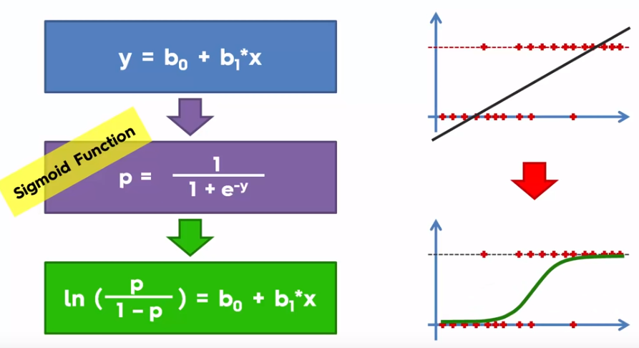
Logistic regression: Model
Notes:
Intuition: the green line is the “best fit line” for this data set
y axis: “predicted” probability

Slide 18
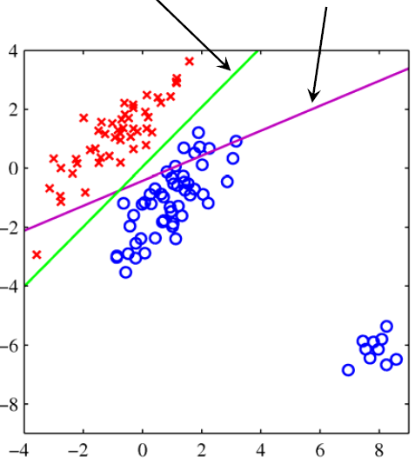
Logistic regression: Model
Logistic Regression Linear Regression
Notes:
Intuition: 2D

Slide 19
Probabilistic Interpretation

Slide 20



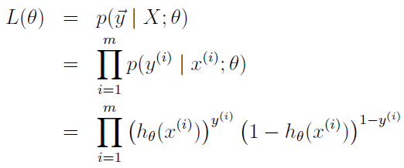

Logistic regression: Likelihood
Write with $θ$for parameter weights
and $hθ$ for the sigmoid hypothesis.
“canonical response function”
[wrt: GLM]
The model becomes:
Compactly: (because Y is a Bernoulli)
Likelihood of $θ$ parameter [$m$ independent training examples]

Slide 21




Logistic regression: log likelihood or cost
The optimal parameters will “maximise the likelihood”
i.e. maximise the probability of training data under our model
i.e. find parameters s.t. maximum probability is assigned to labels observed in the training data
We can optimise either the likelihood function or the log likelihood function, as it is a smooth monotonous function
Goal: search for a value of θ s.t.
p(y=1|x)=h_{θ}(x)
is large when x belongs to “1” class
is small when x belongs to “0” class [ i.e. p(y=0|x) is large ]
training examples, binary labels
cost function measures how well a given h_{θ} fits training data
Notes:
Max +ve prob
or
Min –ve prob

Slide 22

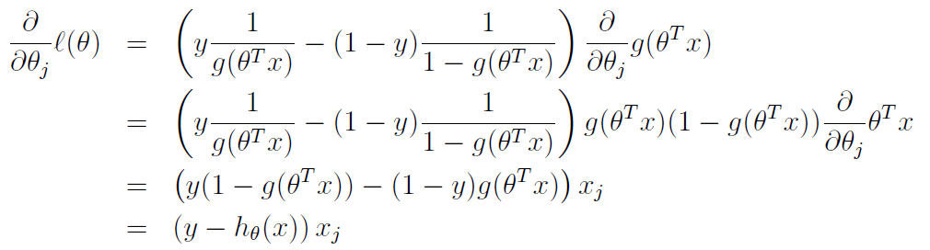
Logistic regression: learning parameters
minimise to find parameters, (take the gradient and set to zero)

Slide 23



Logistic regression: learning parameters
minimise to find parameters,
we take the gradient and set to zero
in vector form:
similar to gradient for linear regression
except that now h_{θ}(x)=σ(θ⊤x)
rewrite without h_{ϴ} & noting y_{i} takes only two values

Slide 24
Logistic regression: with optimal parameters
Classify a new test point as “1” or “0”
by checking which of these two class labels is most probable:
if p( y=1|x ) > p( y=0|x )
then we label the example as a “1”, and “0” otherwise
i.e. same as checking whether h_{θ}(x) > 0.5
Notes:
http://cs229.stanford.edu/notes/cs229-notes1.pdf

