Slide 1
Evaluation (Model Performance)

Slide 2
Questions to ask?

Slide 3
questions at the outset of any project
“How can I measure success for this project?”
“How would I know when I’ve succeeded?”
allow realistic goals to be set (=> when to stop)
prevent working on ill-formulated projects
where good measurement is vague or infeasible
It’s important to think about evaluation up front.

Slide 4
ML Model Evaluation

Slide 5
When to evaluate the ML model
Model selection (i.e. Training)
validation results
measure business metrics such as customer lifetime value, which may not be available on historical data but are closer to what your business really cares about
the distribution of data changes over time
k-fold cross-validation (e.g. hold-out validation, bootstrapping or jackknife resampling)
AIC, BIC hyper parameter tuning
Prior to Production (i.e. Validation)
measures live metrics of the deployed model on live data
Different machine learning tasks have different performance metrics:
classifier to detect spam emails versus normal emails
classification performance metrics
average accuracy,
log-loss,
area under the curve (AUC)
predict a numeric score, such as Apple’s daily stock price
root-mean-square error (RMSE)
ranking items by relevance to a query submitted to a search engine
ranking losses
precision-recall (also popular as a classification metric)
normalized discounted cumulative gain (NDCG)
Production (i.e. Testing)

Slide 6
Validation: Classification Metrics

Slide 7
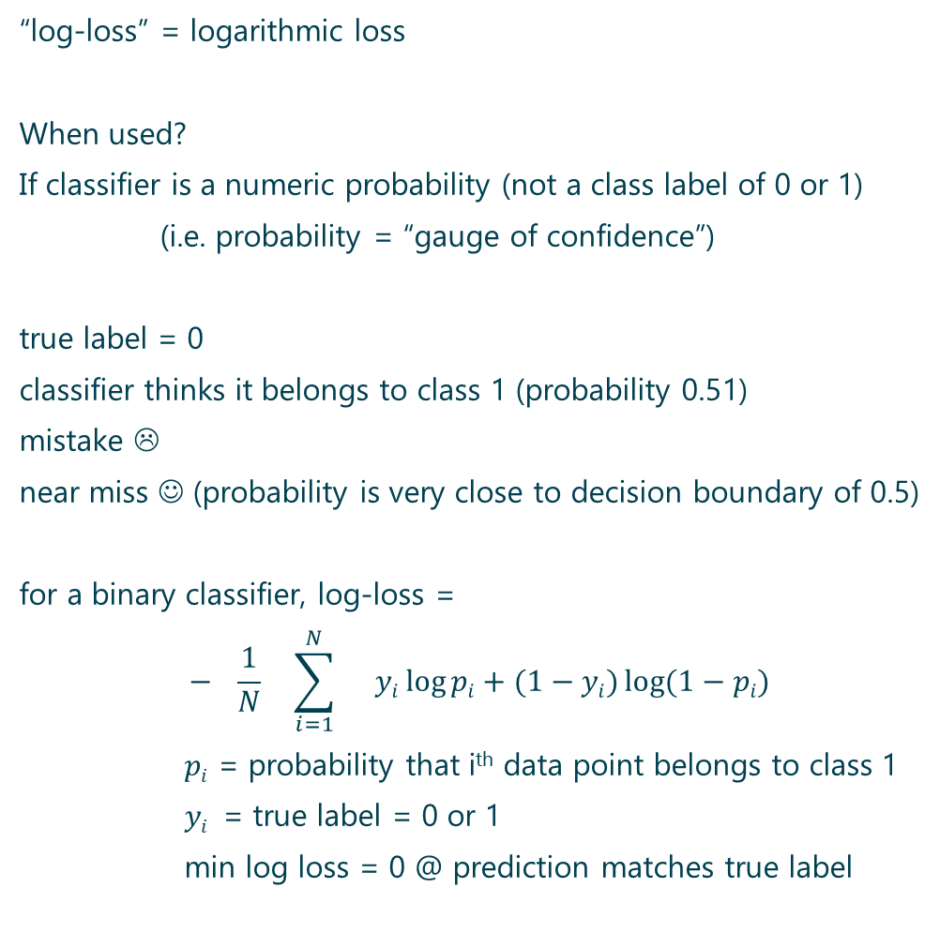
Log-Loss
“log-loss” = logarithmic loss
When used?
If classifier is a numeric probability (not a class label of 0 or 1)
(i.e. probability = “gauge of confidence”)
true label = 0
classifier thinks it belongs to class 1 (probability 0.51)
mistake ☹
near miss ☺ (probability is very close to decision boundary of 0.5)
for a binary classifier, log-loss =
$$− \frac{1}{N} \sum_{i=1}^{N}{}yi\log{pi}+(1−yi)\log{(1−pi)}$$
$pi$ = probability that i^{th} data point belongs to class 1
$yi$ = true label = 0 or 1
min log loss = 0 @ prediction matches true label

Slide 8
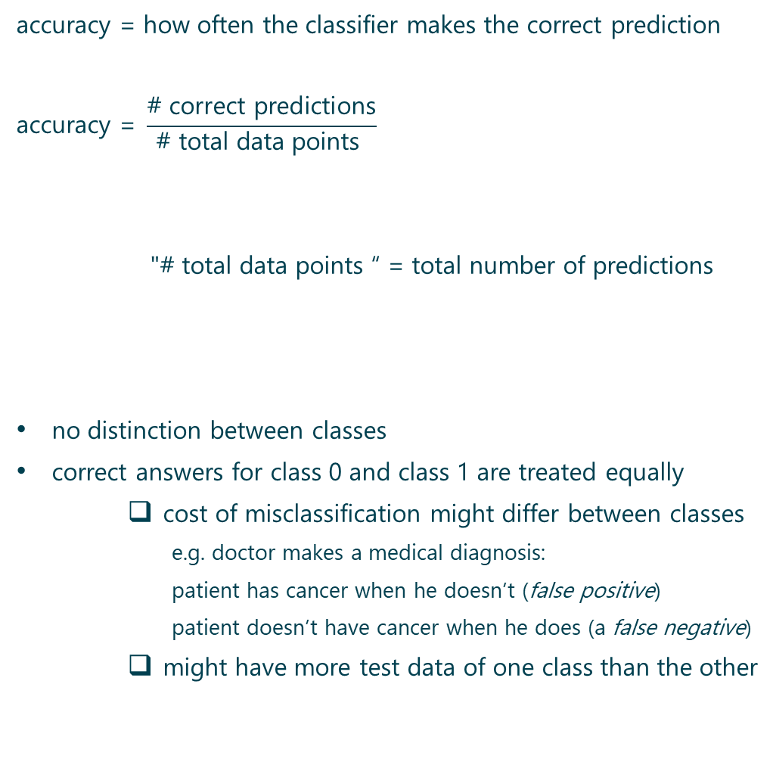
Accuracy
accuracy = how often the classifier makes the correct prediction
$$\text{accuracy}\text{ = }\frac{\text{\# }\text{correct} \text{predictions}}{\text{\# }\text{total} \text{data} \text{points} }$$
"# total data points “ = total number of predictions
no distinction between classes
correct answers for class 0 and class 1 are treated equally
cost of misclassification might differ between classes
e.g. doctor makes a medical diagnosis:
patient has cancer when he doesn’t (false positive)
patient doesn’t have cancer when he does (a false negative)
might have more test data of one class than the other
Notes:
fraction of correctly predicted samples => intuitive ☺

Slide 9
Confusion Matrix
confusion matrix
= confusion table
= detailed breakdown of correct
and incorrect classifications for each class
test dataset: 100 examples in the positive class
200 examples in the negative class
accuracy: positive class: 80/(20 + 80) = 80%
accuracy: negative class: 195/ (5 + 195) = 97.5%
i.e. positive class has lower accuracy,
this information is “hidden”:
overall accuracy: (80 + 195)/(100 + 200) = 91.7%
“Ground Truth Label” | Prediction
 | Prediction = “1” | Prediction = “0”
Label = “1” | 80 | 20
Label = “0” | 5 | 195
Notes:
Confusion matrix captures all the information about a classifier performance
Properties:
Total Sum is Fixed (population).
Row Sums are Fixed (class-wise population).
Quality of model & selected threshold decide how rows are split into columns.
We want diagonals to be “heavy”/large, off diagonals to be “light”/small.

Slide 10

Confusion Matrix
confusion matrix
= confusion table
= detailed breakdown of correct
and incorrect classifications for each class
$\text{accuracy}\text{ = }\frac{\text{\# }\text{correct} \text{predictions}}{\text{\# }\text{total} \text{data} \text{points} }$ $\text{= }\frac{\text{TP}\text{ + }\text{TN}}{\text{TP}\text{ + }\text{TN}\text{ + }\text{FP}\text{ + }\text{FN}}$
“Ground Truth Label” | Prediction
 | Prediction = “1” | Prediction = “0”
Label = “1” | True Positive | False Negative
Label = “0” | False Positive | True Negative
Notes:
Positive is usually the class of interest, rather than being a qualitative description of the class.
FP = Type I Error
FN = Type II Error

Slide 11
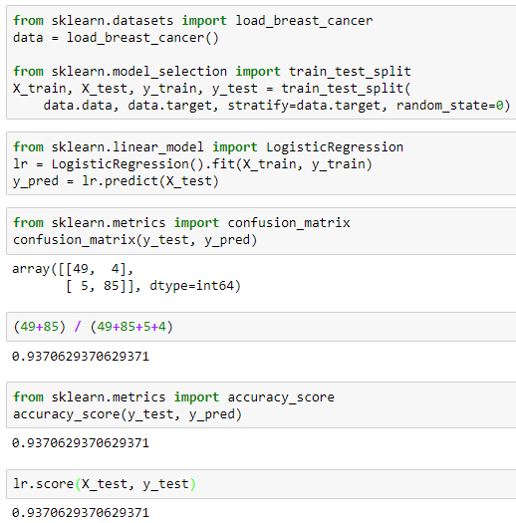
sklearn.metrics Confusion_Matrix accuracy_score
NB: here we see imbalanced classes

Slide 12
Per-Class accuracy
average per-class accuracy
= variation of accuracy
= average of the accuracy for each class
Continuing the previous example,
= (80% + 97.5%)/2 = 88.75% ≠ overall accuracy = 91.7%
(80 + 195)/(100 + 200)
NB 1:
classes = imbalanced
(more examples of one class than the other)
=> accuracy will give a very distorted picture
because the class with more examples will dominate the statistic
NB 2:
few examples of one class
=> test statistics for that class will have a large variance
=> accuracy estimate is not as reliable as other classes
=> average accuracy obscures confidence

Slide 13
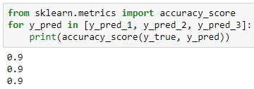
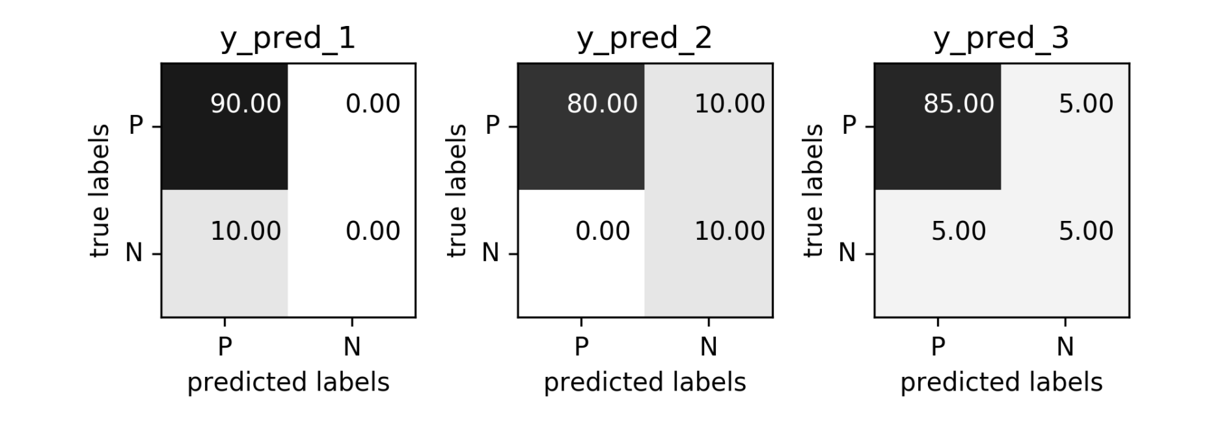
Problems with accuracy
imbalanced classes: data with 90% “positives”: three models
(see notes section of this slide for details of the predictions)
difficult to interpret accuracy
without knowledge of class imbalance
always predicts positive no FP #FP & #FN
correct 90% of time all negatives identified = #TN
accuracy ≠ good model might be a useful model
instead of accuracy; need to consider the confusion matrix…
Notes:
y_true
[1, 1, 1, 1, 1, 1, 1, 1, 1, 1, 0, 0, 0, 0, 0, 0, 0, 0, 0, 0, 0, 0, 0, 0, 0, 0, 0, 0, 0, 0, 0, 0, 0, 0, 0, 0, 0, 0, 0, 0, 0, 0, 0, 0, 0, 0, 0, 0, 0, 0, 0, 0, 0, 0, 0, 0, 0, 0, 0, 0, 0, 0, 0, 0, 0, 0, 0, 0, 0, 0, 0, 0, 0, 0, 0, 0, 0, 0, 0, 0, 0, 0, 0, 0, 0, 0, 0, 0, 0, 0, 0, 0, 0, 0, 0, 0, 0, 0, 0, 0]
y_pred_1
[0, 0, 0, 0, 0, 0, 0, 0, 0, 0, 0, 0, 0, 0, 0, 0, 0, 0, 0, 0, 0, 0, 0, 0, 0, 0, 0, 0, 0, 0, 0, 0, 0, 0, 0, 0, 0, 0, 0, 0, 0, 0, 0, 0, 0, 0, 0, 0, 0, 0, 0, 0, 0, 0, 0, 0, 0, 0, 0, 0, 0, 0, 0, 0, 0, 0, 0, 0, 0, 0, 0, 0, 0, 0, 0, 0, 0, 0, 0, 0, 0, 0, 0, 0, 0, 0, 0, 0, 0, 0, 0, 0, 0, 0, 0, 0, 0, 0, 0, 0]
y_pred_2
[1, 1, 1, 1, 1, 1, 1, 1, 1, 1, 1, 1, 1, 1, 1, 1, 1, 1, 1, 1, 0, 0, 0, 0, 0, 0, 0, 0, 0, 0, 0, 0, 0, 0, 0, 0, 0, 0, 0, 0, 0, 0, 0, 0, 0, 0, 0, 0, 0, 0, 0, 0, 0, 0, 0, 0, 0, 0, 0, 0, 0, 0, 0, 0, 0, 0, 0, 0, 0, 0, 0, 0, 0, 0, 0, 0, 0, 0, 0, 0, 0, 0, 0, 0, 0, 0, 0, 0, 0, 0, 0, 0, 0, 0, 0, 0, 0, 0, 0, 0]
y_pred_3
[1, 1, 1, 1, 1, 0, 0, 0, 0, 0, 1, 1, 1, 1, 1, 0, 0, 0, 0, 0, 0, 0, 0, 0, 0, 0, 0, 0, 0, 0, 0, 0, 0, 0, 0, 0, 0, 0, 0, 0, 0, 0, 0, 0, 0, 0, 0, 0, 0, 0, 0, 0, 0, 0, 0, 0, 0, 0, 0, 0, 0, 0, 0, 0, 0, 0, 0, 0, 0, 0, 0, 0, 0, 0, 0, 0, 0, 0, 0, 0, 0, 0, 0, 0, 0, 0, 0, 0, 0, 0, 0, 0, 0, 0, 0, 0, 0, 0, 0, 0]

Slide 14
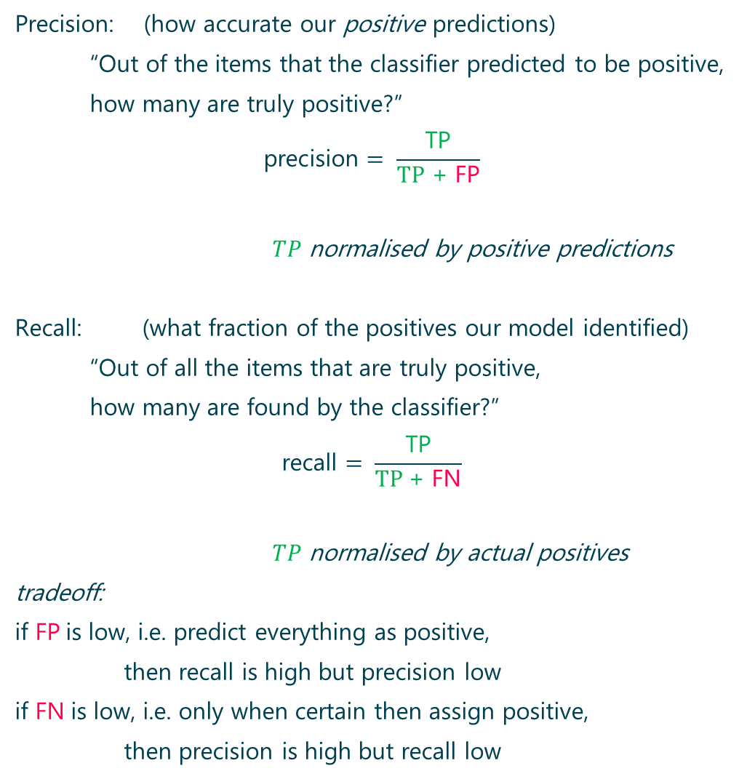
Precision VS Recall
Precision: (how accurate our positive predictions)
“Out of the items that the classifier predicted to be positive,
how many are truly positive?”
$$\text{precision}= \frac{\text{TP}}{TP\text{ + }\text{FP}}$$
$TP$ normalised by positive predictions
Recall: (what fraction of the positives our model identified)
“Out of all the items that are truly positive,
how many are found by the classifier?”
$$\text{recall}= \frac{\text{TP}}{TP \text{+ }\text{F}\text{N}}$$
$TP$ normalised by actual positives
tradeoff:
if $\text{FP}$is low, i.e. predict everything as positive,
then recall is high but precision low
if $\text{FN}$is low, i.e. only when certain then assign positive,
then precision is high but recall low
Notes:
Recall is also known as “coverage”; MEMORY TRICK: covers all the true positives and maybe picked up some more
trade-off between precision and recall:
A model that predicts “yes” when it’s even a little bit confident
=> high recall but a low precision;
i.e. saying “yes” too often => false positives
a model that predicts “yes” only when it’s extremely confident
=> low recall and a high precision
i.e. saying “no” too often => false negatives

Slide 15

F₁
F₁ = (harmonic) average of precision and recall:
$$F1=2\frac{\text{precision}\text{∗}\text{recall}}{\text{precision}\text{ + }\text{recall}}$$
harmonic mean tends toward the smaller of the two elements
i.e. F₁ score will be small if either precision or recall is small.
Notes:
Harmonic mean of A and B = 2 / (1/A + 1/B)

Slide 16
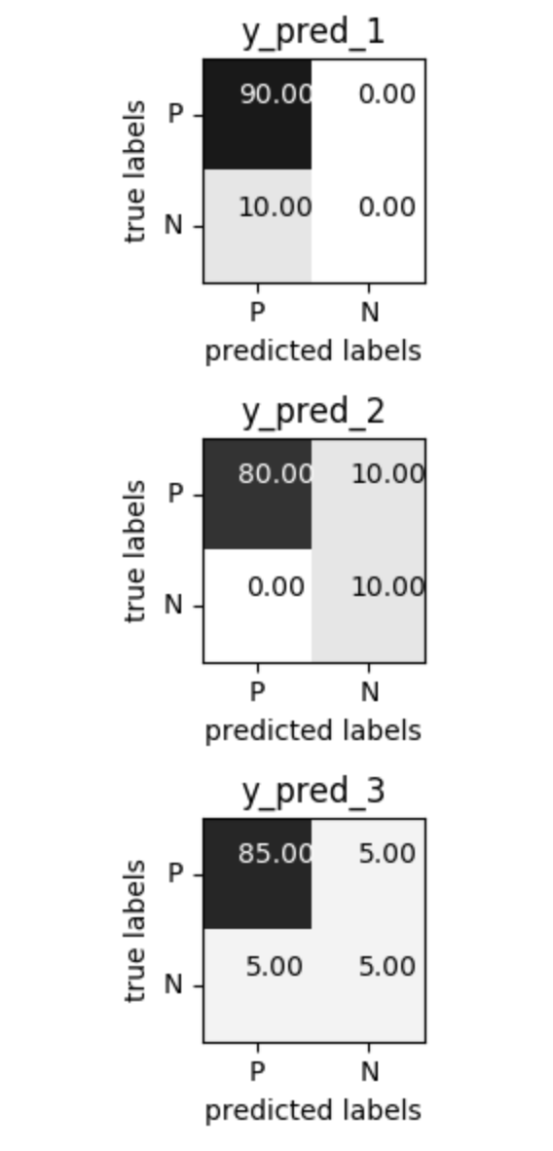
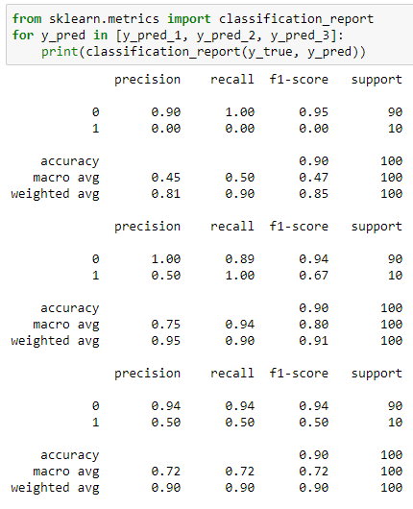
sklearn.metrics classification_report
NB “positive” class in the confusion matrix is the “0” class in output
Notes:
See https://scikit-learn.org/stable/modules/generated/sklearn.metrics.precision_recall_fscore_support.html
'macro':
Calculate metrics for each label, and find their unweighted mean. This does not take label imbalance into account.
'weighted':
Calculate metrics for each label, and find their average weighted by support (the number of true instances for each label). This alters ‘macro’ to account for label imbalance; it can result in an F-score that is not between precision and recall.

Slide 17
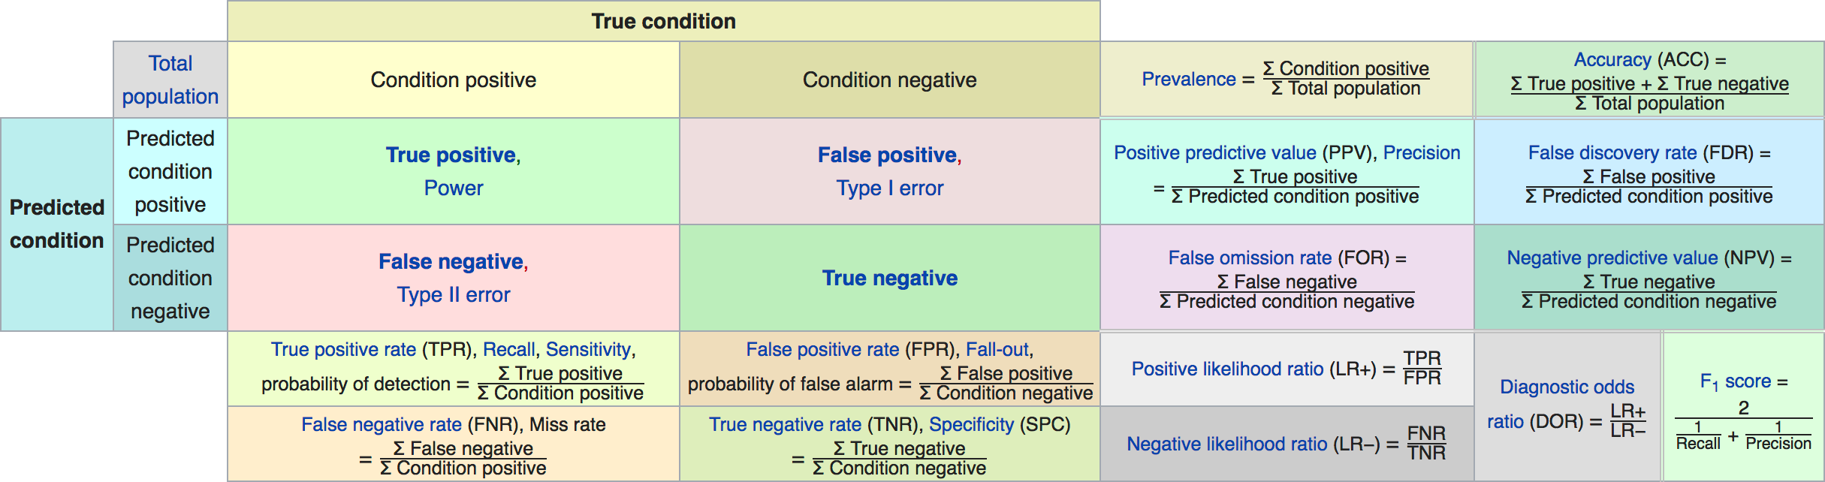
Derivations from a confusion matrix
https://en.wikipedia.org/wiki/Precision_and_recall#Definition_(classification_context)
Notes:
Different row normalisations and column normalisations
Different disciplines use different metrics, usually in ML predictive analytics: recall and precision

Slide 18
“Costs of confusion”
Can assign literal costs:
a false positive: £10
a false negative: £100
What are the benefits of a TP?
new customer…or a product sold…
Can we guarantee anything (other than accuracy)?
Can we answer the questions:
“Out of the items that the classifier predicted to be positive,
how many are truly positive?”
“Out of all the items that are truly positive,
how many are found by the classifier?”
BUT: What about the tradeoff?...
Notes:
By knowing these costs, we can optimise, and choose where to set thresholds… next slide..
Tradefoff.. next slide..

Slide 19
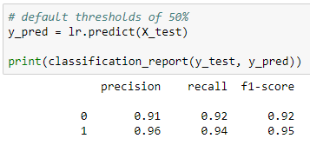
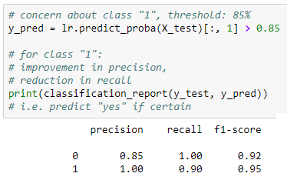
Thresholds
Should we use a threshold that is not 50%?
e.g. imagine we see that a classifier is "generous", (lots of “yes” class)
we may want to apply a specific threshold,
which ensures we are 85% certain before a prediction occurs.
not changing model, affecting decision based on predicted prob
Notes:
from sklearn.datasets import load_breast_cancer
from sklearn.linear_model import LogisticRegression
data = load_breast_cancer()
from sklearn.model_selection import train_test_split
X_train, X_test, y_train, y_test = train_test_split(
data.data, data.target, stratify=data.target, random_state=0)
lr = LogisticRegression().fit(X_train, y_train)
from sklearn.metrics import classification_report

Slide 20
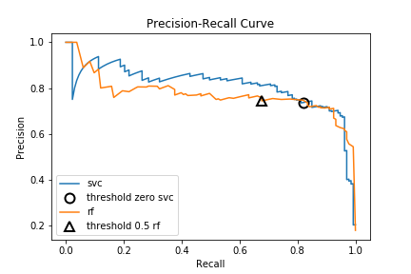
Thresholds
varying decision threshold leads to a different precision and recall:
if precision = 1 then highest threshold; predicts class correctly
if recall = 1 then lowest threshold; predicts “yes” class
“best” combination would be closest to top right corner:
Utilised: from sklearn.metrics import precision_recall_curve
Notes:
NB: the thresholds look pretty arbitrary
precision_svc, recall_svc, thresholds_svc = precision_recall_curve(
y_test, svc.decision_function(X_test))
precision_rf, recall_rf, thresholds_rf = precision_recall_curve(
y_test, rf.predict_proba(X_test)[:, 1])
If you are not too worried about high recall then svc is better

Slide 21
variations
Variations to the Precision Recall Curve:
ROC curves (ML/DS)
lift and gain charts (marketing analytics)
odds ratios (medical)
sensitivity and specificity (statistics)

Slide 22
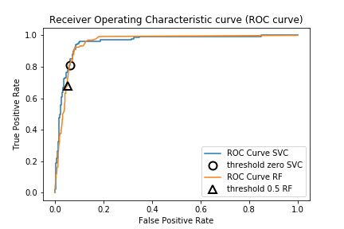
ROC
ROC curve shows the sensitivity of the classifier
True Positive Rate (TPR) = TP/(TP + FN) i.e. “TP/P”
False Positive Rate (FPR) = FP/(FP + TN) i.e. “FP/N”
A good ROC curve has a lot of space under it
(because the true positive rate shoots up to 100% very quickly).
“best” combination would be closest to top left corner
NB: can account for all thresholds via the AUC metric (roc_auc_score)
Notes:
NB: the thresholds look pretty arbitrary
NB: TPR = Recall (y axis here in ROC curve, x axis in Precision-Recall curve)
NB: AUC = 0.5 for random/constant prediction of binary classification => interpretable
ROC => how many correct positive classifications can be gained as you allow for more and more false positives.
TPR => of those that are actually true, how many did I get?
FPR => of everything that's predicted as negative, how many of those were wrongly predicted as negative
For further reading see: The Relationship Between Precision-Recall and ROC Curves: www.biostat.wisc.edu/~page/rocpr.pdf

Slide 23
Validation: Regression Metrics

Slide 24
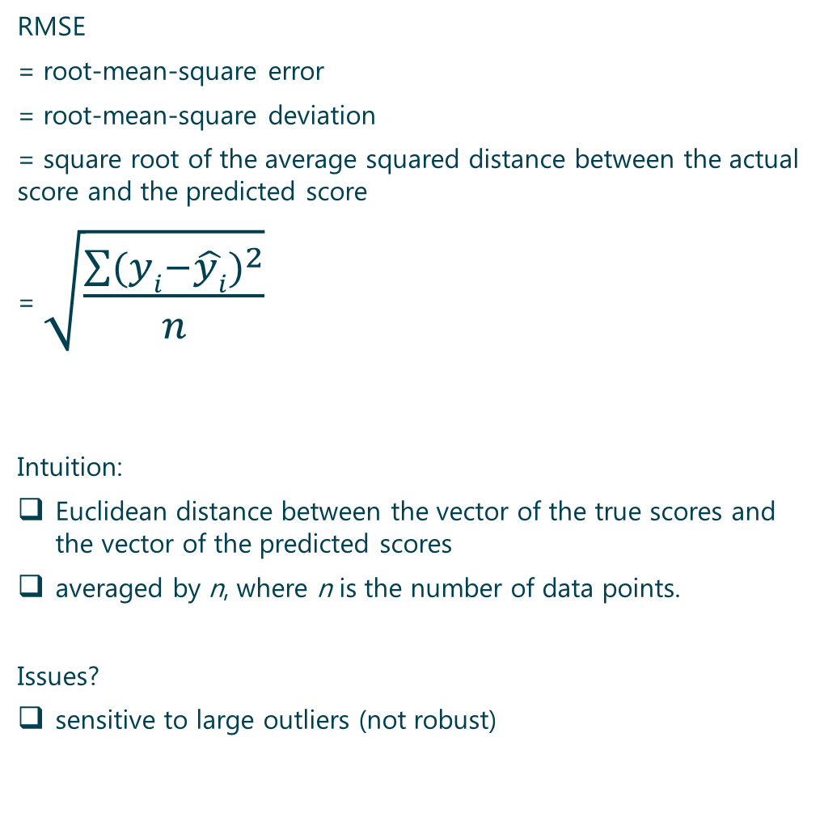
RMSE
RMSE
= root-mean-square error
= root-mean-square deviation
= square root of the average squared distance between the actual score and the predicted score
= $\sqrt{\frac{\sum{{(yi−\hat{yi})}^{2}}}{n}}$
Intuition:
Euclidean distance between the vector of the true scores and the vector of the predicted scores
averaged by n, where n is the number of data points.
Issues?
sensitive to large outliers (not robust)

Slide 25

MAPE
MAPE
= Median Absolute Percentage Error
= $median( \left| \frac{yi−\hat{yi}}{yi} \right| )$
= relative measure of the typical error
Quantiles (or percentiles) = robust, not affected by outliers
Other Quantiles of Errors:
For “almost worst case”, consider:
“90th percentile of the absolute percent error”
Notes:
Quantiles of Errors

Slide 26

“Almost Correct” Predictions
percent of
estimates that differ from the true value by no more than X%
e.g. percent of estimates within 10% of the true values =
$$\left| \frac{yi−\hat{yi}}{yi} \right|<0.10$$
=> notion of the precision

Slide 27
Residuals
unpredictable (zero mean)
random (follow a Normal distribution)
independent (no relationships with each other)
equal-variance (constant) (homoscedasticity)

Slide 28
Validation: Clustering Metrics

Slide 29
Clustering performance evaluation
how well a particular unsupervised method performs will largely depend on why one is doing unsupervised learning in the first place ☺
Adjusted Rand index
Mutual Information based scores
Homogeneity, completeness and V-measure
Fowlkes-Mallows scores
Silhouette Coefficient
Calinski-Harabasz Index
Davies-Bouldin Index
Contingency Matrix
Dunn index
Krzanowski-Lai index
Hartigan index
Separation index
Notes:
See: https://scikit-learn.org/stable/modules/clustering.html#clustering-performance-evaluation

Slide 30
Validation: sklearn.metrics

Slide 31

SCORERS
accuracy
adjusted_mutual_info_score
adjusted_rand_score
average_precision
balanced_accuracy
brier_score_loss
completeness_score
explained_variance
f1
f1_macro
f1_micro
f1_samples
f1_weighted
fowlkes_mallows_score
homogeneity_score
jaccard
jaccard_macro
jaccard_micro
jaccard_samples
jaccard_weighted
max_error
mutual_info_score
neg_log_loss
neg_mean_absolute_error
neg_mean_squared_error
neg_mean_squared_log_error
neg_median_absolute_error
normalized_mutual_info_score
precision
precision_macro
precision_micro
precision_samples
precision_weighted
r2
recall
recall_macro
recall_micro
recall_samples
recall_weighted
roc_auc
v_measure_score

Slide 32
Validation: Caution

Slide 33
Imbalanced classes
Imagine
positive class:
tiny portion of the observed data (1%)
e.g. click-through rates for ads,
user-item interaction data for recommenders,
malware detection,
etc.
a “simple” baseline classifier
always classifies incoming data as negative
would achieve 99% accuracy
metrics that gives equal weight to each instance of a class
difficulty in handling imbalanced classes
because dominated by the class(es) with the most data

Slide 34
Rare data
Real-world user-item interaction data often contains
many users who rate very few items,
items that are rated by very few users
Rare users and rare items are problematic for a “recommender”
during training and evaluation
training data = rare
=> recommender model would not be able to learn
the user’s preferences, or
the items that are similar to a rare item
=> reduces recommender’s performance

Slide 35
outliers
any error made by the regressor on an outlier data point
would dwarf all other errors
effects of large outliers during evaluation
can be mitigated through robust metrics
e.g. quantiles of errors
BUT do not solve the problem for the training phase.
solutions for large outliers
careful data cleaning
reformulating the task
s.t. it’s not sensitive to large outliers

