Slide 1
BIG DATA AND… DATA MODELS

Slide 2
OVERVIEW

Slide 3
DATA

Slide 4
Data was originally collected primarily for transactions
What was purchased?
What was the order status?
c. 60s data and querying was separated
Leading to the development of relational database systems
Initially transactional data was discarded after use
Physical memory was expensive
Historical data-driven analysis wasn’t used (and often today still isn’t!)
DATA as
TRANS
ACTIONS

Slide 5
Data Analytics grew out of recording historical transactions
Answering questions such as
How much do people who buy product-A also buy product-B?
What demographic does product-C most appeal to?
ANALYTICS

Slide 6
Transactions are “atomic”
A transaction only takes place if all the stages of the transaction succeed
Transactions are unitary
They concern and operate on whole units of data
These naturally fit tabular data
Rows are units
A transaction is actions upon rows
TRANS ACTIONS

Slide 7
Tables, or “relations”, are composed of rows and columns
Rows comprise columns
Columns comprise rows
By convention, a row is a unit of data (“examples”)
Columns are its constituent parts (“features”)
TABLES
ID | Price | Quantity | Date
1 | 10 | 1 | 1/1/1970
2 | 7 | 1 | 1/1/1970
3 | 10 | 2 | 1/1/1970

Slide 8
BIG DATA

Slide 9
Big Data
Velocity
Variety
Volume
Veracity
Validation
Value
Fast data
Useful data
Complex data
Performant Data
Sizeable data
Meaningful data

Slide 10
Google processes over 24 petabytes of data a day
There are over 86 million WordPress websites
More than 1.5 billion shares are traded on the New York Stock Exchange every day
Facebook users create 2.7 billion comments and likes every day
Volume

Slide 11
Realtime
Processes are increasingly autonomous
Systems are increasingly interconnected
People are increasingly interacting online
10 MB/s is 850 GB/day
Velocity

Slide 12
Different kinds of (unstructured) data
Social network connections
Log files
Electronic records
Images
Audio
Video
Ratings and reviews
Email
Text
Structure = Tabular
Variety

Slide 13
Order-sensitive queries
eg. Where do order sales peak?
Positional Queries
Who knows this customer?
(what rows associate with what rows which associate with what rows…)
Non-unitary queries
Sub-row level
Highly parameterized queries
Custom operations for each query
Eg., prediction functions
WHY NON-RELATIONAL?

Slide 14
Non-Relational data can be tabularized
A black and white image is a table of pixel intensities
An audio file is rows of amplitude, time
However much big data should not be tabularized
E.g.,
A single three minute audio file has 3 * 44, 000 readings / second
3.1 million rows!
A national UK supermarket has c. 3.1 million transactions / day
( cf. divide annual revenue by average transaction cost )
What a national transactional database sees in one day, an audio recorder sees in three minutes
WHY NON-RELATIONAL?

Slide 15
DATA MODELS

Slide 16
Tabular Data
Joins across tables
Slow
Structured Query Language
Schema
Normalization
Query Independent
ACID
Atomic -- Transactions complete as wholes
Consistent -- Database is always in valid state
Isolated -- Agnostic to sequential or parallel ordering of transactions
Durable -- Completed transaction stored regardless of system failure
The Relational Model

Slide 17
Key-Value Pairs
"Row Segments"
Smallest divisible unit of data: tag-value
Key-Value units (vs. rows) form basis of most non-relational databases
Column-Oriented
vs. Row-Oriented (ie., relational)
Unit of storage is column
Document-Oriented
Documents are collections of key-value pairs
The values may themselves be documents
(and arrays)
Graph (Network)
Dual units: nodes, edges
Edges carry information about connections
Node carry information about data
(usually Key-Value pairs in both cases)
{ "michael": { "location": "UK", "purchased": [1, 2, 3, 4]
}
, "john": { "city": "London", "purchased": [1] },
}
NON-
RELATIONAL
Alice
School Friends
Bob
University
Live together
In a relationship
Eve
Mallory

Slide 18
Schema vs. Schemaless
Predefined vs. On-Read
Containers vs. Schemas
File systems vs. Databases
Schemaless
No standardized query language
Structure is not query-independent
Relational | NoSQL
Tabular Structured | Unstructured (Big Data)
Predefined Schema | Schema-on-Read
Transactional | Non-Transactional
ACID | Non-Acidic
Rigid Consistency | Eventual consistency

Slide 19
C - Consistency
all clients read the same data
A - Availability
all requests receive a successful response
P - Partition tolerance
all requests receive responses regardless of network performance
CAP

Slide 20
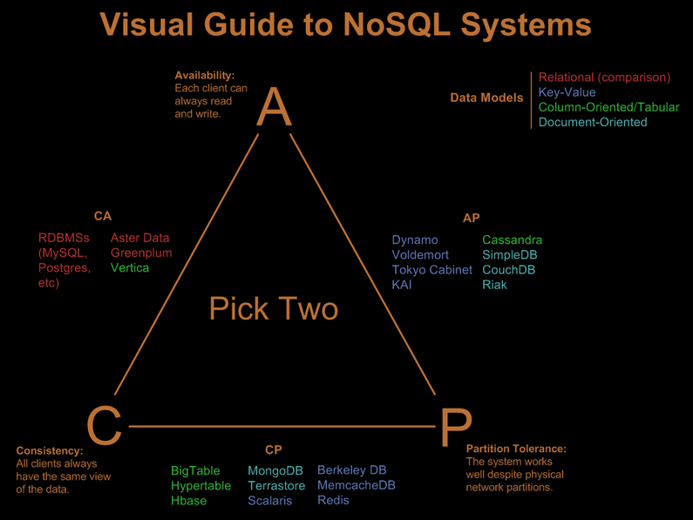
http://blog.nahurst.com

