Slide 1
Graph Analytics
Data Science in a Big Data World

Slide 2
Outline
What is Graph Analytics
Type of problems looked at
Different types of graphs
Social network models

Slide 3
Objectives
By the end of this module you should
Understand the principles of graphs
Be able to interpret some simple social network models

Slide 4
What is Graph Analytics
Graph Analytics try and visualise data as a set of interconnected nodes and edges
Looking in particular at relationships between nodes
Edges can be single or bi-directional
Most of the important metadata is stored in the edges
Friends from school
Alice
Bob
University
Live together
In a relationship
Eve
Mallory
Notes:
Nodes don’t have to be people, they can be places, concepts, devices, accounts. Any ‘thing’ can be a node. Any relationship can be an arrow, such as ‘member of’ or ‘owns’ or ‘knows’

Slide 5
What is Graph Analytics used for?
Understanding how information relates to one another
Social Networks
Groups of people
Who knows who?
How care two people related?
Is it possibly that Alice knows Bob?
Who are all the people that Eve knows?
Who are the most influential people in a group?
Others
Path planning
Patterns of behaviour around a website looking for intrusion attempts
People trying to defraud companies
Any relationship based problem
Notes:
One example is when visualising telephone call data (in the days before mobile phones) it became apparent that there was a small subset of numbers calling another subset of numbers at 11.30pm in the evenings. Calls spiked in this pattern at weekends. These links were between pubs and taxi firms as everyone used to call from the payphone for a ride home! This discovery led to taxi firms offering to put in free phones which connected the people in the pub directly to them for more work!
Mapping relationships: http://www.martingrandjean.ch/social-network-analysis-visualization-morenos-sociograms-revisited/

Slide 6
Path Planning
Path planning is when you want to find a route from A to B
Ideally you will have a list of nodes and edges already
Otherwise this becomes an exploration problem instead!
Once you have a graph you can plan the route by visiting each node and selecting where to go next
Different methods for this Dijkstra, A* planning algorithms
Path planning has become more social
Edge weight used to be based on distance
Now we have traffic analysis as well – so how busy somewhere is

Slide 7
Advantages
Centrality analysis
Find the person in the middle of a group – the most influential person
Path analysis
Connections between people, even via a third party
Community detection
Find unknown connections between people and communities which may not be as obvious
Sub-graph isomorphism
Patterns of relationships to try and answer questions. Looking for abnormal situations.
Notes:
References: https://infocus.emc.com/william_schmarzo/how-can-graph-analytics-uncover-valuable-insights-about-data/
An example of an abnormal situation
A website normally gets 1 hit an hour to a particular page
It suddenly gets 100 hits in an hour, then 1000, then 10,000
What has changed on the website? Is it new content? If not then why are people there?
Identify and manage risk – is there a security hole that was just discovered?

Slide 8
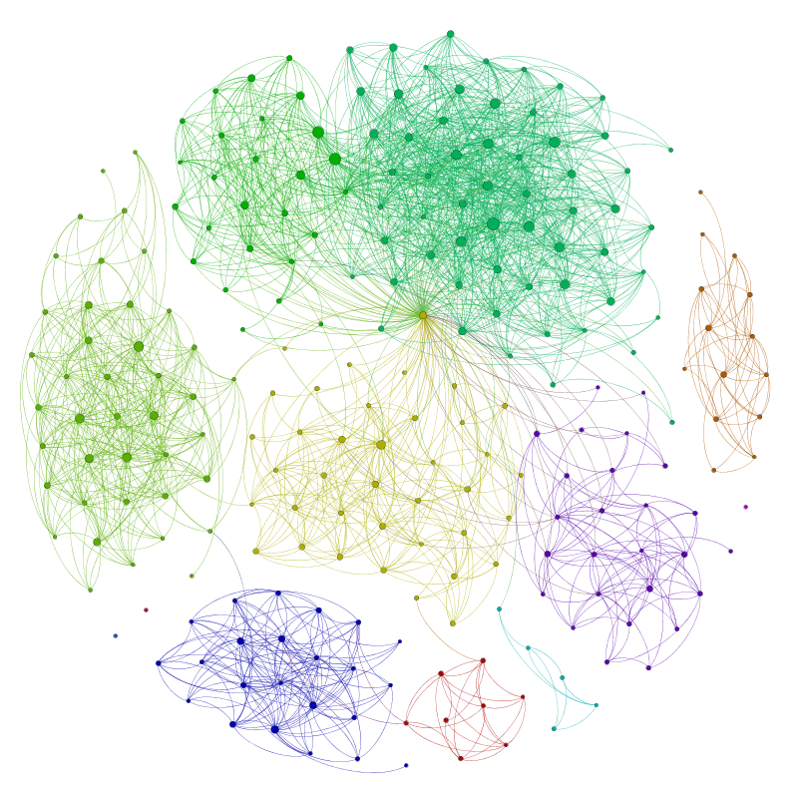
Mapping Social Networks
There are numerous privacy issues with this
No longer possible on Facebook
But we can do it with twitter... Just very very slowly
Notes:
http://allthingsgraphed.com/2014/08/28/facebook-friends-network/
http://allthingsgraphed.com/2014/11/02/twitter-friends-network/

Slide 9
Metrics
Connections
Associativity – how are people connected? Similarity to people they have connected with – some of the echo chamber effect
Geographical location
Mutual connections – think twitter followers
Distributions
Bridge – two clusters with a person creating the link between them
Centrality – how close is a node to the middle, how much influence could they have on their network
Density and Distance
Segmentation
Cliques and bi-cliques

Slide 10
Types of Graphs
Cliques
Every two distinct edges are adjacent (even if its via more than one step)
BiCliques (Bipartate)
Every node in group one is connected to every node in group two
Star Networks
There is a central point that everyone connects to
Think “Cult Leader” or “Most popular kid in school”

Slide 11
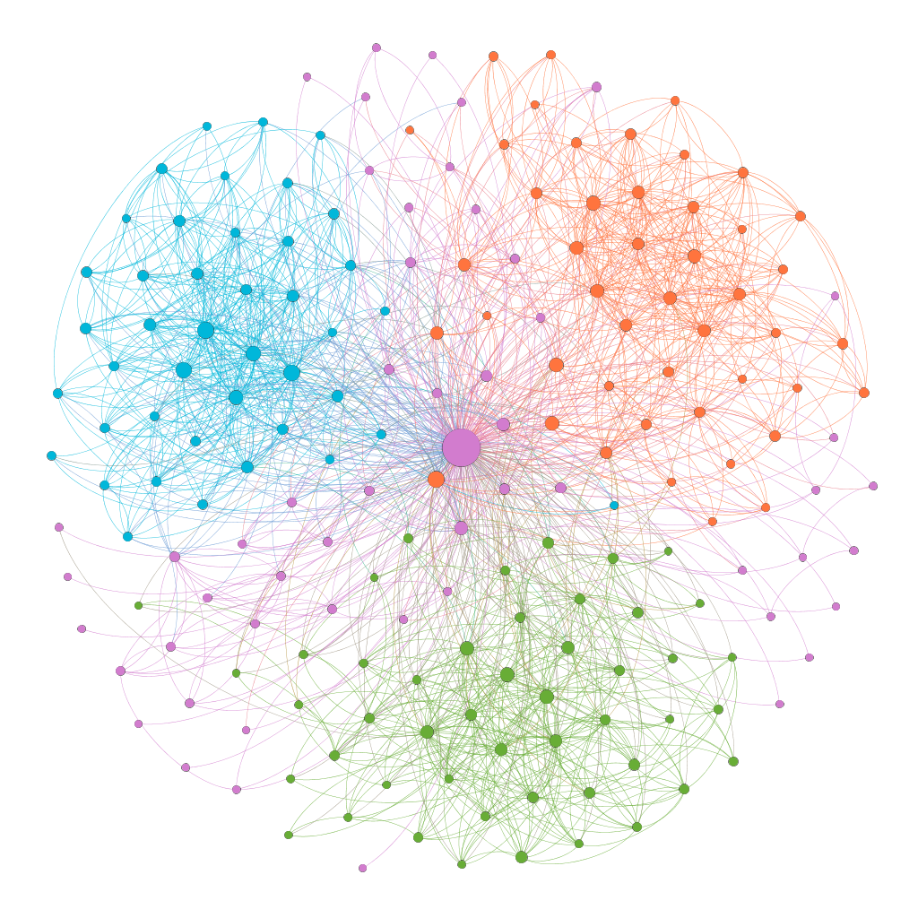
Example – Twitter Followers
Based on the account @kaiylie
Light blue – hobby friends
Orange – university
Pink – gaming
Green – Tech and conferences
Notes:
Install Gephi – load up the graph, have a play

