Slide 1

Project-1-Group-3
Clarajean, Gurpal, Stephen, Carson

Slide 2
Executive Summary
Which District in Toronto is the Best District to Live in?
Six Districts: Old Toronto, York, East York, North York, Scarborough, Etobicoke
Factors to Consider:
Crime Rates
Average Home Prices
Number of Employers/Job Opportunities
School Student Performance
Why is this Important? Purchasing a home is a big step and investment, therefore proper analysis is needed to make the best decision

Slide 3
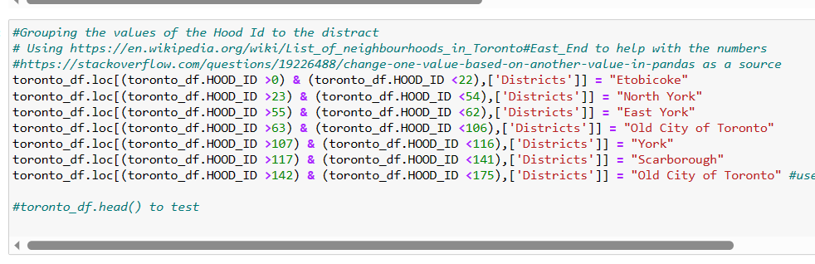
Crime - Data Collection
The source of your data and why it was chosen.
Came from the website of Open.Toronto.ca
It gave a comprehensive dataset about the crimes
Had the information on all neighbourhoods in Toronto
Describe the collection, exploration, and cleanup process.
Download the CSV file from the website
Added part to split into districts
Made smaller data frames based on the crime

Slide 4
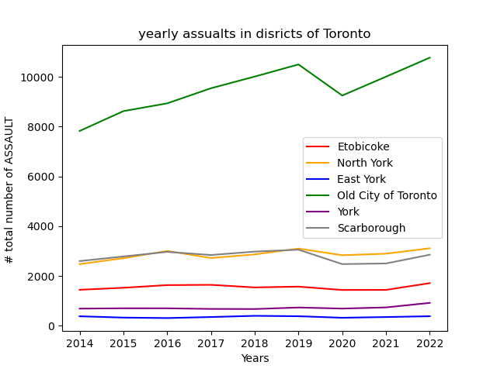
Crime - Analysis Approach
The approach that I took.
Splitting the data into smaller dataframes
Grouping by districts
Making line charts to show the change
Discuss any unanticipated insights or problems that arose and how you resolved them.
Finding ways to sort the data
Finding the totals of each district

Slide 5
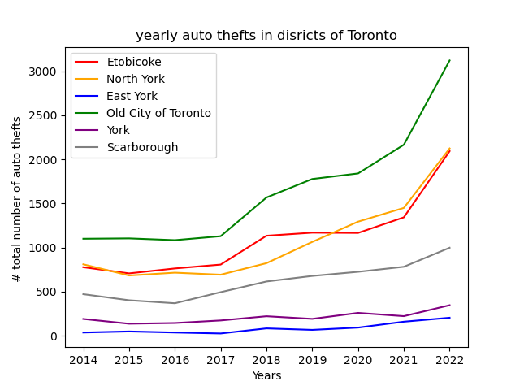
Crime - Analysis Conclusion
Results/conclusions of the application or analysis:
There was an overall increase in crime
Higher populations have a high correlation
East York has the least amount
Old Toronto has the most crime
Most frequent crime: Assaults
Least frequent are Homicides

Slide 6
Real estate Housing Prices - Data Collection
Source of Data:
Toronto Home Price Index (from Kaggle.com)
Contained relevant info: Location, Prices, Dates
Collection, Exploration and Cleanup Process:
Filtered Locations to Toronto only neighbourhoods
Assigned each neighbourhood to a District
Converted Date to Year only
Removed all irrelevant columns

Slide 7
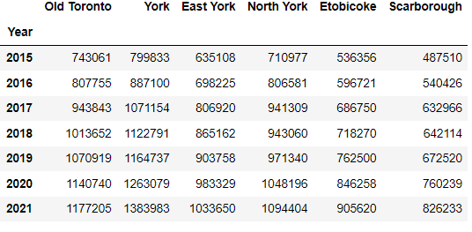
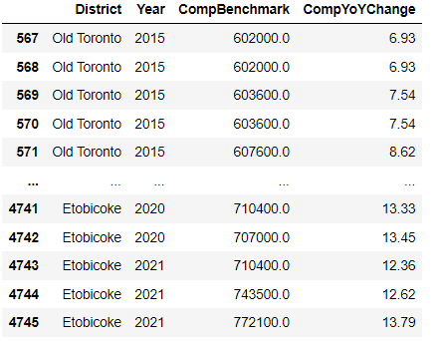

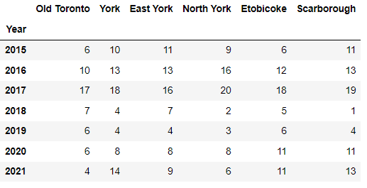
Real estate Housing Prices - Analysis Approach
Data Approach:
v

Slide 8
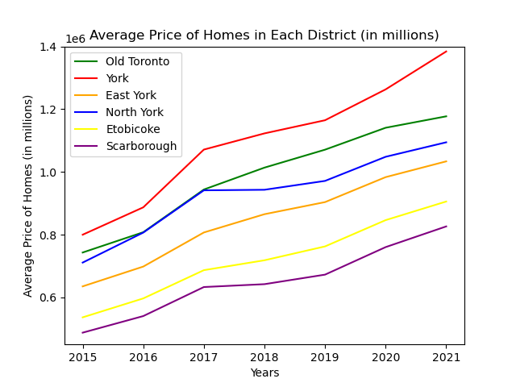
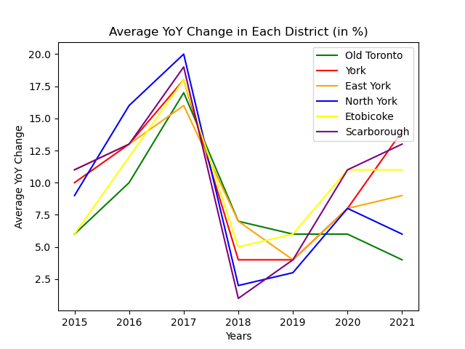
Real estate Housing Prices - Analysis Conclusion

Slide 9
Numbers of Employers - Data Collection
Source of Data:
Toronto neighborhoods information (from Kaggle.com)
Collection, Exploration and Cleanup Process:
Assigned each neighbourhood to the main six districts (East York, Scarborough, North York, Old Toronto, Etobicoke and York)
Removed all irrelevant columns
Created new data frame that contains needed columns for analysis
Creating visualization for analysis
Calculating educated people to employers rate

Slide 10
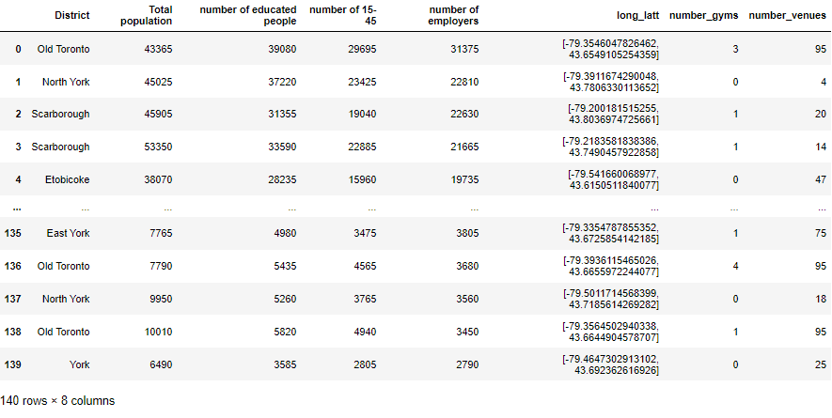
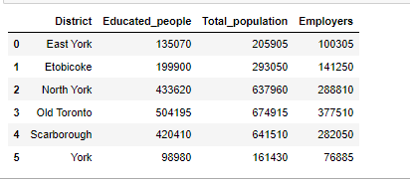
Numbers of Employers - Analysis Approach

Slide 11
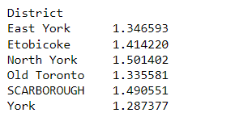
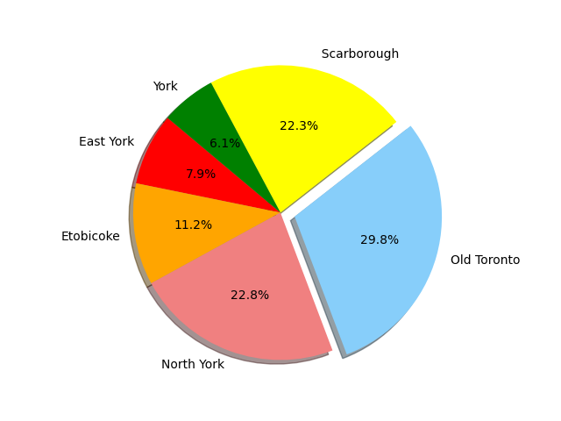
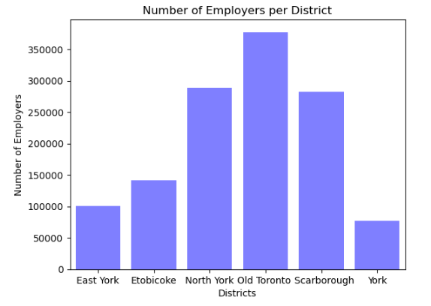
Numbers of Employers - Analysis Conclusion
Results/conclusions of the application or analysis:

Slide 12
School Ratings - Data Collection
Three sources of data:
WellBeing Toronto - Education (2014)
EQAO Results Toronto (2014)
TDSB School Locations (2022)
Exploration & Cleaning
Wellbeing dataset cut into districts by Neighbourhood ID, Mean by District
EQAO Results matched with School Names, then Mean by District

Slide 13
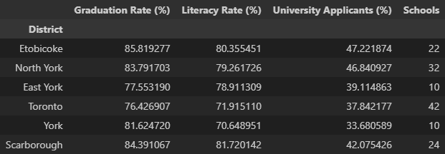
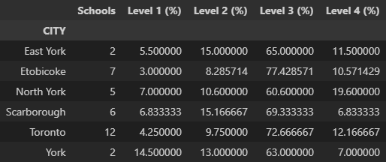
School Ratings - Analysis Approach
Analysis
Mean by District
Both Datasets
Data issues
Inconsistency across reports
Lack of good data source
TDSB / TCDSB Data
Sample Size Issues
Bins from cut() function and sorting

Slide 14
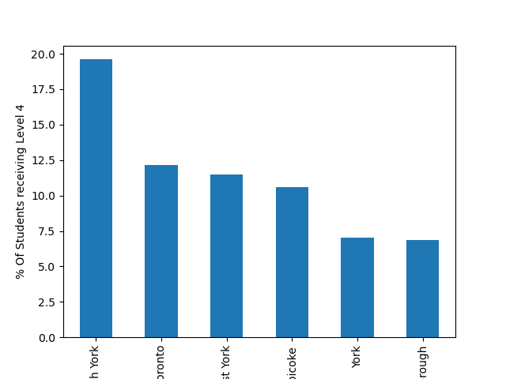
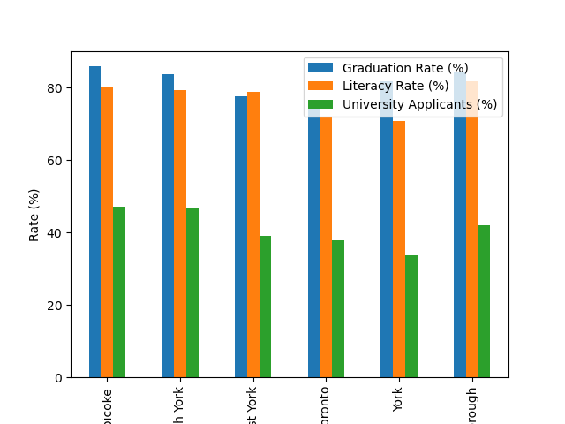
School Ratings - Analysis Conclusions
Largely inconclusive - However, North York appears to be strongest overall

Slide 15
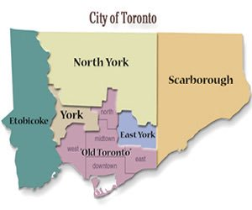
Conclusion
District | Crime | Prices | Employers | Schools | Overall
East York | 6 | 6 | 4 | 4 | 20
Etobicoke | 4 | 5 | 3 | 5 | 17
York | 5 | 1 | 6 | 1 | 13
North York | 2 | 3 | 1 | 6 | 12
Scarborough | 3 | 4 | 2 | 2 | 11
Old Toronto | 1 | 2 | 5 | 3 | 11

