Slide 1
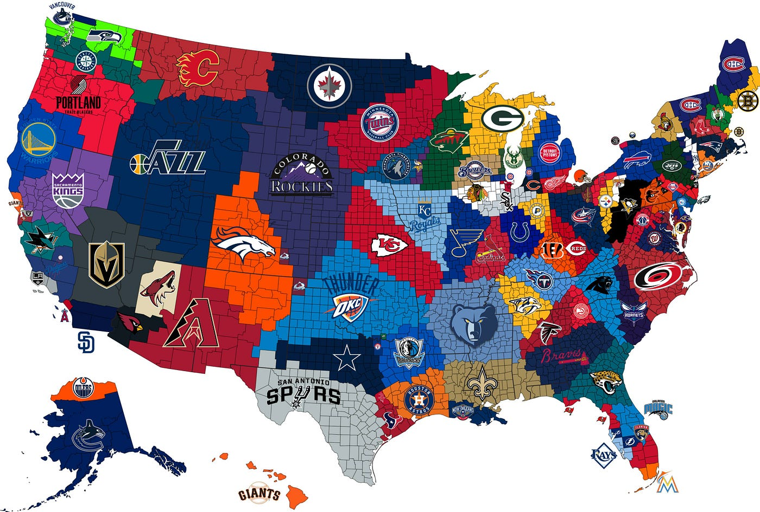
Most Winningest Titles in Sports History
Clarajean, Stephen, Carson, Gurpal
Project-3-Group-2

Slide 2
Executive Summary
Purpose of Project: to help new sports fans gain knowledge about what years, states and city are determined the best in sports history
Five Major League Sports: NBA, NHL, NFL, MLB, MLS
Research Questions to Analyze:
Between 1960 - 2018, which ten-year timeline holds the most sports titles?
Out of the timeline with the most titles, which state holds the most titles?
Out of the state with the most titles, which city holds the most titles?
Dataset Source: https://www.kaggle.com/datasets/thedevastator/winningest-cities-in-sports

Slide 3
Between 1960 - 2018, which ten-year timeline holds the most sports titles?
Why was this question important?
…..
Results from analysis and visuals:
…..

Slide 4
Out of the timeline with the most titles, which state holds the most titles?
Why was this question important?
…..
Results from analysis and visuals:
…..

Slide 5
Out of the state with the most titles, which city holds the most titles?
Why was this question important?
…..
Results from analysis and visuals:
…..

Slide 6
Conclusion

