Slide 1
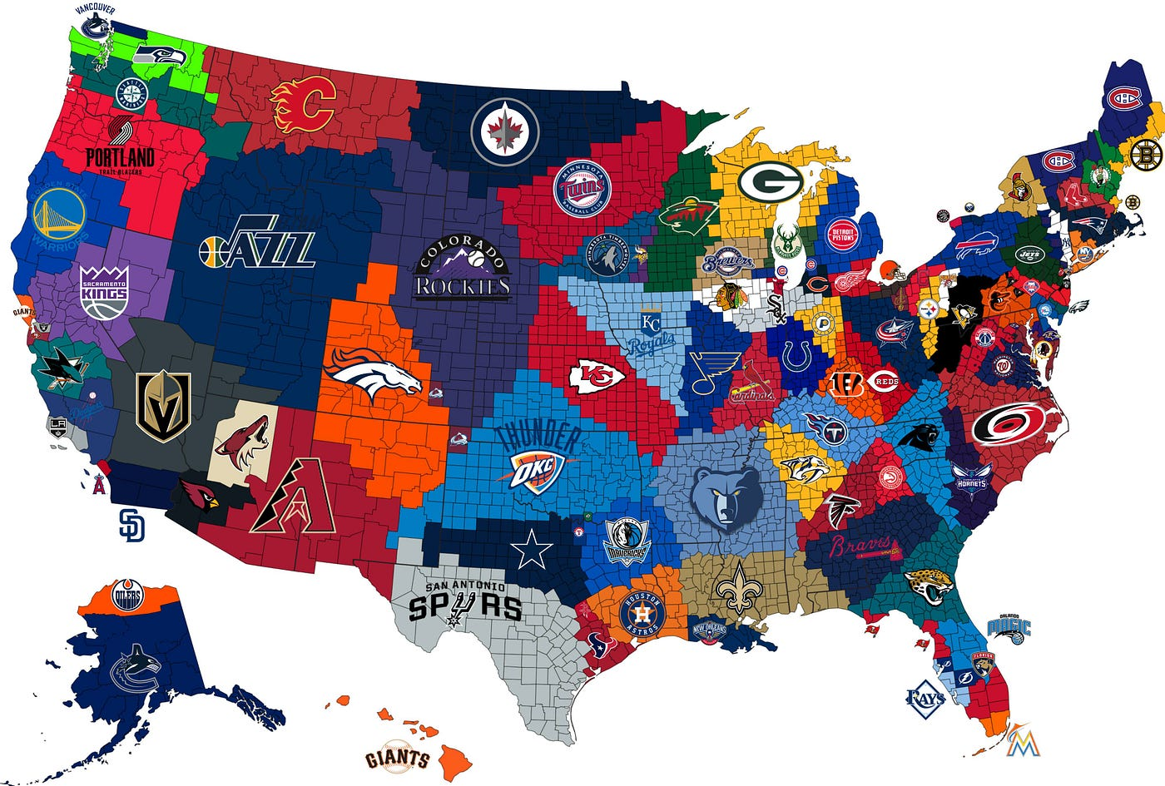
Most Winningest Titles in Sports History
Clarajean, Stephen, Carson, Gurpal
Project-3-Group-2

Slide 2
Executive Summary
Purpose of Project: to help new sports fans gain knowledge about what years, states and city are determined the best in sports history
Five Major League Sports: NBA, NHL, NFL, MLB, MLS
Research Questions to Analyze:
Between 1958 - 2018, which ten-year timeline holds the most sports titles?
Out of the timeline with the most titles, which state holds the most titles?
Out of the state with the most titles, which city holds the most titles?
Dataset Source: https://www.kaggle.com/datasets/thedevastator/winningest-cities-in-sports

Slide 3
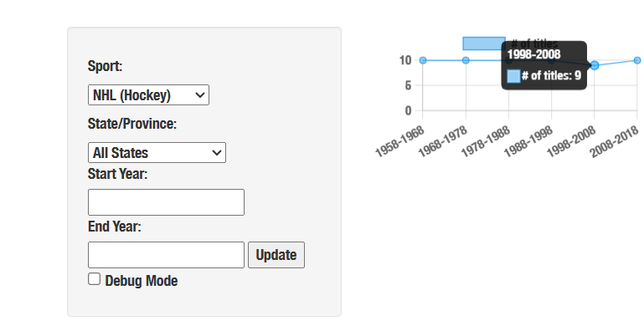
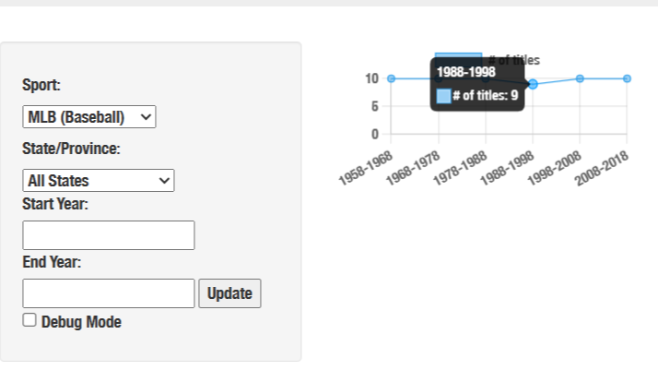
Between 1958 - 2018, which ten-year timeline holds the most sports titles?
Why was this question important?
Some years did not have a champion raised
New sport was created (MLS in 1993)
Can see the state that did better in a ten years
Results from analysis and visuals:
two outliers when one sport did not have a champion
Notes:
Mlb 1994 no world series / playoffs due to players strike
Nhl 2004 no stanley cup final lock out

Slide 4
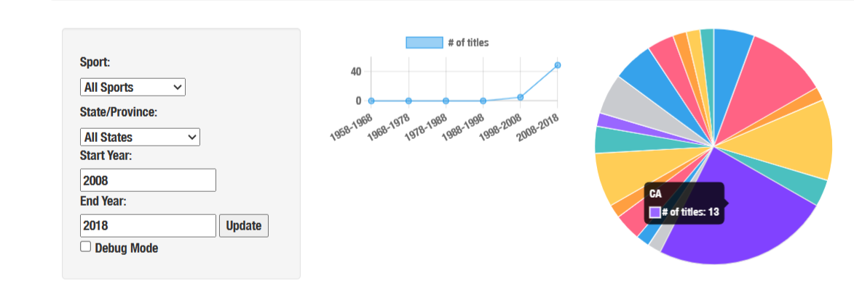
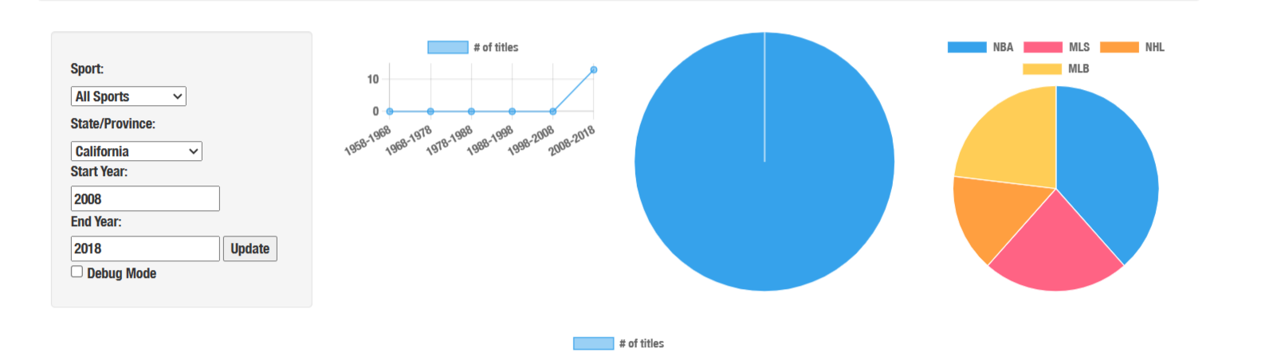
Out of the timeline with the most titles, which state holds the most titles?
Why was this question important?
It shows which state won the most
Gives a break down on each sport
Results from analysis and visuals:
5 NBA titles , 3 MLS titles , 2 NHL titles
3 MLB tiles Totaling 13

Slide 5
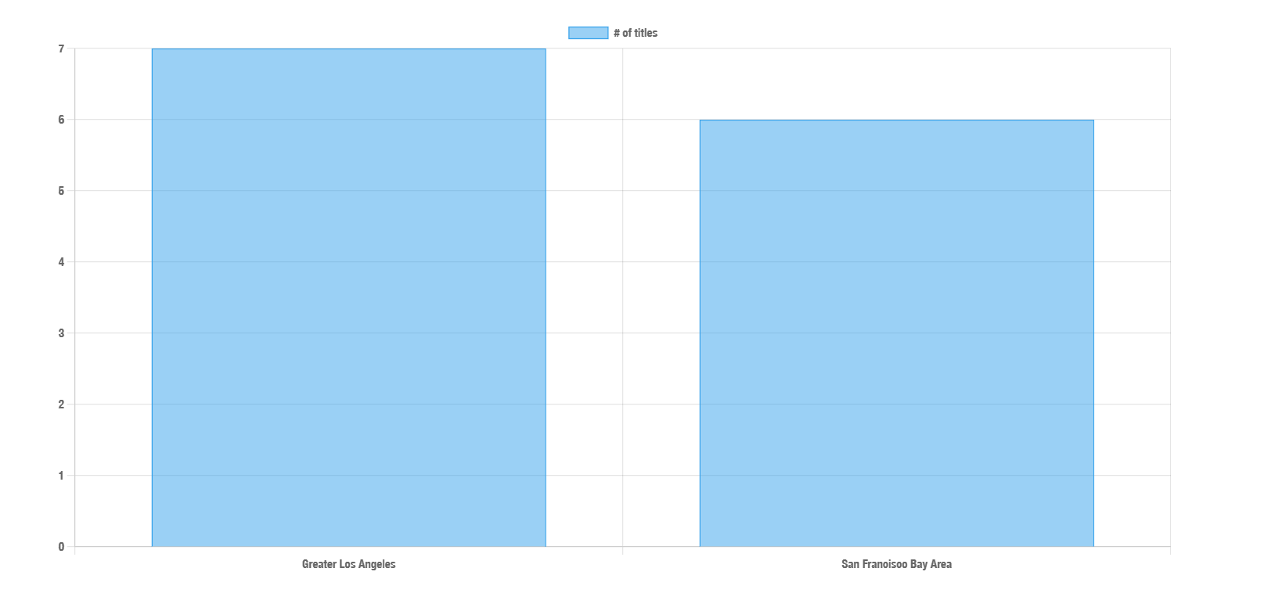
Out of the state with the most titles, which city holds the most titles?
Why was this question important?
Can show which city won the most in a ten years
Show a way to the best team in a decade
Results from analysis and visuals:
Los Angeles won 7 (2 Lakers , 2 Kings , 3 Galaxy)
San Francisco won 6 (3 Giants , 3Warriors)

Slide 6
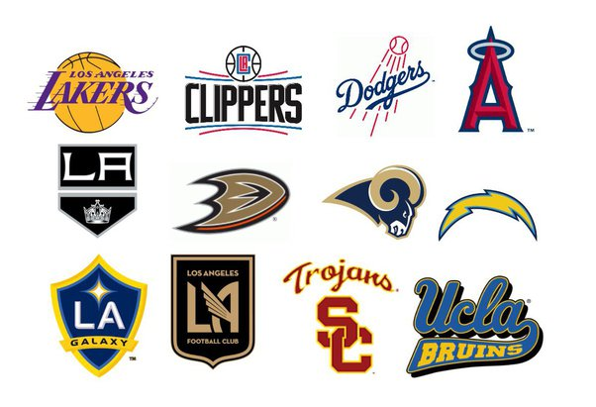
Conclusion
Results from Analysis:
Best Timeline of Sports: 2008 - 2018
State with the Most Titles in the Timeline: California
City with the Most Titles in the State: Greater Los Angeles

