Slide 1

PRESENTATION ON PROJECT REPORT
Submitted in partial fulfillment of the requirement for the award in the degree of
BACHELOR’S OF COMPUTER SCIENCE AND ENGINEERING
In
UNIVERSITY COLLEGE OF ENGINEERING (UCOE)
PUNJABI UNIVERSITY, PATIALA

Slide 2

PERFORMED ON
BOOK STORE DESKTOP APP USING PYTHON
SUBMITTED BY:
Name: GURPREET SINGH
Roll No: 11701137
Group: 3 CE – 5

Slide 3
Table of contents
Introduction
User Interface Design (Front-End)
Building the Back-End
Connecting Front-End to Back-End
Standalone executable version
Bibliography

Slide 4
Introduction
What is Desktop Database Application?
Databases are basically containers for data. Databases are computer structures that save, organize, protect, and deliver data. A system that contains databases is called a database management system, or DBM.
The simplest form of databases is a text database. When data is organized in a text file in rows and columns, it can be used to store, organize, protect, and retrieve data. Saving a list of names in a file, starting with first name and followed by last name, would be a simple database.
Each row of the file represents a record. You can update records by changing specific names, you can remove rows by deleting lines, and you can add new rows by adding new lines.

Slide 5
Desktop database programs are another type of database that's more complex than a text database but intended for a single user. A Microsoft Excel spreadsheet or Microsoft Access is good examples of desktop database programs. These programs allow users to enter data, store it, protect it, and retrieve it when needed. The benefit of desktop database programs over other databases is the speed of changing data, and the ability to store large amounts of data while keeping performance of the system manageable.
Objectives of System
Removes Duplicity
Multiple User Access
Data Protection
Data Backup and Recovery
Everyone can work on Database
Integrity
Platform Independent
Mass Storage

Slide 6
The main objectives of the system are:
User can login to access the data of books.
A new user can register or sign up and make account.
User can view all the records.
User can delete selected record.
User can update selected record.
User can insert new record.
User can Search for any record.
Features
Minimum Duplication and Redundancy.
Saves Storage Space and Cost.
Anyone can work on it.
Large database maintenance.
Provides high level of Security.
Permanent Storage of Data.

Slide 7
tkinter
Python offers multiple options for developing GUI (Graphical User Interface). Out of all the GUI methods, tkinter is most commonly used method. It is a standard Python interface to the Tk GUI toolkit shipped with Python. Python with tkinter outputs the fastest and easiest way to create the GUI applications.
To create a tkinter:
Importing the module – tkinter
Create the main window (container)
Add any number of widgets to the main window
Apply the event Trigger on the widgets.
Importing tkinter is same as importing any other module in the python code. The name of the module in Python 2.x is ‘Tkinter’ and in Python 3.x is ‘tkinter’.

Slide 8
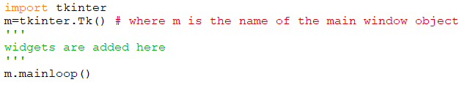
There are two main methods used you the user need to remember while creating the Python application with GUI:
Tk (screen Name = None, base Name = None, class Name = ’Tk’, use Tk=1):
To create a main window, tkinter offers this method. To change the name of the window, you can change the className to the desired one. The basic code used to create the main window of the application is shown in figure.
mainloop( ): There is a method known by the name mainloop() is used when you are ready for the application to run. mainloop() is an infinite loop used to run the application, wait for an event to occur and process the event till the window is not closed.
Fig 1: basic code for using tkinter module.

Slide 9
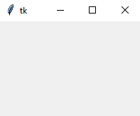
Fig 2: This window generated
will appear shown in figure.
tkinter also offers access to the geometric configuration of the widgets which can organize the widgets in the parent windows. There are mainly three geometry manager classes:
pack ( ) method: It organizes the widgets in blocks before placing in the parent widget.
grid ( ) method: It organizes the widgets in grid (table-like structure) before placing in the parent widget.
place ( ) method: It organizes the widgets by placing them on specific positions directed by the programmer.
Tkinter widgets
Tkinter provides various controls, such as buttons, labels, canvas, entries, check buttons, frames, list boxes, menu buttons, menus, message, radio buttons, scale, scrollbars and text boxes used in a GUI application. These controls are commonly called widgets.

Slide 10
SQLite3
SQLite in general, is a server-less database that can be used within almost all programming languages including Python. Server-less means there is no need to install a separate server to work with SQLite so you can connect directly with the database.
SQLite3 is a very easy to use database engine. It is self-contained, zero-configuration and transactional. It is very fast and lightweight, and the entire database is stored in a single disk file. It is used in a lot of applications as internal data storage. The Python Standard Library includes a module called "sqlite3" intended for working with this database. This module is a SQL interface compliant with the DB-API 2.0 specification
To use sqlite3 module, you must first create a connection object that represents the database and then optionally you can create a cursor object, which will help you in executing all the SQL statements.

Slide 11
Following are important sqlite3 module routines, which can satisfy the requirement to work with SQLite database from Python program:
sqlite3.connect(database [,timeout ,other optional args])
connection.cursor([cursor Class])
cursor.execute(sql [, optional parameters])
cursor.executemany(sql, seq_of_parameters)
connection.executemany(sql[, parameters])
cursor.executescript(sql_script)
connection.commit( )
connection.rollback( )
connection.close( )
cursor.fetchone( )
cursor.fetchmany([size = cursor.arraysize])
cursor.fetchall( )

Slide 12
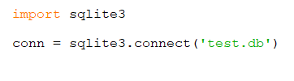
Connect To Database
Following Python code shows how to connect to an existing database. If the database does not exist, then it will be created and finally a database object will be returned.
Here, we can also supply database name as the special name :memory: to create a database in RAM. Now we run the below code to create our database test.db in the current directory. Database will be created respectively.
Once you have a connection, you can create a cursor object and call its execute method to perform SQL commands like CREATE, SELECT, INSERT, DELETE, UPDATE, etc.
Fig 3: basic code for connecting with database

Slide 13
SQLite is widely-used and is favorite among the developers for many reasons -
Extremely light-weighted (not more than 500 KBs)
It is server less which means you do not need any separate server for availing its services
No complex setup
Fully transactional and concurrency-compliant
Some of the most important SQL commands:
SELECT - extracts data from a database
UPDATE - updates data in a database
DELETE - deletes data from a database
INSERT INTO - inserts new data into a database
CREATE DATABASE - creates a new database
ALTER DATABASE - modifies a database
CREATE TABLE - creates a new table
ALTER TABLE - modifies a table
DROP TABLE - deletes a table

Slide 14
os library
The OS module in python provides functions for interacting with the operating system. OS comes under Python’s standard utility modules. This module provides a portable way of using operating system dependent functionality. The *os* and *os.path* modules include many functions to interact with the file system.
Following are some functions in ‘os’ module:
os.name ( ): gives the name of the OS dependent module imported.
os.getcwd ( ): returns the Current Working Directory(CWD) of the file used to execute the code
os.error ( ): All functions in this module raise OSError in the case of invalid or inaccessible file names and paths, or other arguments that have the correct type, but are not accepted by the operating system.
os.popen ( ): opens a pipe to or from command. The return value can be read or written depending on whether mode is ‘r’ or ‘w’.
os.close ( ): A file opened using open(), can be closed by close() only. But file opened through os.popen(), can be closed with close() or os.close( ).

Slide 15
CREATING THE USER INTERFACE DESIGN
The application has two parts backend and frontend.
The backend is database code that interacts with database and frontend is code of tkinter library.
The requirements of this project is to show a list of current records, search a current entry, add entry, select, update, delete data and close the window.
First of all, user will have to login to the store to access information about the books. If a user doesn’t have any account then he/she can register or sign up as a new user.
Here three forms are made:
First form will ask the user if he want to login or register as new user.
Second form will be either login page or register as new user page. Which consists of the username and password entries to be filled. Only registered users are allowed to use the book store.
Third from will be the book store design which consists of various text boxes, entries, list box, scrollbar and labels.

Slide 16
Designing the first form
This form will contain three buttons and a label
Main window is created with screen variable declared as global.
screen geometry and title are set using predefined methods.
Then label is designed with pack ( ) method with shown height, width, font, text, foreground and background color.
Buttons are also designed with pack( ) method with all the parameters as shown in figure.
At the end Mainloop ( ) method infinitely runs the loop and wait for an event to occur and process the event till the window is not closed.
All the other forms are made as children to the first form.
NOTE: Some part of these screenshots code may differ from the original code due to designing of widgets (color, font, etc.) but functionality will be same.

Slide 17
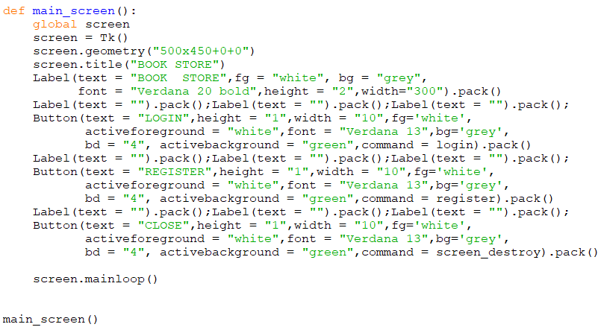
We will only call the main_screen( ) method and all the other methods, all the other methods will be invoked internally using this method.
In the two buttons, commands of login and register are given which will open a new window screen of login page and register page respectively.
Fig 4: Code for first form which is defined in main_screen ( ) method

Slide 18
Designing the second Interface
This form is designed in login method and register method.
screen1 and screen2 variables are used as children to the screen variable(used in first form). This is done by using Toplevel( ) method which is used when a python application needs to represent some extra information, pop-up, or the group of widgets on the new window.
Here also title, geometry are given to both screen1 and screen2.
register( ) method:
username and password are created as String variable.
Labels are created for username and password and empty label between them. Entries for username and password are created with Entry( ) method with first argument as screen1 and text variable as username and password respectively (entries are assigned to store value into text variable). Pack( ) method is used to put these widgets inside screen1.

Slide 19
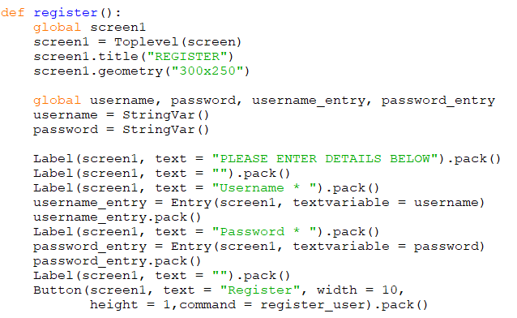
At the bottom we will add the register button. The function of this button is defined in register user method. Register user method will get the username and password details.
Once we have all the values, we will enter into the text file.
Fig 5: Code for second screen. User can register for new account using register ( ) method

Slide 20
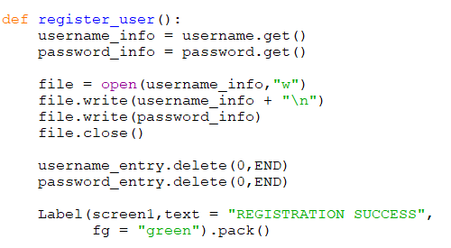
File variable is the File name which will be just a username of the user. In the file we write the username and password information entered by the user. And then close the file.
Username and password variables are made global in register method to be used in register_user method. Entries are cleared using delete method from starting to end.
At the end, we tell the user if registration is successful.
Fig 6: Code for command attached with button in register () method

Slide 21
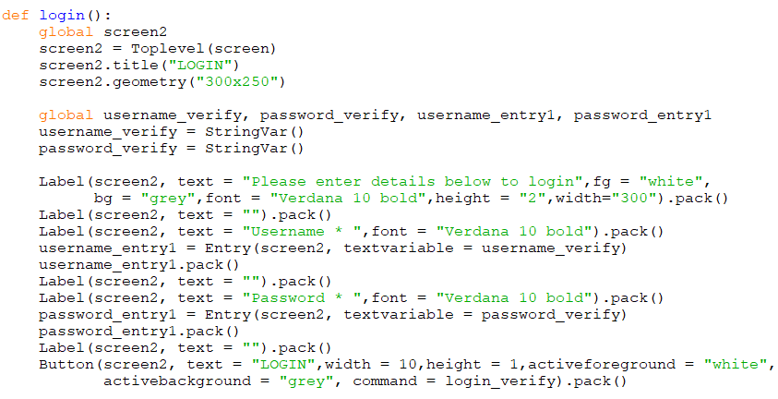
login( ) method:
Here global screen2 variable is created which is used as first parameter in labels, entries and buttons. username_verify and password_verify are created as global string variable.
Entries for username and password are created as global variable as shown in figure.
Fig 7: This also code for second screen but for login( ) method. It is used to login into book store

Slide 22
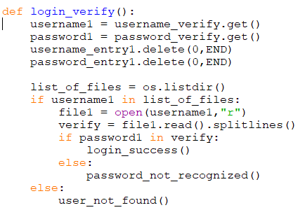
The login button is created with command login_verify( ). This command will validate username and password to check if the user account actually exists or not. Or if password is correctly recognized.
We will get the entered username and password and store in variables username1 and password1. and clear both the entries.
Now we need to gather list of names of files that are stored in
directory where code is saving the accounts. This is done by listdir ( ) method of os library which lists all the Files with in the Current directory as a List. If usrname1 is in list of Files then we want to open the username1 file in read mode.
Fig 8: Code for command attached with button of login( ) method.. It is used to check user login details

Slide 23
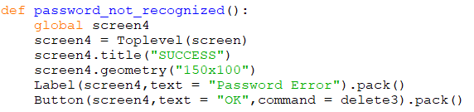
We read the file in verify using read method and split lines method which breaks the string at line boundaries and returns a list of splitted lines in the form of list. It read all the lines in the text file and it will ignore blank space or blank line.
Now we check if the entered password is in the username file which is read. If it is, then we invoke login_success( ) method. Else we invoke password_not_recognized( ) method. If we don’t have username in the directory then we call user_not_found( ) method.
Password_not_recognized ( ) method:
It shows the window pop up to just say that entered password is incorrect.
In button, delete3 method is used to destroy this window.
Fig 9: code for password not recognized. A new screen will be displayed if password is wrong.

Slide 24
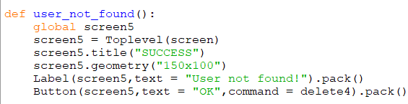

user_not_found ( ) method:
This method is used when username is incorrect or no user is found in the directory.
Screen4 is used; delete4 method used to destroy screen4 window.
Fig 10: if user is not found then a new screen popup will show up.
login_success ( ) method:
Every time a user logs in, a session will be given to the user.
this session consists the code for the third window screen which is the actual book store
Fig 11: This method is defined in login_verify function. If password is verified then this method is called.

Slide 25
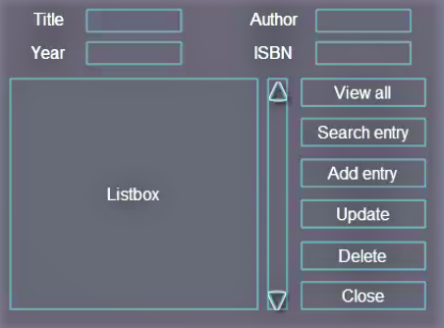
Designing the third interface
Third Interface’s concept is shown in figure and then backend is made and at the end we connect frontend with backend i.e. to connect all the commands of buttons with backend functions.
A code is made that stores information about Title, Author, Year and ISBN of the book. User can view all records, Search an entry, add, update, delete records and close the code.
The interface is to be made with the grid ( ) method of tkinter library.
Widgets used:
4 labels
6 buttons
1 list box
4 entries
1 scrollbar
Fig 12: Design of third form.

Slide 26
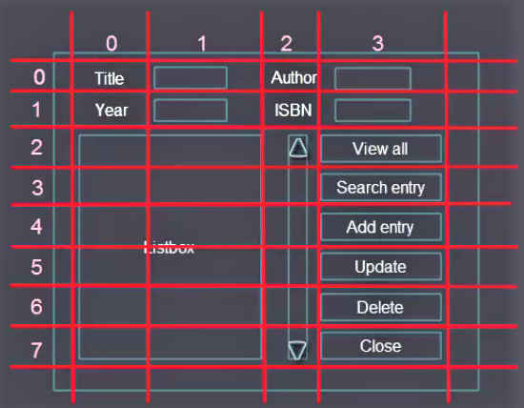
Interface for every tool used
Temporary grids on our interface for no. of row and column.
For example “Author” label is in 0th row and second column.
Fig 13: Structure of rows and columns to be used.

Slide 27

Building Front-end Interface
The first line of the code imports all the functions from tkinter library.
Then we initialize window with Tk( ) method which creates a window object.
At the end we will apply mainloop( ) method which wraps up all the widgets that we will enter in this space.
All this code for 3rd interface will reside in the session ( ) method.
Fig 14: Code for all libraries used.

Slide 28
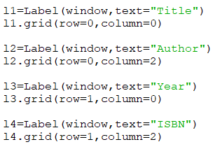
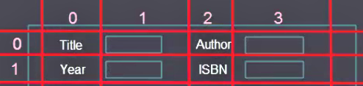
Designing Labels
Here we want to create 4 labels:
Label l1 – “ Title ”
Label l2 – “ Author ”
Label l3 – “ Year ”
Label l4 – “ ISBN ”
window is the parent window.
grid ( ) method is applied according to the position number of row and column.
Fig 15: Code for designing labels.
Fig 16: Given number of rows and columns for labels.

Slide 29
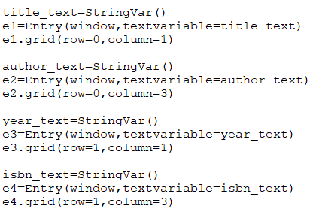
Designing Entries
Entry gets window as the first parameter like any other widget and a text variable parameter which expects as an argument the value that the user will enter in the entry widget.
Text variables of all the entries are created as StringVar ( ), this function creates spatial object.
Fig 17: Code for designing entries.

Slide 30
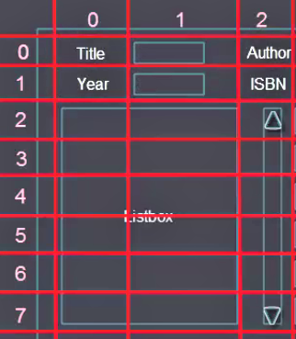
Adding Listbox and Scrollbar
In list box, we want to specify height and width of list box, we can test different height and width and select which fits better.
We want to span the list box on 2 columns 0 and 1 and across 6 rows (from 2nd to 7th row).
Configure method is applied both to list box and scrollbar. This method takes arguments, vertical scrollbar along the y axis will be set to this scrollbar
When we scroll the bar, the vertical list of the view will change.
Fig 18: Interface for number of rows and columns used for each list box and scrollbar.

Slide 31
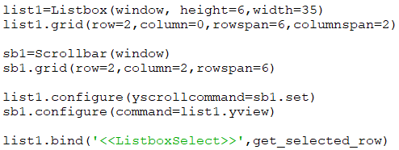
Listbox method is used to make listbox as list1. on which window list box is to be made , height and width are specified in the arguments.
Scrollbar is made with Scrollbar method on the window with 6 rows spanned from 2nd to 7th row and in 2nd column.
Scroll bar is attached with List box using yview function (scrolled in Y – axis direction). get_selected_row function is used to select a row (discussed later).
Fig 19: Code for adding list box and scroll bar.

Slide 32
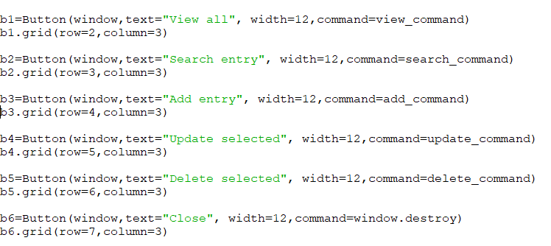
Designing Buttons
Six buttons are to be made and aligned in the 3rd column from 2nd to 7th row.
We have button method and arguments as window, text, width and command which decide what the particular button will do.
Commands (defined later…) written as arguments in Button ( ) function performs a particular task. In button b6 (close button) window.destroy command destroys the window.
Fig 20:
Code for designing and adding all the six buttons.

Slide 33
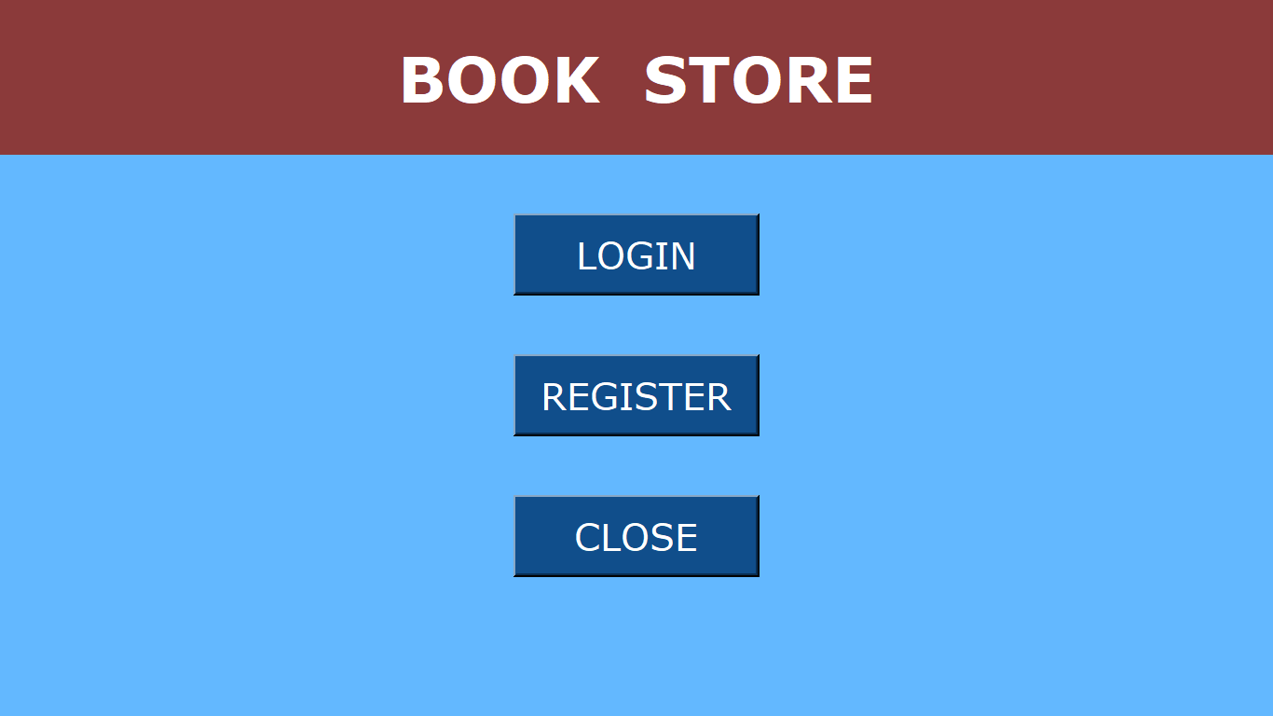
Final look of Interfaces
Fig 21: Main Screen form. This form consists of login, register and close button.

Slide 34
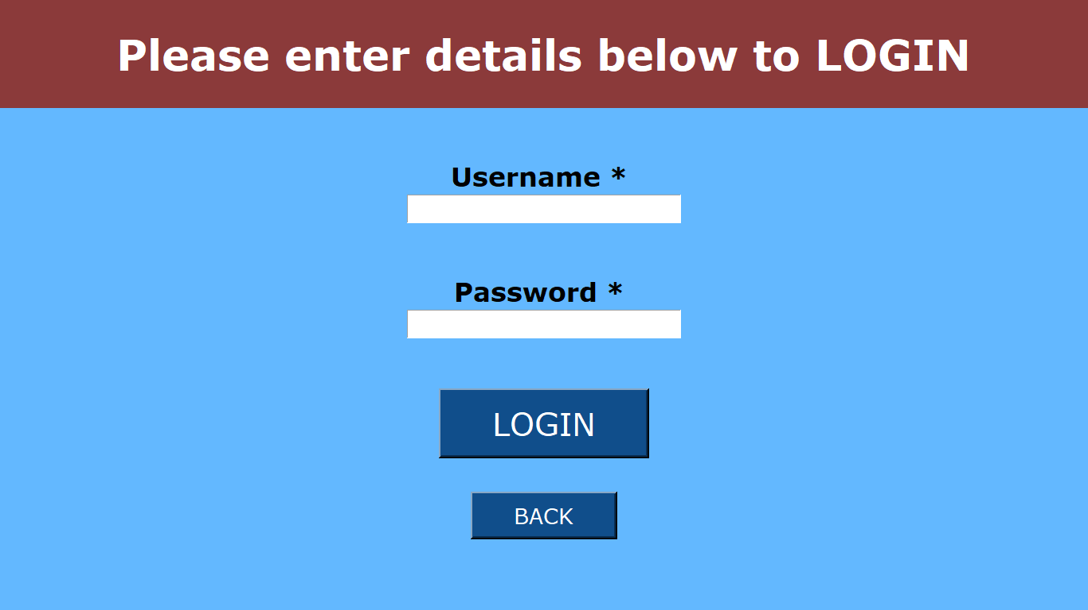
Fig 22: The Login Page

Slide 35
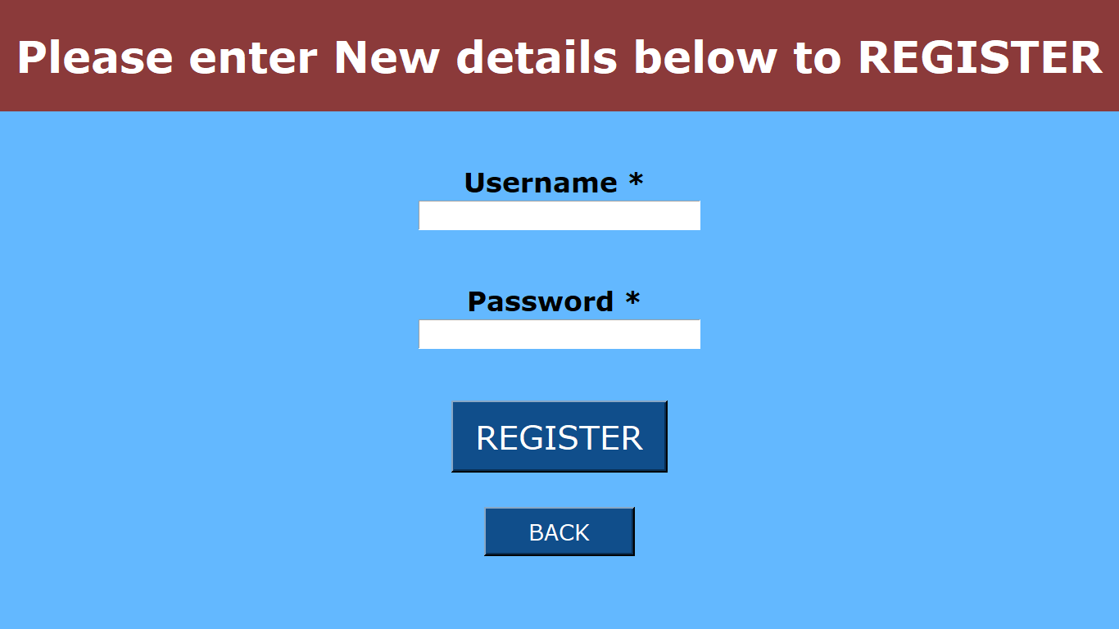
Fig 23: Registration Page.

Slide 36
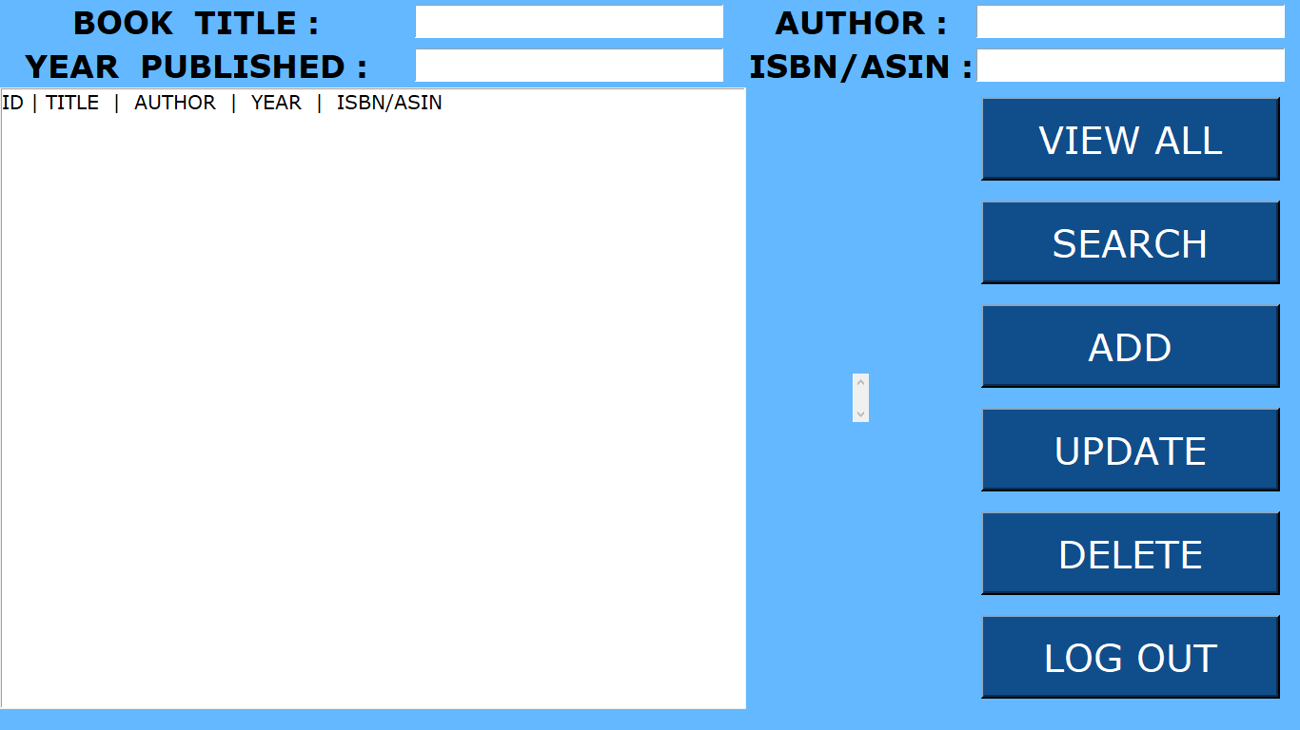
Fig 24: This is the third form of book store which will open when user logins.

Slide 37
BUILDING BACKEND
For making back-end, we create other script and then import this script in the front-end. Lets call new script backend.py
In backend script sqlite3 library is imported.
5 functions are created in the date base:
connect ( )
insert ( )
view ( )
search ( )
delete ( )
update ( )
These functions are then connected to the buttons in the front-end.

Slide 38
Connecting with database
connect ( ) function consists of code for establishing connection with database.
To use backend, we have to make a database file through which we can save our data. ‘books.db’ is created which contains all information regarding books.
‘conn’ is the connection object which establishes a connection with database. Cursor object cur is defined using cursor method and execute the SQL statement inside double quotes.
Every time a user executes a program the script has to check if there is an existing table in books.db database. If there is a table then we don’t create the table and if there is no table, we want to create the table. We name the table book.

Slide 39
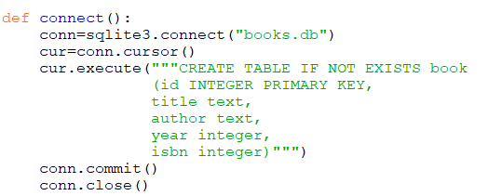
We need to specify arguments in the table. Starting from id which is just a number that will start from zero and it will auto increment by one, so that we have control of how many records we have in database. So id is set as primary key. All the other columns with data type are specified…
commit method is used to permanently save the changes made to the database
At the end, connection is close using close method.
We have to call connect function which will run any time when front end code is executed.
Fig 25: Code for connecting to database and create table with shown attributes.

Slide 40
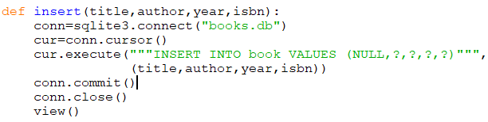
Inserting into table
As there are 4 entries so 4 parameters are passed inside insert function (used to insert data into database table) as shown in fig.
Here also we make connection to the database and make a cursor object. So when user presses add entry button, a new connection to database will be established.
While inserting into the table book, first we have an id which is auto increment value. So we don’t have to pass that manually and we can pass NULL value. Python will create id automatically. 4 question marks are for each 4 values.
Second parameter in the execute function is passed as a tuple of title, author, year and isbn.
Fig 26: Code for inserting data into database table.

Slide 41
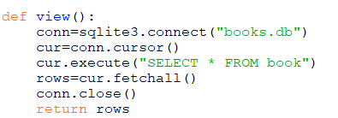
View the data
View function will fetch all the rows of the database table.
Here cursor is executed by simple “SELECT” SQL query. As this is select statement so will not perform any changes to the database, so commit method is not used.
rows variable is used which fetches all the rows of a query result. It returns all the rows as a list of tuples. Selected rows will be put into the list box. An empty list is returned if there is no record to fetch.
rows are returned after closing the connection.
Fig 27: view method is used to display data from database table.

Slide 42
Searching into the database
In this function, an OR search is implemented which means that user will enter a title or an author name, or the year, or the isbn number or he can enter all of them at the same time. If user enter the year only then he’ll get all the rows corresponding to that year.
So 4 parameters are passed. If user want to pass let’s say the author name only to the entries so the function will get only the arguments for the author parameter and other parameters will remain without a value, we may get error as the function is designed to have 4 parameters.
In that case we pass some empty strings as default values, so now if user passes any particular author name, the SQL statement will search for an empty title or for author name or for empty year, all the rows are returned with that particular author name.

Slide 43
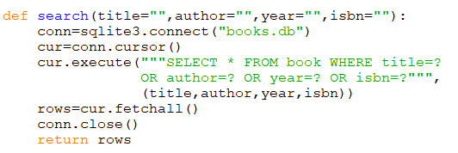
we connect to the database, cursor object is passed and then execute cursor which select row where title is equal something or author is equal something or author and so on….. And second parameter will be a tuple of arguments.
Then we need to fetch all the rows that will be returned form this query using fetchall method and return the rows at the end after closing the connection.
Fig 28: This is code for searching data by title or author or year or ISBN no.

Slide 44
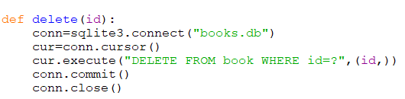
Deleting data from table
User can select one of the records from the list box and want to delete by pressing delete button.
So we want to grab the list selection as a tuple which has unique ID. We want to refer to that ID and go to database table and delete the row with that ID.
Here delete ( ) method is used which takes single argument, id. User can delete a record just by selecting record from the list box.
We want to delete from book where id is equal to something.
User can see if the record has been deleted or not, user can simply check it by displaying the record by clicking on “ view all ” button.
Fig 29: Code for deleting data form database.

Slide 45
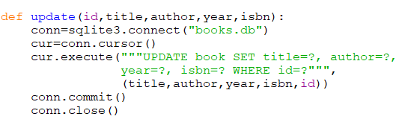
Update the data
To update records, user can select a row from list box and value of that particular selected row would display in the entry widgets. And from there, user may want to change one of the entries and press the update button.
Here also we will get the selection from the list box and then we would refer to the ID as the first parameter. We want to get the new values that the user want from those entries.
All the four parameters along with the ID is passed. And then we want to update the table where ID is equal to question mark.
Fig 30: Code for updating data into database table.

Slide 46
CONNECTING FRONT END WITH BACKEND
Now we want frontend script to fetch data from the backend script, or more specifically is able to get the function outputs which are basically tuples of data, and then insert those tuples of data in the list box. So basically the user presses the button and then these functions are triggered and the data are inserted to the list box.
Connecting frontend with backend involvers import backend script.
Following commands are implemented in the front end script which are connected with buttons:
View
Search
Add
Delete
Update
Get_selected_row

Slide 47

view_command( )
In this function we want to get the records in the list box when the user presses the view all button.
Here deleting the list box(list1) takes 2 arguments, 0 and END which ensures that everything is deleted from the row with index of 0 to the END(last row).
We iterate through the view function in the backend and insert all the rows into the list box. Insert method takes two arguments. The first arguments is the index where we want to insert our values and second is the row in which is iterated through all the rows in backend view command.
This function is attached with button using : -
B1 = Button (window, text = "View all", command = view_command)
Fig 31: Code to display all records in database table. This method is internally using view method from backend.

Slide 48
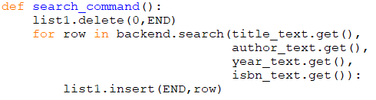
search_command( )
In this function also, first we want to empty the list using delete method.
Then we need to loop to the backend list search( ) method which takes 4 parameters. Text that the user is inputting in the entry widget is taken. Since title_text is a StringVar object so its not a plain string. We need append a get method to output a string object. If user enter any text in the widget, get method will produce a simple text string.
Search function will output for us when it searches the database, then we simply insert new values at the end of the list using insert method.
This function is attached with button using – (wrapper function)
b2 = Button (window, text = "Search ", command = search_command)
Fig 32: Function for performing search in database table. This method internally calls search method from backend.

Slide 49
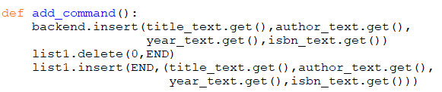
add_command( )
This function is used to store the data that user is inputting in the entries.
Here we need to call insert method from backend and get all the 4 arguments of this method.
Entry record will be shown in listbox when user presses add entry.
First we need to ensure if the list box is empty using delete method.
Then we insert new values at the end of the list which we have taken from get method (i.e. input from user). Here we put all the user input values as a single value, as a tuple.
This function is attached with button using : -
B3 = Button (window, text = "Add ", command = add_command)
Fig 33: Method for inserting records entered by user into database table.

Slide 50
delete_command( )
Here when the user selects one of the rows in the list box, we need to grab the ID of that row and send back ID to the delete function over the backend script.
A user want to delete a particular row, so we implement a method to get a row selected by the user.
bind ( ) method is used to bind a function to a widget event. It takes 2 arguments the event type and function that we want to bind to the event type.
This is written as : list1.bind('<<ListboxSelect>>',get_selected_row)
This function gets special parameter called event which holds the information about the type of the event. So Python know that when we pass these to the bind method, it expects the function to have this event parameter.
We can implement get_selected_row function in try except block.

Slide 51
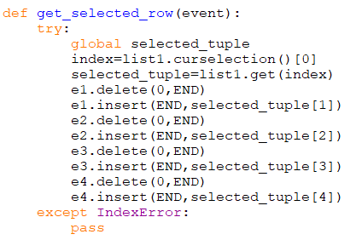
Instead the line under except will be executed which is pass. The pass statement means do nothing. So the function will do nothing when there's an empty list box.
To get the index of the selected row of the list box, curselection method is used. We grab the item with index 0 of the tuple .
From the list box, get the tuple with index x.
If we print the selected_tuple and select a row from a list box then we get row printed out as tuple.
Fig 34:
get_selected_row method returns the selected tuple from the list box and fills the value of that selected record in respective entries.

Slide 52

As the delete method get the argument as ID from backend, so we have tuple called get selected row, we need to return the selected , if we call the function we get the selected.
We want the item with index 0 from the selected tuple.
When user select one of the rows we want to fill the entries with selected row, insert method of entry widget is used. First we make sure that entries are empty using delete method from 0 to end. We want to insert at the END in author entry (second entry) the selected_tuple[1] as id has 0 index and so on… for the other remaining entries.
Fig 35: Delete command is used to delete selected record. This method internally invokes delete function form backend.

Slide 53
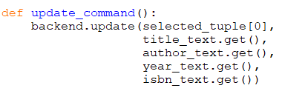
update_command( )
The update method from backend takes five arguments.
A user can update any of the particular record by selecting that record from the list box and then making changes to the particular entries and press the update button. And further he can check the updated record by pressing view all button.
We want to keep the ID of the selected row as the user is changing the other values not the ID. when selected row has all the data in the entries we can update or change them. All updated values are sent back to the selected row.
This function is attached with button using : -
b5 = Button (window, text = "Add entry", width = 12, command = update_command)
Fig 36:
Update_command is used to update records. This method internally calls update function form backend.

Slide 54
Standalone executable version
We can execute the script using python but if you want to give your project to someone else, they can run it if they have python installed in their PC. And execute the program by going to the terminal and invoking python and the script. That may be difficult for users who are not experienced with programming.
We want to make standalone executable version that we can send to anyone and they can click and go ahead, insert data, retrieve data and so on.
File will work for executable version in any operating system.
There exists a library to make standalone executables in python i.e. “ pyinstaller ”(can be installed using pip install pyinstaller).
Pyinstaller script makes a .exe file on windows, .f file on MAC and also bunch of other files are generated which are associated with out program.

Slide 55


Fig. 37 will create a single executable file.
frontend.py is holding all the code and it also imports the backend script.
After running this command where frontend.py is present, frontend.exe will be created (in windows).
By opening the frontend.exe file we get the whole window interface. A new books.db file is generated by default.
If we click view all button, no data will be shown in the list box as we don’t have any data because books.db is created from scratch.
So we want to give the user both the executable file and the existing database.
Fig 37: Commands for making single executable file

Slide 56
Bibliography
Websites:
www.w3schools.com
www.wikipedia.com
www.goodreads.com
www.quora.com
www.tutorialspoint.com

Slide 57
THANK
YOU

