Slide 1

PRESENTATION
On Six Weeks Industrial Training (1 June, 2019 – 15 July, 2019)
On
BOOK STORE DESKTOP APP
USING PYTHON
At NIIT Centre, Patiala
SUBMITTED BY:
GURPREET SINGH
3 CE – 5 (5TH SEM)
11701137

Slide 2
Table of contents
Introduction
User Interface Design (Front-End)
Building the Back-End
Connecting Front-End to Back-End
Standalone executable version
Bibliography

Slide 3
Introduction
What is Desktop Database Application?
Databases are basically containers for data. Databases are computer structures that save, organize, protect, and deliver data. A system that contains databases is called a database management system, or DBM.
The simplest form of databases is a text database. When data is organized in a text file in rows and columns, it can be used to store, organize, protect, and retrieve data. Saving a list of names in a file, starting with first name and followed by last name, would be a simple database.
Each row of the file represents a record. You can update records by changing specific names, you can remove rows by deleting lines, and you can add new rows by adding new lines.

Slide 4
Desktop database programs are another type of database that's more complex than a text database but intended for a single user. A Microsoft Excel spreadsheet or Microsoft Access is good examples of desktop database programs. These programs allow users to enter data, store it, protect it, and retrieve it when needed. The benefit of desktop database programs over other databases is the speed of changing data, and the ability to store large amounts of data while keeping performance of the system manageable.
Objectives of System
Removes Duplicity
Multiple User Access
Data Protection
Data Backup and Recovery
Everyone can work on Database
Integrity
Platform Independent
Mass Storage

Slide 5
The main objectives of the system are:
User can login to access the data of books.
A new user can register or sign up and make account.
User can view all the records.
User can delete selected record.
User can update selected record.
User can insert new record.
User can Search for any record.
Features
Minimum Duplication and Redundancy.
Saves Storage Space and Cost.
Anyone can work on it.
Large database maintenance.
Provides high level of Security.
Permanent Storage of Data.

Slide 6
tkinter
Python offers multiple options for developing GUI (Graphical User Interface). Out of all the GUI methods, tkinter is most commonly used method. It is a standard Python interface to the Tk GUI toolkit shipped with Python. Python with tkinter outputs the fastest and easiest way to create the GUI applications.
To create a tkinter:
Importing the module – tkinter
Create the main window (container)
Add any number of widgets to the main window
Apply the event Trigger on the widgets.
Importing tkinter is same as importing any other module in the python code. The name of the module in Python 2.x is ‘Tkinter’ and in Python 3.x is ‘tkinter’.

Slide 7
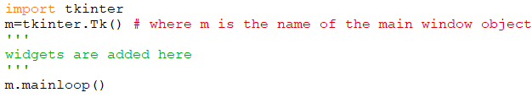
There are two main methods used you the user need to remember while creating the Python application with GUI:
Tk (screen Name = None, base Name = None, class Name = ’Tk’, use Tk=1):
To create a main window, tkinter offers this method. To change the name of the window, you can change the className to the desired one. The basic code used to create the main window of the application is shown in figure.
mainloop( ): There is a method known by the name mainloop() is used when you are ready for the application to run. mainloop() is an infinite loop used to run the application, wait for an event to occur and process the event till the window is not closed.
Fig 1: basic code for using tkinter module.

Slide 8
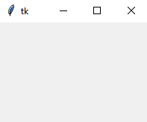
Fig 2: This window generated
will appear shown in figure.
tkinter also offers access to the geometric configuration of the widgets which can organize the widgets in the parent windows. There are mainly three geometry manager classes:
pack ( ) method: It organizes the widgets in blocks before placing in the parent widget.
grid ( ) method: It organizes the widgets in grid (table-like structure) before placing in the parent widget.
place ( ) method: It organizes the widgets by placing them on specific positions directed by the programmer.
Tkinter widgets
Tkinter provides various controls, such as buttons, labels, canvas, entries, check buttons, frames, list boxes, menu buttons, menus, message, radio buttons, scale, scrollbars and text boxes used in a GUI application. These controls are commonly called widgets.

Slide 9
SQLite3
SQLite in general, is a server-less database that can be used within almost all programming languages including Python. Server-less means there is no need to install a separate server to work with SQLite so you can connect directly with the database.
SQLite3 is a very easy to use database engine. It is self-contained, zero-configuration and transactional. It is very fast and lightweight, and the entire database is stored in a single disk file. It is used in a lot of applications as internal data storage. The Python Standard Library includes a module called "sqlite3" intended for working with this database. This module is a SQL interface compliant with the DB-API 2.0 specification
To use sqlite3 module, you must first create a connection object that represents the database and then optionally you can create a cursor object, which will help you in executing all the SQL statements.

Slide 10
Following are important sqlite3 module routines, which can satisfy the requirement to work with SQLite database from Python program:
sqlite3.connect(database [,timeout ,other optional args])
connection.cursor([cursor Class])
cursor.execute(sql [, optional parameters])
cursor.executemany(sql, seq_of_parameters)
connection.executemany(sql[, parameters])
cursor.executescript(sql_script)
connection.commit( )
connection.rollback( )
connection.close( )
cursor.fetchone( )
cursor.fetchmany([size = cursor.arraysize])
cursor.fetchall( )

Slide 11
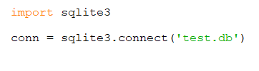
Connect To Database
Following Python code shows how to connect to an existing database. If the database does not exist, then it will be created and finally a database object will be returned.
Here, we can also supply database name as the special name :memory: to create a database in RAM. Now we run the below code to create our database test.db in the current directory. Database will be created respectively.
Once you have a connection, you can create a cursor object and call its execute method to perform SQL commands like CREATE, SELECT, INSERT, DELETE, UPDATE, etc.
Fig 3: basic code for connecting with database

Slide 12
SQLite is widely-used and is favorite among the developers for many reasons -
Extremely light-weighted (not more than 500 KBs)
It is server less which means you do not need any separate server for availing its services
No complex setup
Fully transactional and concurrency-compliant
Some of the most important SQL commands:
SELECT - extracts data from a database
UPDATE - updates data in a database
DELETE - deletes data from a database
INSERT INTO - inserts new data into a database
CREATE DATABASE - creates a new database
ALTER DATABASE - modifies a database
CREATE TABLE - creates a new table
ALTER TABLE - modifies a table
DROP TABLE - deletes a table

Slide 13
os library
The OS module in python provides functions for interacting with the operating system. OS comes under Python’s standard utility modules. This module provides a portable way of using operating system dependent functionality. The *os* and *os.path* modules include many functions to interact with the file system.
Following are some functions in ‘os’ module:
os.name ( ): gives the name of the OS dependent module imported.
os.getcwd ( ): returns the Current Working Directory(CWD) of the file used to execute the code
os.error ( ): All functions in this module raise OSError in the case of invalid or inaccessible file names and paths, or other arguments that have the correct type, but are not accepted by the operating system.
os.popen ( ): opens a pipe to or from command. The return value can be read or written depending on whether mode is ‘r’ or ‘w’.
os.close ( ): A file opened using open(), can be closed by close() only. But file opened through os.popen(), can be closed with close() or os.close( ).

Slide 14
CREATING THE USER INTERFACE DESIGN
The application has two parts backend and frontend.
The backend is database code that interacts with database and frontend is code of tkinter library.
The requirements of this project is to show a list of current records, search a current entry, add entry, select, update, delete data and close the window.
First of all, user will have to login to the store to access information about the books. If a user doesn’t have any account then he/she can register or sign up as a new user.
Here three forms are made:
First form will ask the user if he want to login or register as new user.
Second form will be either login page or register as new user page. Which consists of the username and password entries to be filled. Only registered users are allowed to use the book store.
Third from will be the book store design which consists of various text boxes, entries, list box, scrollbar and labels.

Slide 15
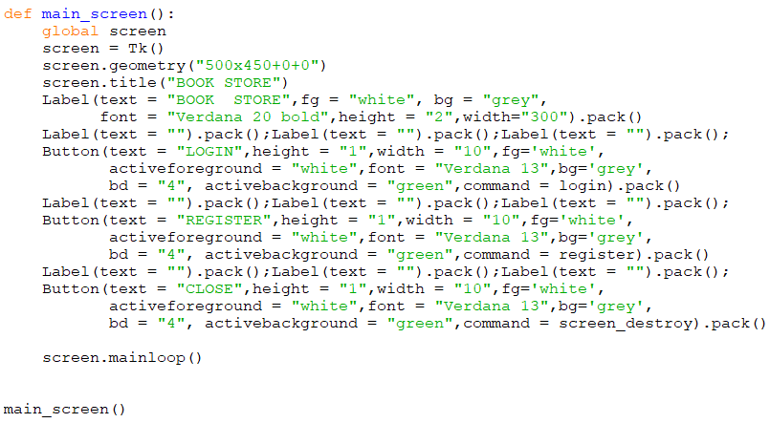
Designing the First Interface
Fig 4: Code for first form which is defined in main_screen ( ) method

Slide 16
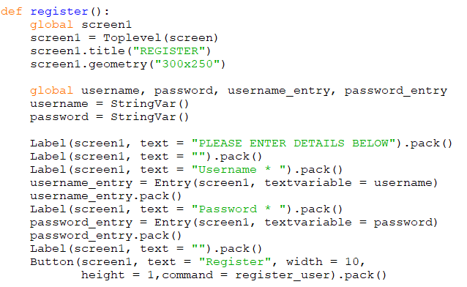
Designing the second Interface
Fig 5: Code for second screen. User can register for new account using register ( ) method

Slide 17
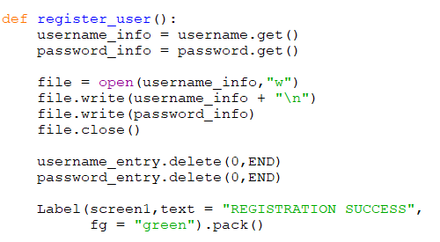
NOTE: Some part of these screenshots code may differ from the original code due to designing of widgets (color, font, etc.) but functionality will be same.
Fig 6: Code for command attached with button in register () method

Slide 18
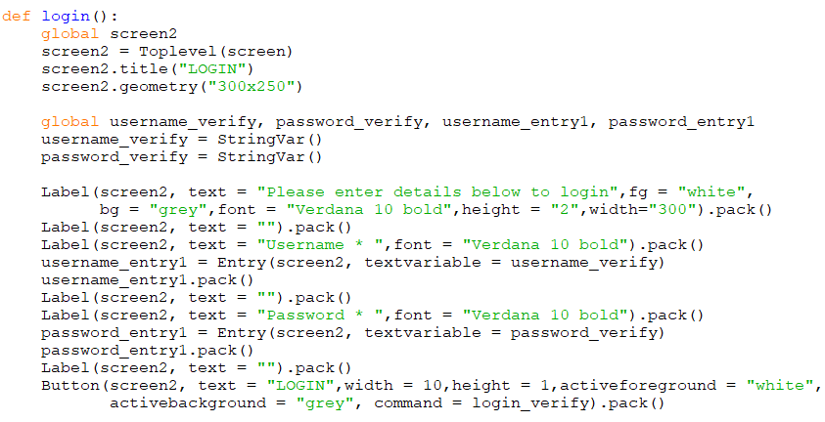
Fig 7: This also code for second screen but for login( ) method. It is used to login into book store

Slide 19
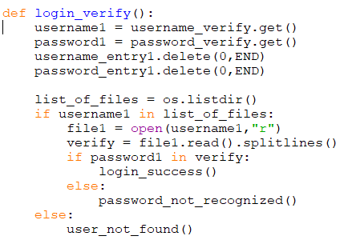
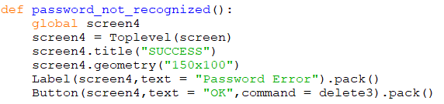
Fig 8: Code for command attached with button of login( ) method.. It is used to check user login details
Fig 9: code for password not recognized. A new screen will be displayed if password is wrong.

Slide 20
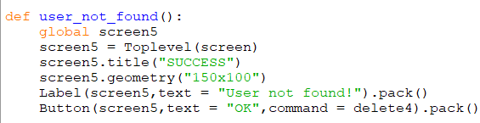

Fig 10: if user is not found then a new screen popup will show up.
Fig 11: This method is defined in login_verify function. If password is verified then this method is called. session consists the code for the third window screen which is the actual book store.

Slide 21
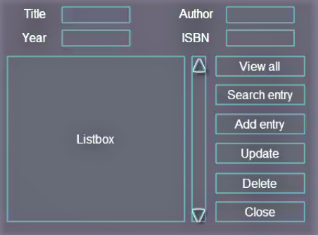
Designing the third interface
Third Interface’s concept is shown in figure and then backend is made and at the end we connect frontend with backend i.e. to connect all the commands of buttons with backend functions.
A code is made that stores information about Title, Author, Year and ISBN of the book. User can view all records, Search an entry, add, update, delete records and close the code.
The interface is to be made with the grid ( ) method of tkinter library.
Widgets used:
4 labels
6 buttons
1 list box
4 entries
1 scrollbar
Fig 12: Design of third form.

Slide 22
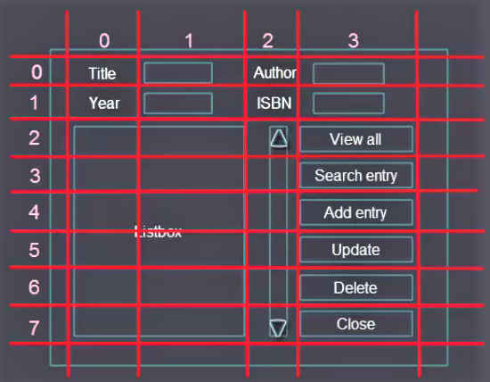

Interface for every tool used
Fig 13: Structure of rows and columns to be used.
Fig 14: Code for all libraries used.

Slide 23
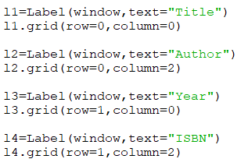
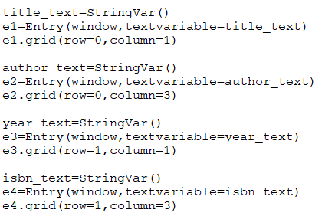
Fig 15: Code for designing labels.
Fig 16: Code for designing entries.

Slide 24
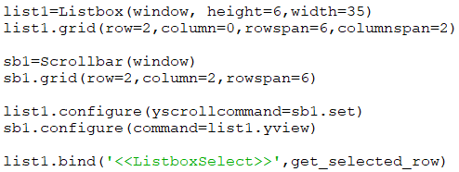
Listbox method is used to make listbox as list1. on which window list box is to be made , height and width are specified in the arguments.
Scrollbar is made with Scrollbar method on the window with 6 rows spanned from 2nd to 7th row and in 2nd column.
Scroll bar is attached with List box using yview function (scrolled in Y – axis direction). get_selected_row function is used to select a row (discussed later).
Fig 17: Code for adding list box and scroll bar.

Slide 25
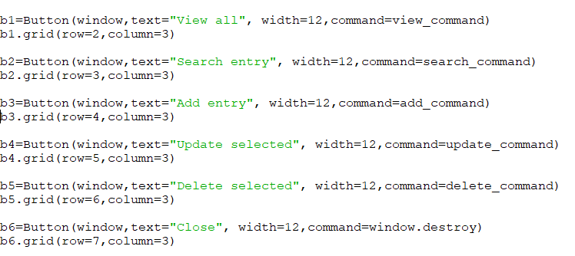
Fig 18:
Code for designing and adding all the six buttons. Commands (defined later…) written as arguments in Button ( ) function performs a particular task. In button b6 (close button) window.destroy command destroys the window.

Slide 26
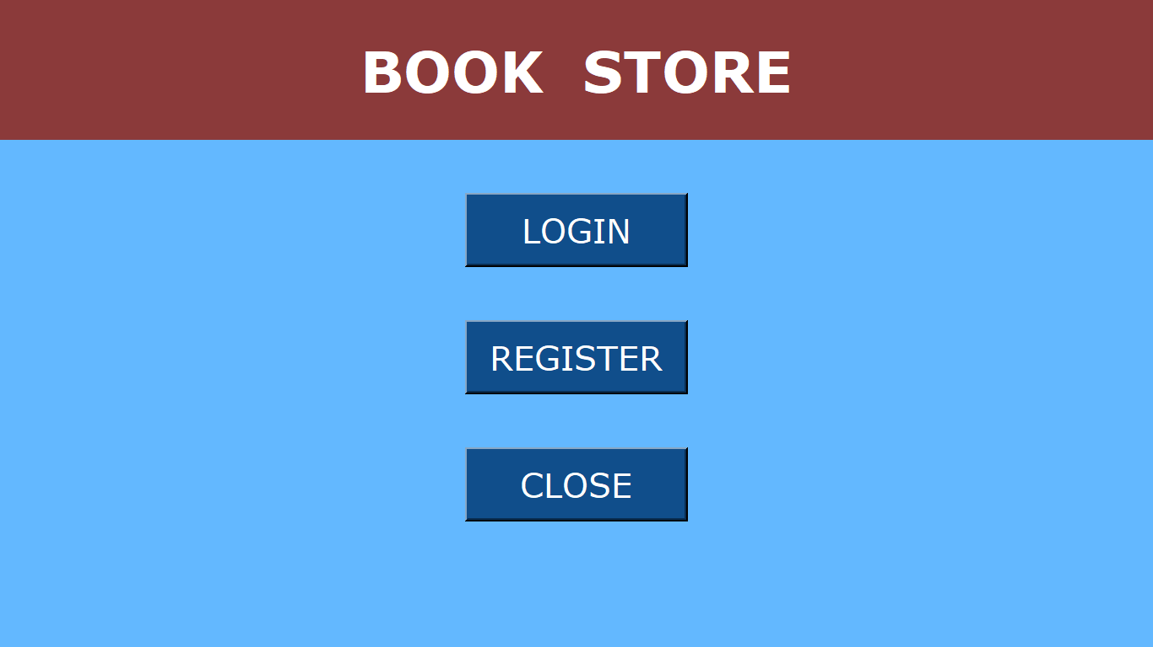
Final look of Interfaces
Fig 19: Main Screen form. This form consists of login, register and close button.

Slide 27
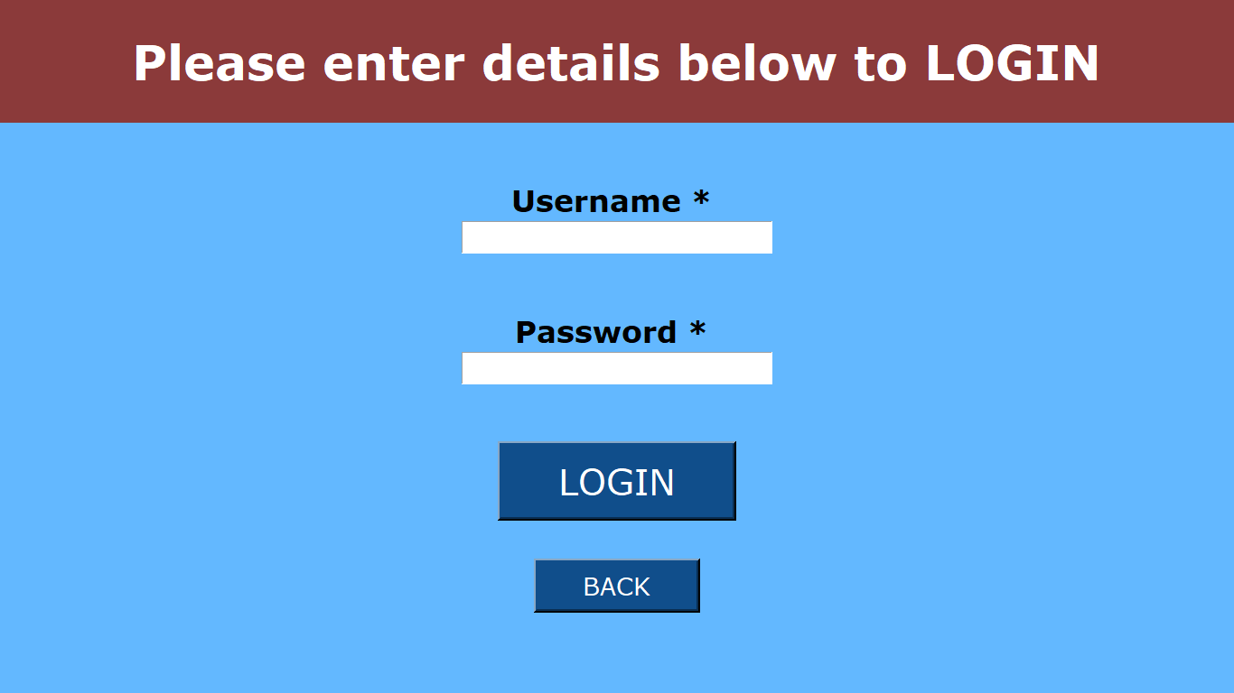
Fig 20: The Login Page

Slide 28
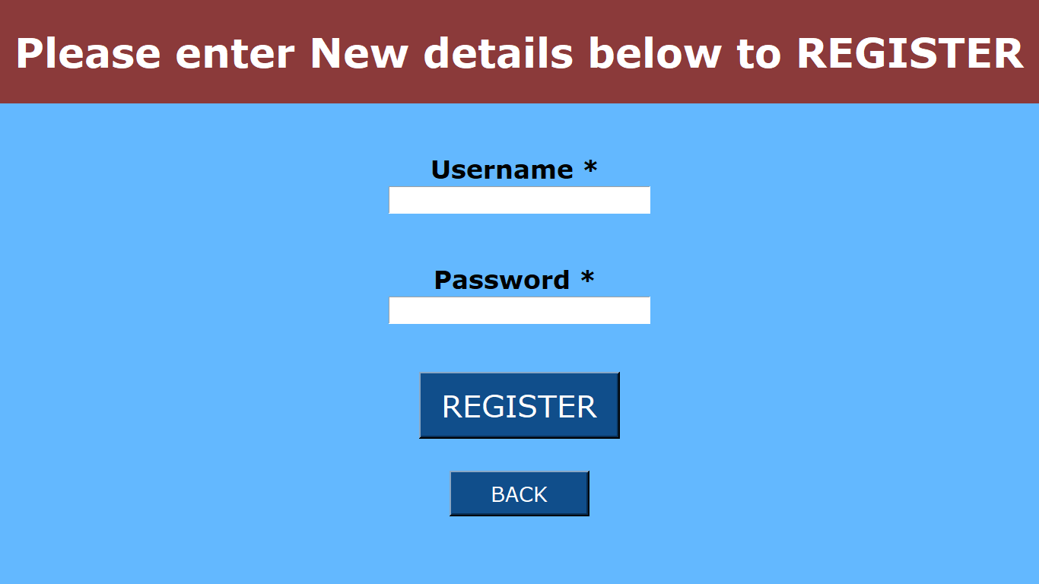
Fig 21: Registration Page.

Slide 29
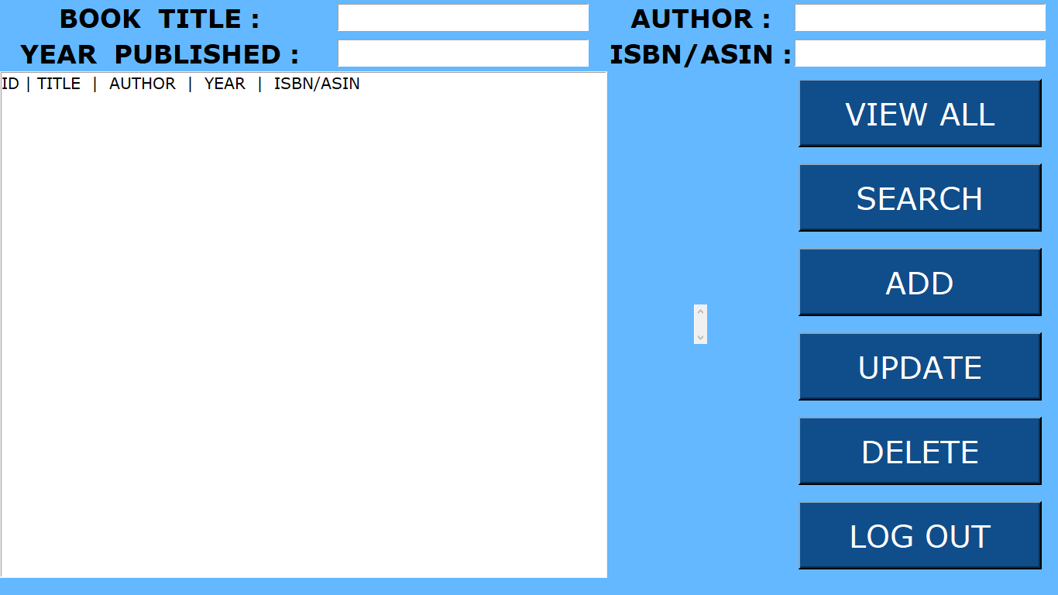
Fig 22: This is the third form of book store which will open when user logins.

Slide 30
BUILDING BACKEND
For making back-end, we create other script and then import this script in the front-end. Lets call new script backend.py
In backend script sqlite3 library is imported.
5 functions are created in the date base:
connect ( )
insert ( )
view ( )
search ( )
delete ( )
update ( )
These functions are then connected to the buttons in the front-end.

Slide 31
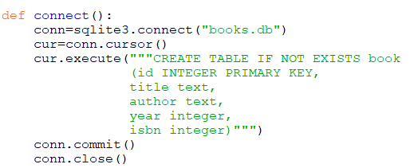
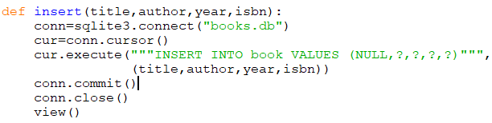
Fig 23: Code for connecting to database and create table with shown attributes.
Fig 24: Code for inserting data into database table.

Slide 32
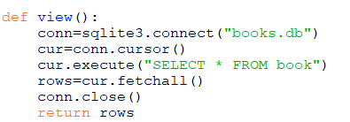
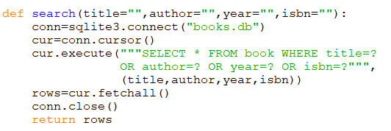
Fig 25: view method is used to display data from database table.
Fig 26: This is code for searching data by title or author or year or ISBN no.

Slide 33
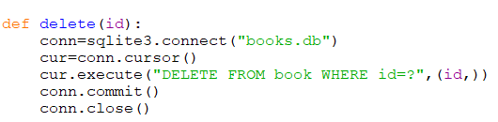
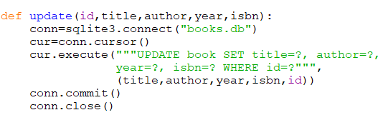
Fig 27: Code for deleting data form database.
Fig 28: Code for updating data into database table.

Slide 34
CONNECTING FRONT END WITH BACKEND
Now we want frontend script to fetch data from the backend script, or more specifically is able to get the function outputs which are basically tuples of data, and then insert those tuples of data in the list box. So basically the user presses the button and then these functions are triggered and the data are inserted to the list box.
Connecting frontend with backend involvers import backend script.
Following commands are implemented in the front end script which are connected with buttons:
View
Search
Add
Delete
Update
Get_selected_row

Slide 35

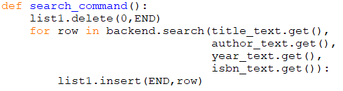
Fig 29: Code to display all records in database table. This method is internally using view method from backend.
Fig 30: Function for performing search in database table. This method internally calls search method from backend.

Slide 36
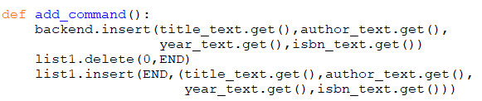
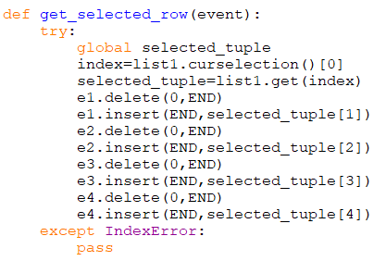
Fig 31: Method for inserting records entered by user into database table.
Fig 32:
get_selected_row method returns the selected tuple from the list box and fills the value of that selected record in respective entries.

Slide 37

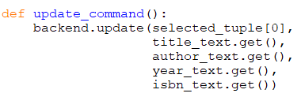
Fig 33: Delete command is used to delete selected record. This method internally invokes delete function form backend.
Fig 34:
Update_command is used to update records. This method internally calls update function form backend.

Slide 38


Standalone executable version
We can execute the script using python but if you want to give your project to someone else, they can run it if they have python installed in their PC. And execute the program by going to the terminal and invoking python and the script. That may be difficult for users who are not experienced with programming.
We want to make standalone executable version that we can send to anyone and they can click and go ahead, insert data, retrieve data and so on.
There exists a library to make standalone executables in python i.e. “ pyinstaller ”(can be installed using pip install pyinstaller).
Pyinstaller script makes a .exe file on windows, .f file on MAC and also bunch of other files are generated which are associated with out program.
Fig 35: Commands for making single executable file

Slide 39
Bibliography
Websites:
www.w3schools.com
www.wikipedia.com
www.goodreads.com
www.quora.com
www.tutorialspoint.com

Slide 40
THANK
YOU

