Slide 1
MINOR PROJECT · PHASE-I
DeepFake
Detection
Using Deep Learning
GURPREET KAUR
300111324046
CSE(AI)
Notes:
Introduce the project as a Phase-I foundation for a web-based deepfake detection system. Emphasize that the work establishes the research direction, methodology, and first frontend layer.

Slide 2
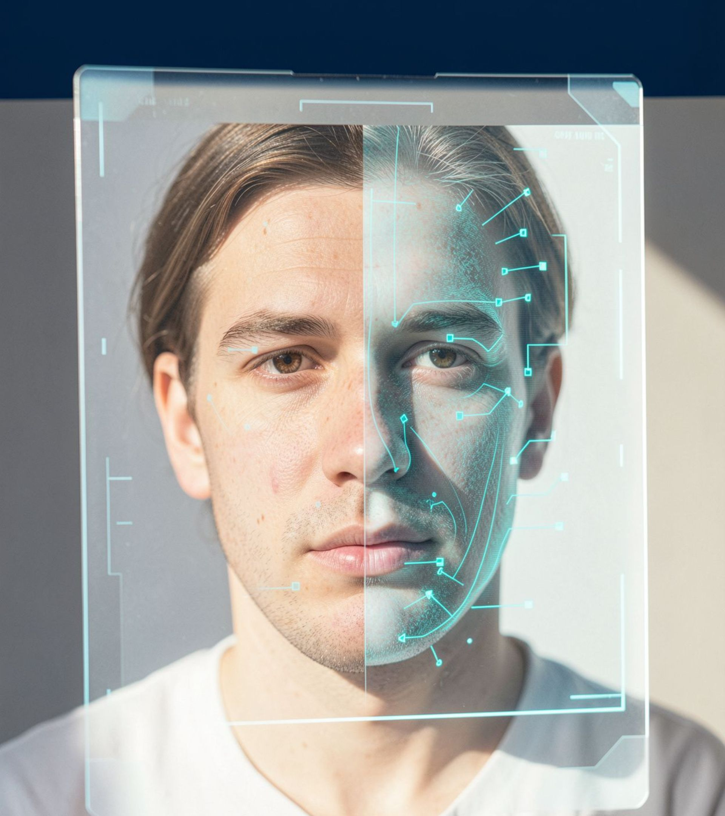




THE SHIFT
01 · THE PROBLEM
REAL IMAGE → AI MANIPULATION → SYNTHETIC / DEEPFAKE
Why Deepfake Detection Matters
The result becomes difficult to verify by sight alone.
Highly realistic manipulated media makes manual verification increasingly difficult. Detection must help people distinguish authentic content from synthetic or altered media.
Misinformation
Identity Misuse
Digital Trust
Content Verification
Notes:
Move from authentic media toward manipulation and synthetic output. The key issue is verification: realism raises the cost of relying on manual inspection alone.

Slide 3

02 · LITERATURE SIGNALS
CNN-Based Detection
What Existing Research Tells Us
Learns visual manipulation patterns.
FaceForensics++
Benchmark direction for manipulated-face analysis.
KEY INSIGHT
Capability is established. Efficiency remains the constraint.
Xception-Based Detection
Deep learning can identify manipulation patterns, but computational efficiency remains an important consideration.
An influential deepfake detection approach.
Transfer Learning
Reuses learned visual representations.
Lightweight Detection
Supports practical deployment constraints.
Notes:
Frame the literature as a set of established directions rather than a claim of a single best model. CNNs learn visual patterns, benchmarks structure evaluation, Xception influenced the field, transfer learning reuses representations, and lightweight models support deployment.

Slide 4
03 · DESIGN DECISION
From Complex Models to a Practical Approach
EXISTING APPROACHES
OUR DIRECTION
Complex
Practical
Resource-intensive and computationally demanding.
Lightweight architecture with transfer learning.
RESEARCH GAP
PROPOSED DIRECTION
CLAIM BOUNDARY
Deployment under practical constraints
MobileNetV2
Proposed, not yet validated
Phase-I focuses on a responsible, implementable direction rather than an unsupported accuracy claim.
Notes:
Be explicit about the boundary of the claim. MobileNetV2 is proposed because it aligns with the practical deployment goal. Training, evaluation, and comparative performance are not completed in Phase-I.

Slide 5
04 · SYSTEM BLUEPRINT
Proposed Detection Pipeline
A compact path from uploaded image to interpretable model output.
01
02
03
04
05
06
Input
Preprocess
MobileNetV2
Classifier
Output
Confidence
Upload image
Resize + normalize
Feature extraction
Binary prediction
REAL / FAKE
Interpret model output
MODEL CONTRACT
The pipeline is the proposed system flow. Its performance will be established after training and evaluation.
One image in
One binary decision with confidence out.
Notes:
Walk left to right. The frontend supplies the image, preprocessing standardizes it, MobileNetV2 extracts features, and the classifier produces the REAL or FAKE prediction with confidence for interpretation.

Slide 6





SCREENSHOT PLACEHOLDER
05 · FIRST WORKING LAYER
[INSERT ACTUAL FRONTEND SCREENSHOT]
Our First Working Layer — Frontend
Replace this empty frame with the implemented interface.
Frontend development establishes the user-facing layer of the proposed detection system.
UPLOAD
IMAGE PREVIEW
DETECTION RESULT
SCREENSHOT PLACEHOLDER
[INSERT ACTUAL UPLOAD SCREENSHOT]
Do not use fabricated interface imagery.
CONFIDENCE
REAL / FAKE
Notes:
Show the frontend as the first concrete system layer. The placeholders are intentional and should be replaced only with actual project screenshots when available.

Slide 7
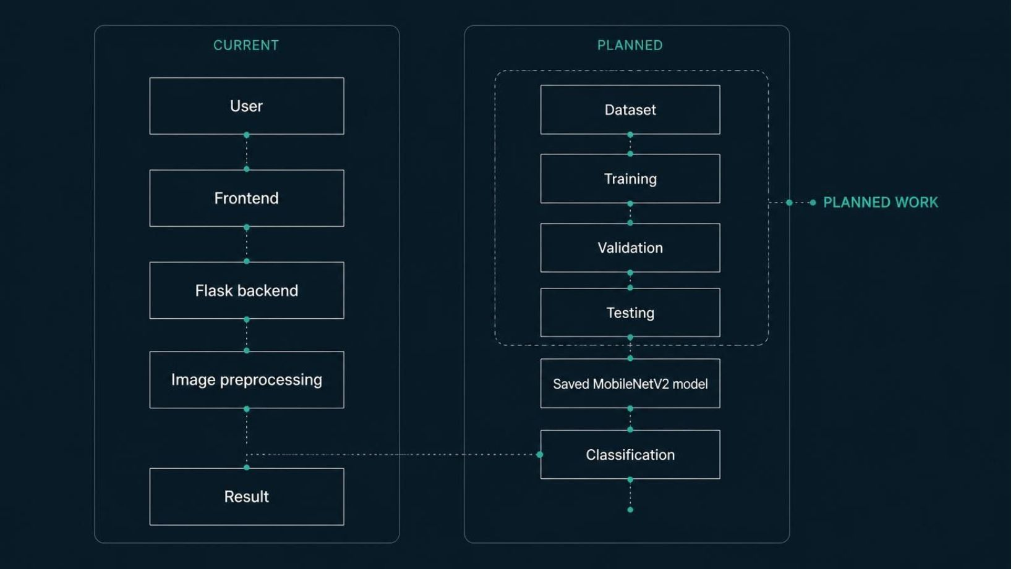
06 · SYSTEM VIEW
Inside the System
CURRENT
Frontend layer and user-facing flow
PLANNED
Training, validation, testing, and saved model
Notes:
Use this slide to prevent a common misunderstanding. The frontend flow is the current working direction. Dataset preparation, training, validation, testing, and the saved model remain planned work.

Slide 8
07 · DATA PREPARATION
01
02
03
From Dataset to Model Input
Dataset
Preprocess
Model input
Train, validation, test
Check, resize, normalize
Standardized image tensor
Dataset extraction and structural inspection are currently in progress. No dataset size or model result is claimed at this stage.
DATASET SCREENSHOT PLACEHOLDER
[INSERT ACTUAL DATASET SCREENSHOT]
Use the real extracted structure when inspection is complete.
Notes:
Explain that model input quality depends on a disciplined path from dataset structure to preprocessing. Inspection is active work, so avoid presenting fabricated counts, samples, or training outcomes.

Slide 9
08 · PHASE-I STATUS
Where We Are Now
Stage | Status
Research | Completed
Methodology | Completed
Frontend | Completed
Dataset | Active inspection
Model | Upcoming
Evaluation | Upcoming
Integration | Upcoming
COMPLETED
Problem, literature, research gap, methodology, frontend.
IN PROGRESS
Dataset, environment, frontend refinement.
NEXT
Preprocessing, training, testing, integration.
Notes:
Use the status line to distinguish evidence from intention. Research and methodology are complete, frontend work is underway, and the dataset is under inspection. The model and evaluation are upcoming.

Slide 10
09 · THE DIRECTION AHEAD
From Research
to Detection
01
02
03
04
Image
AI analysis
REAL / FAKE
Confidence
Current: Phase-I foundation established.
Next: Train and evaluate the MobileNetV2 model.
Final goal: A web-based deepfake detection system.
THANK YOU
Notes:
Close with the project direction, not a performance claim. The foundation is established; the next technical milestone is training and evaluating the proposed MobileNetV2 model, leading toward a web-based detection system.

