Slide 1

NetSentinel
From a notebook to a live, human-approved detection platform
Notes:
NetSentinel started as a Jupyter notebook on CICIDS-2017 and ended as a running platform: ingest API, ML detection, agents, Claude investigations, risk scoring, human-approved responses, tickets and a dashboard.

Slide 2
What was built, in four numbers
19/19
100%
12
145
end-to-end checks passed on the live, hardened system
recall on never-seen brute-force attacks (48% before v2)
pipeline steps, from ingest to dashboard, running as 9 services
automated tests, including security and tamper tests
Machine learning decides; Claude explains; a human approves every action.
Notes:
Four headline numbers. The design principle: the model makes the detection decision, the LLM only explains with labelled evidence, and nothing is ever executed without a human.

Slide 3
The starting point
A notebook whose results looked strong but could not be trusted

Slide 4





Five problems behind 96% accuracy
Target leakage
'Attempted Category' was a model input and marks exactly the '… - Attempted' labels
Not a time split
Files loaded alphabetically, so the 'future' test set held attack types absent from training
Identity, not behaviour
Source and destination IPs ranked #4 and #7: the model memorised the lab's addresses
Wrong ROC-AUC
Computed from 0/1 predictions for two models: balanced accuracy reported as AUC
Binary only
Attack / not attack, with no family or type for triage
Notes:
Each issue was verified on the data, not assumed. The leakage check: every row with Attempted Category other than -1 has an '- Attempted' label.

Slide 5
Same code and seed, three different answers
The data pipeline reproduced exactly
3,167 duplicates, 27 dropped features, 1,467,762 / 629,042 rows: identical.
The headline model did not
Its test attacks were never seen in training, so catching them depended on incidental tree splits.
Notes:
v0 replays the notebook from raw CSVs. Isolation Forest reproduced cell-for-cell; Random Forest swung from 87% to 48% recall across library versions with the same seed.

Slide 6
The detection model
v1: a clean feature set and a hierarchy · v2: each source's last 60 seconds

Slide 7
Three questions, and only the first one decides
1
2
3
Normal or attack?
Which family?
Which attack type?
Decides. Threshold tuned to 0.1% false alerts
Answers only at ≥ 60% confidence, else 'unknown'
Answers only at ≥ 80% confidence
Clean inputs: 83 fixed features (no leakage, no IPs or ports-as-identity) · missing values kept, not dropped · real duplicates removed (259k, not 3k)
Attack types seen in training: 99.999% recall at 0.09% false alerts. Treat as a ceiling: CICIDS-2017 is easy when tools repeat.
Notes:
Stages 2 and 3 never change stage 1's decision; a flow the family model can't name is still an attack.

Slide 8
Window features close the unseen-attack gaps
How it was tested
Each family is removed from training, then tested at the same 0.1% false-alert budget.
Why it works
A scan probe looks like a handshake; 997 ports in a minute does not. Features are causal: only flows already ended count.
Notes:
Both detectors were trained on the same rows and splits; only the window features differ. v2 needed the authors' corrected CICIDS-2017 with full timestamps, because the Kaggle copy lost the hour.

Slide 9

v2 caught every attack in real replayed traffic
Real traffic slice | Attacks caught | Family correct | False alarms
Port scan (Fri, 1 min) | 997 / 997 | 100% | 0 / 279
FTP brute force (Tue, 2 min) | 124 / 124 | 100% | 2 / 1,816
SSH brute force (Tue, 2 min) | 102 / 102 | 100% | 6 / 1,318
Botnet attempts (Fri, 3 min) | 42 / 42 | 100% | 6 / 1,645
Every attack flow caught and named
False alarms ran higher than the 0.10% seen in validation; all scored just above v2's very low threshold.
1,265 / 1,265
0.28%
attack flows caught
false alarms on 5,058 benign flows
Notes:
Replays send flows in the order they ended, with a 60-second warm-up and no overlap between replays; live window values were checked equal to training values.

Slide 10
The platform
Twelve steps, six agents, one human in control

Slide 11







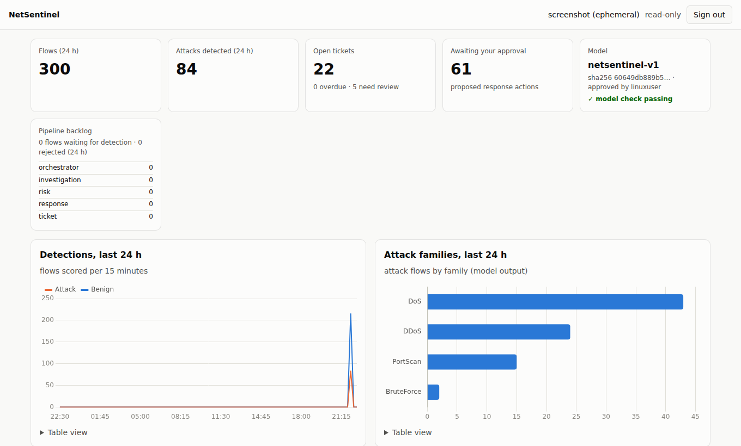
From a network flow to a ticket in one pipeline
Ingest
Detect
Correlate
Investigate
Score risk
Propose
Ticket
API key, validation
Model Check, v2 model
cases by source
Claude, guarded
explainable rules
reversible only
SLA, timeline
Every investigation keeps four labelled sections
VERIFIED TELEMETRY · MODEL OUTPUT · LLM ANALYSIS · RECOMMENDATION
Claude cannot change a detection or a risk score. A guard rejects any analysis naming an IP that is not in the evidence, and strips containment steps from its advice.
Notes:
Agents talk through a Postgres event bus with at-least-once delivery. The dashboard screenshot is the live read-only view.

Slide 12



A human approves; secrets stay out of code
Human approval
Secrets in OpenBao
Hardened services
Response actions are a closed list of reversible steps. The database refuses any decision by an agent; dashboard decisions re-ask for your key.
Database password rotates daily through the Security Wall. API keys are stored only as hashes; you created yours on your own PC.
Sandbox score 8.5 → 1.6 (systemd). HTTPS with Let's Encrypt, dashboard limited to your IPs, model files hash-checked before loading.
Notes:
Security review: no secrets in git or logs, least-privilege database role, append-only audit tables, no known dependency vulnerabilities.

Slide 13
Live traffic: ranking holds, thresholds don't
Labels from the server's own logs
Firewall blocks mark scanners; failed SSH logins mark password guessing. ROC-AUC 0.95.
Decision: alerts stay off
The sensor runs in shadow mode (scored, no tickets) until calibrated on a day of data.
Notes:
A first alert-mode run flagged 55% of flows, including the server's own HTTPS and its Claude API calls; those 75 cases were closed and shadow mode added. The flow meter needed four fixes to match training: microseconds, exact timestamps, a double-counted first packet, and a 240-second export delay.

Slide 14
Next steps
Calibrate on 24 h of live traffic (netsentinel calibrate)
Retrain on features from the same flow meter as the sensor
Approve a per-source alert threshold, then switch the sensor to --alert
Notes:
Everything else is live, tested and documented in the repository (README, docs/, presentation notebook).

