Slide 1
MediCure
A Life Saving SOS Application

Slide 2
Problem Statement
Build a notification system which will help hospital in retrieving the correct address of the injured person. This will allow ambulance to reach at the right spot as soon as possible.

Slide 3
Facts
Generally, people die in road accidents due to various reasons. Some of the reasons are- Nearest Hospital is not informed, Traffic due to construction going on in the path.
In 2017, as per Ministry of Road, Transport & Highways, there were 4,64,910 accidents out of which 1,47,913 lost their lives.
3% GDP falls due to road accidents. Which is why, avoiding accidents is on top of priority of the government.
India, as a signatory to Brasilia declaration, intends to reduce road accidents by 50% till 2020. But, that is still far away now.

Slide 4
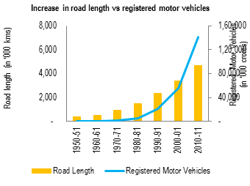
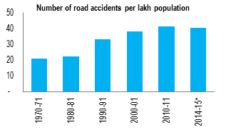
Some Statistics from last few years

Slide 5
Where to use :-
Usually, people refrain in supporting the person injured leading to his/her death. In such cases, if SOS is available, then there might be less ignorance and more lives could be saved.
These SOSs must be installed at accident-prone areas.
We have built a google action using which anyone present on the accident spot can use his/her phone to call ambulance using the assistant quickly.

Slide 6
Technologies Used:-
Action on Google(A.O.G):- Actions on Google is a development platform for the Google Assistant. The actions platform supports "direct" actions, as well as "conversational” actions for more complex applications.
Twilio:-
Twilio is a cloud communication platform as a service(CPaaS) company based in San Francisco, California. Twilio allows software developers to make and receive phone calls, send and receive text messages, and perform other communication function using it’s web API.

Slide 7
Technologies Used(Continued)
Android Studio:-
Android is a mobile operating system developed by Google. It is used by several smartphones and tablets. The Android OS is based on Linux kernel.

Slide 8
FUTURE ASPECT:-
Twilio:- Since currently we are using the trial version and in that case we are unable to send messages to the multiple hospitals for ambulance. Using the paid version we can send request to the multiple hospitals.
Using OpenCV we can detect accidents occurred at places and can call the ambulance.

Slide 9
Business model:-
Earnings:- We can earn by adding advertisements at the bottom when the app opens.

