Slide 1
WordCount
Hadoop
By – Gurpreet Singh Sahni

Slide 2
WordCount project Works on
Hadoop MapReduce
Hadoop MapReduce is a programming paradigm at the heart of Apache Hadoop for providing massive scalability across hundreds or thousands of Hadoop clusters on commodity hardware. The MapReduce model processes large unstructured data sets with a distributed algorithm on a Hadoop cluster.
The term MapReduce represents two separate and distinct tasks Hadoop programs perform-Map Job and Reduce Job. Map job scales takes data sets as input and processes them to produce key value pairs. Reduce job takes the output of the Map job i.e. the key value pairs and aggregates them to produce desired results. The input and output of the map and reduce jobs are stored in HDFS.

Slide 3
Steps for Project ‘WordCount’ using Java code which include code for Map and Reduce.

Slide 4
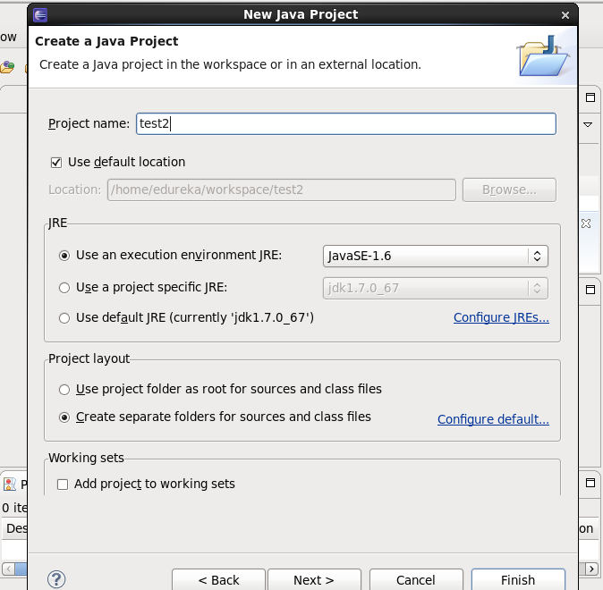
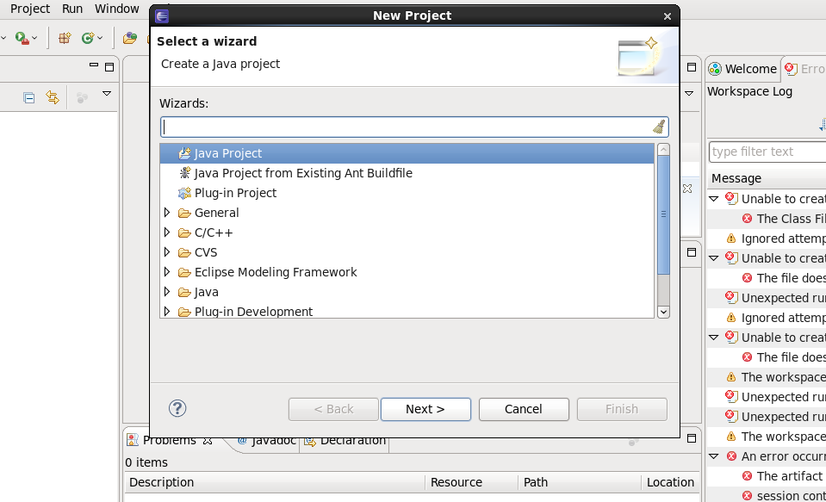
Step1:Firstly we will open Eclipse and create new project and name it.

Slide 5
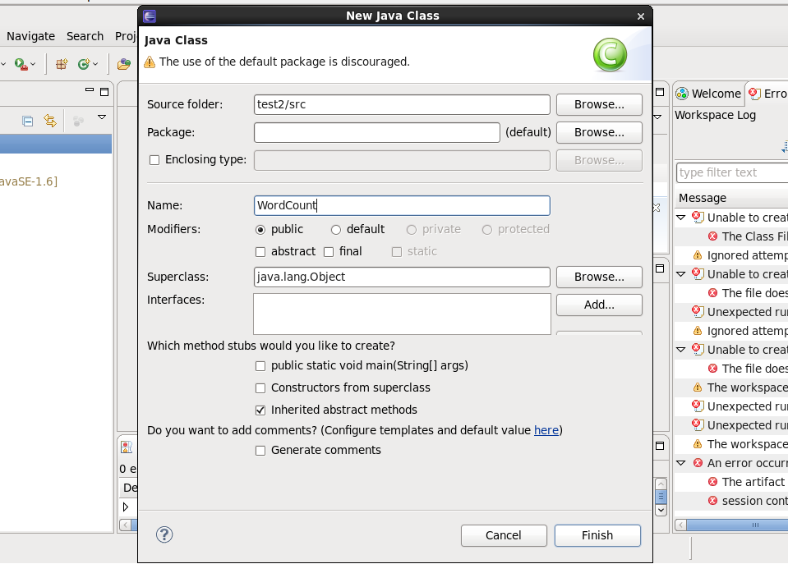
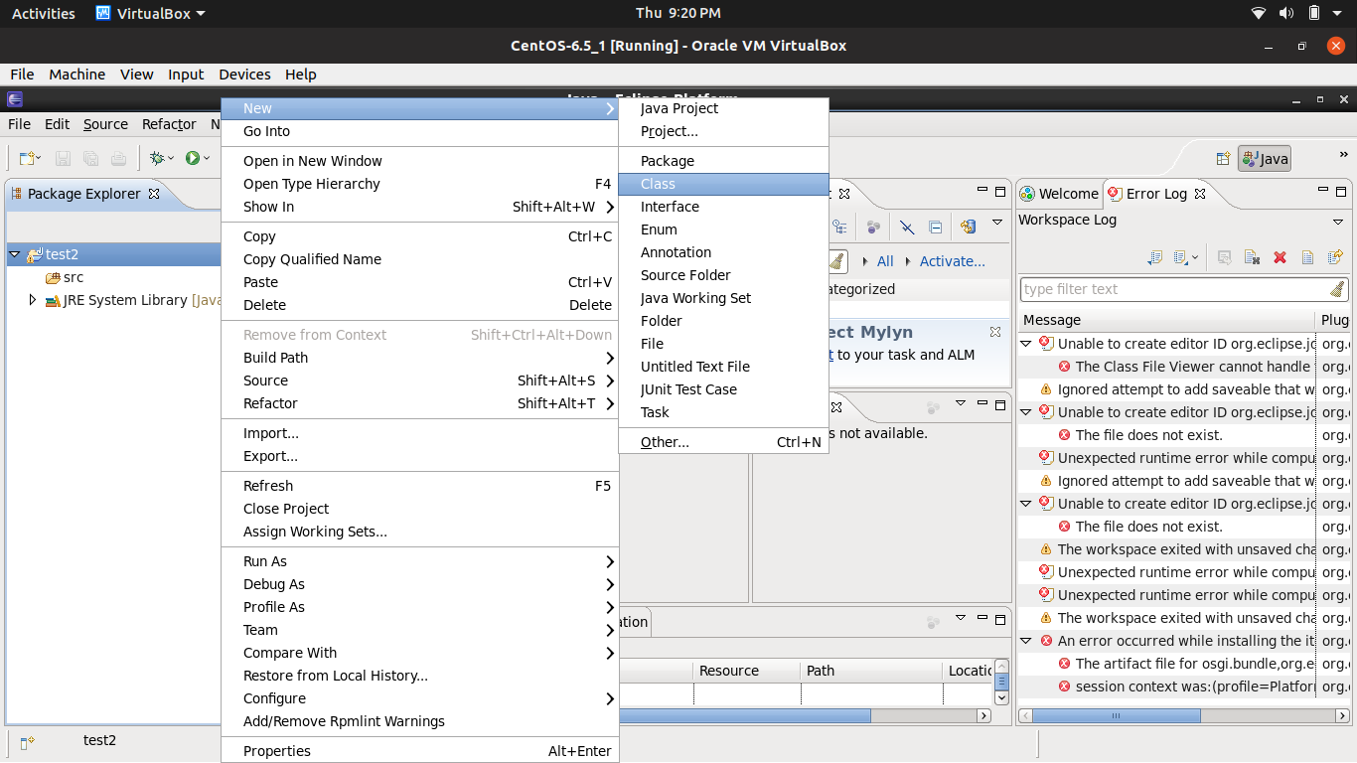
Step2: Now we will right click on project name and go to new and click on class and make class of name WordCount.

Slide 6
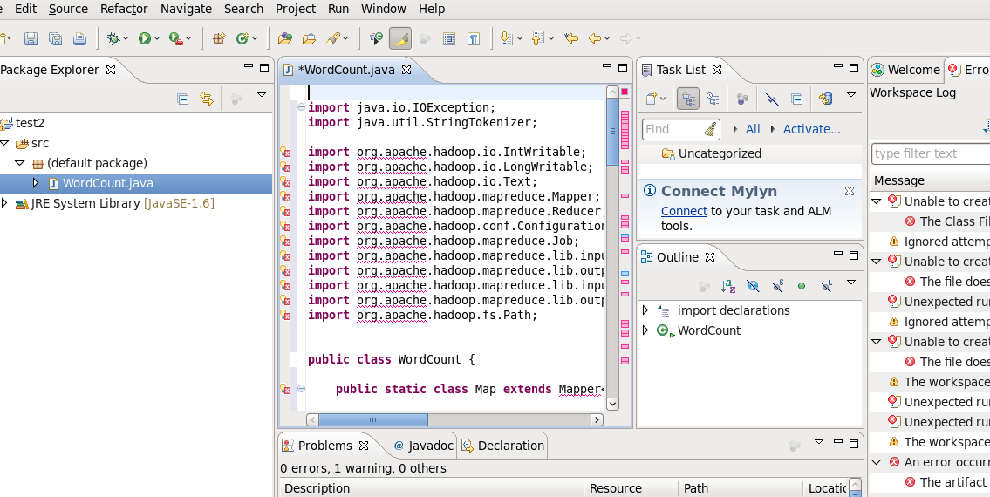
Step3: Now we will write the code .

Slide 7
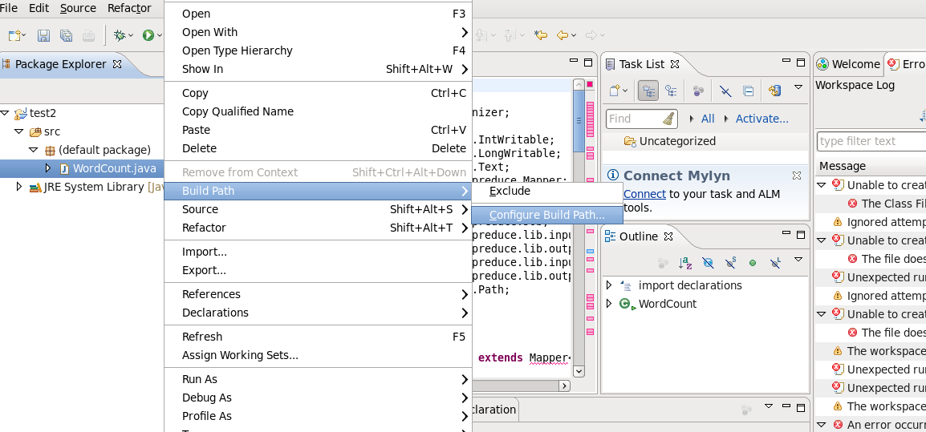
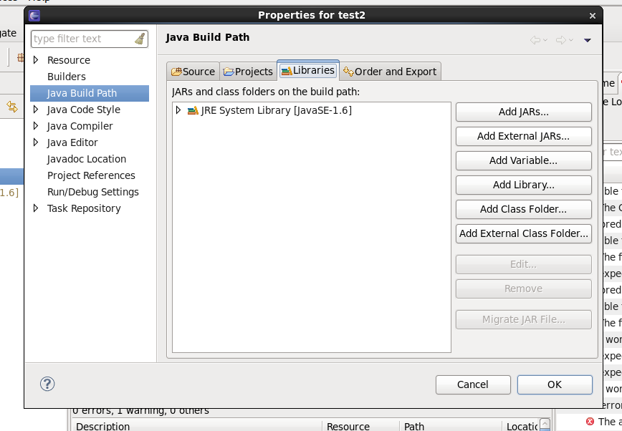
Step4: Now right click on ‘WordCount.java’ and go to Build Path and click on ‘Configure Build Path’ and this right side window will appear.

Slide 8
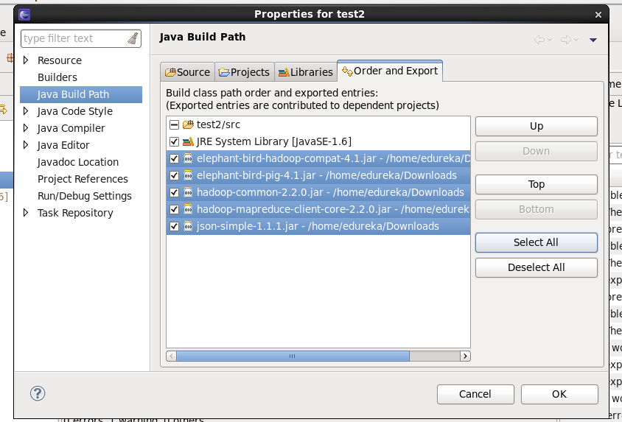
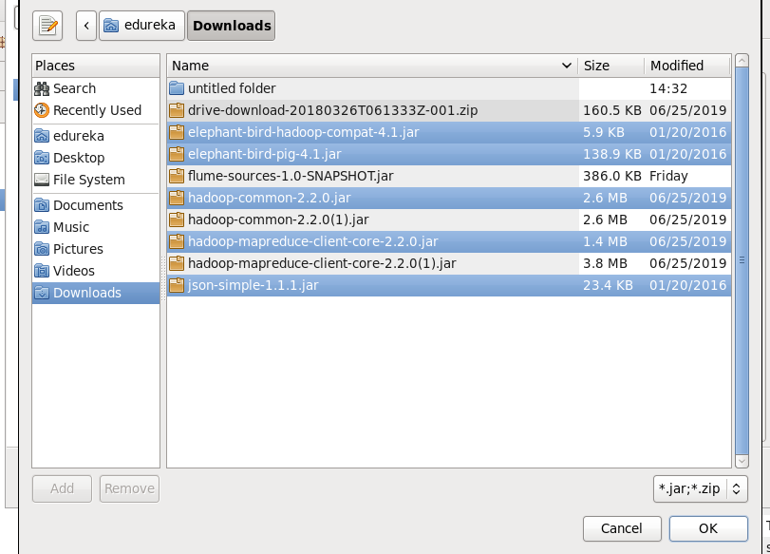
Step5: Now we click on ‘Add External Jars’ and add all the jAR file which we have downloaded from Internet and after adding it click on ‘Order and Export’ and than select all and click OK.
1
3
2

Slide 9
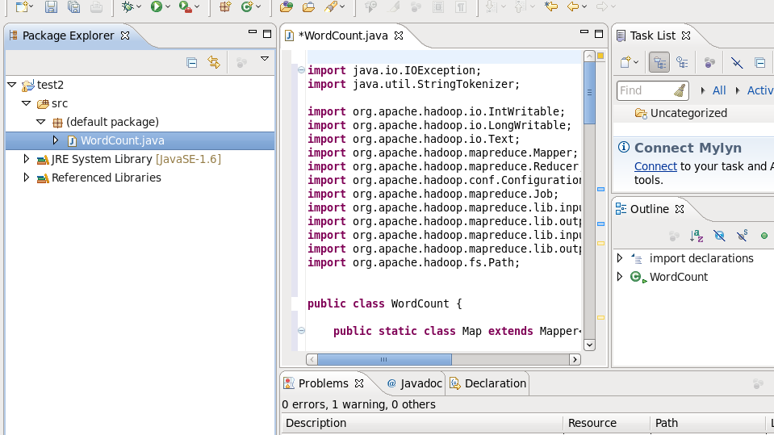
Now you can see that all the Errors are removed as we have added all the jAR files that was imported in the code.

Slide 10
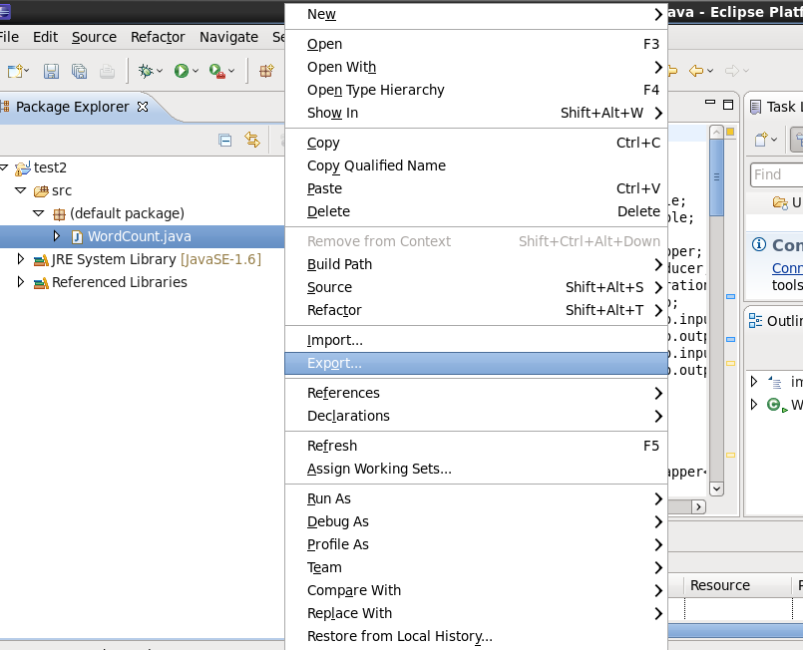
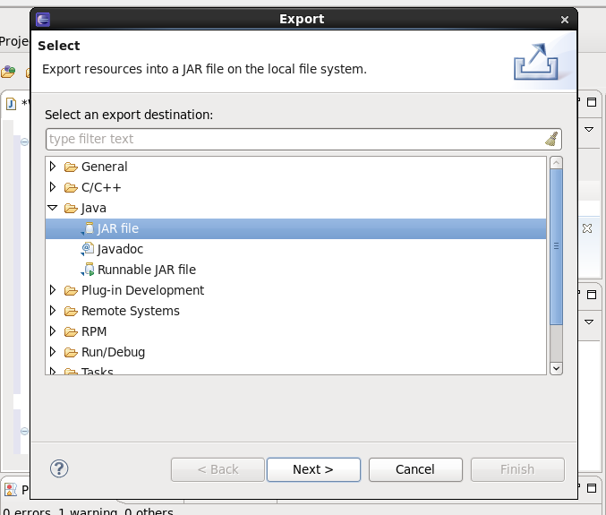
Step6: Right click on ‘WordCount.java’ and than click on ‘ Export’. Right side window will appear, and now select jAR file and click Next.

Slide 11
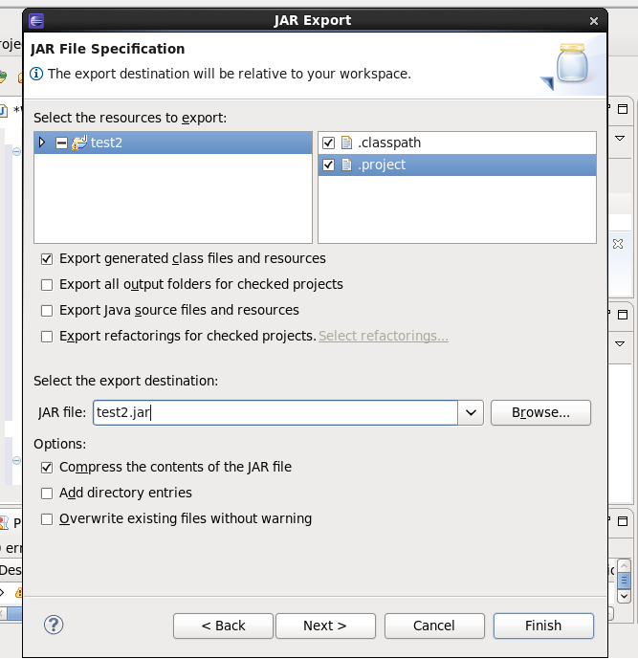
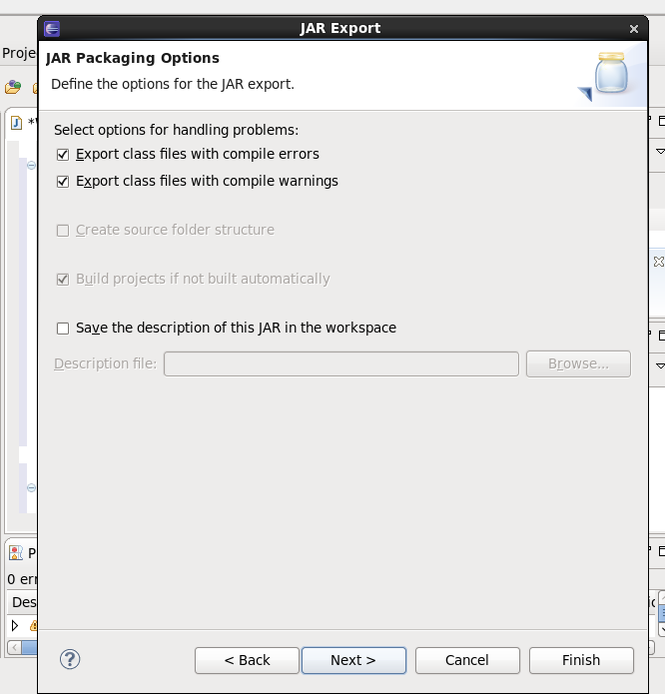
Step7: Now Select ‘.classpath’ and ‘.project’ , after that name the jAR file and click Next. Right side window will appear and again click Next.

Slide 12
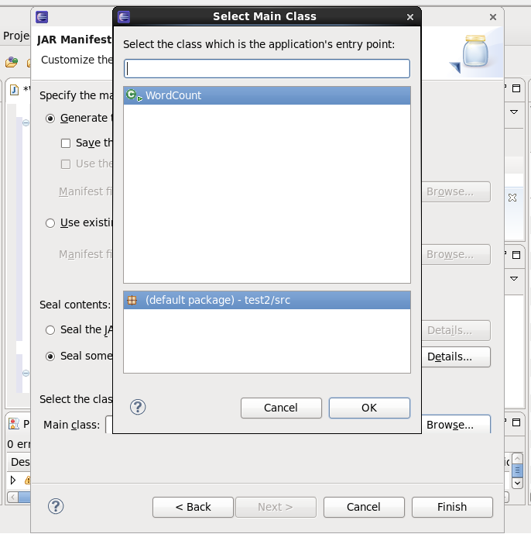
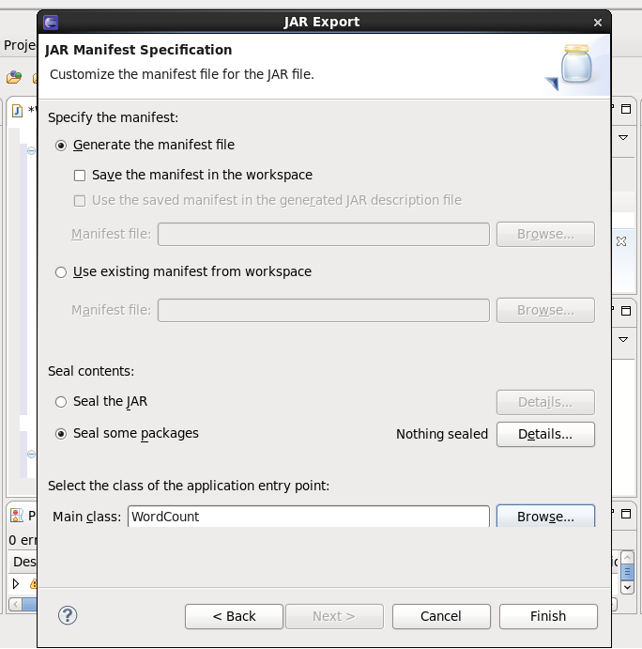
Step8: Now select WordCount as Main Class and click OK , after this you will see WordCount written in the block of Main Class ,now click Finish and by this your jAR file will be created which will have code of WordCount.

Slide 13
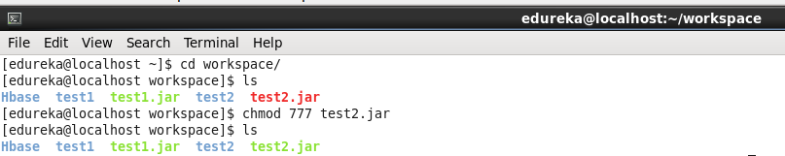
Step9: Now we will open Terminal and check our jAR file in workspace and give full Permission to jAR file by ‘chmod 777 <jAR file_name>’.

Slide 14
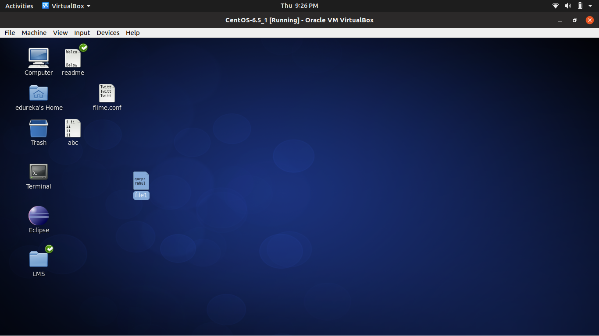
Step10: Now we will create file and write the data inside the file on which we want to perform WordCount ,after creating file copy the file to HDFS(Hadoop Distributed File System).

Slide 15
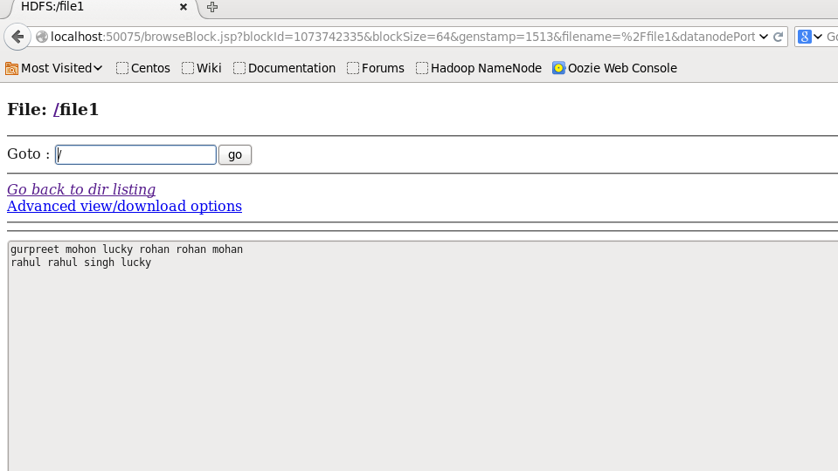
This is the file in HDFS.

Slide 16
Step11: Now we will write the command on Terminal which will extract the code from jAR file that will give us output by counting words in data file.
Command is hadoop jar <location_of_jAR file> ‘</name_of_data_file>’ <name_of_file_in_which_you_want_to_see_output>

Slide 17
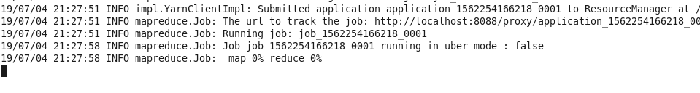
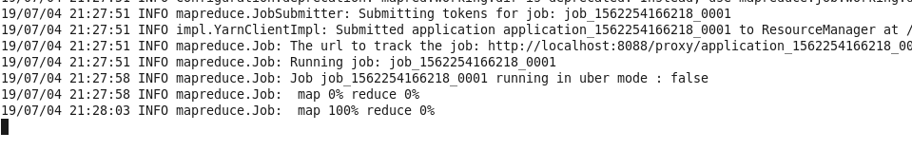
After running the command you will first see map 0% reduce0% than after few time you will see map 100% reduce 0%.

Slide 18
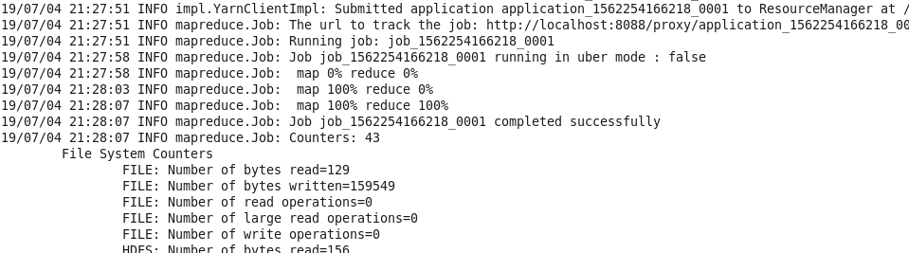
And in the end you will see map 100% reduce 100% , and by this the process get completed and you can see result in HDFS.

Slide 19
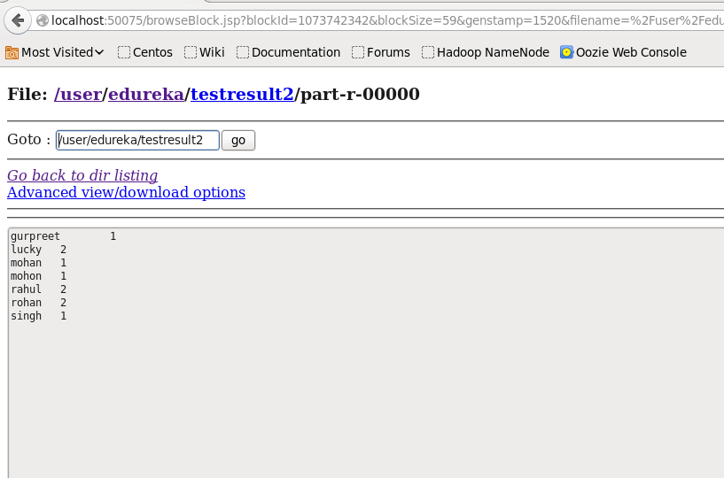
This is the result which counts the words in the file.

Slide 20
THANK YOU

