Slide 1
Agentic Security

Slide 2
Framework
Enterprise Agent
Trust and Accountability
Governance
Compliance
Security and Access
Security
Identity
Quality and Evolution
Operational Excellence
Privacy
Evaluation
AI safety
Lifecycle Management
Observability
Resilience
Optimization

Slide 3
Top 10 Threats in Agentic Application
OWASP Edition – Notes
Link: https://genai.owasp.org/resource/owasp-top-10-for-agentic-applications-for-2026/

Slide 4
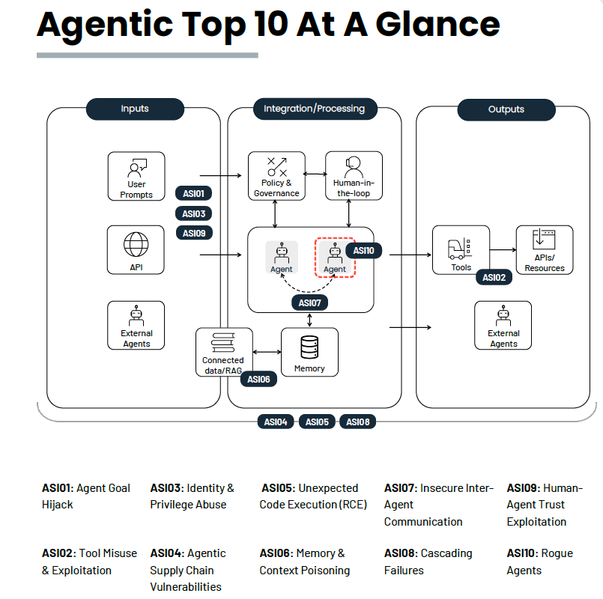
OWASP Top 10 for Agentic Application

Slide 5
ASI01: Agent Goal Hijack
What: Manipulation of goal and multi-step behavior ; autonomous misalignment that emerges without active attacker control.
Cause: Agents rely on untyped natural-language inputs and loosely governed orchestration logic, they cannot reliably distinguish legitimate instructions from attacker -controlled content.
How: Can occur interactively or pre-positioned input. Ex: Prompt-based manipulation, deceptive tool outputs, malicious artefacts, forged agent-to-agent messages, or poisoned external data.
Result: Attackers can manipulate an agent’s objectives, instructions, tool selection, or decision
OWASP Agentic AI Threats and Mitigation Guide
T06 (Goal Manipulation) and T07 (Misaligned and deceptive behavior)

Slide 6
ASI01: Agent Goal Hijack
Example Vulnerability
Direct prompt injection
Indirect Prompt Injection via hidden instruction payloads embedded in web pages or documents
Indirect Prompt Injection external communication channels (e.g. email, calendar, teams) sent from outside
Prevention and Mitigation Guidelines
Treat all natural language input as untrusted
Route them through the same input-validation and prompt-injection safeguards defined before they can influence goal selection, planning, or tool calls.
enforcing least privilege for agent tools and requiring human approval for high-impact or goal-changing actions.
Define and lock agent system prompts so that goal priorities and permitted actions are explicit and auditable. Changes to changes in goals or reward definitions must go through configuration management and human approval.
At run time, validate(human approval, policy engine, platform guardrails) both user intent and agent intent before executing goal-changing or high impact actions
Pause or block execution on any unexpected goal shift, surface the deviation for review, and record it for audit.
When building agents, evaluate use of “intent capsule”, an emerging pattern to bind the declared goal, constraints, and context to each execution cycle in a signed envelope, restricting run-time use.

Slide 7
ASI02: Tool Misuse and Exploitation
What: An unintended or unsafe use of already authorized tool
Causes: Prompt injection, misalignment, or unsafe delegation or ambiguous instruction , how the agent chooses and applies tools; agent memory, dynamic tool selection, and delegation
Result: Leading to data exfiltration, tool output manipulation or workflow hijacking, chaining, privilege escalation, and unintended actions.
Example: deleting valuable data, over-invoking costly APIs, or exfiltrating information.
OWASP Agentic AI Threats and Mitigation Guide
T2 Tool Misuse , T4 Resource Overload and T16 Insecure Inter-Agent Protocol Abuse

Slide 8
ASI02: Tool Misuse and Exploitation
Example Vulnerability
Over privileged or over scoped tool access
Internal query -> external exfiltration ; auto-run/approved tool
Unvalidated input forwarding
Treat LLM or planner outputs as untrusted
Unsafe browsing or federated calls or External data tool poisoning
Compromising tool interface ; tool chaining
Loop amplification
Prevention and Mitigation Guidelines
Require explicit authentication for each tool invocation and human confirmation for high-impact or destructive actions
Enforce fully qualified tool names and version pins
Validate the intended semantics of tool calls rather than relying on just syntax
Just in time and Ephemeral Access - Grant temporary credentials or API tokens that expire immediately after use. Bind keys to specific user sessions to prevent lateral abuse.
Adaptive tool budgeting - Apply usage ceilings (cost, rate, or token budgets) with automatic revocation or throttling when exceeded.
A pre-execution Policy Enforcement Point (PEP/PDP) validates intent and arguments, enforces schemas and rate limits, issues short-lived credentials, and revokes or audits on drift.
Run tool or code execution in isolated sandboxes.
Enforce outbound allowlists and deny all non-approved network destinations
Define per-tool least-privilege profiles (scopes, maximum rate, and egress allowlists) and restrict agentic tool functionality and each tool’s permissions and data scope to those profiles

Slide 9
ASI03: Identity and Privilege Abuse
What: Exploits dynamic trust and delegation in agents
Identity refers to agents defined persona and to any authentication material it represents.
Cause: Agent to agent trust or inherited credentials; architectural mismatch between user-centric identity systems and agentic design. Agent permission, tool integration.
How: manipulating delegation chains, role inheritance, control flows, and agent context; context includes cached credentials or conversation history across interconnected systems. Prompt Injection
Result: Escalate access, hijack privileges, or execute unauthorized actions
OWASP Agentic AI Threats and Mitigation Guide:
T3: Privilege Compromise
OWASP AIVSS:
Core Risk 2: Agent Access Control Violation.

Slide 10
ASI03: Identity and Privilege Abuse
Example Vulnerability
Occurs when a high-privilege manager delegates tasks without applying least-privilege scoping
If memory is not segmented or cleared between tasks or users, Page 16 genai.owasp.org attackers can prompt the agent to reuse cached secrets, escalate privileges, or leak data from a prior secure session into a weaker one.
Cross-Agent Trust Exploitation (Confused Deputy). In multi-agent systems, agents often trust internal requests by default.
Time-of-Check to Time-of-Use (TOCTOU) in Agent Workflows. Permissions may be validated at the start of a workflow but change or expire before execution
Synthetic Identity Injection
Prevention and Mitigation Guidelines
Issue short lived, narrowly scoped tokens per task
Require re-authentication on context switch.
Prevent privilege inheritance across agents unless the original intent is re-validated.
Bind OAuth tokens to a signed intent that includes subject, audience, purpose, and session.
Require human approval for high-privilege or irreversible actions to provide a safety net that would stop Memory-Based Escalation, Cross-Agent Trust Exploitation, and Maintenance Window attacks.
Run per-session sandboxes with separated permissions and memory, wiping state between tasks to prevent Memory-Based Escalation and reduce Cross- Repository Data Exfiltration.
Notes:
Issue short-lived, narrowly scoped tokens per
task and cap rights with permission boundaries - using per-agent identities and short-lived
credentials (e.g., mTLS certificates or scoped tokens) - to limit blast radius, block delegated-abuse
and maintenance-window attacks, and mitigate un-scoped inheritance, orphaned privileges, and
reflection-loop elevation.

Slide 11
ASI04: Agentic Supply Chain Vulnerabilities
What: Arise when agents, tools, and related artefacts they work with are provided by third parties and may be malicious, compromised, or tampered with in transit. Can be both static or dynamic (including models and model weights, tools, plug-ins, datasets, other agents, agentic interfaces - MCP (Model Context Protocol), A2A (Agent2Agent) - agentic registries and related artifacts, or update channels.)
Cause: Composing capabilities at runtime(loading external tools- agent personas dynamically), combined with agentic autonomy
Result: Unsafe code, hidden instructions, or deceptive behaviors into the agent’s execution chain.
OWASP Agentic AI Threats and Mitigation Guide
T17 Supply Chain Compromise in Agentic Threats and Mitigations and across T2 Tool Misuse, T11 Unexpected RCE and Code Attacks, T12 Agent Communication Poisoning, T13 Rogue Agent and T16 Insecure Inter-Agent Protocol Abuse.
Notes:
Tackling this problem requires careful development-time tooling and runtime orchestration, where components are dynamically loaded, shared, and trusted.

Slide 12
ASI04: Agentic Supply Chain Vulnerabilities
Example Vulnerability
Poisoned prompt templates loaded remotely consisting of hidden instructions
Embed hidden instructions or malicious payloads into a tool’s metadata or MCP card – host agent interprets as trusted guidance and acts upon
Dynamically discovers or connects to external services/tools - typo squatted endpoint of a symbol attack
Vulnerable third party agent
Compromised registry/MCP server
Poisoned knowledge plug in
Prevention and Mitigation Guidelines
Supply chain kill switch
Pin prompts, tools, and configs by content hash and commit ID – staged rollout and auto-rollback on hash drift or behavioral change
Re-check signatures, hashes, and SBOMs (incl. AIBOMs) at runtime
Enforce mutual auth and attestation via PKI and mTLS; no open registration; sign and verify all inter-agent messages.
Dependency gatekeeping – scan for typosquats ; verify for provenance before install or activate; auto-reject unsigned or unverified
Maintain an inventory of AI application
Notes:
Implement emergency revocation mechanisms that can instantly disable specific tools, prompts, or agent connections across all deployments when a compromise is detected, preventing further cascading damage.

Slide 13
ASI05: Unexpected Code Execution
What: Escalate action into Remote code execution (attacker defined code)
Cause: Vibe coding tool that often generate and execute code - it can bypass tradition security controls; Host or container compromise, persistence, or sandbox escape
How: Exploit code-generation features or embedded tool access ; Prompt injection, tool misuse or unsafe serialization
Result: Convert text into unintended executable behavior
OWASP Agentic AI Threats and Mitigation Guide

Slide 14
ASI05: Unexpected Code Execution
Example Vulnerability
Prompt injection
Code hallucinations – generating malicious or exploitable constructs
Shell command invocation from reflected prompts
Unsafe function calls, object deserialization or code evaluation
Use of exposed, unsanitized eval() functions – powering agent memory that have access to untrusted content
Unverified or malicious package install
Prevention and Mitigation Guidelines
Ban eval in production agents – safe interpreters, taint-tracking on generated code
Never run as root
Do static scans before execution

Slide 15
ASI06: Memory and Context Poisoning
What: Focuses on corruption of storage knowledge and retrievable information (snapshot of its conversation history, a memory tool or expanded context) and context (info an agent retains, retrieves or reuses - summaries, embeddings, RAG stores but excludes one time input prompt. )
Causes: Ingestion sources such as uploads, API feeds, user input, or peer-agent exchanges may be untrusted or only partially validated.
How: Adversaries corrupt or seed this context with malicious or misleading data, causing future reasoning, planning, or tool use to become biased, unsafe, or aid exfiltration.
Result: Can lead to ASI01 as corrupted context or long-term memory can alter the agent’s goal interpretation, reasoning path, or tool-selection logic.
OWASP Agentic AI Threats and Mitigation Guide
T1 Memory Poisoning in Agentic Threats and Mitigations, with related impacts in T4 Memory Overload, T6 Broken Goals, and T12 Shared Memory Poisoning. In AIVSS, the AARS fields Memory Use and Contextual Awareness raise the agentic vulnerability score.

Slide 16
ASI06: Memory and Context Poisoning
Example Vulnerability
Malicious or manipulated data enters the vector DB via poisoned sources, direct uploads, or over-trusted pipelines.
Reused or shared contexts let attackers inject data through normal chats, influencing later sessions.
Long term memory drift due to incremental exposure to subtly tainted data
Contaminated context or shared memory spreads between cooperating agents, compounding corruption and enabling long-term data leakage or coordinated drift
Prevention and Mitigation Guidelines
Encrypt in transit and at rest combined with lease privilege access
Scan for sensitive content before committing agent response to memory
Memory segmentation – Isolate user sessions and domain contexts
Enforce context aware access per task
Minimize retention by data sensitivity
Require source attribution
Prevent automatic re-ingestion of an agent’s own generated outputs into trusted memory
Expire unverified memory to limit poison persistence.

Slide 17
ASI07: Insecure Inter-Agent Communication
What: Focuses on compromising real-time messages between agents, leading to misinformation, privilege confusion, or coordinated manipulation across distributed agentic systems.
Cause: Decentralized architecture, varying autonomy, and uneven trust makes perimeter based security model ineffective. Lack proper authentication, integrity, or semantic validation - Weak inter agent controls for authentication, integrity, confidentiality, or authorization
How: The threat spans transport, routing, discovery, and semantic layers, including covert or side-channels where agents leak or infer data through timing or behavioral cues. Semantic injection via unencrypted communication
Result: Allowing interception, spoofing, or manipulation of agent messages and intents.
OWASP Agentic AI Threats and Mitigation Guide
T12 – Agent Communication Poisoning & T16 – Insecure Inter-Agent Protocol Abuse
Notes:
Multi agent systems depend on continuous communication between autonomous agents that coordinate via APIs, message buses, and shared memory, significantly expanding the attack surface.

Slide 18
ASI07: Insecure Inter-Agent Communication
Example Vulnerability
Misdirected discovery traffic - forges relationships with malicious agents or unauthorized coordinators.
Spoofing agent descriptors
Coerce agents into weaker communication
Replayed delegation or trust messages trick agents into granting access or honoring stale instructions.
Context confusion via replay
Malicious MCP endpoint advertises spoofed agent descriptors or false capabilities.
Fake peer agent
A single instruction is parsed into divergent intents by different agents, producing conflicting but seemingly legitimate actions.
Prevention and Mitigation Guidelines
Use end-to-end encryption with per-agent credentials and mutual authentication. Enforce PKI certificate pinning, forward secrecy, and regular protocol reviews to prevent interception or spoofing.
Digitally sign messages, hash both payload and context, and validate for hidden or modified natural-language instructions.
Protect all exchanges with nonces, session identifiers, and timestamps tied to task windows. Maintain short-term message fingerprints or state hashes to detect cross context replays.
Using fixed size or padded messages – avoiding deterministic communication schedule
Define and enforce allowed protocol versions
Authenticate all discovery and coordination messages using cryptographic identity.
Secure directories with access controls and verified reputations, validate identity and intent end-to-end
Notes:
Use registries or marketplaces that provide digital attestation of agent identity, provenance, and descriptor integrity. Require signed agent cards and continuous verification before accepting discovery or coordination messages. Leverage the PKI trusted root certificate registries to enable robust agent verification and attestation of critical attributes.

Slide 19
ASI08: Cascading Failures
What: Propagation and amplification of an initial fault and not the initial/origin vulnerability. Spread across agents, sessions and workflows. Degradation after poisoning occurs.
Cause: Agents Plan, persist, delegate autonomously. Form emergent links to new tools and peers.
How: Agentic cascading failures occur when a single fault (hallucination, malicious input, corrupted tool, or poisoned memory) propagates across autonomous agents, compounding into system-wide harm. Inject hidden instructions
Result: Compromise confidentiality, integrity, availability, leading to widespread service failures across agent networks, systems, and workflows.
Defense: the ability to trace, attribute, and audit cascading behaviors through resilient logging and nonrepudiation mechanisms that prevent silent propagation.
Speed and scale of fault propagation is so high that its difficult for humans to keep up.
OWASP Agentic AI Threats and Mitigation Guide
T5 – Cascading Hallucination Attacks while T8 – Repudiation and Untraceability

Slide 20
ASI08: Cascading Failures
Example Vulnerability
Hallucinating or compromised planner
Unencrypted channels – inject hidden instructions
Poisoned long-term goals or state entries continue influencing new plans and delegations
Poisoned messages between agents
Cascading tool misuse and privilege escalation
Prevention and Mitigation Guidelines
Zero trust model
Isolation and trust boundaries - Sandbox agents, least privilege, network segmentation, scoped APIs, and mutual auth. to contain failure propagation.
Separate planning and execution via an external policy engine to prevent corrupt planning from triggering harmful actions

Slide 21
ASI09: Human Agent Trust Exploitation
What: humans over-rely on autonomous recommendations or unverifiable rationales, approving actions without independent validation.
Cause: Adversaries or misaligned designs may exploit the trust
How: natural language fluency, emotional intelligence, and perceived expertise, known as anthropomorphism; Leveraging Authority bias(Missing confirmation), persuasive or fake explainability (opaque reasoning) and emotional trust( exploited) make abuse look legitimate and hard to spot.
Result: Influence user decisions, extract sensitive information, or steer outcomes for malicious purposes.
OWASP Agentic AI Threats and Mitigation Guide
(T7) Misaligned & Deceptive, (T8) Repudiation & Untrace ability, (T10) Overwhelming the Human in the Loop.

Slide 22
ASI09: Human Agent Trust Exploitation
Example Vulnerability
Insufficient explainability
Lack of a final verification step converts user trust into immediate execution.
Fabricated convincing rationales
Prevention and Mitigation Guidelines
Continuously adjust the level of agent autonomy and required human oversight based on contextual risk scoring.
Attach verifiable metadata-source identifiers, timestamps, and integrity hashes-to all recommendations and external data.
Digital signature validation and Run time policy checks

Slide 23
ASI10: Rogue Agents
What: Malicious or compromised AI Agents that deviate from their intended function or authorized scope, acting harmfully, deceptively, or parasitically within multi-agent or human-agent ecosystems. Actions may individually appear legitimate, but its emergent behavior becomes harmful
How: Prompt injection, Goal Hijacking, Supply chain tampering, share signals in unintended ways; game their assigned reward system, Self replication
Result: Loss of behavioral integrity and governance once the drift begins; sensitive information disclosure, misinformation propagation, workflow hijacking, and operational sabotage. Consuming resources
OWASP Agentic AI Threats and Mitigation Guide
T13 – Rogue Agents in Multi-Agent Systems.
The OWASP AIVSS framework
Behavioral Integrity (BI), Operational Security (OS), and Compliance Violations (CV), with elevated severity for critical or self-propagating deployments.

Slide 24
ASI10: Rogue Agents
Example Vulnerability
Indirect prompt injection or conflicting objectives
Exploiting flawed metrics to generate misleading results
Prevention and Mitigation Guidelines
Assign Trust Zones with strict inter-zone communication rules and deploy restricted execution environments (e.g., container sandboxes) with API scopes based on least privilege.
Implement rapid mechanisms like kill-switches and credential revocation to instantly disable rogue agents.
Integrate a behavioral verification layer that continuously monitors tasks for deviations from the declared manifest
Establish trusted baselines for restoring quarantined or remediated agents. Require fresh attestation, dependency verification, and human approval before reintegration into production networks.

Slide 25
Comprehensive Logging
Tool invocation
Parameter changes
Inter module telemetry
Lineage
Privilege use
All queries and responses
Traffic pattern

Slide 26
Continuous Monitoring
Unusual tool chaining patterns
Anomalous execution rates
Policy violations
Possible anomaly
agents request new scopes or reuse tokens outside their original, signed intent.
when an agent gains new permissions indirectly through delegation chains.
Inherit or is handed higher privilege scopes during multi agent workflows
Runtime monitoring
Prompt injection pattern
Sensitive data exposure

