Slide 1
MSI/AVR Rebate Technical Design & Components
Jan 22nd 2025

Slide 2
Agenda
To Be Architecture
Technical Components
Data Conversion
Rebate Calculation & Payment Options
Roles & Permissions
Notes:
Project Charter (Sponsors, Scope, Assumptions, Out-Of-Scope, Risks)
Expectations from the group, Commitment
Timelines/Milestone
Key Assumptions

Slide 3















MSI/AVR To-Be Architecture
To-Be / Proposed Channel Management Solution Approach
Channel Management Application
Activation Data Collection
Rebate
Processor
Shipment Details
Installer Master*,
SPA Master
UI/UX
Installer Master,
Site &
Activation Data
Business Rules Engine
Rebate Payment
Instructions
Site &
Device Activation Data
Approval Workflow
Rebate
Processing &
Payment Details
Operational Reporting
Oracle DB
Analytical
Reporting

Slide 4
Key Business Decisions
Enligthen is the source of truth for Activation Data
Site Stage >=3 is Eligible for Rebate
All Payments will be made to INSTALLERS ONLY. Distributors will NOT be paid.
Rebates will be PAID on a MONTHLY Basis
Rebates will be AUTO APPROVED by the System
Existing Alternate SKU Definitions functionality will be used for MSI SKU Eligibility
Any adjustments (positive or negative) or clawbacks from Installer or Distributors will be handled outside CHM application manually.
Analytical reporting capabilities will be provided in Incorta.
Notes:
Make the flow its own slide

Slide 5














Rebate Calculation & Payment Processing
1
Site & Activation Data Collection
2
Activation Data Enrichment
3
Rebate Qualification
Distributor, Revenue/RMA
Identification
& Tagging
SPA Eligibility
Lookup
SPA identification & Rebate Eligibility Tagging
Receive
Data
Validate
Data
Consolidate
Data
S/N Lookup
$
5
Rebate Payments & Settlements
4
Rebate Calculation
EFT/Check Payment
$
Unit Activation Rebate
AP Invoice
Installer
Rebate Eligible
Activation Data
Pay to Installer
Calculated Rebate Payment Batches
System Attachment
Rebate
$
$
System Size
Rebate

Slide 6
CHM Rebate Calculation Details Example
Enligthen Activation Data
SITE_ID | SERIAL_NUM | TYPE | HW_PART_NUM | SKU | CREATED_DATE | FIRST_INTERVAL_END_DATE
5369641 | 122432014563 | IQ Battery Microinverter | 800-01729-r02 | IQ8D-BAT | 1-Jan-25 | 1-Jan-25
5369641 | 87262622292 | IQ Energy Router+ | 300-987-09h | HEMS-HP-01 | 1-Jan-25 | 1-Jan-25
CHM Calculated Rebate Amounts
SITE_ID | SKU | SERIAL_NUM | REBATE_TYPE | REBATE_TIER | REBATE_AMOUNT | REBATE_DATE | PAYEE_ENLIGHTEN_ID | PAYEE_SFDC_CUSTOMER_KEY
5369641 | IQ8D-BAT | 122432014563 | UNIT_INCENTIVE | N/A | $25 | 1/1/2025 | 12876556 | 078654
5369641 | HEMS-HP-01 | 87262622292 | SYSTEM_ATTACHEMENT | N/A | $20 | 1/1/2025 | 12876556 | 078654
5369641 | IQ8D-BAT | 122432014563 | SYSTEM_SIZE | 1 | $10 | 1/23/2025 | 12876556 | 078654
5369641 | IQ8D-BAT | 122432014563 | SYSTEM_SIZE | 2 | $5 | 2/9/2025 | 12876556 | 078654
5369641 | IQ8D-BAT | 122432014563 | SYSTEM_SIZE | 3 | $3 | 2/10/2025 | 12876556 | 078654
5369641 | IQ8D-BAT | 122432014563 | SYSTEM_SIZE | 4 | $2 | 2/11/2025 | 12876556 | 078654
5369641 | IQ8D-BAT | 122432014563 | SYSTEM_SIZE | 5 | $1 | 2/12/2025 | 12876556 | 078654
CHM Payment Batches
BATCH_ID | BATCH_FROM_DATE | BATCH_TO_DATE | PAYEE_ID | CURRENCY | AMOUNT
1001 | 01-JAN-2025 | 31-JAN-2025 | 12876556 | EUR | 55
1023 | 01-FEB-2025 | 28-FEB-2025 | 12876556 | EUR | 11

Slide 7
Technical Components
Integration Components
S.NO | Name | New/ Existing | Source | Destination | Tech | Frequency | Load Type | Comments
1 | SFDC --> CHM Installer Interface (Bank Details Flag) | Existing | SFDC | CHM | OIC | Once Daily | Upsert | Enhance existing interface to bring additional attributes
2 | SFDC --> CHM MSI/AVR SPA Interface | New | SFDC | CHM | OIC | Once Daily | Upsert
3 | Enlighten --> CHM Sites & Device Activation Data | New | Enlighten | CHM | Boomi | Multiple times Daily | Upsert | Enhance existing Boomi interface into SFDC to also push the data into CHM
4 | Oracle Fusion WMS --> CHM Shipment Details | New | Oracle | CHM | OIC | Once Daily | Upsert
5 | CHM --> Incorta MSI/AVR Rebate Payment Details | New | CHM | Incorta | Incorta | Once Daily | Upsert | Data Pull from DB direct connection
6 | Enlighten → SFDC Installer Interface (Bank Details Flag) | New | Enlighten | SFDC | Boomi |  | Upsert
7 | CHM → Oracle AR Credit Memo Interface | New | CHM | Oracle | OIC | Once Daily | Insert
8 | CHM → Oracle AP Invoice Interface | New | CHM | Oracle | OIC | Once Daily | Insert
9 | Enlighten → Oracle Create Installer as AP Vendor | New | Enlighten | Oracle | OIC | Once Daily | Upsert
Notes:
Make the flow its own slide

Slide 8
Technical Components
S.No | Track | Component Name | Type | New/ Existing | Comments
1 | CHM | Installer Details – Read Only | Apex Screen | Existing | Enhance existing interface to bring additional attributes
2 | CHM | MSI/AVR SPA Master – Read Only | Apex Screen | New
3 | CHM | Shipment Details – Read Only | Apex Screen | New
4 | CHM | Enlighten Sites Information – Read Only | Apex Screen | New
5 | CHM | Enlighten Device Activation Data – Read Only | Apex Screen | New
6 | CHM | MSI/AVR Rebate Calculation(s) | PLSQL | New
7 | CHM | MSI/AVR Rebate Batch Screen | Apex Screen | New
8 | CHM | MSI/AVR Rebate Approval Workflow | Workflow | New
9 | CHM | MSI/AVR Rebate Approval Screen | Apex Screen | New
10 | CHM | MSI/AVR Exception Handling Screen | Apex Screen | New
11 | CHM | MSI/AVR Exception Handling Workflow | Workflow | New
12 | CHM | AP/AR Settlement File Creation | Apex Screen | New
13 | CHM | AP Settlement File Screen | PLSQL | New
14 | CHM | AR Settlement File Screen | PLSQL | New
15 | CHM | Roles & Permissions Assignment | Apex Screen | Existing | Enhance existing screen to include the new APEX features
16 | CHM | Audit features | PLSQL | New
17 | CHM | Automations | PLSQL | New
18 | CHM | Views for Incorta Reporting | SQL Views | New
19 | CHM | Receiving Settlement information from Fusion AP | PLSQL | New
20 | CHM | Receiving Settlement information from Fusion AR | PLSQL | New
21 | CHM | New Lookup Types and Values | Lookups | New | Use existing Lookup Screens
22 | CHM | New Profile Values | Profile Values | New | Use existing Profile Lookup
23 | CHM | Enlighten Device and Activation Historical Data Conversion | PLSQL | New | One time activity
24 | CHM | Oracle Shipments Historical Data Conversion | PLSQL | New | One time activity
Notes:
Make the flow its own slide

Slide 9
Technical Components : SFDC
S.No | Track | Component Name | Type | New/ | Comments
 |  |  |  | Existing
1 | SFDC | Add Bank Account flag on Account | New Field | New | New field on Account ojbect
2 | SFDC | Add MSI/AVR eligible flag on Product | New Field | New | New field on Product object
3 | SFDC | Add new record type on SPA | Record Type | New | To get new page layouts
4 | SFDC | Update Special Pricing Type field on SPA | New Field | New | MSA Installer/ MSI Distributor/ MSI Quaterly
5 | SFDC | New fields on spa to hold zip/teri data | New Field | New | 8 fields for tier values and zip/country/state values
6 | SFDC | New object for holding Unit Activation incentive | New Ojbect | New | new object and corresponding fields
7 | SFDC | New object for holding System attachment incentive | New Ojbect | New | new object and corresponding fields
8 | SFDC | New object to store System Size/ Quarterly incentive | New Object | New | new object and corresponding fields
9 | SFDC | LWC to display System Size/ Quarterly incentive | LWC | New | To give appropriate UI for Tier based incentive
10 | SFDC | Validations on SPA creation | Validation | New | Bank account, Installer Enlighten Id and Installer Country restrictions and Installer should not be branch installer.
11 | SFDC | Add all branch installer on newly created AVR SPA | Trigger | New | Adding the branch installer
12 | SFDC | New object for AVR SPA Branch Installer | New Ojbect | New | Object to store all child installer branches of installer
13 | SFDC | Validations on SPA Approval | Trigger | New | No overlapping SPA For installer
14 | SFDC | Product page layouts change | Page Layout | Existing | Layout change to include new fields
15 | SFDC | Page layout for SPA | Page Layout | New | New page layout for new SPA Record Type needs to be created which would match with AVR SPA fields requirements.
Notes:
Make the flow its own slide

Slide 10
Data Conversion
Key Objectives of Data Conversion:
Ensure accurate migration of
Oracle shipments data with Serial Numbers
Enlighten site, and activation data into the CHM application.
Support serial number (S/N) validation and rebate calculations.
Plan for efficient data archiving to manage large data volumes.
Notes:
Make the flow its own slide

Slide 11
Data Conversion
Oracle Shipments with Serial Number
Enlighten Sites and Device Activation
Scope: Bring shipment data at the serial number (S/N) level into CHM.
Purpose: Enable S/N validation functionality for Activation Data (Disti Identification and Revenue vs. RMA Order Type)
Key Decision: Determine the historical data range for migration (e.g., 2 years, 5 years, or beyond).
Factors to Consider:
Business requirement for S/N validation across specific timeframes.
Volume and format of historical shipment data.
Performance impact of bringing extensive historical data into CHM.
Scope: Migrate Enlighten sites and activation data into CHM.
Purpose: Support Rebate Calculations within the system
Key Decision: Determine the historical data range for migration (e.g., past activations within 3-5 years).
Factors to Consider:
Business rules for rebate calculations based on historical activations.
Data format and volume challenges during migration.
Dependency on historical rebate data for compliance or audits.
Notes:
Make the flow its own slide

Slide 12
Rebate Calculation & Payment - Options
IT Recommendation
Monthly Rebate Calculations and Payments
Quarterly Rebate Calculations and Payments
Better Control Over Payments:
Provides a consolidated view of rebates, reducing errors or discrepancies.
Allows more time to verify and validate rebate calculations.
Reduction in Volume of Payments:
Significantly lowers the number of Electronic Funds Transfers (EFT) or checks processed by Accounts Payable (AP).
Simplifies reconciliation processes for finance teams.
Optimized System Processing Needs:
Requires less frequent processing, reducing strain on system resources and processing power.
Minimizes potential downtime or performance issues during peak periods.
Improved Resource Allocation:
IT and Finance teams can allocate resources more efficiently by avoiding daily workload spikes.
Ease of Auditing:
Monthly reports are easier to manage, and audit compared to daily logs.
Advantages (Includes Monthly Benefits Plus Additional):
Further Reduction in Payment Volume:
Consolidates payments further, drastically reducing EFT/check transactions and reconciliation efforts.
Lower Administrative Overhead:
Finance and IT teams need to process fewer transactions, freeing up time for other activities.
Increased Negotiation Opportunity:
Quarterly payments allow better financial planning and possible negotiations for early discounts or incentives.
Notes:
Make the flow its own slide

Slide 13
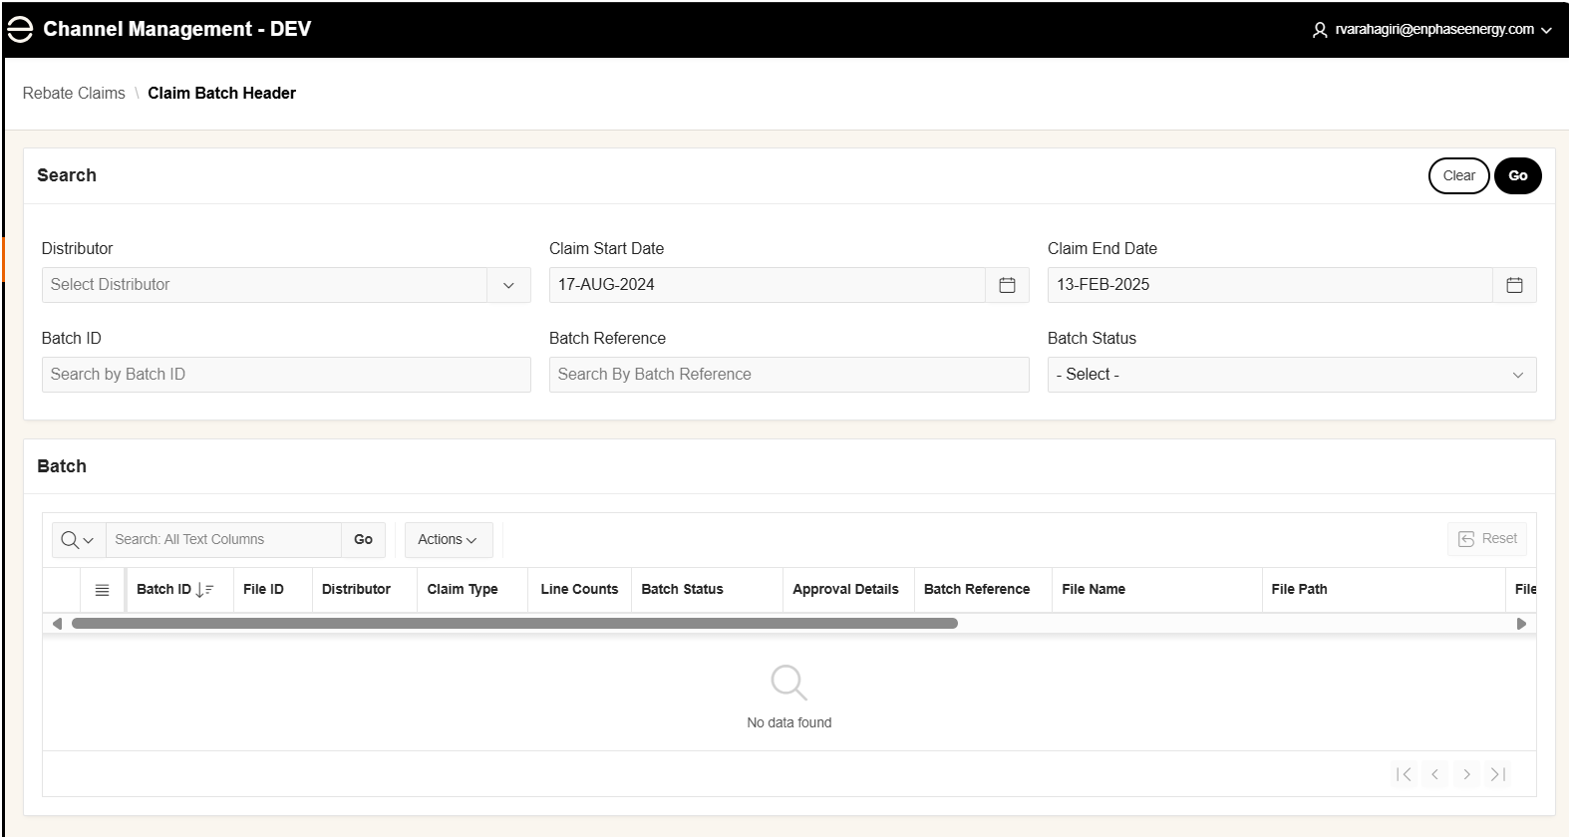
Rebate Claims Batch
MSI

Slide 14
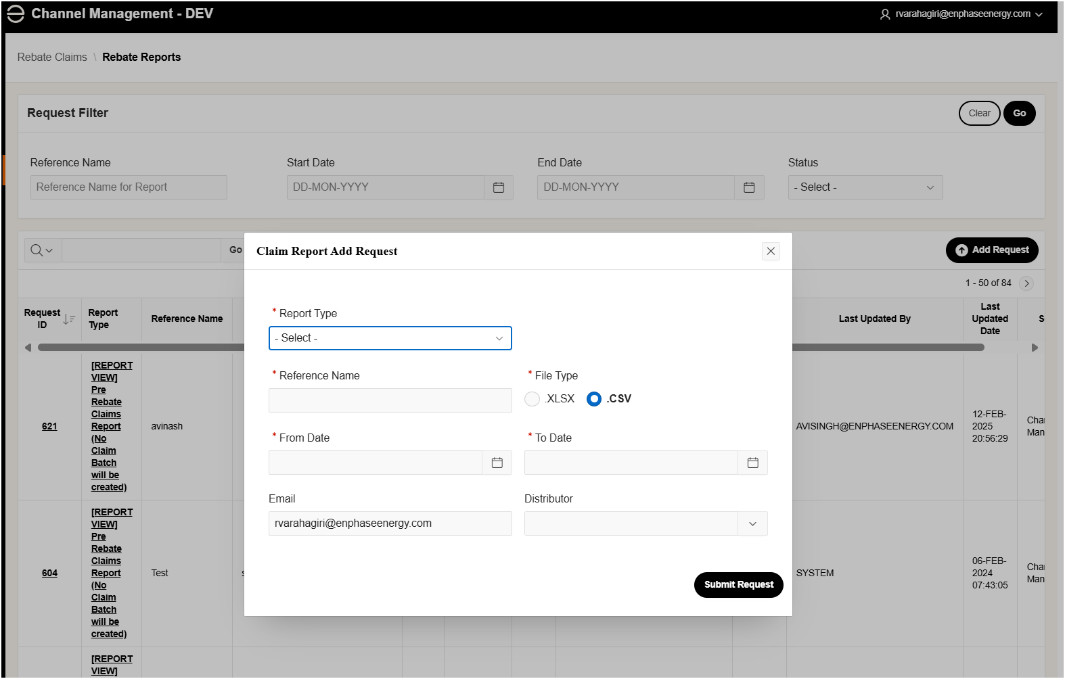
Rebate Claims Batch Creation
MSI
MSI Rebate Batch Creation
01-JAN-2025
31-JAN-2025
Installer

Slide 15
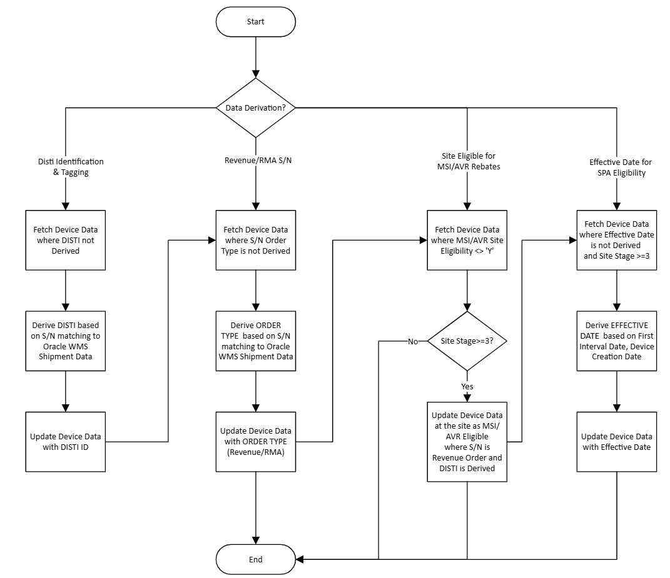
Additional Attribute Derivation

Slide 16
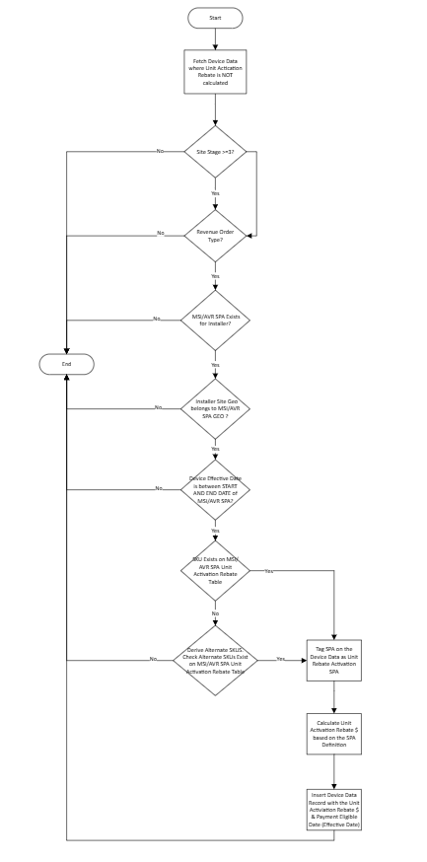
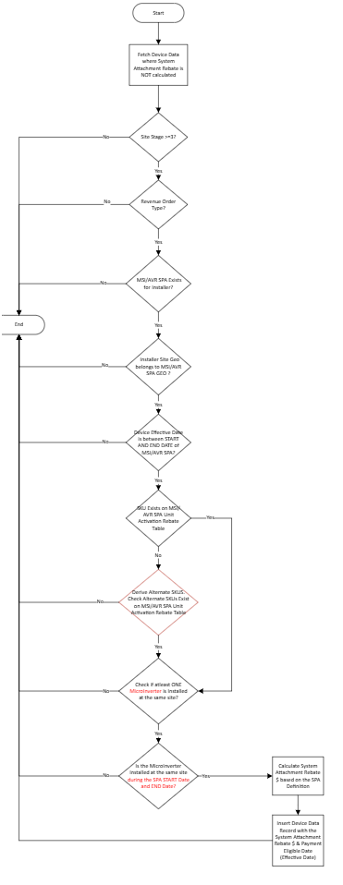
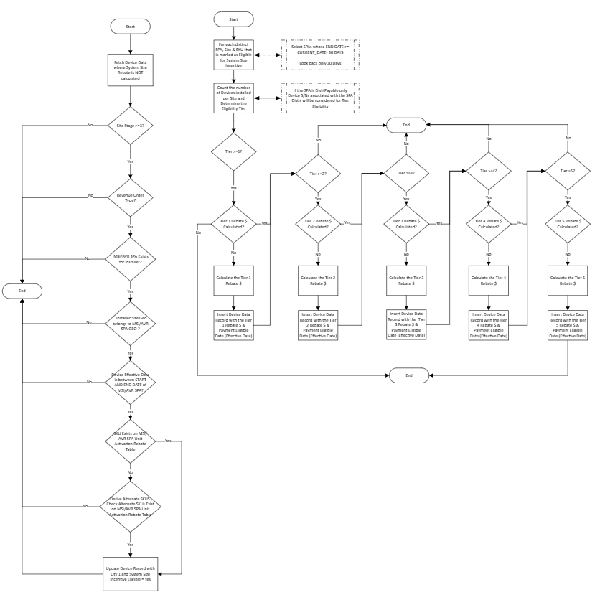
Rebate Calculation
Unit Incentive
System Attachment
System Size

Slide 17
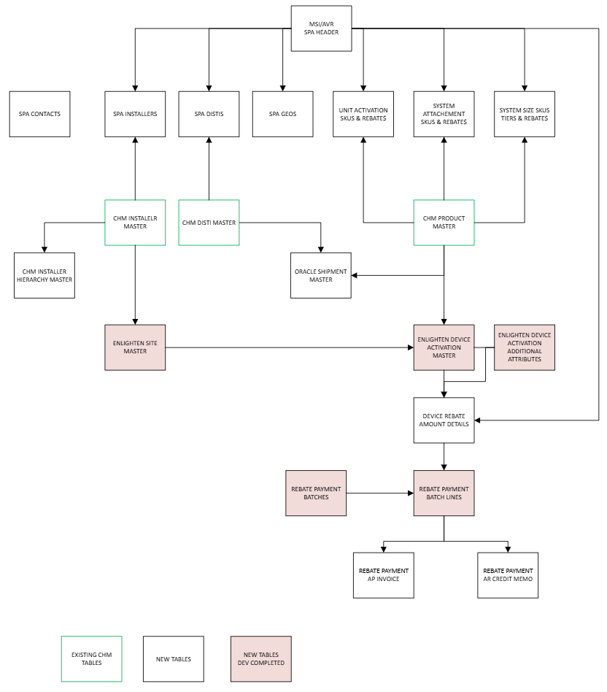
ERD - Tables

Slide 18




Users, Roles & Permissions
USERS
ROLES
PERMISSIONS
ADMIN
Role Assignments
Notes:
Make the flow its own slide

Slide 19
APPENDIX
APPENDIX

Slide 20



Rebate Calculation & Payment Processing
1
Site & Activation Data Collection
2
Activation Data Enrichment
3
Rebate Qualification
Distributor, Revenue/RMA
Identification
& Tagging
SPA Eligibility
Lookup
SPA identification & Rebate Eligibility Tagging
Receive
Data
Validate
Data
Consolidate
Data
S/N Lookup
$
5
Rebate Payments & Settlements
4
Rebate Calculation
AR Credit Memo Application
AR Credit Memo
Distributor
Pay to Distributor
$
Unit Activation Rebate
Rebate Eligible
Activation Data
Calculated Rebate Payment Batches
System Attachment
Rebate
EFT/Check Payment
$
AP Invoice
Installer
Pay to Installer
$
System Size
Rebate

