Slide 1
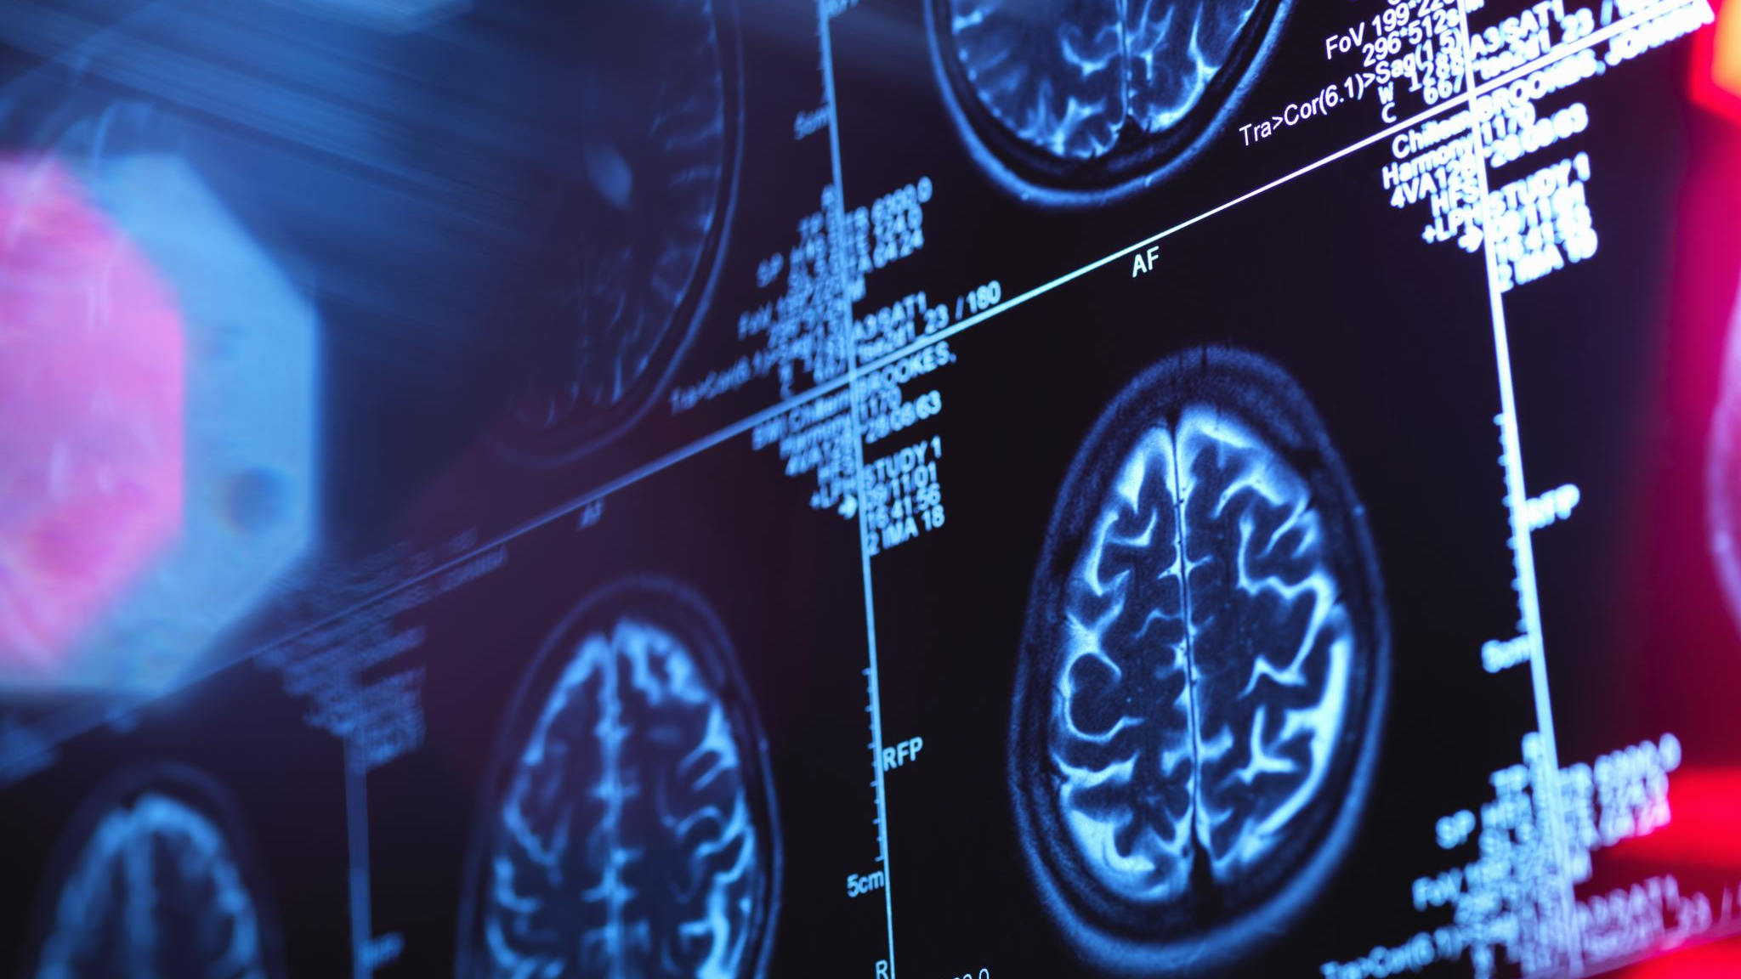
Utilities of ai and Segmentation of Thermal Images from Thyroid Patients for early detection of abnormalities
Presented by – Gopal
B.Tech Engineering Physics
IIT Roorkee

Slide 2
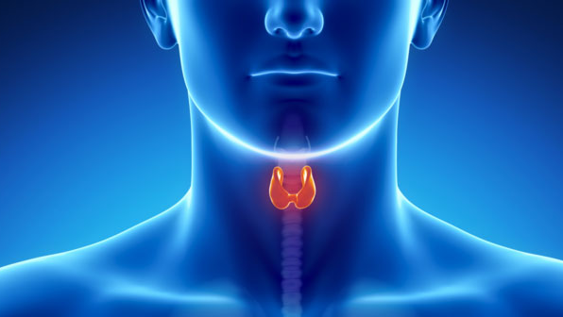
Content
Introduction
Anatomy
Thyroid Disorders types
Lab Investigation
Steps for Thyroid detection using ai

Slide 3
Introduction
Thyroid diseases are amongst one of the most common endocrine disease.
Through the hormones it produces, the thyroid gland influences almost all the metabolic processes in the body.
Thyroid disease can range from a small, harmless goiter that needs no treatment to life threatening cancer.
The most common thyroid problems involves abnormal production of hormones which are Hyperthyroidism and Hypothyroidism.
Although the effects can be unpleasant or uncomfortable, most thyroid problems can be managed well if properly diagnosed and treated.

Slide 4
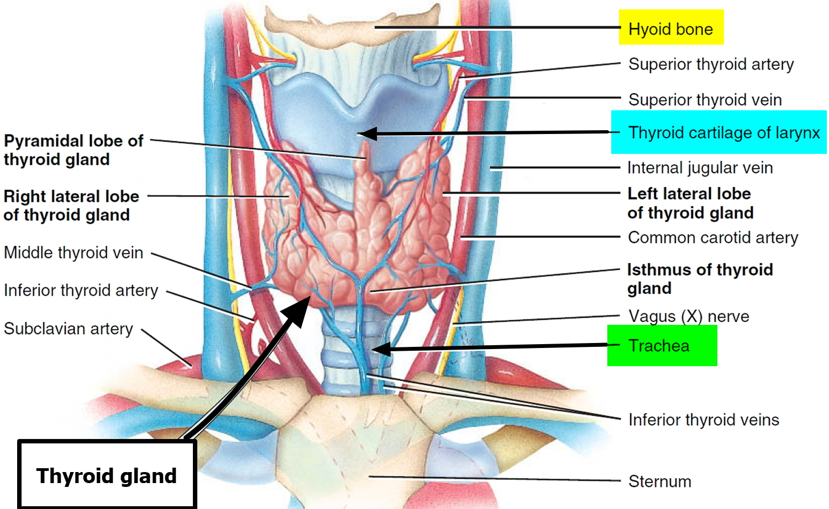
ANATOMY
Hormones of thyroid gland
Hormones secreted by thyroid gland
Thyroxine[T4]
Triiodothyronine [T3]
All organ systems are affected by thyroid hormones. Thyroid hormones increases metabolic rate, heart rate and ventricle contractility, as well as muscle and central nervous system(CNS) excitability.

Slide 5
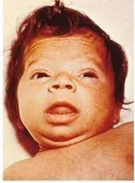
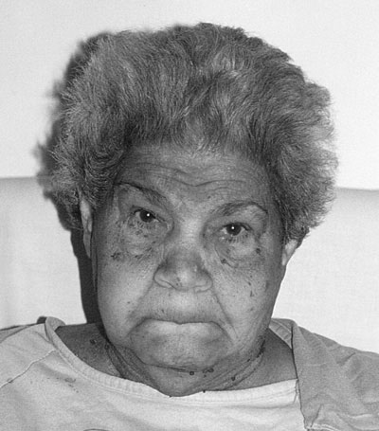
Thyroid Disorder Types
HYPOTHYROIDISM
Hyperthyroidism, is a state of insufficient thyroid hormone production.
Worldwide, the most common cause is iodine deficiency.
Hypothyroidism secondary to iodine deficiency remains the leading causes of preventable intellectual disability.
In iodine-sufficient regions, the most common cause of hypothyroidism is Hashimoto’s thyroiditis, also an auto immune disorder.
Dry skin, increased temperature sensitivity, hair thinning, weight loss, elevated heart rate, high blood pressure, excessive perspiration, neck enlargement, anxiety, menstrual cycle shortening, irregular stomach movements, and handshaking are some of the symptoms.

Slide 6
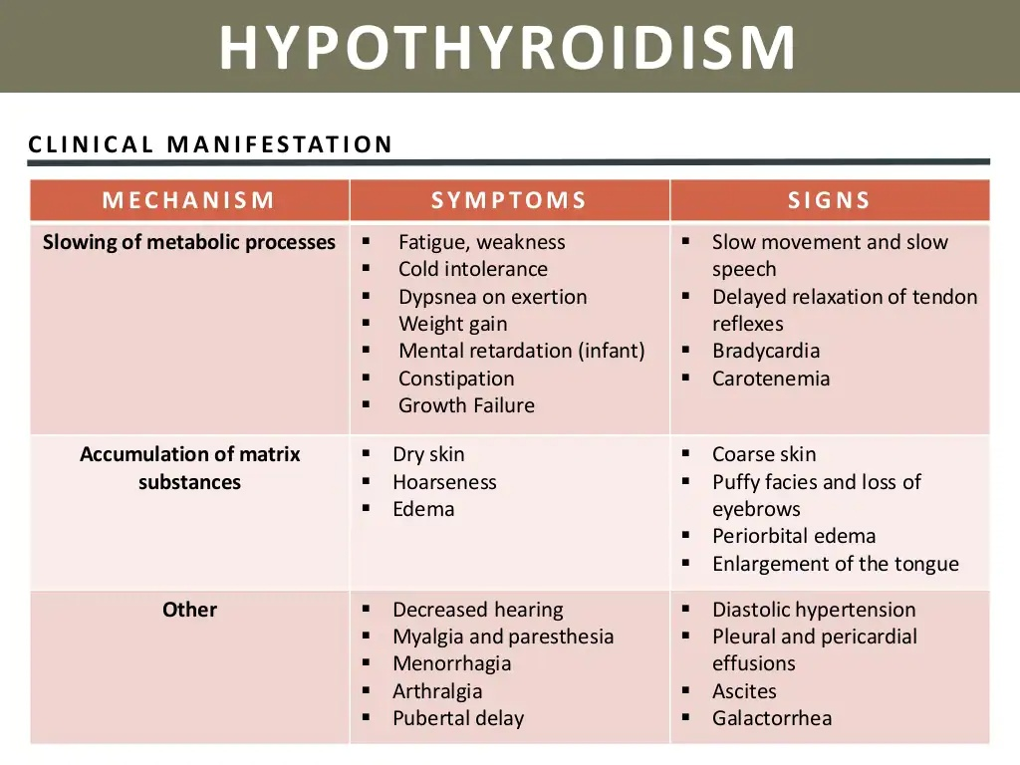

Slide 7
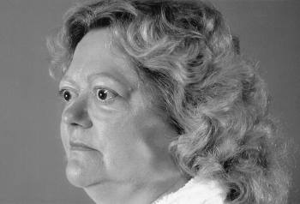
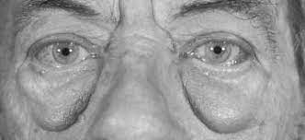
Thyroid Disease Types
HYPERTHYROIDISM
It occurs when gland produces excessive amounts of thyroid hormones.
The most common cause is Graves’s disease, an autoimmune disorder.
Hypothyroidism is a disorder wherein thyroid hormone production is diminished, causing the thyroid gland to become underactive. Hypo means inadequate or less in medical terms.
PCOS symptoms include obesity, a low heart rate, increased temperature sensitivity, neck swelling, dry skin, hand numbness, hair problems, heavy menstrual cycles, and digestive troubles. These symptoms may develop over time if left untreated.

Slide 8
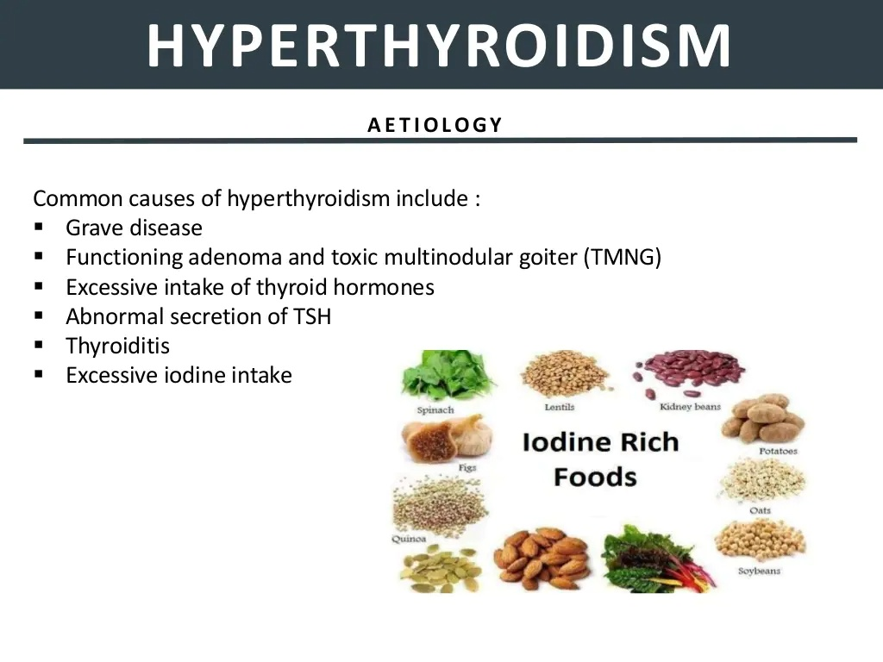

Slide 9
Thyroid detection using artificial intelligence

Slide 10
Steps for Thyroid detection using artificial intelligence
Data collection
Data pre-processing
Data machine learning algorithms
Create model
Training Model
Test model

Slide 11
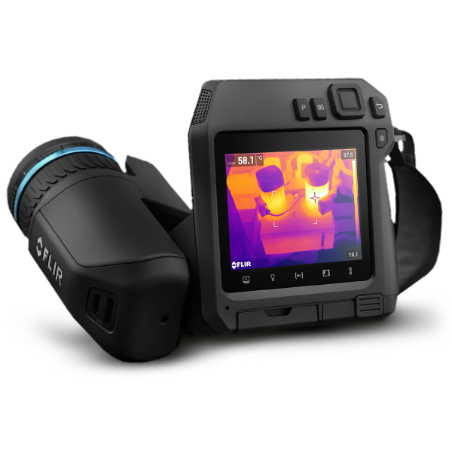

Data Collection
Using FLIR camera, Thermal image data collection.
In a procedure, a FLIR camera collects and generates a picture of an item using infrared light generated by the object.
allows one to see variations in temperature.
Thermographic cameras typically detect and generate pictures of radiation in the long-infrared band of the electromagnetic spectrum.
FLIR T-540

Slide 12
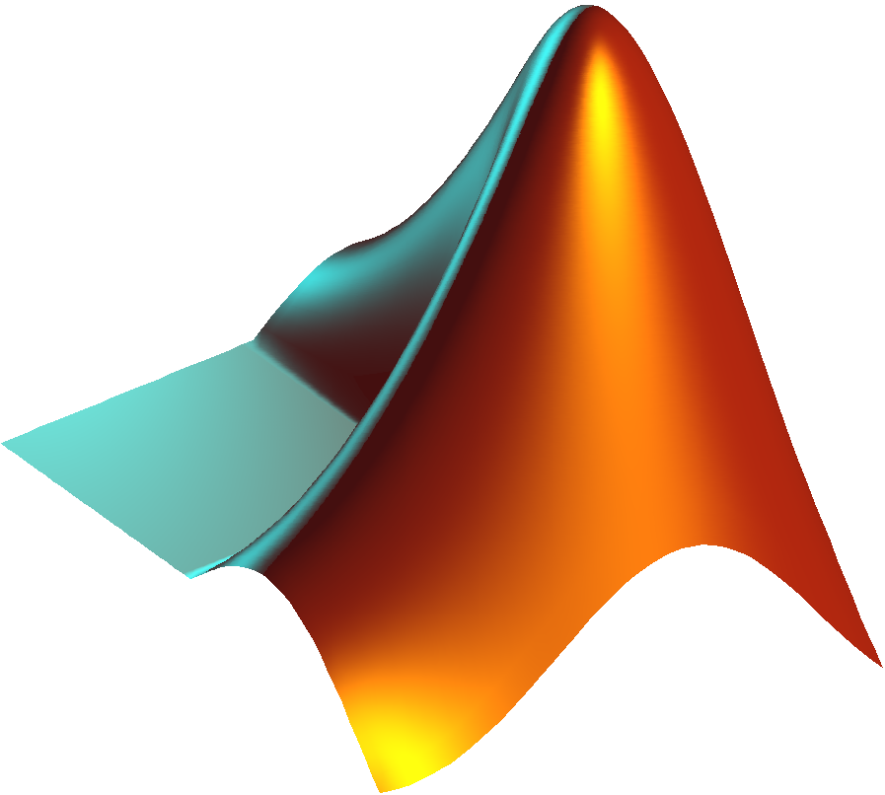
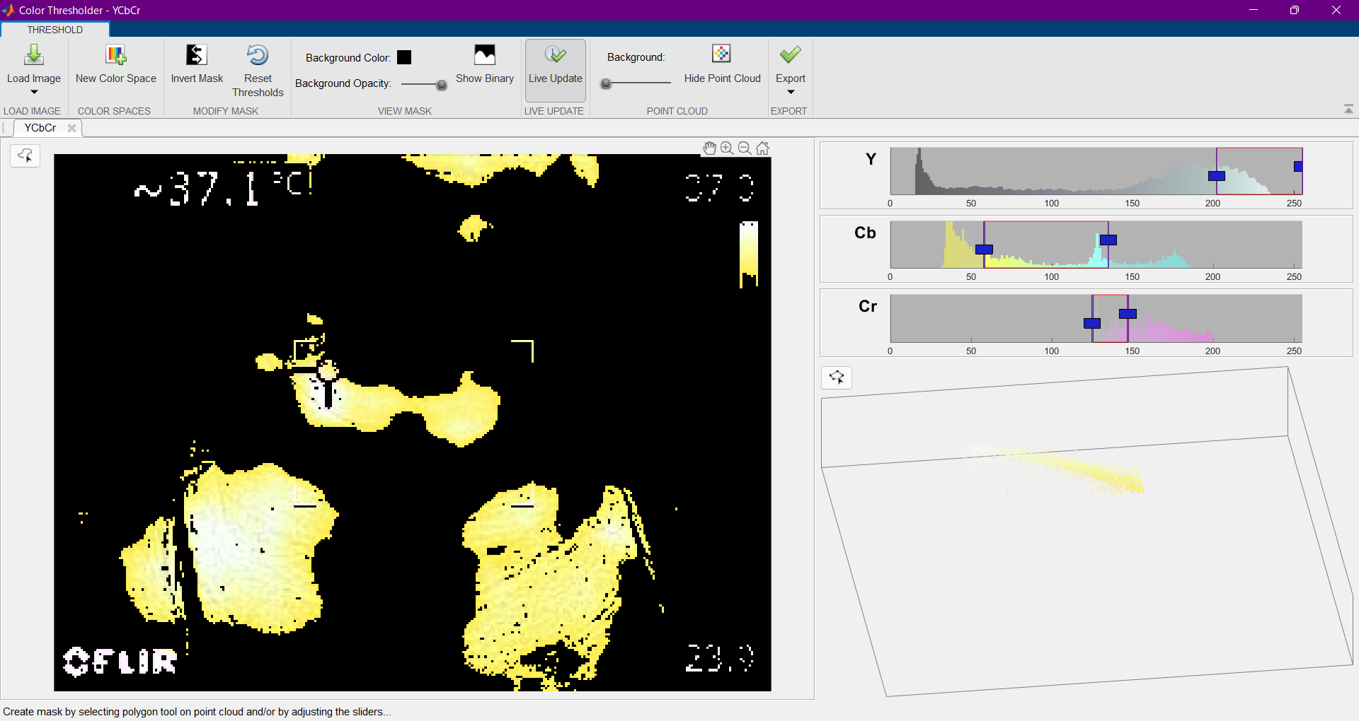
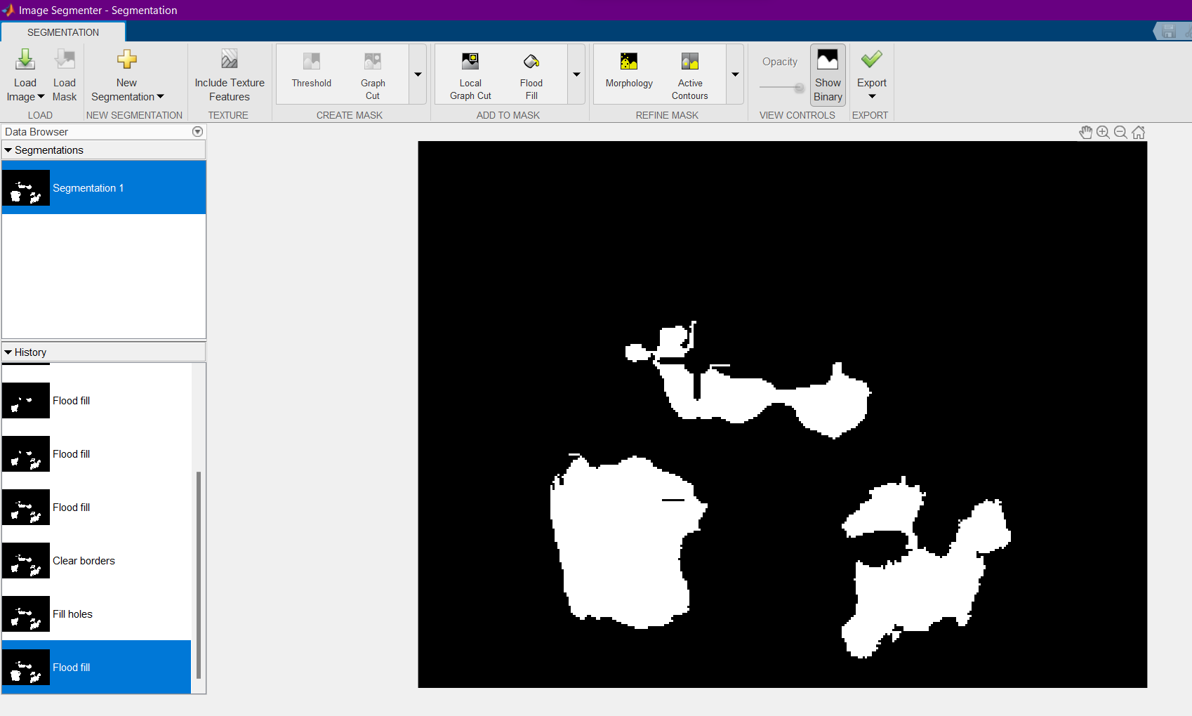
Data pre-processing

Slide 13
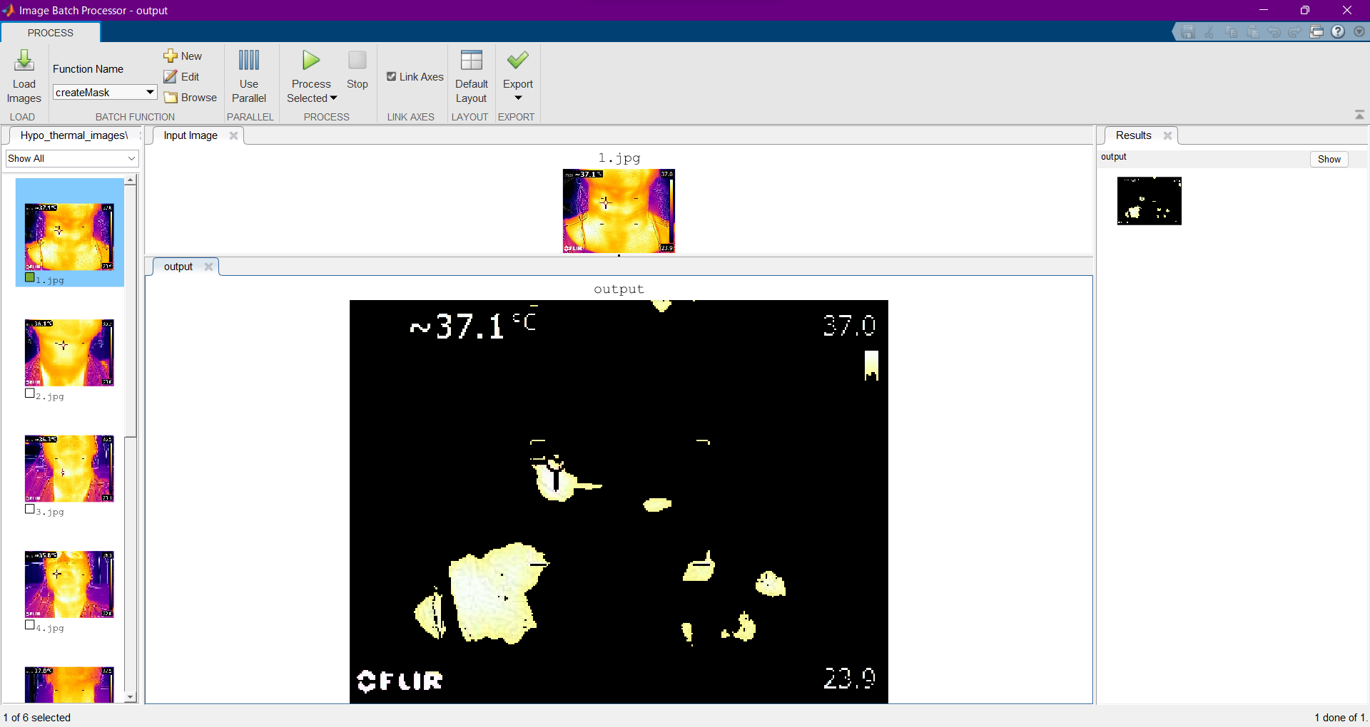
Data pre-processing

Slide 14
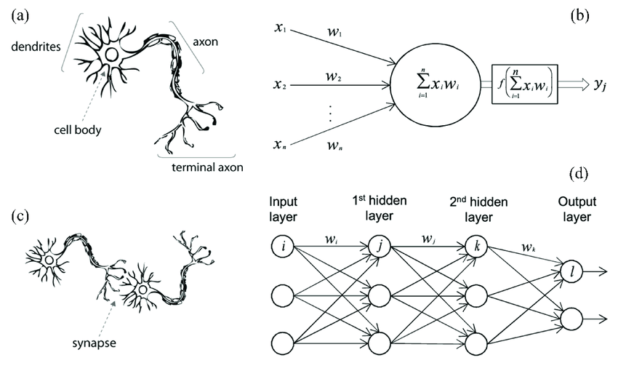
Neural Networks

Slide 15

Data machine learning algorithm
SVM (Support Vector Machine)

Slide 16
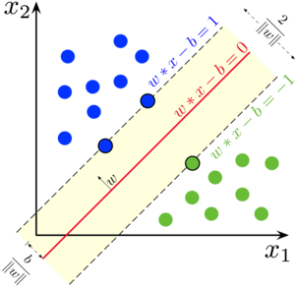
SVM
Support-vector machines (SVMs, also known as support-vector networks) are supervised learning models that examine data for classification and regression analysis in machine learning.
SVMs, which are based on statistical learning frameworks, are one of the most reliable prediction approaches.
SVMs are capable of doing non-linear classification in addition to linear classification.
SVM translates training examples to points in space in order to widen the distance between the two categories as much as possible. New instances are then mapped into the same space and classified according to which side of the gap they land on.

