Slide 1

Shell Scripting Course

Slide 2
SHELL SCRIPTING
A Bash script is a plain text file which contains a series of commands. These commands are a mixture of commands we would normally type ourselves on the command line (such as ls or cp for example)
Anything you can run normally on the command line can be put into a script and it will do exactly the same thing. Similarly, anything you can put into a script can also be run normally on the command line and it will do exactly the same thing.
SHELL is a program which provides the interface between the user and an operating system. When the user logs in OS starts a shell for user
To check current shell
#echo $SHELL

Slide 3
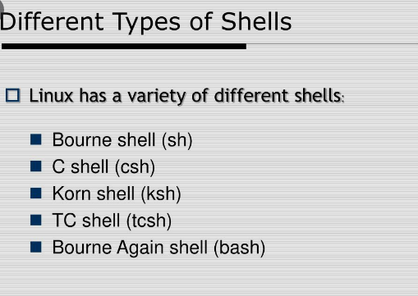
SHELL SCRIPTING

Slide 4
SHELL SCRIPTING
Start creating new script
Vi file1.sh
#!/bin/bash
#This is sample script
echo “Welcome to RNS”
:wq
Provide executable permissions for file
#chmod +x file1.sh
Run the scipt
#./file1.sh or bash file1.sh

Slide 5
SHELL SCRIPTING
Let's break it down:
Line 1 - The Shebang (#!)
Line 2 - This is a comment. Anything after # is not executed.
Line 3 - Is the command echo which will print a message to the screen. You can type this command yourself on the command line and it will behave exactly the same.
Few IMP commands:
An alias is a (usually short) name that the shell translates into another (usually longer) name or command.
#alias c=clear
To list the list of alias are available use command
#alias

Slide 6
SHELL SCRIPTING
Unalias the command
#unalias c
To view previously executable commands
#history
.bash_history file will be there for every user and there it will store commands
banner command in linux is used to print the ASCII character string in large letter to standard output.
#banner “RNS” or banner rns

Slide 7
SHELL SCRIPTING
ECHO
The echo command is one of the most commonly and widely used built-in commands for Linux bash and C shells, that typically used in a scripting language and batch files to display a line of text/string on standard output or a file.
Options:
-n: No new Line
-e: enable escape sequence
\n- new line escape sequence
\t- new horizontal tap escape sequence

Slide 8


