Slide 1
DBMS MINI PROJECT
DevMatch AI
Developer Portfolio & Hiring Platform
A relational database project using Flask and MySQL
DevMatch AI
01
Notes:
Timing: 0:00–0:20 (20 seconds)
Good morning. Our project is DevMatch AI, a developer portfolio and hiring platform. It brings developer profiles, job requirements and application decisions into one relational MySQL database. I will explain the workflows, ER model, relational schema, normalization and SQL demonstrations, then show how database changes appear in the website.
Sources: D:/DBMS_DevApp/DevMatch_AI_DBMS_Mini_Project/devmatch-ai/app.py, mysql_demo.sql, README.md, DBMS_PROJECT_DOCUMENTATION.md.

Slide 2
Problem statement
Hiring information is scattered
Profiles, portfolios, resumes and job requirements often exist in separate places.
Unstructured skill lists make comparison difficult
Repeated details and comma-separated values complicate search and updates.
Proposed solution
A web application that connects developer evidence, job requirements and application decisions through related MySQL tables.
DevMatch AI
02
Notes:
Timing: 0:20–1:00 (40 seconds)
The problem is that hiring information is spread across resumes, portfolios and job listings. Recruiters need a consistent way to compare a candidate's skills with a vacancy. Developers need one place to maintain their evidence and track applications. Our solution connects these records using keys and relationships. The database is central because the same developer can have multiple skills, projects and applications, while each recruiter can post multiple jobs. Keeping these facts related makes updates and searches easier to explain and verify.
Sources: D:/DBMS_DevApp/DevMatch_AI_DBMS_Mini_Project/devmatch-ai/app.py, mysql_demo.sql, README.md, DBMS_PROJECT_DOCUMENTATION.md.

Slide 3
Objectives and application modules
Developer | Recruiter
Maintain profile, skills and projects | Maintain company profile and vacancies
Upload PDF and view resume analysis | Review applicant profiles and resumes
Search jobs and apply once per job | Inspect matched and missing skills
Track application status | Change application status after review
DBMS objective: related tables, normalized data, integrity constraints and SQL demonstrations
DevMatch AI
03
Notes:
Timing: 1:00–1:40 (40 seconds)
The system has two main roles. A developer maintains a profile, adds skills and projects, uploads a PDF resume, searches jobs and applies. A recruiter maintains company information, posts vacancies, reviews candidate evidence and changes application status. We prevent repeat applications to the same job. The database objective is to demonstrate real CRUD operations, relational joins and integrity constraints. Resume analysis supports the workflow, while the recruiter still reviews the evidence before making a final decision.
Sources: D:/DBMS_DevApp/DevMatch_AI_DBMS_Mini_Project/devmatch-ai/app.py, mysql_demo.sql, README.md, DBMS_PROJECT_DOCUMENTATION.md.

Slide 4
System architecture
Desktop / laptop browser
HTML, CSS, JavaScript
Python + Flask
Routes, sessions and validation
MySQL 8
SQLAlchemy + PyMySQL
Resume workflow
PDF text extraction with PyMuPDF
Optional Gemini analysis, with local extraction fallback
Optional Supabase Storage stores private resume PDFs. MySQL stores application records.
DevMatch AI
04
Notes:
Timing: 1:40–2:20 (40 seconds)
The user interacts through a browser. HTML, CSS and JavaScript form the interface, and Flask handles routes, sessions and validation. SQLAlchemy models map Python objects to MySQL tables, with PyMySQL as the connection driver. All application records live in MySQL. PyMuPDF extracts text from resume PDFs. Gemini analysis is optional and local skill extraction provides a fallback. Supabase, when configured, stores private PDF files only. Its PostgreSQL database does not hold this project's application tables.
Sources: D:/DBMS_DevApp/DevMatch_AI_DBMS_Mini_Project/devmatch-ai/app.py, mysql_demo.sql, README.md, DBMS_PROJECT_DOCUMENTATION.md.

Slide 5
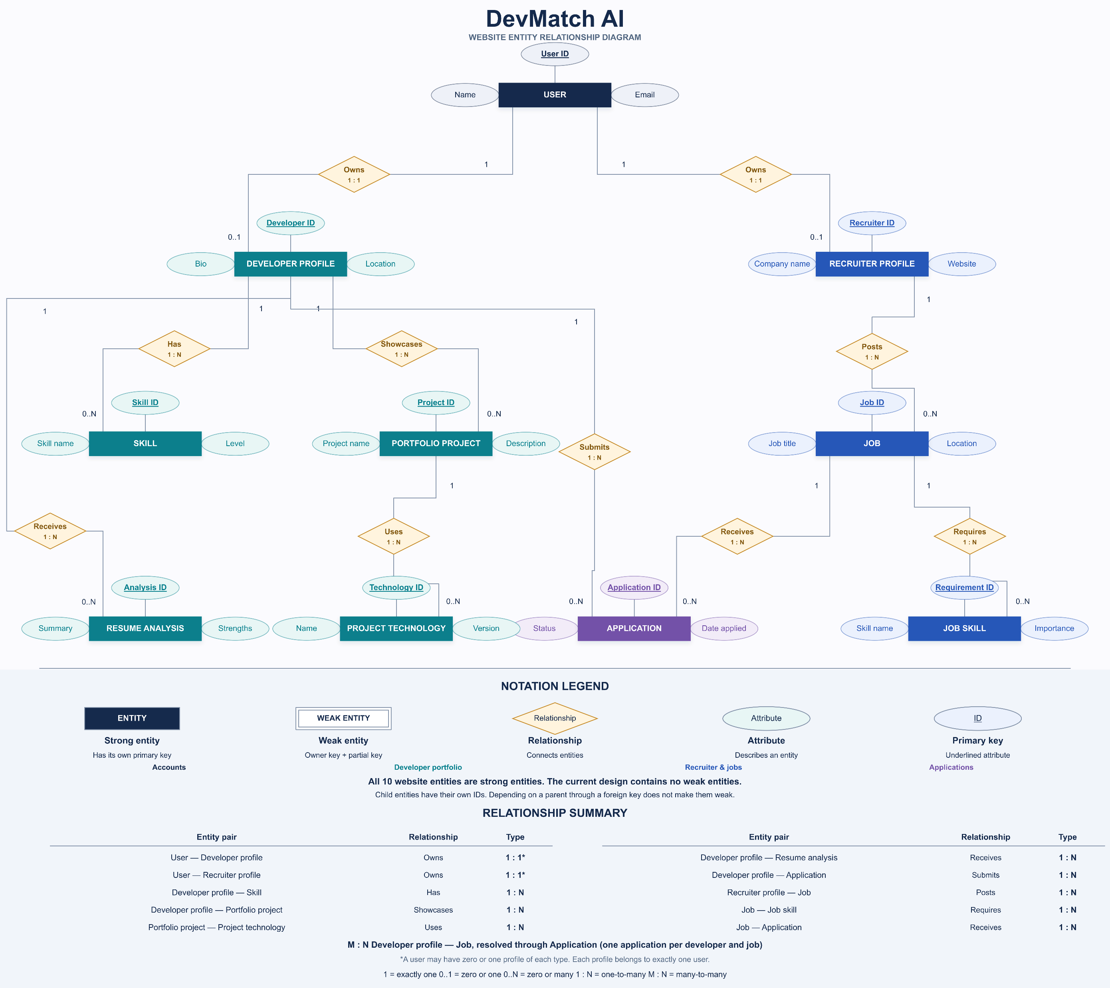
03 / DATABASE DESIGN
ER diagram and cardinalities
User
1 : 0..1
1 : 0..1
Developer profile
Other links: 1 : 0..N
Developer and Job: M : N via Application
Recruiter profile
Skill
Project
Application
Job
Resume analysis
Project technology
Status history
Job skill
DevMatch AI
05
Notes:
Timing: 2:20–3:40 (80 seconds)
This is the ER model. Users are the account entity. A user can have an optional developer profile or recruiter profile. The profile's unique user foreign key gives an optional one-to-one relationship. A developer has many skills, projects, resume analyses and applications. Each project has multiple technology records. A recruiter posts multiple jobs, and a job has multiple required-skill rows. The key relationship is developers and jobs: many developers can apply to many jobs. We resolve that many-to-many relationship through the Application entity. Each application belongs to exactly one developer and one job. Status history adds multiple audit records for an application. This audit entity is installed by the SQL demonstration script, while the ten core entities come from the application models. Read the diagram's remaining parent-child links as one to zero or many.
Sources: D:/DBMS_DevApp/DevMatch_AI_DBMS_Mini_Project/devmatch-ai/app.py, mysql_demo.sql, README.md, DBMS_PROJECT_DOCUMENTATION.md.

Slide 6
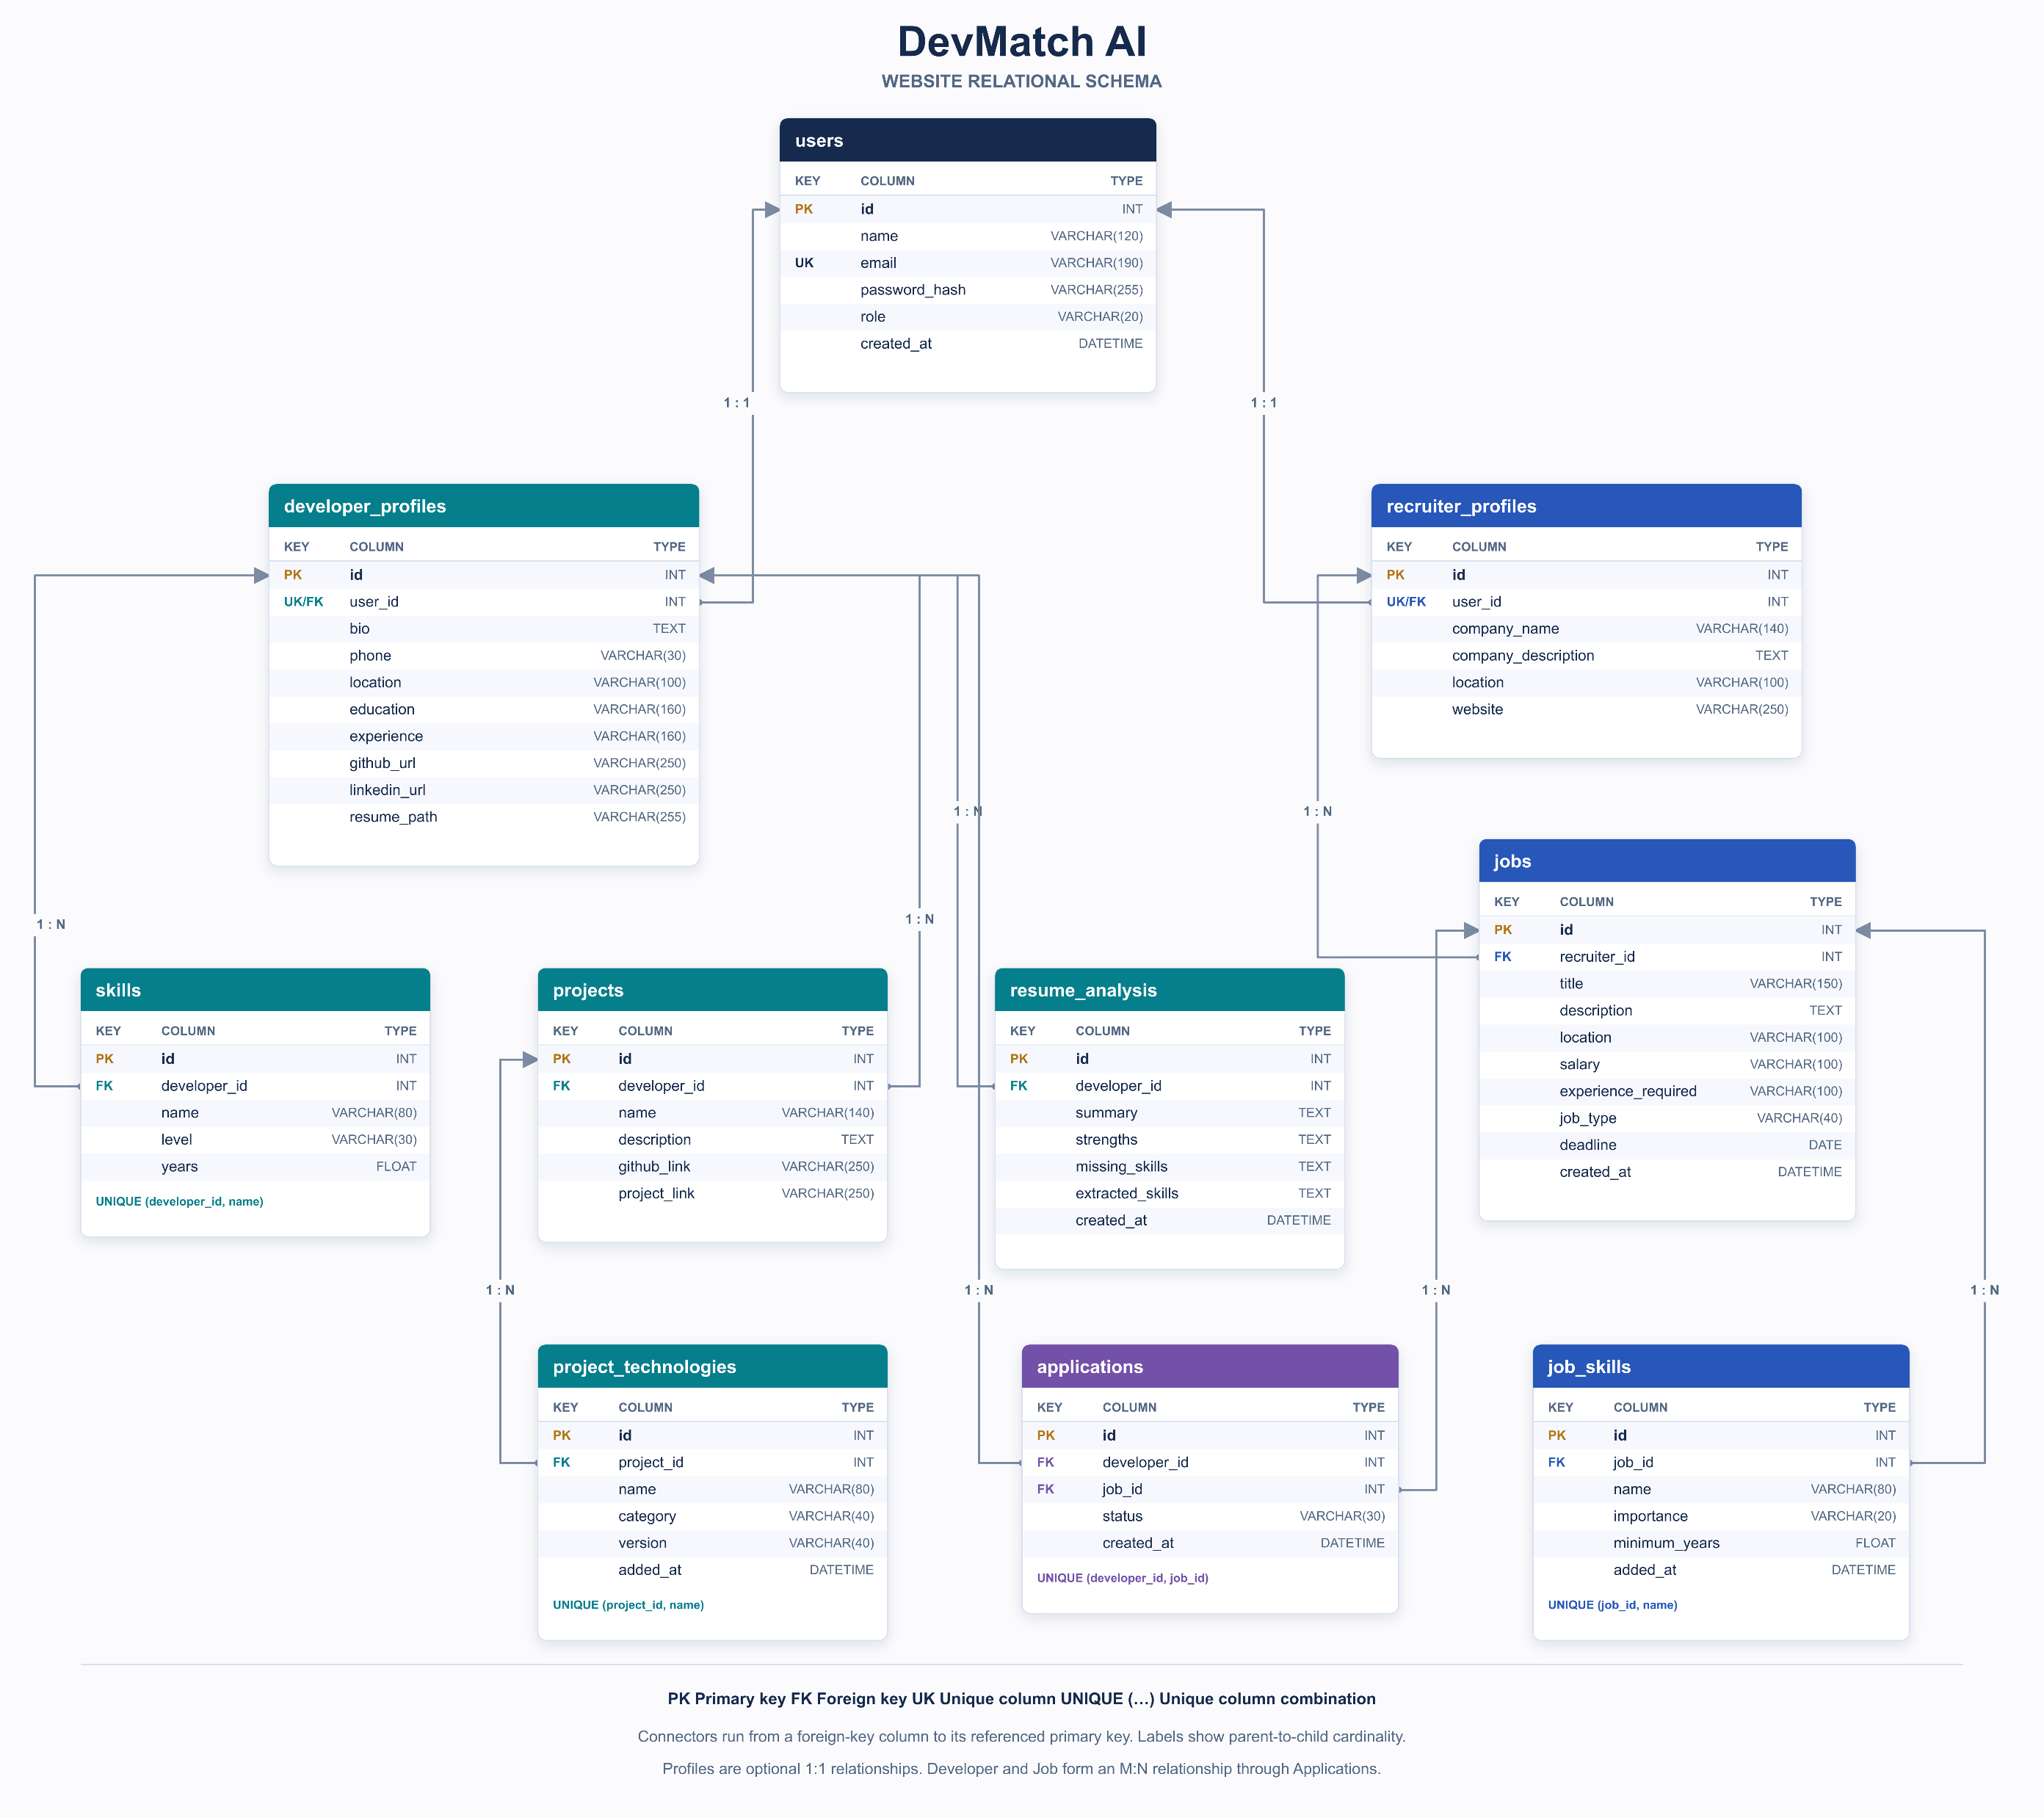
03 / DATABASE DESIGN
Relational schema: accounts and portfolios
users
id PK, name, email UK, password_hash, role, created_at
developer_profiles
id PK, user_id FK/UK, bio, phone, location, education, experience, github_url, linkedin_url, resume_path
recruiter_profiles
id PK, user_id FK/UK, company_name, company_description, location, website
skills
id PK, developer_id FK, name, level, years
UK (developer_id, name)
projects
id PK, developer_id FK, name, description, github_link, project_link
project_technologies
id PK, project_id FK, name, category, version, added_at
UK (project_id, name)
FK links: profiles.user_id = users.id; skills/projects.developer_id = developer_profiles.id; technologies.project_id = projects.id
DevMatch AI
06
Notes:
Timing: 3:40–4:35 (55 seconds)
This slide maps account and portfolio entities into relations. Every table uses an integer id as its primary key. Users stores identity, a unique email and a password hash. Developer profiles stores profile-specific details and references users through a unique user_id. Recruiter profiles does the same for company information. Skills references a developer and stores the skill name, level and years. Projects references its developer and stores project evidence. Project technologies references its project. Unique parent-and-name pairs prevent repeated skill or technology records within the same parent. PK identifies a row, FK points to another relation, and UK indicates uniqueness.
Sources: D:/DBMS_DevApp/DevMatch_AI_DBMS_Mini_Project/devmatch-ai/app.py, mysql_demo.sql, README.md, DBMS_PROJECT_DOCUMENTATION.md.

Slide 7
Skill match calculation
Match (%) = matched required skills ÷ total required skills × 100
Illustrative example | Value
Job requirements | Python, Flask, MySQL
Candidate evidence | Python, Flask
Result | 2 ÷ 3 × 100 = 66.7% (display: 67%)
Initial status for this example | Rejected, because the score is at or below 70%
Above 70%: Shortlisted. Recruiters can change the initial status after review.
DevMatch AI
7
Notes:
Timing: 11:30–12:30 (60 seconds)
The ATS calculation is deterministic skill matching. The application normalizes skill names with casefold and compares job requirements against the union of profile skills and skills extracted from the latest resume analysis. The percentage is the number of matched required names divided by the total required names, multiplied by 100. Matching two of Python, Flask and MySQL gives 66.7 percent, displayed as 67 percent. The initial status is Rejected because the exact ratio is at or below 70 percent. Above 70 percent gives Shortlisted. Exactly 70 percent does not pass. With no requirements, the score is zero and the application is rejected. The stored importance and minimum_years fields do not weight this score. Recruiters can review evidence and override the initial decision.
Sources: D:/DBMS_DevApp/DevMatch_AI_DBMS_Mini_Project/devmatch-ai/app.py, mysql_demo.sql, README.md, DBMS_PROJECT_DOCUMENTATION.md.

