Slide 1
FINAL DBMS PRESENTATION
DevMatch AI
Developer Portfolio & Hiring Platform
Database Management System Mini Project
CMR Institute of Technology, Bengaluru
Department of Electronics and Communication Engineering
Academic year 2026–27
Presented by: ____________________ USN: ____________________
Guide: ____________________
DevMatch AI
01
Notes:
Introduce the project as a developer portfolio and hiring platform. The core database is MySQL. The application runs in a desktop or laptop browser.
Sources: project app.py, mysql_demo.sql, README.md and DBMS_PROJECT_DOCUMENTATION.md in D:/DBMS_DevApp/DevMatch_AI_DBMS_Mini_Project/devmatch-ai. Requirements: C:/Users/gurra/Downloads/DBMS Mini Project_Guidelines.pptx.

Slide 2
01 / INTRODUCTION
Problem statement
Hiring information is scattered
Profiles, portfolios, resumes and job requirements often exist in separate places.
Unstructured skill lists make comparison difficult
Repeated details and comma-separated values complicate search and updates.
Proposed solution
A web application that connects developer evidence, job requirements and application decisions through related MySQL tables.
DevMatch AI
02
Notes:
Explain why a relational database helps: developers, vacancies and decisions must stay consistent. Avoid claiming that skill match measures overall competence.
Sources: project app.py, mysql_demo.sql, README.md and DBMS_PROJECT_DOCUMENTATION.md in D:/DBMS_DevApp/DevMatch_AI_DBMS_Mini_Project/devmatch-ai. Requirements: C:/Users/gurra/Downloads/DBMS Mini Project_Guidelines.pptx.

Slide 3
01 / INTRODUCTION
Objectives and application modules
Developer | Recruiter
Maintain profile, skills and projects | Maintain company profile and vacancies
Upload PDF and view resume analysis | Review applicant profiles and resumes
Search jobs and apply once per job | Inspect matched and missing skills
Track application status | Change application status after review
DBMS objective: related tables, normalized data, integrity constraints and SQL demonstrations
DevMatch AI
03
Notes:
Developer and recruiter accounts access their own workflows. The role-specific pages use the same database.
Sources: project app.py, mysql_demo.sql, README.md and DBMS_PROJECT_DOCUMENTATION.md in D:/DBMS_DevApp/DevMatch_AI_DBMS_Mini_Project/devmatch-ai. Requirements: C:/Users/gurra/Downloads/DBMS Mini Project_Guidelines.pptx.

Slide 4
02 / DEVELOPMENT
System architecture
Desktop / laptop browser
HTML, CSS, JavaScript and Jinja
Python + Flask
Routes, sessions and validation
MySQL 8
SQLAlchemy + PyMySQL
Resume workflow
PDF text extraction with PyMuPDF
Optional Gemini analysis, with local extraction fallback
Optional Supabase Storage stores private resume PDFs. MySQL stores application records.
DevMatch AI
04
Notes:
A browser submits forms to Flask. SQLAlchemy uses PyMySQL to connect to MySQL. PDF extraction uses PyMuPDF. Gemini is optional. Supabase holds resume files only when configured, not relational application records.
Sources: project app.py, mysql_demo.sql, README.md and DBMS_PROJECT_DOCUMENTATION.md in D:/DBMS_DevApp/DevMatch_AI_DBMS_Mini_Project/devmatch-ai. Requirements: C:/Users/gurra/Downloads/DBMS Mini Project_Guidelines.pptx.

Slide 5
02 / DEVELOPMENT
Application development process
Stage | Work completed in the project
Requirements | Defined developer, recruiter and hiring workflows
Database design | Created ER model, key mapping and normalized child tables
Implementation | Built Flask routes, forms and SQLAlchemy CRUD
Demonstration data | Added demo seed, SQL view and status audit trigger
Verification | Added schema/row checks and the database demonstration page
DevMatch AI
05
Notes:
Use the steps to explain the project process without claiming a measured test result.
Sources: project app.py, mysql_demo.sql, README.md and DBMS_PROJECT_DOCUMENTATION.md in D:/DBMS_DevApp/DevMatch_AI_DBMS_Mini_Project/devmatch-ai. Requirements: C:/Users/gurra/Downloads/DBMS Mini Project_Guidelines.pptx.

Slide 6
03 / DATABASE DESIGN
ER diagram and cardinalities
User
1 : 0..1
1 : 0..1
Developer profile
Other links: 1 : 0..N
Developer and Job: M : N via Application
Recruiter profile
Skill
Project
Application
Job
Resume analysis
Project technology
Status history
Job skill
DevMatch AI
06
Notes:
Read a link as parent to child. Each child has exactly one parent. User to either profile is optional one-to-one. All remaining links are one-to-zero-or-many. Applications resolve the developer-to-job many-to-many relationship. Status history is the SQL audit extension.
Sources: project app.py, mysql_demo.sql, README.md and DBMS_PROJECT_DOCUMENTATION.md in D:/DBMS_DevApp/DevMatch_AI_DBMS_Mini_Project/devmatch-ai. Requirements: C:/Users/gurra/Downloads/DBMS Mini Project_Guidelines.pptx.

Slide 7
03 / DATABASE DESIGN
Relational schema: accounts and portfolios
users
id PK, name, email UK, password_hash, role, created_at
developer_profiles
id PK, user_id FK/UK, bio, phone, location, education, experience, github_url, linkedin_url, resume_path
recruiter_profiles
id PK, user_id FK/UK, company_name, company_description, location, website
skills
id PK, developer_id FK, name, level, years
UK (developer_id, name)
projects
id PK, developer_id FK, name, description, github_link, project_link
project_technologies
id PK, project_id FK, name, category, version, added_at
UK (project_id, name)
FK links: profiles.user_id = users.id; skills/projects.developer_id = developer_profiles.id; technologies.project_id = projects.id
DevMatch AI
07
Notes:
PK means primary key. FK means foreign key. UK means uniqueness. The schema labels include all model attributes, not only a selected subset. Resume analysis text fields store narrative/extraction results, while searchable skills use separate rows.
Sources: project app.py, mysql_demo.sql, README.md and DBMS_PROJECT_DOCUMENTATION.md in D:/DBMS_DevApp/DevMatch_AI_DBMS_Mini_Project/devmatch-ai. Requirements: C:/Users/gurra/Downloads/DBMS Mini Project_Guidelines.pptx.

Slide 8
03 / DATABASE DESIGN
Relational schema: hiring and analysis
jobs
id PK, recruiter_id FK, title, description, location, salary, experience_required, job_type, deadline, created_at
job_skills
id PK, job_id FK, name, importance, minimum_years, added_at
UK (job_id, name)
applications
id PK, developer_id FK, job_id FK, status, created_at
UK (developer_id, job_id)
resume_analysis
id PK, developer_id FK, summary, strengths, missing_skills, extracted_skills, created_at
application_status_history (SQL audit extension)
id PK, application_id FK, old_status, new_status, changed_at
FK parents: jobs / recruiter_profiles; job_skills / jobs; applications / developers and jobs; analysis / developers; history / applications
DevMatch AI
08
Notes:
The first four entities are application models. application_status_history is installed by mysql_demo.sql. Each table has a primary key and at least five attributes. All child foreign keys refer to the parent id.
Sources: project app.py, mysql_demo.sql, README.md and DBMS_PROJECT_DOCUMENTATION.md in D:/DBMS_DevApp/DevMatch_AI_DBMS_Mini_Project/devmatch-ai. Requirements: C:/Users/gurra/Downloads/DBMS Mini Project_Guidelines.pptx.

Slide 9
03 / DATABASE DESIGN
ER-to-relational mapping
Relationship | Mapping rule | Project example
Entity | Create table with a primary key | users.id
1 : 0..1 | Unique FK in the profile table | developer_profiles.user_id
1 : N | FK in the child table | jobs.recruiter_id
M : N | Bridge table with both FKs | applications
Repeated value | Separate child records | job_skills, project_technologies
UNIQUE (developer_id, job_id) allows one application per developer per job
DevMatch AI
09
Notes:
Use the application bridge as the main mapping example. User does not need its own outgoing foreign key because profiles reference it. Every entity participates in a relationship.
Sources: project app.py, mysql_demo.sql, README.md and DBMS_PROJECT_DOCUMENTATION.md in D:/DBMS_DevApp/DevMatch_AI_DBMS_Mini_Project/devmatch-ai. Requirements: C:/Users/gurra/Downloads/DBMS Mini Project_Guidelines.pptx.

Slide 10
03 / DATABASE DESIGN
Normalization of the relations
1NF: one skill or technology per child row
job_skills and project_technologies replace comma-separated operational lists.
2NF: facts depend on the complete key
Skill level and years describe a developer-skill pair. Application status describes a developer-job application.
3NF: separate facts about separate entities
User credentials, company details and job details stay in their own tables. Applications reference developers and jobs through foreign keys.
DevMatch AI
10
Notes:
The normalized operational skill and technology records use one row per value. Narrative resume-analysis text is distinct from the normalized searchable skills. Key facts belong to their entity. The score is calculated, not duplicated in applications.
Sources: project app.py, mysql_demo.sql, README.md and DBMS_PROJECT_DOCUMENTATION.md in D:/DBMS_DevApp/DevMatch_AI_DBMS_Mini_Project/devmatch-ai. Requirements: C:/Users/gurra/Downloads/DBMS Mini Project_Guidelines.pptx.

Slide 11
04 / DBMS EVIDENCE
Table and record requirements
Table | Attributes | Fresh demo seed rows
users | 6 | 10
developer_profiles / recruiter_profiles | 10 / 6 | 5 each
skills / projects | 5 / 6 | 15 / 5
project_technologies | 6 | 10
jobs / job_skills | 10 / 6 | 5 / 15
applications / resume_analysis | 5 / 7 | 5 each
application_status_history* | 5 | At least 5 after SQL backfill
10 application tables + 1 audit table. *Audit extension requires mysql_demo.sql.
DevMatch AI
11
Notes:
These are fresh-seed row counts from app.py, not a live database inspection. Run verify-dbms before the presentation to verify the actual database. The audit script backfills one initial history row per application. users participates in relationships through incoming profile FKs.
Sources: project app.py, mysql_demo.sql, README.md and DBMS_PROJECT_DOCUMENTATION.md in D:/DBMS_DevApp/DevMatch_AI_DBMS_Mini_Project/devmatch-ai. Requirements: C:/Users/gurra/Downloads/DBMS Mini Project_Guidelines.pptx.

Slide 12
04 / DBMS EVIDENCE
Sample data: five related job records
Job title | Recruiter company | Required skills
Python Backend Engineer | Northstar Labs | Python, Flask, MySQL
Frontend Developer | Pixel Forge | JavaScript, React, Git
ML Engineer Intern | Cloudline | Python, Machine Learning, Pandas
Java API Developer | Vertex Systems | Java, SQL, Docker
Cloud Software Engineer | Bright Data | Python, AWS, JavaScript
Each job references a recruiter. Each listed skill is a separate job_skills row.
DevMatch AI
12
Notes:
Rows shown are the five original demo job postings and their recruiter companies from the project seed. They illustrate related sample data. IDs/links are resolved by the seed workflow and may differ in an existing database.
Sources: project app.py, mysql_demo.sql, README.md and DBMS_PROJECT_DOCUMENTATION.md in D:/DBMS_DevApp/DevMatch_AI_DBMS_Mini_Project/devmatch-ai. Requirements: C:/Users/gurra/Downloads/DBMS Mini Project_Guidelines.pptx.

Slide 13
04 / DBMS EVIDENCE
Keys and integrity constraints
Constraint | Purpose
Primary key id on every table | Identify each record uniquely
Foreign keys between related tables | Keep references tied to their parent entity
Unique email and profile user_id | Prevent duplicate accounts and same-role profiles
Unique developer_id + job_id | Prevent repeat applications to the same job
Unique parent_id + skill/technology name | Prevent duplicate values within a parent
Application controls also check user roles, ownership and form submissions.
DevMatch AI
13
Notes:
The models have integer primary keys. Foreign keys connect child records. Uniqueness constraints prevent duplicate values in each parent. Login uses hashed passwords and role checks. Do not claim database checks enforce every business rule.
Sources: project app.py, mysql_demo.sql, README.md and DBMS_PROJECT_DOCUMENTATION.md in D:/DBMS_DevApp/DevMatch_AI_DBMS_Mini_Project/devmatch-ai. Requirements: C:/Users/gurra/Downloads/DBMS Mini Project_Guidelines.pptx.

Slide 14
05 / SQL COMMANDS
MySQL CRUD demonstration
INSERT INTO jobs (recruiter_id, title, description, location)
VALUES ((SELECT id FROM recruiter_profiles ORDER BY id LIMIT 1),
'Final Demo Job', 'DBMS demonstration', 'Bengaluru');
SET @demo_job_id = LAST_INSERT_ID();
SELECT id, title, location FROM jobs WHERE id = @demo_job_id;
UPDATE jobs SET location = 'Hyderabad' WHERE id = @demo_job_id;
DELETE FROM jobs WHERE id = @demo_job_id;
Refresh /dbms-demo after each committed change to show insert, update and delete.
DevMatch AI
14
Notes:
Use a dedicated demonstration database. Choose an existing recruiter with the subquery. Run in the same MySQL session to preserve @demo_job_id. Autocommit makes changes visible to a second connection. Refresh /dbms-demo after each operation. Delete only the dedicated test row.
Sources: project app.py, mysql_demo.sql, README.md and DBMS_PROJECT_DOCUMENTATION.md in D:/DBMS_DevApp/DevMatch_AI_DBMS_Mini_Project/devmatch-ai. Requirements: C:/Users/gurra/Downloads/DBMS Mini Project_Guidelines.pptx.

Slide 15
05 / SQL COMMANDS
SELECT, JOIN, LIKE and aggregation
SELECT u.name, s.name AS skill, s.level
FROM users u
JOIN developer_profiles d ON d.user_id = u.id
JOIN skills s ON s.developer_id = d.id
WHERE s.name LIKE '%Python%'
ORDER BY u.name;
SELECT status, COUNT(*) AS total
FROM applications
GROUP BY status ORDER BY total DESC;
Search candidate skills and summarize application decisions with relational queries.
DevMatch AI
15
Notes:
First query joins users, developer profiles and skills, filters Python with LIKE and sorts names. Second query groups application statuses. Results depend on the current database.
Sources: project app.py, mysql_demo.sql, README.md and DBMS_PROJECT_DOCUMENTATION.md in D:/DBMS_DevApp/DevMatch_AI_DBMS_Mini_Project/devmatch-ai. Requirements: C:/Users/gurra/Downloads/DBMS Mini Project_Guidelines.pptx.

Slide 16
05 / SQL COMMANDS
ALTER, MODIFY and VIEW
ALTER TABLE jobs
MODIFY COLUMN salary VARCHAR(150) NULL DEFAULT 'Not disclosed';
CREATE OR REPLACE VIEW job_application_summary AS
SELECT j.id AS job_id, j.title, r.company_name,
COUNT(a.id) AS applicant_count
FROM jobs j
JOIN recruiter_profiles r ON r.id = j.recruiter_id
LEFT JOIN applications a ON a.job_id = j.id
GROUP BY j.id, j.title, r.company_name;
SELECT * FROM job_application_summary;
DevMatch AI
16
Notes:
The ALTER/MODIFY command widens the salary field. The view joins recruiters and jobs and aggregates applications. LEFT JOIN retains jobs without applicants. The full SQL script also includes shortlisted_count.
Sources: project app.py, mysql_demo.sql, README.md and DBMS_PROJECT_DOCUMENTATION.md in D:/DBMS_DevApp/DevMatch_AI_DBMS_Mini_Project/devmatch-ai. Requirements: C:/Users/gurra/Downloads/DBMS Mini Project_Guidelines.pptx.

Slide 17
05 / SQL COMMANDS
TRIGGER for application status history
DELIMITER $$
CREATE TRIGGER log_application_status
AFTER UPDATE ON applications FOR EACH ROW
BEGIN
IF OLD.status <> NEW.status THEN
INSERT INTO application_status_history
(application_id, old_status, new_status)
VALUES (NEW.id, OLD.status, NEW.status);
END IF;
END$$
DELIMITER ;
A saved status change creates an audit row with the old status, new status and time.
DevMatch AI
17
Notes:
Run mysql_demo.sql once to create the audit table, initial history records and trigger. The simplified excerpt below is the actual trigger definition. Test with a saved recruiter status change, then SELECT the matching application_id in history. The script transactional CRUD example ends with ROLLBACK and does not prove cross-connection page visibility.
Sources: project app.py, mysql_demo.sql, README.md and DBMS_PROJECT_DOCUMENTATION.md in D:/DBMS_DevApp/DevMatch_AI_DBMS_Mini_Project/devmatch-ai. Requirements: C:/Users/gurra/Downloads/DBMS Mini Project_Guidelines.pptx.

Slide 18
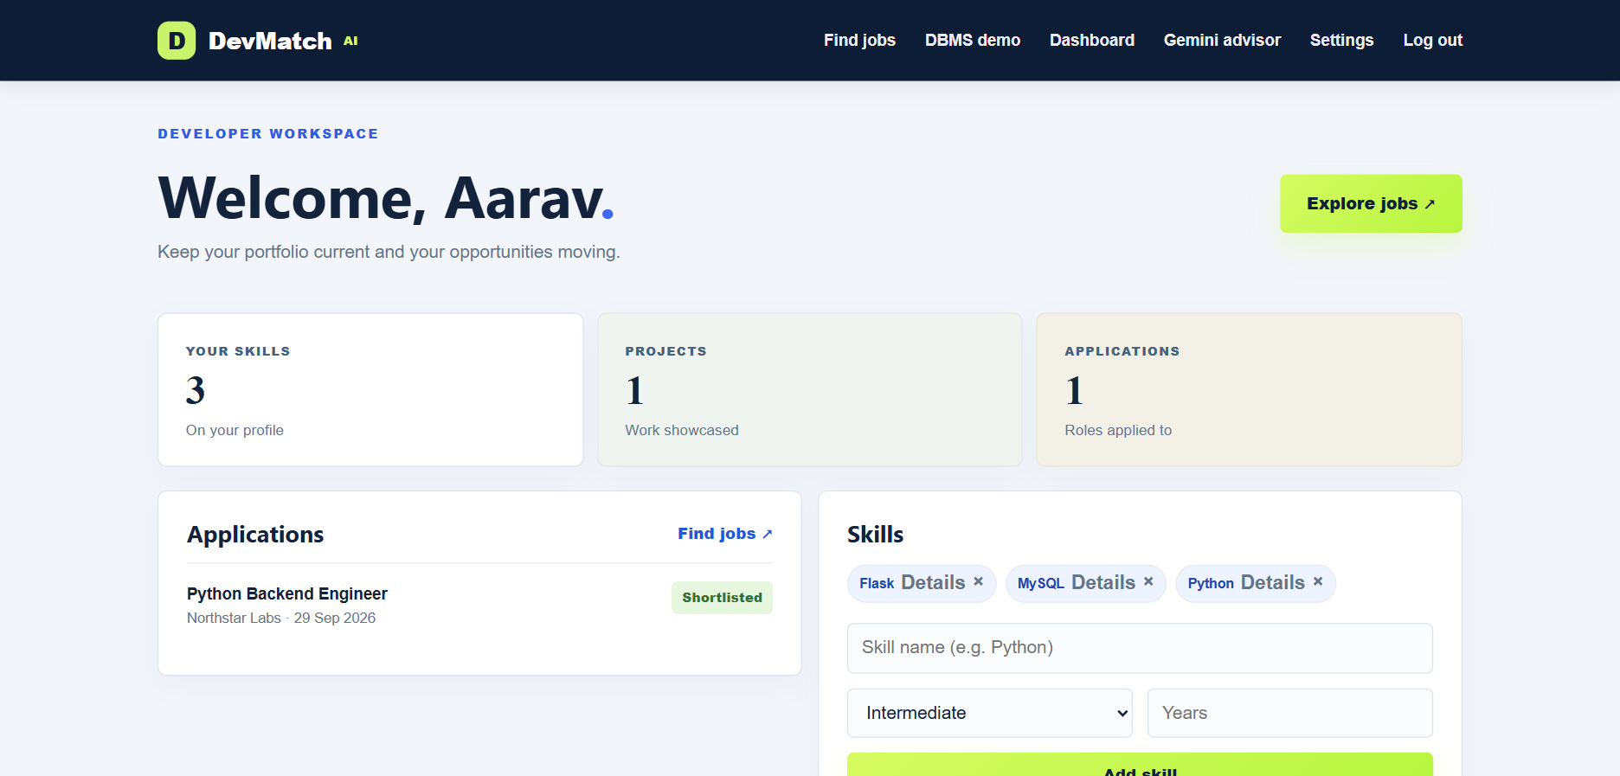
06 / APPLICATION RESULTS
Developer dashboard
Profile skills and application status come from related MySQL records.
DevMatch AI
18
Notes:
Explain the visible profile skills, project count and application status. This is an existing project screenshot with demonstration records.
Sources: project app.py, mysql_demo.sql, README.md and DBMS_PROJECT_DOCUMENTATION.md in D:/DBMS_DevApp/DevMatch_AI_DBMS_Mini_Project/devmatch-ai. Requirements: C:/Users/gurra/Downloads/DBMS Mini Project_Guidelines.pptx.
Screenshot source: D:/DBMS_DevApp/tmp/report/developer_short.png. Captured project demonstration data, not a current database count.

Slide 19
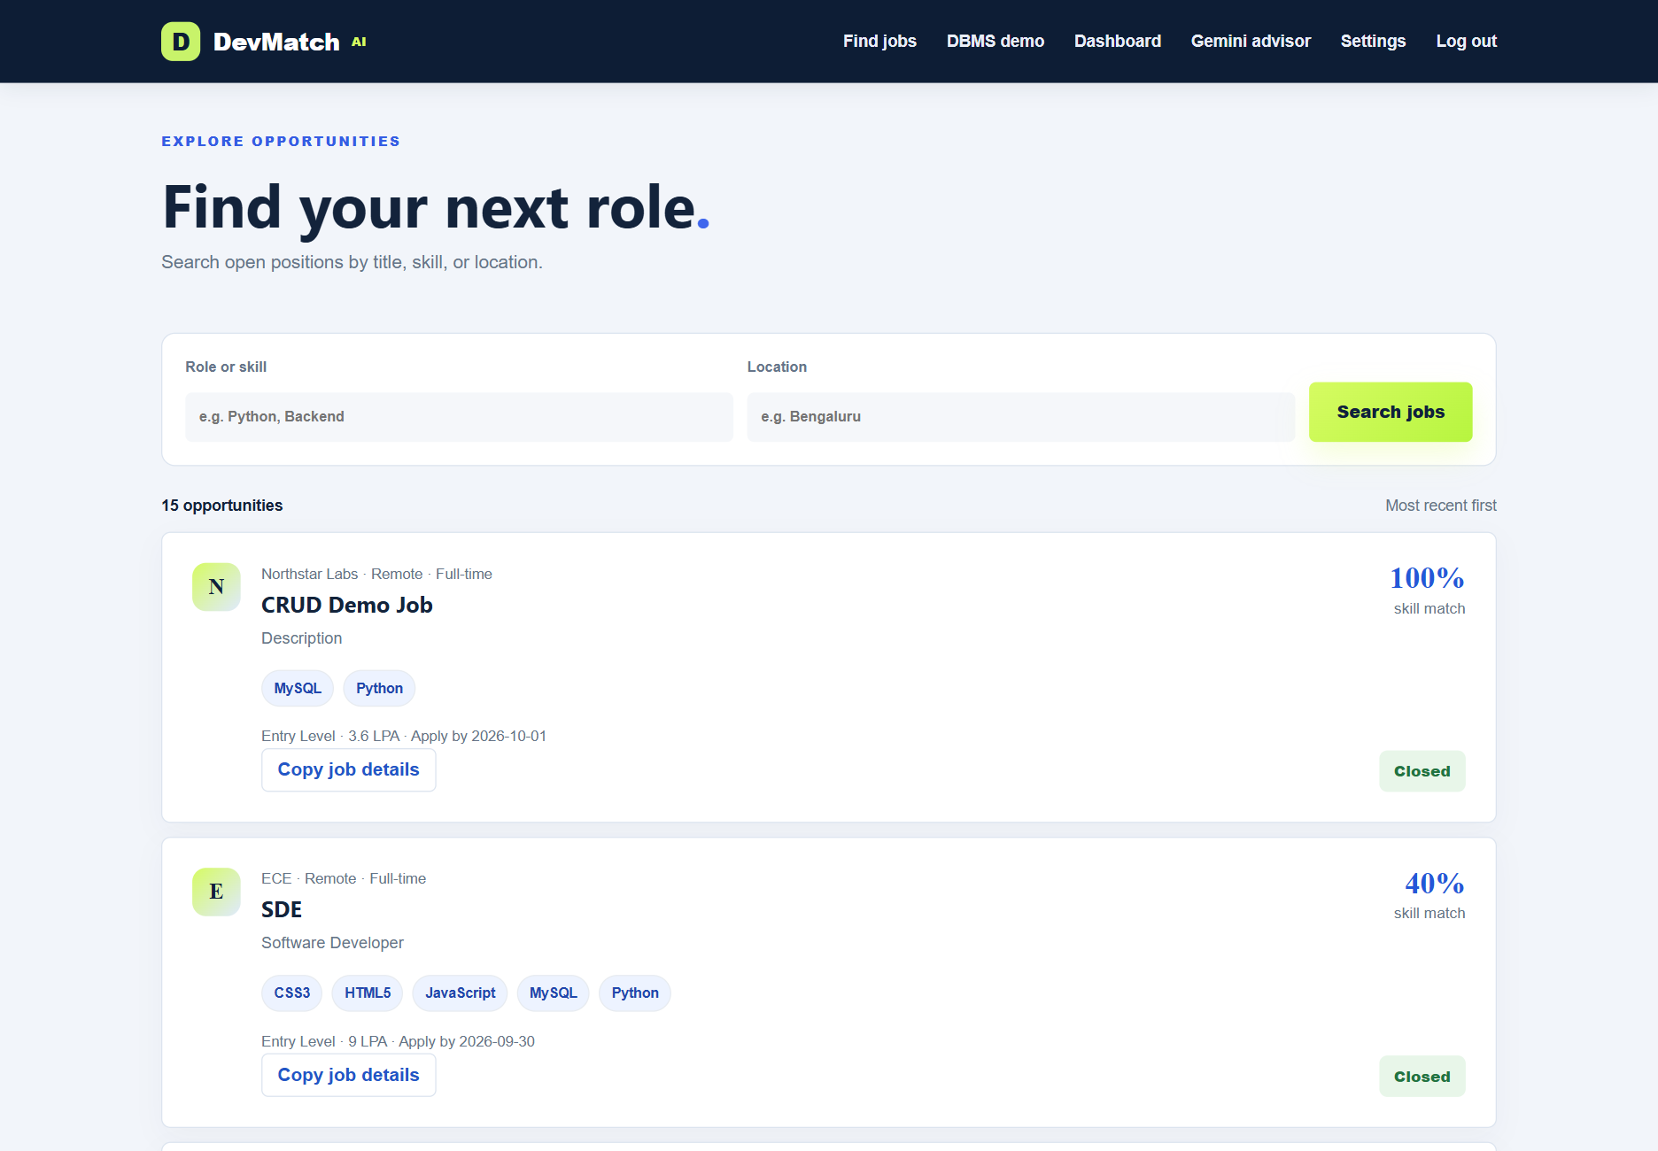
06 / APPLICATION RESULTS
Job search and skill matching
Search vacancies
by role, skill or location
Compare required skills
with profile and resume
evidence
Captured demo data
DevMatch AI
19
Notes:
The captured job-search page shows examples of skill matches. Closed listings in the screenshot are historical demo records. For live demonstration, create a job without a past deadline.
Sources: project app.py, mysql_demo.sql, README.md and DBMS_PROJECT_DOCUMENTATION.md in D:/DBMS_DevApp/DevMatch_AI_DBMS_Mini_Project/devmatch-ai. Requirements: C:/Users/gurra/Downloads/DBMS Mini Project_Guidelines.pptx.
Screenshot source: D:/DBMS_DevApp/tmp/report/match.png. Captured project demonstration data, not a current database count.

Slide 20
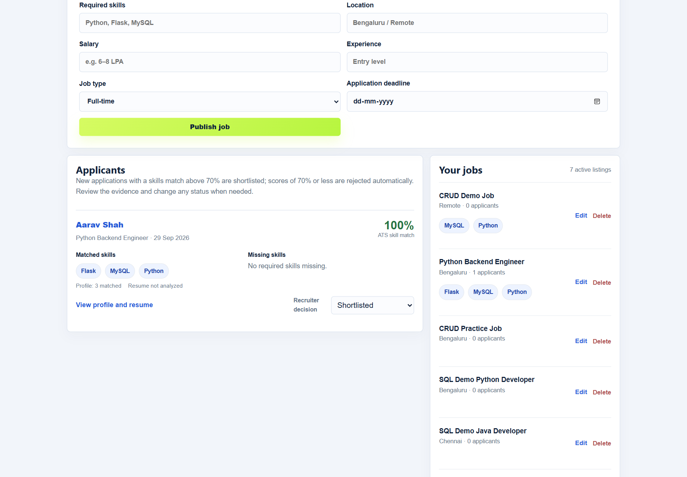
06 / APPLICATION RESULTS
Recruiter applicant review
Review skill evidence
Inspect portfolios
and resumes
Update the application
status after review
Captured demo data
DevMatch AI
20
Notes:
Show the score, matched/missing skills and recruiter decision selector. This screenshot records a 100 percent skill match and a shortlisted status. It does not establish hiring quality.
Sources: project app.py, mysql_demo.sql, README.md and DBMS_PROJECT_DOCUMENTATION.md in D:/DBMS_DevApp/DevMatch_AI_DBMS_Mini_Project/devmatch-ai. Requirements: C:/Users/gurra/Downloads/DBMS Mini Project_Guidelines.pptx.
Screenshot source: D:/DBMS_DevApp/tmp/report/applicants.png. Captured project demonstration data, not a current database count.

Slide 21
06 / APPLICATION RESULTS
Skill match calculation
Match (%) = matched required skills ÷ total required skills × 100
Illustrative example | Value
Job requirements | Python, Flask, MySQL
Candidate evidence | Python, Flask
Result | 2 ÷ 3 × 100 = 66.7%
Initial status for this example | Rejected, because the score is at or below 70%
Above 70%: Shortlisted. Recruiters can change the initial status after review.
DevMatch AI
21
Notes:
ats_match normalizes required skills and the union of profile plus latest extracted resume skills. Match is the percentage of required names present. New scores above 70 are Shortlisted, and scores at or below 70 are Rejected. Recruiters can override these initial statuses. This does not evaluate experience, skill depth or overall competence.
Sources: project app.py, mysql_demo.sql, README.md and DBMS_PROJECT_DOCUMENTATION.md in D:/DBMS_DevApp/DevMatch_AI_DBMS_Mini_Project/devmatch-ai. Requirements: C:/Users/gurra/Downloads/DBMS Mini Project_Guidelines.pptx.

Slide 22
07 / LIVE DEMONSTRATION
Two-way website and MySQL demonstration
1. Website changes appear in MySQL
Publish a dedicated test job. Use SELECT in MySQL to locate its title. Edit or delete it in the website and repeat SELECT.
2. MySQL changes appear in the website
Run the INSERT, UPDATE and DELETE examples on slide 14. Refresh /dbms-demo after each change.
SELECT id, title, location FROM jobs
WHERE title = 'Final Demo Job';
DevMatch AI
22
Notes:
This is the required live demonstration, not an automated synchronization claim. Keep the website and SQL client connected to the same MySQL database. Use committed changes. The /dbms-demo page disables browser caching and queries fresh rows.
Sources: project app.py, mysql_demo.sql, README.md and DBMS_PROJECT_DOCUMENTATION.md in D:/DBMS_DevApp/DevMatch_AI_DBMS_Mini_Project/devmatch-ai. Requirements: C:/Users/gurra/Downloads/DBMS Mini Project_Guidelines.pptx.

Slide 23
07 / LIVE DEMONSTRATION
Final review checklist
Guideline requirement | Evidence to show
At least 5 related entities | 10 application tables with PK/FK links
At least 5 attributes and rows per table | Schema and fresh-seed inventory, then verify-dbms
Schema, ER mapping and normalization | Design slides 6–10
INSERT, UPDATE, DELETE, ALTER/MODIFY, VIEW, TRIGGER | SQL demonstrations on slides 14–17
Changes visible in both directions | Website + MySQL demonstration on slide 22
Desktop or laptop application | Run the web application in a computer browser
Before presenting: flask --app app verify-dbms
DevMatch AI
23
Notes:
This is a preparation checklist, not a claim that runtime checks were executed while producing the deck. The final review should include the live MySQL output and UI reflection. The verifier checks the history table too when installed.
Sources: project app.py, mysql_demo.sql, README.md and DBMS_PROJECT_DOCUMENTATION.md in D:/DBMS_DevApp/DevMatch_AI_DBMS_Mini_Project/devmatch-ai. Requirements: C:/Users/gurra/Downloads/DBMS Mini Project_Guidelines.pptx.

Slide 24
08 / CONCLUSION
Conclusion and future scope
Project outcome
DevMatch AI connects developer portfolios, vacancies and application records through a relational MySQL design.
DBMS learning
Keys, normalization and related queries support consistent data. Views and a status trigger extend the SQL demonstration.
Future improvements
Add richer skill evidence, interview scheduling and resume scanning. Extend audit coverage and reporting.
DevMatch AI
24
Notes:
State implemented capabilities first. Future additions are proposals, not completed work. Skill matching is a support measure and recruiter review remains necessary.
Sources: project app.py, mysql_demo.sql, README.md and DBMS_PROJECT_DOCUMENTATION.md in D:/DBMS_DevApp/DevMatch_AI_DBMS_Mini_Project/devmatch-ai. Requirements: C:/Users/gurra/Downloads/DBMS Mini Project_Guidelines.pptx.

Slide 25
QUESTIONS & LIVE DEMONSTRATION
Thank you
DevMatch AI
Developer Portfolio & Hiring Platform
Ready to demonstrate the website and MySQL database
DevMatch AI
25
Notes:
Invite questions about the relational design, SQL demonstrations and skill matching. Open the application and SQL client for the live review.
Sources: project app.py, mysql_demo.sql, README.md and DBMS_PROJECT_DOCUMENTATION.md in D:/DBMS_DevApp/DevMatch_AI_DBMS_Mini_Project/devmatch-ai. Requirements: C:/Users/gurra/Downloads/DBMS Mini Project_Guidelines.pptx.

